Slide 1
Learning about Copyright Made (Mostly) Easy
Julia Guy and Michael B. McNally
jguy@ualberta.ca / mmcnally@ualberta.ca
https://sites.library.ualberta.ca/copyright/ / copyright@ualberta.ca /
Maskwacis Cultural College Microlearning Session – June 8, 2020
Notes:
Hi everyone thanks for joining us for this microlearning session! My name is Julia Guy and I am a grad student working toward a masters in digital humanities and library and information studies. I grew up in treaty 7 territory but now live and work in Amiskwacîwâskahikan. Before we begin we’d like to acknowledge that even though we are spread out from each other today the land that we call home and work from is on Treaty 6 Territory, and Metis region 4. This is a gathering place for nations including the Cree/Nehiyawak, Blackfoot, Nakota Sioux ,Iroquois, Dene, Ojibway / Saulteaux /Anishinaabe, Metis, Inuit and others whose histories, languages, and cultures continue to positively influence us. We also recognize that Copyright is a western concept and there a huge tension and fundamental incompatibility between copyright and Indigenous knowledges and cultural expression. Although this is not the topic of our presentation today we wanted to acknowledge that and our hope that by contributing to copyright education with this project can help reveal some of those issues.
As I said my name is Julia and I’ll let Michael introduce himself.
Thanks Julia. My name is Michael McNally, and like Julia I was born on Treaty 7 territory but grew up on the unceded territory of the Algonquin nation before returning to the west and Treaty 6 territory. I’m involved in the Opening Up Copyright project as a professor in the Faculty of Education. Before turning it back to Julia, I also want to acknowledge and thank Manisha Khetarpal and Maskwacis Cultural College who have been strong supporters of open education in Alberta, and provided many opportunities for knowledge exchanges across a range of subjects
We work on a project called Opening Up Copyright- the project is a series of instructional videos, meant to appeal to several different audiences. The goal of the series is to increase peoples understanding of copyright in many different contexts. Understanding copyright better can help people find materials and resources that they can use, and also empower folks to make things that they create more accessible to others while still maintaining certain controls over how their works are used and what is done with it.

Slide 2
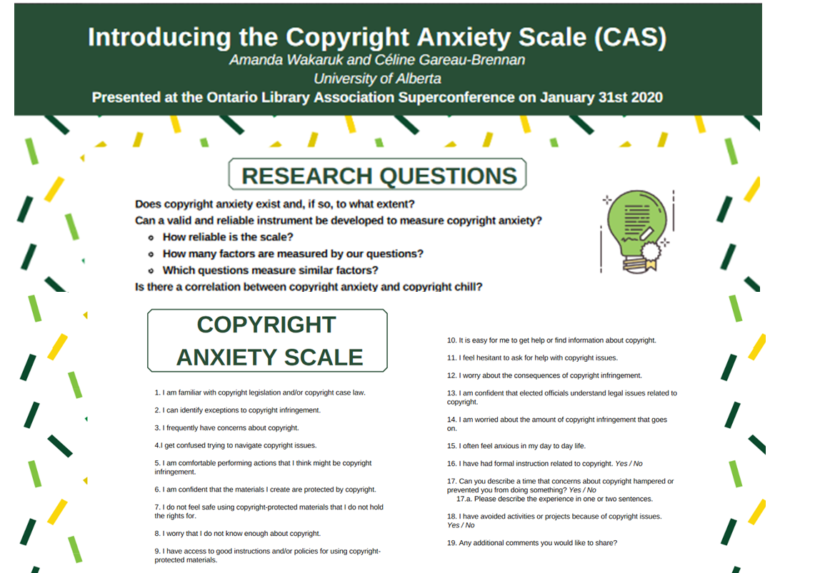
Copyright Chill
Address copyright fear
Low levels of copyright literacy in LIS and academia
Copyright literacy a responsibility of libraries – see IFLA Statement on Copyright Education and Copyright Literacy (2018)
Modified version of A. Wakaruk and C. Gareau-Brennan. 2020. “Introducing the Copyright Anxiety Scale (CAS).” Presented at the Ontario Library Association Superconference. 31 Jan 2020. https://doi.org/10.7939/r3-69zc-gg58 Licensed CC-BY 4.0
Notes:
We know that copyright is a subject that many people want to avoid. While there is little research on the Canadian context, what studies have been done show that not only is it something the average person may know little about, even in academia more broadly and library and information science more narrowly people don’t understand copyright and are even afraid of it. Julia and I are happy to note this idea of copyright fear or anxiety is actually something two of our colleagues – Amanda Wakaruk and Celine Gareau-Brennan, both Librarians at the UofA, are actively studying and they have been working on developing a Copyright Anxiety Scale.
Despite copyright fears, within librarianship, we have a responsibility to not only be copyright literate, but copyright educators, and this is reflected by the 2018 International Federation of Library Associations and Institutions statement on copyright literacy.

Slide 3
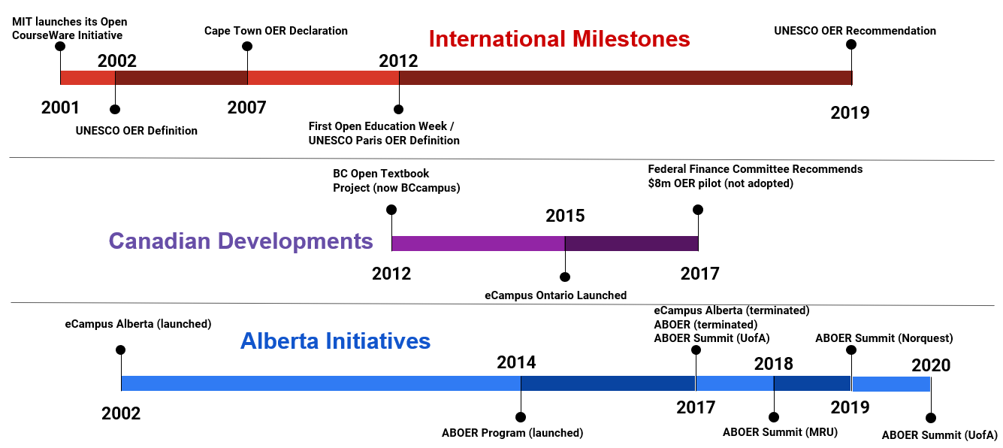
Rise of Open Education and OER
Notes:
While copyright may be a source of professional fear, over the past 20 years we’ve seen more interest in what can be called open content – open source software, open access publishing – generally and OER or open educational resources specifically. This slide highlights some of the major developments internationally, nationally and here in Alberta, and without going into the details, the rise of OER, where teaching and learning materials are openly licensed, most often using a Creative Commons licence, is another factor that guides the Opening Up Copyright or OUC project.

Slide 4
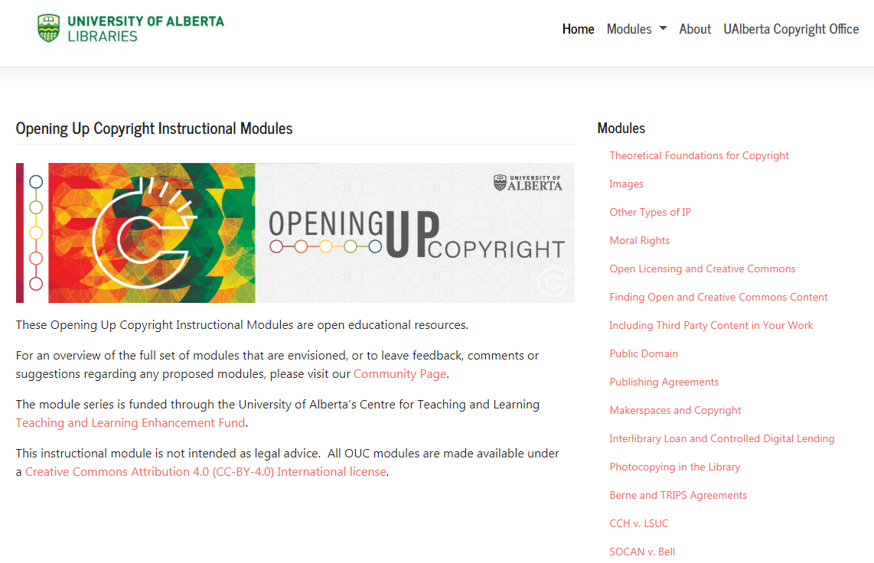
About OUC
Grant funded copyright literacy instructional video series
Currently 26 modules, each ~6-8 minutes
Modules range from introductory subjects to focus on the Copyright Act and key cases
All modules CC-BY 4.0
OUC Website: https://sites.library.ualberta.ca/copyright/
Notes:
So OUC then, is a grant funded series of instructional videos on copyright, and the videos themselves are all openly licensed. As noted we currently have over two dozen modules, most of which are between six and eight minutes dealing with various facets of copyright. The modules range from more introductory to detailed examinations of specific sections of the Copyright Act. The module series is non linear, meaning that people can watch one video on a specific topic, or work through a group of modules based on their interest or needs.

Slide 5
OUC Contributors
Copyright Office
Centre for Teaching and Learning
Technologies in Education
Adrian Sheppard
Amanda Wakaruk
Cosette Lemelin
Graeme Pate
Krysta McNutt
Anwen Burk
Matt Cheung
Jamie Stewart
University of Alberta Libraries
School of Library and Information Studies
Michelle Brailey
Lauren Bourdages
Jesse Carson
Luc Fagnan
Toby Grant
Julia Guy
Kris Joseph
Samantha Sheplawy
Michael B. McNally
Notes:
I quickly want to note that this project is a collaboration of many individuals and units from across UofA. The Copyright Office and School of Library and Information Studies have been the two most active contributors, but the Library, Centre for Teaching and Learning and Technologies in Education have all been involved, and those names in bold and red are the current active project team members. The cross campus collaboration has been a really boon to the project.

Slide 6
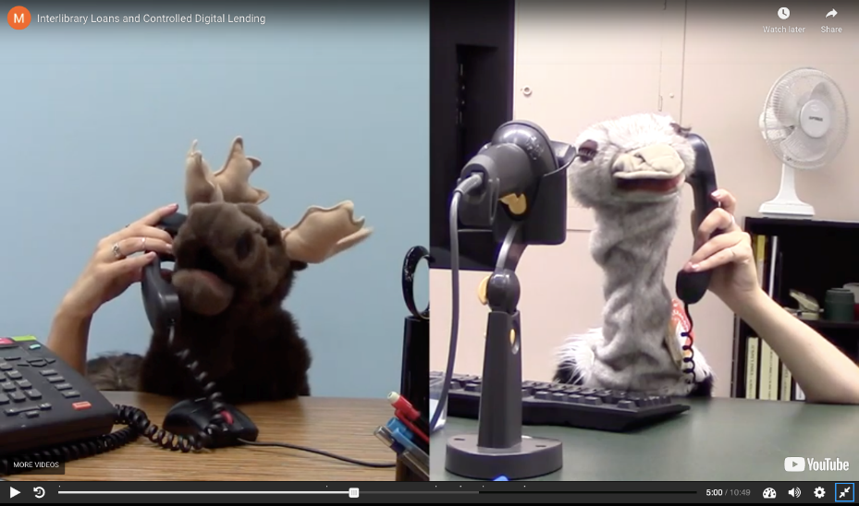
OUC Modules
OUC Module – “Open Licensing and Creative Commons”
OUC Module – “Interlibrary Loans and Controlled Digital Lending”
OUC Module – “Alberta (Education) v. Access Copyright ”
OUC Module – “S.29: Fair Dealing”
Notes:
As we mentioned there is quite a range of modules. Here are four screenshots of four different modules. Some of them cover specific scenarios and contexts like the one in the upper right corner is “Interlibrary loan and controlled digital lending” which explains ILL and CDL for at library staff and users. Some of the modules give overviews of issues or concepts. The one in the top left for example is from Open Licensing and Creative Commons and it breaks down the copyright spectrum including the spectrum of openness that exists in licensing systems like Creative Commons. Other modules are more focused on specific court cases and decisions and sections of the Copyright Act. These hopefully help the non-lawyer folk understand copyright law and how it’s interpreted. For example the one in the bottom right is on S.29 Fair Dealing. There are several modules that center around fair dealing both the court cases that have involved it, the actual section of the copyright act, and how to apply it.

Slide 7
Engagement
Interactivity through H5P
Narrative use of story and characters
OUC Module – “Makerspaces”
OUC Module – “Publishing Agreements
Notes:
As you can imagine some of this stuff is dry. Not only that but it is often very hard to keep videos short because so many of the concepts in copyright build on each other and some background explanation is often needed to make sense of things. Because of this we try our best to make things engaging. Some modules have characters with a problem to solve – like professor Pam on the right or Sandy on the left who both have short narratives in their respective videos. We also include interactivity in the modules with things like test questions at the end, links to other articles and videos, and text pop ups that can help to clarify things but also\allow for some more engagement. There are limits to what we can do as we are not animators or videographers- but we try to keep the videos dynamic and relatable.

Slide 8
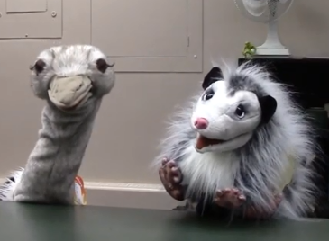
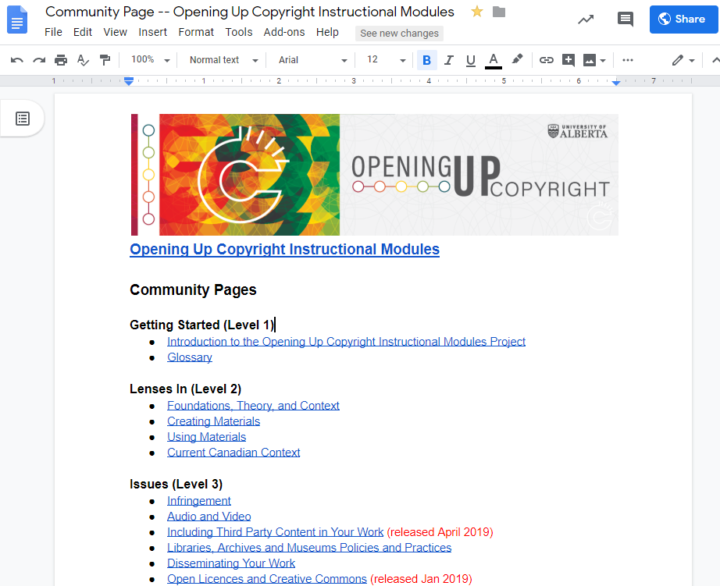
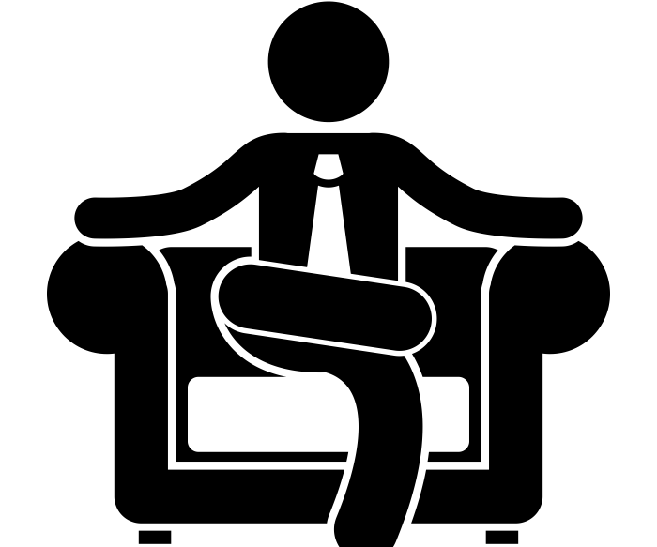
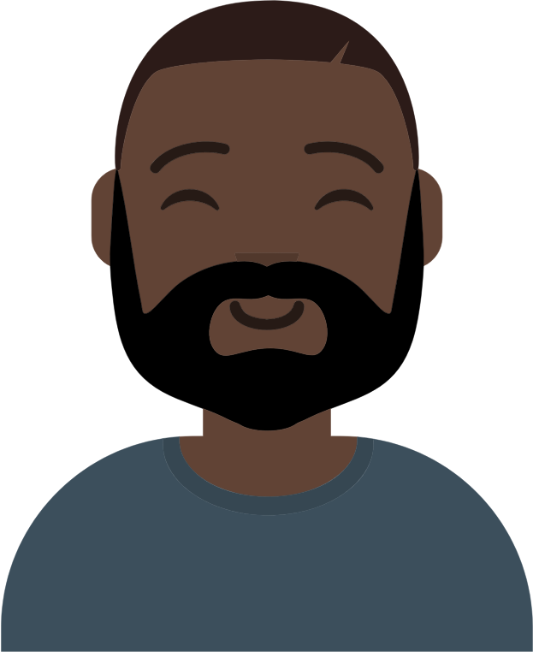
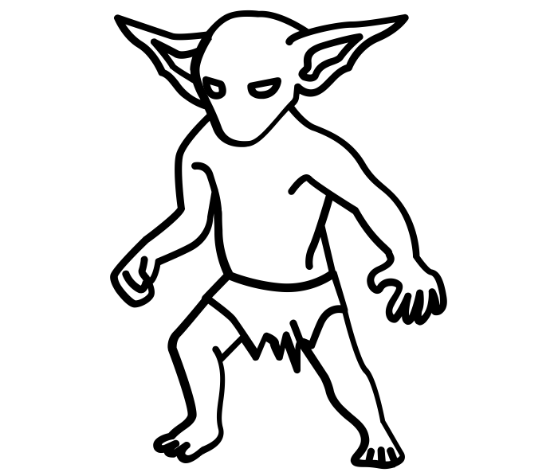
Engagement
Characters and puppets
Community contributions
Notes:
We also have a variety of characters. Animal and Goodbrarian are some of our puppet librarians. That said not everyone can relate to an Ostrich so we try to include a variety of characters of different ethnicities, ages, and genders including a non-binary character to make sure the people using the modules can see themselves represented in the videos.
Lastly one other tool for engagement we use is our community pages. Every module has an open google doc associated with it and anyone can comment, suggest, or provide feedback and ideas there which we will try to incorporate into the videos in order to make them more useful.

Slide 9
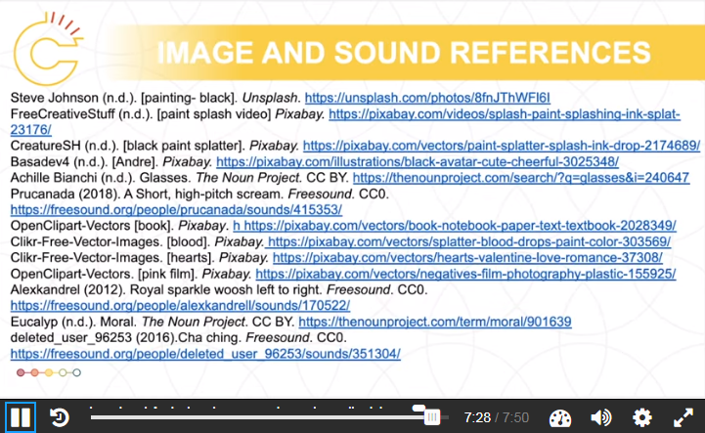
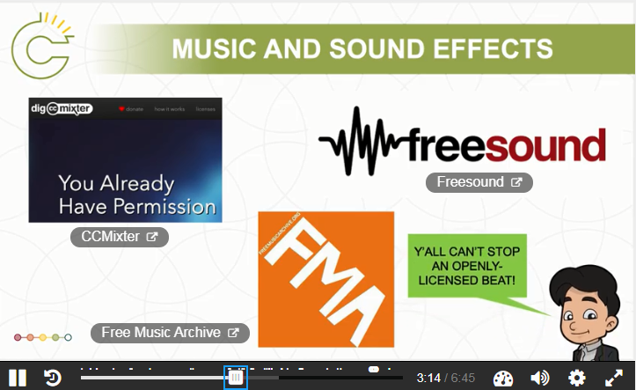
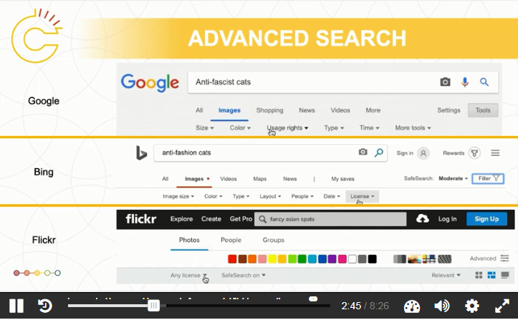
Openness in Practice
OUC Module – “Finding Open and Creative Commons Content”
OUC Module – “Moral Rights”
OUC Module – “Including Third Party Content in Your Work”
Notes:
As both a copyright literacy project and an open educational resource set, we’ve really tried to include openness as a guiding concept. In addition to the open community pages we have instructional modules on open content both more generally, and finding guides covering not only images, but sound and video. Our “Including 3rd party content in your work” module covers how to use major search engines to find open content. And of course, we aim to model best practice in not only using open content but properly citing it at the end of every module.

Slide 10
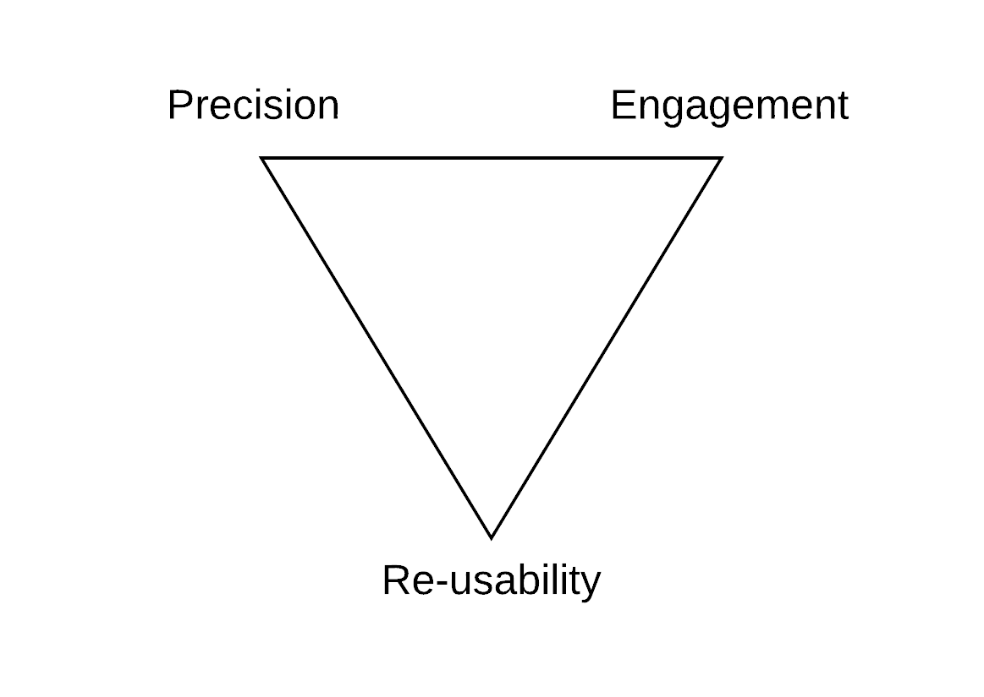
Balancing Precision, Engagement and Re-usability
Balancing these three factors equally in OER development is a challenge
Overemphasis on one comes at the cost of one of the others
Tensions are magnified by multiple audiences
An OER Triangle
For the full discussion see: Joseph, K., Guy, J., Wakaruk, A., Sheppard, A., and McNally, M. B. (2020). “Know your audience(s): Collaborating for copyright education.” International Journal of Open -Educational Resources, 2(1): 79-98. doi:10.18278/ijoer.2.1
(Variant of Atkinson’s (1999) “scope, schedule, cost” triangle)
Notes:
We’ve talked about out efforts to make things open and reusable, as well as engaging. The other factor that is key for copyright education is precision. We need to keep things accurate at the same time as we try to make them engaging and understandable. We grapple with how can we simplify these complex concepts while making sure we don’t over-simplify them to the point where they could be misinterpreted. This is also challenging considering these modules will be used by a variety of audiences. Law students looking for an overview of a court case will benefit from different terminology and explanations than people with very little understanding of the law -let alone copyright law. Additionally, the content that would be most useful for students might be redundant for a librarian depending on what it is. So we try to balance usability and understandability while trying to make sure the videos are not extremely boring and long winded.

Slide 11
Acknowledgements and Affiliations
The Opening Up Copyright Instructional Module Series is funded through both a Teaching and Learning Enhancement Fund (TLEF) grant and OER Grant from the Centre for Teaching and Learning at the University of Alberta
Julia Guy – Master of Arts in Digital Humanities, and Master of Library and Information Studies Student, University of Alberta
Michael B. McNally – Associate Professor, Faculty of Education, University of Alberta
Notes:
Thank you Julia, and thank you Manisha as well for giving us time to talk about the OUC project. It is certainly not finished we are still adding to the series of modules and in the spirit of openness we are always open to feedback on the existing modules or new module topics or even new collaborations.

Slide 12
Image Sources
Image sources (slide 8):
Animal and Goodbrarian – OUC. (2019). OUC Module “Photocopying in the Library Module” (screenshot). CC BY. https://sites.library.ualberta.ca/copyright/photocopying-at-the-library/
GraphicMama-team. (2016) Arab girl. Pixabay. CC0 https://pixabay.com/en/arabian-arab-girl-female-ethnic-1456184/
Boss: Ghan Koon Lay. (n.d). Boss. The Noun Project. CC0. https://thenounproject.com/icon/1587076
Chrystalelizabeth. (2014) Teacher-bookworm-glasses-professor. Pixabay. CC0. https://pixabay.com/illustrations/teacher-bookworm-glasses-professor-359311/
Basadev4 (n.d.). [Andre]. Pixabay. https://pixabay.com/illustrations/black-avatar-cute-cheerful-3025348/
Parkjisun. (n.d.). Goblin. The Noun Project. CC BY https://thenounproject.com/icon/1005005
https://pixabay.com/de/illustrations/cartoon-l%C3%A4ssig-charakter-zeichnung-3685566/

