Slide 1
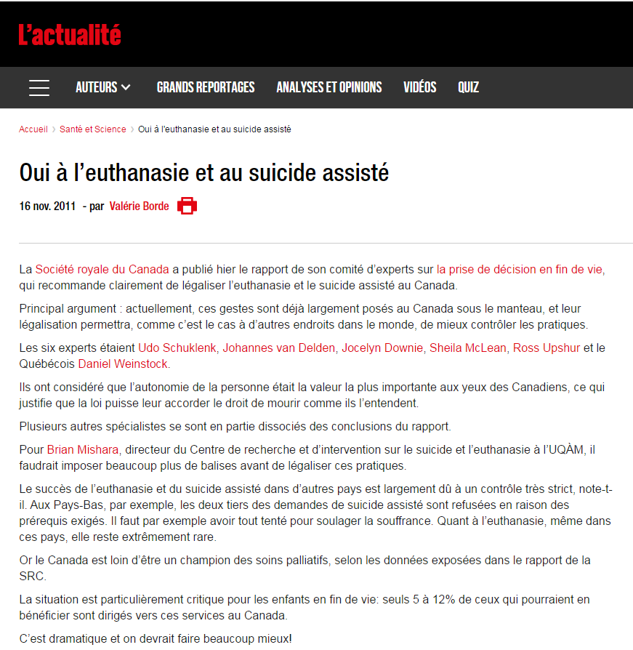
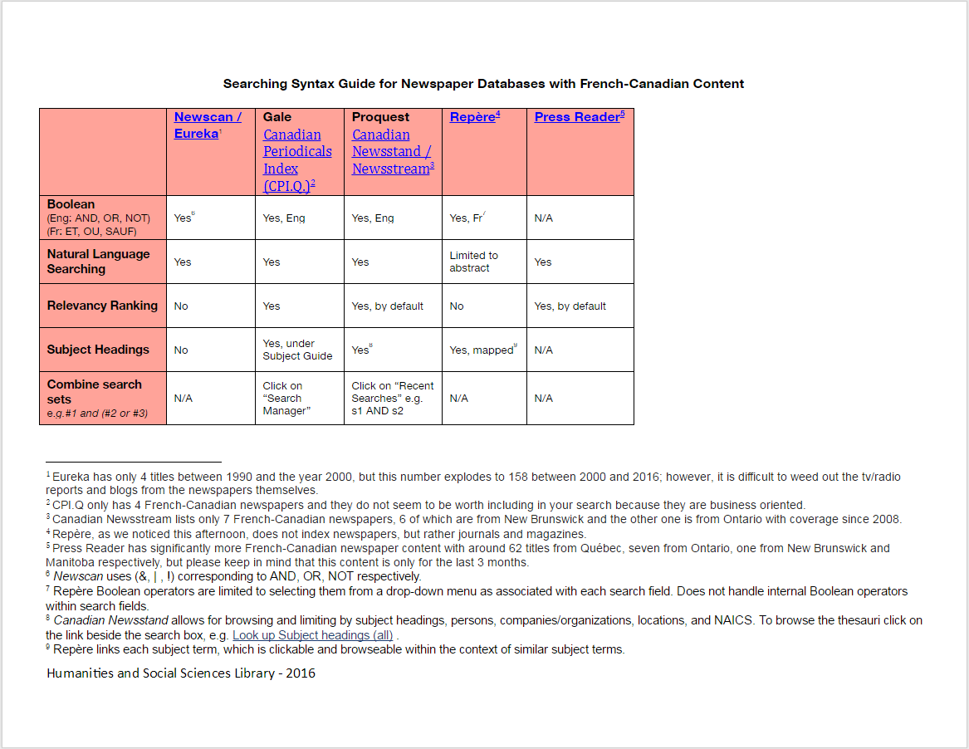
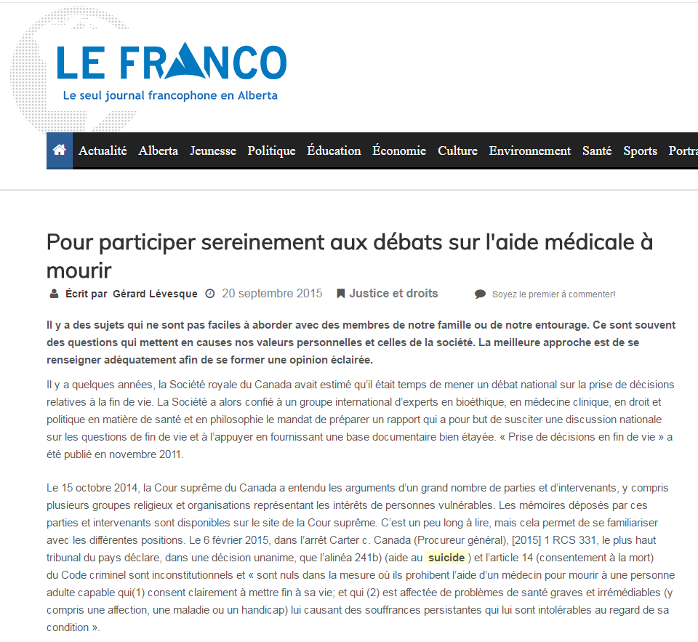
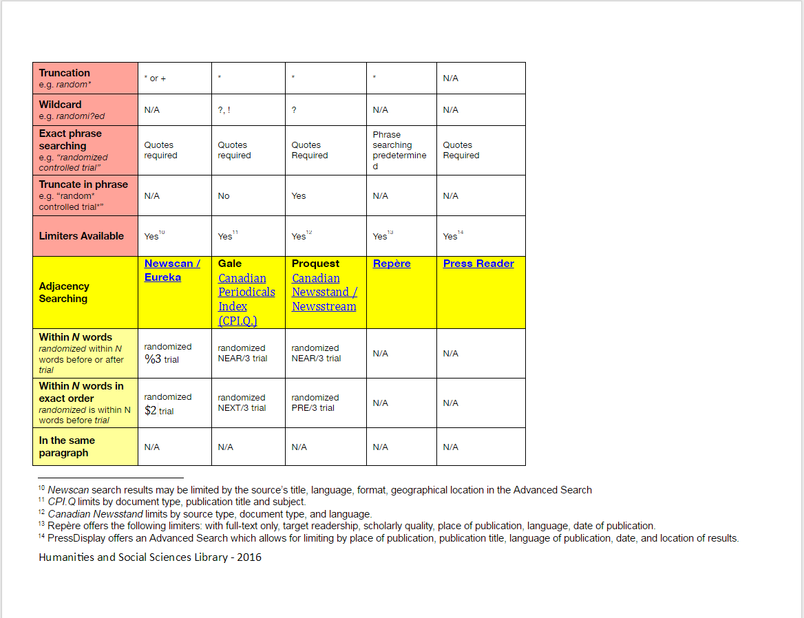
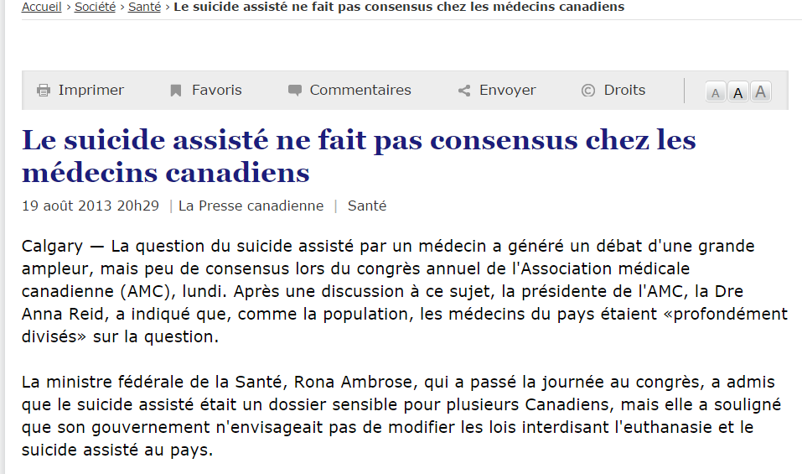
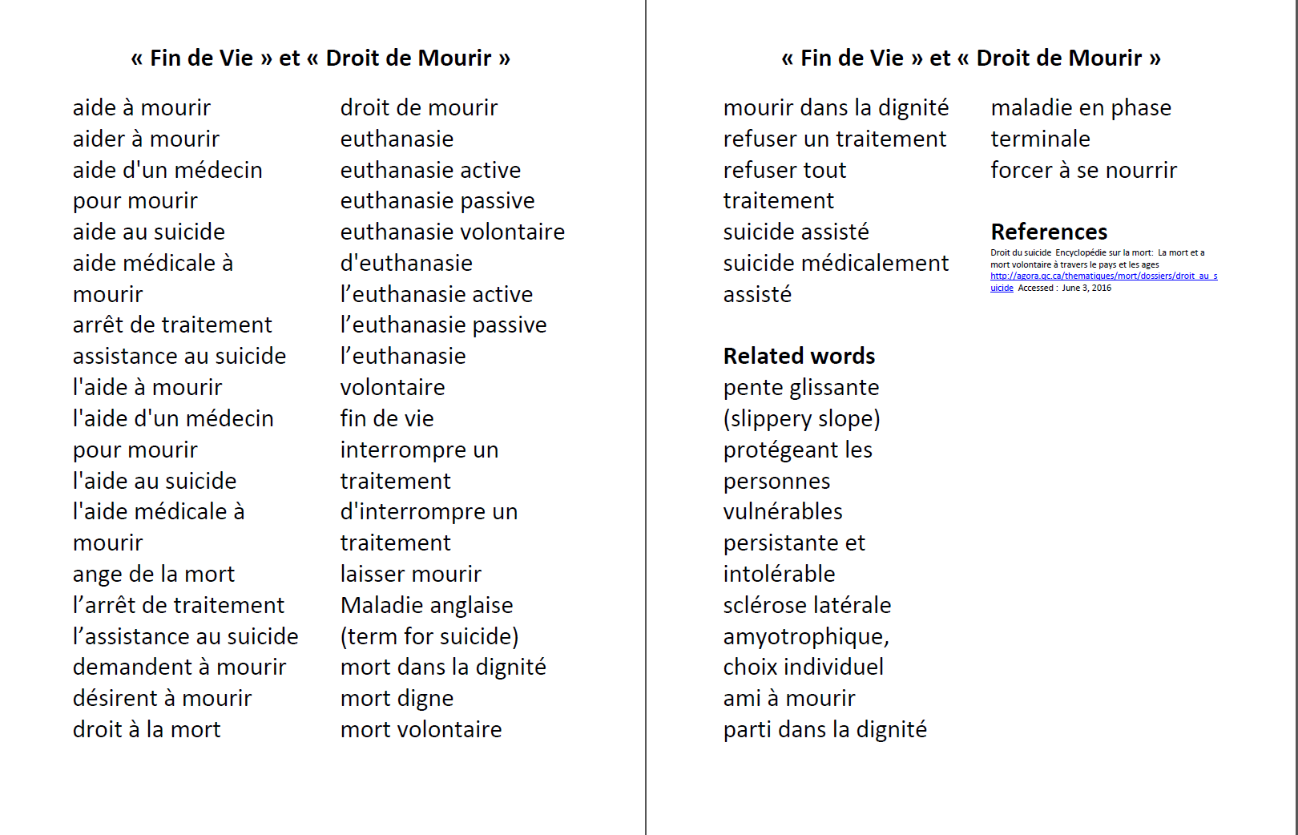
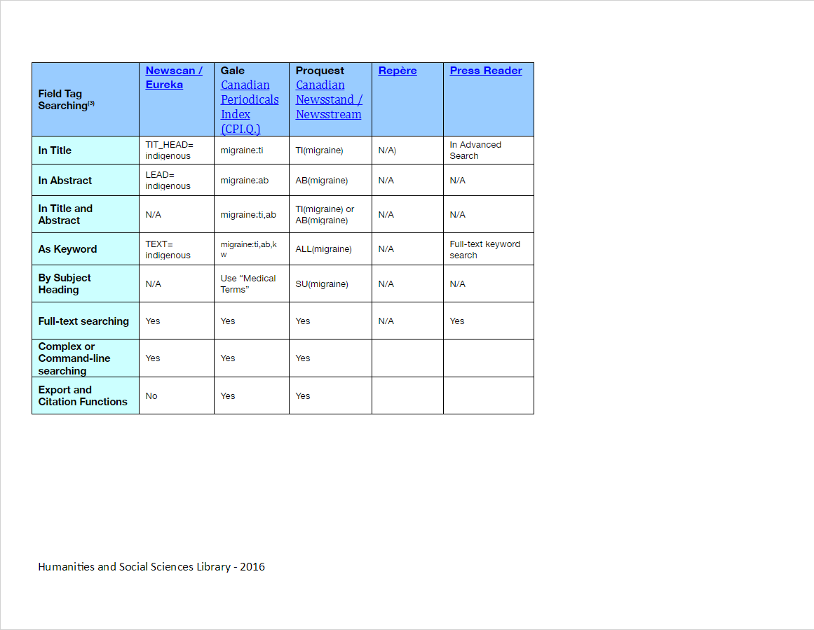
Eureka.cc Vocabulary Search Strategy (droit | aide | assistance | digne | dignité) %4 (suicide | mourir | mort) "fin de vie" (euthanasie) %2 (volontaire | active | passive) (refus* %2 traite*) & mort* (interromp* %2 traitement) & mort*
Searching French Language Canadian Newspapers for Health Topics: a case study of searching physician assisted death
Denis Lacroix and Sandy Campbell (University of Alberta Libraries)
Background
I
Where to Search First
Syntax Guide
Media, and specifically newspapers, play a large role in the general public’s understanding of health issues. Consequently the presentation of health issues in media is the subject of academic study. A significant number of Canadian newspapers are published in French. Searching databases that contain content from French language Canadian newspapers presents some unique challenges. Nothing has been published on the use of Franco-Canadian newspapers as data sources for health studies, although some health studies have used them.
In this study, the concept of “physician assisted death” is used as a case study for determining the best resources and techniques for identifying health related articles in French language Canadian newspapers.
Outcomes of this study include analysis of retrieval, guidance on selection of relevant databases, a syntax guide for the databases and a French language search vocabulary for fin de vie et suicide médicalement assisté.
If you want to be able to search using index terms,
Start with : Proquest Canadian Newsstand, Repère, CPI.Q, but only the first includes franco-Canadian newspapers.
If you are looking for English language translation of the French articles:
Start with: Does not exist!
If you want current national level coverage:
Start with: There is no national level francophone newspaper, like Radio Canada for television. However, the wire feed, La Presse Canadienne, as indexed in Canadian Newsstand is the closest there is to a national news stream.
If you are looking for current local coverage:
Start with: Eureka.cc, also known as Newscan, and Press Reader
Supplement your search by consulting the website of relevant local newspapers, eg: Nunavoix (Nunavut).
If you are looking for archival coverage in digital format of French-language Canadian newspapers:
Start with: Eureka.cc / Newscan; University of Alberta Libguide – Newspapers – Quebec et Francophonie lists several archival sources. http://guides.library.ualberta.ca/newspapers/quebec-and-francophonie
Search Methods
Outcomes
Vocabulary
Eureka.cc Vocabulary Search Strategies
(droit | aide | assistance | digne | dignité) %4 (suicide | mourir | mort)
"fin de vie"
(euthanasie) %2 (volontaire | active | passive)
(refus* %2 traite*) & mort*
(interromp* %2 traitement) & mort*
For example, a search of French language Canadian newspapers for
((droit | aide | assistance | digne | dignité) %4 (suicide | mourir | mort)) | "fin de vie" | ((euthanasie) %2 (volontaire | active | passive))
Retrieves 33,767 press articles over the entire Eureka.cc issue archive (some newspaper archives go back to 1992, e.g. Le Devoir, but most are more recent)
Proquest Canadian Newsstand:
Limit to newspapers & wire feeds in French
("fin de vie") OR ((aide) NEAR/4 (mourir)) OR ((assist*) NEAR/4 (suicide)) OR ((droit) NEAR/4 (mort)) OR ((droit) NEAR/4 (mourir)) OR ("euthanasie volontaire") OR ("euthanasie active") OR ("euthanasie passive") OR ((refus*) NEAR/2 (traite*) AND mort*) ((interromp*) NEAR/2 (traitement) AND mort*)
Retrieves:
Newspapers (83)
Wire Feeds (643)
Total 726 results over the last nine years (2008-2017)
Examples of studies that include French-Canadian newspapers:
Tonmyr L, Jack S. Media Analysis of Early Dissemination of Canadian Child Maltreatment Surveillance Data. Child Welfare. 2010;89(1):81-101.
Lanovaz MJ, Dufour M-M, Shah S. Newspaper Coverage of Autism Treatment in Canada: 10-Year Trends (2004–2013). Canadian Journal of Psychiatry Revue Canadienne de Psychiatrie. 2015;60(7):329-333.
Newspaper chains frequently publish identical articles in multiple newspapers. A search for French language Canadian articles published on the topic of « aide à mourir » in Eureka for February 24th 2017 revealed 10 unique articles out of a tolal of 25 (40% unique).
Of newspapers indexed in Eureka.cc, Le Devoir, La Presse, L’Actualité, and Le Soleil published the least number of duplicates over a two-year period.
Articles published by other Association de la presse francophone (APF) newspapers outside of Québec may not be indexed in Eureka, which includes only 45% of APF titles. Newspapers indexed in Eureka include:
Le Franco (Edmonton and Calgary editions)
All 5 Atlantic provinces titles
2 out of 3 titles from the Territories
2 out of 11 titles from Ontario
A search for keywords on newspaper websites (e.g. La Liberté, L’Eau-Vive) did not reveal any duplicates with Le Franco articles on the topic of physician assisted death. There were 8 unique articles that were authored by Saskatchewan journalists in their local francophone newspaper, L’Eau Vive.
Conclusions:
Not all French Canadian newspapers are covered by newspaper indexes. In addition to searching databases, it is worth searching specific newspaper websites for a unique perspectives.
Duplication of stories makes precise retrieval of unique
information more difficult.
Variations in newspaper database functions and syntaxes make
newspaper searching challenging for researchers, so intermediary
searching may be required.
Last 2 combinations retrieve mostly the same articles identified with the first 3 searches
Multilingual French and English health terminologies and ontologies available through HeTOP.
References
Nisbet MC, Scheufele DA, Shanahan J, Moy P, Brossard D, Lewenstein BV. Knowledge, reservations, or promise? A media effects model for public perceptions of science and technology. Commun. Res .2002 29(5): 584-608
Seale C. and Charteris – Black J. Keyword analysis: a new tool for qualitative research in Bourgeault I., Dingwall R., de Vries R. (eds). The SAGE Handbook of Qualitative Methods in Health Research. Los Angeles, CA: SAGE, 2010.
Future Research
Future research directions include:
Identify the extent of inclusion of French Canadian newspapers in newspaper based studies.
Understanding the benefits and drawbacks of using newspapers vs social media as data sources.
Identifying ways of including other language newspapers as source data.

