Slide 1
History of Copyright
*April 2020
Notes:
*Updated: December 2023
Hello and welcome to the University of Alberta’s Opening Up Copyright Instructional Module on the History of Copyright.

Slide 2

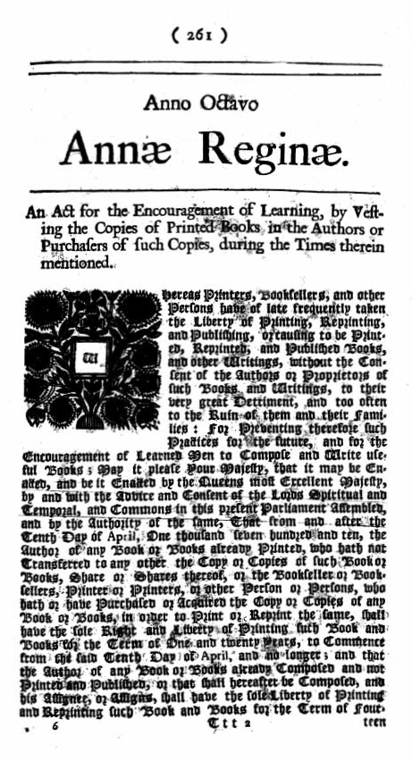


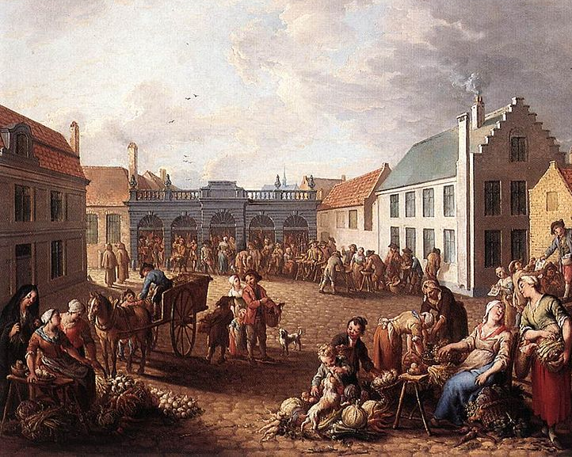
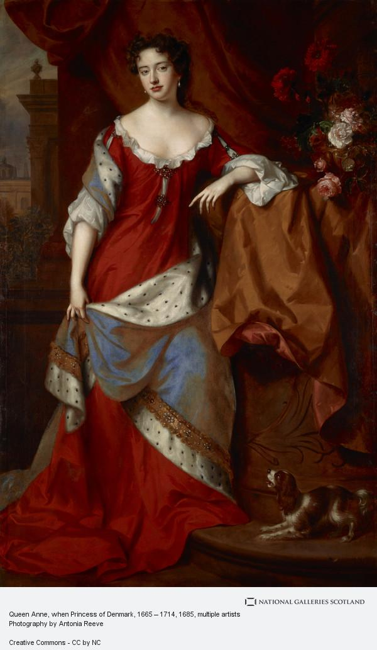
WHERE IT ALL BEGAN
Copy-what?!
Hello peasant, didn’t see you there.
STATUTE OF ANNE
Girl, no idea!
Notes:
Copyright is increasingly important in our modern economy, but for much of copyright’s 300-plus year history it has been relatively unimportant for the overwhelming majority of people. So how did things end up this way?
Copyright effectively began in 1710 with the Statute of Anne in Great Britain. While the Statute of Anne was passed to deal with concerns of publishers over book reprinting, the preamble of the Act is notable. The Statute was intended as: “An act for the encouragement of learning, by vesting the copies of printed books in the authors or purchasers of such copies, during the times therein mentioned.”
Wait a minute… that can’t be right. Copyright is to encourage learning? Isn’t it supposed to be about an incentive to create and promote economic prosperity? So how did copyright go from an act for the encouragement of learning to a modern economic policy?

Slide 3






WHAT HAPPENED?
Then
Now
Copyright Term
Notes:
For starters, Copyright has expanded from covering just printed books to covering all forms of creative expression. It has also expanded in relation to the term, or length, of copyright protection. We can’t pack the entirety of copyright’s expansionary history into this module, so we will focus on ten key events to help explain its changing purpose and role in society, both for Canada and for the rest of the world.

Slide 4
WHAT HAPPENED?
Statute of Anne
TRIPS
The Copyright Pentalogy
Berne Convention
Théberge
US Constitution
US Copyright Extension Act
The Copyright Act Review
Canadian Copyright Act
CCH v. LSUC
Notes:
We can’t pack the entirety of copyright’s expansionary history into this module, so we will focus on ten key events to help explain its changing purpose and role in society, both for Canada and for the rest of the world.

Slide 5

STATUTE OF ANNE
STATUTE OF ANNE
It Me!
1710
Copyright Term
Copyright Term
Protected for 21 years
after they were written
Protected for 14 years
after they were written
Notes:
First Key Event – the Statute of Anne. As noted earlier, the scope of copyright was initially narrow – it only covered printed books. The term of protection in the Statute is also notable. Books published before the Statute gained copyright protection for 21 years after they were written, while new books would be protected for 14 years, with the option of an additional 14 years of protection if the author was still alive at the end of the first term.

Slide 6
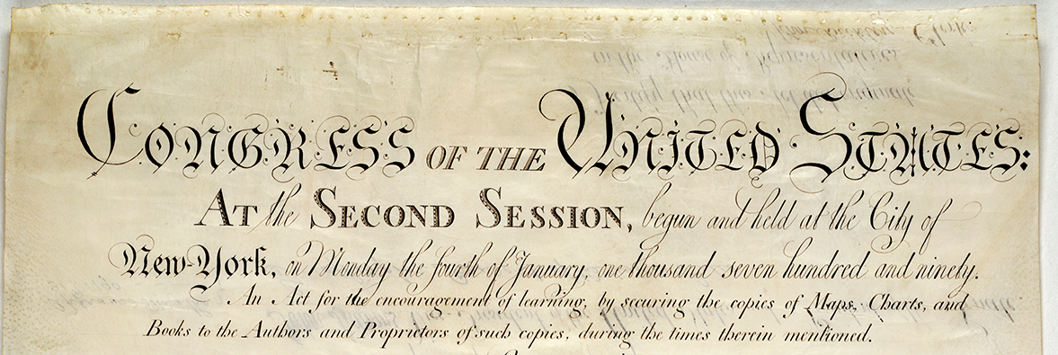
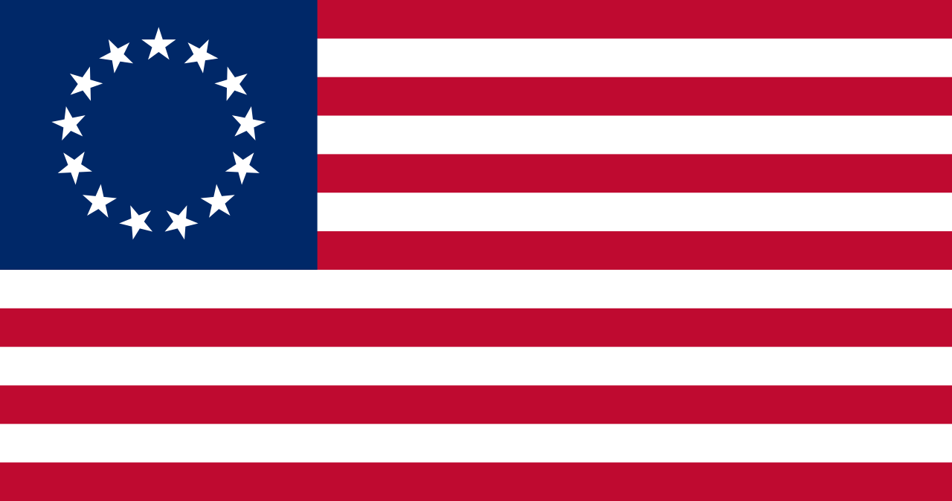

US CONSTITUTION
US CONSTITUTION
1790
1787
Copycats!
Notes:
Second Key Event – the US Constitution. The 1787 US Constitution included a clause empowering Congress to protect authors and inventors. Just three years later, in 1790, the newly independent United States would pass its first Copyright Act. Like the Statute of Anne, the term of protection was 14 years, with the right of renewal for a second 14-year period if the author was still alive. And notably, this too was explicitly an act to promote the encouragement of learning.

Slide 7


THE BERNE CONVENTION
THE BERNE CONVENTION
Let’s just get along, ya’ll
Righto!
1886
1908
Copyright Term
Protected for 50 years after
the death of the author
Protected for 14 years
after they were written
Notes:
Third Key Event – the Berne Convention. Throughout the 19th century, copyright protection became more common, and concerns about international copyright protection became an issue. This culminated in the 1886 crafting of the Berne Convention. The Berne Convention has been revised several times with numerous parties joining along the way. One notable change was the 1908 revision that stipulated member countries would provide copyright protection for a minimum term of life of the author plus 50 years. The move to a life + 50 year term of protection was driven by the desire from various governments to harmonize the term of protection.

Slide 8


The Copyright Act
The Copyright Act
Oh Haii!
Sick Berne, everyone!
1928
1921
Copycats!
Notes:
Fourth Key Event – a Copyright Act for Canada. Canada passed its first domestic Copyright Act in 1921, modelled directly off of the 1911 UK Act. A few years later, in 1928, Canada joined the Berne Convention as a party in its own right, though had previously been part of the Convention through its dominion relationship with the UK.

Slide 9

TRIPS
TRIPS
TRIP
rade-
1994
elated aspects of
ntellectual
TRIPS
roperty right
S
Notes:
Fifth Key Event – TRIPS. The 1980s saw intellectual property protection and free trade become linked, reflecting in part the growth of information and service-based industries. This led to the 1994 agreement on Trade-Related Aspects of Intellectual Property Rights, or “TRIPS.” This World Trade Organization agreement introduced a considerably stronger level of international protection to copyright holders than had previously been the case under Berne.

Slide 10
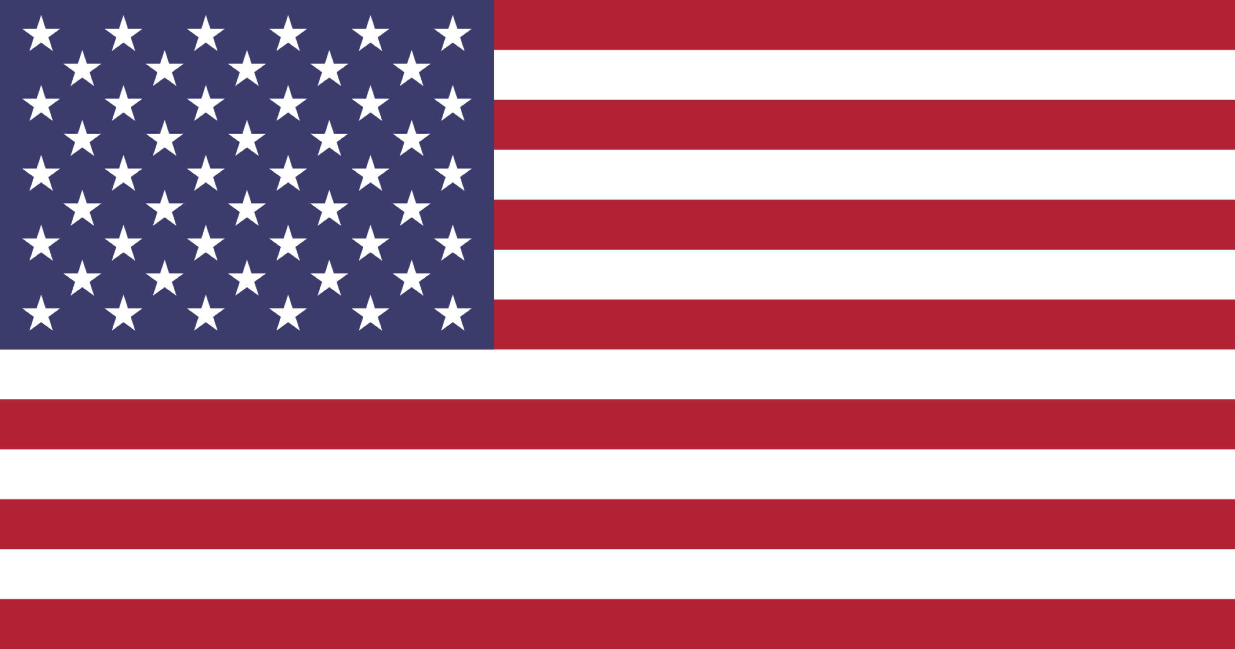


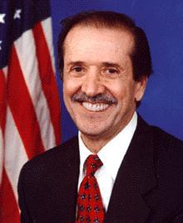
US Copyright Term Extension Act
US Copyright Term Extension Act
1998
Copyright Term
Protected for 70 years after
the death of the author
Protected for 50 years after
the death of the author
I got you, babe.
Notes:
Sixth Key Event – US Copyright Term Extension Act. In 1998, US musician turned Senator Sonny Bono led the crafting of the Copyright Term Extension Act that expanded the term of protection in the US from life plus 50 to life plus 70 years. The Act is sometimes called the Mickey Mouse Copyright Term Extension Act, because it ensured that Steamboat Willie – an animated short film from 1928 that first depicted Disney’s iconic rodent, would not enter the public domain for an additional 20 years.

Slide 11

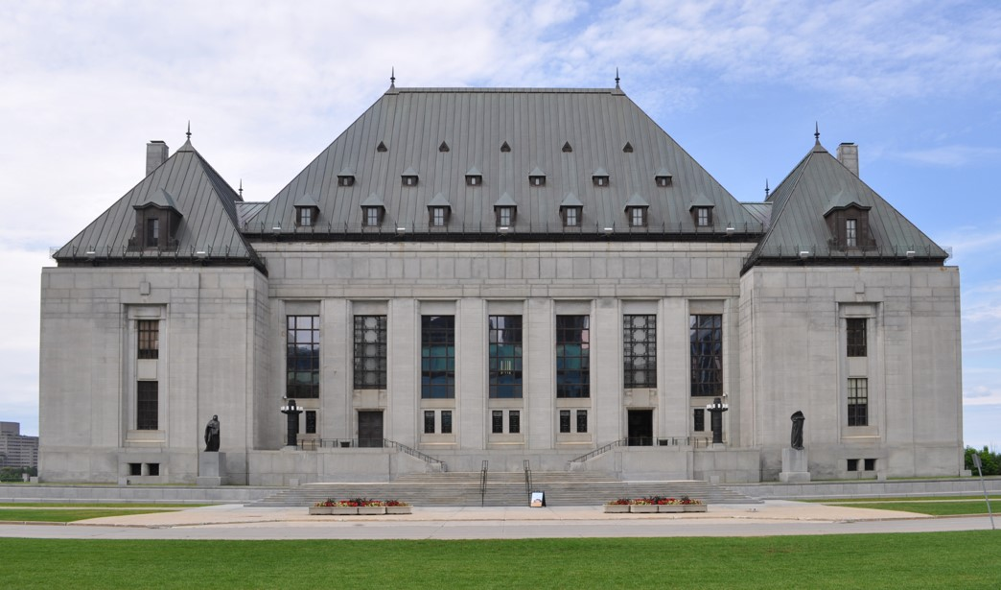

Théberge v. Galerie d’Art…
Théberge v. Galerie d’Art…
2002
Notes:
Seventh Key Event – Théberge. As copyright rose in importance over the decades, it was also taking on more visibility in Canadian courts. 2002 marked the first major Canadian Supreme Court case on copyright – the Théberge decision. The high court’s 2002 ruling notably explicated that the purpose of copyright was to balance the rewarding of creators with encouraging the dissemination of works, and it even cautioned against protecting creators’ rights excessively.

Slide 12

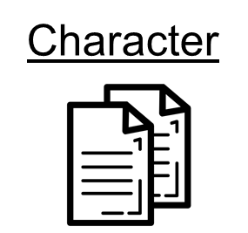
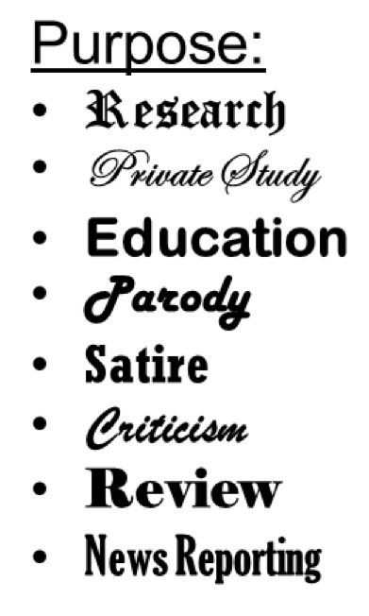

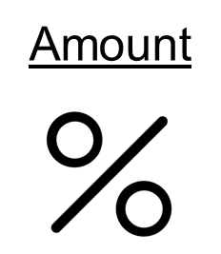
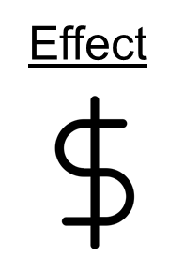
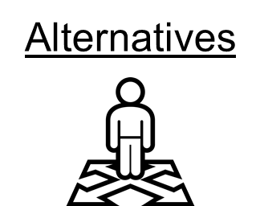
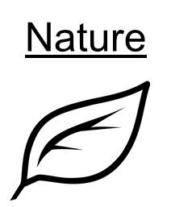
CCH v. LSUC
CCH v. LSUC
2004
Assessing Fair Dealing:
Purpose
Notes:
Eighth Key Event – the 2004 CCH case. Although fair dealing had been part of Canada’s Copyright Act since the 1920s, it was only during the CCH case that the Supreme Court of Canada outlined how to apply fair dealing. CCH laid the groundwork for making determinations about whether a specific dealing with a copyright-protected work is fair and thus not an infringement of copyright.

Slide 13
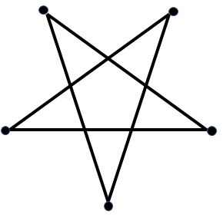

COPYRIGHT PENTALOGY
COPYRIGHT PENTALOGY
2012
SOCAN v. Bell
Alberta (Education) v. Access Copyright
Rogers v. SOCAN
Re:Sound v. MPTAC
ESAC v. SOCAN
Notes:
Ninth Key Event – Pentalogy. 2012 marked another milestone in Supreme Court jurisprudence with the court releasing five decisions on copyright in the summer of that year. The five cases, known as the pentalogy, dealt with a variety of issues, but the SOCAN and Alberta (Education) cases were particularly notable for their application of the CCH six factor test for determining if a dealing is fair.

Slide 14

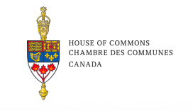

Copyright Act Review
Copyright Act Review
2019
Notes:
Tenth Key Event – Copyright Act Review. In 2017, Canada began a lengthy statutorily-mandated review of the Copyright Act, with issues such as educational fair dealing being hotly contested by various parties. Both the Industry and Heritage Committees of the House of Commons delivered contrasting reports on how the Copyright Act might be revised.

Slide 15

CONCLUSION
Notes:
Regardless of what new issues emerge, such as copyright for AI generated content… the history of copyright shows how it has been transformed from a very limited set of protections designed to encourage learning, to a large and complicated set of creator and user rights with an increasingly economic nature.

Slide 16
CONCLUSION
Statute of Anne
TRIPS
The Copyright Pentalogy
Berne Convention
Théberge
US Constitution
US Copyright Extension Act
The Copyright Act Review
Canadian Copyright Act
CCH v. LSUC
Notes:
…the history of copyright shows how it has been transformed from a very limited set of protections designed to encourage learning, to a large and complicated set of creator and user rights with an increasingly economic nature.

Slide 17
LEARNING OBJECTIVES
You should now be able to:
Recall key events relevant to the history of copyright in Canada
Understand how copyright has evolved, in particular from a means of encouraging learning to an economic policy
Understand how copyright’s history is shaped by the interplay of domestic and international factors
Notes:
You should now be able to:
● Recall key events in the history of copyright
● Understand how copyright has evolved, in particular from a means of encouraging learning to an economic policy
● Understand how copyright’s history is shaped by the interplay of domestic and international factors

Slide 18
Notes:
This has been the University of Alberta’s Opening Up Copyright instructional module on the history of copyright. Thank you for your attention.

Slide 19
QUESTIONS
Copyright as we know it effectively began with:
  A Statue of Anne of Green Gables
  The Statute of Anne
  The Berne Convention
  The first cave painting circa 38 000 B.C.E
The US Copyright Term Extension Act is also known as:
  The Sonny and Cher-Dealing Act
  The Mickey Mouse Copyright Term Extension Act
  The Steamboat Willie Act
  The Walt Disney Act
Copyright was originally thought of as a means of encouraging:
  Learning
  Harmony between governments
  The dissemination of works
  Compensation for creators

Slide 20
QUESTIONS
As intellectual property protection and trade became linked, the 1994 TRIPS agreement brought about greater international protection for copyright holders.
  True
  False
In Canada the future of copyright is:
  Hotly contested
  Subject to international factors
  Something that will impact the way we all use creative works
  All of the above

Slide 21
Bannerman, S. (2011). Canadian copyright: History, change, and potential. Canadian Journal of Communication 36(1) 31-49. Retrieved from: https://web.archive.org/web/20180310085304/https://www.cjc-online.ca/index.php/journal/article/view/2321/2938
Bogsch, A. (1986). The first hundred years of the Berne Convention for the Protection of Literary and Artistic Works. International Bureau of Intellectual Property. WIPO. Retrieved from: https://web.archive.org/web/20200316213331/https://www.wipo.int/edocs/pubdocs/en/copyright/877/wipo_pub_877.pdf
FixCopyright. (2016). Copy (aka Copyright) tells the story of his life [Video]. CC BY. Retrieved from: https://www.youtube.com/watch?v=0fdUDecJ6jc
Schlackman, S. (2014). How Mickey Mouse keeps changing copyright law. Artrepreneur Art Law Journal. Retrieved from: (https://web.archive.org/web/20200116090232/https://alj.artrepreneur.com/mickey-mouse-keeps-changing-copyright-law/

Slide 22
8 Ann. c. 21
1 Statutes at Large, 124
The Copyright Act, 1921
Théberge v. Galerie d’Art du Petit Champlain inc., [2002] 2 S.C.R. 336, 2002 SCC 34
Society of Composers, Authors and Music Publishers of Canada v. Bell Canada, 2012 SCC 36, [2012] 2 S.C.R. 326
Alberta (Education) v. Canadian Copyright Licensing Agency (Access Copyright), 2012 SCC 37, [2012] 2 S.C.R 345
Rogers Communications Inc. v. Society of Composers, Authors and Music Publishers of Canada, 2012 SCC 35, [2012] 2 S.C.R. 283
Entertainment Software Association v. Society of Composers, Authors and Music Publishers of Canada, 2012 SCC 34, [2012] 2 S.C.R. 231
Re:Sound v. Motion Picture Theatre Associations of Canada, 2012 SCC 38, [2012] 2 S.C.R. 376

Slide 23
IMAGE AND SOUND REFERENCES
Clckr- Free- Vector Images. (n.d.). Pixabay. https://pixabay.com/vectors/copyright-copywrite-36078/
Mohammad_hassan. (n.d.). Pixabay. https://pixabay.com/vectors/money-icon-dollar-giving-badge-3614661/
Patrick Tomasso. (n.d.). Pixabay. https://unsplash.com/photos/Oaqk7qqNh_c
Antonia Reeve. (n.d.). Queen Anne when Princes of Denmark, 1665-1714. National Galleries Scotland. CC BY NC. https://www.nationalgalleries.org/art-and-artists/1738/queen-anne-when-princess-denmark-1665
Jan Antoon Garemijn. (1778). The Pandreitje in Bruges. Wikimedia Commons.
https://commons.wikimedia.org/wiki/File:Jan_Antoon_Garemijn_-_The_Pandreitje_in_Bruges_-_WGA08468.jpg
“Statute of Anne.” Wikimedia Commons. PD. https://upload.wikimedia.org/wikipedia/commons/e/ec/Statute_of_anne.jpg
Plasterbrain. (2017). Tada Fanfare G. Freesound. https://freesound.org/people/plasterbrain/sounds/397353/
Enshia. (n.d.). Book. The Noun Project. CC BY. https://thenounproject.com/icon/1787402/
ProSymbols. (n.d.). Art. The Noun Project. CC BY. https://thenounproject.com/icon/1976897
Atif Arshad. (n.d). Gramophone. The Noun Project. CC0. https://thenounproject.com/icon/1306170/
Montu Yadav. (n.d.). Broadcast. The Noun Project. CC BY. https://thenounproject.com/term/broadcast/201837

Slide 24
Priyanka. (n.d.). Viewing. The Noun Project. CC BY. https://thenounproject.com/term/viewing/1694590
Blair Adams. (n.d.). Drama. The Noun Project. CC BY. https://thenounproject.com/term/drama/953398
Shastry. (n.d.). DVD. The Noun Project. CC BY. https://thenounproject.com/term/dvd/2163746
Andrey Vasiliev. (n.d.). Film Projector. The Noun Project. CC BY. https://thenounproject.com/term/film-projector/336166
Michael Kaminski (n.d.). One. The Noun Project. CC BY. https://thenounproject.com/search/?q=one&i=2010363
Michael Kaminski (n.d.). Two. The Noun Project. CC BY. https://thenounproject.com/kaliphast/uploads/?i=2010370
[Betsy Ross American Flag]. https://en.wikipedia.org/wiki/Flag_of_the_United_States#/media/File:Flag_of_the_United_States_(1777-1795).svg
“Copyright Act of 1970”. https://www.copyright.gov/about/images/1790_First_US_Copyright_Law_P1_8.jpg
Michael Kaminski. (n.d.). Three. The Noun Project. CC BY. https://thenounproject.com/kaliphast/uploads/?i=2010367
Maadmacs. (2017). Horse and Carriage. Freesound. https://freesound.org/people/maadmacs/sounds/388391/
Atif Arshad. (n.d.). Globe. The Noun Project. CC BY. https://thenounproject.com/search/?q=globe&i=1299776
Joseph Ferdinand Keppler. (1886). The Pirate Publisher. Wikimedia Commons. PD. https://commons.wikimedia.org/wiki/File:Joseph_Ferdinand_Keppler_-_The_Pirate_Publisher_-_Puck_Magazine_-_Restoration_by_Adam_Cuerden.jpg

Slide 25
Michael Kaminski. (n.d.). Four. The Noun Project. CC BY. https://thenounproject.com/kaliphast/uploads/?i=2010371
[Canadian Flag]. https://drive.google.com/file/d/1aQzFvb1VmDAhn1Jhx6GMxNhqDUqNtu73/view
Michael Kaminski. (n.d.). Five. The Noun Project. CC BY. https://thenounproject.com/kaliphast/uploads/?i=2010369
National Cancer Institute. (1987). [A librarian at the National Library of Medicine]. Pixabay. https://unsplash.com/photos/OHx5zVsv_gY
Timbre. (2010). Transmoogrified Piano. Freesound. https://freesound.org/people/Timbre/sounds/106978/
[WTO Logo]. https://drive.google.com/file/d/1VVDARTWr0MRCtdp4VNqyPP4PAmgV9wpS/view
Michael Kaminski. (n.d.). Six. The Noun Project. CC BY. https://thenounproject.com/kaliphast/uploads/?i=2010368
Raul654. US Congressional photo of Sonny Bono. Wikimedia Commons. PD. https://en.wikipedia.org/wiki/Sonny_Bono#/media/File:Sonny_Bono.jpg
Jonathan Lutaster. (n.d.). Mouse Ears. The Noun Project. CC BY. https://thenounproject.com/search/?q=mouse&i=315445
Reitanna. (2014). Giggle2. Freesound. https://freesound.org/people/Reitanna/sounds/235167/
[Flag of the US]. https://drive.google.com/file/d/1YO613AnLUiGwCZViqsV-_46d_nChlO3S/view

Slide 26
Michael Kaminski. (n.d.). Seven. The Noun Project. CC BY. https://thenounproject.com/kaliphast/uploads/?i=2010366
Dig deeper. (2017). [Supreme Court of Canada]. Wikimedia Commons. CC BY 4.0. https://commons.wikimedia.org/wiki/File:Supreme_court_of_Canada_in_summer.jpg
Kick. (n.d.). Scales. The Noun Project. CC BY. https://thenounproject.com/search/?q=scale&i=1320645
Michael Kaminski. (n.d.). Eight. The Noun Project. CC BY. https://thenounproject.com/kaliphast/uploads/?i=2010372
Dezign, Ruslan. (n.d.). Target. The Noun Project. CC BY. https://thenounproject.com/icon/1005058/
ATOM, TH. (n.d.). Copy. The Noun Project. CC BY. https://thenounproject.com/search/?q=copy&i=1474212
Тимур Минвалеев, RU. (n.d.). Percent. The Noun Project. CC BY. https://thenounproject.com/search/?q=percent&i=397874
Farais, B, CL. (n.d.). Decision. The Noun Project. CC BY. https://thenounproject.com/search/?q=alternatives&i=1074053
AFY Studio, ID. (n.d.). Leaf. The Noun Project. CC BY. https://thenounproject.com/AFYstudio/uploads/?i=1737325
Farais, B, CL. (n.d.). Decision. The Noun Project. CC BY. https://thenounproject.com/search/?q=alternatives&i=1074053
AFY Studio, ID. (n.d.). Leaf. The Noun Project. CC BY. https://thenounproject.com/AFYstudio/uploads/?i=1737325
Michael Kaminski. (n.d.). Nine. The Noun Project. CC BY. https://thenounproject.com/kaliphast/uploads/?i=2010365

Slide 27
Michael Kaminski. (n.d.). Zero. The Noun Project. CC BY. https://thenounproject.com/kaliphast/uploads/?i=2010364
Clckr- Free- Vector Images. (n.d.). [Robot]. Pixabay. https://pixabay.com/vectors/robot-machine-technology-mechanical-312208/
Morganpurkins. (2016). Clang. Freesound. https://freesound.org/people/morganpurkis/sounds/370245/
Wilhelboy. (2016). Lightringingclang. Freesound. https://freesound.org/people/wilhellboy/sounds/351372/
Closing Slides Music: Rybak, Nazar. “Corporate Inspired.” HookSounds. N.d. http://www.hooksounds.com (used under a CC-BY 4.0 Licence)
Unattributed materials are contributions from the Opening Up Copyright Project Team and placed in the Public Domain

Slide 28
University of Alberta. (2020). History of Copyright. Opening Up Copyright Instructional Module. https://sites.library.ualberta.ca/copyright/

Slide 29
Toby Grant

