Slide 1
Working with Copyright
October 2022
Notes:
Hello, and welcome to the University of Alberta’s Opening Up Copyright Instruction Module on “Working with Copyright.”

Slide 2
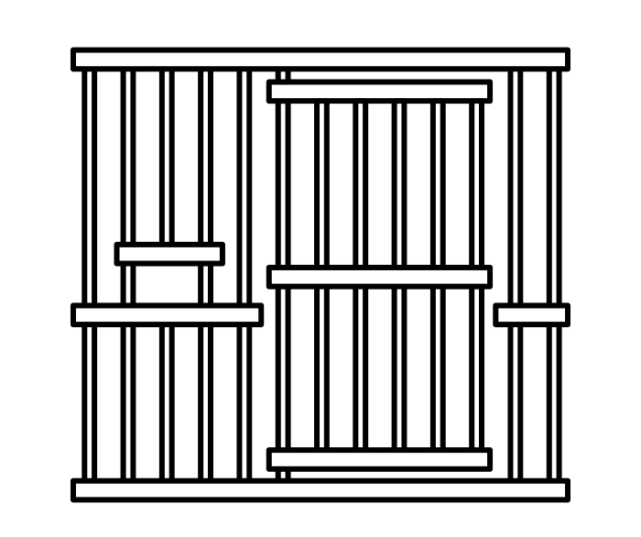
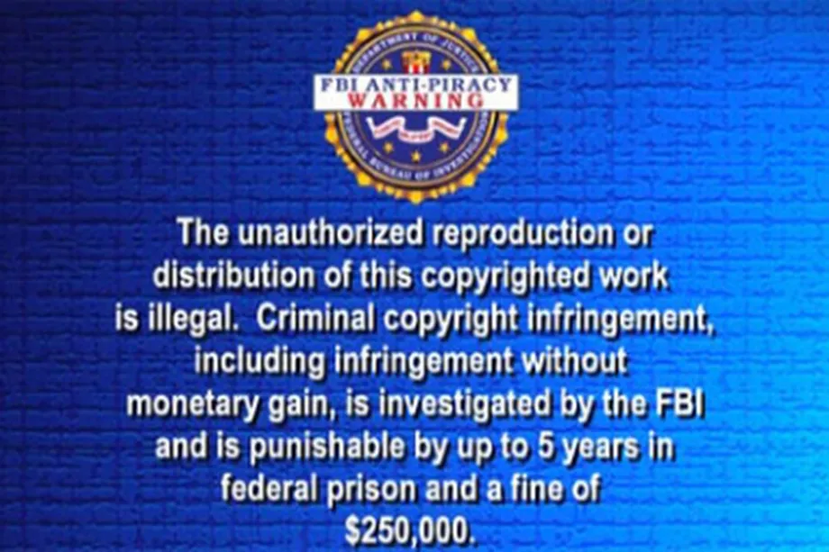
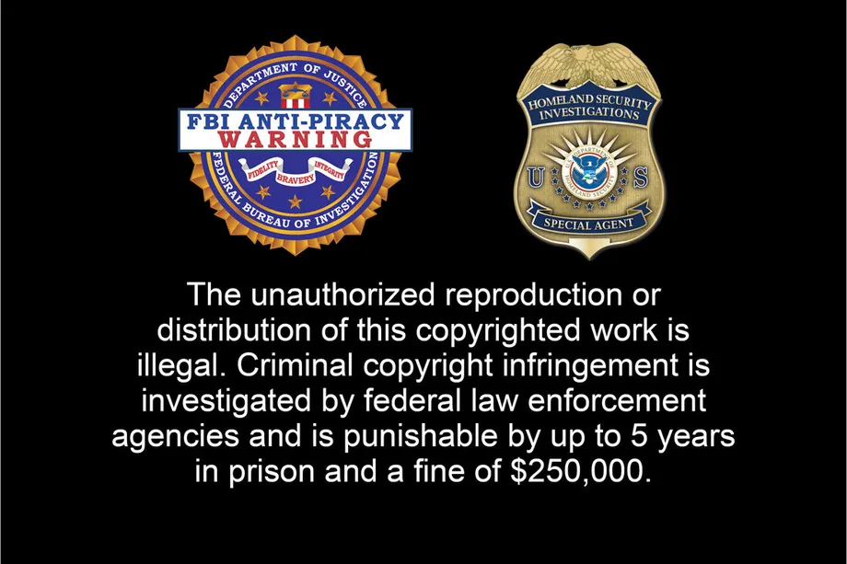
HOW DOES COPYRIGHT WORK?
©
All Rights Reserved
Prison… seriously?
Notes:
You’ve likely seen that FBI warning at the beginning of a movie that says something about copyright and 5 years in prison or the statement on the inside cover of a novel or textbook that says “all rights reserved.” But how does copyright really work, and how can you work with copyright protected materials without doing a stint in the Big House?

Slide 3
CONTROL… LIMITED CONTROL
What kinds of rights do I have?
©
= CONTROL
What kinds of rights do we have?
©
Notes:
Copyright protection of a work gives the rights holder a lot of control in determining how that work can be used, but there are limits to that control. This module will explore the options that are available to rights holders when they share or make their works available to others. It will also consider the rights that are available to users of copyright-protected works.

Slide 4
ALL RIGHTS RESERVED… MAYBE
©
Some for me… and some for others
Mine… it’s all mine
All Rights Reserved
©
Notes:
We have all seen the words “All Rights Reserved” next to the copyright symbol. This indicates that the rights holder wishes to exercise all the rights that are available to them under the Copyright Act. But there are limits on those rights, and there is nothing that requires a rights holder to exercise all of them. In fact, there are many cases where the rights holder may have their interests served by having their work used in ways that copyright would limit.

Slide 5
SHARING IS CARING
This thing is great
I can see why this made you famous!
Cool! Thanks for sharing
Notes:
For example, many creators want other people to share and remix their works. For many, visibility and impact of their research or creative expression is more important than maintaining overreaching economic and moral control.

Slide 6
BETWEEN ALL RIGHTS AND NO RIGHTS
©
Public Domain
No One Has Any Rights
All Rights Reserved
©
Please, may I…
“A short quote…”
(insubstantial copying)
©
Notes:
The all rights reserved approach to copyright management is only one side of the story. There are all kinds of intellectual works that have no copyright protection at all. These materials belong to what is known in copyright terms as the “public domain” or our intellectual commons. And it’s not just a binary of the full protection of copyright or the lack of any protections for material in the public domain. From copyright term limits and insubstantial copying to open licensing or asking permission, all the way to exceptions in the Copyright Act, there are a number of ways copyright protected materials can be used.

Slide 7
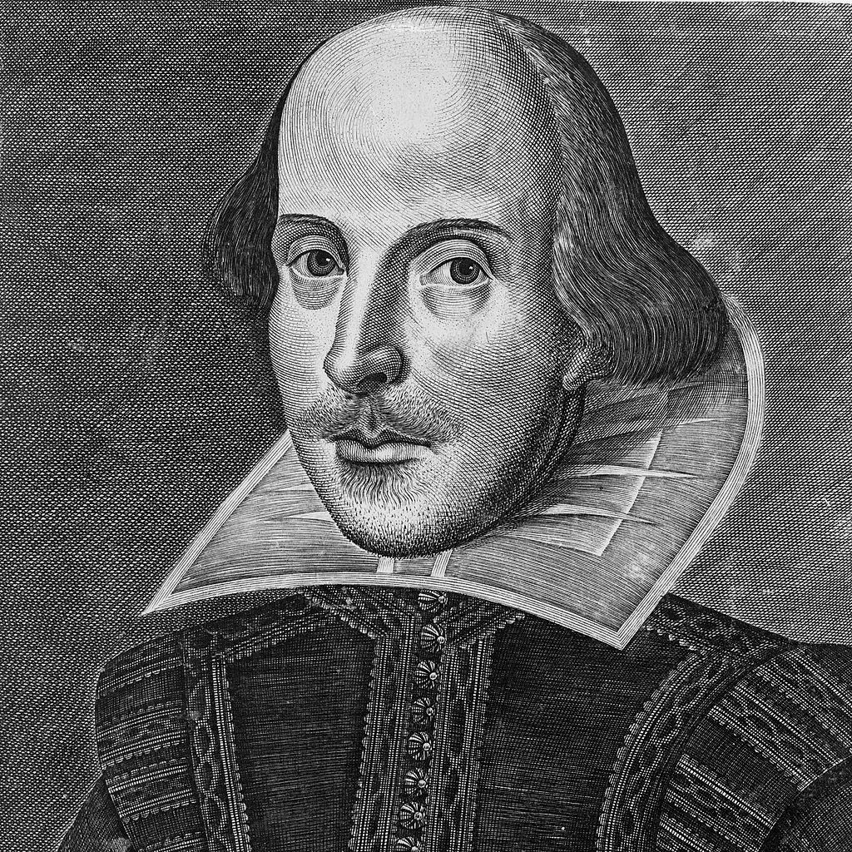
THE LIMITS TO COPYRIGHT
It’s mine… and it’s protected
Hamlet
Public Domain
and
Zombies
©
©
Has anyone seen Yorick? We’ve both been gone a long time
©
Notes:
While copyright protection is broad, it’s not absolute. And it’s not forever. The general term of copyright protection extends for decades after the death of the creator, but when that term expires the works enter the public domain. If the material you want to use is in the public domain, copyright controls are no longer relevant to your use. If you wanted to copy all of Shakespeare’s Hamlet or Macbeth, or modify or adapt them into new works, there is nothing stopping you, at least not from a copyright perspective.

Slide 8
INSUBSTANTIALITY
Public Domain
©
“A short quote…”
A short quote from a long work is often not a substantial piece of the work.
Insubstantial amounts of a work do not fall under copyright protection at all.
“A short quote…”
“A short quote…”
Notes:
In addition, copyright only applies if you are using a substantial part of a work. So using an insubstantial amount of work, like a short quote, would not be copyright infringement.

Slide 9
EVERYONE IS A CREATOR AND A USER
I’m a creator and a user… just like everyone else!!
Creator
©
Public Domain
No One Has Any Rights
All Rights Reserved
©
User
Notes:
In between the “all rights reserved” of copyright and the “no one has any rights” of the public domain there are a whole range of ways copyright-protected materials can be used. It's important to understand these as both a creator and user of copyright protected material - and everyone is both a creator and user.

Slide 10
OPEN LICENSING
Open Licences
I can see why this made you famous!
This thing is great
©
How can I share this…
on my terms
… no, too restrictive
Perfect!
Cool! Thanks for sharing
Notes:
What can you do if you want to allow others to use something you created without giving up all rights associated with copyright? Generally speaking, when you are the rights holder then copyright protection limits the ability of others to use your work. If you want to share some of your works broadly, perhaps for greater visibility and impact, you can make that decision clear to others by assigning an open licence to the work. Open licences do not mean that anyone can use your work however they want, but they do allow you to efficiently communicate terms of use. Creative Commons licences are the most common and they are free and easy to assign.

Slide 11
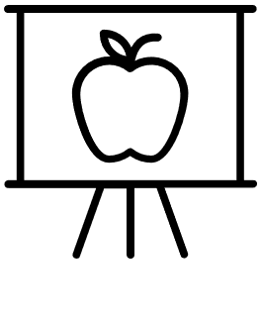
USING OTHERS WORK
???
Talk about easy to understand
Notes:
As a user of someone else’s work, an open licence makes it clear how and when it’s ok for you to use that work. Otherwise, when you find someone else’s copyright-protected image, writing, song or any other work you wish to use, it is important to first determine if and how you can legally use that material.

Slide 12
ASKING PERMISSION
Please, may I…
I wish we could copy the whole thing
Sure… for five bucks
©
Notes:
Let’s say you want to use a substantial amount of someone else’s copyright-protected work that is not covered by an open licence. When is it ok to do that? Well, you could ask for permission to use the work from the rights holder directly. This may or may not include a transactional licence that involves paying for the right to use the work.

Slide 13
COPYRIGHT ACT EXCEPTIONS
Please, may I
Exceptions to Infringement s. 29-32.2
Notes:
Even if a rights holder hasn’t assigned an open licence, there may be other ways in which you can legally use someone else’s copyright-protected work without seeking permission. As we noted earlier, copyright protection is not absolute. It is also important to consider what exceptions to copyright infringement may apply in your situation.

Slide 14
COPYRIGHT ACT EXCEPTIONS
©
Fair dealing (s. 29)
Individual Exceptions (s. 29.21 to 29.23)
Exceptions to Infringement s. 29-32.2
Institutional Exceptions (s. 29.4 to 30.4)
Notes:
The exceptions in the Copyright Act that might apply to your use include fair dealing, individual exceptions, and institutional exceptions. Of the three types of exceptions, fair dealing is the most common and the most important. For example, if you are using a work for the purposes of research, private study or education, such as making a copy of a chapter for a class, that use may be covered under fair dealing.

Slide 15
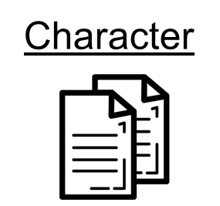
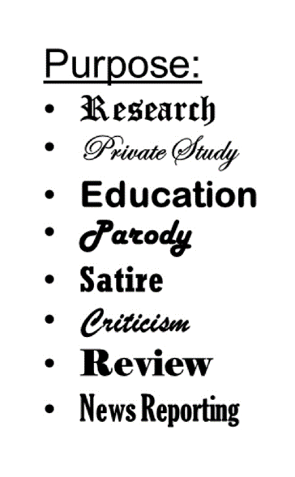
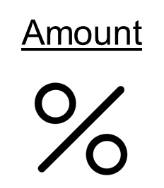
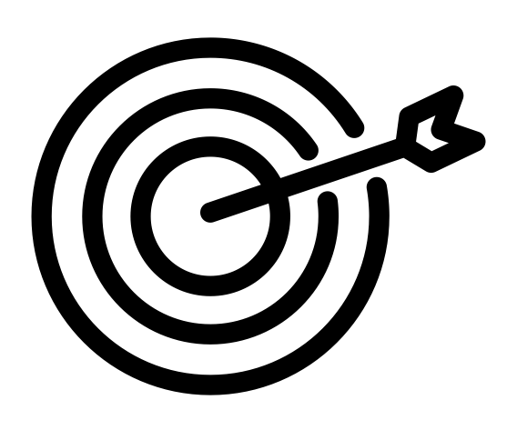
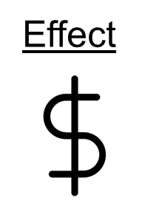
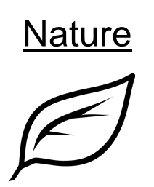
FAIR DEALING
©
Purpose
STEP 1: Assess the Purpose
STEP 2: Assess the Dealing
Notes:
This does not, however, mean that you can do anything you want with the material. Completing a six-factor fair dealing assessment will help you consider whether your dealing with the work is fair or not. To find out more about fair dealing see our modules on Applying Fair Dealing and section 29 of the Copyright Act, which covers Fair Dealing.

Slide 16
INDIVIDUAL EXCEPTIONS
User-Generated Content (UGC)
Time shifting (recording for later use) and
Format shifting (switching media)
Backup Copies
Backup Copies
Backup Copies
Don’t forget to check the conditions (limitations)
Notes:
There are also limited personal exceptions for incorporating the work of others in your own user-generated content, as well as provisions for format shifting, time shifting and back-up copies. But it is important to remember that each one of these exceptions has specific conditions around when it can be used.

Slide 17
INSTITUTIONAL EXCEPTIONS
Don’t forget to check the conditions (limitations)
Didn’t you just say that?
Yeah, but it’s important!
Notes:
In regards to use by libraries and museums or use in educational institutions, it is important to check the conditions for institutional exceptions outlined in the Copyright Act to confirm whether your use as an employee would fall under this kind of exception.

Slide 18
IT’S ALL ABOUT BALANCE
©
©
©
“A short quote…”
Notes:
Term length, substantiality, and exceptions to copyright infringement all serve to balance the rights of users with the rights of, well, rights holders. In this way, copyright is said to involve a balance of interests.
At its core, copyright is about balancing the interests of creators and rights holders with the interests of potential users of those works in a way that maximizes the overall public benefit.

Slide 19
LEARNING OBJECTIVES
You should now be able to:
Recognize when copyright is a factor when using material created by someone else
Describe the range of ways copyright might impact use from all rights reserved to no rights for anyone
Understand that term lengths, substantiality and a variety of exceptions aim to balance the interests of rights holders and users
Notes:
You should now be able to:
Recognize when copyright is a factor when using material created by someone else
Describe the range of ways copyright might impact use from all rights reserved to no rights for anyone
Understand that term length, substantially and a variety of exceptions aim to balance the interests of rights holders and users

Slide 20
Notes:
This has been the University of Alberta’s Opening Up Copyright Instructional Module on “Working with Copyright”. Thank you for your attention.

Slide 21
QUESTIONS
“All rights reserved” in the front of a book means you can never, ever legally reproduce any part of that book.
A. True
B. False
2. Balance is a big deal in copyright law. What are the provisions in the Copyright Act, as a whole, attempting to balance?
Financial compensation for authors and students needing to copy educational materials.
Slices of cheese and measuring weights.
Interests of rights holders and users of works that are subject to copyright protection.
Financial compensation for rights holders and libraries needing to make copies of works for posterity.

Slide 22
QUESTIONS
3. You can legally make and share copies of a copyright-protected work under which of the following scenarios?
When your use is supported by an exception to infringement in the Copyright Act.
When the rights holder has given you permission to do so.
When the amount of the work you are using is insubstantial.
All of the responses are correct.
4. If something is freely available on the Internet then it is in the public domain and you don’t have to worry about copyright.
True
False
5. Which of the following exceptions to copyright infringement is the most common and most important?
Fair Dealing
Educational Institutions
Personal Desire
Emergency Measures

Slide 23
Murray, L.J., & Trosow, S.E. (2013). Canadian copyright: A citizen’s guide. 2nd Ed. Toronto, ON: Between the Lines.
Vaver, D. (2011). Intellectual property law : copyright, patents, trade-marks. 2nd Ed. Toronto: Irwin Law.

Slide 24
Federal Bureau of Investigations (FBI). n.d. FBI Warning. PD. From Patel, N. 2011. “Does senate bill 978 make YouTube and video game run-through videos illegal? Not Really.” The Verge. https://www.theverge.com/2011/07/06/senate-bill-978-youtube-video-game-lets-play-videos-illegal
FBI. 2012. FBI Warning [2012]. PD. From Webster, A. 2012. “US Government unveils new piracy warnings for DVDs and Blu-rays.” The Verge. https://www.theverge.com/2012/5/9/3009210/us-government-dvd-blu-ray-piracy-warnings
Jolan Soens. (n.d.). Prison. The Noun Project. CC BY. https://thenounproject.com/icon/567031/
endritprnku. (n.d.). Prison doors closing. FreeSound. CC0. https://freesound.org/people/endritprenku/sounds/613498/
Ghan Koon Lay. (n.d). Boss. The Noun Project. CC0. https://thenounproject.com/icon/1587076
Oksana Latysheva. (n.d.). People group. The Noun Project. CC BY. https://thenounproject.com/icon/people-group-1310753/
Tippawan Sookruay. (2021). Artist. The Noun Project. CC BY. https://thenounproject.com/icon/artist-4275231/
Creative Commons. (n.d.). [Creative Commons Logo]. https://creativecommons.org/about/downloads
AFY Studio. 2019. Scale. The Noun Project. CC BY. https://thenounproject.com/icon/scale-2772463
Jeff Ahlberg. 2013. Circus Tent. The Noun Project. CC BY. https://thenounproject.com/icon/circus-tent-9821/
Rob Crosswell. 2017. Library. The Noun Project. CC BY. https://thenounproject.com/icon/library-1122689/
Bieu Tuong. 2018. School. The Noun Project. CC BY. https://thenounproject.com/icon/school-1983588/

Slide 25
Martin Droeshout. (1623). William Shakespeare. Wikimedia Commons. CC0. https://commons.wikimedia.org/wiki/File:Shakespeare_Droeshout_1623.jpg
Enshia. (n.d.). Book. The Noun Project. CC BY. https://thenounproject.com/icon/1787402/
ProSymbols. (2018). Art. The Noun Project. CC BY. https://thenounproject.com/icon/1976897
DinosoftLab. (2018). CD The Noun Project. CC BY. https://thenounproject.com/icon/cd-2152164/
Creative Commons. (n.d.). [Creative Commons Logos]. https://creativecommons.org/about/downloads
Ruslan Dezign. (n.d.). Target. The Noun Project. CC BY.: https://thenounproject.com/icon/1005058/
ATOM, TH. (n.d.). Copy. The Noun Project. CC BY. https://thenounproject.com/search/?q=copy&i=1474212
Тимур Минвалеев, RU. (n.d.). Percent. The Noun Project. CC BY. https://thenounproject.com/search/?q=percent&i=397874
B. Farais. (n.d.). Decision. The Noun Project. CC BY. https://thenounproject.com/search/?q=alternatives&i=1074053
AFY Studio, ID. (n.d.). Leaf. The Noun Project. CC BY. https://thenounproject.com/AFYstudio/uploads/?i=1737325
Gregor Cresnar. (n.d.). Dollar sign. The Noun Project. CC BY. https://thenounproject.com/search/?q=dollar%20sign&i=171145

Slide 26
Unattributed materials are contributions from the Opening Up Copyright Project Team and placed in the Public Domain
Closing Slides Music: Rybak, Nazar. “Corporate Inspired.” HookSounds. (n.d). http://www.hooksounds.com (used under a CC-BY 4.0 Licence)

Slide 27
University of Alberta. 2022. “Working with Copyright.” Opening Up Copyright Instructional Module. https://sites.library.ualberta.ca/copyright/

