Slide 1
Opening Up Copyright: An Introduction
October 2022
Notes:
Hello, and welcome to the University of Alberta’s Opening Up Copyright Instructional Module Series.

Slide 2

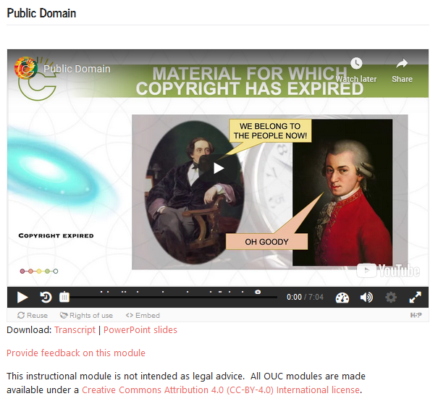
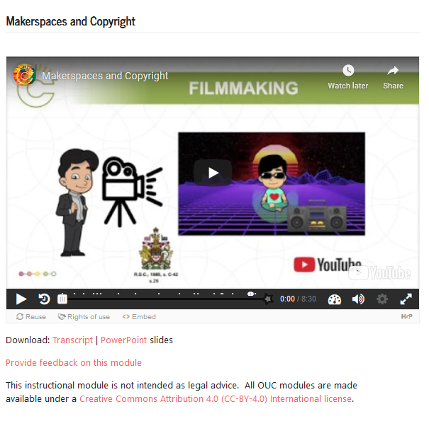

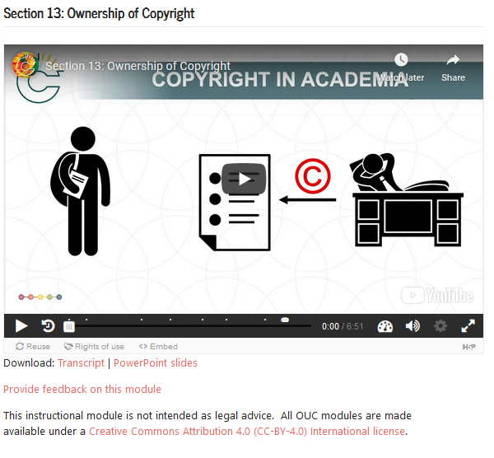

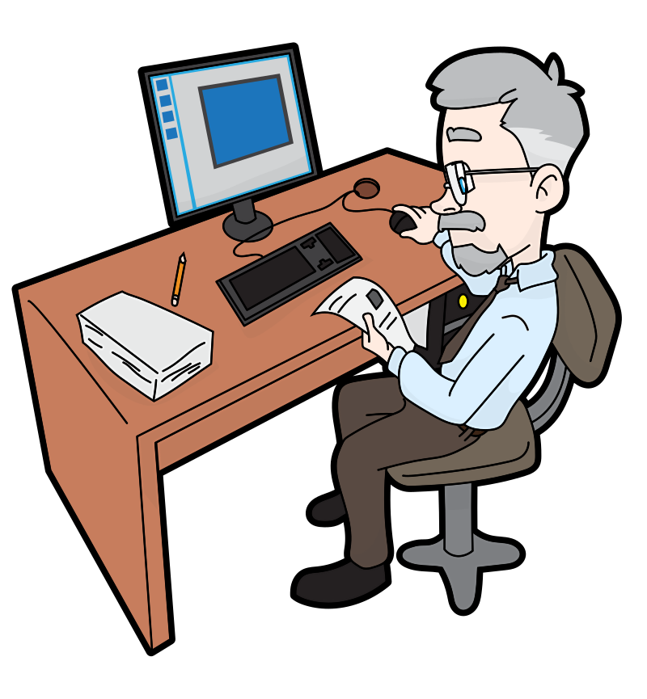
WHAT IS OUC?
Notes:
Opening Up Copyright, or OUC, is a series of openly licensed, interactive instructional videos on Canadian copyright. The series aims to make copyright information available to all, whether you are a student, an instructor or just someone looking for more information. At the outset though, it is important to note that these modules are not legal advice.

Slide 3
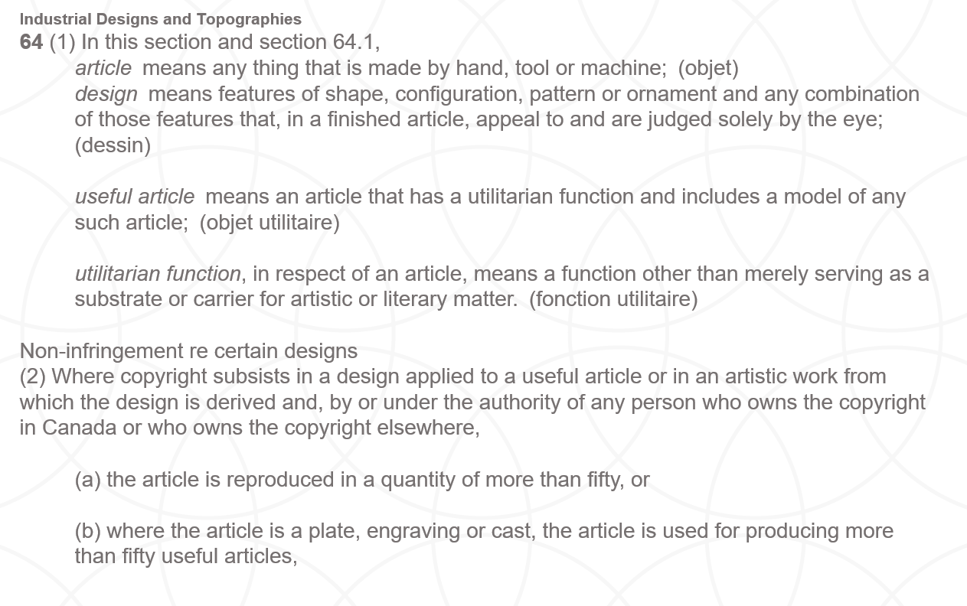

COPYRIGHT CONFUSION
?
?
?
Notes:
Copyright is a topic with a definite learning curve. While not all aspects of copyright are complex, most become complicated by their context. This can leave those who need to learn about copyright feeling frustrated and confused, especially if they don’t have ready access to someone with more knowledge or experience in the area. OUC modules were designed and written for a diverse group of different audiences, both within and outside the post-secondary community.

Slide 4


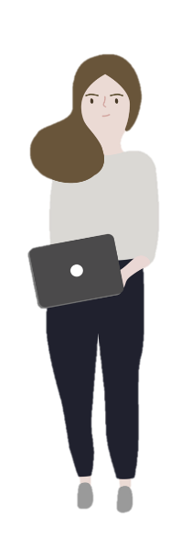


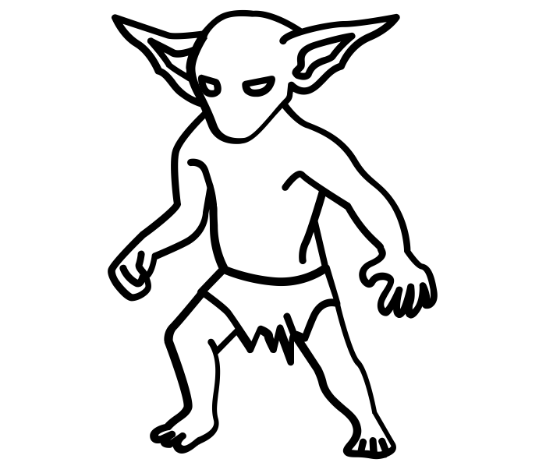
COPYRIGHT CONFUSION
?
?
?
Notes:
OUC modules were designed and written for a diverse group of different audiences, both within and outside the post-secondary community.

Slide 5





OUC GOALS
Broaden access to copyright information
Advance the values associated with openness and open content
Reach multiple audiences and avoiding duplication in resource development, and
Produce open educational resources (OER) about copyright that can serve as an enabler for other open education projects
Notes:
The goals of the series are to:
Broaden access to copyright information
Advance the values associated with openness and open content
Reach multiple audiences and avoid duplication in resource development, and
Produce an open educational resource (OER) about copyright that can serve as an enabler for other open education projects
This series is very much aligned with and indebted to the open content movement. If you are wondering what open content or open licensing is, well… we have a module for that.

Slide 6
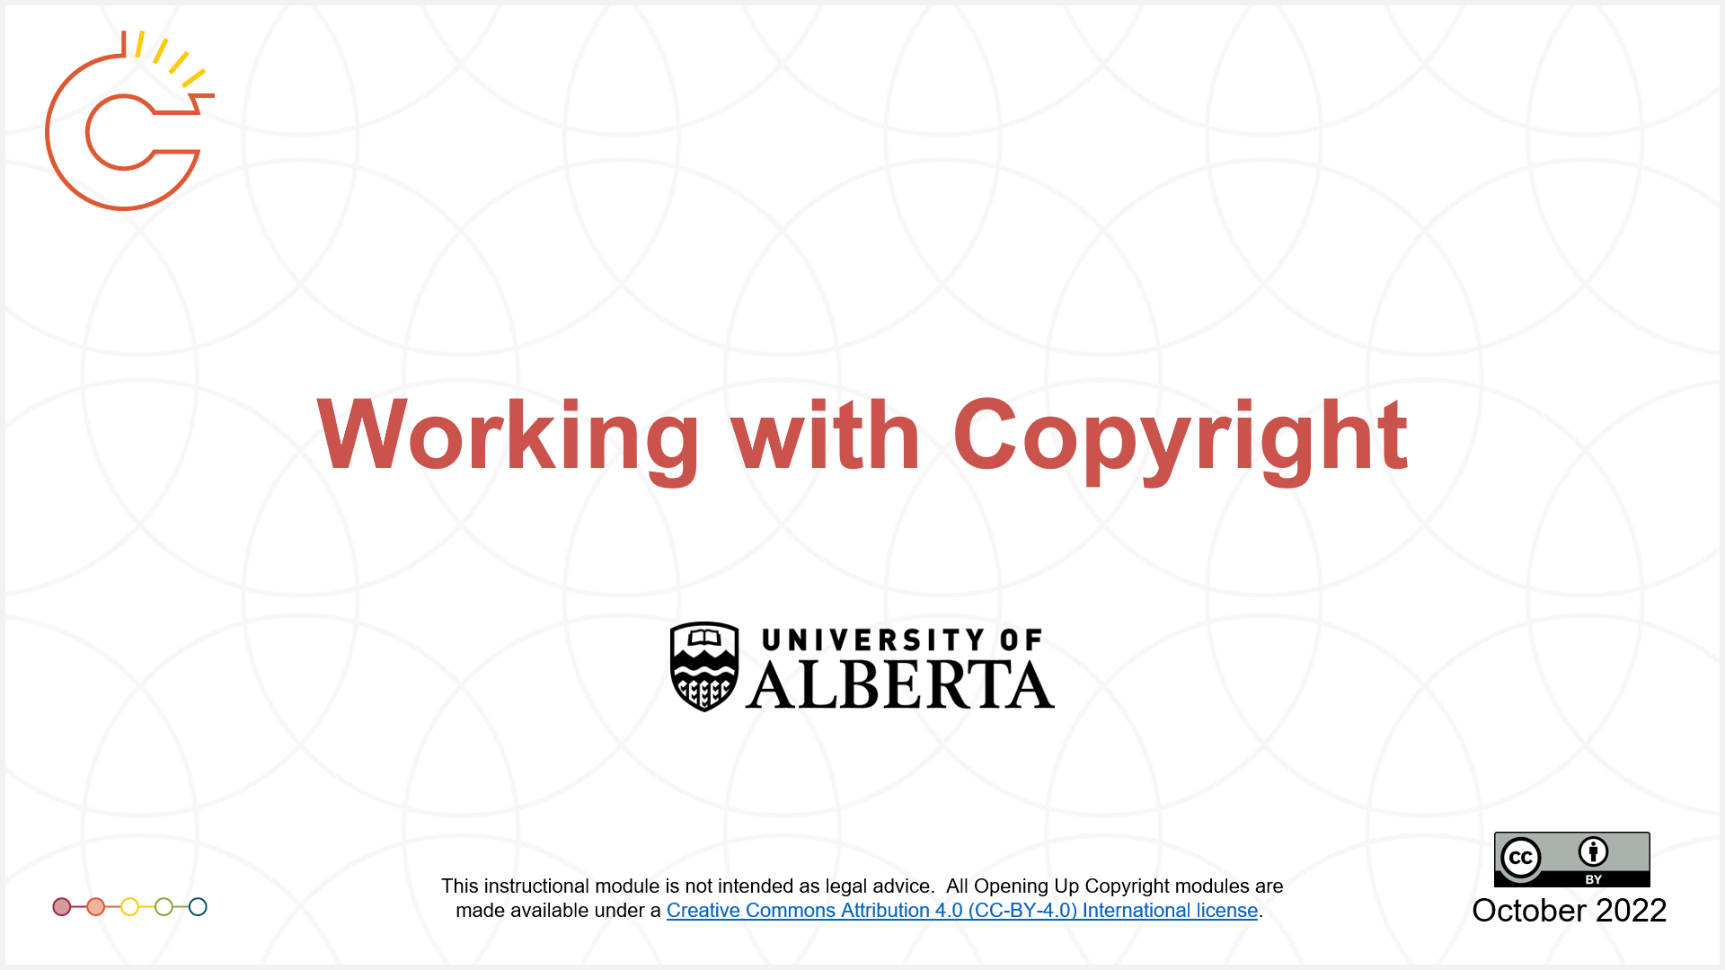
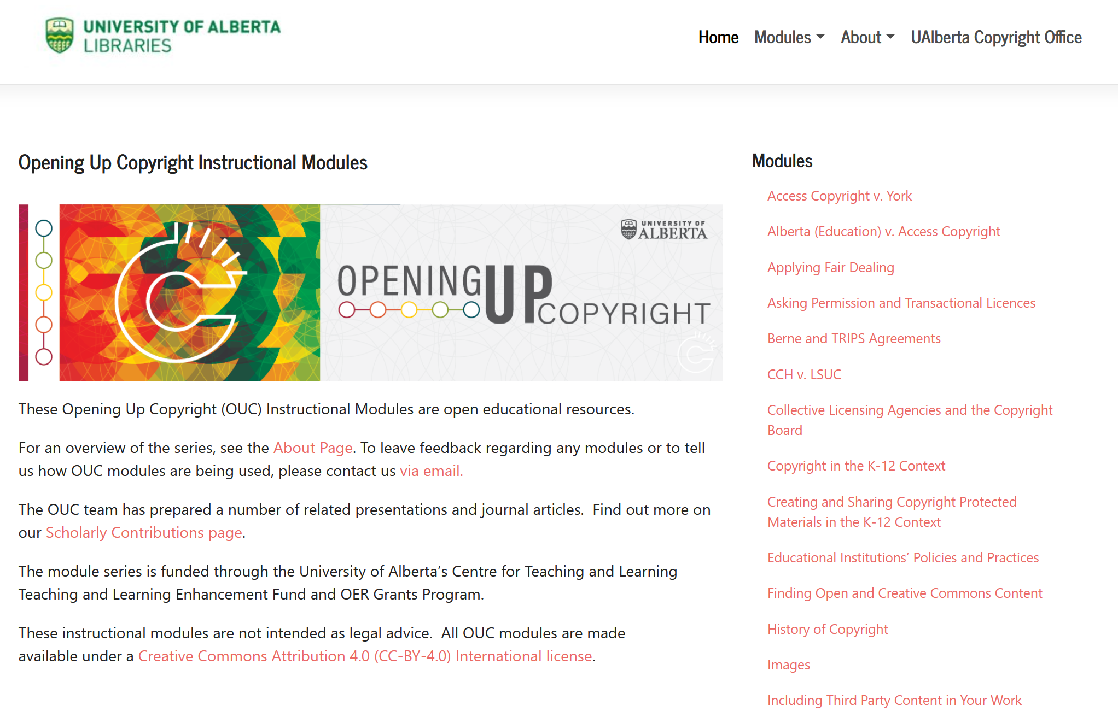






STRUCTURE OF OUC
Notes:
That is also a good segue for discussing how the series is structured. OUC modules cover a variety of topics -- ranging from introductory subjects such as creating and sharing materials to more advanced topics such as applying fair dealing. We even have videos on specific sections of the Copyright Act and key court cases. While the series does have modules at different levels of generality… in fact five levels indicated in part by colour of the slides, they don’t have to be viewed in any particular order.

Slide 7
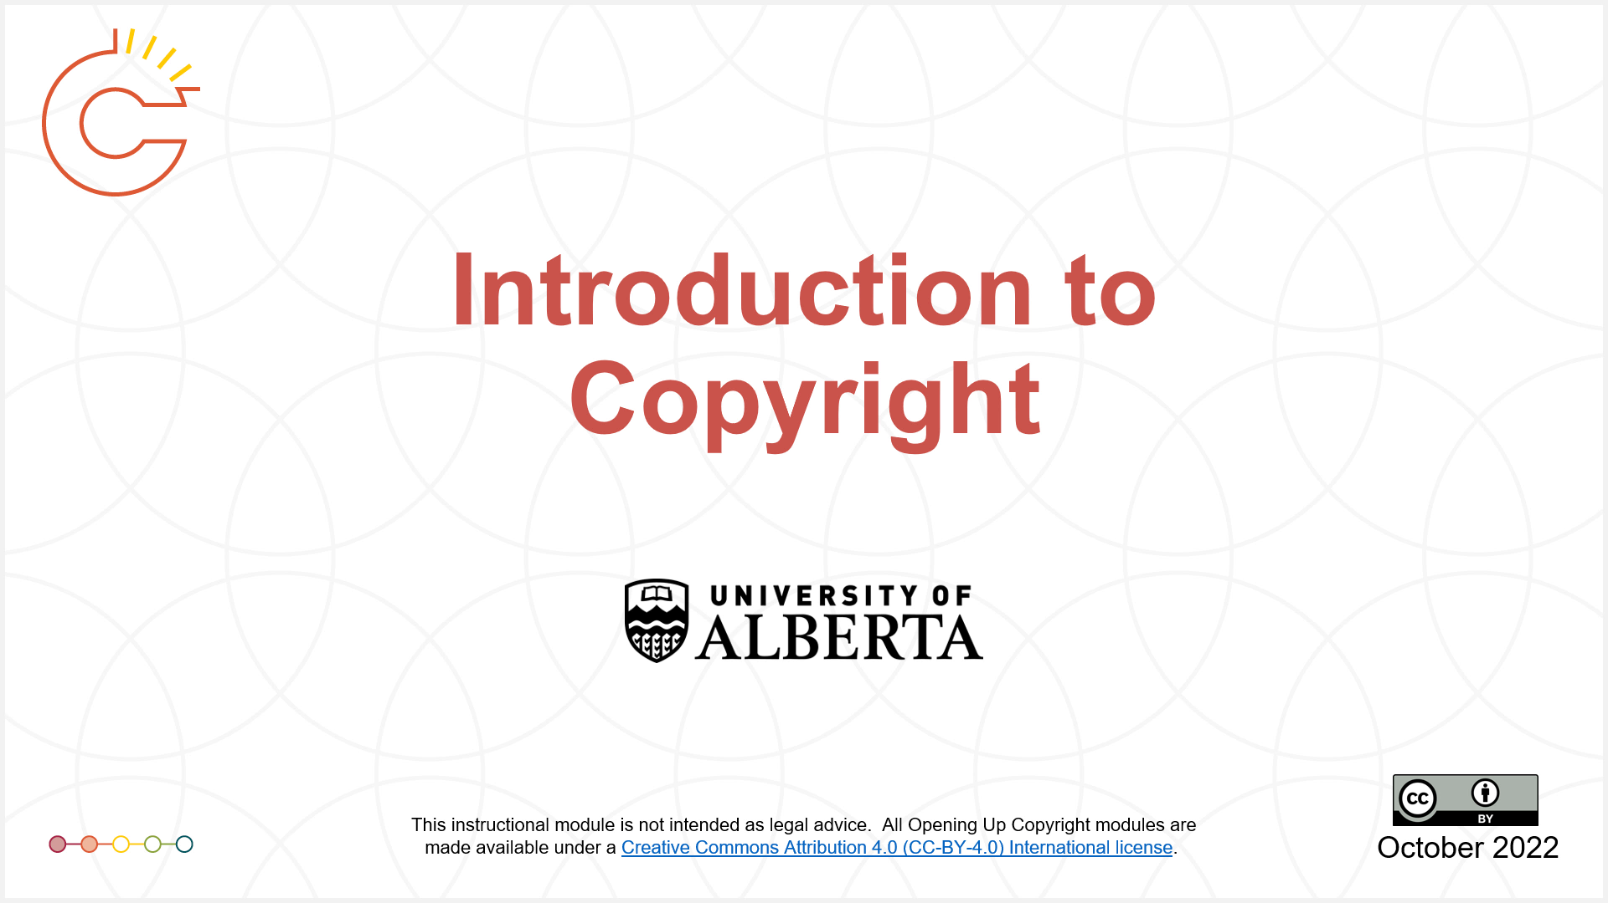
STRUCTURE OF OUC
Notes:
That said, there are natural starting points to this series. We have an Introduction to Copyright video to get you started and an introductory module on Working with Copyright. These two modules serve as entry points to many of the other, more specific, modules. There are also a few clusters of modules grouped around specific topics, such as copyright in higher education or technological protection measures.

Slide 8
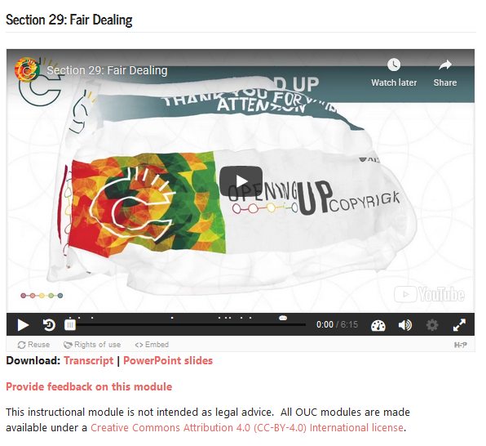
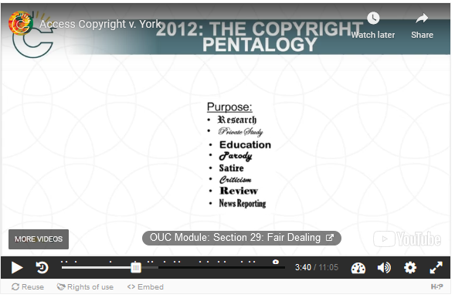
NAVIGATION AND H5P
Notes:
To help you navigate the series, we use H5P “pop ups” to provide links within the videos, like the one you saw before for the OUC Module: Open Licensing and Creative Commons.

Slide 9
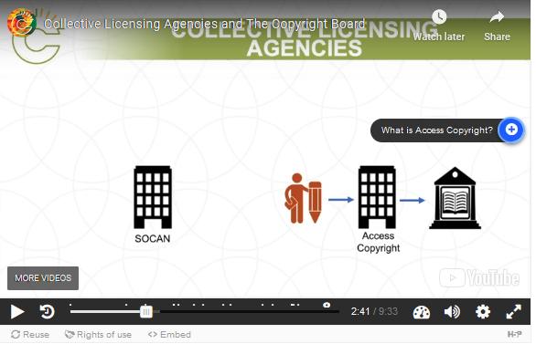
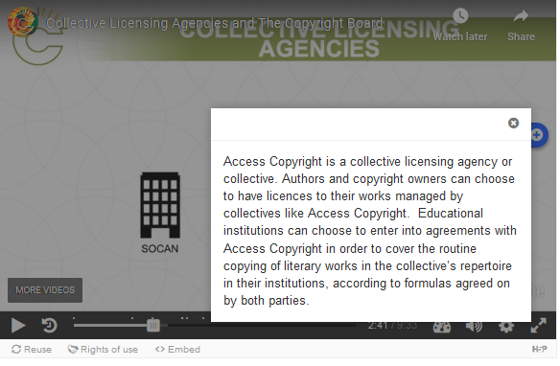
NAVIGATION AND H5P
Notes:
These “pop ups” are also used to provide additional information or links to outside resources. Wherever possible, we try to ensure that those links are to other open and accessible resources.

Slide 10
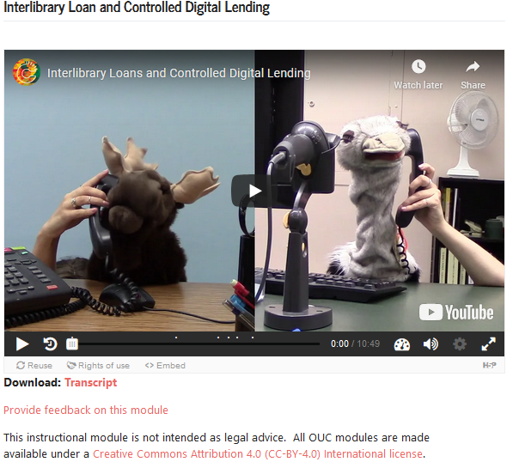
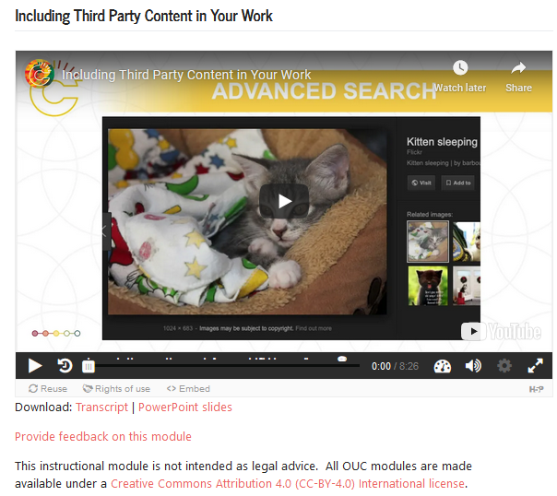
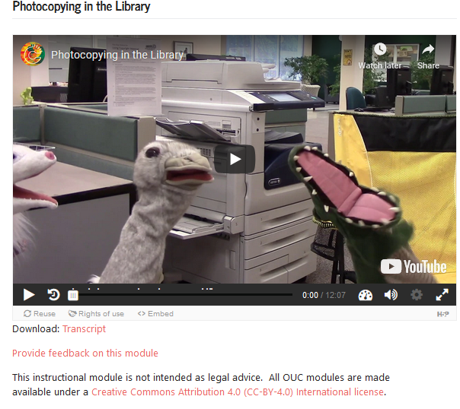
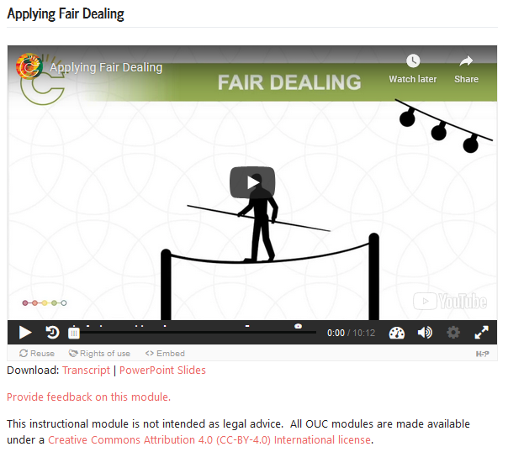
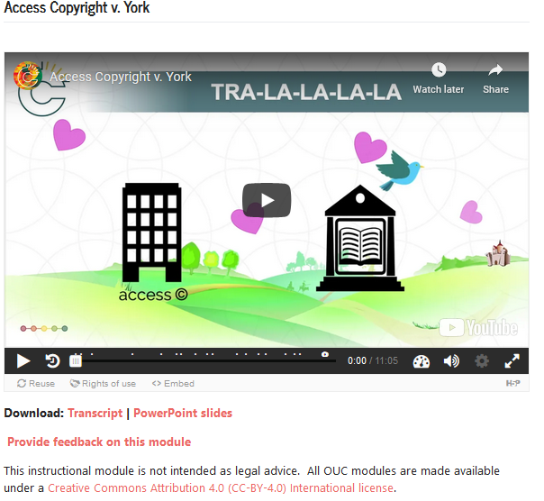
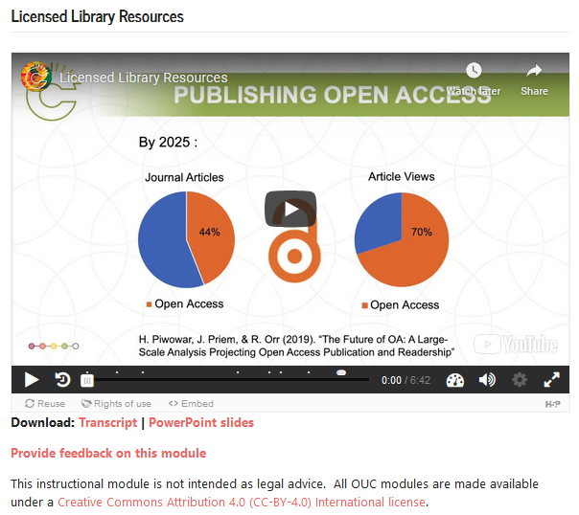
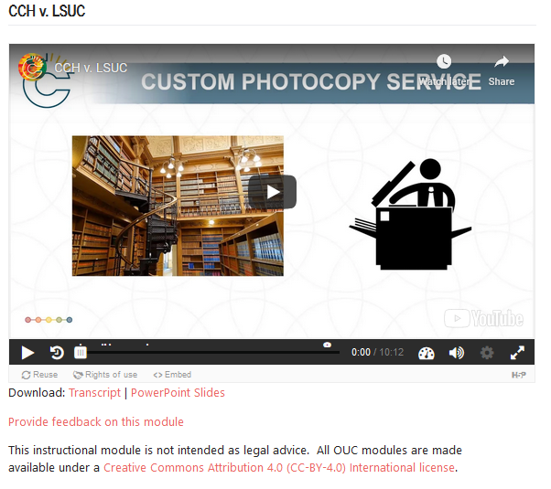
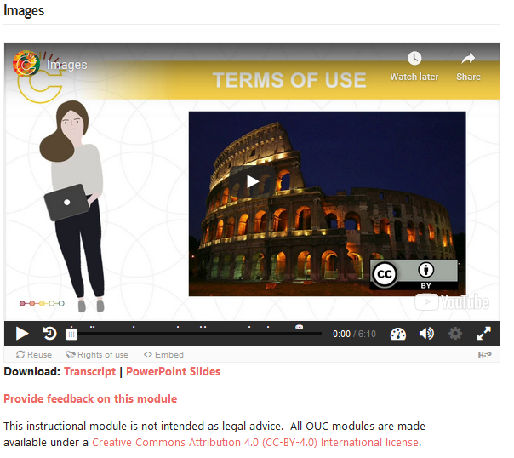
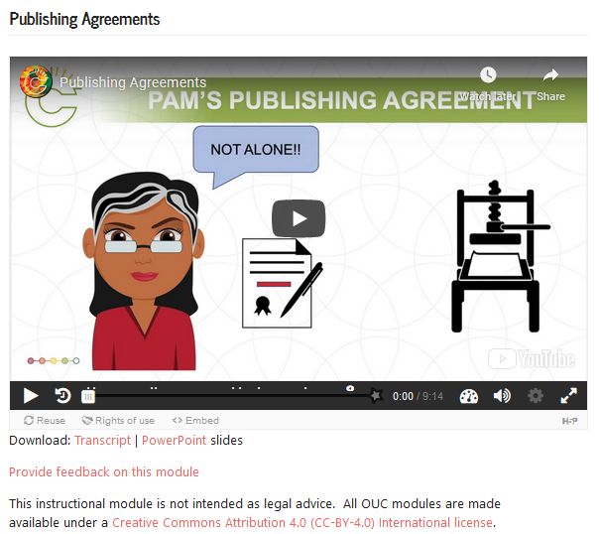
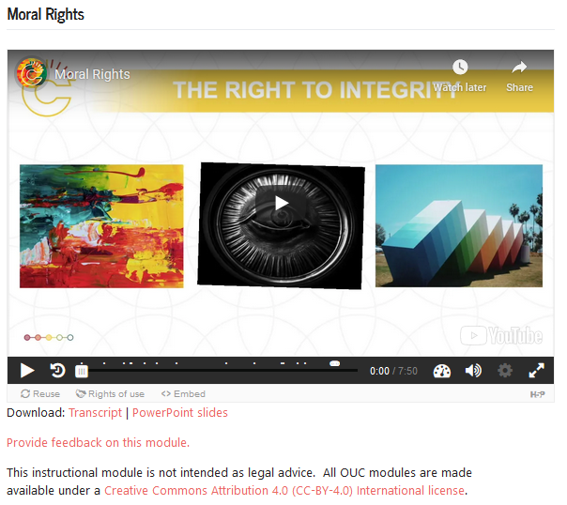
LOST?
?
?
?
Notes:
For example, let’s say you’re feeling a bit lost in the “fair dealing” forest. Start with the module that introduces this Copyright Act provision, then move on to the one about Applying Fair Dealing, which will also link you to the modules on specific court cases that consider fair dealing, such as CCH v LSUC and Access Copyright v York.
If you are a graduate student, you might want to start with Publishing Agreements and Including Third Party Content, as both are relevant to the preparation of your thesis. It's likely that the module on Applying Fair Dealing will be too! And if you are an art student then the videos on Images and Moral Rights will help you learn about your rights as a creator of copyright-protected works.
Library workers will probably find it useful to start with the modules on Licensed Library Resources and Interlibrary Loan and Controlled Digital Lending before digging into scenario-based case law such as the CCH case. And don't miss Photocopying in the Library, which is based on what we learned from the CCH case.

Slide 11
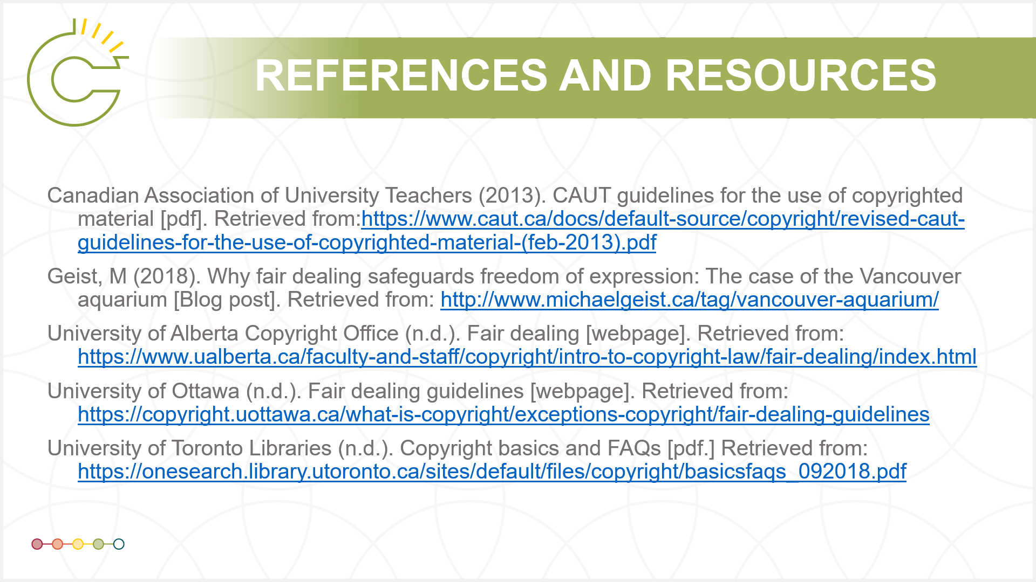
REFERENCES AND RESOURCES
Notes:
Each module also has a list of references and resources at the end, where you can find even more information about the topic being covered. Sometimes this will include more scholarly sources that you might need to track down through a library.

Slide 12
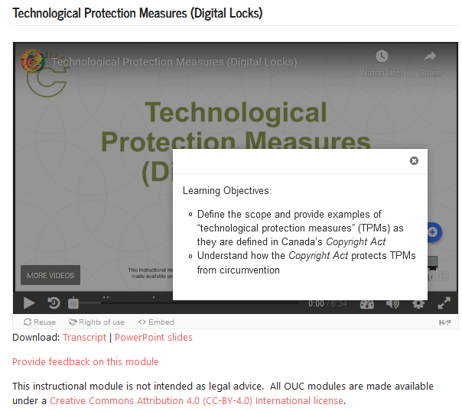
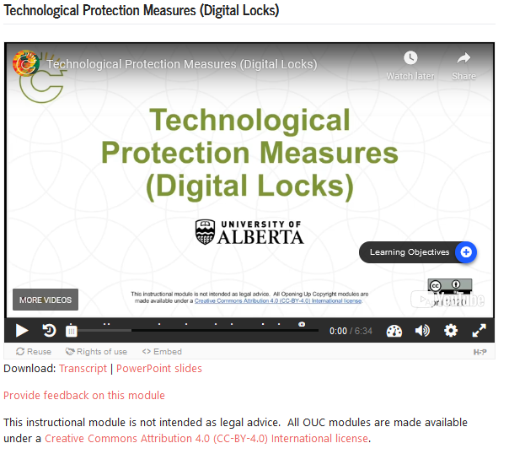
LEARNING OBJECTIVES
Notes:
Each module includes learning objectives, available as a pop up near the beginning of the module.

Slide 13
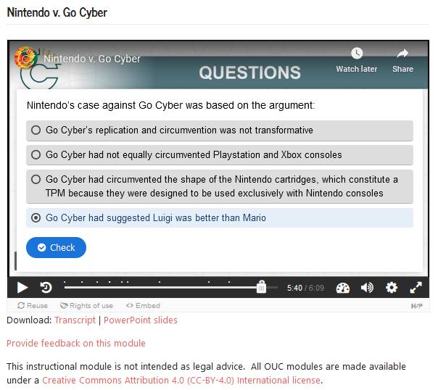
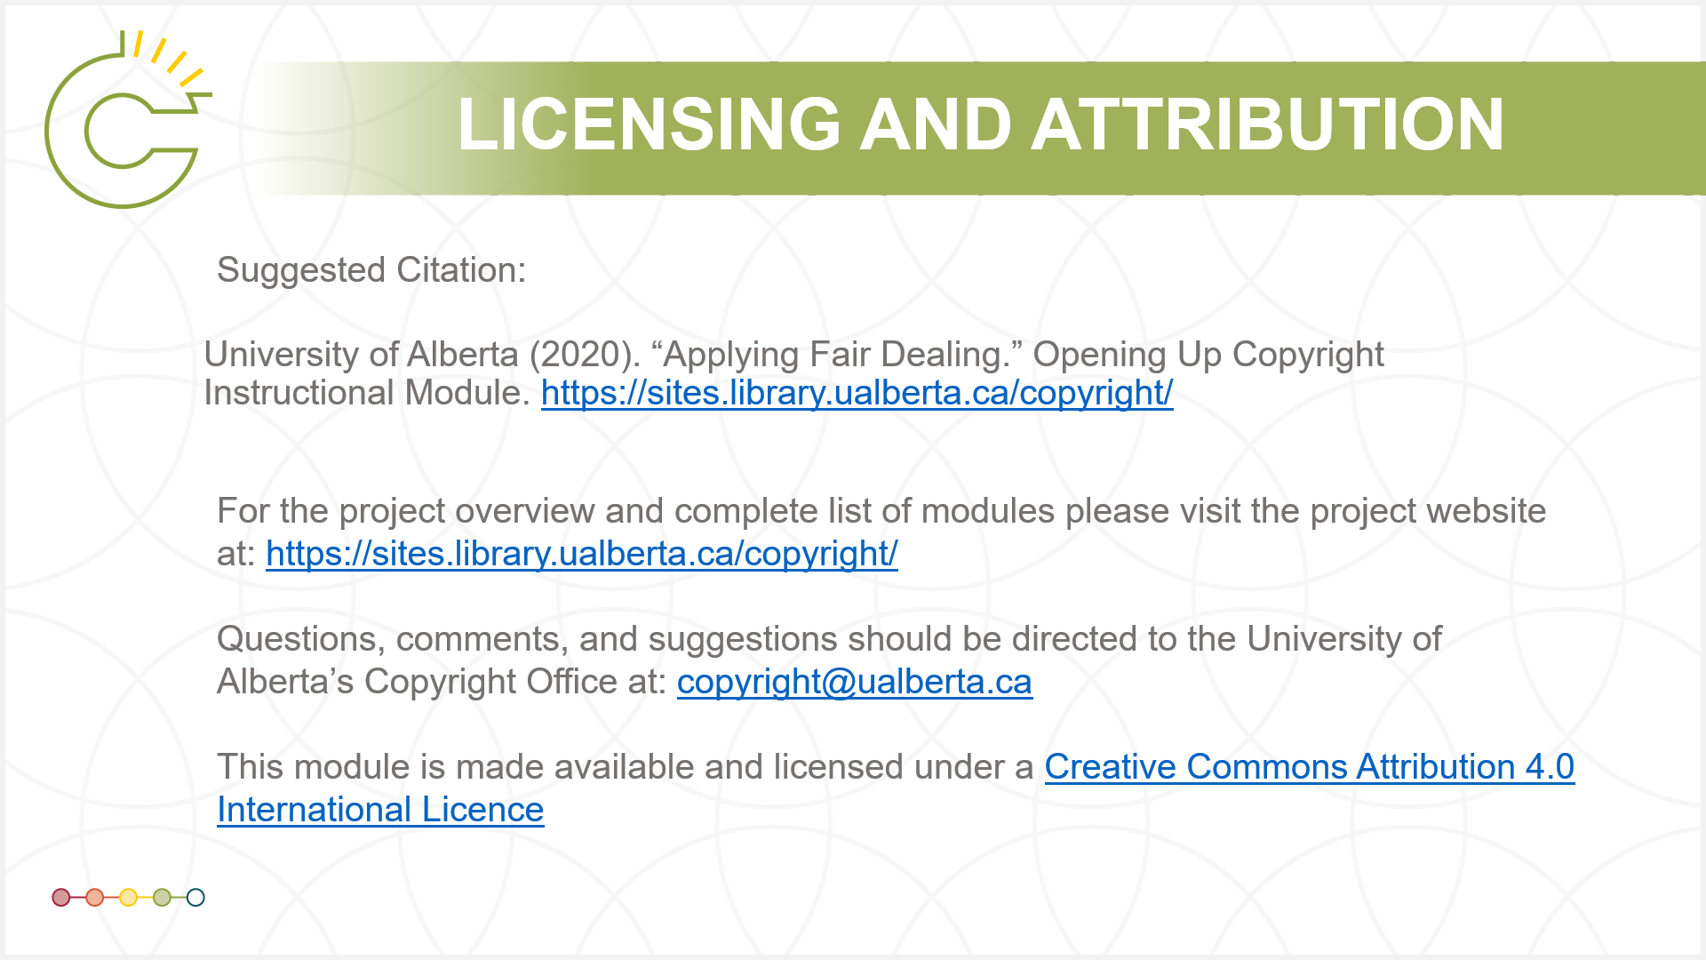
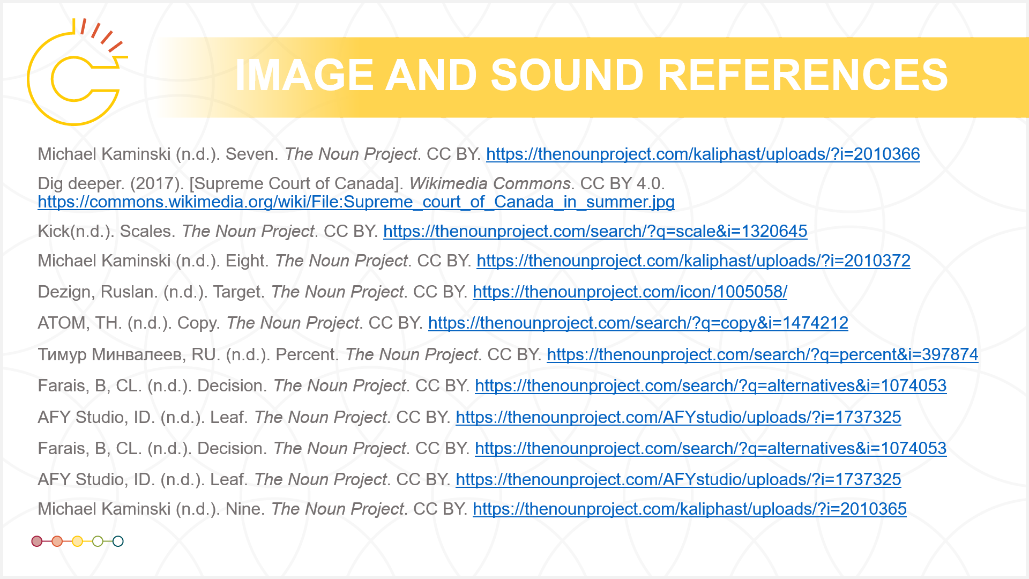
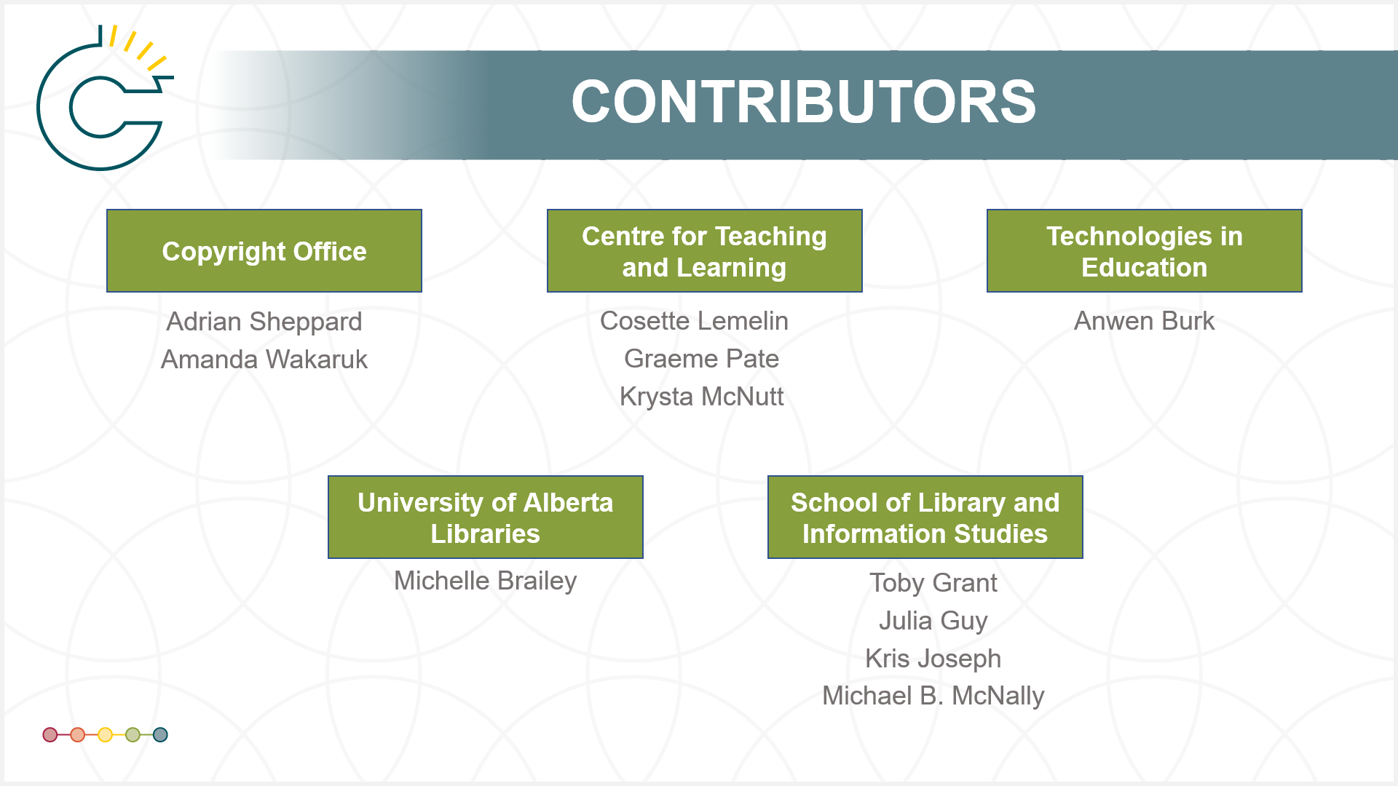
QUIZZES, SOURCES, ATTRIBUTION AND CONTRIBUTORS
Notes:
Quizzes are provided at the end, where you can test your learning. To help model best practices in openness, we have included full information about the source of each of the images, sounds and other content used in that module, along with a suggested citation and information about who was involved in its creation.

Slide 14
FACILITATING OPENNESS
Notes:
Each module is openly licensed under a Creative Commons Attribution or CC-BY 4.0 license. To help facilitate openness, we also make available the slides and transcripts, so you can modify or adapt it to suit your own needs. Transcripts and slides can be downloaded through the OUC website, which also contains links to presentations and research papers about the series.

Slide 15
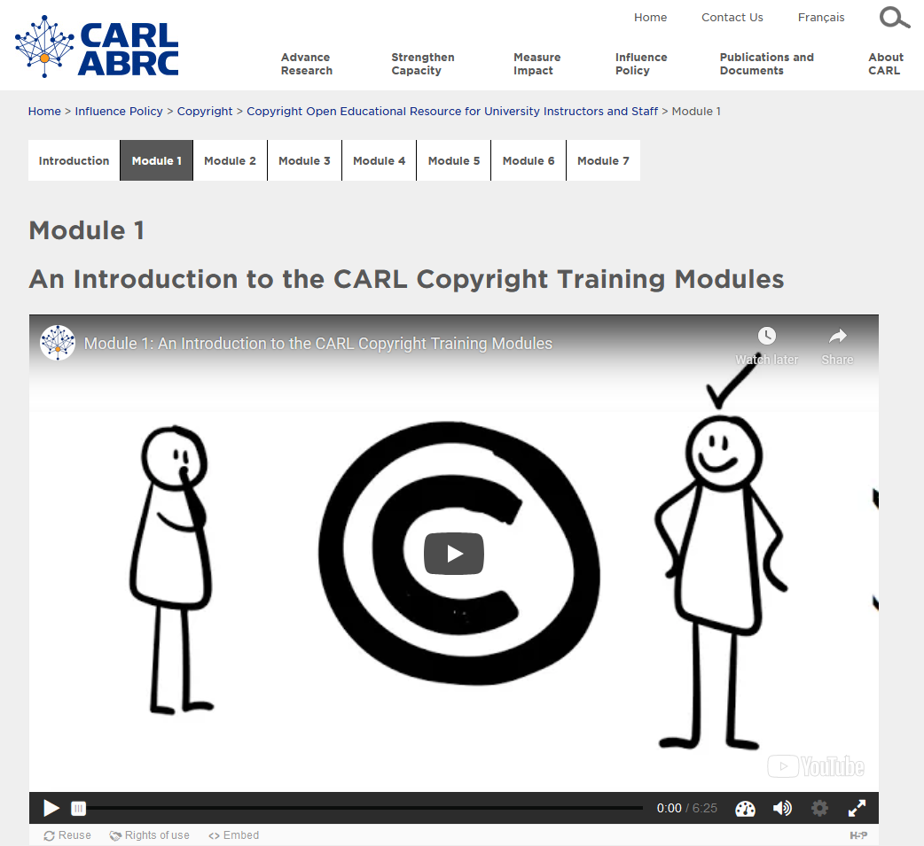
OTHER COPYRIGHT RESOURCES
Notes:
We also want to highlight that OUC isn’t the only place to get Canadian copyright information. The Canadian Association of Research Libraries, or CARL, also has a set of openly licensed copyright videos. The CARL Copyright Open Educational Resource for University Instructors and Staff series offers seven bilingual instructional modules that introduce key elements of Canadian copyright law as it applies in a university environment, for university employees.
Of course, the Government of Canada also has some information available through the Canadian Intellectual Property Office, but this tends to focus more on commercialization.
There are also some key Canadian copyright blogs that can help you stay current, and more useful links on the University of Alberta’s Copyright Office website.

Slide 16

CONTRIBUTORS
Copyright Office
Centre for Teaching and Learning
Library and Museums
Faculty of Education
Notes:
Speaking of the University of Alberta’s Copyright Office, it is one the key contributors that makes this series possible. OUC is a collaboration of the University of Alberta’s: Copyright Office, Centre for Teaching and Learning, Library and Museums, and Faculty of Education. The series has been made possible by ongoing support from these units and a Teaching and Learning Enhancement Fund grant.

Slide 17
LEARNING OBJECTIVES
You should now be able to:
Describe the goals of the Opening Up Copyright series
Identify resources for learning more about Canadian copyright
Understand how to navigate the Opening Up Copyright series
Notes:
You should now be able to:
Describe the goals of the Opening Up Copyright series
Identify resources for learning more about Canadian copyright, and
Understand how to navigate the Opening Up Copyright series

Slide 18
Notes:
This has been the Introduction to the University of Alberta’s Opening Up Copyright series. Thank you for your attention.

Slide 19
Canadian Association of Research Libraries (CARL). (n.d.). Copyright Open Educational Resource for University Instructors and Staff. https://www.carl-abrc.ca/influencing-policy/copyright/opencopyrightcourse/
Geist, Michael. (n.d.). Michael Geist [Blog]. https://www.michaelgeist.ca/blog/
Knopf, Howard. (n.d.). Excess Copyright. http://excesscopyright.blogspot.com/
Murray, L.J., & Trosow, S.E. (2013). Canadian copyright: A citizen’s guide. 2nd Ed. Toronto, ON: Between the Lines.
University of Alberta. (n.d.). Copyright Office. https://www.ualberta.ca/faculty-and-staff/copyright/index.html
Vaver, D. (2011). Intellectual property law : copyright, patents, trade-marks. 2nd Ed. Toronto: Irwin Law.

Slide 20
CCH Canadian Ltd. V. Law Society of Upper Canada. 2004 SCC 13, [2004] 1 SCR 339. https://scc-csc.lexum.com/scc-csc/scc-csc/en/item/2125/index.do
York University v. Canadian Copyright Licensing Agency (“Access Copyright”). 2021 SCC 32. https://www.canlii.org/en/ca/scc/doc/2021/2021scc32/2021scc32.html

Slide 21
GraphicMama-team. (2016) Arab girl. Pixabay. CC0. https://pixabay.com/en/arabian-arab-girl-female-ethnic-1456184/
Free Clip Art. (2018). Senior guy at the office. Wikimedia Commons. CC BY SA. https://en.wikipedia.org/wiki/File:Senior_Guy_At_The_Office_Cartoon.svg
Chrystalizabeth. (n.d.). [Professor Pam]. Pixabay. Pixabay Licence. https://pixabay.com/en/teacher-bookworm-glasses-professor-359311/
Clip Art by Vector Toons. (2018). Charming Cartoon Businessman. Wikimedia Commons. CC BY. https://commons.wikimedia.org/wiki/File:Charming_Cartoon_Businessman.svg
Basadev4. (n.d.). [Andre]. Pixabay. https://pixabay.com/illustrations/black-avatar-cute-cheerful-3025348/
Mohamed_hassan. (n.d.). Programmer Computer Woman Support. Pixabay. CC0. https://pixabay.com/vectors/programmer-computer-woman-support-3607627/
Ghan Koon Lay. (2018). Boss. The Noun Project. CC0. https://thenounproject.com/icon/1587076
Rawpixel. (n.d.). [Isabelle]. Pixabay. Pixabay Licence. https://pixabay.com/illustrations/cartoon-casual-character-drawing-3685566/
parkjisun. (n.d). Goblin. The Noun Project. CC BY https://thenounproject.com/icon/1005005

Slide 22
PLOS. (2008). Open Access Logo. Wikimedia Commons. CC0. https://commons.wikimedia.org/wiki/File:Open_Access_logo_PLoS_white.svg
Jonathansmello. (2012). UNESCO OER Logo. Wikimedia Commons. CC BY. https://commons.wikimedia.org/wiki/File:Global_Open_Educational_Resources_Logo.svg
Creative Commons. (2006). Creative Commons Logo. Wikimedia Commons. Public Domain. https://commons.wikimedia.org/wiki/File:Cc.logo.circle.svg
Larry Ewing. (2008). Linux’s Penguin. Wikimedia Commons. CC0. https://commons.wikimedia.org/wiki/File:Tux.svg
Unattributed materials are contributions from the Opening Up Copyright Project Team and placed in the Public Domain
Closing Slides Music: Rybak, Nazar. “Corporate Inspired.” HookSounds. (n.d). http://www.hooksounds.com (used under a CC-BY 4.0 Licence)

Slide 23
University of Alberta. 2022. “Opening Up Copyright: An Introduction.” Opening Up Copyright Instructional Module. https://sites.library.ualberta.ca/copyright/

