Slide 1
Know your rights
What to consider before you submit to a journal and sign a copyright transfer agreement
Jessica Lange | Scholarly Communications Librarian
Alexandra Kohn Head | Head, Office of Copyright Compliance
Please note that all logos, screenshots and publisher content are used here under fair dealing and do not fall under the terms of the Creative Commons licence
Notes:
SK

Slide 2
Objectives
Identify and compare copyright transfer agreements in academic journals
Evaluate journals based on their author rights agreements
Describe which rights are retained/revoked in these agreements
Determine whether a journal’s policies allow you to comply with the Tri-Agency Open Access Policy on Publications
Notes:
SK

Slide 3
Disclaimer
Content in this presentation is provided for informational purposes only and should not be relied on for legal advice
Notes:
SK

Slide 4
Workshop Outline
Introduction + background
Brainstorming activity
Key terminology and phrasing in agreements
Group activity
Copyright transfer agreements
Debrief
Wrap-up and discussion
Notes:
SK
Introduction + background (5-10 min)
Brainstorming (5-7 minutes)
· What kinds of ‘things’ do you want to know if you can do with your article? (e.g. post to website, deposit in an IR etc.) <JL and AK write on board>
· Discussion of versioning <provide handout/slide of commonly-used terms>
Group activity
1. CTA handouts (10-15 minutes for activity + 5 minutes to debrief)

Slide 5
Introduction
What are copyright transfer agreements?
Why do they matter?
Shifting landscape
Open access movement
Funding requirements
Notes:
SK
A copyright transfer agreement is a contract you sign with a publisher. It usually entails you signing over copyright to your work (e.g. book, article etc.). Copyright means the right to publish, copy, translate, and distribute the work and the right to authorize others to do so. Basically these transfer agreements mean publishers now have (in many cases) the sole right to publish, translate, and distribute your work. By signing these agreements you are transferring those rights to them and thus no longer maintain those rights yourself.
Copyright agreements vary widely by publisher. It‘s important to be aware of what rights you are tranferring/maintaining when you enter these agreements. For example, many authors are surprised to learn they often no longer have the rights to images/graphs/figures they produced and thus have to request permission from the publisher in order to use them in future works.
Author rights have been a growing subject of debate within the publishing community. With the advent of the open access movement, many journals, particularly open access journals, permit authors to retain their copyrights.
It‘s also important to be aware of any funding agency requirements. Some funding agencies are now requiring the results of grant-funded research to be made open access. Some publisher agreements permit this while others do not.

Slide 6
What is a copyright transfer agreement?
¹
¹Right to publish, copy, translate, and distribute the work…and authorize others to do so
Notes:
SK
A copyright transfer agreement is a contract you sign with a publisher. It usually entails you signing over copyright to your work (e.g. book, article etc.). Copyright means the right to publish, copy, translate, and distribute the work and the right to authorize others to do so. Basically these transfer agreements mean publishers now have (in many cases) the sole right to publish, translate, and distribute your work. By signing these agreements you are transferring those rights to them and thus no longer maintain those rights yourself.

Slide 7
What is a copyright transfer agreement?
Notes:
SK
It’s sometimes easier to think of copyright as a bundle of rights. You as author may maintain one ‘slice’ while another component goes to the journal. For example, you may retain the right to republish the article in an edited book but other rights (like translation, electronic distribution etc.) may go to the publisher.
This will vary by publisher. Some agreements will ask for all your copyrights but more commonly, you will get to retain a certain set of rights.

Slide 8
What is a copyright transfer agreement?
Notes:
SK

Slide 9
Brainstorming activity
What kinds of activities do you want to know
if you can do with your article
(e.g. share with colleagues, post to a website etc.)?
Notes:
SK

Slide 10
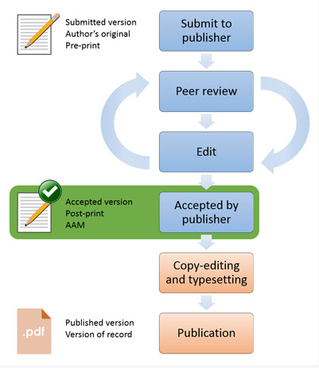
Key terms: Versions
Pre-print
Author’s original, submitted version
Author’s accepted manuscript (AAM)
Accepted version
Post-print
Publisher’s final version
Publisher’s PDF
Version of Record (VoR)
Source: "Open Access Research FAQ.” Higher Education Funding Council for England. http://www.hefce.ac.uk/rsrch/oa/FAQ/#deposit4
Notes:
SK
These are some important definitions to keep in mind when reviewing copyright transfer agreements (CTAs). Often these agreements will stipulate different rights for different versions of your article. Unfortunately, the terms for these versions are not completely standardized across publishers, but most will recognize three distinct versions of the article which correspond to different stages in the publication process.
For example, most CTAs will permit you to post a pre-print of your article to your personal website. However, few will permit this for the publisher PDF.

Slide 11
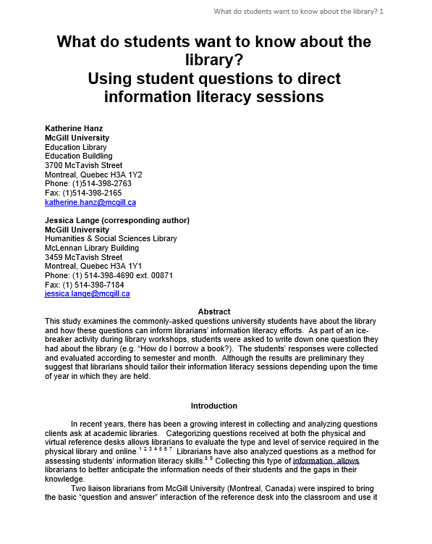
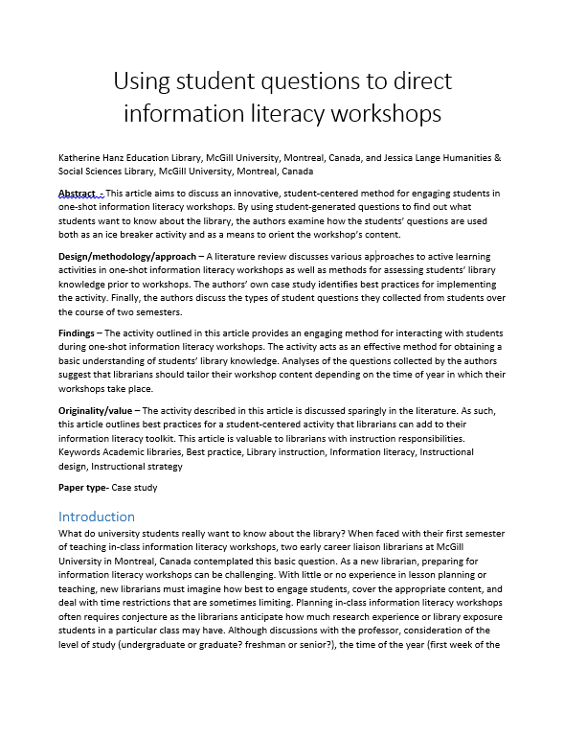
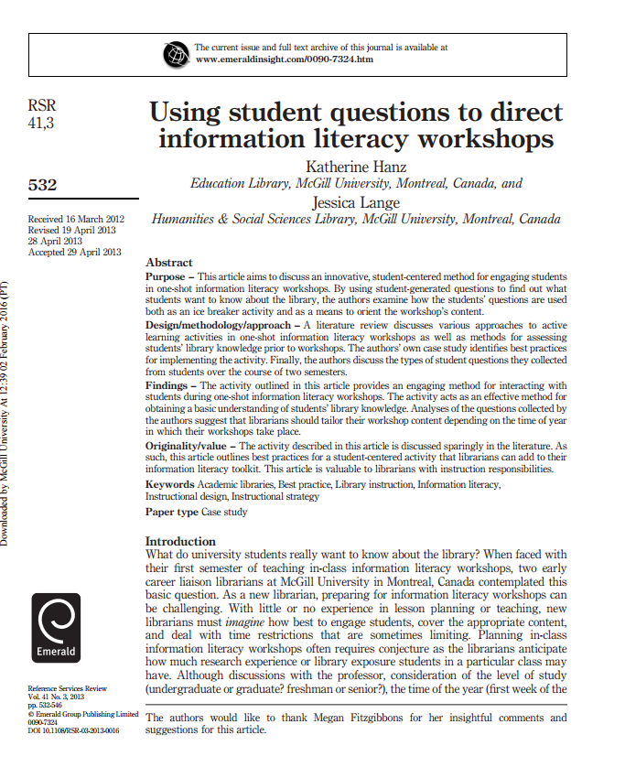
Archive your versions and your author agreements!
Pre-print = Initial submission
Post-print = Final version without layout
Publisher’s version = Final copy with layout
Notes:
SK

Slide 12
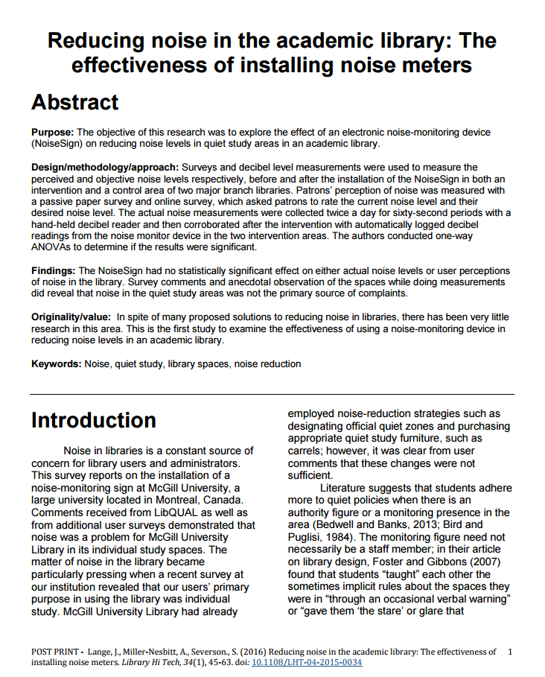
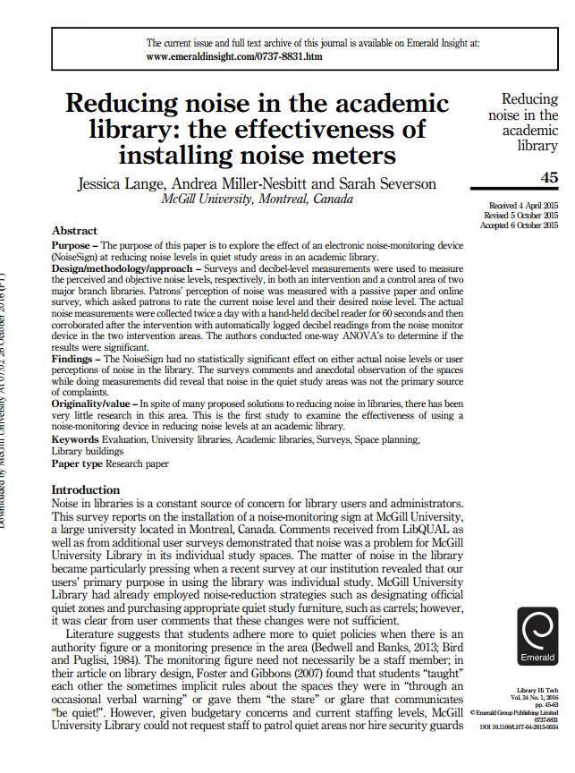
What is a post-print (cont’d)?
VS
Post-print
Saved by RESEARCHER
Typically CAN be posted to repositories
Usually must include DOI/link/citation to original article
Publisher’s version
Created by PUBLISHER
Typically CANNOT be posted to repositories
Notes:
SK
Remember to save (and appropriately name) the different versions of your article.

Slide 13
Key terms: Assigning vs. licensing
Assignment/transfer
Transfer of some or all of your rights to another party (e.g. a publisher).
License
Permission for another party to use your work under certain conditions
You maintain copyright ownership
Note: In many agreements, you transfer copyright to the publisher and they license certain rights back to you.
Notes:
SK

Slide 14
Key terms: Exclusive vs. non-exclusive license
Exclusive
Non-Exclusive
✓
Notes:
SK
An exclusive license means the rights that are being given can only be used exclusively by that publisher/person. For example, if you signed an exclusive publishing agreement with Sage, that means you cannot license anyone else to publish your article.
A non-exclusive license is the opposite. You can elect to license those rights to other publishers/persons as well. For example, if you signed a non-exclusive license with Sage to publish your article, you can also license that article to Cambridge.

Slide 15
Exclusive and Non-exclusive cont’d
For example, PLOS applies the Creative Commons Attribution (CC BY) license to articles and other works they publish. If you submit your paper for publication by PLOS, you agree to have the CC BY license applied to your work.
Notes:
SK
Creative Commons licenses are an example of a non-exclusive license.
For example, PLOS applies the Creative Commons Attribution (CC BY) license to articles and other works they publish. If you submit your paper for publication by PLOS, you agree to have the CC BY license applied to your work. Under this Open Access license, you as the author agree that anyone can reuse your article in whole or part for any purpose, for free, even for commercial purposes. Anyone may copy, distribute, or reuse the content as long as the author and original source are properly cited. (http://journals.plos.org/plosone/s/licenses-and-copyright)

Slide 16
Group Activity: Copyright Transfer Agreements
At your table, review the copyright transfer agreements provided (~5-10 minutes)
Highlight anything that’s unclear/confusing
Fill in the chart on your handout
Notes:
JL

Slide 17
CTA debrief
Permitted uses | Pre-print | Post-Print/Accepted manuscript | Publisher PDF | Conditions
Ex. Post to personal website
Reuse of images
Deposit in an institutional repository
Deposit in a subject repository
Classroom teaching and internal distribution
Sharing link / DOI
Post to social networking site (e.g. ResearchGate)
Reuse in a later publication (e.g. edited book)
Notes:
JL

Slide 18
CTA debrief
Permitted uses | Pre-print | Post-Print/Accepted manuscript | Publisher PDF | Conditions
Ex. Post to personal website | YES | YES | NO | Immediately; link to final publication (DOI) and have license CC BY NC ND
Reuse of images | NO | NO | NO | See: Supplemental Materials
Deposit in an institutional repository | YES | YES | NO | Immediately for preprint; after embargo period for post-print; link to final publication (DOI) and have license CC BY NC ND; should not be enhanced to look like publisher version
Deposit in a subject repository | YES | YES | NO | Immediately for preprint; after embargo period for post-print; link to final publication (DOI) and have license CC BY NC ND; should not be enhanced to look like publisher version; non-commercial repositories only
Classroom teaching and internal distribution | YES | YES | YES | Not for MOOCs; paper or electronic distribution permitted to known colleagues
Sharing link / DOI | Unclear/YES | Unclear/YES | YES
Post to social networking site (e.g. ResearchGate) | Unclear/Yes | NO | NO | Prohibits commercial use for post-print and publisher version
Reuse in a later publication (e.g. edited book) | YES | YES | YES | Provide full acknowledge of original publication.
Notes:
JL

Slide 19
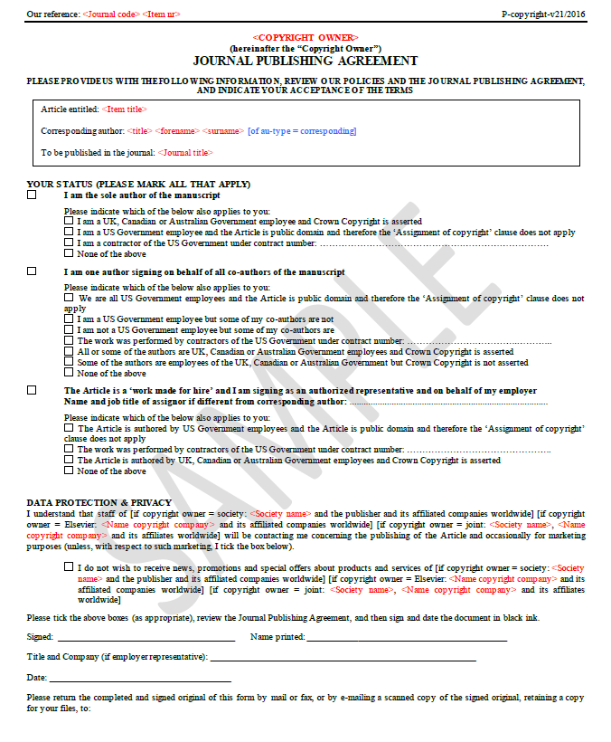
p. 1
Overview of author status and affiliation
Notes:
JL
Page 1 in this case is just going over author status and affiliation. This is included because the work done by U.S. government employees falls under a different set of copyright rules.
Otherwise, this first page isn’t particularly interesting.

Slide 20
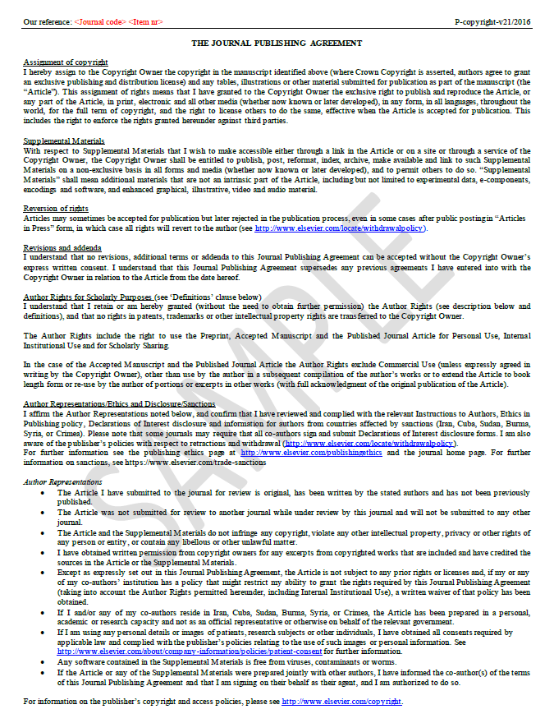
p. 2
Standard copyright assignment
Author representations
Notes:
JL
Page 2 gets more into the nitty gritty of the actual agreement. It includes a fairly standard copyright assignment clause (see Assignment of Copyright). Additionally it includes information on what rights you retain as author ( see Author Rights for Scholarly Purposes).

Slide 21
Notes:
JL
If we parse the Assignment of copyright section further we see it includes not only the article (aka manuscript) but also any tables, illustrations or other material submitted for publication. The copyright for all these items will now lie with this publisher.
This is also an exclusive license. Meaning you cannot enter into another agreement with another publisher regarding the right to publish and reproduce the article. This also means the publisher now has the right to license your article to other publishers/persons (e.g. license a translation of your work).
Finally, it states that the publisher has the right to enforce any of these rights. So for example, if someone was found to breaking copyright with regards to this article, the publisher could pursue them.

Slide 22
Notes:
JL
This section outlines what rights are maintained. For example, intellectual property rights remain with the author. Furthermore, the author maintains rights for personal use, internal institutional use and for scholarly sharing (see p.3 for definitions of what those mean). The agreement also permits the author to use the work in a future compilation of the author’s work (provided acknowledge is provided of the original publication).

Slide 23
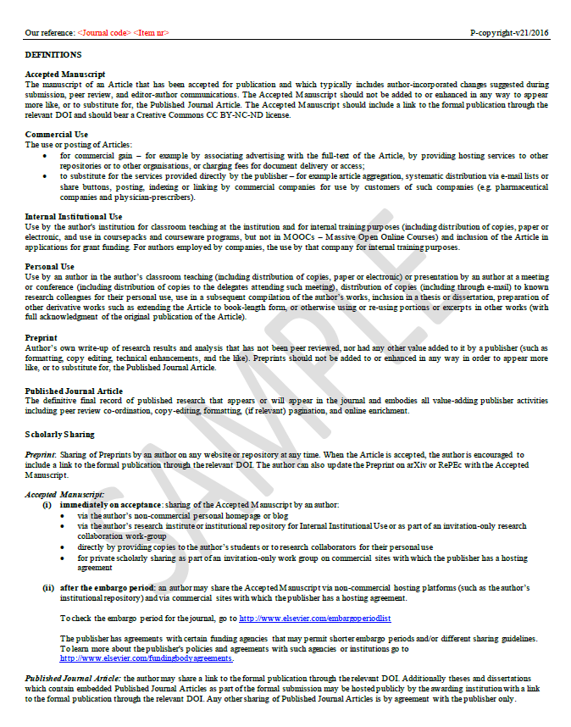
p. 3
Details of author rights and definitions
Notes:
JL
: Page 3 is where all the details are. On the previous slide we mentioned that Personal Use, Institutional Use, and Scholarly Sharing are defined herein. This page provides all the details of what that means.

Slide 24
Lots of variation (Springer article)
The copyright to this article, including any graphic elements therein (e.g. illustrations, charts, moving images), is hereby assigned for good and valuable consideration to Springer effective if and when the article is accepted for publication…
Authors may self-archive the Author’s accepted manuscript of their articles on their own websites. Authors may also deposit this version of the article in any repository, provided it is only made publicly available 12 months after official publication or later. He/she may not use the publisher‘s version (the final article)…
Notes:
JL
There’s no “standard” copyright transfer agreement although often you’ll see similar language. However, rights of the author vary publisher to publisher and the agreements often change so it’s important to keep track of what you sign.

Slide 25
Lots of variation (book)
Author retains, in addition to uses permitted by law, the right to communicate the content of the Contribution to other research colleagues, to share the Contribution with them in manuscript form, to perform or present the Contribution or to use the content for non-commercial internal and educational purposes, provided the original source of publication is cited according to current citation standards.
Notes:
JL
: There’s no “standard” copyright transfer agreement although often you’ll see similar language. However, rights of the author vary publisher to publisher and the agreements often change so it’s important to keep track of what you sign.

Slide 26
Lots of variation
“Contributors may re-use figures, tables, artwork, and selected text up to 250 words from their Contributions”
(Wiley)
“..agreement..does not allow full articles to be posted on SSRN, or other such commercial networks.”
(Cambridge University Press)
“…you agree to have the CC BY license applied to your work…you as the author agree that anyone can reuse your article... even for commercial purposes. Anyone may copy, distribute, or reuse the content as long as the author and original source are properly cited”
(PLOS)
Notes:
JL
There’s no “standard” copyright transfer agreement although often you’ll see similar language. However, rights of the author vary publisher to publisher and the agreements often change so it’s important to keep track of what you sign.

Slide 27
Copyright Transfer Agreement
"In consideration of Emerald agreeing to consider the above-named previously unpublished original Work for publication (both parties agree that such consideration shall be deemed sufficient), I/We, by signing this form hereby assign worldwide copyright of the Work in all forms and media (whether now known, or hereafter developed), in all languages for the full term of copyright and all extensions and renewals thereof.
I/We understand that Emerald will act on my/our behalf to publish, reproduce, distribute and transmit the Work and will authorise other reputable third parties (such as document delivery services) to do the same, ensuring access to and maximum dissemination of the Work.
Licence to Author: Emerald grants to Author a non-exclusive licence to use and reproduce in printed form all or part of the Work (after first publication by the Journal): as photocopies for an Author’s use for classroom teaching to be distributed to students free of charge, and in any literary work written or edited by the Author. This licence is granted providing that all such copies include full attribution to the Journal and the appropriate copyright line. For further information about additional Author rights, please see Emerald’s Author Charter.
Notes:
JL
: For example, in comparison to the sample Elsevier agreement we saw earlier, this agreement from Emerald is much shorter and less specific.
However, it does provide some similar language. The underlined paragraph above notes what rights are maintained by the author (such as using the article in teaching or using it in future works published/edited by the author etc. ).
Note the last sentence references an Emerald Author Charter where there’s more information about additional rights. Thus, you may be granted more rights than what’s apparent in this document, however you must go and seek them from the publisher’s website.

Slide 28
Publisher Websites
How can I know the policies before I submit?
SHERPA/ROMEO
Database of publisher policies
http://www.sherpa.ac.uk/romeo/index.php
Publisher website
See Sections:
Copyright
Author guidelines
Permissions
Author services
Submission guidelines
Instructions for authors
Etc.
Notes:
JL
There’s lots of resources to help you understand publisher policies. SHERPA/ROMEO is a handy tool for understand publisher’s self-archiving policies (i.e. the right to post your article/work to a repository or website). Note however it doesn’t look at the full suite of rights - just those specific to self-archiving. This tool is handy if you’ve received funding that has an open access requirement.
Otherwise, the publisher’s website is the best source of information. Locating the copyright agreement information can be tricky sometimes. Depending on the publisher it will appear in various sections (as listed above). You can also always write the editor or the journal publisher if you have questions.

Slide 29
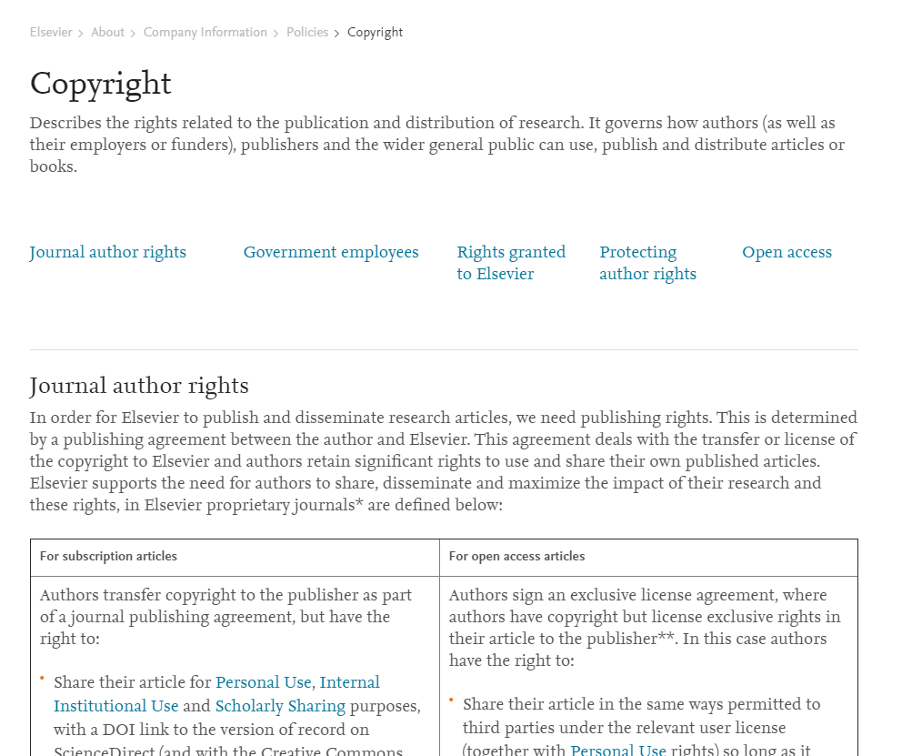
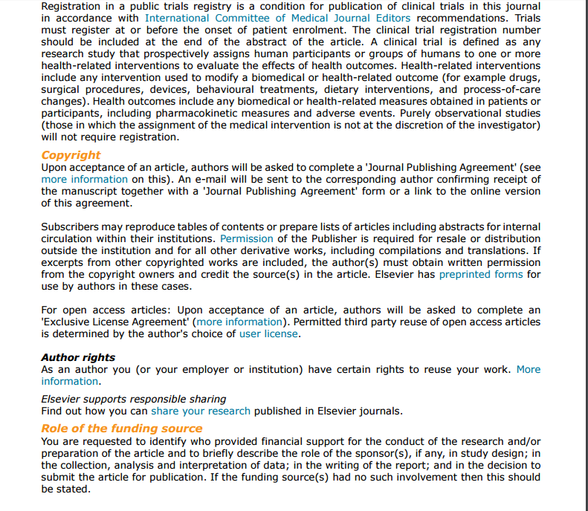
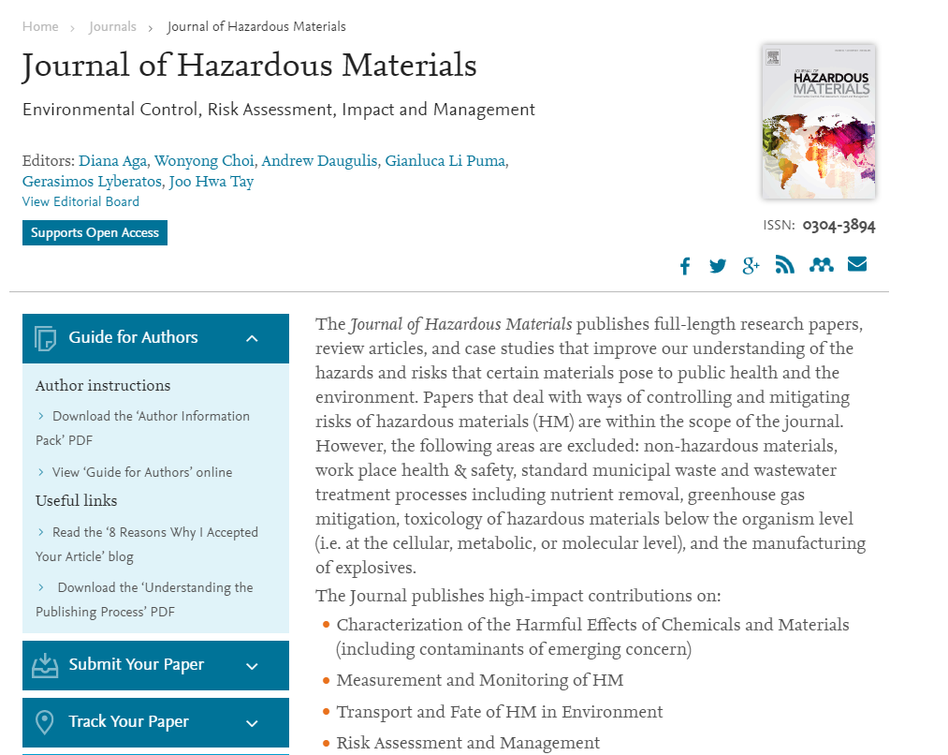
Websites
Notes:
JL

Slide 30
Compliance with Tri-Agency Open Access policy
Grant recipients are required to have their peer-reviewed journal publications freely accessible online within 12 months of publication.
Harmonized for all 3 agencies (SSHRC, NSERC, CIHR)
All grants awarded after May 1, 2015
For CIHR, policy applies to grants awarded January 1, 2008
http://www.science.gc.ca/eic/site/063.nsf/eng/h_F6765465.html?OpenDocument

Slide 31
Compliance with FRQ Open Access policy
Grant recipients are required to have their peer-reviewed journal publications freely accessible online within 12 months of publication.
All grants awarded after April 1, 2019
Applies to all peer-reviewed article publications
Applies to student grants
http://www.frqsc.gouv.qc.ca/en/science-ouverte
Notes:
JL

Slide 32
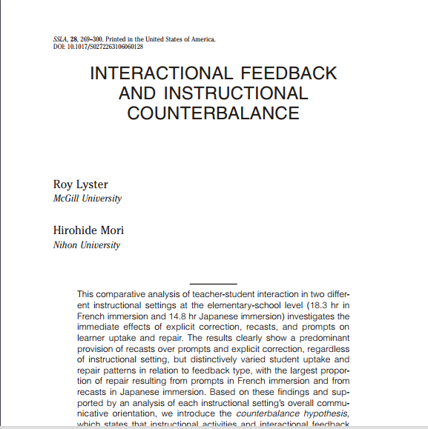
Option 1: Deposit in a repository
Example:
You publish in Molecular Astrophysics.
Email accepted manuscript to escholarship.library@mcgill.ca
A second copy now lives in the repository (after 12 month embargo)
Notes:
JL

Slide 33
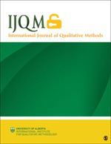
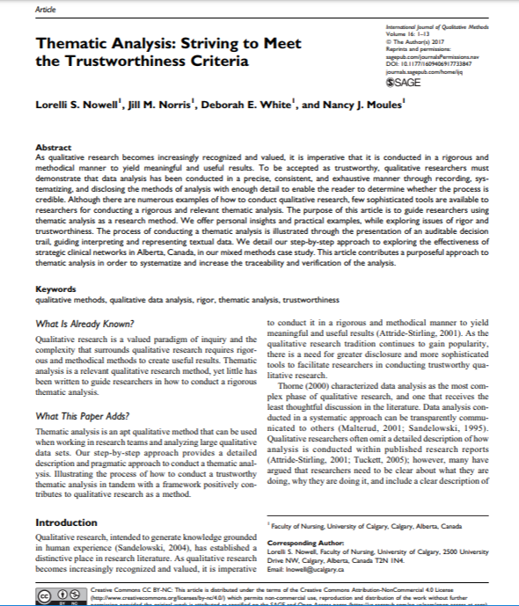
Option 2: Publish in an open access journal
Example:
You publish in International Journal of Qualitative Methods.
Pay $1300 APC (Canadian dollars)
Article is now freely available to everyone on the journal’s website.
Notes:
JL

Slide 34
Negotiation tips
Determine what matters to you
E.g. Reusing images; depositing in a repository, etc.
Engage in back and forth with publisher/ editor
Send an email ; provide an addendum ; strike out material, etc.
Same as negotiating for any other matter
e.g. mortgage, car etc.
Negotiation Resources
Arizona State Negotiation Guide
SPARC author addendum
Science Commons sample addendums
Quilter, Laura, "2I Negotiating Author Agreements" (2015). New England Copyright Boot Camp. Paper 14. http://scholarworks.umass.edu/cbc/14
Notes:
JL
Negotiating these contracts is an option although it’s perhaps more common if you’re publishing a book than an article. If you’re interested in trying to engage with the publisher the above resources and tips are available to you.

Slide 35
See the guide! http://libraryguides.mcgill.ca/authorrights

Slide 36
FAQs
The lead author signed the agreement without telling me about the license conditions. Am I bound to those conditions?
What if I want to do something that’s not permitted by my agreement?
What if the copyright transfer agreement doesn’t match what’s on the publisher’s website?
What happens if I breach the agreement?

Slide 37
Questions?

Slide 38
Contact
Notes:
We are both available if you have any additional questions. We are very happy to review any copyright agreements or assist you in determining a publisher’s/journal’s policies.

Slide 39
Image Credits
Resume by Nicholas Menghini from the Noun Project: https://thenounproject.com/
student by Mourad Mokrane from the Noun Project: https://thenounproject.com/

