Slide 1

Copyright OER as Open Education Enabler
Amanda Wakaruk, Julia Guy, Kris Joseph, Luc Fagnan, Adrian Sheppard, and Michael B. McNally
https://sites.library.ualberta.ca/copyright/ / copyright@ualberta.ca / amanda.wakaruk@ualberta.ca
Open Education Global 2019, Milan, Italy, Nov. 27, 2019

Slide 2
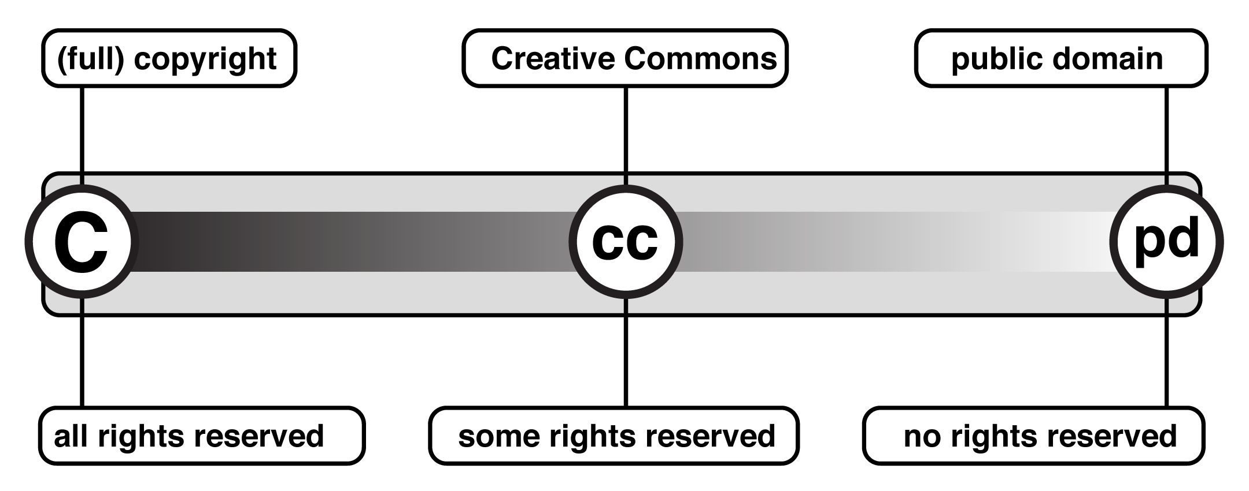
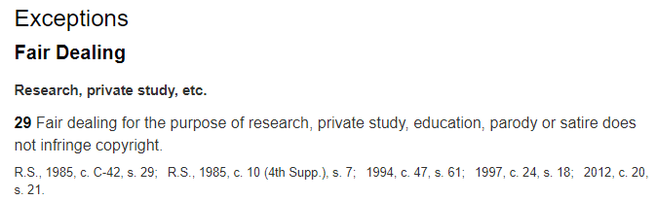
Why focus on copyright?
  Copyright is an intentional barrier to the reuse of content; it is a policy that mediates the relationship between rights holder and user
  Ability to reuse, remix content is at the heart of OE; these rights are largely held by the copyright owner
UMKC. https://info.umkc.edu/oer/2019/02/22/day-2-the-o-of-oer/ CC BY
Canada. Copyright Act. https://laws-lois.justice.gc.ca/eng/acts/C-42/index.html

Slide 3
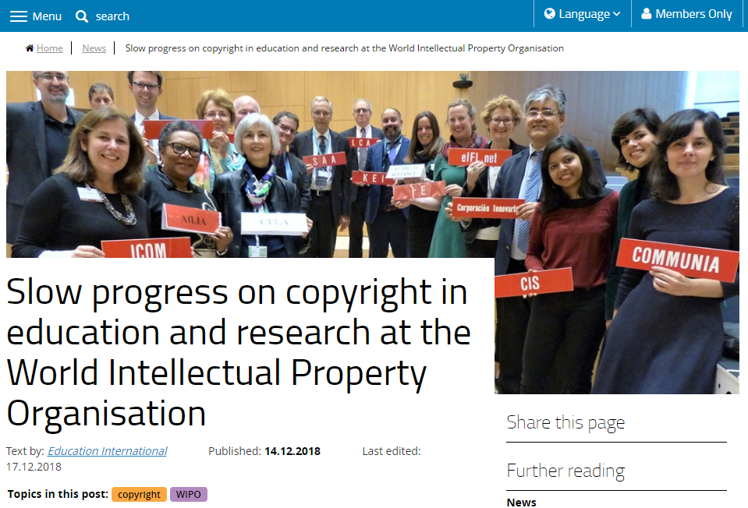

Why focus on copyright?
  Low level of copyright literacy, especially around user rights
  Educators are hesitant to rely on exceptions to infringement (e.g., educational exceptions)
  Exceptions to infringement are not universal
https://ei-ie.org/en/detail/16097/slow-progress-on-copyright-in-education-and-research-at-the-world-intellectual-property-organisation

Slide 4
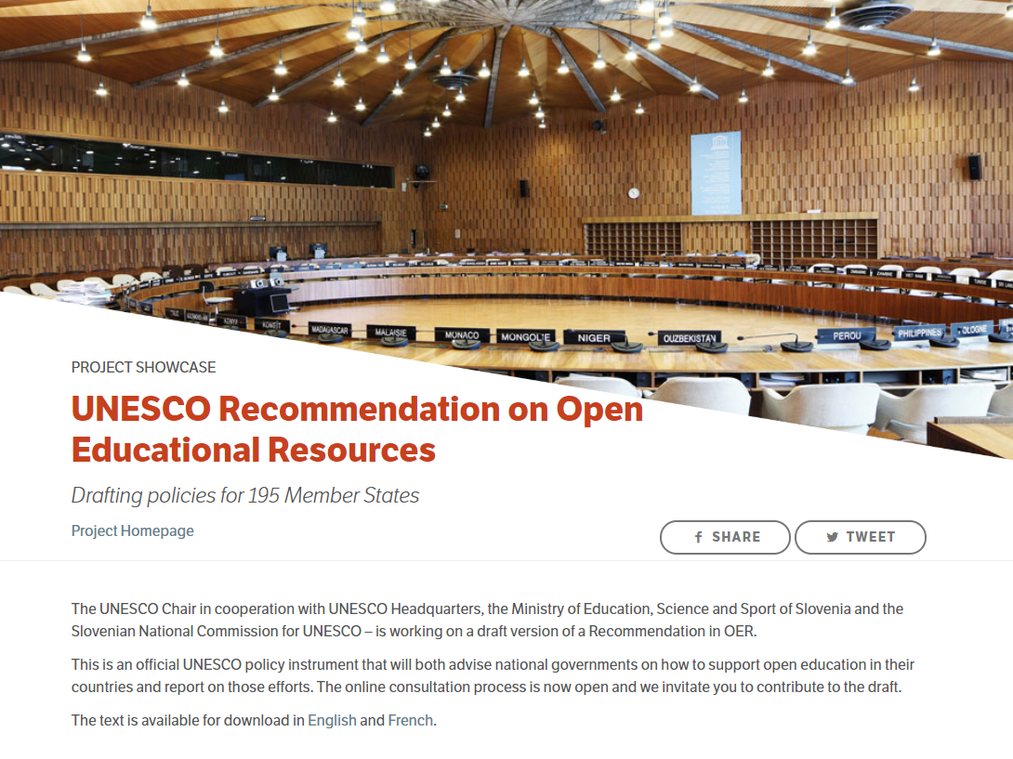
Why focus on copyright?
UNESCO Recommendation on Open Educational Resources unanimously adopted at 40th General Conference (November 2019)
Recommendation recognizes the infrastructural element of open copyright licences and identifies copyright literacy as an area of action
11. Member States are recommended to strategically plan… [and] are encouraged to consider the following:
… (e) making available easily accessible resources that provide information and assistance to all OER stakeholders on OER related topics including copyright and open licensing of educational material

Slide 5
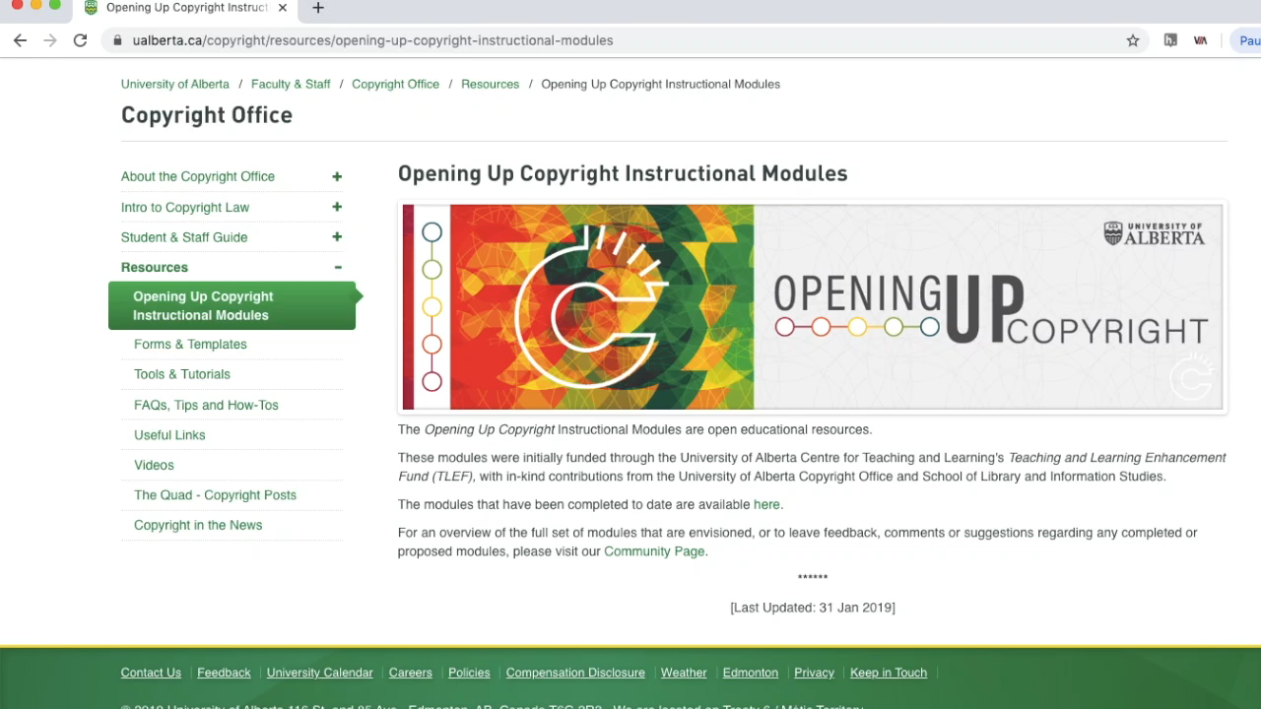
About Opening Up Copyright (OUC)
  Grant-funded copyright literacy instructional video series
  Currently 19 modules, mostly ~6-8 minutes
  Modules range from introductory subjects to focus on the Copyright Act and key cases
  All modules CC-BY 4.0
https://sites.library.ualberta.ca/copyright/

Slide 6
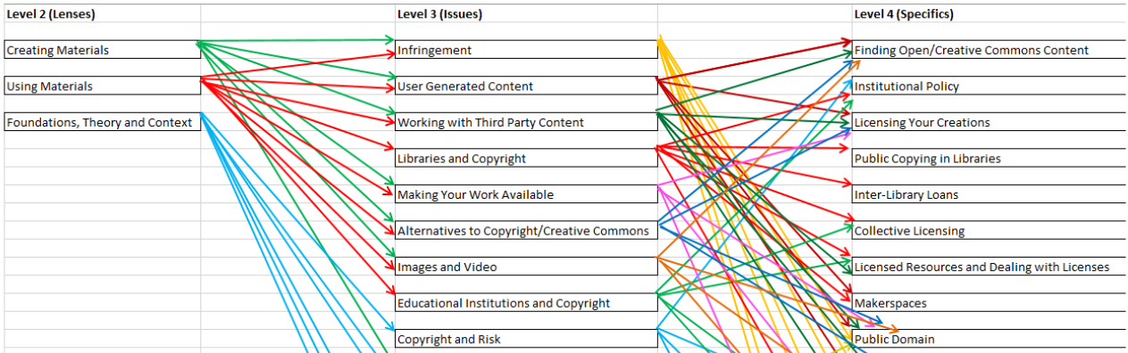
OUC Audiences
Library studies grad students
Staff, students and faculty at UofA
General public
OER community (adopters/adapters)
OUC Planning Document Showing Module Levels and Learner Pathways

Slide 7
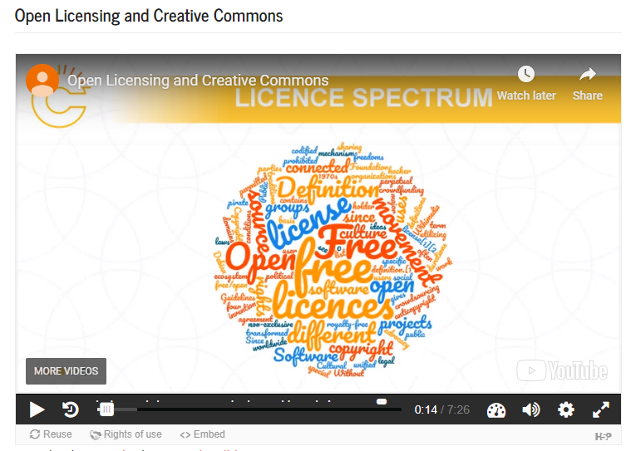
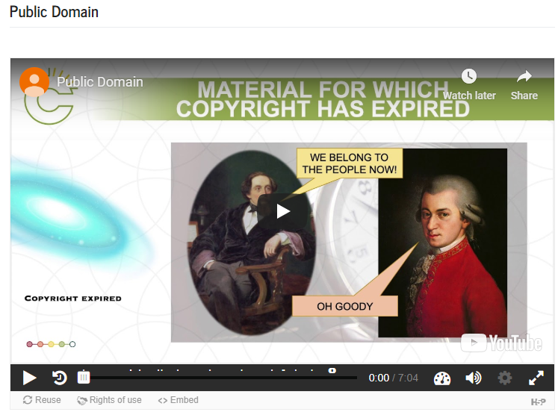
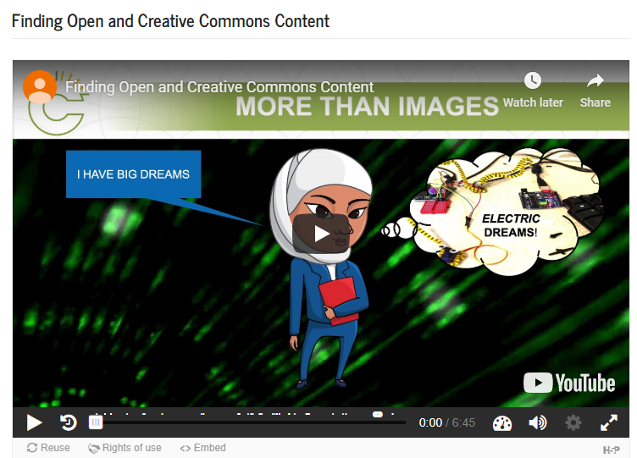
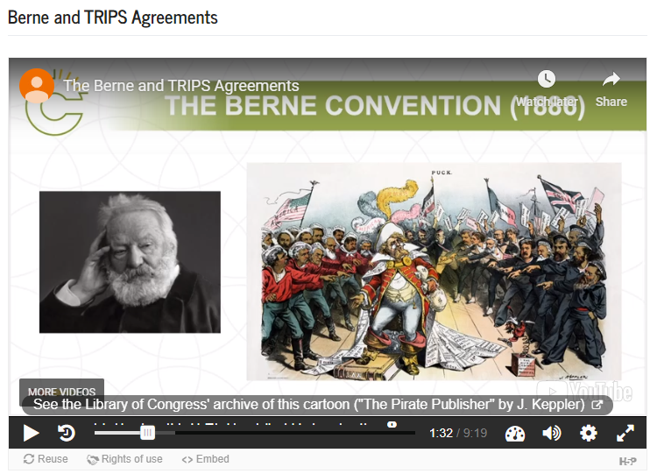
Multi-jurisdictional content

Slide 8
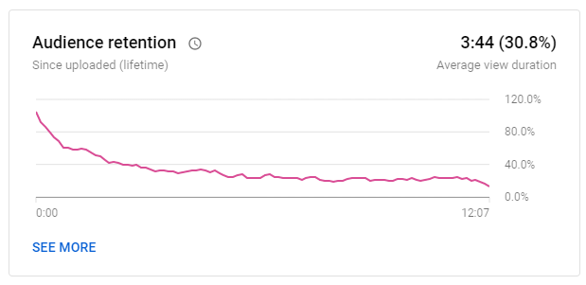
Engagement and Instructional Videos
Have learning objectives^{1, 2, 3}
Use scripts ^{2, 4}
Include interactivity ^{3, 5, 6}
Avoid jargon and chunk content^{2, 3, 4,} ^{5, 6}
Avoid text filled blocks⁴
Use conversational narrative⁵
Keep videos short (~3-4 min) ^{1, 2,} ⁵
“Photocopying in the Library” [OUC Module] – Audience Retention. (27, Oct. 2019).
YouTube Analytics.
1 – Evans (2014)
2 – Weeks and Davis (2017)
3 – Lo and Dale (2009)
4 – Clossen (2014)
5 – Martin and Martin (2015)
6 – Smith (2010)

Slide 9
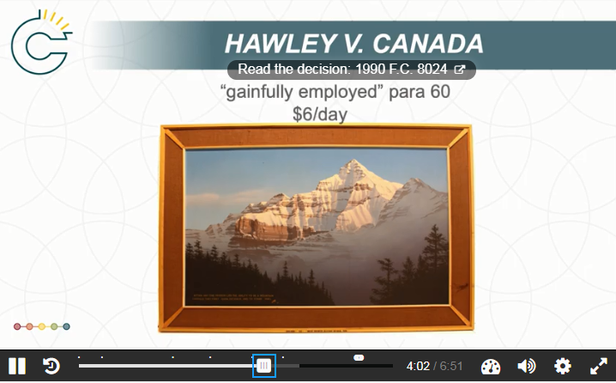
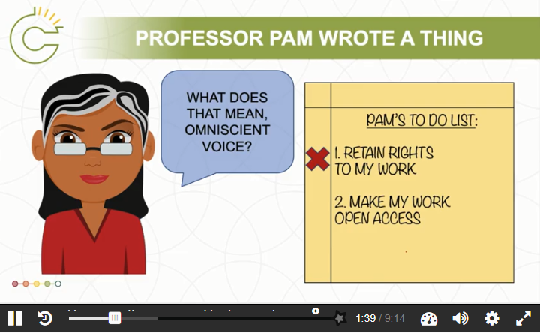
Creating Narratives
Narratives drive engagement (Laurillard, 1998)
  Though narrativization needs to be balanced with precision
Two common approaches:
  Character facing an issue/situation
  Find relevant and notable court cases
OUC Module – “Section 13: Ownership of Copyright” (screenshot)
OUC Module – “Publishing Agreements” (screenshot)

Slide 10

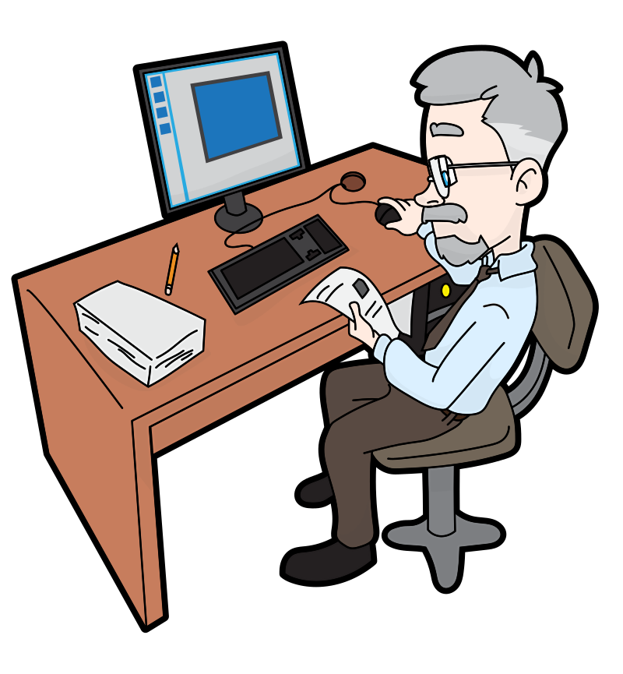

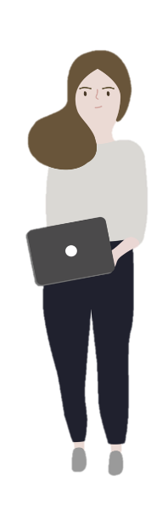

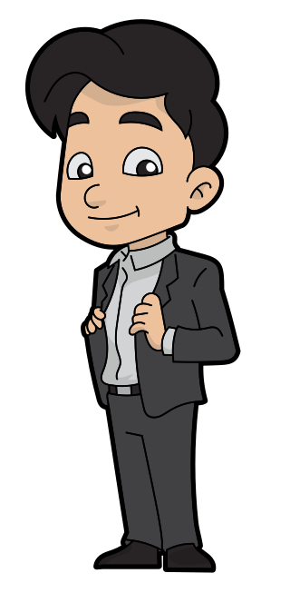

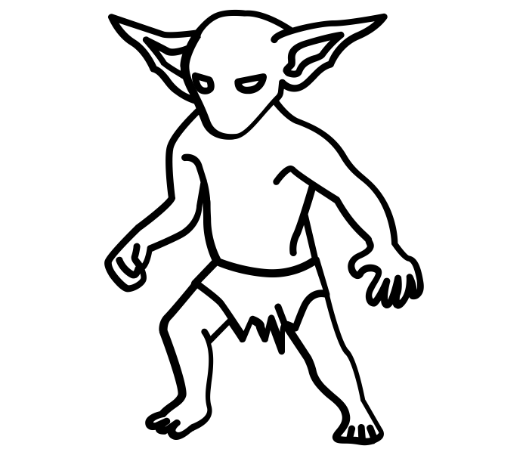
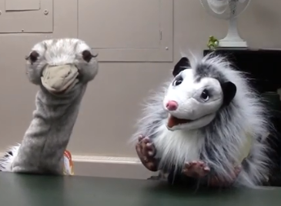
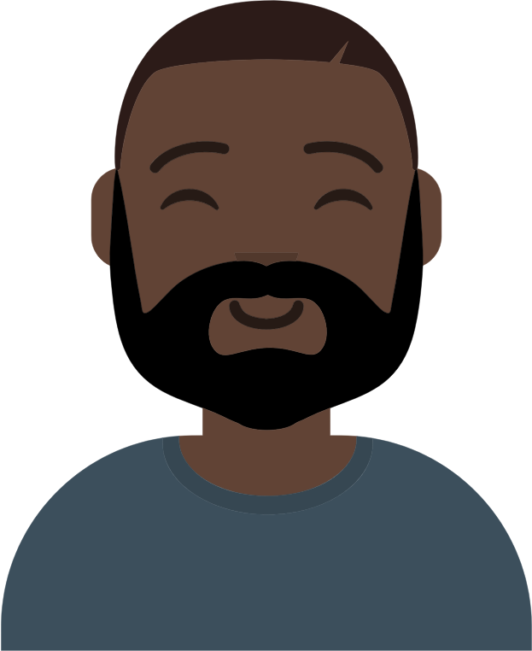
Achieving Inclusivity
Diversity a focus casting characters for narratives
Aim for diversity in:
  Copyright users and creators
  Occupation/social role
  Racial and gender diversity
Aim to balance engagement and reusability

Slide 11
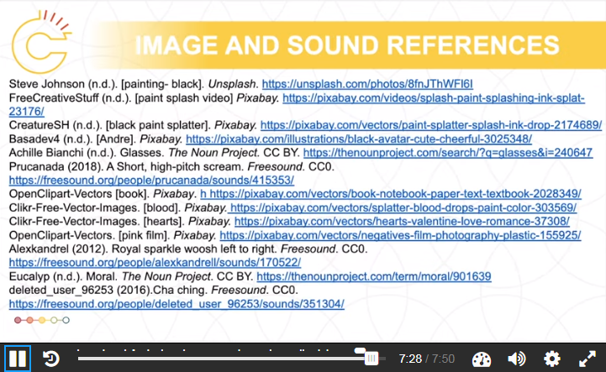
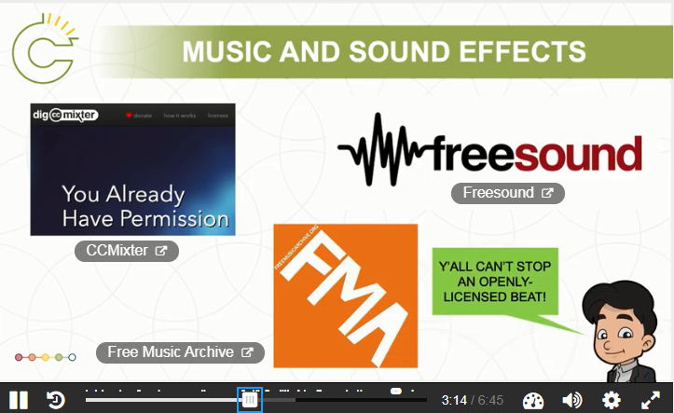
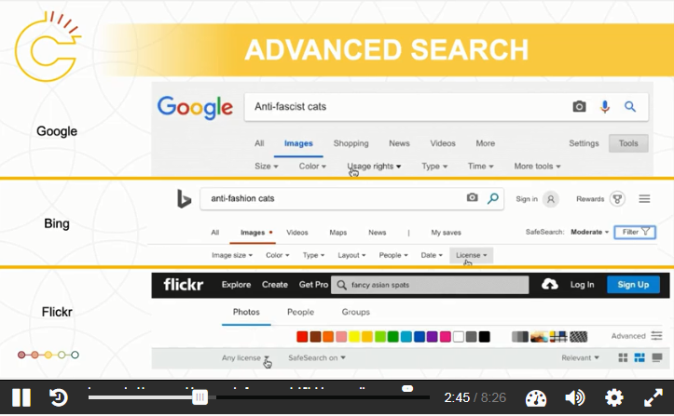
Modelling Use of Open Content
OUC Module – “Finding Open and Creative Commons Content” (screenshot)
OUC Module – “Moral Rights” (screenshot)
OUC Module – “Including Third Party Content in Your Work” (screenshot)

Slide 12

Community and Collaboration
Copyright Office
Centre for Teaching and Learning
Technologies in Education
Adrian Sheppard
Amanda Wakaruk
Cosette Lemelin
Graeme Pate
Krysta McNutt
Anwen Burk
Matt Cheung
Jamie Stewart
University of Alberta Libraries
School of Library and Information Studies
Michelle Brailey
Jesse Carson
Luc Fagnan
Toby Grant
Julia Guy
Kris Joseph
Michael B. McNally

Slide 13
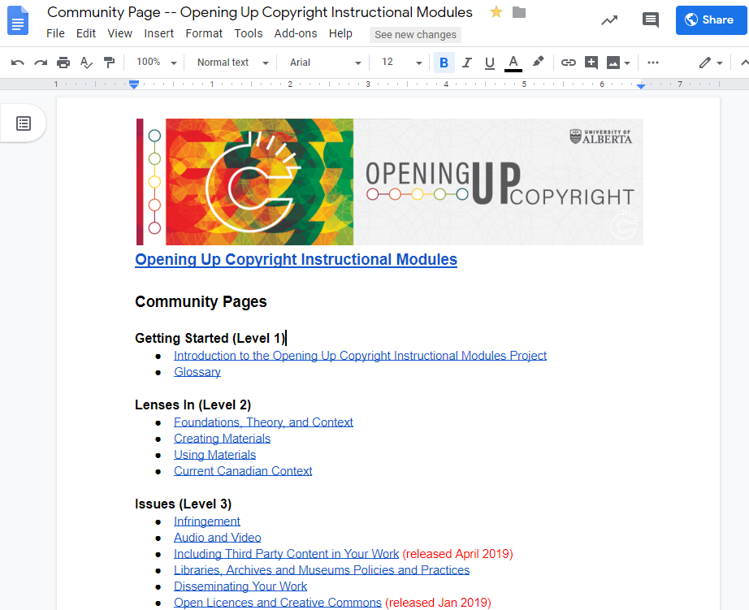
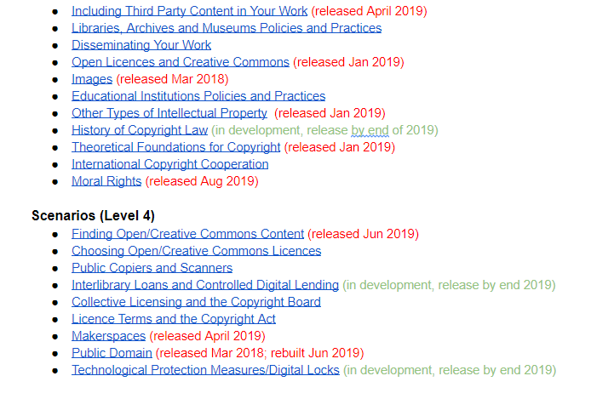
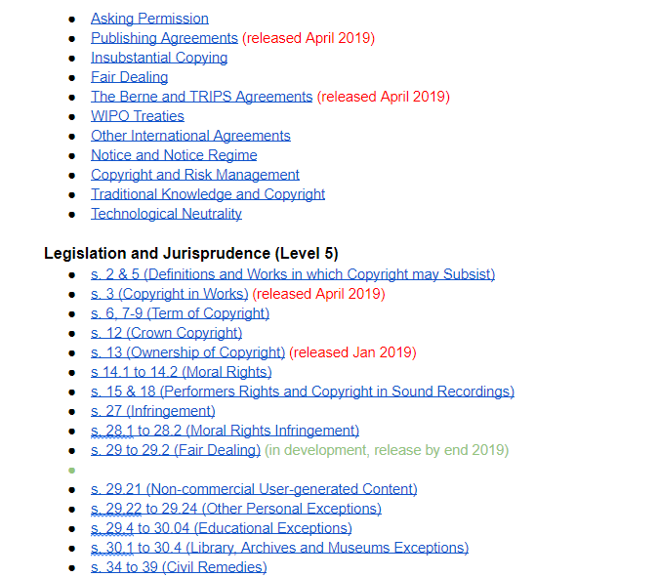
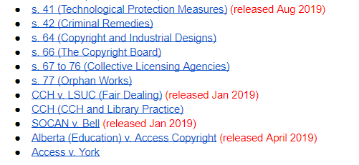
Community and Collaboration
  Conference presentations (8 and counting)
  Peer-reviewed papers (2 and counting)
  Posters (1)
  Dedicated web space for non-module content is in progress

Slide 14
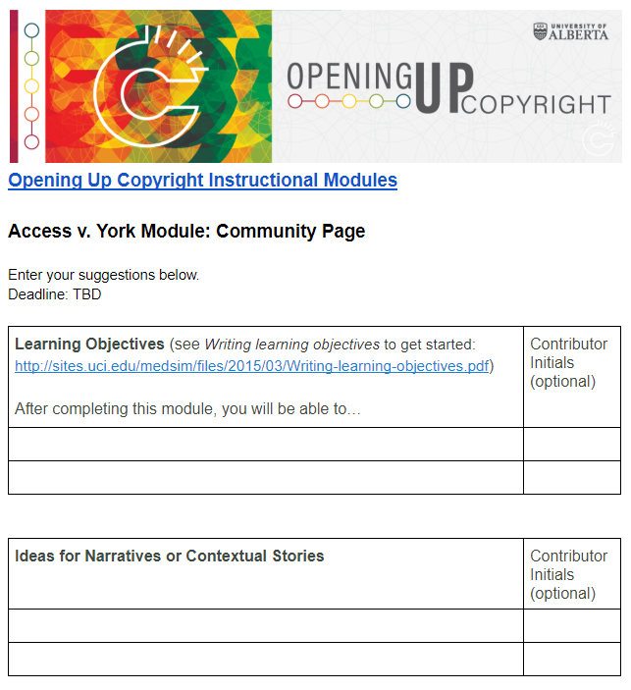
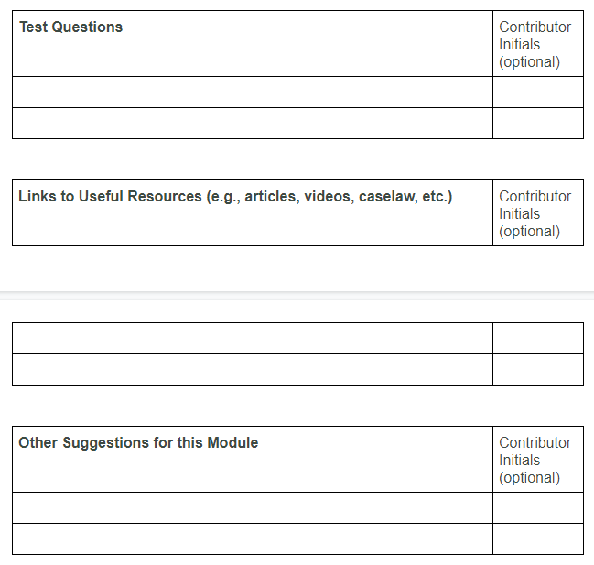
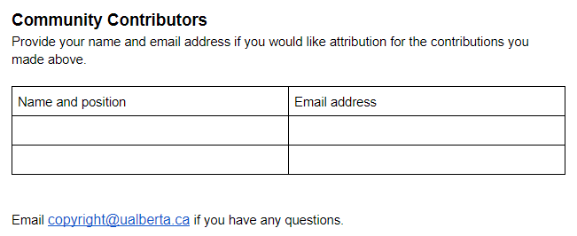
Module Community Page
OUC Website: https://sites.library.ualberta.ca/copyright/

Slide 15
Summary
Series of instructional modules improving access to knowledge about copyright:
  through content creation and delivery
  by modeling best practices
  by incorporating community engagement into design

Slide 16
References
Atkinson, Roger. (1999). Project management: Cost, time and quality, two best guesses and a phenomenon, its time to accept other success criteria. International Journal of Project Management, 17(6), (December 1999): 337–42. https://doi.org/10.1016/S0263-7863(98)00069-6
Brunet, Mélanie & Amanda Wakaruk. (2019). “An Exercise in Contradiction? The Role of Academic Copyright Librarians,” in Copyright Conversations: Rights Literacy in a Digital World, edited by Sara Benson. ACRL Publications / American Library Association. https://doi.org/10.7939/r3-3p3b-h251
Clossen, A. S. (2014). Beyond the Letter of the Law: Accessibility, Universal Design, and Human-Centered Design in Video Tutorials. Pennsylvania Libraries: Research & Practice, 2(1), 27–37. https://doi.org/10.5195/PALRAP.2014.43
Evans, R. (2014). Cooking up cauldrons of content: Recipes for video tutorials. Articles, Chapters and Online Publications. 32. Retrieved from https://digitalcommons.law.uga.edu/law_lib_artchop/32
Laurillard, D. (1998). Multimedia and the learner’s experience of narrative. Computers & Education, 31(2), 229–242. https://doi.org/10.1016/S0360-1315(98)00041-4
Lo, L. S., and Dale, J. M. (2009). Information literacy ‘learning’ via online tutorials: A collaboration between subject specialist and instructional design librarian.” Journal of Library and Information Services in Distance Learning, 3: 148-158.
Martin, N. A., and Martin, R. (2015). “Would you watch it? Creating effective and engaging video tutorials.” Journal of Library and Information Services in Distance Learning, 9: 40-56.
McNally, M. B., & Christiansen, E. G. (2019). Open enough? Eight factors to consider when transitioning from closed to open resources and courses: A conceptual framework. First Monday, 24(6). https://doi.org/10.5210/fm.v24i6.9180
Smith, B., & Lee, L. (2017). Librarians and OER: Cultivating a Community of Practice To Be More Effective Advocates. Journal of Library & Information Services in Distance Learning, 11(1–2), 106–122. https://doi.org/10.1080/1533290X.2016.1226592
Weeramuni, L., (2019). How to Fight Fair Use Fear, Uncertainty, and Doubt: The Experience of One Open Educational Resource. Journal of Copyright in Education and Librarianship, 3(1), 1-21. https://doi.org/10.17161/jcel.v3i1.9751
Weeks, T., and Davis, J. P. (2017). Evaluating best practices for video tutorials: A case study.” Journal of Library and Information Services in Distance Learning, 11(1-2): 183-195.

Slide 17
Image Sources
  Mohamed_hassan. (n.d.). Programmer Computer Woman Support. Pixabay. CC0. https://pixabay.com/vectors/programmer-computer-woman-support-3607627/
  GraphicMama-team. (2016) Arab girl. Pixabay. CC0 https://pixabay.com/en/arabian-arab-girl-female-ethnic-1456184/
  Boss: Ghan Koon Lay. (n.d). Boss. The Noun Project. CC0. https://thenounproject.com/icon/1587076
  Chrystalelizabeth. (2014) Teacher-bookworm-glasses-professor. Pixabay. CC0. https://pixabay.com/illustrations/teacher-bookworm-glasses-professor-359311/
  Clip Art by Vector Toons. (2018). Charming Cartoon Businessman. Wikimedia Commons. CC BY. https://commons.wikimedia.org/wiki/File:Charming_Cartoon_Businessman.svg
  Basadev4 (n.d.). [Andre]. Pixabay. https://pixabay.com/illustrations/black-avatar-cute-cheerful-3025348/
  Parkjisun. (n.d.). Goblin. The Noun Project. CC BY https://thenounproject.com/icon/1005005
  Free Clip Art. (2018). Senior guy at the office. Wikimedia Commons. CC BY SA.https://commons.wikimedia.org/w/index.php?title=Special:Search&limit=50&offset=500&profile=default&search=man+cartoon&advancedSearch-current={%22namespaces%22:[6,12,14,100,106,0]}#/media/File:Senior_Guy_At_The_Office_Cartoon.svg
  Rawpixel/3254 Bilder. (2018). Cartoon Lassig Charackter Zeichnung. Pixabay. CC 0. https://pixabay.com/de/illustrations/cartoon-l%C3%A4ssig-charakter-zeichnung-3685566/
  Animal and Goodbrarian – OUC. (2019). OUC Module “Photocopying in the Library Module” (screenshot). CC BY. https://sites.library.ualberta.ca/copyright/photocopying-at-the-library/

Slide 18
Acknowledgements and Affiliations
The Opening Up Copyright Instructional Module Series is funded through a Teaching and Learning Enhancement Fund (TLEF) grant from the Centre for Teaching and Learning at the University of Alberta
  Luc Fagnan – Master of Library and Information Studies Student, University of Alberta
  Julia Guy – Master of Arts in Digital Humanities, and Master of Library and Information Studies Student, University of Alberta
  Amanda Wakaruk – Copyright Librarian, Copyright Office, University of Alberta
  Adrian Sheppard – Director, Copyright Office, University of Alberta
  Michael B. McNally – Associate Professor, Faculty of Education, University of Alberta

Slide 19

Questions?
  Presenter:
  Amanda Wakaruk, MLIS, MES
  Copyright Librarian
  University of Alberta
  amanda.wakaruk@ualberta.ca
  @awakaruk (personal)

