Slide 1
Design, Demonstration and Discussion of
Michael B. McNally and Amanda Wakaruk
Notes:
Amanda to make opening statement here… outline / goals of the presentation
First: discuss how the tutorials are being developed
Second: demonstrate some of the developed tutorials
Third: talk about how we are working with colleagues around the country
Why do we need copyright tutorials that are OER?
Lack of course materials or offerings that address the needs of the Canadian post secondary sector
Tutorials that are available have barriers; fee-based, geographically bound
Evidence of copyright chill… current and recent “high profile” cases serve to confuse and scare the vast majority… part of this is because the structure of Act and resulting litigation focuses on the rights of creators and owners, not users. [INDU MPs are probably feeling the full weight of this right about now] For the non-expert and probably many experts, it’s going to feel safer to do less than rely on rights we don’t fully understand. This copyright chill...

Slide 2
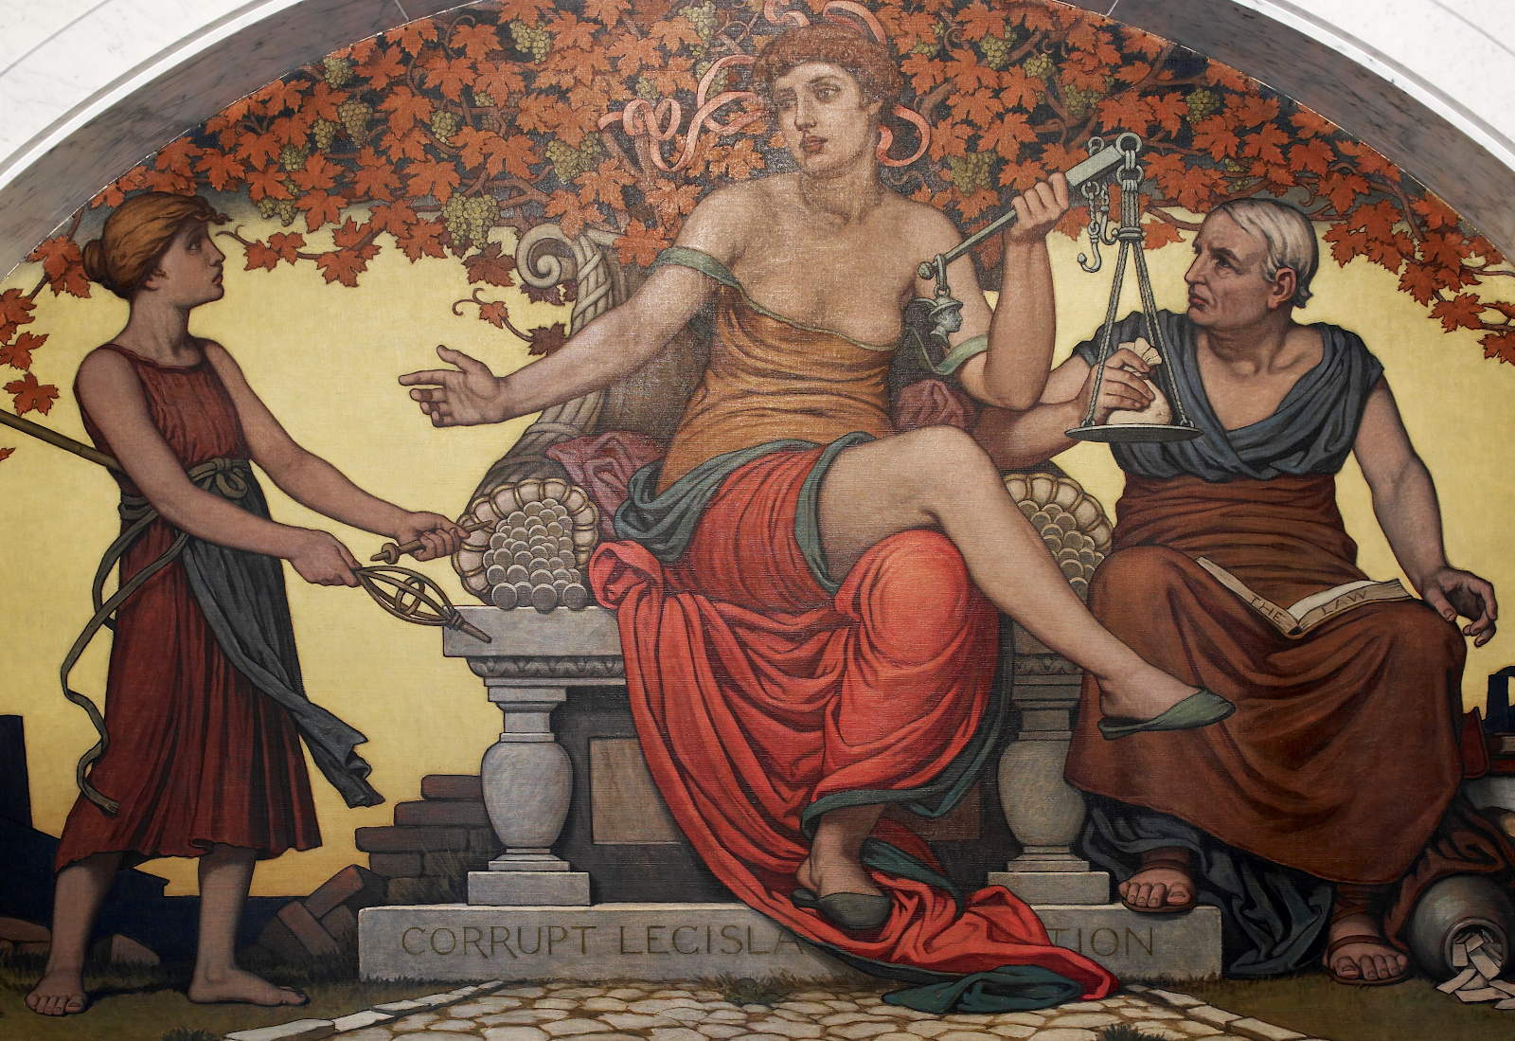
Collateral Damage of Copyright Chill
In a legal context, chill is the inhibition or discouragement of the legitimate exercise of an individual’s rights by the threat (perceived or otherwise) of legal sanction.
Mural: Elihu Vedder. 1896. “Corrupt Legislation.”
Photo: Carol Highsmhit n.d.
Notes:
Amanda
...comes with collateral damage.
Evidence of collateral damage of copyright chill:
Instructors that can’t be bothered with FD assessment, even if it’s just against institutional guidelines: students suffer
Removal of third party content from theses: public at large and future academics suffer

Slide 3
First Attempts: Previous Open Copyright Work
Open Education Week 2017 Modules
LIS 598 “Information Policy”
Notes:
Amanda
Pilot/proof of concept (OE Week 2017)
Demonstrated the amount of labour, challenges
Not entirely satisfactory
LIS 598 Info Policy (as OCW)
“Super boring, but high volume of content” -- AW quoting Michael
This work and lessons learned helped inform the eventual grant proposal for the current project

Slide 4
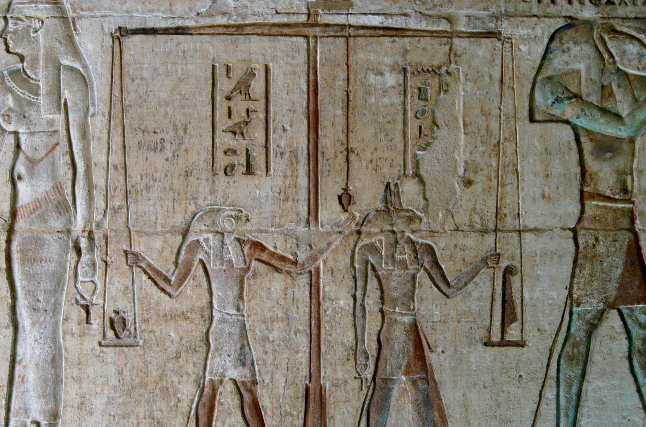
Considerations and Origins
Normative:
Open up copyright education
Pragmatic:
Multiple audiences/avoid duplication
Photo: Olaf Tausch. 2011. “Relief im Innenraum des Hathor-Tempels von Deir el-Medina.” CC-BY-3.0.
Notes:
Michael

Slide 5
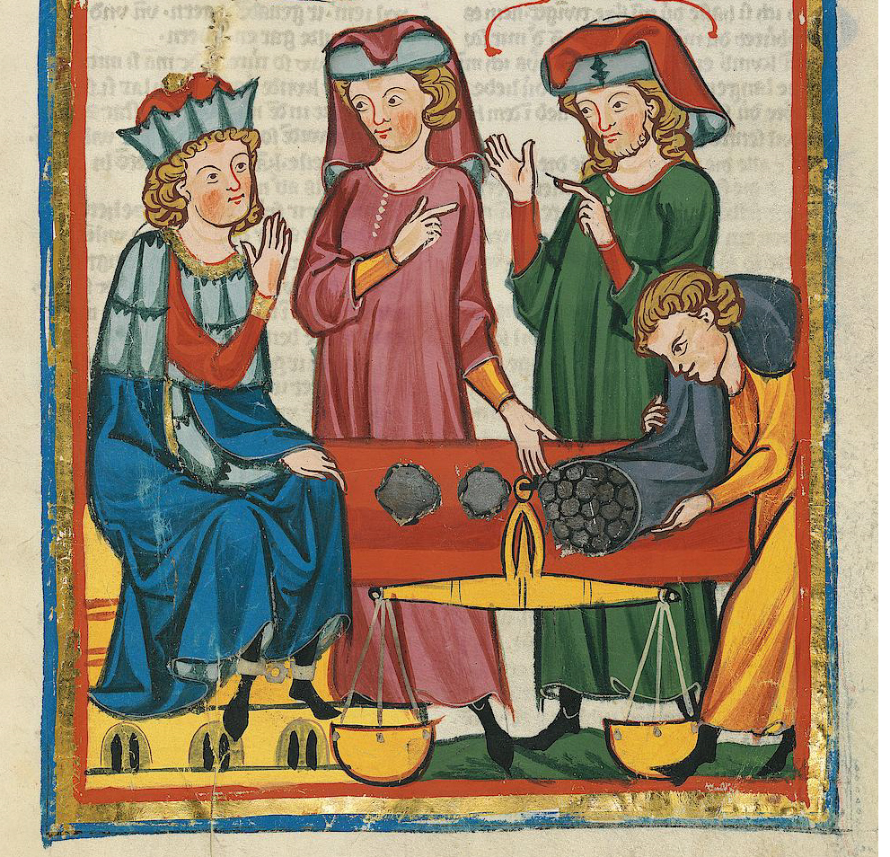
Project Structure
U of A Centre for Teaching and Learning (CTL) Teaching and Learning Enhancement funded
Project Partners:
Copyright Office
School of Library and Information Studies
Technologies in Education
Centre for Teaching and Learning
U of A Libraries
Meister des Codex Manesse. ~1310. “Codex Manesse.”
Notes:
Michael

Slide 6
Scope
Goal: 60+ modules at five different levels
Multiple learning pathways
Notes:
Michael

Slide 7
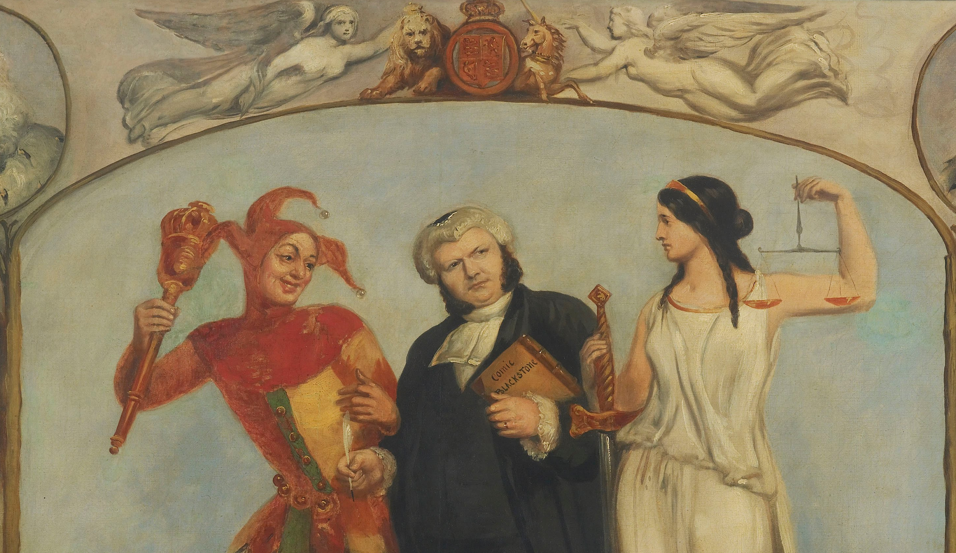
Design
Competing design priorities:
Engaging
Informative
Interactive
High Quality
Open/editable
Retrievable
Not to technical
Multiple Audiences
Archibald S. Henning. 1864. “Portrait of Renton Nicholson with Allegorical Scenes and Figures.”
Notes:
Michael

Slide 8
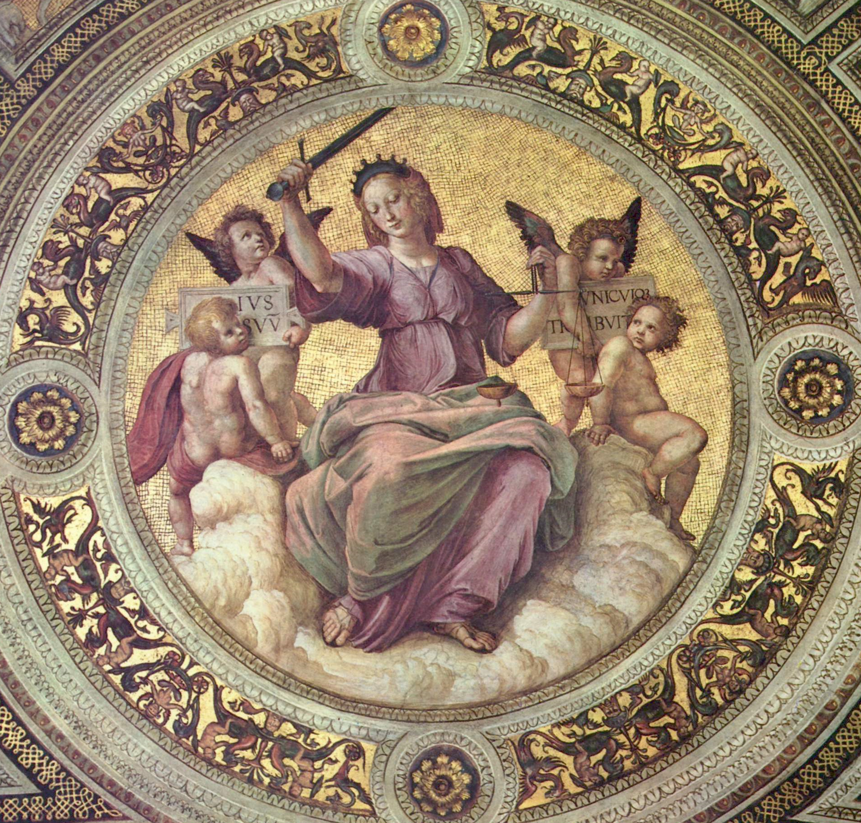
Flagship Modules
Certain high demand modules to receive ‘flagship’ treatment, e.g.:
Images
Fair Dealing
However, current ‘flagship’ treatment conflicts with openness
Raphael. 1508. “Stanza della Segnatura im Vatikan.”
Notes:
Amanda
Flagship
Initially Go Animate - fancy, not open at all (not even a sense of open)
PowToons - less fancy, “open enough”
Open (AW/MM as open maximalist relative to most)

Slide 9
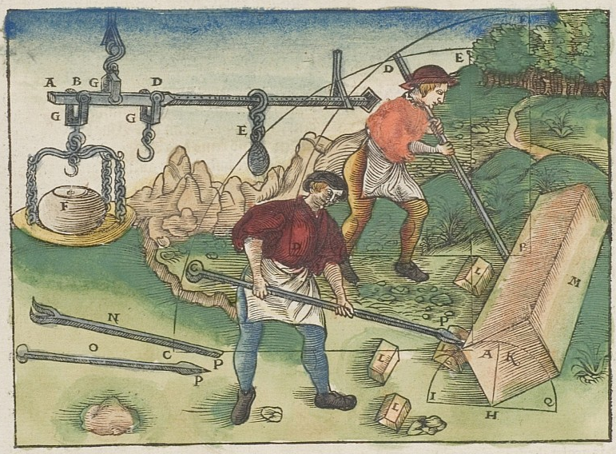
Community Engagement
Never intended as solely U of A project
Modules revised after 4-6 month initial launch
Contributions can vary
Walter Hermann Ryff. 1547. “Waage & Mathematik & Hebelwirkung.”
Notes:
Amanda

Slide 10
Work to Date – Images Module
Idealized Flagship module (not actually released/used)
Notes:
Michael

Slide 11
Work to Date – Images Module
Actual Flagship Module (Images)

Slide 12
Work to Date – SOCAN v. Bell Module
Current Module in Production (with standard design)

Slide 13
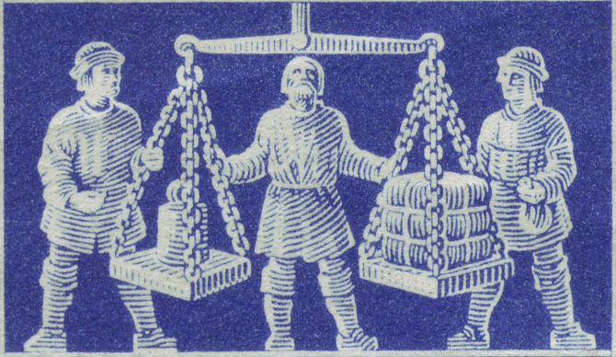
Challenges
Audience diversity
Openness
Visualization
E.g. “Nature of the Work”
Hoepner. 1948. “Exhibition Hannover.”
Notes:
Michael

Slide 14
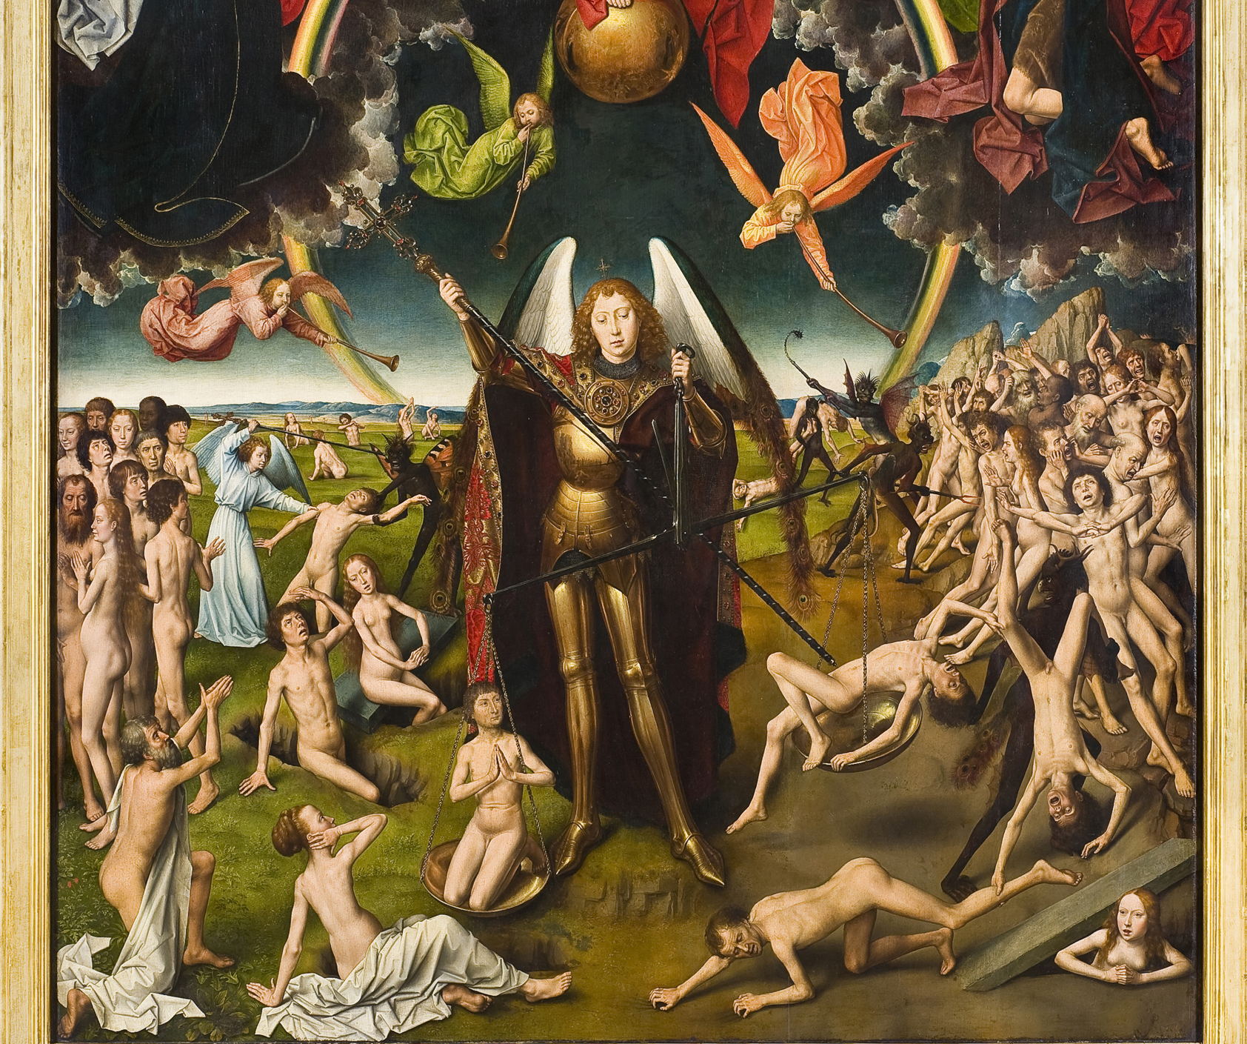
Challenges
Balancing perspectives
Domain vs. Design knowledge
Time
Hans Memling. ~1466-1473. “The Last Judgement.”
Notes:
Michael

Slide 15
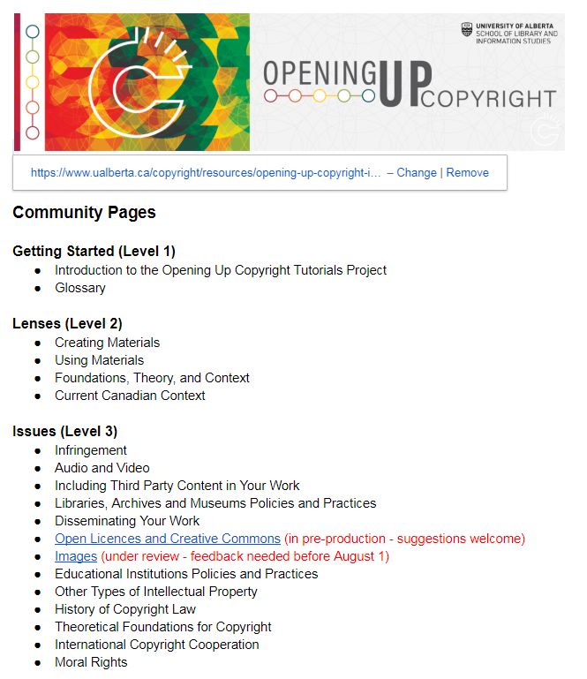
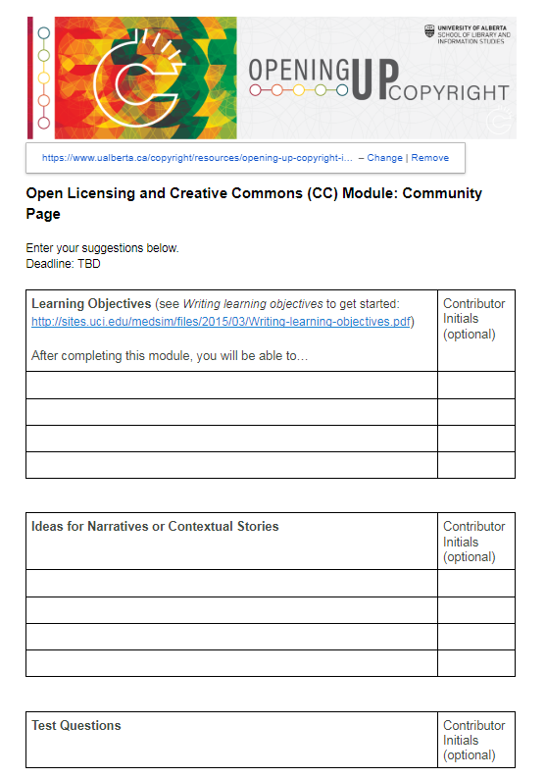
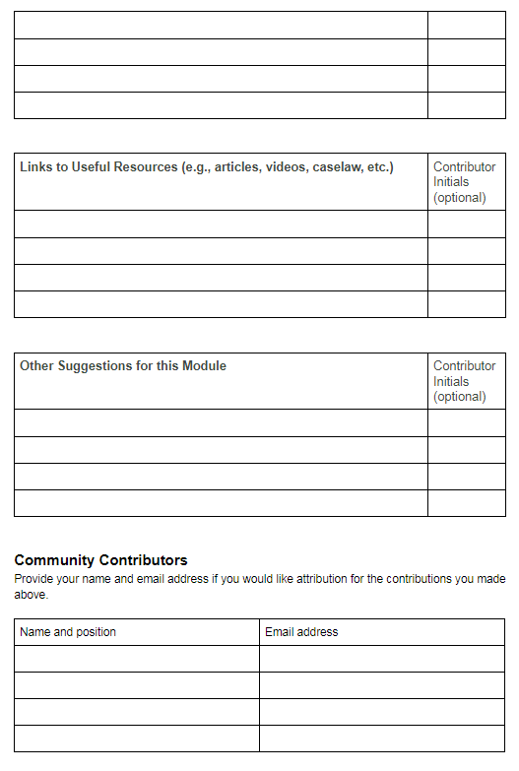
Community Pages
[goo.gl/GKctGo]
Notes:
Amanda to work on May 28, 29
Mid term feedback (can’t please everyone)/Project has no project manager
Summary of OLA feedback

Slide 16
Questions?
Amanda Wakaruk:
Copyright Librarian,
Copyright Office
University of Alberta
amanda.wakaruk@ualberta.ca
Michael B. McNally
Assistant Professor,
School of Library and Information Studies
University of Alberta
mmcnally@ualberta.ca
https://www.ualberta.ca/copyright/resources/opening-up-copyright-instructional-modules
Notes:
Michael to source some snappy pics?

