Slide 1
How can we make this better?
Understanding and improving the copyright transfer agreement experience
Alexandra Kohn | McGill University
ABC Fall Speakers Series
October 28, 2020

Slide 2
How do academic authors experience CTAs and how can we make this better?
Notes:
- talking mostly about journal copyright transfer agreements

Slide 3
Publishers’ CTAs and the information they provide about author rights are:
Hard to find
Hard to understand
Often leave out critical information about what authors care about
Often seem intentionally obtuse

Slide 4
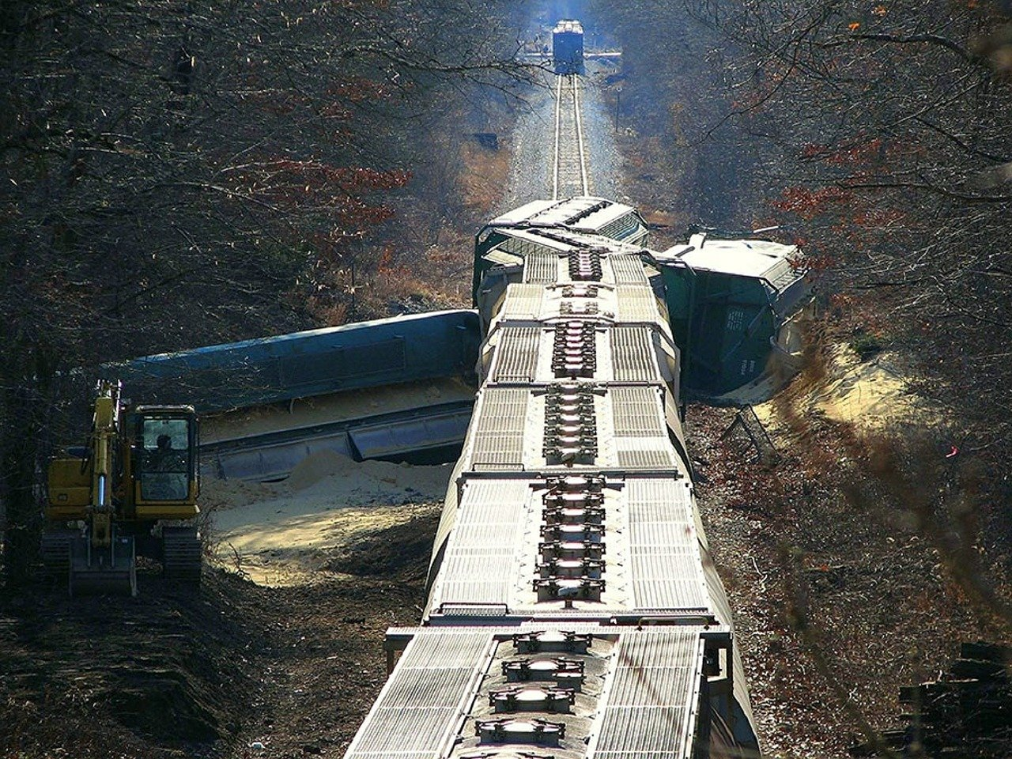
Image by allenrobert from Pixabay
Notes:
Acknowledge that there is a wider systemic issue
Wish i didn’t have to talk about this at all and that all journals simply asked for a license to publish and distribute and authors retained all their other rights without having to pay 11,000 for a Creative Commons licence
Or that tenure, promotion and scholarly validity were not tied to publishing in certain journals, but unfortunately we’re not there yet

Slide 5
Image by Gerd Altmann from Pixabay

Slide 6
Can we make it (a little bit) better?
Education: empower our users to with the tools to understand CTAs
Improving: think about what would make a better CTA

Slide 7
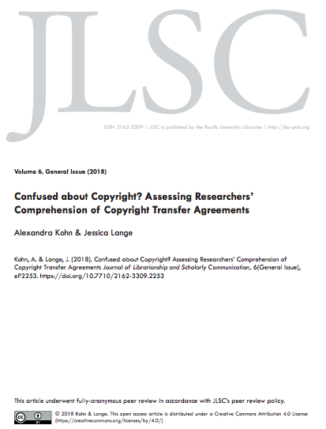
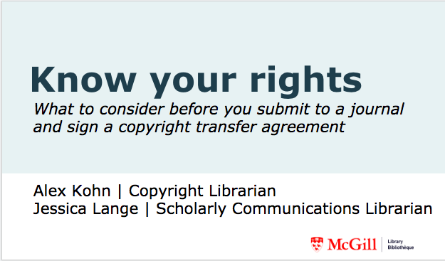
Our experience
Ran workshops
Workshop designed to help academic authors understand CTAs
Survey experiment designed to gauge how well authors understand CTAs
Notes:
Use the data we got from our paper to back up the anecdotal evidence from our workshop and job experience

Slide 8
Plan for today
Context
Description and run-through of workshop
Workshop feedback and lessons learned
How does our experience match up with our research
How can CTAs be improved to be more useful and easier to understand
What do you think?

Slide 9
CONTEXT

Slide 10
So many questions:
“I want to send by email and post on our website … [a published figure from one our faculty members]..Is it ok if I send the [figure] with the correct source by email? Is it also ok if I post it on the web with the source?”

Slide 11
“A professor in Australia has asked if I can send them a copy of my published article. Am I allowed to do this?”

Slide 12
“I was wondering if you could help me clarify some things about posting my published work on ResearchGate. My article...is published in the [redacted] Journal. Based on the SHERPA/RoMEO website, it says that the publisher's vision I currently have posted online should not be done. However, if I don't publish that, what other complete version should I post? It doesn't seem like most journals offer an "author's post-print" copy in a proper format. To follow the guidelines, is it best for me to copy and paste the text in a blank word document and then upload that onto ResearchGate or Academia.edu?”

Slide 13
Who is asking?
Grad students, ECRs, experienced faculty (basically everyone)
Librarians (benchmarking survey)
What do they want to know?
What can I do?
Where do I find the information?
How do I interpret the information I can find?
How to deal with conflicting information in CTA and publishers’ website

Slide 14
The literature confirms copyright confusion....

Slide 15
A major obstacle to self-archiving
Increasing complexity: between 2004 and 2015, “the volume of restrictions around how, where and when self-archiving may take place has increased 119%, 190% and 1000% respectively” (Gadd & Troll Covey, 2016).
In one survey: 63% of respondents indicated a lack of understanding of publisher policy as an important or very important factor in failing to deposit an article in an IR (Frass et al., 2014)
Respondents in another international survey (Spezi, Fry, Creaser, Probets, & White, 2013) reported that determining their rights regarding self-archiving was the most challenging part of the process, with 2/3 reporting some degree of difficulty in doing so.

Slide 16
WORKSHOP

Slide 17
Workshop Background
Inspired by: Wirth, A.A., & Chadwell, F.A. (2010). Rights Well: An Authors’ Rights Workshop for Librarians. portal: Libraries and the Academy 10(3), 337-354. doi:10.1353/pla.0.0105
First given for librarians and library staff in 2016 with dual function: train the trainer and guinea pigs for other participants
General workshop, offered to all grad students, researchers and faculty
Partnered with liaison librarians to give targeted for particular departments, classes or research groups

Slide 18
Know your rights
What to consider before you submit to a journal and sign a copyright transfer agreement
Alex Kohn | Copyright Librarian
Jessica Lange | Scholarly Communications Librarian
Notes:
75 - minutes

Slide 19
Objectives
Identify and compare copyright transfer agreements in academic journals
Evaluate journals based on their author rights agreements
Describe which rights are retained/revoked in these agreements
Notes:
We give three handouts - a copy of an actual CTA, an activity sheet and a list of key terms

Slide 20
Workshop Outline
Introduction + background
Brainstorming activity
Key terminology and phrasing in agreements
Group activity
Copyright transfer agreements
Debrief
Wrap-up and discussion
Notes:
Introduction + background (5-10 min) - we allow 75 minutes (trial and error)
Brainstorming (5-7 minutes)
· What kinds of ‘things’ do you want to know if you can do with your article? (e.g. post to website, deposit in an IR etc.) <JL and AK write on board>
· Discussion of versioning <provide handout/slide of commonly-used terms>
Group activity
1. CTA handouts (10-15 minutes for activity + 5 minutes to debrief)

Slide 21
Introduction
What are copyright transfer agreements?
Why do they matter?
Shifting landscape
Open access movement
Funding requirements
Notes:
A copyright transfer agreement is a contract you sign with a publisher. It usually entails you signing over copyright to your work (e.g. book, article etc.). Copyright means the right to publish, copy, translate, and distribute the work and the right to authorize others to do so. Basically these transfer agreements mean publishers now have (in many cases) the sole right to publish, translate, and distribute your work. By signing these agreements you are transferring those rights to them and thus no longer maintain those rights yourself.
Copyright agreements vary widely by publisher. It‘s important to be aware of what rights you are tranferring/maintaining when you enter these agreements. For example, many authors are surprised to learn they often no longer have the rights to images/graphs/figures they produced and thus have to request permission from the publisher in order to use them in future works.
Author rights have been a growing subject of debate within the publishing community. With the advent of the open access movement, many journals, particularly open access journals, permit authors to retain their copyrights.
It‘s also important to be aware of any funding agency requirements. Some funding agencies are now requiring the results of grant-funded research to be made open access. Some publisher agreements permit this while others do not.

Slide 22
What is a copyright transfer agreement?
¹
¹Right to publish, copy, translate, and distribute the work…and authorize others to do so
Notes:
A copyright transfer agreement is a contract you sign with a publisher. It usually entails you signing over copyright to your work (e.g. book, article etc.). Copyright means the right to publish, copy, translate, and distribute the work and the right to authorize others to do so. Basically these transfer agreements mean publishers now have (in many cases) the sole right to publish, translate, and distribute your work. By signing these agreements you are transferring those rights to them and thus no longer maintain those rights yourself.

Slide 23
What is a copyright transfer agreement?

Slide 24
Brainstorming activity
What kinds of activities do you want to know
if you can do with your article
(e.g. share with colleagues, post to a website etc.)?
Notes:
Get them to take an active approach to considering what they might want to do with their article
Brings up interesting examples that we haven’t considered before

Slide 25
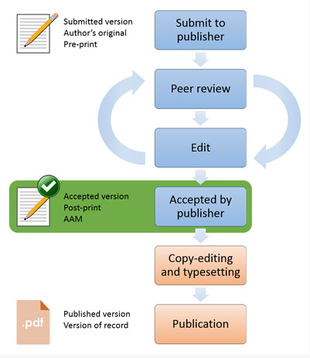
Key terms: Versions
Pre-print
Author’s original, submitted version
Author’s accepted manuscript (AAM)
Accepted version
Post-print
Publisher’s final version
Publisher’s PDF
Version of Record (VoR)
Source: "Open Access Research FAQ.” Higher Education Funding Council for England. http://www.hefce.ac.uk/rsrch/oa/FAQ/#deposit4
Notes:
These are some important definitions to keep in mind when reviewing copyright transfer agreements (CTAs). Often these agreements will stipulate different rights for different versions of your article. Unfortunately, the terms for these versions are not completely standardized across publishers, but most will recognize three distinct versions of the article which correspond to different stages in the publication process.
For example, most CTAs will permit you to post a pre-print of your article to your personal website. However, few will permit this for the publisher PDF.

Slide 26
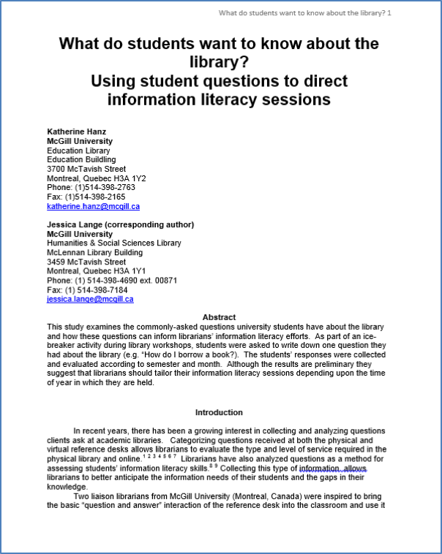
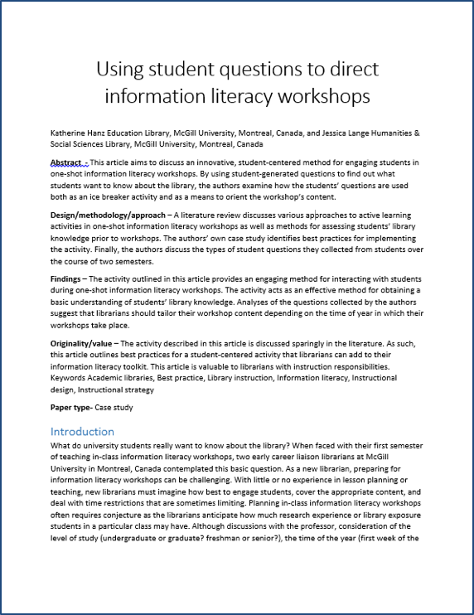
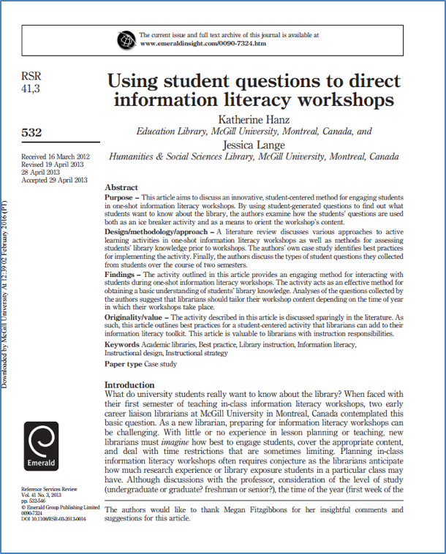
Article versioning
Pre-print – initial submission, no peer review
Post-print – final accepted version without layout, peer reviewed
Publisher's version/version of record – final copy with layout
Notes:
Important for authors to be able to identify the different versions since different rights are associated with each of these
Important reminder to keep the different versions, especially your accepted manuscript and to name them something you will recognize

Slide 27
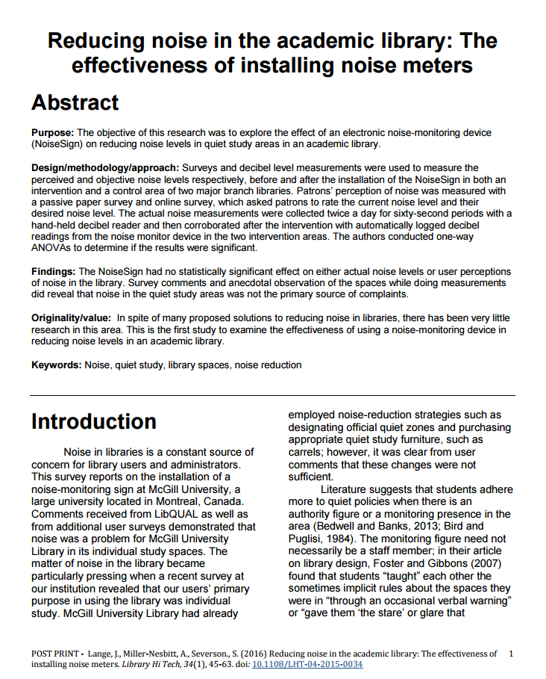
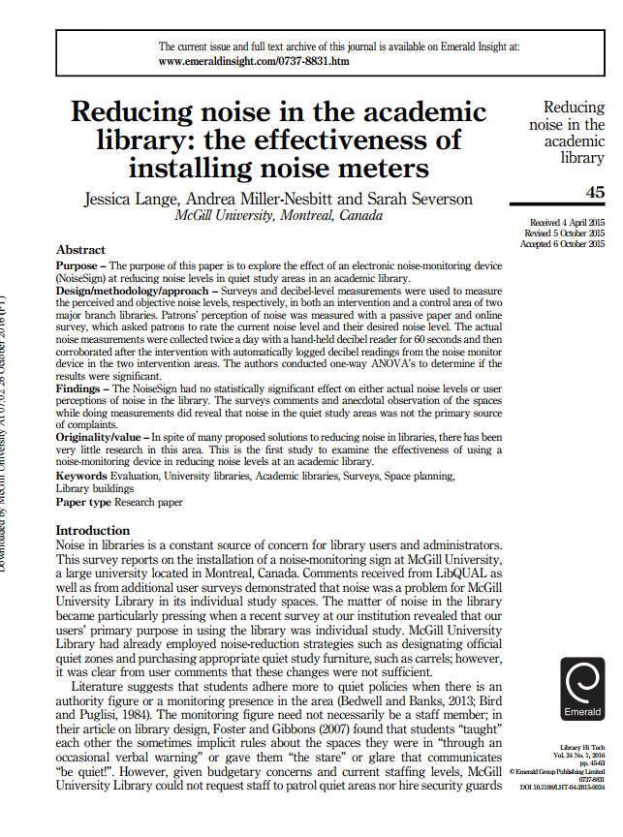
What is a post-print (cont’d)?
VS
Post-print
Saved by RESEARCHER
Typically CAN be posted to repositories
Usually must include DOI/link/citation to original article
Publisher’s version
Created by PUBLISHER
Typically CANNOT be posted to repositories
Notes:
Remember to save (and appropriately name) the different versions of your article.

Slide 28
Key terms: Assigning vs. licensing
Assignment/transfer
Transfer of some or all of your rights to another party (e.g. a publisher).
License
Permission for another party to use your work under certain conditions
You maintain copyright ownership
Note: In many agreements, you transfer copyright to the publisher and they license certain rights back to you.

Slide 29
Key terms: Exclusive vs. non-exclusive license
Exclusive
Non-Exclusive
✔
Notes:
Explain the difference between an exclusive and a non-exclusive licence and also point out that sometimes an exclusive licence is so extensive that there is little difference between that an full transfer or assignment of copyright

Slide 30
A special kind of non-exclusive: Creative Commons
Notes:
Creative Commons licenses are an example of a non-exclusive license.
For example, PLOS applies the Creative Commons Attribution (CC BY) license to articles and other works they publish. If you submit your paper for publication by PLOS, you agree to have the CC BY license applied to your work. Under this Open Access license, you as the author agree that anyone can reuse your article in whole or part for any purpose, for free, even for commercial purposes. Anyone may copy, distribute, or reuse the content as long as the author and original source are properly cited. (http://journals.plos.org/plosone/s/licenses-and-copyright)

Slide 31
Group Activity: Copyright Transfer Agreements
At your table, review the copyright transfer agreements provided (~10 minutes)
Highlight anything that’s unclear/confusing
Fill in the chart on your handout

Slide 32
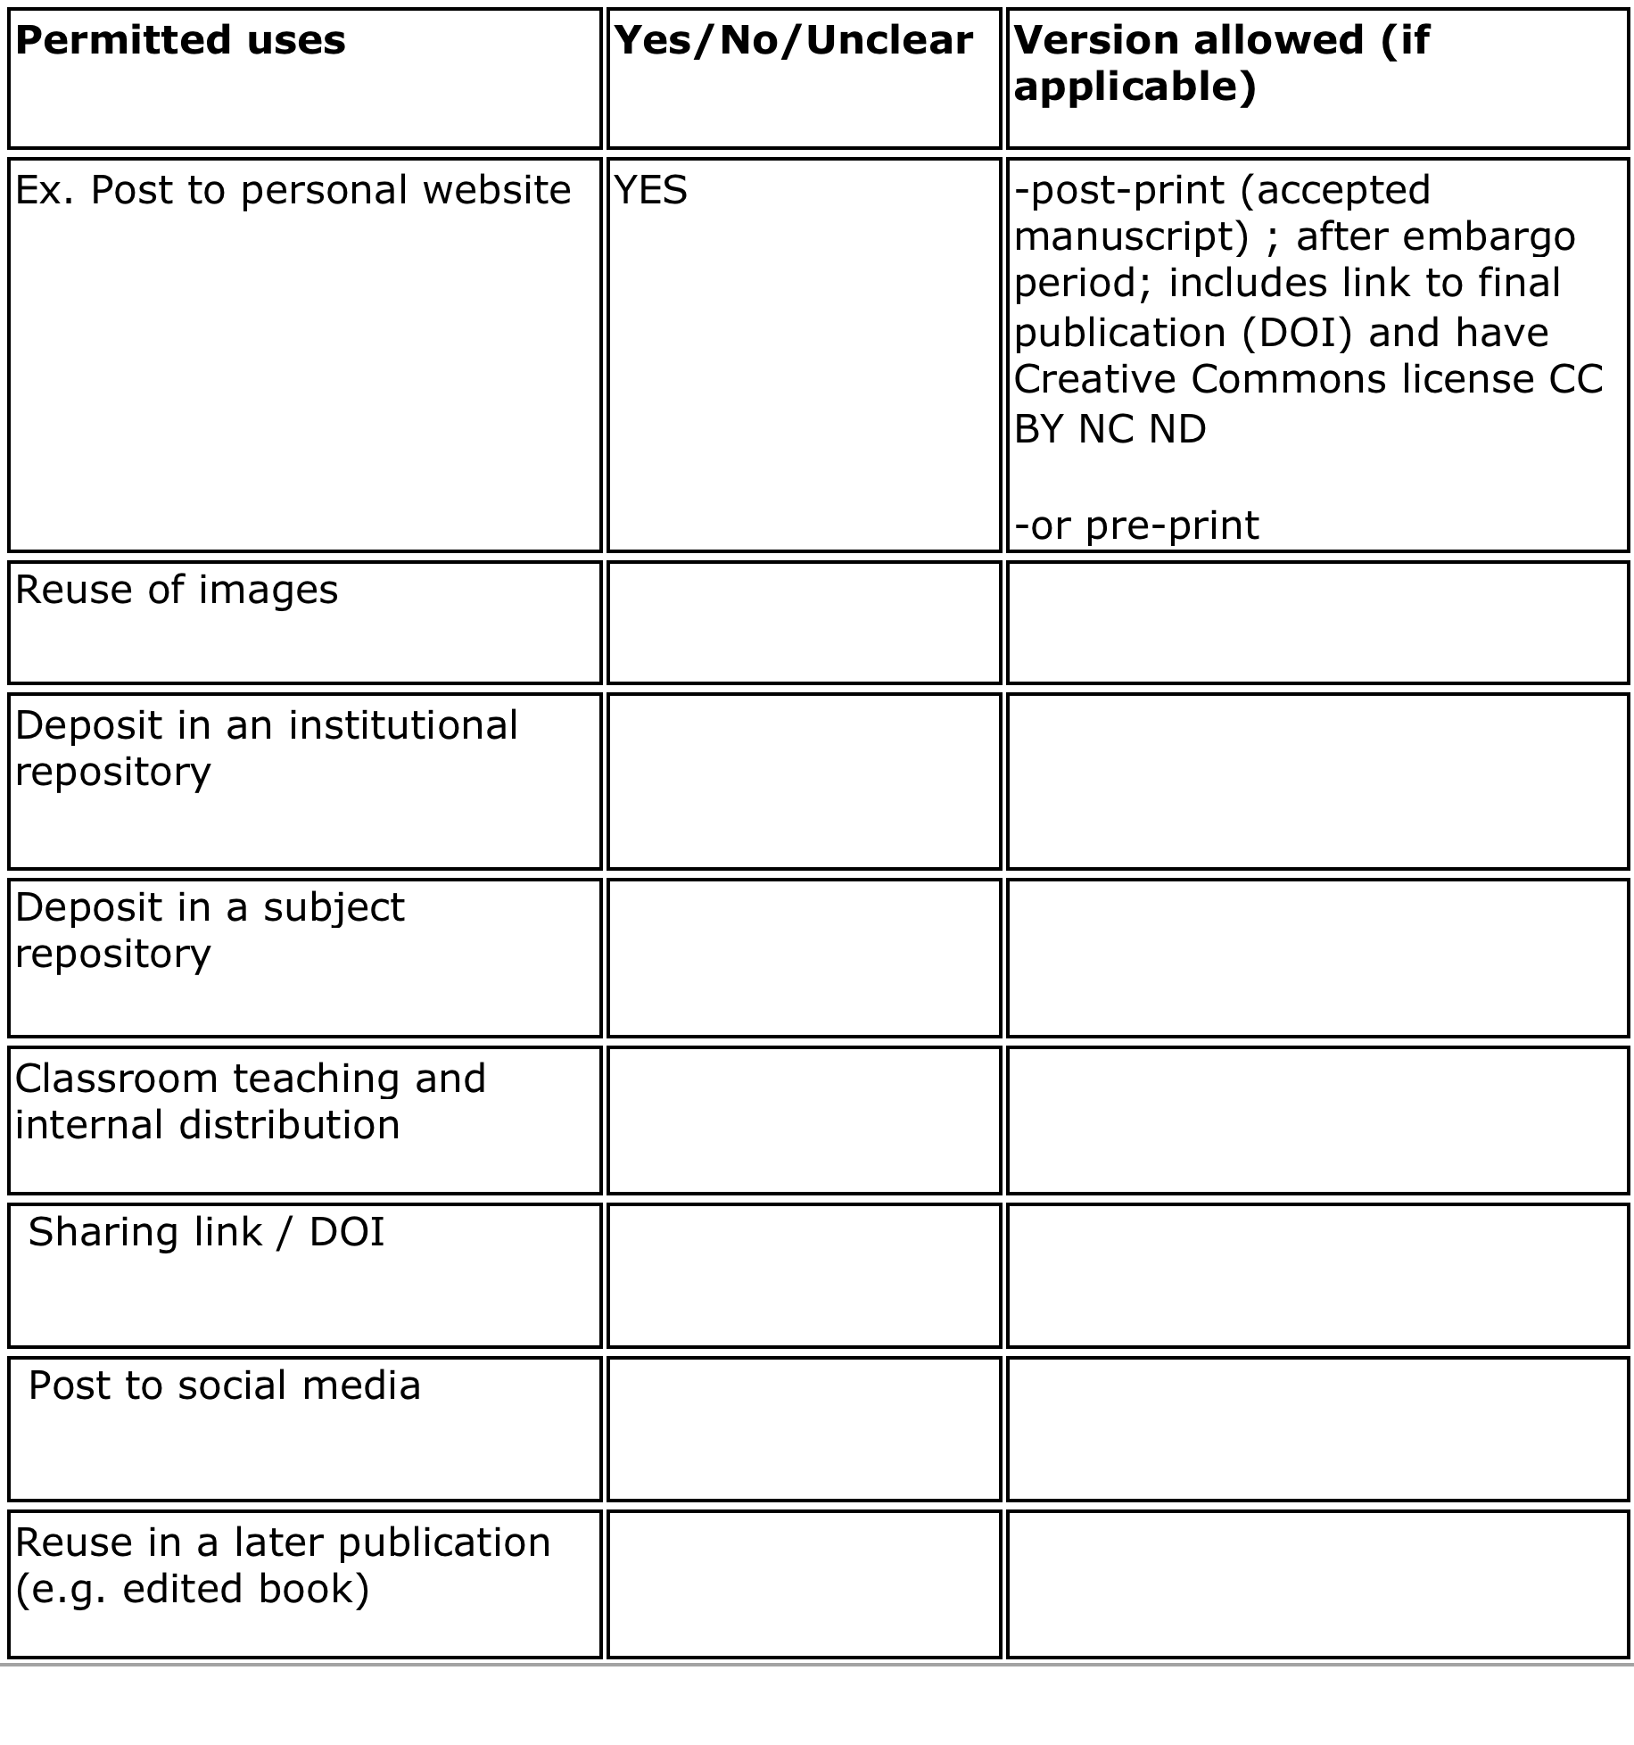

Slide 33
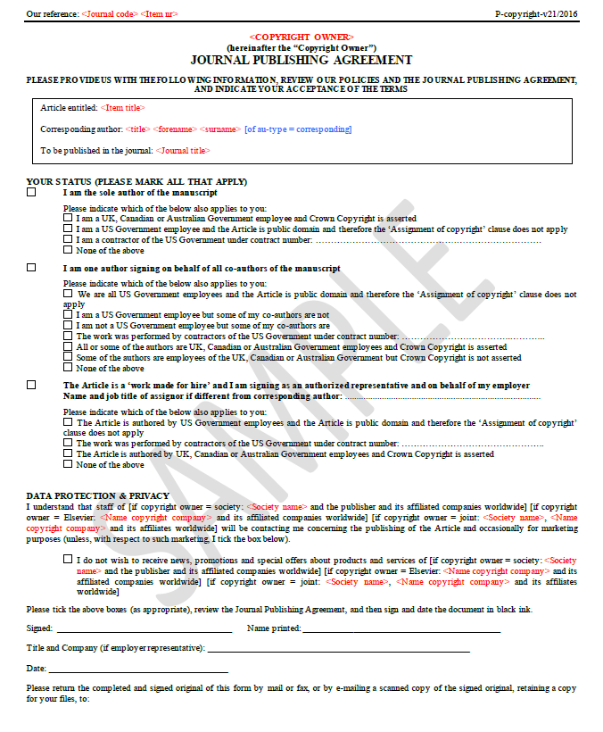
p. 1
Overview of author status and affiliation
Notes:
Page 1 in this case is just going over author status and affiliation. This is included because the work done by U.S. government employees falls under a different set of copyright rules.
Otherwise, this first page isn’t particularly interesting.

Slide 34
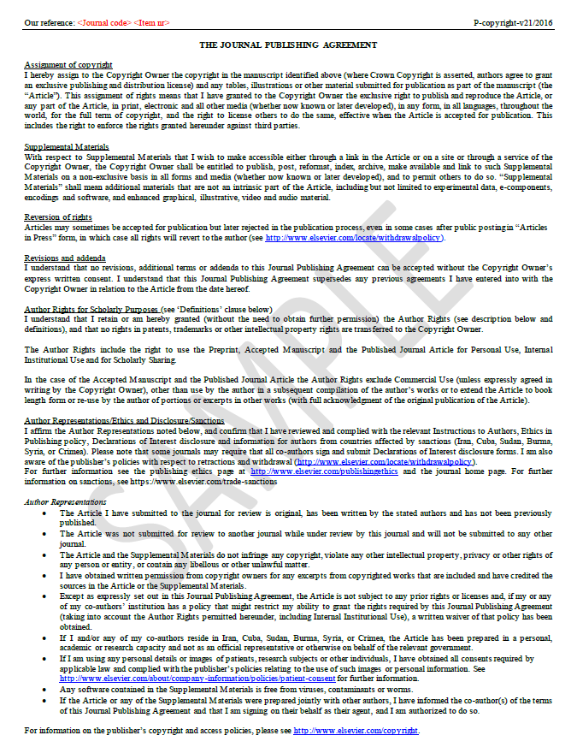
p. 2
Standard copyright assignment
Author representations
Notes:
Page 2 gets more into the nitty gritty of the actual agreement. It includes a fairly standard copyright assignment clause (see Assignment of Copyright). Additionally it includes information on what rights you retain as author ( see Author Rights for Scholarly Purposes).

Slide 35
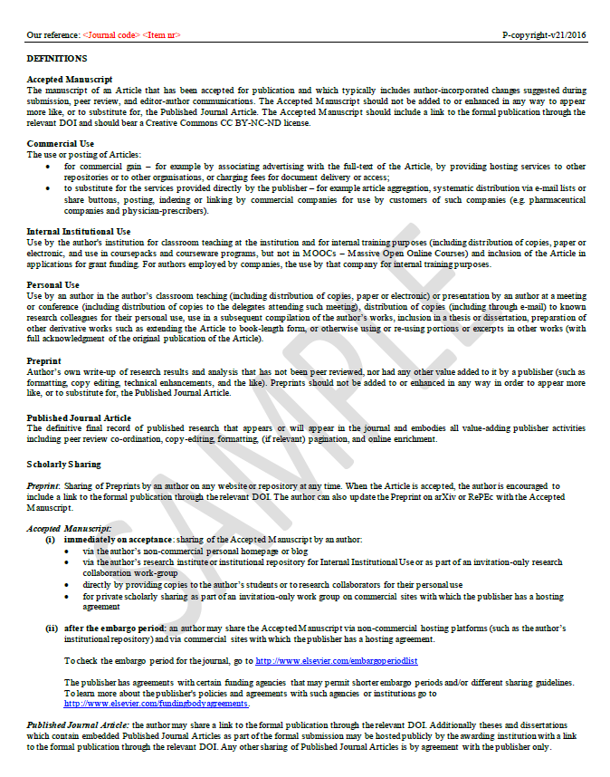
p. 3
Details of author rights and definitions
Notes:
Page 3 is where all the details are. On the previous slide we mentioned that Personal Use, Institutional Use, and Scholarly Sharing are defined herein. This page provides all the details of what that means.

Slide 36
Notes:
This section outlines what rights are maintained. For example, intellectual property rights remain with the author. Furthermore, the author maintains rights for personal use, internal institutional use and for scholarly sharing (see p.3 for definitions of what those mean). The agreement also permits the author to use the work in a future compilation of the author’s work (provided acknowledge is provided of the original publication).

Slide 37
CTA debrief
Permitted uses | Yes/No/Unclear | Version allowed (if applicable)
Ex. Post to personal website | YES | post-print
Reuse of images | NO | n/a
Deposit in an institutional repository
Deposit in a subject repository
…

Slide 38
Lots of variation
“Contributors may re-use figures, tables, artwork, and selected text up to 250 words from their Contributions”
(Wiley)
“..agreement.. does not allow full articles to be posted on SSRN, or other such commercial networks.”
(Cambridge University Press)
“…you agree to have the CC BY license applied to your work…you as the author agree that anyone can reuse your article... even for commercial purposes. Anyone may copy, distribute, or reuse the content as long as the author and original source are properly cited”
(PLOS)
Notes:
There’s no “standard” copyright transfer agreement although often you’ll see similar language. However, rights of the author vary publisher to publisher and the agreements often change so it’s important to keep track of what you sign.

Slide 39
How can I know the policies before I submit?
SHERPA/ROMEO
Database of publisher policies
https://v2.sherpa.ac.uk/romeo/
Publisher website
See Sections:
Copyright
Author guidelines
Permissions
Author services
Submission guidelines
Instructions for authors
Etc.
Notes:
There’s lots of resources to help you understand publisher policies. SHERPA/ROMEO is a handy tool for understand publisher’s self-archiving policies (i.e. the right to post your article/work to a repository or website). Note however it doesn’t look at the full suite of rights - just those specific to self-archiving. This tool is handy if you’ve received funding that has an open access requirement.
Otherwise, the publisher’s website is the best source of information. Locating the copyright agreement information can be tricky sometimes. Depending on the publisher it will appear in various sections (as listed above). You can also always write the editor or the journal publisher if you have questions.

Slide 40
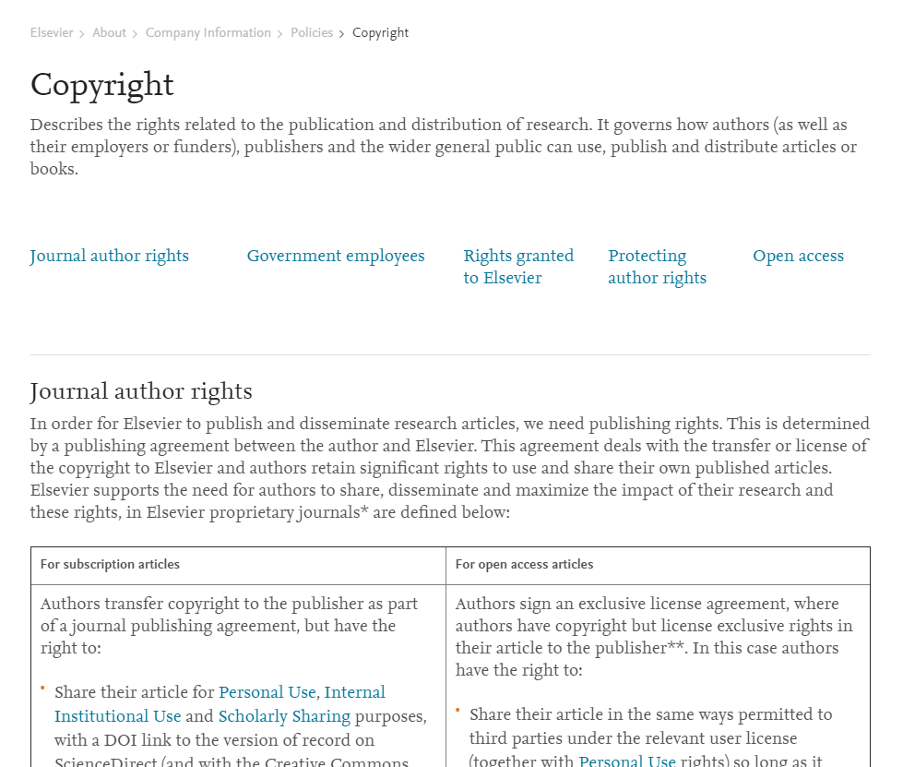
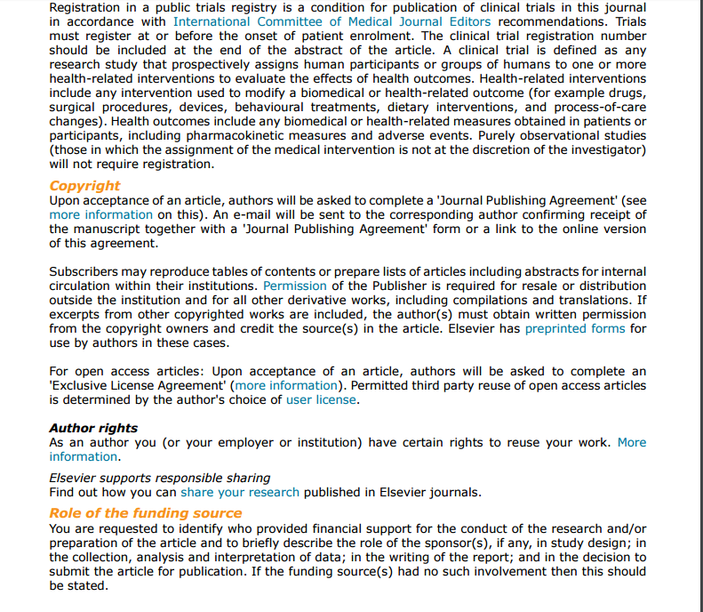
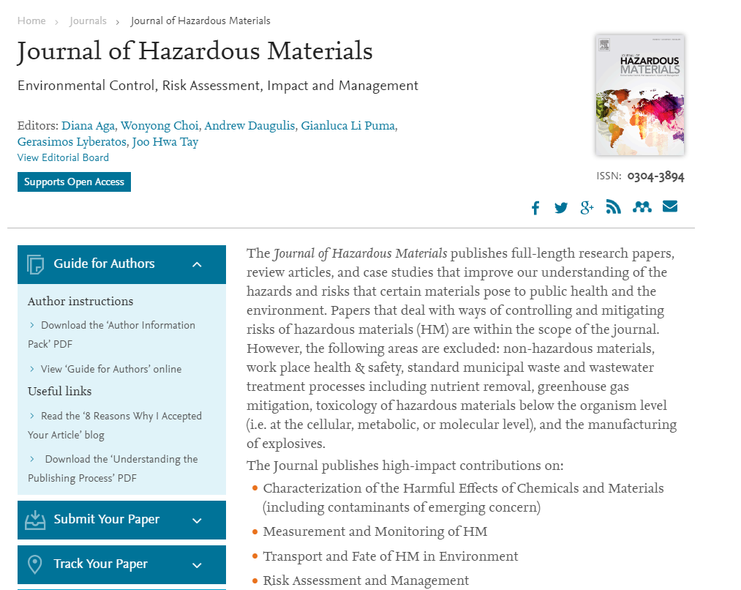
Websites

Slide 41
Negotiation tips
Determine what matters to you
E.g. Reusing images; depositing in a repository, etc.
Engage in back and forth with publisher/ editor
Send an email ; provide an addendum ; strike out material, etc.
Same as negotiating for any other matter
e.g. mortgage, car etc.
Negotiation Resources
Arizona State Negotiation Guide
SPARC author addendum
Science Commons sample addendums
Quilter, Laura, "2I Negotiating Author Agreements" (2015). New England Copyright Boot Camp. Paper 14. http://scholarworks.umass.edu/cbc/14
Notes:
Negotiating these contracts is an option although it’s perhaps more common if you’re publishing a book than an article. If you’re interested in trying to engage with the publisher the above resources and tips are available to you.

Slide 42
See the guide! http://libraryguides.mcgill.ca/authorrights

Slide 43
FAQs
The lead author signed the agreement without telling me about the license conditions. Am I bound to those conditions?
What if I want to do something that’s not permitted by my agreement?
What if the copyright transfer agreement doesn’t match what’s on the publisher’s website?
What happens if I breach the agreement?

Slide 44
Additional points to consider
Funding and author requirements
E.g. Tri-Agency Open Access Policy on Publications
Grant recipients must make any peer-reviewed articles open access within12 months of publication.
CTAs often change - keep your copy!

Slide 45
Questions?

Slide 46
WORKSHOP FEEDBACK & EVIDENCE FROM OUR RESEARCH

Slide 47
Participant Feedback
Participants tended to be mostly PhD students, postdocs and ECRs, but some more experienced faculty too
From a wide cross-section of disciplines
Across the board, they said they found the CTAs very difficult to understand

Slide 48
Is this just anecdotal? We investigated
To what extent do authors understand the terms of publisher policies as expressed in publishers’ copyright transfer agreements (CTAs), taking into account such factors as the authors’ disciplines, publishing experience and the wording and structure of these agreements?

Slide 49
Online survey experiment:
Distributed to corresponding authors of academic research articles indexed in Scopus.
Participants randomly assigned to read one of two CTAs and were subsequently asked to answer a series of questions about these agreements to determine their level of comprehension.
Basic demographic information as well as information about participants’ previous publishing experience was also collected.

Slide 50
Results
Overall scores:
33% likely to answer correctly to questions about Agreement X
34% likely to answer correctly to questions about Agreement Y
(about the same as if they had chosen answers at random!)
No variable affected ability to respond correctly:
Discipline
How many papers published
Even if they had published with that publisher previously!

Slide 51
Education does help
Workshop participants reported feeling much more confident in their ability to assess & understand CTAs post-workshop. They particularly valued:
Defining common terminology (exclusive vs. non-exclusive, etc.)
Distinguishing among different versions of the paper (pre-print, accepted)
Knowing to look for capitalized terms
Being proactive about what rights you want to keep
Being aware of sneaky rights grabs

Slide 52
So is there such thing as a better (or worse) CTA?
Maybe. In our research, there was some variation between agreements for individual questions:
Respondents were more likely to answer the questions correctly if the specific activity they wanted to undertake was mentioned.
If it was unclear whether an activity was permitted, respondents often assumed permissions

Slide 53
Questions the authors were less likely to answer correctly:

Slide 54
Q. According to the agreement you just viewed, you can post which version of the article to which of the following sites without seeking further approval or information: Social networking sites (e.g. ResearchGate, Academia.edu, etc.) (Possible responses: Publisher version; Accepted version; Submitted/Prior Version; Not permitted for any version, Unclear which version).
“Prior versions of the article published on non-commercial pre-print servers like arXiv.org can remain on these servers and/or can be updated with the author’s accepted version. The final published version (in PDF or HTML/XML format) cannot be used for this purpose.”
(Roughly 80% of respondents said Publisher Version, Accepted Version or Submitted/Prior Version)

Slide 55
Questions the authors were more likely to answer correctly:

Slide 56
Q. According to the agreement you just viewed you can post the article in a course management system.”
(Possible responses: Yes, absolutely; Yes, with conditions; No; Unclear):
“Electronic posting of the Final Published Version in connection with teaching/training at the Contributor’s company/institution is permitted subject to the implementation of reasonable access control mechanisms, such as user name and password.”

Slide 57
Q. According to the agreement you just viewed, you can post which version
of the article to which of the following sites without seeking further approval
or information: Institutional repository.”
(Possible responses: Publisher version; Accepted version; Submitted/Prior Version; Not permitted for any version)
“Authors may self-archive the author's accepted manuscript of their articles on their own websites. Authors may also deposit this version of the article in any repository, provided it is only made publicly available 12 months after official publication or later.”

Slide 58
“It would help if they discuss…more details and with easier language specific examples of the things that actually researchers do.”

Slide 59
What authors actually want to do with their work:
Post on their personal website
Deposit in an IR (esp. to fulfill Tri-Agency and other funder OA requirements)
Republish in a book
Include articles (at various stages) in thesis
Sharing to social networking sites (Researchgate, Academia.edu, etc.)
Use for teaching duties (emailed, put on an institutional intranet, distributed in a coursepack)
Retain rights to supplemental materials: data, illustrations, photography, etc.

Slide 60
Be aware (beware?) of unanticipated rights grabs
“Supplemental Materials” shall mean materials published as a supplemental part of the Article, including but not limited to graphical, illustrative, video and audio material. With respect to any Supplemental Materials that I submit, the Copyright Owner shall have a perpetual worldwide non-exclusive right and license to publish, extract, reformat, adapt, build upon, index, redistribute, link to and otherwise use all or any part of the Supplemental Materials in all forms and media (whether now known or later developed), and to permit others to do so.

Slide 61
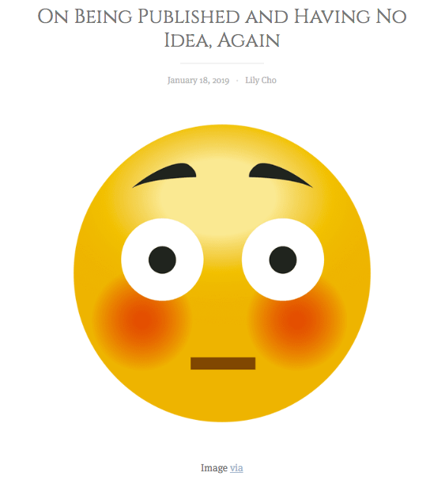
https://hookandeye.ca/2019/01/18/on-being-published-and-having-no-idea-again/

Slide 62
Some ideas for improvement
Explicitly anticipate the most common activities that authors care about: (e.g "You may not post to ResearchGate"; rather than “you may post to electronic websites that are non-commercial in nature.”)
Plain language to the extent possible
Have a clear defined terms section
Include relevant information in the CTA or as an appendix - e.g. have an embargo period? List it in the text!

Slide 63
THANK YOU! WHAT DO YOU THINK?

Slide 64
What do you think?
Are there educational initiatives or approaches you think are particularly helpful?
What elements do you think can improve a CTA?
Type your answers into the Q&A or the Google Doc:
https://docs.google.com/document/d/1bDfzvOO6t9F-gKFskCbpEye5uKsRbuxg1hvUrp8Q8cA/edit?usp=sharing

