Slide 1
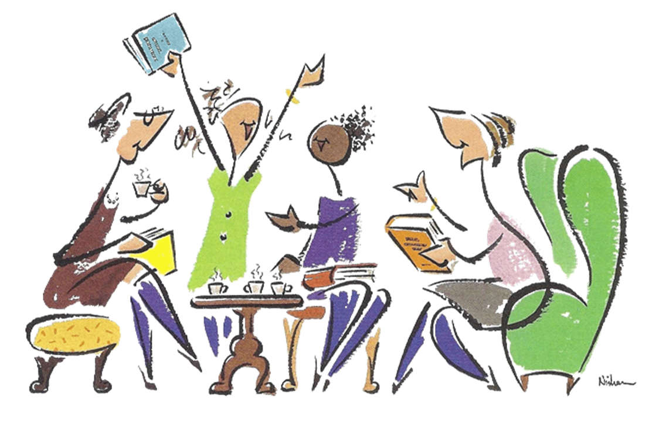
Reading for Resilience: Bibliotherapy lights the road to recovery for mental health patients
Sharon Bailey¹ , MI, AHIP
Sandy Iverson², MEd, MLIS, Psychotherapist
Carolyn Ziegler² , MA, MIS
¹ Centre for Addiction & Mental Health, Toronto
²St. Michael’s Hospital, Toronto

Slide 2
Overview
What is Bibliotherapy?
Brief History
Types of Bibliotherapy
Exploring effectiveness
Bibliotherapy @ St. Mikes
STAR Program
Psychiatric In-Patients
Evaluation
Image by Robert Burdock; CC. 2.0 [https://www.flickr.com/photos/robaround/5274209090]

Slide 3
Books and reading as “Medicine for the soul”

Slide 4
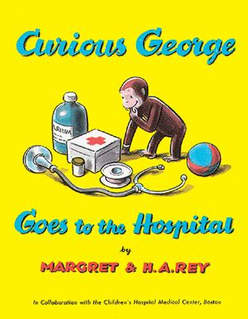
READING
to assist in the process
of coping with life

Slide 5
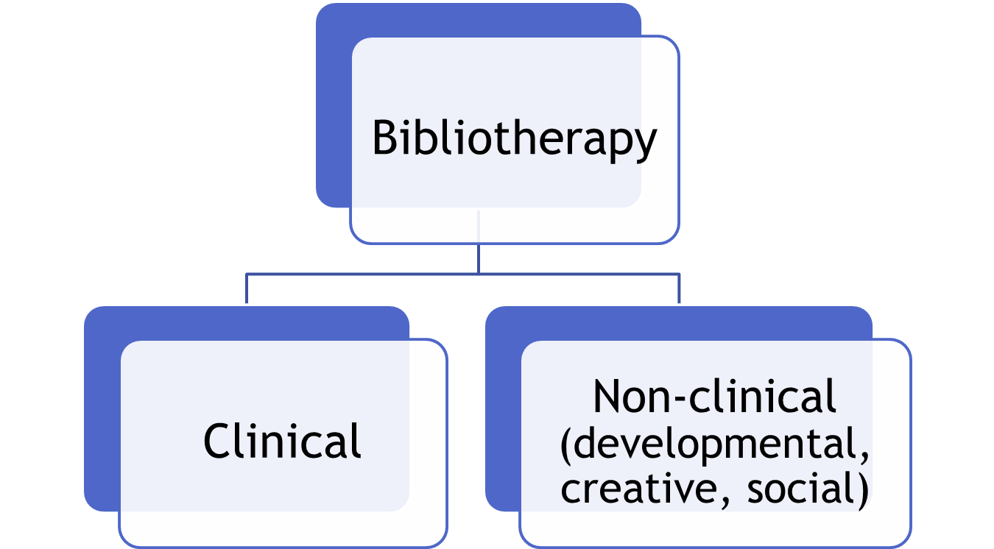

Slide 6
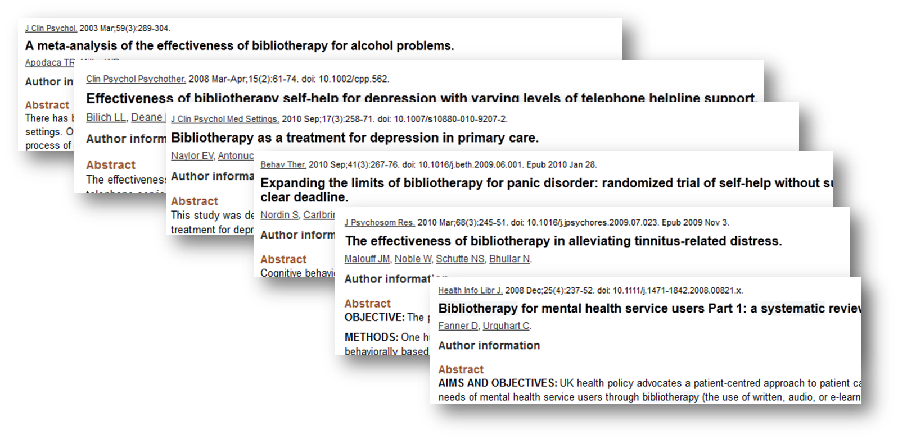
Is it effective?

Slide 7
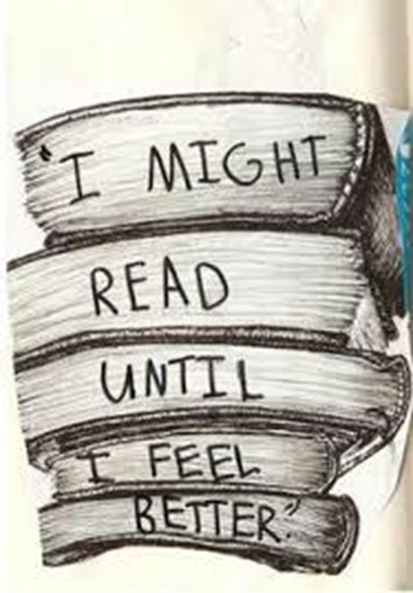
Transformational
power
of
words

Slide 8
Image Source: Front. Hum. Neurosci., 01 October 2010 | https://doi.org/10.3389/fnhum.2010.00168
Re-wiring our experience through reading

Slide 9
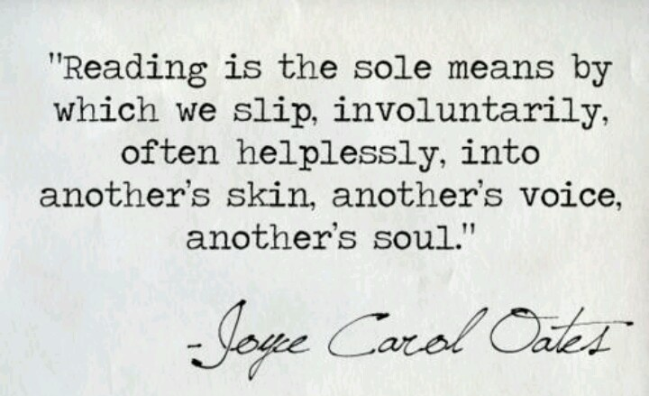

Slide 10
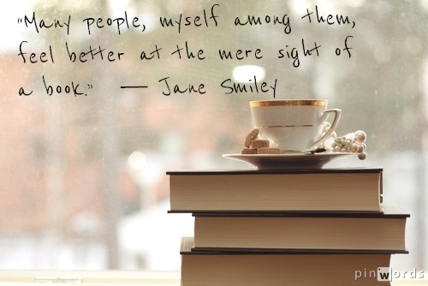

Slide 11
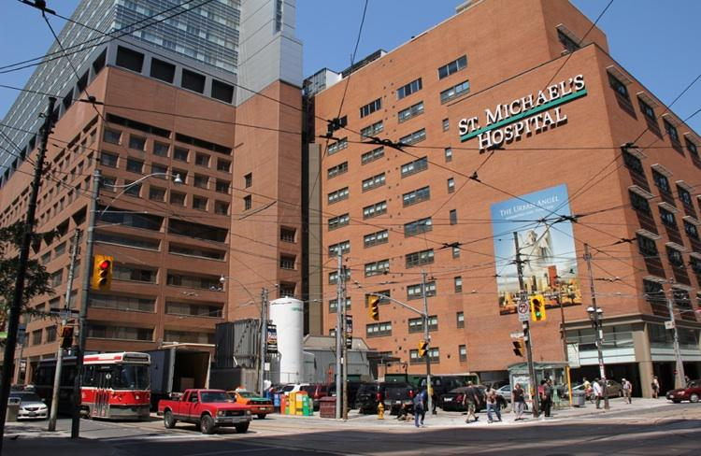
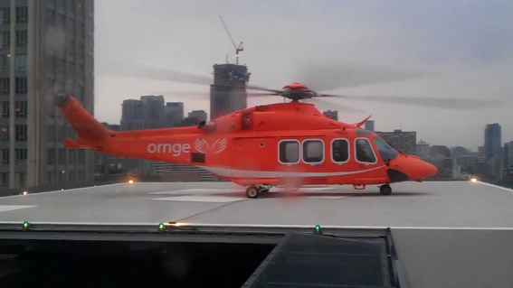
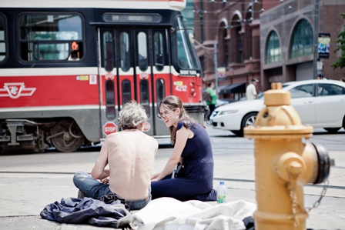
St. Michael’s Hospital
Inner city hospital
5000 + staff
Trauma & critical care
Inner city health
Research

Slide 12
Shared Reading Group Session
Read-aloud activity
Guided group discussion
Closure
Check-in

Slide 13
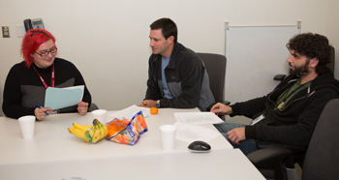
Supporting Transitions and Recovery
(STAR) Learning Centre
The STAR Learning Centre was the first initiative of St. Michael’s Urban Angel Fund for Homeless People.

Slide 14
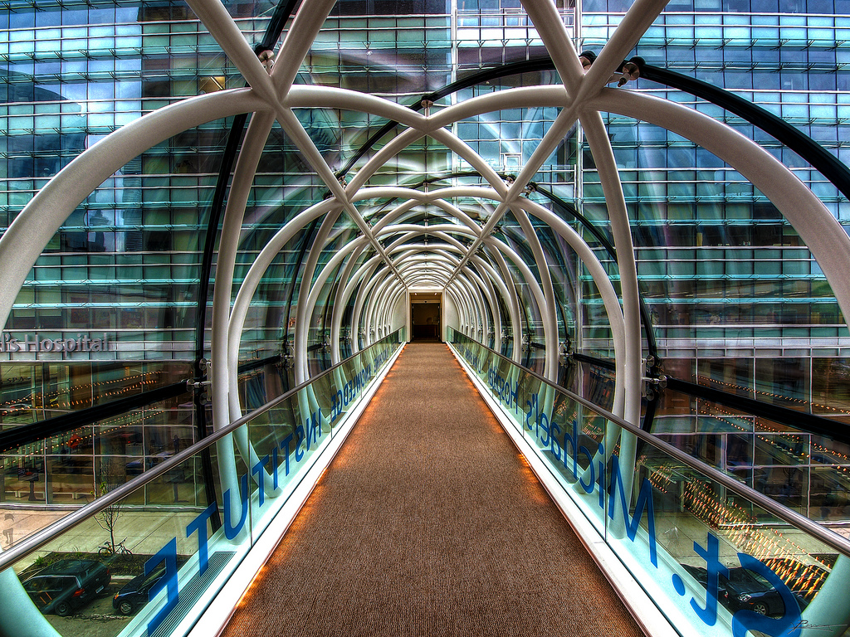
Reading for Resilience – Working with psychiatric in-patients

Slide 15
Participants explore their own problems
through discussing themes in literature
[Loneliness]
[Responsibility]
[Gratitude]
[Resilience]
[Courage]
[Forgiveness]
[Positive thinking]
[Love & Giving]

Slide 16
Participant Evaluative Feedback
I am very impressed with the selection of poems and essays.
I enjoyed being a part of the group. It was nice and the readings were warm. I feel at peace with much of my past. I’m lucky I have so much love in my life, both at home and here at St. Mikes. Thanks for your time.
Very enjoyable topics.
Thank you. Awesome! Forgiveness, gratitude and appreciation is great.
I enjoyed the readings. It was a good time. I would like topics of depression and tackling challenges.

Slide 17
Reflective Evaluation

Slide 18
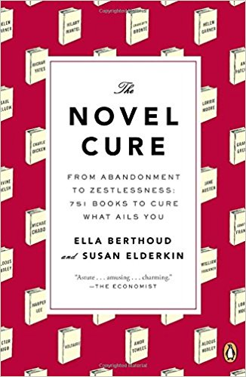
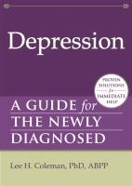
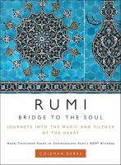
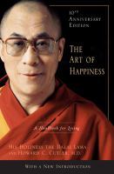
Material selection

Slide 19
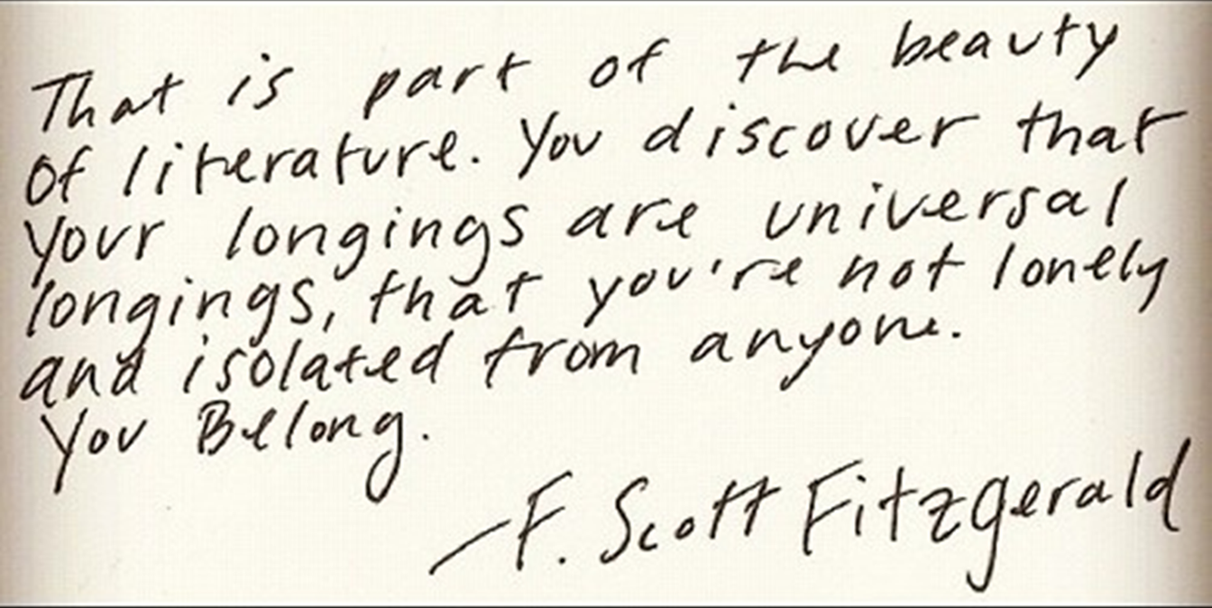

Slide 20
References & Further Reading
“About | Reading Well”. Reading-well.org.uk. N.p., 2017. http://reading-well.org.uk/about
Berthoud, Ella, and Susan Elderkin. 2013. The novel cure: an A-Z of literary remedies.
Davis J. Enjoying and enduring: groups reading aloud for wellbeing. Lancet. 2009 Feb; 373:714-5.
Gold, J. Read for your life. Toronto (ON): Fitzhenry & Whiteside; 2001.
Gold, J. The story species: Our life-literature connection. Toronto (ON): Fitzhenry & Whiteside; 2003.
Hodge S, Robinson J, Davis P. Reading between the lines: The experiences of taking part in a community reading project. J Med Ethics. 2007: 33:100-104.
McCulliss, D. 2012. “Bibliotherapy: Historical and research perspectives” Journal of poetry therapy. Vol. 25.
Tukhareli N. Healing through books: The evolution and diversification of bibliotherapy. Lewiston (NY): Edwin Mellen Press; 2014.

