Slide 1
Open Educational Resources in Higher Education and the Role of the Academic Library
Presentation for University of Alberta Libraries, May 28, 2014
Michael B. McNally
Assistant Professor, School of Library and Information Studies
University of Alberta
mmcnally@ualberta.ca

Slide 2
Outline
Brief overview of OER
Librarians’ role in OER
Advocacy and promotion
Locating
Evaluating
Disseminating
Copyright and licensing help
OER creation considerations

Slide 3
Defining Open Educational Resources (OER)
Term “Open Educational Resources” coined at a 2002 UNESCO conference (http://portal.unesco.org/ci/en/ev.php-URL_ID=2492&URL_DO=DO_TOPIC&URL_SECTION=201.html)
OER defined as, “the open provision of educational resources, enabled by information and communications technologies, for consultation, use and adaption by a community of users for non-commercial purposes”
OECD in Giving Knowledge for Free (2007) (http://www.oecd-ilibrary.org/education/giving-knowledge-for-free_9789264032125-en) defined OER as:
“digitised materials offered freely and openly for educators, students and self-learners to use and reuse for teaching, learning and research”

Slide 4
Openness and the Academy
OER include:
Open Course Ware (OCW)
Open Textbooks
Conference and research presentation materials
Assessment materials
Educational audio/visual material
Individual learning objects
Research (Output) :
Open Access Publishing
Teaching:
Open Educational Resources
Research (Input) :
Open Data
Technology:
Open Source Software

Slide 5
More than Content
Content not the only facet of OER
Also includes tools for creation and distribution and implementation resources (such as licensing systems)
Library has a particularly important role to play in the areas of tools and implementations resources
OER discussions should also be focused on both sides of the equation – use and creation

Slide 6
Institutional Benefits
MIT (2009) reports numerous institutional and community benefits to its OCW initiative:
Global use – 54% of OCW traffic is non US
Recruitment – 35% of freshmen aware of the OCW initiative were influenced to attend MIT because of it
Little impact on class levels – fewer than 4% of participating faculty report drops in in-class attendance
Positive student experience – 94% of MIT students say OCW has positively impacted student experience
MIT, (2009), 2009 Program Evaluation Findings Summary, http://ocw.mit.edu/ans7870/global/09_Eval_Summary.pdf

Slide 7
OER and Academic Libraries
Libraries and librarians have several roles to play in relation to OER
Advocacy and promotion
Assist in locating OER
Instruct on evaluating OER
Disseminate OER
Address copyright and licensing concerns

Slide 8
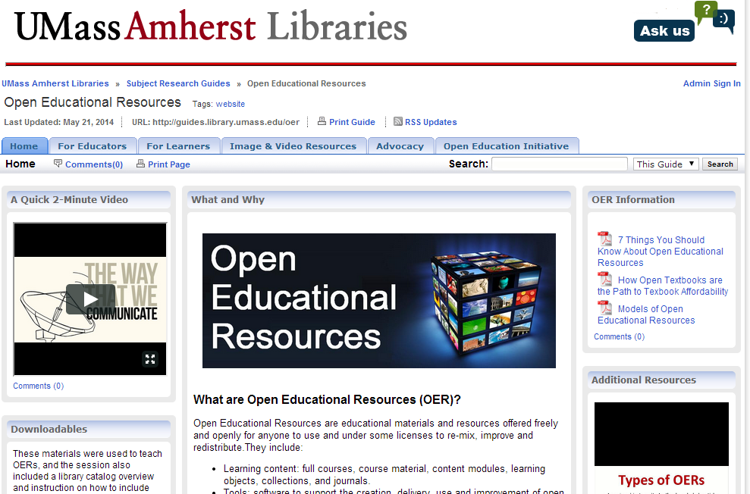
OER Lib Guides
Niagara College http://nclibraries.niagaracollege.ca/oer
Mohawk College http://mohawkcollege.ca.libguides.com/Learningobjects
Algonquin College http://www.algonquincollege.com/oer/oers.htm
UMass Amherst http://guides.library.umass.edu/oer
Arizona State University http://libguides.asu.edu/OEResources
Washington State University http://libguides.wsulibs.wsu.edu/content.php?pid=444272&sid=3638617
Eastern Michigan University Library http://guides.emich.edu/content.php?pid=521731&sid=4292801

Slide 9
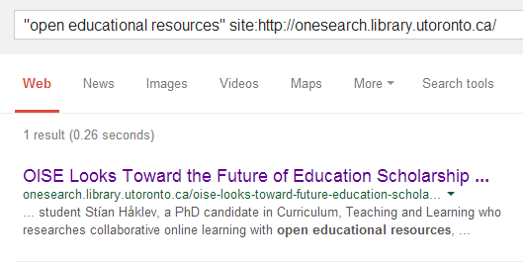
Canada’s Big 4 and OER
Not much from Canada’s leading university libraries on OERs

Slide 10
OER Advocacy and Promotion
OER align with other ‘open’ movements, particularly open data, open source software, and open access
Open Education Week is in early March
Serials pricing crisis is mirrored by a textbook pricing
78% of undergrads report not purchasing a required course textbook due to cost (Billings et al. 2012)
UMass Amherst calculates that its OER initiative has resulted in an average savings of $128 per student per course (Billings et al. 2012)
Notes:
78% of undergrads report not purchasing a required course textbook due to cost (Billings et al. 2012)
UMass Amherst calculates that its OER initiative has resulted in an average savings of $128 per student per course (Billings et al. 2012)
Billings, M.S., et al. 2012. “Open Educational Resources as Learning Materials: Prospects and Strategies for University Libraries” Research Library Issues, Sept 2012, p. 2-10.

Slide 11
Locating OER
General OER Repositories, Directions and Search Engines:
Open CourseWare Consortium: http://www.ocwconsortium.org/
OER Commons: http://www.oercommons.org/
Google OCW/OER Search: http://www.google.com/cse/home?cx=000793406067725335231%3Afm2ncznoswy
iTunes U: http://www.apple.com/education/itunes-u/
Multimedia Educational Resource for Learning and Online Teaching: http://www.merlot.org/merlot/index.htm?action=find
There are also numerous subject/discipline repositories, national repositories, institutional repositories and other OER sources

Slide 12
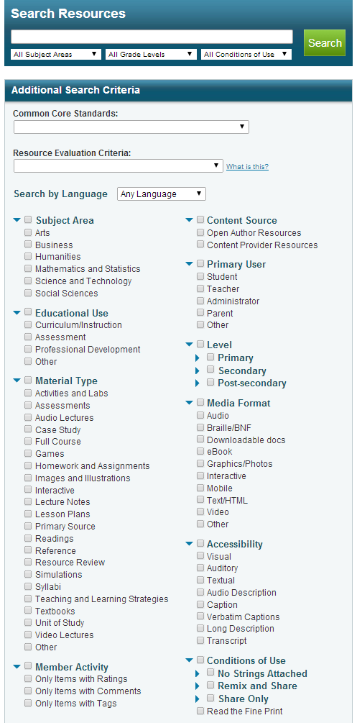
Locating OER and IL
Some OER repositories have very well developed search functionality
These could possibly serve as a platform for some instruction on searching/search skills
OER Commons Advanced Search

Slide 13
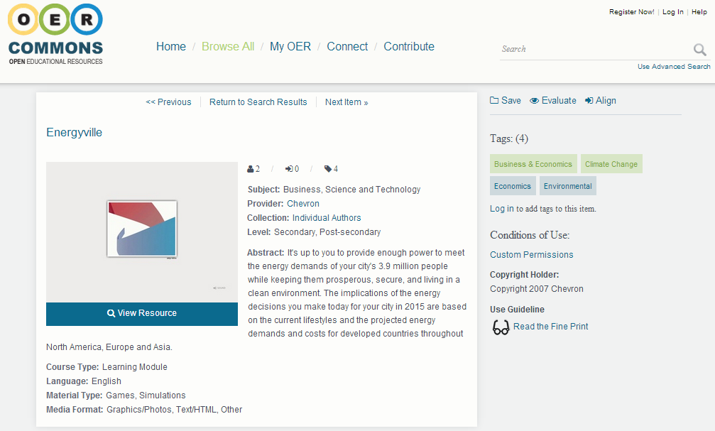
Evaluating OER
Librarian expertise on evaluating information sources is also relevant to OER
Even top quality repositories have resources that range considerably
For example the Energyville OER suffers from some bias as its creator is Chevron

Slide 14
Disseminating OER
Institutional Repository is a key element of the library’s role in OER
Maximizing the potential of the repository includes
Encouraging deposit
Ensuring high quality metadata
Making repository content discoverable
Getting in into the catalogue/discovery system
Getting index by search engines and/or linking it to other OER repositories
OER from a local institutional repository come with one huge benefit from the potential of faculty – guest speakers

Slide 15
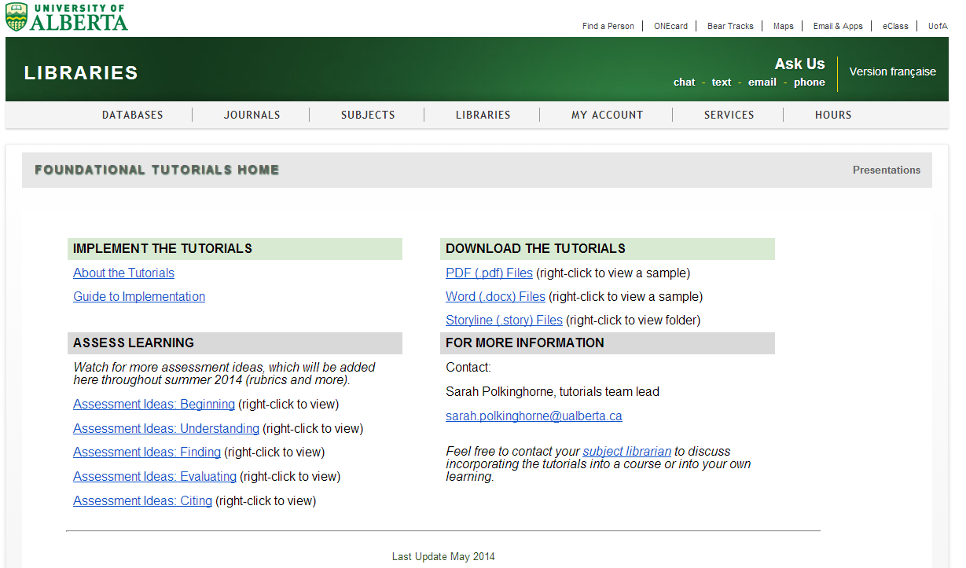
Library as Model OER User/Creator
Librarians are already great at sharing – and as such we make great model users

Slide 16
Copyright and Licensing Instruction
Concerns over copyright and licensing are one of the biggest barriers to use and creation of OER
Numerous issues including:
Lack of knowledge/understanding of copyright
Lack of understanding on copyright exceptions – particularly de minimus use and fair dealing
Lack of knowledge/understanding on licensing
Challenges in working with materials with various licenses
Institutional exceptions to copyright may not exist elsewhere
There are specific copyright exceptions for educational institutions in Canada
National differences in fair dealing/use

Slide 17
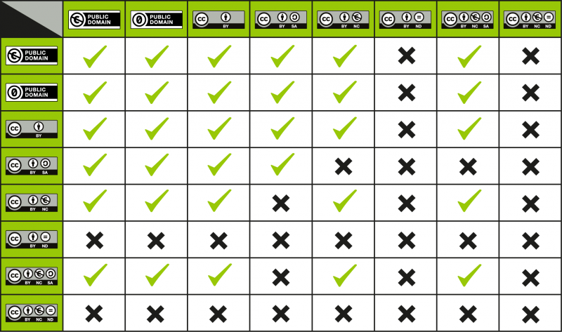
Copyright and Licensing Instruction
At a minimum libraries can point to Creative Commons compatibility tables (found in the Creative Commons FAQ - http://wiki.creativecommons.org/Frequently_Asked_Questions)
Creative Commons Compatibility Table

Slide 18
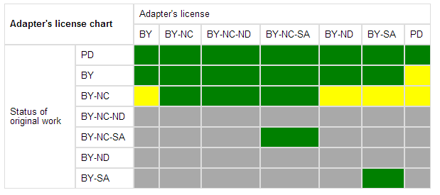
Copyright and Licensing Instruction
Libraries can also encourage OER creation with more permissive licenses (or even surrender to the public domain)
Libraries should also play a role in insuring institutional copyright policies are up-to-date and reflective of current law and jurisprudence
Creative Commons Adapter’s License Chart

Slide 19
Creating OER
Even though extensive OER exist, there are still gaps to be filled
OER are best developed collaboratively
Ask for feedback from both peers and students
Seek institutional support for both space to publish materials and recognition for OER work
Be mindful of copyright and other intellectual property rules as well as privacy policies and legislation

Slide 20
Creation Considerations
As an OER creator you have two means to control how open the resources is:
The licensing terms, and
The format of the file(s)
Surrender to the public domain, a CC Attribution (CC BY) license, and a CC Attribution, Share-Alike (CC BY-SA) licenses grant other users the greatest amount of freedom
Editable file formats (such as HTML, RTF and PNG) allow for much easier modification, while formats such as PDF fetter alteration
Logically, if the license allows modification of the OER, it makes sense to disseminate the file in an editable format

Slide 21
Creation Considerations
Consideration should also be given to proprietary file formats – many users may not be able to use the most current versions of major commercial software
Hyperlinks are most useful when they are both linked and have the URL provided as potential users may print materials rather than use them in electronic form
Large fonts, captions for audio materials and clear contrasts between colours make works more accessible
Localized or obscure cultural references, slang and neologisms can impede learning by users who are not familiar with the author’s language and culture

Slide 22
D-III. Pedagogical Concerns
Ideally OER creation should not undermine teaching, but
In class room techniques may not necessarily translate to OER
Recording of class time for outside consumption may supress discussion
Quantitative assignments and open access readings are ideal for OER but not all classes
Designing for global audience may mean not utilizing domestic fair dealing rights

Slide 23
Feedback and License Information
Previous OER Resources
If you are interested in other OER resources I have prepared please see:
Democratizing Access to Knowledge: http://ir.lib.uwo.ca/wlevents/10/
Broadening Access to Knowledge: http://hdl.handle.net/10402/era.38224
Feedback
Feedback, including criticism, on this presentation is welcomed and can be sent to: mmcnally@ualberta.ca
References
For references to non hyper linked documents, please see the note section of relevant slides
Copyright and Licensing Information
On slide 5, the screenshot of the University of Alberta Libraries Education & Research Archive webpage originates from: https://era.library.ualberta.ca/public/home - copyright University of Alberta Libraries
On slide 8, the screenshot of the UMass Amherst Libraries OER Library Guide originates from: http://guides.library.umass.edu/oer - copyright University of Massachusetts Amherst
On slide 10, the Open Educational Resources logo originates from: http://www.unesco.org/new/en/communication-and-information/access-to-knowledge/open-educational-resources/global-oer-logo/ - used under a CC-BY 3.0 Attribution license – original author Jonathas Mellos http://www.unesco.org/new/fileadmin/MULTIMEDIA/HQ/CI/CI/pdf/Events/global_oer_logo_manual_en.pdf
On slide 12, the OER Commons Advanced Search webpage originates from: http://www.oercommons.org/advanced-search - used under a CC-BY-NC-SA 3.0 license – original author OER Commons
On slide 13, the OER Commons record page for “Energyville” originates from: http://www.oercommons.org/courses/energyville - used under a CC-BY-NC-SA 3.0 license – original author OER Commons
On slide 15, the University of Alberta Libraries Information Literacy Tutorials Supplementary Materials webpage originates from: http://www.library.ualberta.ca/tutorials/supplementary/index.cfm - copyright University of Alberta Libraries
On slides 17 and 18, the two Creative Commons License Compatibility tables originate from: http://wiki.creativecommons.org/Frequently_Asked_Questions - used under a CC-BY 4.0 license - original author Creative Commons

