Slide 1
Good morning! As you settle in….
Begin to think about:
What do you already know about “Active Learning”
What do you want to learn about “Active Learning”
Connect to wifi (Guest@UofA), open up a browser and type in:
kahoot.it (we will use this later)
Log in to your (or create a) Twitter account
Hashtags for this morning’s work: #activelearning #WILU2017

Slide 2
Active Learning Bootcamp
WILU 2017
Carla L. Peck, Associate Director (Curriculum)
Centre for Teaching & Learning
carla.peck@ualberta.ca
@cpeck3 on Twitter

Slide 3
Today’s Plan
What is Active Learning?
Why should I build Active Learning strategies into my teaching?
Looking closely at some Active Learning strategies (and how technology can be integrated into some strategies)
Selecting and personalizing Active Learning strategies

Slide 4
Let’s get active!
Get into groups of 5 or 6 people
Choose a piece of chart paper (on the wall) as your starting point.
Discuss the question and write down 1 or 2 answers (can be point form).
In 90 seconds, move to the next piece of chart paper and repeat the process.

Slide 5
What is Active Learning and why should I use it?
“Active learning is a process whereby students engage in activities, such as reading, writing, discussion, or problem solving that promote analysis, synthesis, and evaluation of class content.” – University of Michigan CRTL (http://www.crlt.umich.edu/tstrategies/tsal)
Responsibility for learning is transformed from a one-way responsibility (“the teacher teaches me so I should learn”) to a two-way responsibility (“the teacher teaches me but I also need to actively engage in order to understand and learn.”)
Promotes higher-order thinking (beyond content memorization)

Slide 6
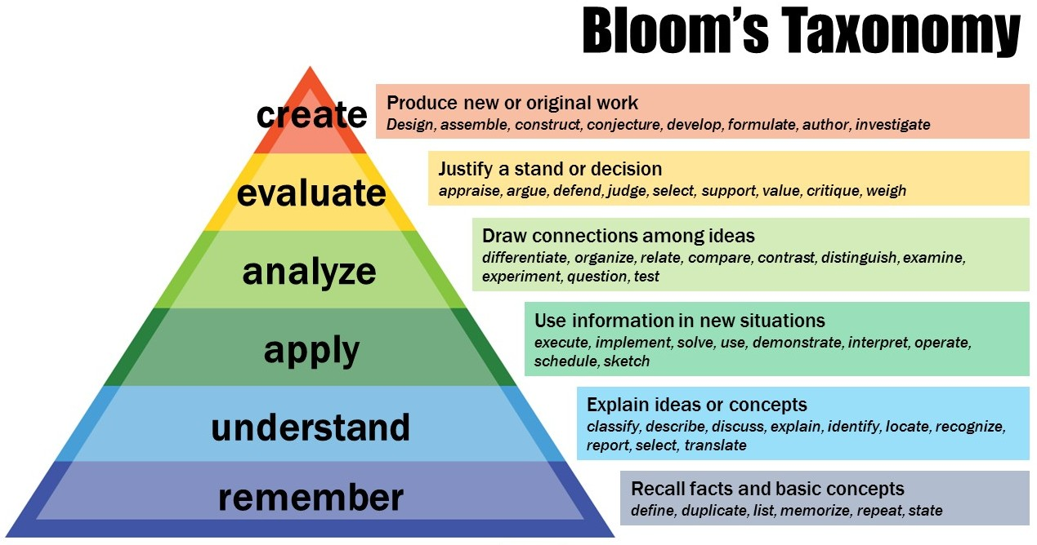

Slide 7
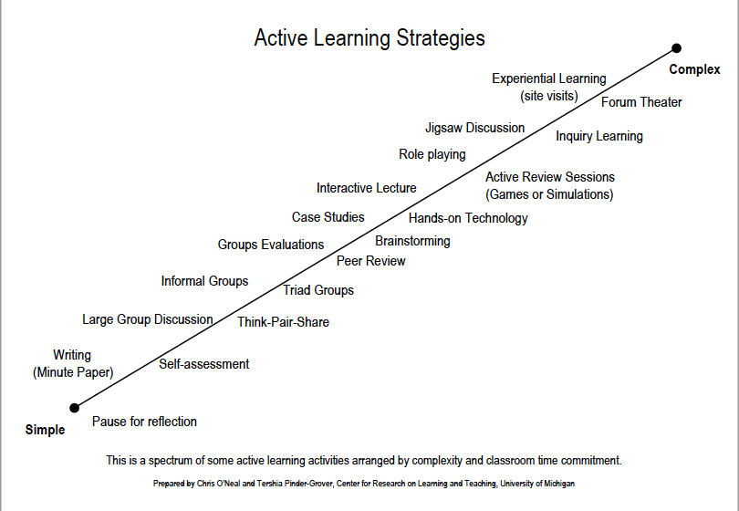

Slide 8
At the BEGINNING of a lesson: Assessing & activating prior knowledge
Pedagogical benefits:
When done at the beginning of a new unit of study/course, this activates students’ prior knowledge of a topic or concept (VELCRO)
By revealing students’ prior knowledge, instructor can assess students’ thinking – areas of strength, but also misconceptions, naïve conceptions
Promotes meta-cognition: students’ thinking about their thinking

Slide 9
“The most important single factor influencing learning is what the learner already knows. Ascertain this and teach him [sic] accordingly.”
(Ausubel, 1968, p. vi)

Slide 10
Strategies to Assess & Activate Students’ Prior Knowledge
3-2-1: List 3 things you already know about the topic, 2 things you’d like to know or learn more about, and 1 question related to the key concept.
KWL Chart: 3 column chart: What I KNOW, what I WANT to know, What I’ve LEARNED. Students fill in first 2 columns at the beginning of the lesson and the last column at the end of the lesson.
Carousel Brainstorming: Place chart paper around the room, each one with a different question or prompt on it. Distribute students in small groups (3-4 per group) to each piece of paper. Students discuss and respond to prompt. After a few minutes, all students circulate to next paper.

Slide 11
Think-Pair-Share: Pose a question or topic to class. Give students 1-2 minutes to THINK about the question/topic, then have them PAIR up and SHARE their ideas. Variations: Think-Pair-Write, Think-Write-Share.
4 Corners: Have 4 topics, questions, or answers posted in 4 corners of classroom and have students move to one based on a prompt.
Concept Mapping: Have students make a simple concept map to identify everything they know about a topic. Return to concept map at the end of the lesson so students can refine their thinking based on new knowledge.
Can use text and drawings.
Can be done individually or collaboratively.
Can be more complex, using lines between map bubbles to explain connections.

Slide 12
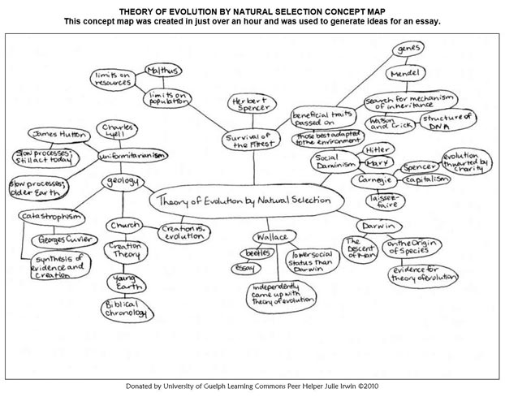
Simple Concept Map

Slide 13
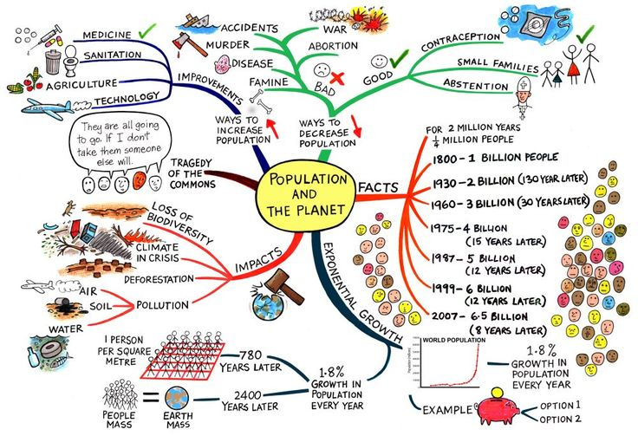
Complex Concept Map

Slide 14
Application (5 minutes)
Identify one lesson or workshop where you could integrate one of these quick strategies to assess learners’ prior knowledge.
Which strategy will you use?
How will you implement it?
How will their responses inform what you do next?

Slide 15
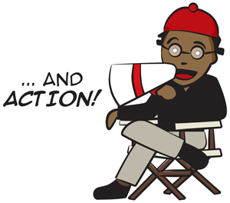
Active learning strategies to use DURING a lesson
When done mid-way or near the end of a unit of study, can assess students’ understanding of major course concepts/topics.
Role play: Group students into groups of 2-4 people and have them role play a scenario related to what you are teaching them.
For example: Person 1 approaches Person 2 to ask for help researching a topic. Person 1 has to use their understanding of library research to teach/demo Person 2 how to do it.
Take 90 seconds to brainstorm with your table-mates other topics students could role play.

Slide 16
Pro- and Con- Grid: Students list advantages and disadvantages of any issue or topic (can be done individually or in groups). This helps students think critically about the topic and pushes them to go beyond their initial reaction. For example: What are the pros and cons for students (or instructors) of a university using plagiarism-checking software?
Modeling Skills: Similar to Role Playing but may be less formal. You model a skill to students and then have them practice the skill with a partner. Break skills into small pieces throughout the lesson – save time at the end to put all of the pieces together and have students work through the entire skill.
One-Minute Paper: Have students respond to a prompt and tell them they have one minute to write a response. You can provide paper (or students use their own paper), or you could do this in a Google Doc.

Slide 17
Skits: Give groups of students a topic or issue that you’ve been working on and tell them they have to act out in a 2 minute skit. Give them 5-7 minutes to plan their skit, 2 minutes to do it, and then other students have to guess the topic or issue.
Placemat Activity: Good for problem-solving and consensus building. Students work in groups of 4 to consider an issue and write their individual response on the outside of the placemat, then work together to come to consensus – which is what is written in the middle.
Games: Create a game for students to play to learn some of the content or skill you want them to learn! For example:
Webquests: http://webquest.org/search/index.php
Why do I need to learn this? I already know how to search.

Slide 18
At the END of a lesson: Assessing learning & promoting meta-cognition
Enables you to assess student learning. Encourages students to internalize their learning.
“Ticket out the door”:
Similar to the “one minute paper” idea, except this happens at the end of the class.
Students have to give you their “ticket” to “get out the door”
Can be anonymous – some advantages to this
Ask students to write down, on a piece of paper, something you want to know:
What was the most surprising thing you learned in today’s class and why did it surprise you?
How has your thinking about ______ changed or grown?
How would you explain ______ to someone else?
What topics did you find confusing or difficult to understand?
List 3 ways this topic is relevant for society today.

Slide 19
At the END of a lesson: Assessing learning & promoting meta-cognition
Let’s play Kahoot! GO TO: kahoot.it
Kahoot is a web-based game much like what you play at the movies (if you go to the movies!)
All you need is a web browser to play
Video tutorial, https://getkahoot.com
Active Learning Kahoot

Slide 20
Application
What Active Learning Strategies will you try?
Identify one Active Learning strategy that you could use at the beginning, middle, and end of a class.
Start to map out what you will do.
Get ready to share your ideas with us!

Slide 21
Final Thoughts
IMPORTANT:
Be willing to try things more than once – you and your students will need time to learn how to use these strategies.
Investing time at the start of the term to incorporate these strategies into your teaching will pay off in dividends during the rest of the term:
More active classes
More engagement for everyone!
Deeper learning, that is both challenging & meaningful
Think about how you can collaborate with your colleagues to support one another! Start a shared Google Doc folder!

Slide 22
Active Learning Bootcamp
WILU 2017
Carla L. Peck, Associate Director (Curriculum)
Centre for Teaching & Learning
carla.peck@ualberta.ca
@cpeck3 on Twitter

