Slide 1
Insights from the Performing Arts for Information Professionals who Teach
Sarah Polkinghorne, University of Alberta
sarah.polkinghorne@ualberta.ca

Slide 2
Today
Teaching=Entertaining?
Physicality
Defining the Situation
Extemporizing
Acting
Scripts
Please pose questions and comments any time.
Content: food for thought; modest side of tips ‘n’ tricks.
Notes:
This session is about food for thought, ways of thinking and habits of mind that you might apply to your instruction work.
Focus here is on face-to-face instruction, with some thoughts on online teaching and learning toward the end.

Slide 3
A bit about me
Practice
Subject librarian for Art & Design, Drama, Psychology
Teaching
Workshops, seminars, [many, many, many] “one-shots”…
SLIS: Instructional Strategies for Information Professionals
Research
Librarians’ teaching experiences; teaching as performance
Background
MLIS, Library & Information Science
MA, Drama; BA (Hons.), Theatre & English
Notes:
Reference, consultations, collections
Teaching: course-specific instruction; SLIS teaching
Research: librarians teaching is a complex phenomenon – what actually happens between a librarian and a group of learners in a classroom?
Background: Dramaturgy, directing, stage management
(Side note: this sort of slide is useful if you’re ever teaching via a webinar.)
First we’ll focus on a way of thinking that is quite influential around us today: the equation of teaching with entertaining.
Isn’t a good teacher the one who can stand at the front of the class and entertain?

Slide 4
Librarians as performance artists “Libraries have to compete.” We hear it often enough: Bookstores, Google, coffee shops… There are many resources that draw the attention of our students (cell phones/text messaging, Facebook/MySpace, sleep), and we have to work harder to get them to come to us. But getting them to the library is just the beginning. So we have to compete! Be more interesting, more compelling than anything else in the students’ vicinity. And change perspectives; they are not your students: They are your audience. Audiences demand entertainment. It’s no longer enough to be a knowledgeable teacher with a strong instructional paradigm. You must also be a performer, captivating students with wit, creativity and charisma. Join an [academic] librarian as he shares instructional strategies that incorporate skills developed from stand-up and improv comedy to turn instruction sessions into entertaining workshops that keep student attention. And learn what happened when he began teaching “performance skills” workshops for librarians that are designed to encourage them to abandon traditional approaches to interacting with groups, tap their creativity, and rely more on their wits. If you’re looking for new ways to beat the competition, thinking about releasing your inhibitions and embracing your inner “theatre geek”, or want to polish your own performance skills, check out this exciting and hilarious session and go home with a grin! You’ll discover a new sense of fun, make your students laugh a little, and add some silliness to a profession that can take itself a bit too seriously.
Teaching=Entertaining?
Physicality
Defining the Situation
Extemporizing
Acting
Scripts
http://www.loexconference.org/2009/program/sessions.html
Notes:
What do you make of this conference session abstract? Anything leap out at you?
What assumptions exist here about students?
What assumptions exist here about librarians and our work?

Slide 5
Librarians as performance artists “Libraries have to compete.” We hear it often enough: Bookstores, Google, coffee shops… There are many resources that draw the attention of our students (cell phones/text messaging, Facebook/MySpace, sleep), and we have to work harder to get them to come to us. But getting them to the library is just the beginning. So we have to compete! Be more interesting, more compelling than anything else in the students’ vicinity. And change perspectives; they are not your students: They are your audience. Audiences demand entertainment. It’s no longer enough to be a knowledgeable teacher with a strong instructional paradigm. You must also be a performer, captivating students with wit, creativity and charisma. Join an [academic] librarian as he shares instructional strategies that incorporate skills developed from stand-up and improv comedy to turn instruction sessions into entertaining workshops that keep student attention. And learn what happened when he began teaching “performance skills” workshops for librarians that are designed to encourage them to abandon traditional approaches to interacting with groups, tap their creativity, and rely more on their wits. If you’re looking for new ways to beat the competition, thinking about releasing your inhibitions and embracing your inner “theatre geek”, or want to polish your own performance skills, check out this exciting and hilarious session and go home with a grin! You’ll discover a new sense of fun, make your students laugh a little, and add some silliness to a profession that can take itself a bit too seriously.
Teaching=Entertaining?
Physicality
Defining the Situation
Extemporizing
Acting
Scripts
…keep student attention…
…beat the competition…
http://www.loexconference.org/2009/program/sessions.html
…abandon traditional approaches...
They are your audience.
Audiences demand entertainment.
It’s no longer enough to be a knowledgeable teacher with a strong instructional paradigm.
Notes:
Here are a few claims made by this abstract:
Keeping student attention relies on entertainment
Librarians are in a directly competitive relationship with Google
Librarians should abandon traditional approaches
Librarians should entertain students because this is what students demand
It’s no longer enough to be a knowledgeable teacher with a strong instructional paradigm. (Ouch.)
This abstract intends to be empowering and encouraging, but is actually disheartening and discouraging. Two reasons for this.
When teaching simply equals entertainment, librarians are positioned as deficient. You need to lighten up, have fun. This directly reinforces a prevalent librarian stereotype, which is that we can’t take a joke.
When teaching simply equals entertainment, we can also fall into deterministic thinking, which is: If I do this, students will be engaged. If I have the best jokes, then I have taught successfully.
Entertainment is good. Entertainment is fantastic. But we need to always be checking our assumptions and avoiding oversimplification. Because teaching is actually a very complex thing to do.

Slide 6
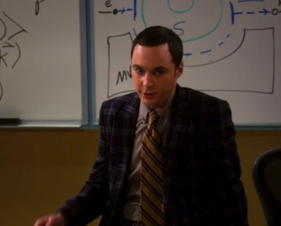
“I was expecting applause, but I suppose stunned silence is equally appropriate.” -Sheldon Cooper, The Big Bang Theory (Season 4, Episode 14, “The Thespian Catalyst”)
Teaching=Entertaining?
Physicality
Defining the Situation
Extemporizing
Acting
Scripts
http://www.sfsignal.com/archives/2011/02/the_big_bang_theory_recap_-_the_thespian_catalyst/
Notes:
There’s an episode ofThe Big Bang Theory in which the protagonist, physicist Sheldon Cooper, gives a guest lecture.
He thinks that he is so obviously a genius, and what he has to say is so obviously brilliant, and that that should be enough for students to appreciate and be grateful for his teaching.
His students are repelled by how condescending and oblivious he is.
So he takes acting lessons from Penny in an attempt to become a better teacher (Lorre and Prady 2011).

Slide 7
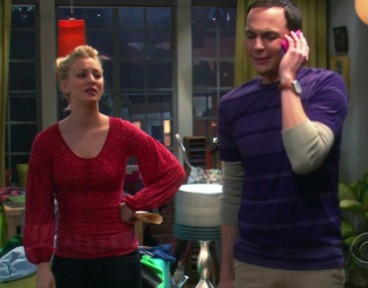
Functioning discourse: a good teacher is a successful entertainer
Teaching=Entertaining?
Physicality
Defining the Situation
Extemporizing
Acting
Scripts
http://wegotthiscovered.com/tv/big-bang-theory-season-414-thespian-catalyst-recap/
Notes:
Sheldon has an emotional breakdown as a result of getting in touch with his emotions.
So, there is a discourse at work here (a way of thinking, an assumption), which is that a good teacher is a successful entertainer. This discourse underpins the drama and dialogue in this episode.
Within LIS circles, the equation of entertaining with educating also influences concepts of library instruction.

Slide 8
Reasons to Go Beyond Teaching = Entertaining
Teaching=Entertaining?
Physicality
Defining the Situation
Extemporizing
Acting
Scripts
To make learning experiences more significant for our patrons
To tackle glossophobia (fear of public speaking)
To address instruction-related feelings of disengagement and discomfort (experienced by many librarians)
To problematize prevailing assumptions about technology’s role in high-quality instruction
Notes:
Teaching is about helping people learn things that will be significant to them. If we fixate on entertainment, we take our eye off this primary goal. Does everything that entertains you also give you a significant learning experience?
Emphasizing entertainment can actually make things worse for people who are anxious about teaching (added worry about telling jokes, etc.). Also, instruction requires more than speaking skills, and many instruction-related fears go beyond public speaking fear. There can be anxiety about fielding questions, about adapting when a session seems to be failing, or about classroom management. We need to understand the entire instructional interaction and how to thrive within that.
Many librarians report feeling uncomfortable with or disengaged from instructional work. (e.g., Julien and Peckoskie). This is a phenomenon; it has been documented. Disengagement diminishes the quality and effectiveness of the work, so this is a serious concern.
We tend to seek technological solutions to improving our instruction, as illustrated by our practitioner-oriented publications and many of the trends in instruction. This approach overlooks the fact that in face-to-face instruction, if the librarian does not present well, if the librarian gives off that she is stressed or unenthusiastic or condescending, then the potential positive impact of any technology is use is greatly diminished. Technology can also create additional stresses and inefficiencies that further alienate librarians from instructional work.
So. Teaching is not just entertaining. But teaching IS performing.
And it’s helpful to understand teaching as a performance.

Slide 9
Performance Defined
Teaching=Entertaining?
Physicality
Defining the Situation
Extemporizing
Acting
Scripts
A performance is a complex, objective-driven event that involves enacting, displaying, or presenting something for someone
Performances are made of choices
Notes:
What I mean by performance is: the action of enacting, displaying, or presenting something for someone.
Performance is not the same as acting (we’ll talk about that in a bit). What examples you can think of where a person is performing but not acting?
Note: I don’t mean performance in the sense of measurement or appraisal.
And what makes up a performance? Choices.
Every performance is a series of choices, made for different reasons (hopefully well-informed, interesting, and intentional). What to say, how to organise it, how to say it, how to move around in the room, what to wear, how to respond to questions, how to deal with the unexpected…
We constantly make choices to adjust, react, adapt on the fly. This is inherent to teaching; it can never be eliminated completely. However, choices are something we can become aware of, and think about, and change if we want to.
The following sections are different areas within which we can make choices.

Slide 10
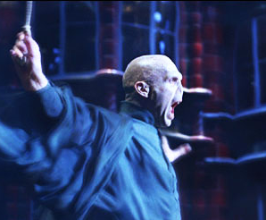
“I found little physicalities in the role, and something always happened when I put those long, flowing robes on. That’s when I felt Voldemort.” -Ralph Fiennes
Teaching=Entertaining?
Physicality
Defining the Situation
Extemporizing
Acting
Scripts
http://www.top10films.co.uk/img/voldemort1.jpg
Notes:
Here’s Ralph Fiennes speaking in an interview about playing Voldemort. What he’s talking about is the relationship between physicality and performance. The process of building his performance by figuring out its physicality: posture, gesture, movement, facial expression, and the influence of the costume.
This is a good example of what’s typically considered a British approach to acting, “outside-in.”
As a librarian teaching, your physicality affects and influences your instructional work.
If you don’t believe me, try banging your fist loudly against a tabletop and see how long it takes before you actually feel angry.

Slide 11
Physicality
Teaching=Entertaining?
Physicality
Defining the Situation
Extemporizing
Acting
Scripts
Our bodies are instruments, and need to be cared for as such
Prepare physically: to start, try a vocal warm-up and anything to raise your heart rate – e.g., brisk walking – especially if nerves are a concern
Be thoughtful and intentional about entrances, exits, classroom conditions, and other physical aspects of instruction
Notes:
In my first-year acting textbook, the first two-thirds are entirely about how to take care of your body.
Be cognizant of your posture, stretching, and so on. Good food, rest, exercise. Hydrate.
As well, think about your costume, if you will, for instruction. (e.g., shoes)
Give yourself a warm-up. We often have physical symptoms of nerves – what are some symptoms that you have?
We often cope with nerves with cognitive strategies, such as by overpreparing, or going over our notes again and again. But you are having physical symptoms, which you can deal with physically.
Entrances and exits: Learners’ impressions of us begin the moment we walk through the door.

Slide 12
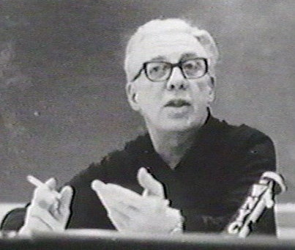
Teaching=Entertaining?
Physicality
Defining the Situation
Extemporizing
Acting
Scripts
http://applyingshurtleff.blogspot.ca/p/michael-shurtleff-bio.html
“Every scene you will ever act begins in the middle, and it is up to you […] to provide what comes before.” -Michael Shurtleff
Notes:
Michael Shurtleff was a casting agent who wrote a very famous book called Audition. He has a great deal to say about self-presentation.

Slide 13
Defining the Situation
Teaching=Entertaining?
Physicality
Defining the Situation
Extemporizing
Acting
Scripts
[In real life] interactions are more likely to succeed if there is a shared understanding of what is going on (Goffman)
In our instructional work, defining the situation is a complex process, and the responsibility to do it is ours
Be thoughtful and intentional about what is revealed and what is concealed (honesty vs. idealization)
Notes:
Erving Goffman: a Canadian sociologist
“Defining the situation”: Other teachers do not have quite the same challenge with this. These are all things that I regularly must choose whether or not and how to clarify within my instruction sessions:
the research process.
what the library is.
what the library can do for students.
what I will do for students.
how to describe myself as a professional. How do I convey my authority?
Honesty vs. idealisation. Example: RefWorks.

Slide 14
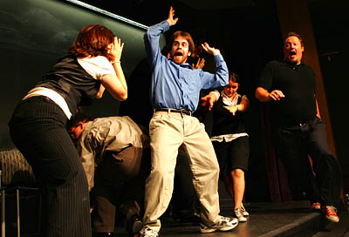
Teaching=Entertaining?
Physicality
Defining the Situation
Extemporizing
Acting
Scripts
http://www.tumblr.com/tagged/improv-troupe-names
“[Improvisers] see a palette of possibilities in front of them and make instant connections,
using what they have.”
-Huffaker, Robertson, Hirsch, and Poynton,
OD Practitioner 35(3)
Notes:
Photo: what we think about improvisers: wacky, zany (!), shucks, everything-goes
Actually, improvisers give fine-tuned, highly intelligent performances. The best improv is based on principles and restraints.
It’s important for us to discuss improv/extemporising. A lot of the anxiety experienced by newer librarians who teach comes from anticipating that someone might ask a question that will require an extemporaneous, off-the-cuff answer.
Watch http://www.youtube.com/watch?v=cL3OJppw2ww. Discuss: what principles are explained here that could relate to your instructional work?

Slide 15
Extemporizing (I)
Teaching=Entertaining?
Physicality
Defining the Situation
Extemporizing
Acting
Scripts
Listening is the most important strategy; use your inner monitor
Don’t block: don’t be dismissive
Make choices: don’t wimp or waffle
Ask clarifying questions: don’t leap to conclusions
If possible, show; don’t tell
Notes:
Monitor: Alan Rickman’s “geiger counter”
Blocking example: a student question such as “Why can’t there be one search box for everything?”
Choices example: don’t wimp. E.g., a question such as “Why can’t I download ebooks?”
Don’t leap to conclusions: same principle as our reference training.

Slide 16
Extemporizing (II)
Teaching=Entertaining?
Physicality
Defining the Situation
Extemporizing
Acting
Scripts
Be confident
If you must rely on notes, then make your notes work for you. Enlarge the font size on paper, or consider an app such as ProPrompter
Notes:
Be confident! Make choices.
Do as much as you can to release yourself from having to read from your notes. You’re not on radio, you’re standing in front of people, and this makes engaging with them more complex. That’s why “make eye contact” always appears in lists of public speaking advice.

Slide 17
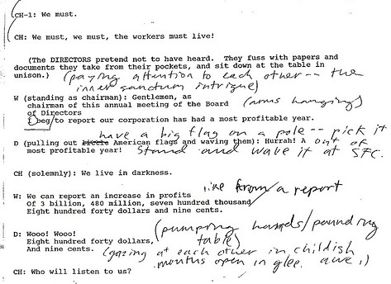
Teaching=Entertaining?
Physicality
Defining the Situation
Extemporizing
Acting
Scripts
flickr.com/photos/juggernautco/541805974
“Arthur looked up. ‘Ford!’ he said, ‘there’s an infinite number of monkeys outside who want to talk to us about this script for Hamlet they’ve worked out.’”
-Douglas Adams, The Hitchhiker’s Guide to the Galaxy
Notes:
Scripts are sometimes used in instruction. For example, we have a large group of colleagues who do a large number of first-year English sessions. In scenarios such as this there can be an impulse to create a script for everyone to follow, to ensure “consistency.”

Slide 18
Considering Scripts (I)
Teaching=Entertaining?
Physicality
Defining the Situation
Extemporizing
Acting
Scripts
Imposed scripts can exacerbate public speaking anxiety (Wilder)
Text and subtext: “That that is, is”
Scripts do not make performances, or performers, interchangeable
Likewise, instruction is fundamentally ephemeral
Notes:
Scripting can actually increase public speaking anxiety because scripts force people to use words that are not naturally their own.
An actor works with a script by finding the thinking, meaning, action, and context underpinning the words. The script is like a musical score; it does not contain all meaning superficially. You've heard of actors saying “what's my objective”? They’re figuring out what the subtext is. The words mean what they mean, but what do they mean?
Good example: that that is is. It’s very difficult to make this line understandable without knowing its subtext. (Twelfth Night )
Scripts do not make performances interchangeable. If they did, every performance of Hamlet would be the same. You cannot divorce the content from its performance or presentation.

Slide 19
Considering Scripts (II)
Teaching=Entertaining?
Physicality
Defining the Situation
Extemporizing
Acting
Scripts
Scripts make it easier for learners to disengage (Cebula)
Ask what’s important: is it important for all instruction to meet the same teaching and learning goals, or is it important for all instructors to employ the same words?
If scripts are unavoidable (e.g., reasons relating to job descriptions), incorporate a script meeting for table work
Notes:
Even more points about scripts…
Scripts can tell learners that they can go ahead and disengage.
Script meeting: find the meaning in the script. Don’t assume that it’s obvious or that it’s shared.
Anxiety is a very real issue. I encourage you to consider how, over time and with lots of practice, you can speak from notes rather than a script.

Slide 20
Acting and Performing
Teaching=Entertaining?
Physicality
Defining the Situation
Extemporizing
Acting
Scripts
flickr.com/photos/maxbraun/104431360
flickr.com/photos/stuckincustoms/3026078169
Non-Acting
Acting
All acting is performance. Not all performance is acting.
Notes:
Acting has been variously defined as impersonating, imitating, interpreting, creating, feeling, radiating, reacting, being, behaving, believing, etc. etc. etc.
For our purposes, this continuum model is very useful. All acting is performance, but not all performances are acting.
The degree of acting, in this model, relates to the degree of “pretend,” of deliberate, intentional construction.
You know when you’re acting, and audiences also detect that.
As information professionals who teach, you can consider this model as a way of understanding the different choices you make about your instruction.
When we think about any given performance on this continuum, we realise that it’s actually a whole matrix…

Slide 21
Teaching=Entertaining?
Physicality
Defining the Situation
Extemporizing
Acting
Scripts
Body
Voice
Language
Dress
Emotion
Content
Non-Acting
Acting
Michael Kirby’s “matrix approach”
to acting and non-acting
Notes:
…Of different factors.
This looks like a mixing board, no?
Discuss one example: dress.

Slide 22
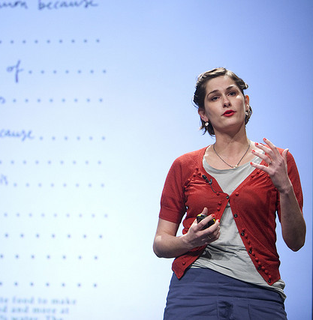
Teaching=Entertaining?
Physicality
Defining the Situation
Extemporizing
Acting
Scripts
Dress
Non-Acting
Acting
flickr.com/photos/kk/4039492159
familiesonly.com/Community/blogs/overdad/archive/2009/10/22/costume-conundrum.aspx

Slide 23
Teaching=Entertaining?
Physicality
Defining the Situation
Extemporizing
Acting
Scripts
Body
Voice
Language
Dress
Emotion
Content
Non-Acting
Acting
Michael Kirby’s “matrix approach”
to acting and non-acting
Notes:
When we consider our own performances, we are sometimes more strategic, more deliberate about certain facets than others.
This could be a reflection about how I’m thinking about teaching on a day where I’m presenting something I’m really familiar with, but it’s for a group of influential faculty. It’s first thing in the morning and I haven’t slept well.
This is how some actors may think about their characters: they decide where to direct their effort and attention most. (e.g., dialect)

Slide 24
What about online instruction?
Teaching=Entertaining?
Physicality
Defining the Situation
Extemporizing
Acting
Scripts
Teaching is not primarily about technology. It’s about learners.
Consider: engagement, availability, contact, compassion, humour
How will people feel they’re treated?
Ephemerality vs. posterity
Notes:
With online instruction, the details are different, but the fundamentals remain the same: instructor presence and responsiveness are crucial.

Slide 25
Takeaways (I)
Teaching=Entertaining?
Physicality
Defining the Situation
Extemporizing
Acting
Scripts
http://www.berndnaut.nl/works.htm
Ephemerality
Notes:
Instructional events happen and then are gone
Do your best, learn from it, let go, move on, try again.
Beckett: Ever Tried. Ever Failed. No Matter. Try Again. Fail Again. Fail Better.

Slide 26
Takeaways (II)
Teaching=Entertaining?
Physicality
Defining the Situation
Extemporizing
Acting
Scripts
flickr.com/photos/usnationalarchives/3679283768/
Holism
Notes:
Instruction improves when we acknowledge that our bodies, voices, and emotions are involved.
You are not a brain on a stick, and neither are learners.

Slide 27
Takeaways (III)
Teaching=Entertaining?
Physicality
Defining the Situation
Extemporizing
Acting
Scripts
flickr.com/photos/shutterhack/3116000481
Make Choices
Notes:
Make choices, be confident, keep trying. Don’t waffle.

Slide 28
Takeaways (IV)
Teaching=Entertaining?
Physicality
Defining the Situation
Extemporizing
Acting
Scripts
flickr.com/photos/camdiluv/4441155157
Individuality
Notes:
Fly your freak flag.
There’s a very important book called The Courage to Teach:
You must connect what you do with who you are
You must pay attention to your inner life
Good teaching flows from the identity and integrity of the teacher
If you have integrity as a teacher, a strong instructional presence based on who you actually are and what you care about, learners will have fundamental respect for you. If you’re hypocritical, students will sniff that out. Everyone’s been a student, so you can consider whether you agree with that.

Slide 29
Takeaways (I-IV)
Teaching=Entertaining?
Physicality
Defining the Situation
Extemporizing
Acting
Scripts
Notes:
All clouds, but all different. Teaching is the same.
As librarians, many of us value organization, consistency, order, and control.
But when you’re teaching, think about what you’re doing as something that’s always going to grow and change, and will never be perfect. Recognize that what you’re doing is for learners, and you can’t control everything.
If you get to grips with this, I think you’ll find that teaching can be fun, and you can make it genuinely learning-centred.
Thanks, and discussion?

Slide 30
Sources & Reading
Cebula, Larry. 2013. “We Know You Can Read. So Can We.” The Chronicle of Higher Education http://chronicle.com/article/We-Know-You-Can-Read-So-Can/136607/ (accessed February 21, 2013).
Goffman, Erving. 1959. The Presentation of Self in Everyday Life. Garden City, NY: Doubleday.
Julien, Heidi, and Jen (J.L.) Pecoskie. 2009. “Librarians’ Experiences of the Teaching Role: Grounded in Campus Relationships.” Library & Information Science Research 31: 149-154.
Kirby, Michael. 2002. “On Acting and Not-acting.” In Acting (Re)considered: A Theoretical and Practical Guide, edited by Phillip B. Zarrilli, 40-52. London: Routledge.
Mason, Marc. 2009. “Beating the Competition: Librarian as Performance Artist.” Abstract for presentation given at the LOEX Annual Conference, Albuquerque, NM. http://www.loexconference.org/2009/program/sessions.html (accessed January 22, 2012).
Palmer, Parker. 1998. The Courage to Teach. San Francisco: Jossey-Bass.
Rapid Fire Theatre Company. 2010. RFT Academy Presents: Back to Basics! http://www.youtube.com/watch?v=cL3OJppw2ww (accessed February 21, 2013).
Wilder, Lilyan. 1999. 7 Steps to Fearless Speaking. New York: Wiley.

