Slide 1
Libraries and Broadband Policy: From Internet Providers to Policy Leaders Presentation for the 5th Annual Southern Alberta Library Conference Lethbridge, AB – March 7, 2014
Dr. Michael B. McNally Dr. Samuel E. Trosow
Assistant Professor Associate Professor
School of Library and Information Studies Faculty of Law and Faculty of Information
University of Alberta and Media Studies
University of Western Ontario

Slide 2
Outline
Broadband and the Canadian Context
Early successes in internet advocacy
Shifting government priorities
Digital economy and wireless broadband failures
Successful advocacy redux – Birdsall’s Right to Communicate

Slide 3
Budget 2014
Federal government commits $305 million over five years to connect 280,000 households to broadband internet
Establishes “near universal access”
However
The Canadian Radio-television and Telecommunications Commission (CRTC) set 2015 as the goal for universal access
The target speed (5Mbps download) is
is considerably unambitious
Australia is aiming for universal speeds
five times faster (25 Mbps)

Slide 4
Broadband Primer
Several different modes of broadband
Wired
DSL and ADSL (copper wire)
Coaxial Cable
Fibre
Wireless
Mobile/Cell phones (licensed radiospectrum)
Satellite and fixed wireless
Main measure is download (not upload speed)
1.5 Mbps (megabits per second) is the low end
1000 Mbps (or 1 Gbps) is the fastest

Slide 5
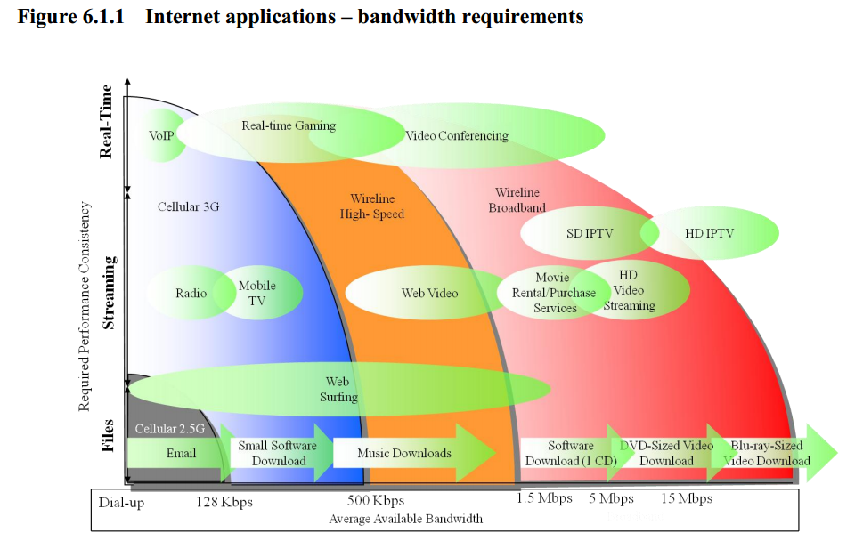
Broadband Primer
Source: CRTC, Communications Monitoring Report 2013, p. 174.

Slide 6
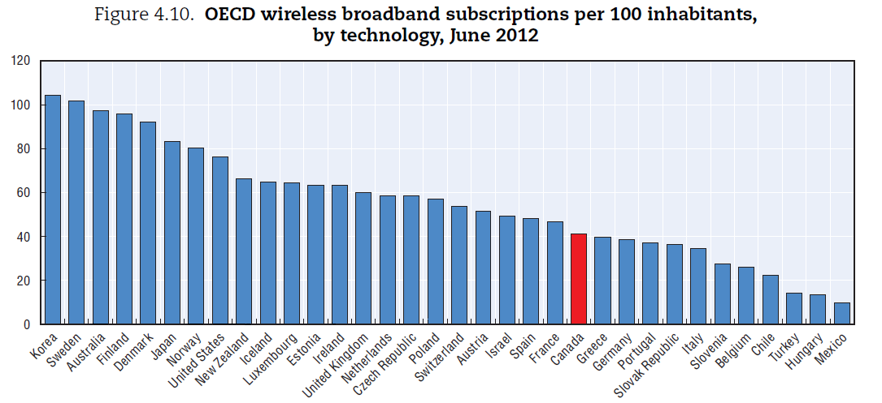
The State of Canadian Broadband
In early 2000s Canada was a global leader in broadband (second only to South Korea)
Now Canada’s ranks near the bottom in terms of both fibre
and wireless broadband
Source: OECD, Communications Outlook 2013, p. 102.

Slide 7
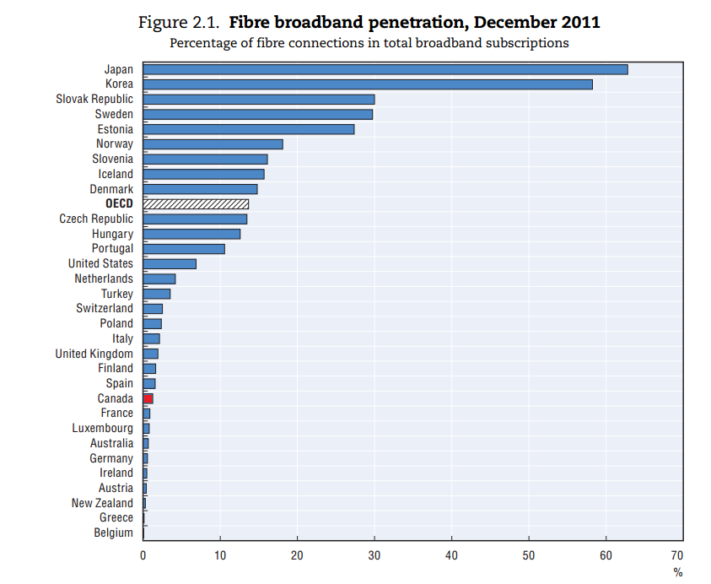
The State of Canadian Broadband
Source: OECD, Information Economy Outlook 2012, p. 65.

Slide 8
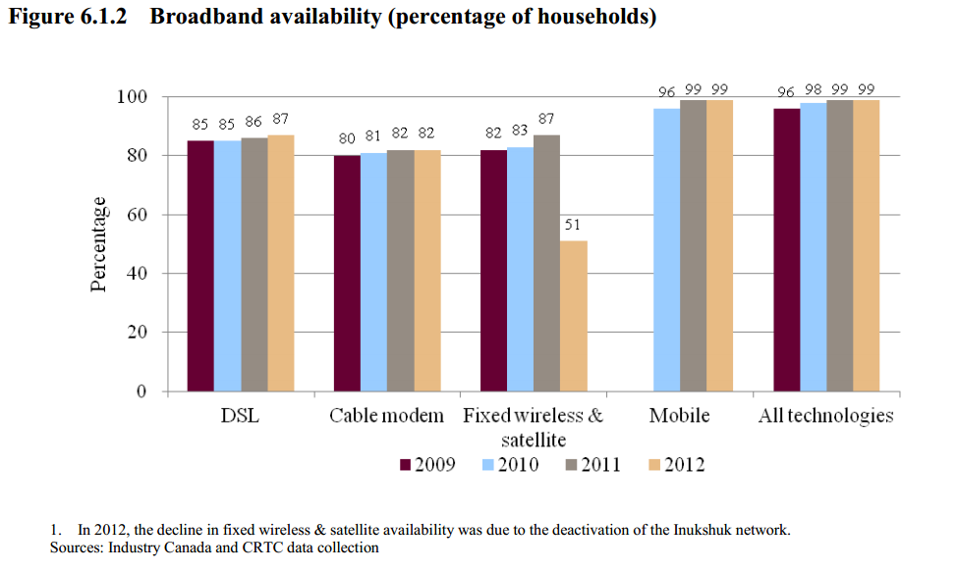
The State of Canadian Broadband
Source: CRTC, Communications Monitoring Report 2013, p. 177.

Slide 9
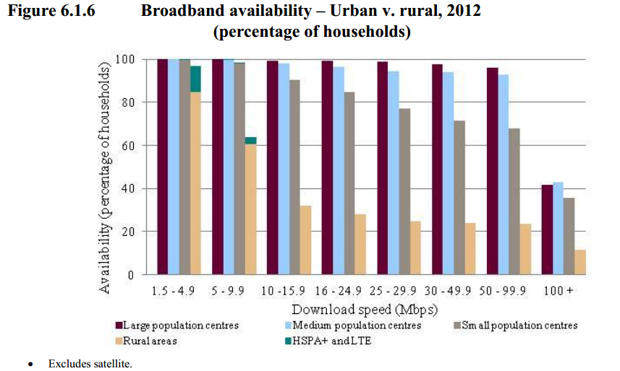
The State of Canadian Broadband
Source: CRTC, Communications Monitoring Report 2013, p. 181.

Slide 10
Early Library Internet Advocacy
Throughout the 90s, librarians were leaders in advocating for internet access
CLA’s 1994 Position statement on Information and Telecommunications Access Principles (July 18, 1994) stated:
Access to information and telecommunication network services should be available and affordable to all regardless of factors such as age, religion, ability, gender, sexual orientation, social and political views, national origin, economic status, location, and information literacy…
Opportunities should be created for broad public participation in the determination of information and telecommunication policy.
Provincial groups such as OLA’s Coalition for Public Information (CPI) were equally forward thinking in advocating for universal access

Slide 11
Information Highway Advisory Council
Early advocacy work led to involvement with federal Information Highway Advisory Committee (IHAC)
Two of the 29 members of the panel were from the LIS community
OLA President and CPI chair Elizabeth Hoffman
Dalhousie School of Library and Information Studies Professor Mary Dykstra
Over half of IHAC members were senior officials from telecom companies

Slide 12
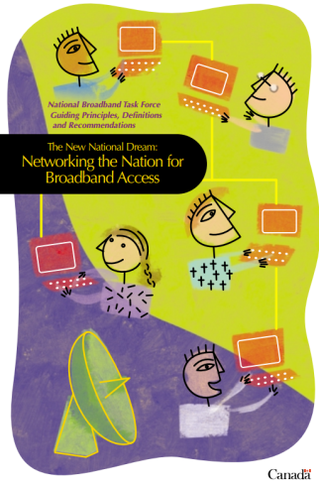
CAP – A Pyrrhic Victory
The 2001 National Broadband Task Force report suggested universal access by 2004, and stated every public library should have broadband internet
By 2003-04 CAP funding was providing access to 8,800 sites
Through the late 2000s CAP funding dwindled, and the program ended in 2012
A 2009 government assessment concluded it has many successes, but outlived its usefulness

Slide 13
From Connecting Communities to Connecting Individuals
CAP’s early successes led to new government initiatives favouring connecting individuals and households
Industry Canada has deemphasized digital skills development
Telecommunications regulation has been shifted to emphasize market forces “to the maximum extent feasible”
From both a 2006 Privy Council Office directive to the CRTC and the 2007 Industry Canada Spectrum Policy Framework

Slide 14
The Broadband Canada Program
Initially launched as part of the 2009 Budget
Spent $225 million to connect roughly 218,090 households
Unlike the direct investments in community broadband, Broadband Canada provided matching funds
As such, the funded projects were overwhelmingly private
Some Indigenous bands did get funding, but these were an extreme minority

Slide 15
The Digital Economy Consultation
Several library groups participated in the digital economy consultation
Submissions around broadband were vague and filled with unsupported claims
CLA suggested the number of homes with sufficient speed was quite low
Canadian Urban Libraries Council critiqued
performance ceilings and called for unlimited
broadband
OLA called for universal access and suggested
it would ameliorate the digital divide

Slide 16
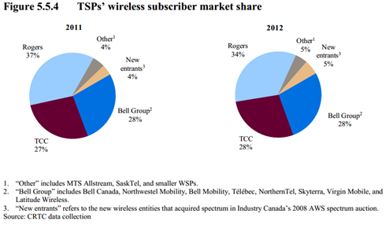
Wireless Broadband
Significant area over oversight in library community has been failing to recognize the importance of licensed radiospectrum
Despite government rhetoric, the Canadian wireless market is extremely concentrated
Source: CRTC Communications Monitoring Report 2013, p. 161

Slide 17
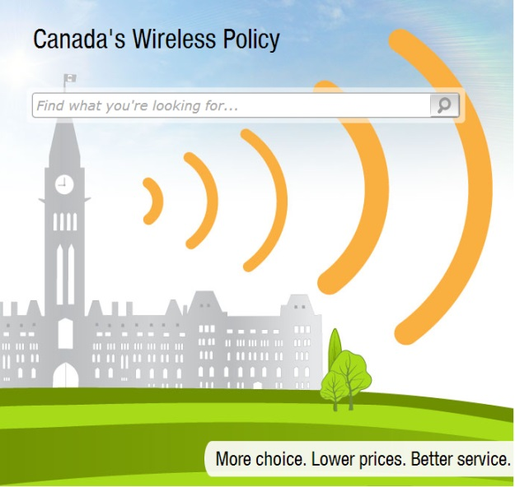
Wireless Broadband
The recent and upcoming spectrum auctions will do little to advance the needs of rural Canadians
Bell, Rogers, Telus and Videotron have five years (2019) before they have to provide 700MHz (4G) service to cover 90% of the population served by their existing networks
There is no 100% deployment requirement
Korea wants to have 5G service rolled out
by the time it hosts the 2018 Olympics

Slide 18
Wireless Broadband
On Jan. 10, 2014, Industry Minister James Moore announced the rules for the upcoming (2015) 2500 MHz auction stating:
“Spectrum in the 2500 MHz band is ideal for delivering next-generation LTE services on the latest smartphones and tablets, both in urban and suburban areas. It is also well suited to enhancing Internet services for Canadians living in rural areas.”
Deployment Requirements for 2500 MHz Licenses after 10 Years (2025)
Region | Minimum Population Coverage
Bas du fleuve/Gaspésie | 15%
Upper Outaouais | 10%
Pembroke | 15%
Listowel/Goderich/ Stratford | 15%
Moose Jaw | 25%
Red Deer | 25%
Grande Prairie | 25%
Edmonton | 50%
Medicine Hat/Brooks | 30%
Lethbridge | 40%
Calgary | 50%
Kootenays | 15%
Yukon | 20%
Nunavut | 20%
Northwest Territories | 20%
Source: Industry Canada, Licensing Framework for the Broadband Radio Service (BRS) – 2500 MHz Band (2013), p. 63-64

Slide 19
Overcoming Barriers
While universal access will be (eventually) achieved, there is a renewed need for library advocacy around broadband on:
Urban – rural divisions
Need for digital literacy skills training
Speeds for both wired and wireless services
Affordable prices
Greater consideration of the public interest
Requires greater collaboration between libraries (particularly rural ones), library associations and the academic community

Slide 20
Right to Communicate
William Birdsall has repeatedly suggested libraries reframe their advocacy around the right to communicate
“The right to communicate meets the need to move beyond a narrow conception of universal access based on technical connectivity.”
William F. Birdsall, “Policy and Participation on the Canadian Information Highway,” First Monday, 4(3), (1999): http://firstmonday.org/ojs/index.php/fm/article/view/653/568
“The right to communicate provides a conceptual framework within which Canadians can address not only access to information and the Internet, but related issues of intellectual freedom, language rights, cultural identity, intellectual property rights and so forth.”
William F. Birdsall, “Libraries, Communication Rights, and Access in a Digital World,” in Access to Information in a Digital World (2004), p. 164

Slide 21
Right to Communicate
William F. Birdsall, “Libraries and the Communicative Citizen in the Twenty-first Century,” Libri: International Journal of Libraries and Information Services, 2(3) (Sept. 2005) p. 80.
It establishes a legal foundation for the library that is in accord with the global expansion of electronic communication and human rights in the 21st century.
It provides a framework for re-evaluating and trans- forming traditional library values to meet the needs of the new communicative environment.
It envisions a social role for the library as an institution that continues to meet the needs of the individual and the community regardless of its material or digital form.

Slide 22
Right to Communicate
It stakes out a role for the library as an important component of global communication networks.
It shifts the focus of the library and librarianship from information to communication, from content to process, from the informed citizen to the communicative citizen.
It serves as a basis upon which to develop library organization and operations focused on dynamic communication processes and services rather than the traditional focus on passive content and collections.
It means libraries should be evaluated on the quality of services they provide rather than the size of their collections.

Slide 23
Right to Communicate
It assumes the primary resource of the library is the staff rather than the collection.
It opens up the possibility of attracting a more inclusive clientele for libraries.
It is the foundation for creating political alliances with other groups having a stake in promoting communication rights.
It provides a concept of the library that forms the basis for professional collaborative initiatives with researchers and practitioners in a wide range of disciplines including library and information studies, communication studies, computing science, law, public administration, journalism, and so forth.

Slide 24
Libraries and Broadband
Research community need local library input (your stories)
Connectivity concerns
How much choice and at what cost?
Digital literacy skills
What is the state of current skills instruction, what are the barriers to future instruction?
Conversely the academic community can:
Provide guidance on policy issues and advocacy approaches
Help facilitate connections between industry, government and community stakeholders
Need to also be cognizant of limitations

Slide 25
Acknowledgements and Feedback
Graphics Animation and New Media (GRAND) Networks of Centres of Excellence (NCE) has provided research funding
Graduate Research Assistants Lilian Pintos and Brandy Mowatt (School of Library and Information Studies, U of A)
Michael B. McNally – mmcnally@ualberta.ca
Samuel E. Trosow – strosow@uwo.ca

