Slide 1

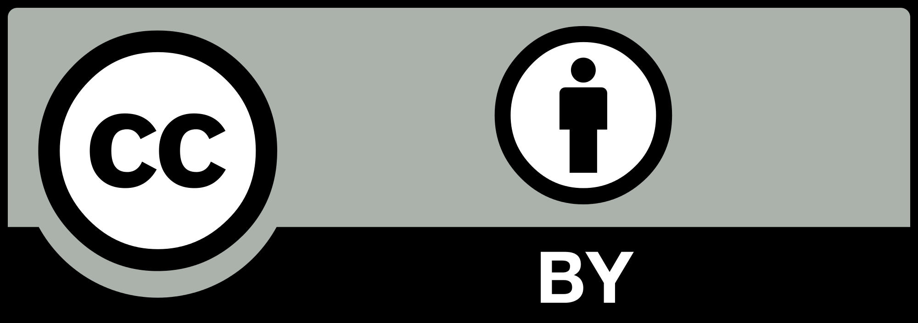
Biting off as Much (or Maybe More) than You Can Chew:
Insights on Managing an OER Project from
https://www.ualberta.ca/copyright/resources/opening-up-copyright-instructional-modules
Toby Grant, Amanda Wakaruk, Michael B. McNally

Slide 2
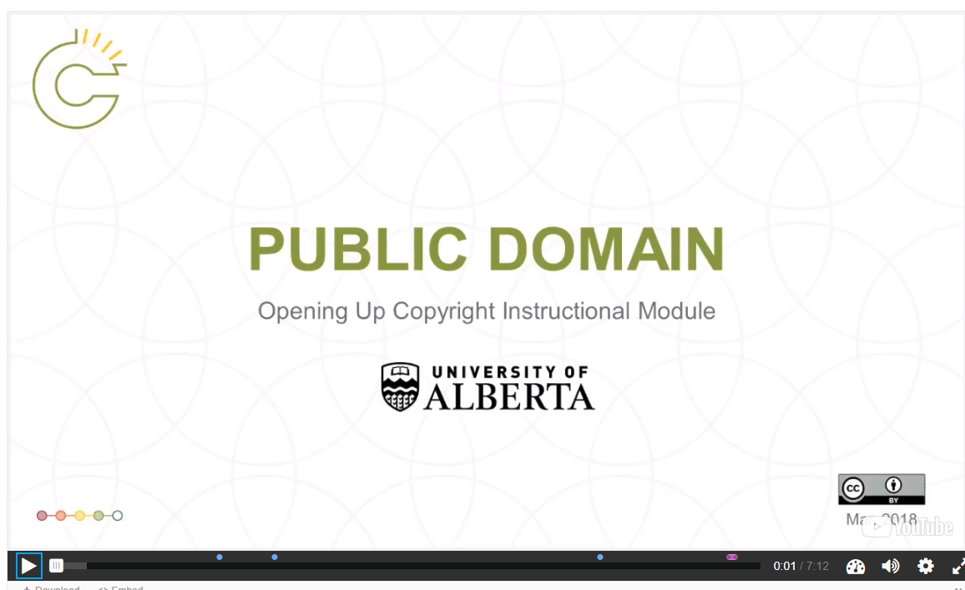
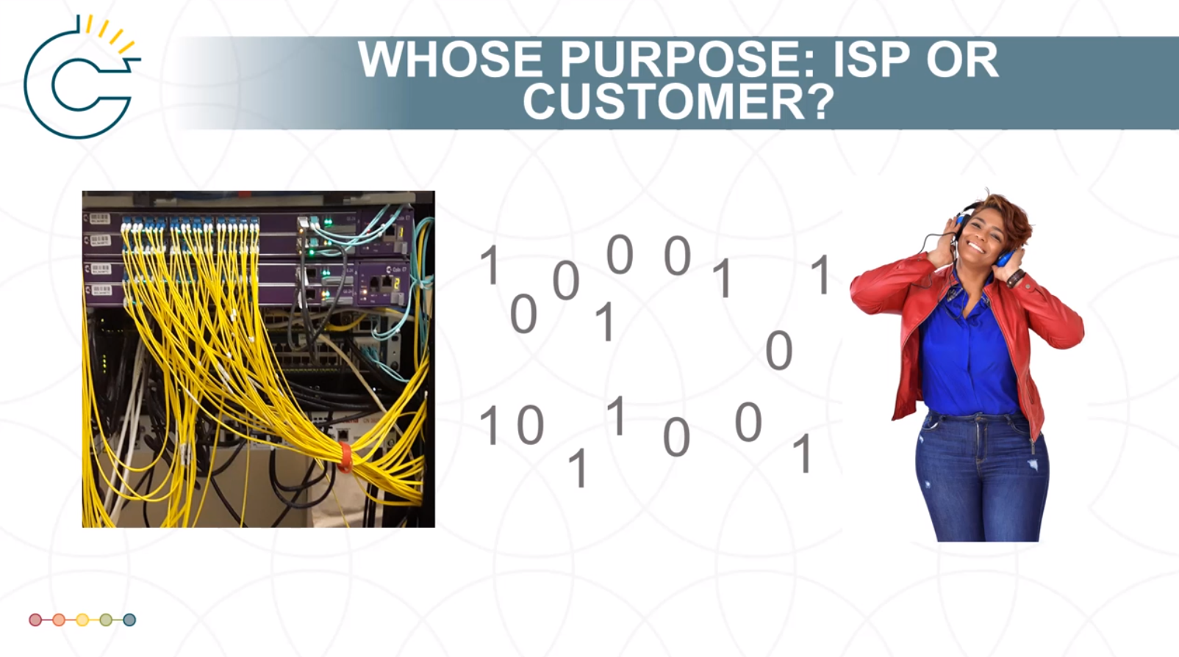
Project Overview
The Project
U of A Teaching and Learning Enhancement Fund (TLEF) funded project
Cross campus collaboration
Non linear, interactive video module series for staff, students, faculty and the general public
Principles
Make learning about law, higher education and LIS education accessible
Fight copyright chill and anxiety as well as institutional risk avoidance
Open builds capacity and reduces barriers
Screenshot of the opening slide of the “Public Domain” module - the first module developed
Screenshot from the “SOCAN v. Bell” module

Slide 3
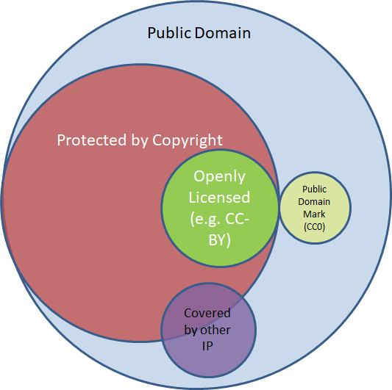
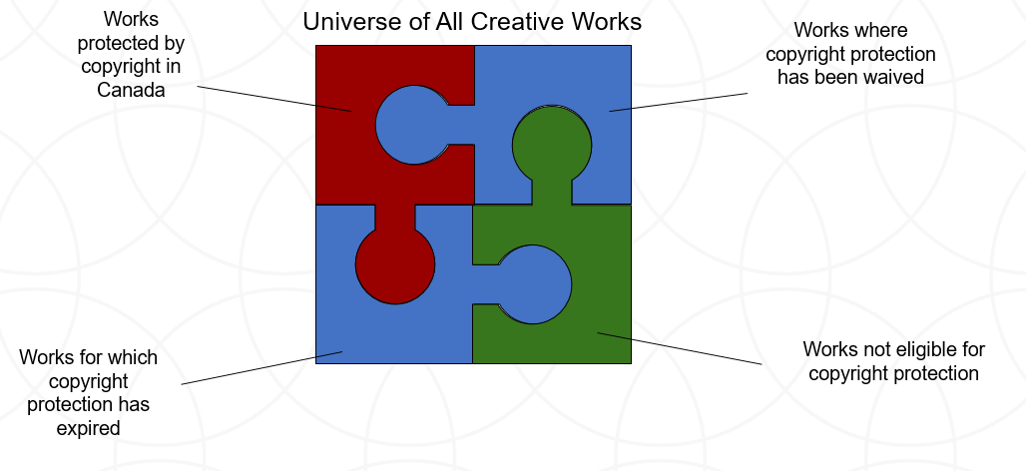
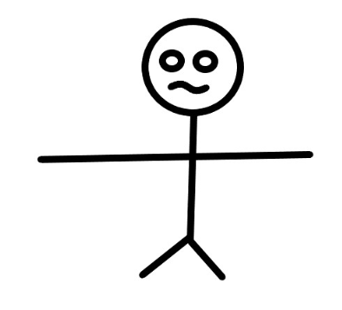
Challenges
Starting from scratch
Lack of design skills
Figuring out workflow
Leveraging the OER and Copyright communities
Left: Original image for illustrating the “Universe of All Creative Works”
Right: Final model for illustrating the “Universe of All Creative Works” from the “Public Domain” module
“Frank” - a prototype (and thankfully unused) image. (CC-1)

Slide 4
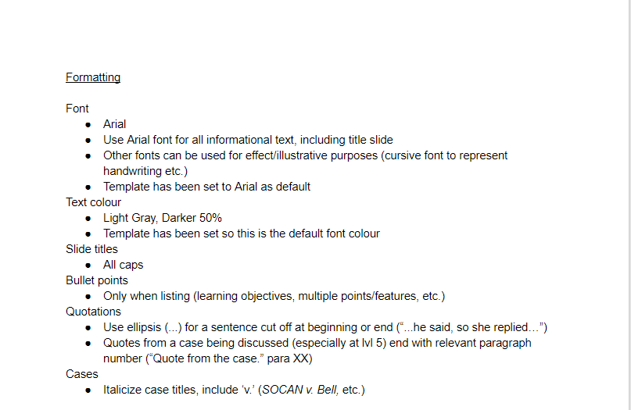
Standardization
Standardization has been built as the project has grown
PowerPoint slides (template from Technologies in Education)
Fonts, citations, layout, animations
H5P development
Citations, content development
Notes:
Content development such as developing learning objectives

Slide 5
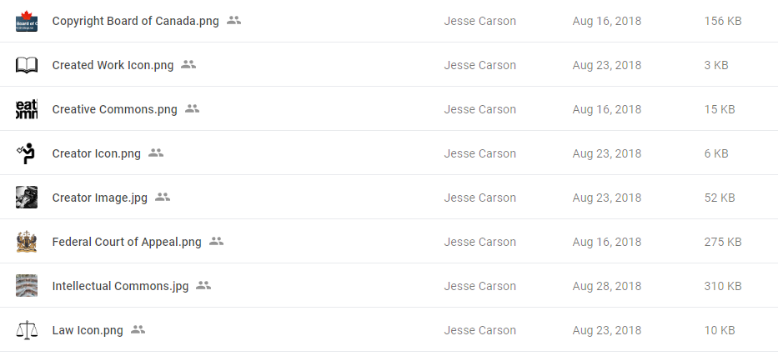
The Visual Glossary
Developed by Jesse Carson, former RA
Tool for standardization
Puts images and icons we have used in one place
Reference for the image citations

Slide 6
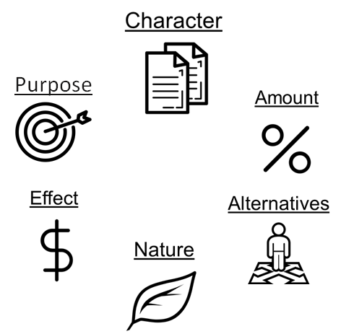
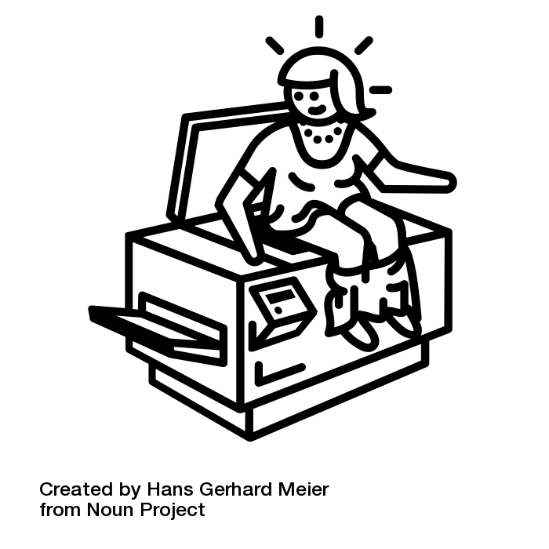
Using the Noun Project
A website with black and white icons
Icons are created by creators from around the world.
Icons are CC-BY or Public Domain.
Has guidelines for citations depending on license level
The Noun Project has an extensive catalogue of icons
We used it to build some of our repeating images.
Notes:
https://thenounproject.com/search/?q=butt%20copy&i=830264
•Dezign, Ruslan, ID. (n.d.). Target. The Noun Project. CC BY. https://thenounproject.com/search/?q=purpose&i=1005058
•ATOM, TH. (n.d.). Copy. The Noun Project. CC BY. https://thenounproject.com/search/?q=copy&i=1474212
•Тимур Минвалеев, RU. (n.d.). Percent. The Noun Project. CC BY. https://thenounproject.com/search/?q=percent&i=397874
•Farais, B, CL. (n.d.). Decision. The Noun Project. CC BY. https://thenounproject.com/search/?q=alternatives&i=1074053
•Cresnar, Gregor. (n.d.). Dollar sign. The Noun Project. CC BY. https://thenounproject.com/search/?q=dollar%20sign&i=171145
•AFY Studio, ID. (n.d.). Leaf. The Noun Project. CC BY. https://thenounproject.com/AFYstudio/uploads/?i=1737325

Slide 7
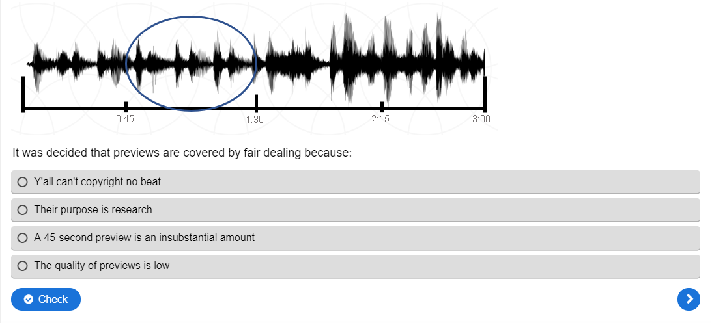
H5P
H5P is an interactive framework tool
It is digital tool that allows us to make our videos easily interactive.
Eg. Allows users to click on an external link in the video, go to the link, have the video pause, and come back to the video.
Notes:
Example of a question done in H5P from our test questions

Slide 8
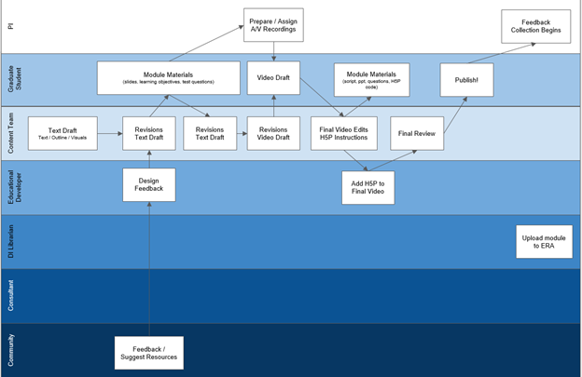
Working out the Workflow
Project management not initially seen as a needed skill set
Workflow emerged iteratively
As volume of work has increased (more in production modules) workflow to be revisited

Slide 9
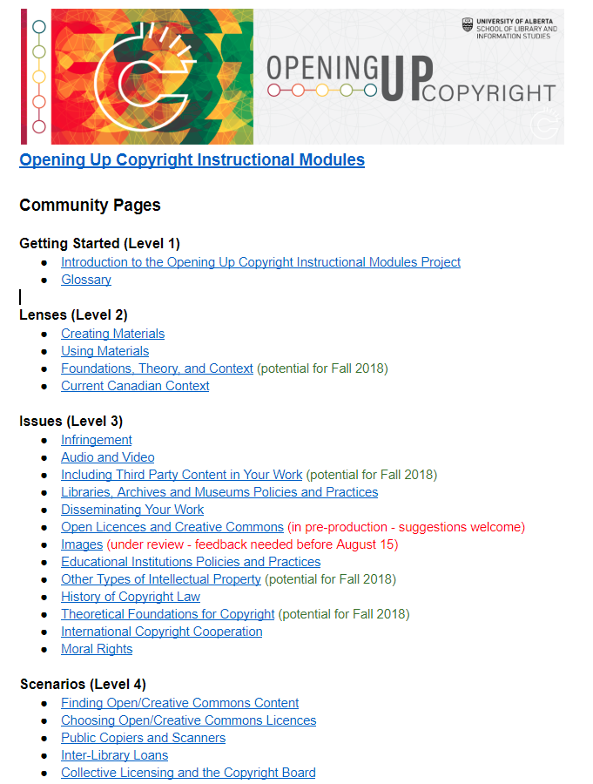
Engaging the Community
Open Google docs used to capture feedback from those outside the project
Each module given one page for contributions; anyone can contribute:
  Learning objectives
  Ideas for narratives or contextual stories
  Test questions
  Links to relevant resources
  Other suggests

Slide 10
Future Steps (and Challenges)
Two initial modules launched in March 2019 (Images and Public Domain)
  Three new modules nearing completion, several scripts/graphics in development
Emerging challenges:
  Project team turnover
  Module currency (Public Domain changes and USMCA)
  Engaging the community
  Scope creep

Slide 11
Citations
•Dezign, Ruslan, ID. (n.d.). Target. The Noun Project. CC BY. https://thenounproject.com/search/?q=purpose&i=1005058
•ATOM, TH. (n.d.). Copy. The Noun Project. CC BY. https://thenounproject.com/search/?q=copy&i=1474212
•Тимур Минвалеев, RU. (n.d.). Percent. The Noun Project. CC BY. https://thenounproject.com/search/?q=percent&i=397874
•Farais, B, CL. (n.d.). Decision. The Noun Project. CC BY. https://thenounproject.com/search/?q=alternatives&i=1074053
•Cresnar, Gregor. (n.d.). Dollar sign. The Noun Project. CC BY. https://thenounproject.com/search/?q=dollar%20sign&i=171145
•AFY Studio, ID. (n.d.). Leaf. The Noun Project. CC BY. https://thenounproject.com/AFYstudio/uploads/?i=1737325

