Slide 1


The Balancing Act of Collaboration, Openness, Quality and Ensuring Impact in the Creation of OER Copyright Resources
Michael B. McNally and Michelle Brailey

Slide 2
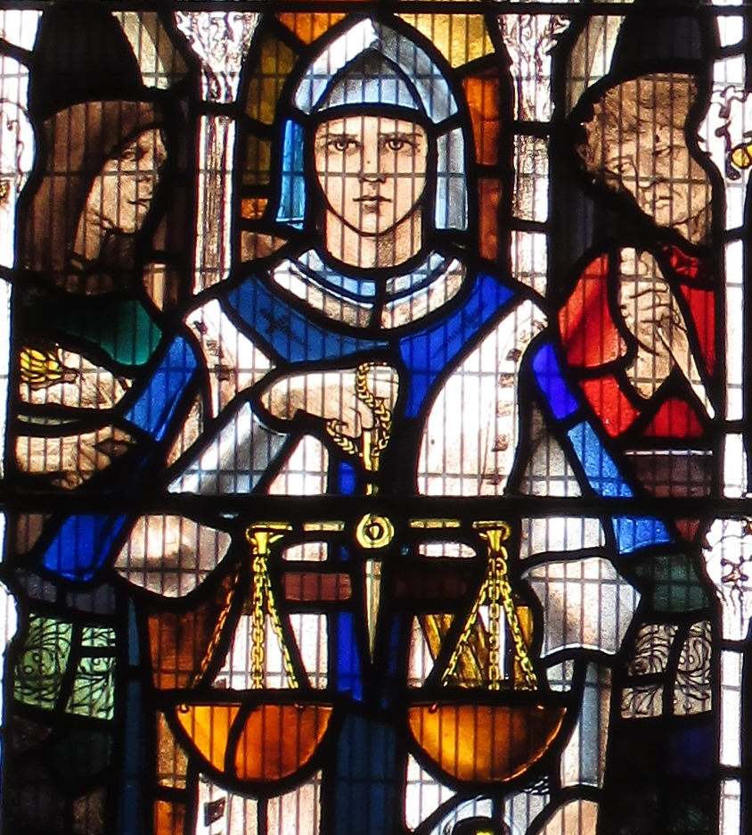
Outline
Origins and Previous Work
Project Structure and Scope
Tensions:
Openness and Quality
Audience(s)
Technology and Infrastructure
Project Control and Coordination
Conclusion
Antiquary. 2017. “Third Window, South Chapel, All Saints Church.”

Slide 3
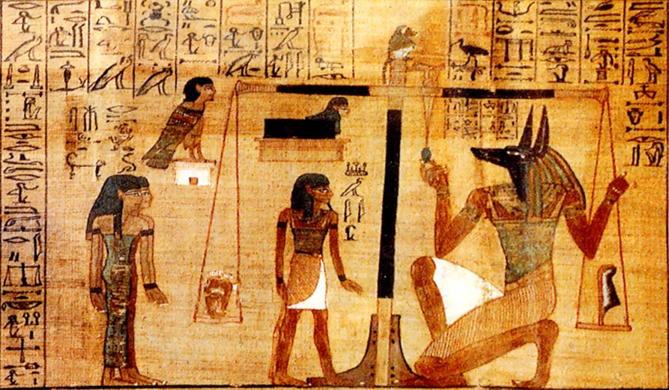
Considerations and Origins
Normative:
Copyright information available for all
Openness a key LIS value
Pragmatic:
Multiple audiences/avoid duplication
Copyright OER as enabler for more OER
FinnBjo~commonswiki. 2006. “Plate 3 of the Papyrus of Ani.”

Slide 4
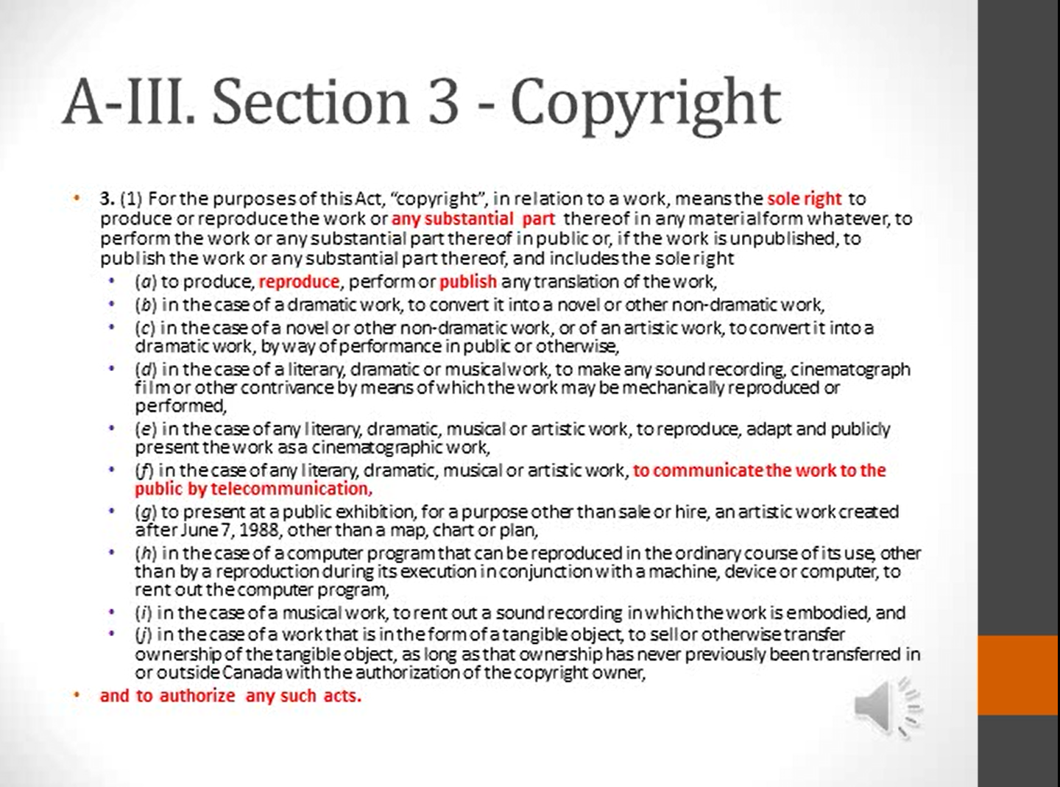
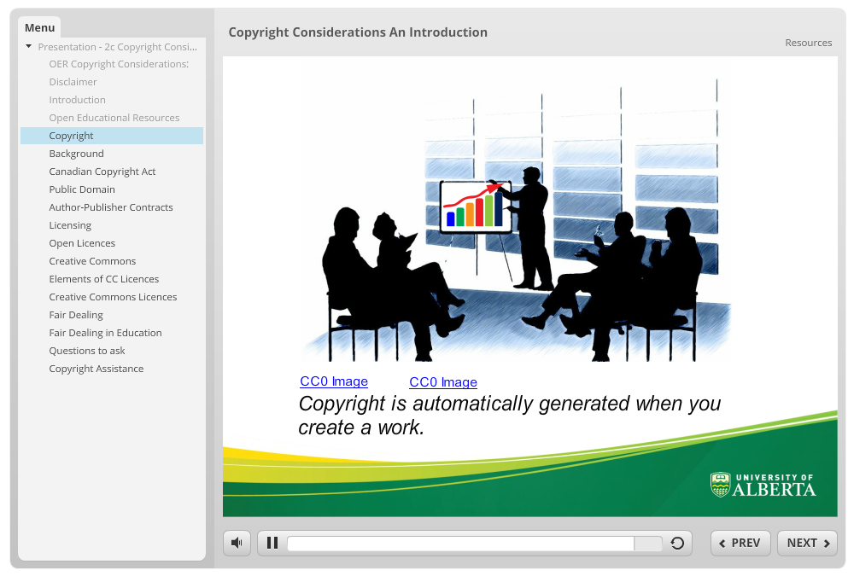
Previous Open Copyright Work
Open Education Week 2017 Modules
LIS 598 “Information Policy” OCW Experiment

Slide 5
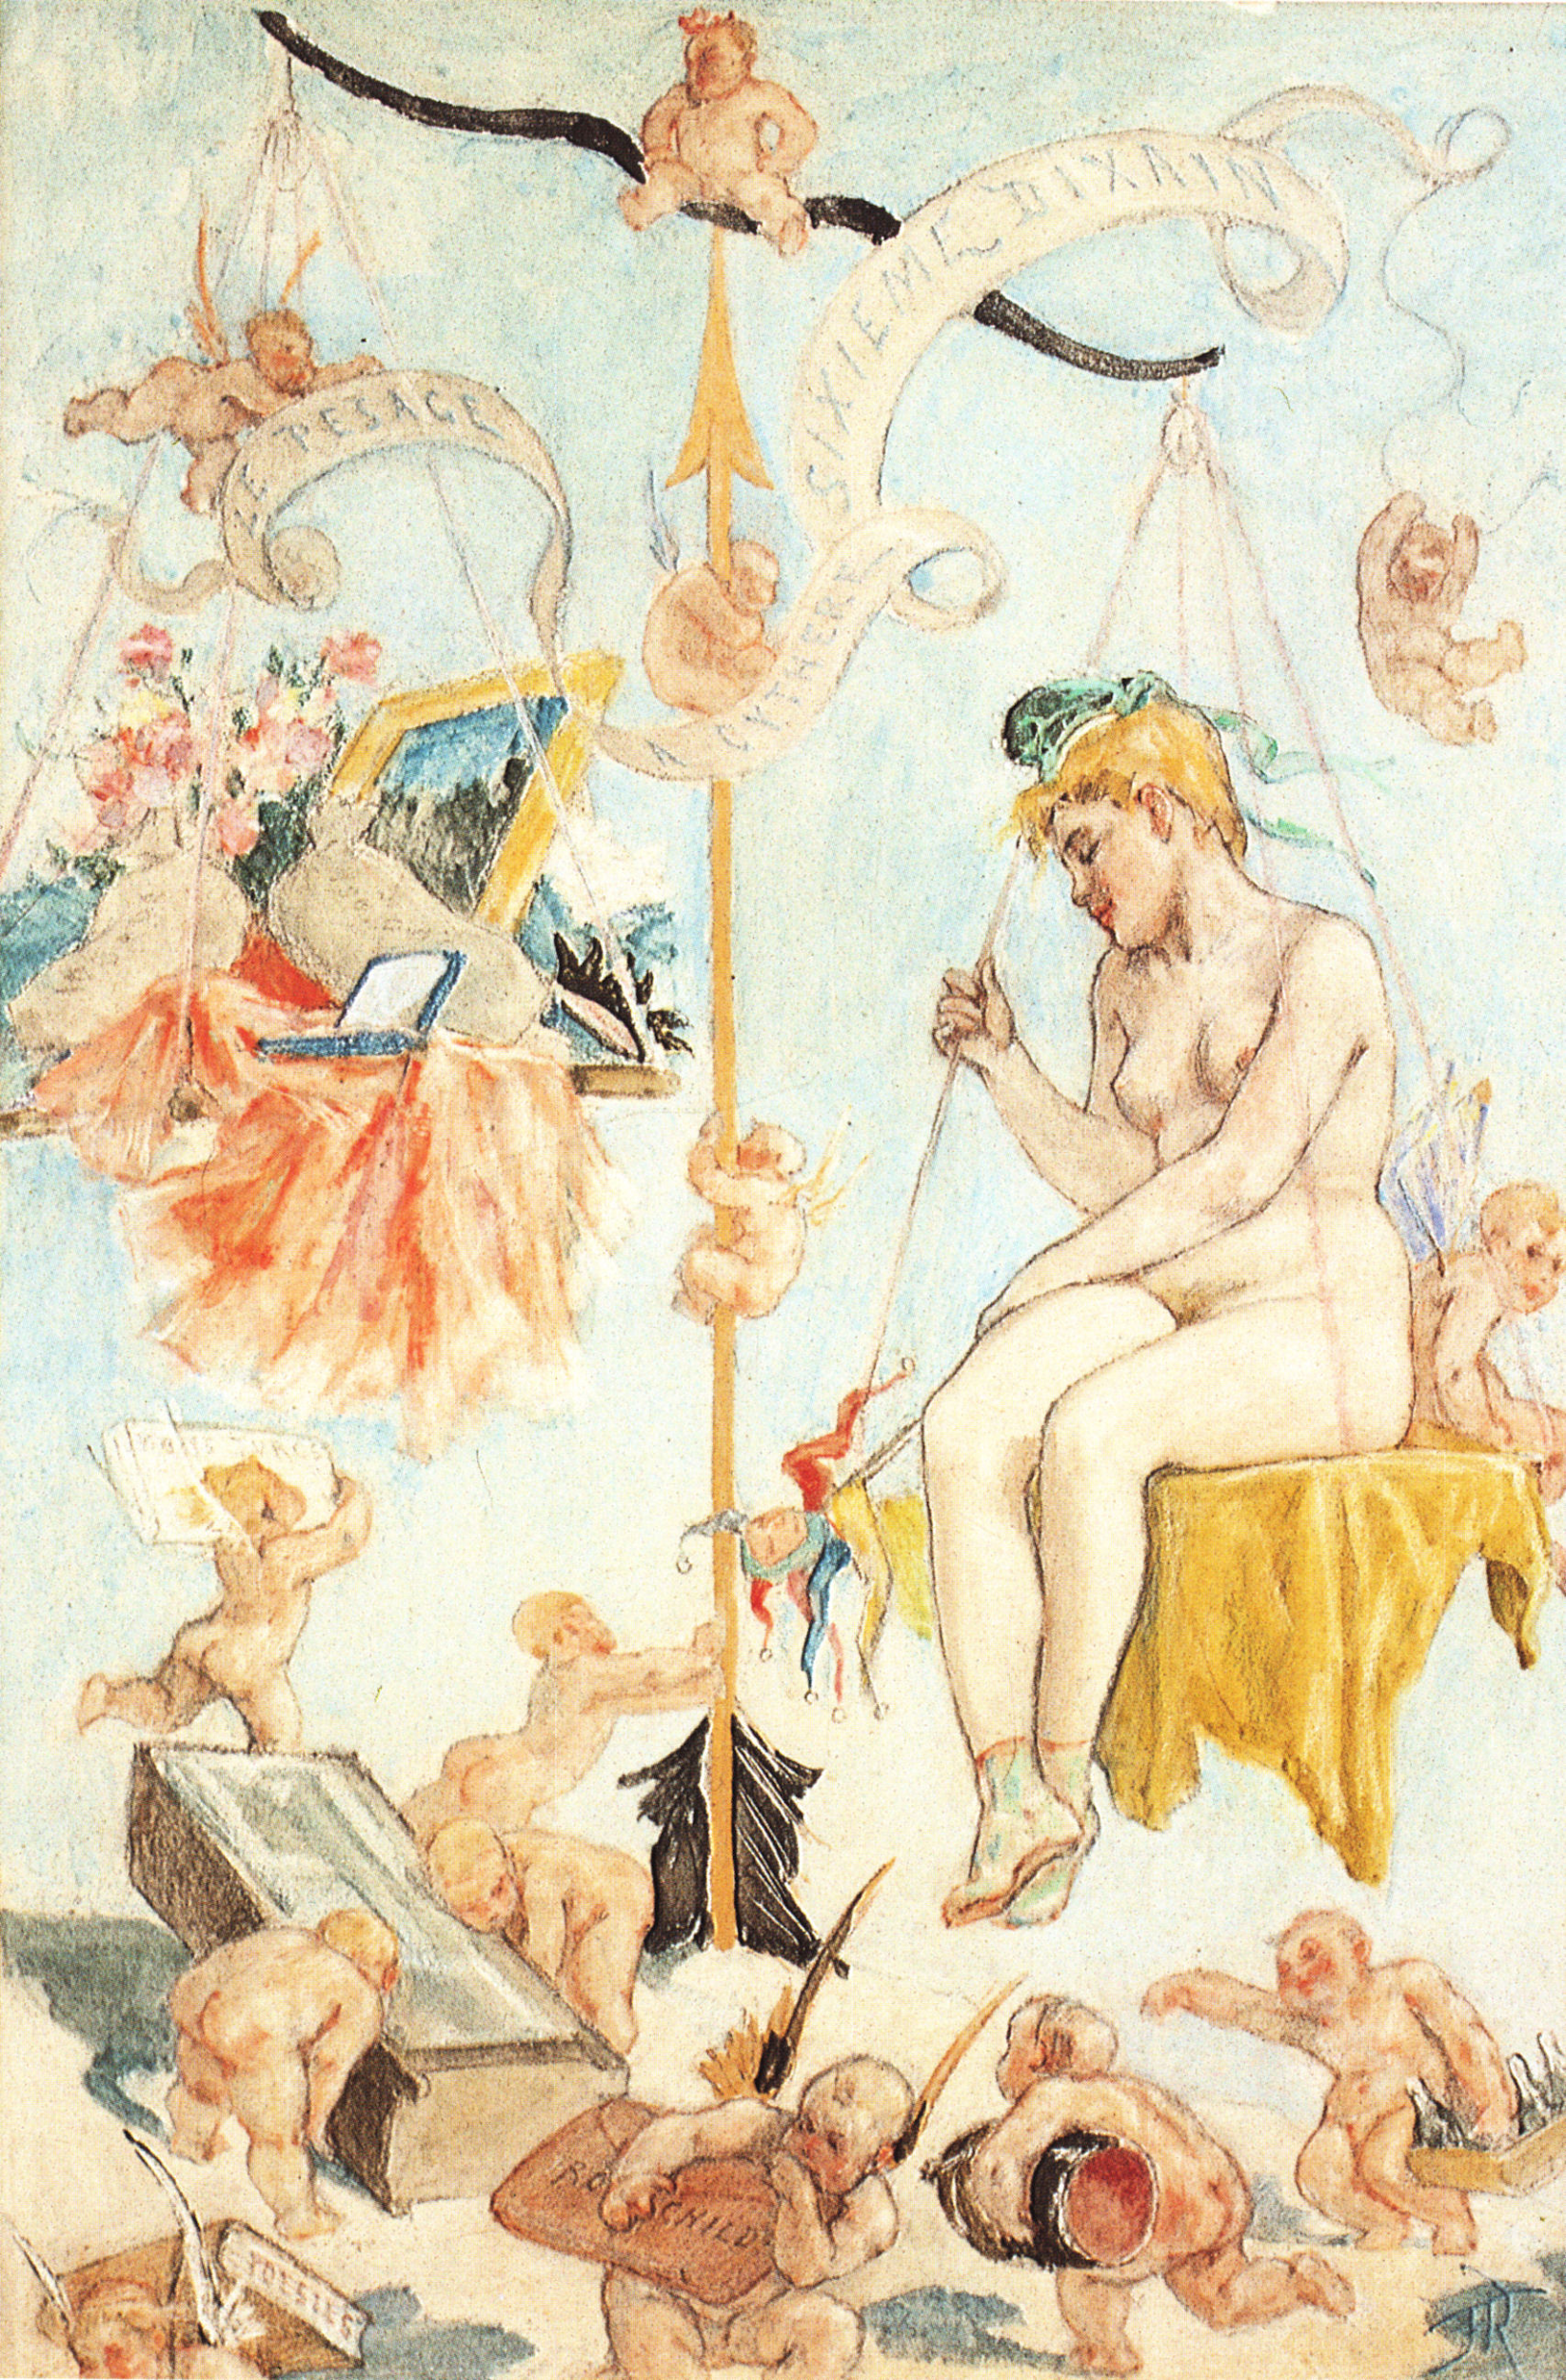
Project Structure
U of A Centre for Teaching and Learning (CTL) Teaching and Learning Enhancement funded
Project Partners
Copyright Office
School of Library and Information Studies
Technologies in Education
Centre for Teaching and Learning
U of A Libraries
Felicien Rops. ~1880. “Sixième dizain - Le pesage à Cythère.”

Slide 6
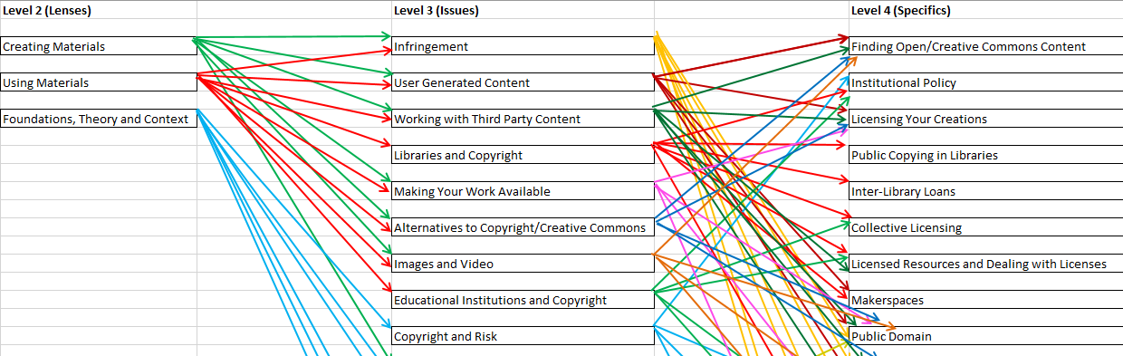
Scope
Goal: 60+ modules at five different levels
Multiple learning pathways

Slide 7
Tensions
Several tradeoffs shape the project:
Openness and quality tradeoff
Multiple audiences/learner levels
Technology and infrastructure limitations
Facilitating collaboration, maintaining a degree of control
Hans Memling. ~1466-1473. “The Last Judgement.”

Slide 8
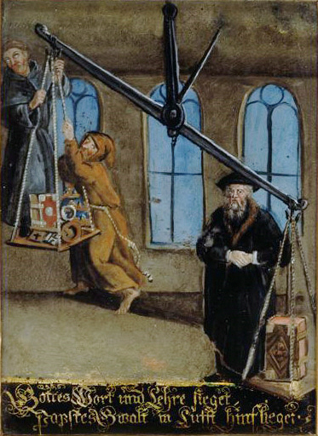
Openness and Quality
Many quality Canadian copyright resources not free:
Goal was to move from simply free to editable and adaptable
Solution:
PowerPoint + Audio > Video + H5P
~5 Flagship models (PowToons)
Author Unknown. ~18thC. “Konfessionsstreit.”

Slide 9


Openness and Quality
Samples for Images (unused draft) and Public Domain Modules

Slide 10
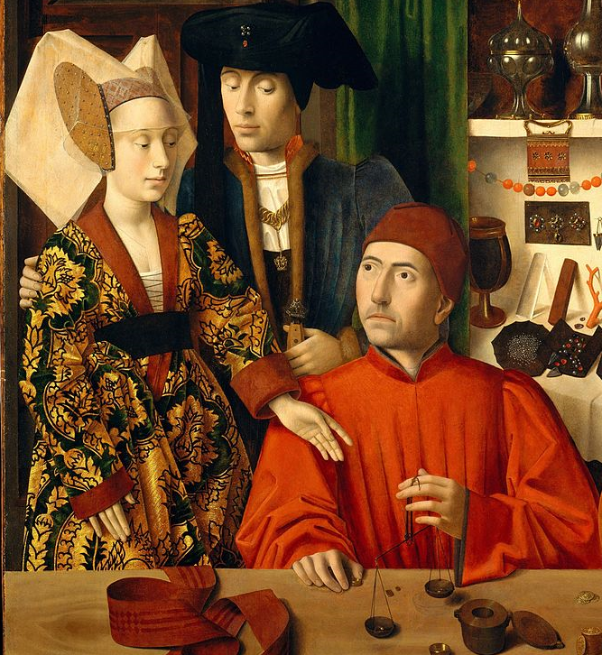
Audience(s)
Numerous audiences:
MLIS graduate students
All students, staff and faculty
General public
OER Community
Solution:
Varied levels of modules and multiple learning paths
Petrus Christus. 1449. “A Goldsmith in his Shop.”

Slide 11
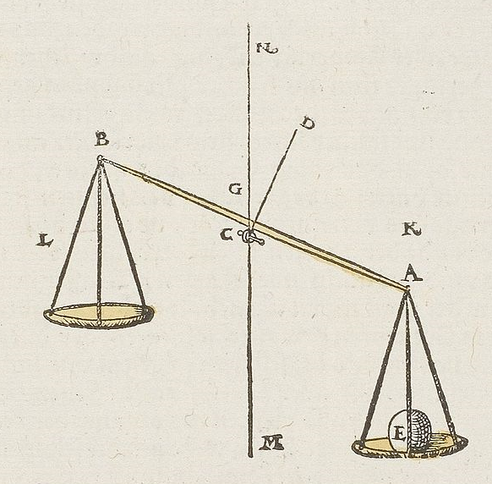
Technology and Infrastructure
Goal of employing existing infrastructure (primarily U of A Libraries)
Challenges:
Platform for H5P
Institutional Repository (ERA)
Libraries streaming service (ERA A+V)
Walther Hermann Ryff. 1547. “Waage.”

Slide 12
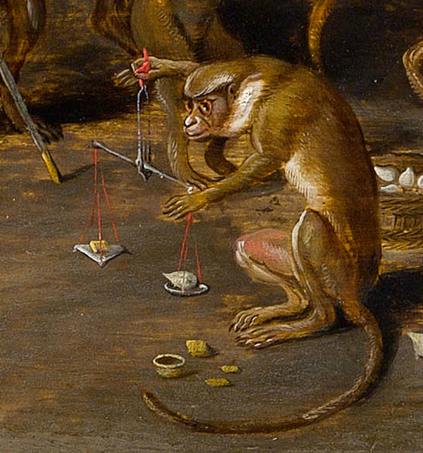
Project Control and Coordination
Never intended to be a solely U of A project, but limited by:
Lack of project manager/full time (or even part time) manager
Challenge of managing expectations
Time management
Copyright of academics surrendered
Jan Brueghel the Younger. ~1640. “Ein Affe Wiegt Eine Tulpenzwibel in Gold Auf.”

Slide 13
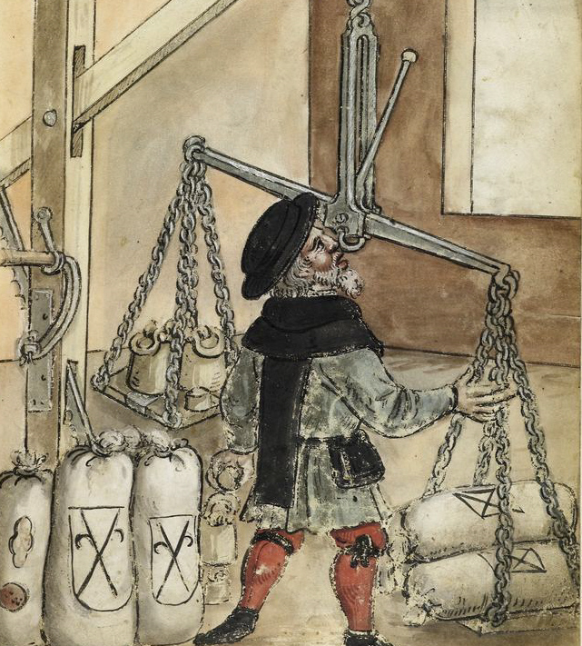
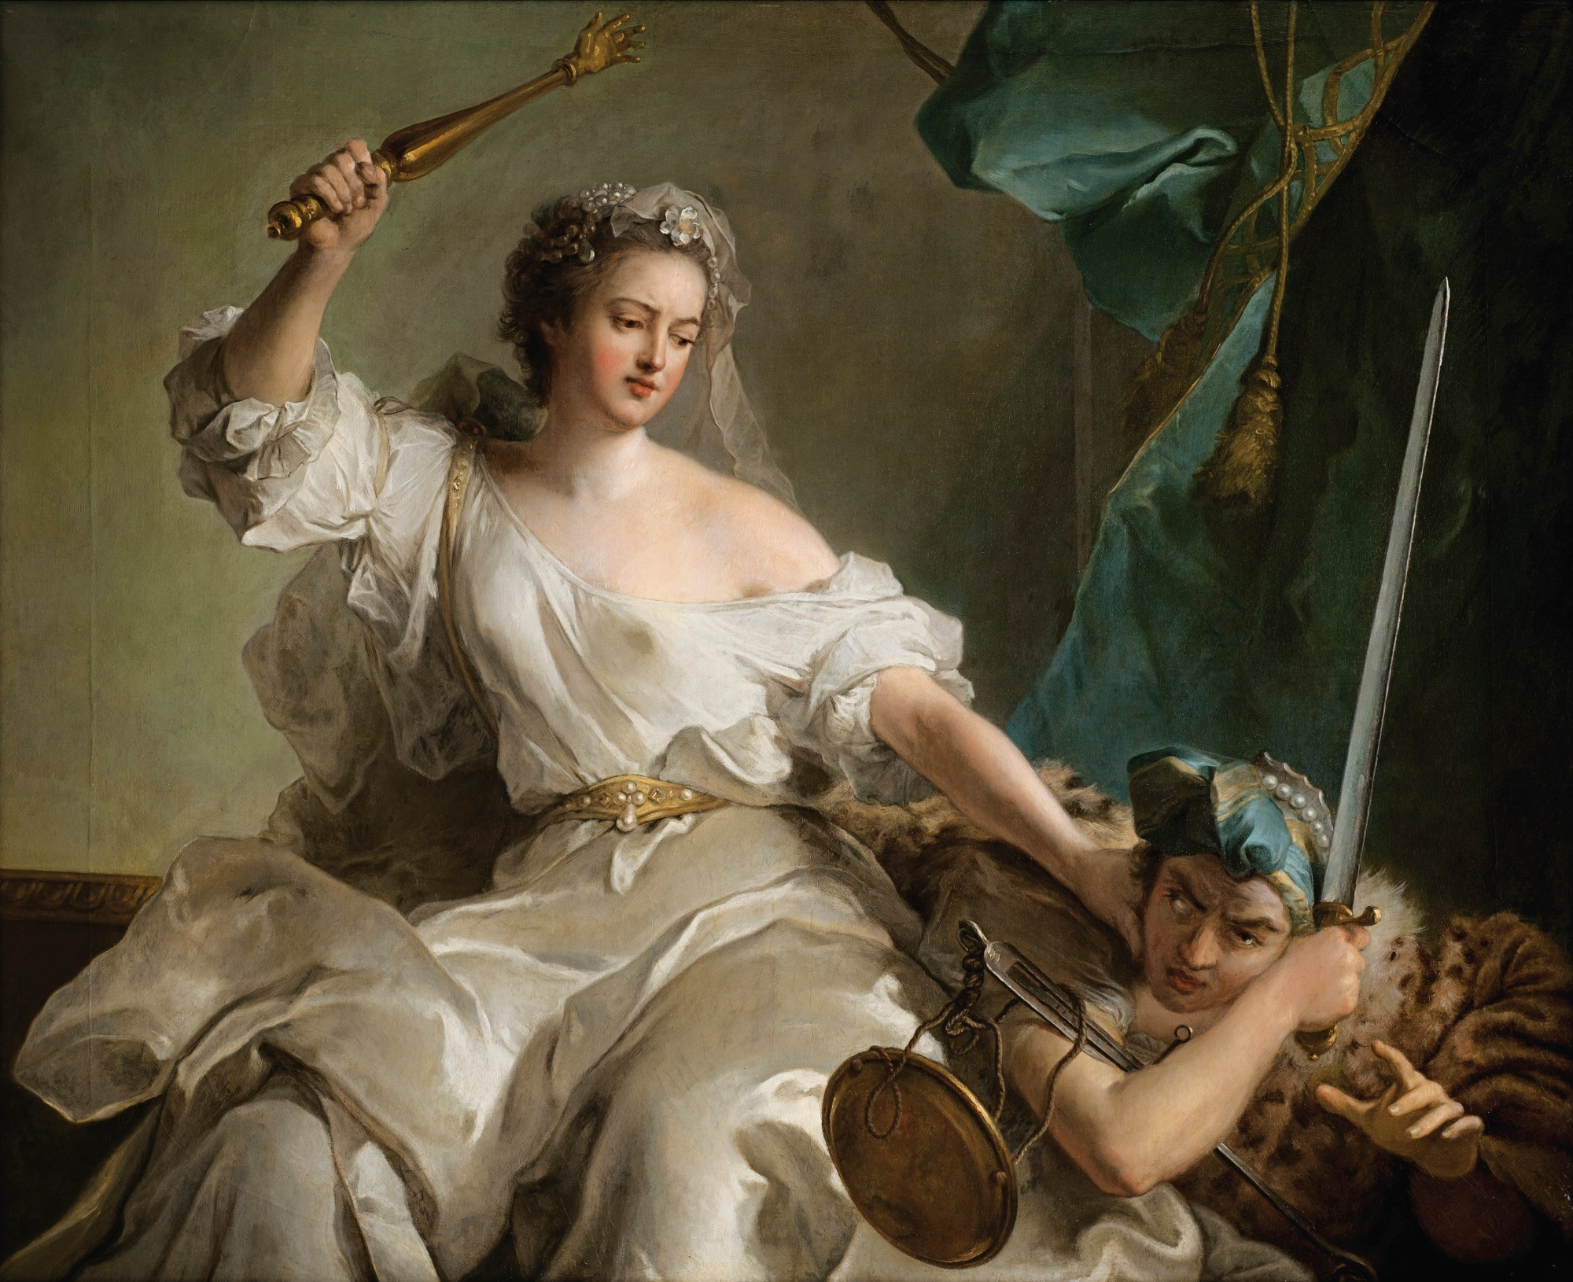
Conclusion
Maximizing openness has limitations;
  Particularly for video with interactivity
Institutional scale OER projects require ‘institutional scale’ support
Trial by Fire is ineffective for project management, but great for learning
Author Unknown. ~16thC. “Hausbuch der Landauerschen Zwölfbrüderstiftung, Band 1.”
Jean-Marc Nattier. 1737. “Allegory of Justice Punishing Injustice.”

