Slide 1
Strengthening Spectrum License Deployment Requirements:
An Analysis of the Path of Least Resistance for the AWS-3 Auction
Robyn Stobbs, MLIS
Jennifer Evaniew, MLIS/MBA Candidate
Dr. Michael McNally, Assistant Professor
Dr. Dinesh Rathi, Associate Professor
School of Library and Information Studies, University of Alberta

Slide 2
Overview
Spectrum Auctions in Canada
Deployment Requirements
Measure and Compare of Deployment Requirements
Notes:
AWS: advanced wireless service

Slide 3
Background:
Spectrum Auctions in Canada
Radio frequency spectrum is a finite resource.
Where demand exceeds supply the Canadian Government holds spectrum auctions to license different bands of spectrum.
This presentation focuses on the recent AWS 3 auction which was completed in March, 2015.
1750 – 1780 MHz and 2155 – 2180 MHz
(Industry Canada, March 2011)
Notes:
http://www.ic.gc.ca/eic/site/smt-gst.nsf/eng/sf01626.html
Advanced wireless services spectrum enables service for tablets, smartphones, and mobile devices.

Slide 4
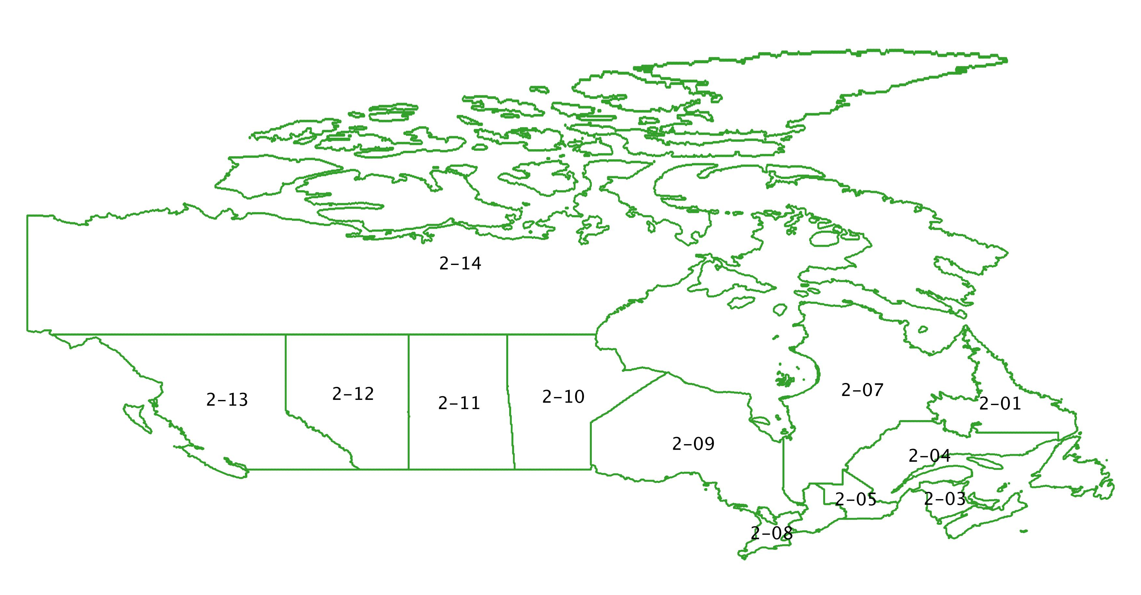
Tier 2 Divisions

Slide 5
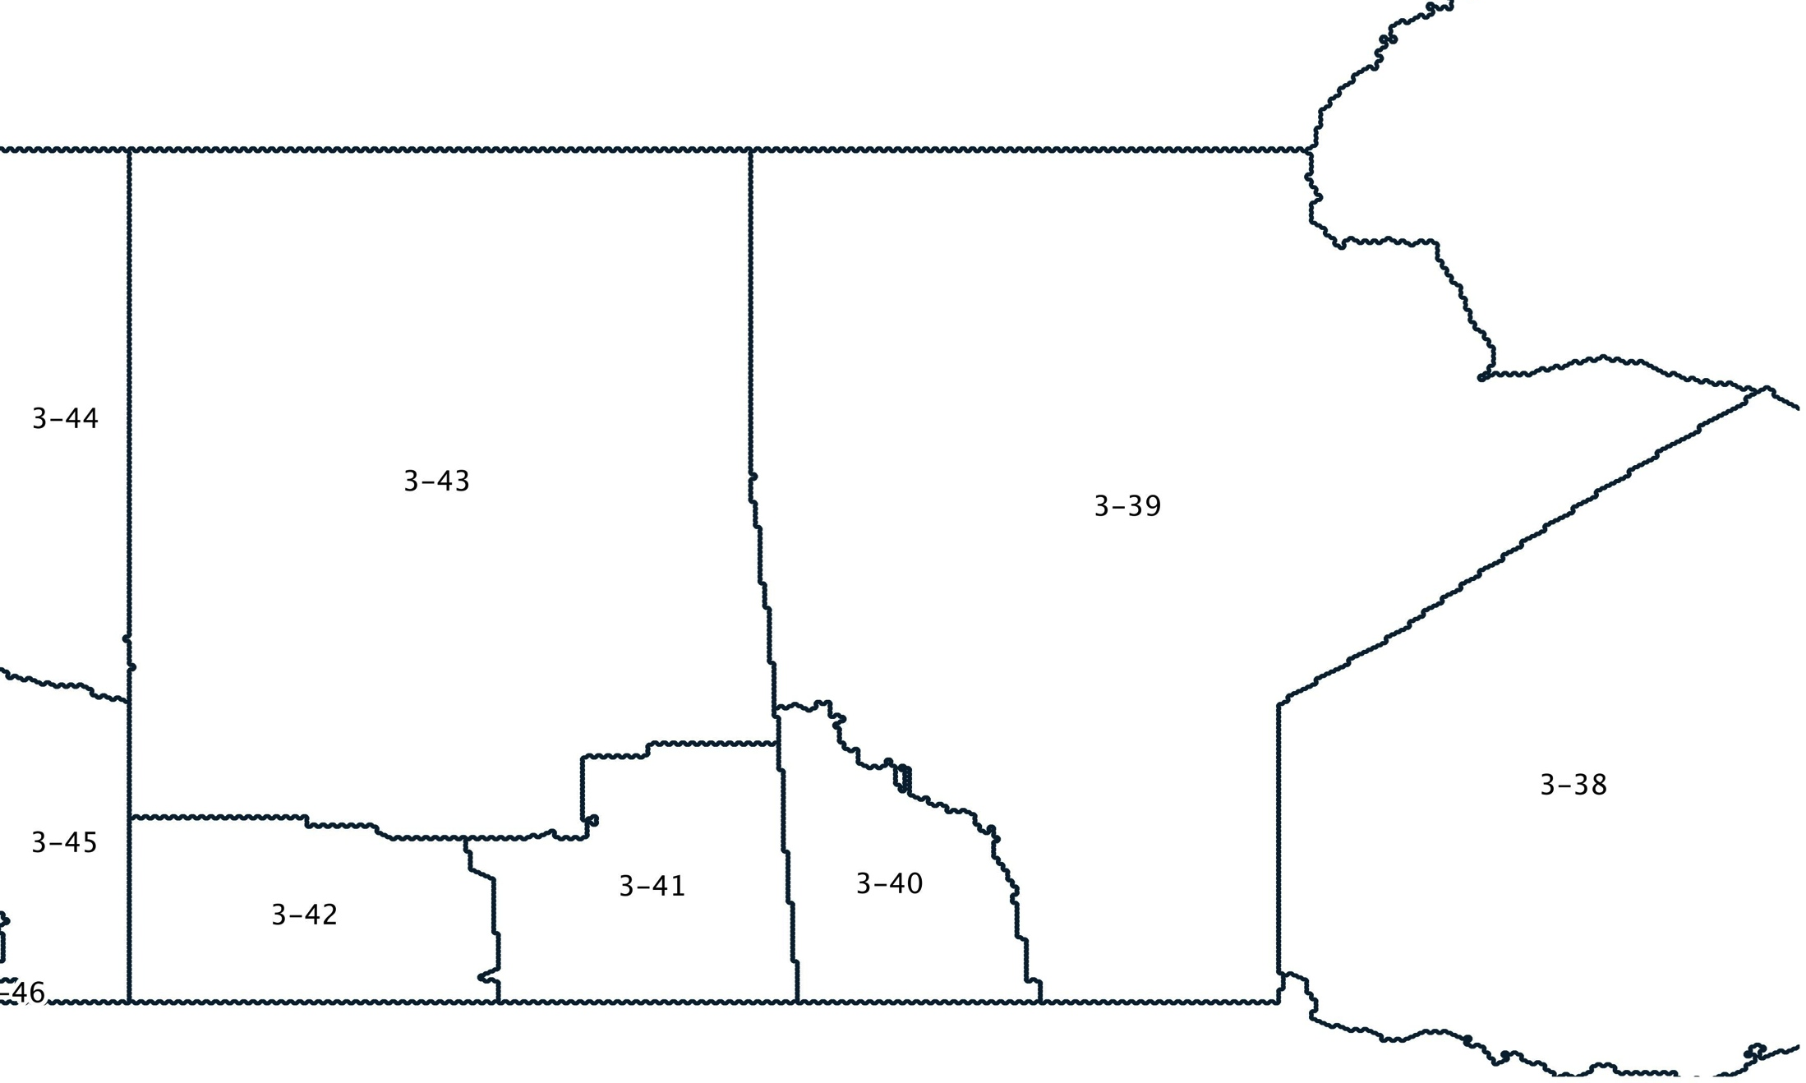
Tier 3 Divisions

Slide 6
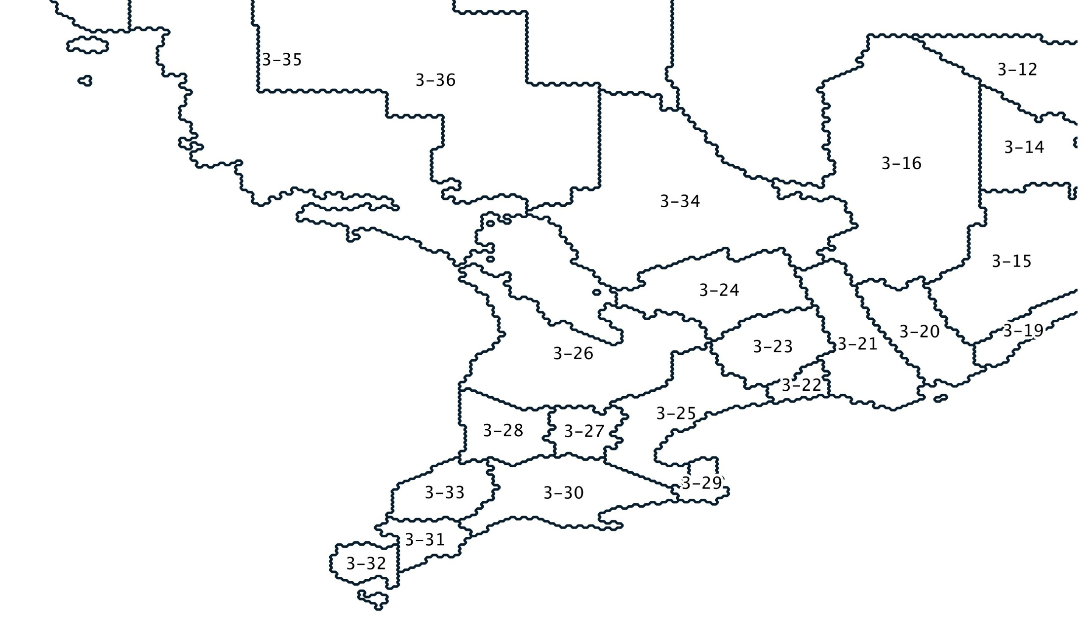
Tier 3 Divisions

Slide 7
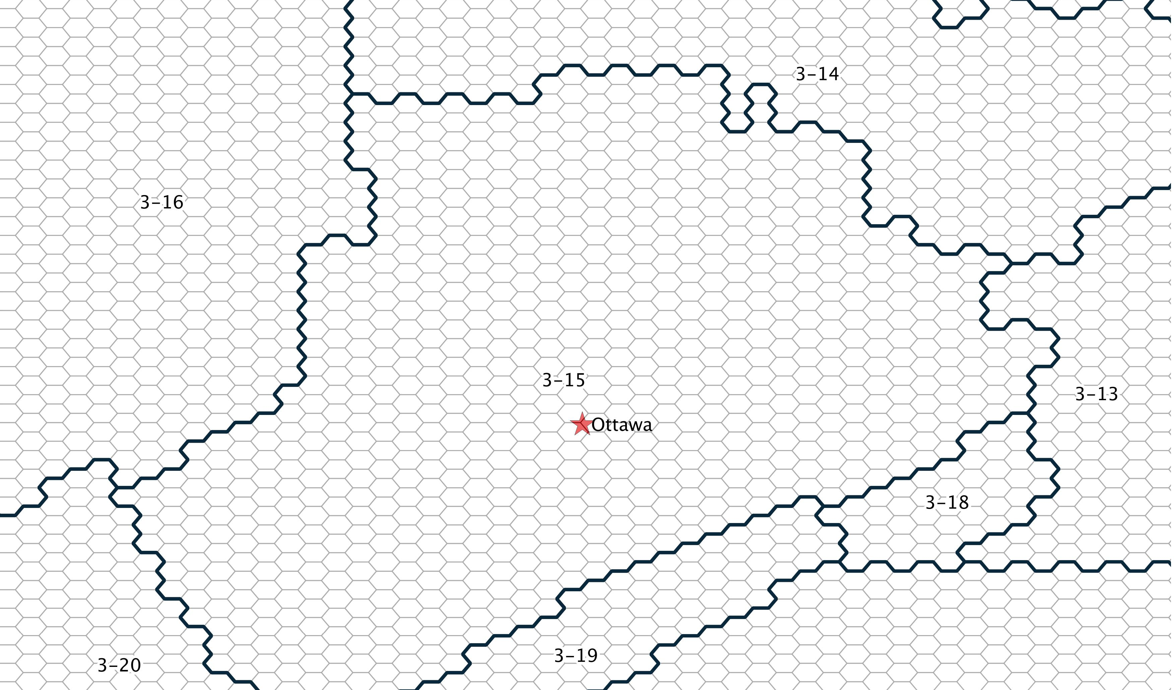
Hexagonal Grid Cells
Notes:
25 km2
Boundaries defined by grid cells are the boundaries used in any case where interference between licenscees is an issue

Slide 8
Deployment Requirements
Percentages of population to have service in a particular area. (e.g. 40% of tier 3-15).
The requirements are intended to ensure spectrum is used in a “timely manner” and to prevent purchase of spectrum to stop competitors from getting it (Industry Canada, July 2014).
Initially the targets from the previous AWS auction were to be used with longer time lines for AWS 3 and its tier 3 requirements.
Public consultations were here opened in July of 2014 and decisions announced in December 2014.
Notes:
We care because policy goals to increase access cannot be achieved if license holders do not have to provide that access. This is especially important in rural areas.
http://www.ic.gc.ca/eic/site/smt-gst.nsf/eng/sf10851.html#s9.3

Slide 9
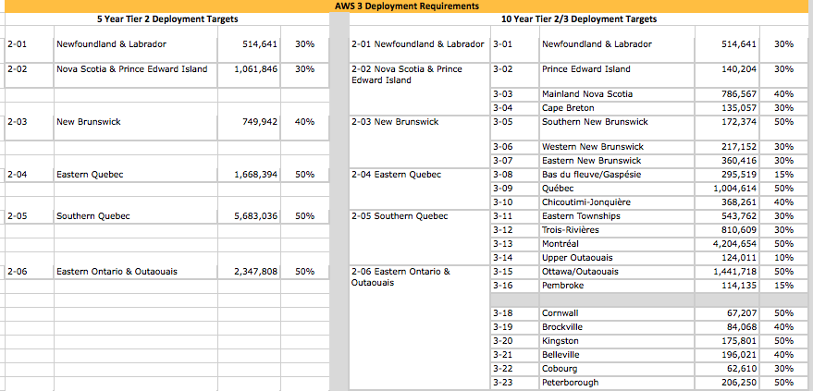
Deployment Requirements
Suggested Requirements before Consultation
Notes:
Before consultation the requirements were within 5 years at the tier 2 level and 10 at the tier 3.

Slide 10
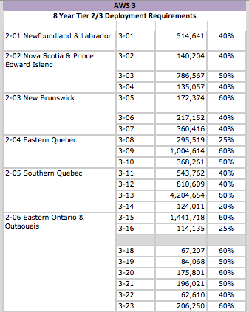
Deployment Requirements
Changed Requirements after Consultation
Notes:
After consultation higher the requirements were all given at the tier 3 level in an 8 year time frame. All tier 3 requirements were raised 10% as a result of the consultation. The timeframe of 8 years was given because Industry Canada was concerned about difficulties deploying (to allow providers flexibility), but the targets were increased for to encourage wider deployment.

Slide 11
Research Questions
What would be a measure or basis we could use to examine the possible effectiveness of deployment requirements for spectrum auctions?
Are the deployment requirements likely to result in provision of services in areas with lower population levels?

Slide 12
Method
Calculation of the least number of population centres within a tier that would need to be served to meet the roll-out requirements
We chose to use the centres with highest population to show the easiest or “least resistant” way a license holder can meet the rollout requirements.
Notes:
Using 2011 census data to get the population count for each centre. Population centres have a population of at least 1,000 with no fewer than 400 people per sq km
https://www12.statcan.gc.ca/census-recensement/2011/ref/dict/geo049a-eng.cfm
We did the same set of calculations with both the proposed requirements before consultation and the requirements that were changed as a result of the consultation.

Slide 13
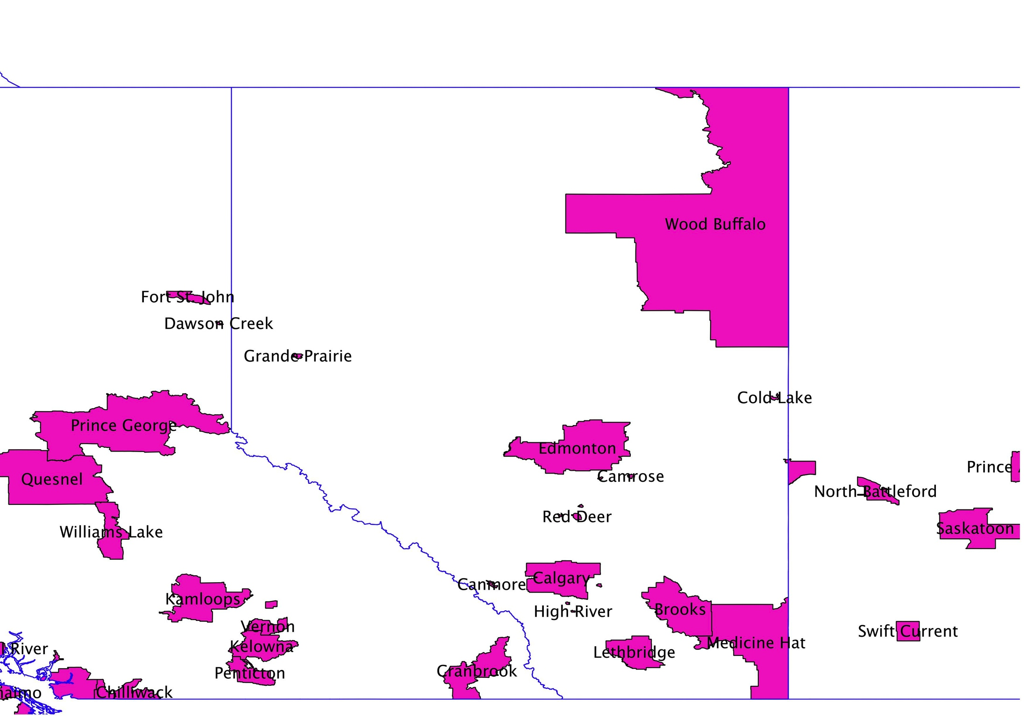
CMAs and CAs in Alberta
Notes:
We used population centres not CMAs because they are smaller, more precise geographic areas with denser populations (thereby making population centres easier to provide services to than CMAs). For example, the Wood Buffalo CMA in Alberta covers a large part of the northern end of the province. But has little population centres. By defintion as CMA can have larger spread: “: “A census metropolitan area (CMA) or a census agglomeration (CA) is formed by one or more adjacent municipalities centred on a population centre (known as the core). A CMA must have a total population of at least 100,000 of which 50,000 or more must live in the core. A CA must have a core population of at least 10,000. To be included in the CMA or CA, other adjacent municipalities must have a high degree of integration with the core, as measured by commuting flows derived from previous census place of work data” (http://www12.statcan.gc.ca/census-recensement/2011/ref/dict/geo009-eng.cfm)

Slide 14
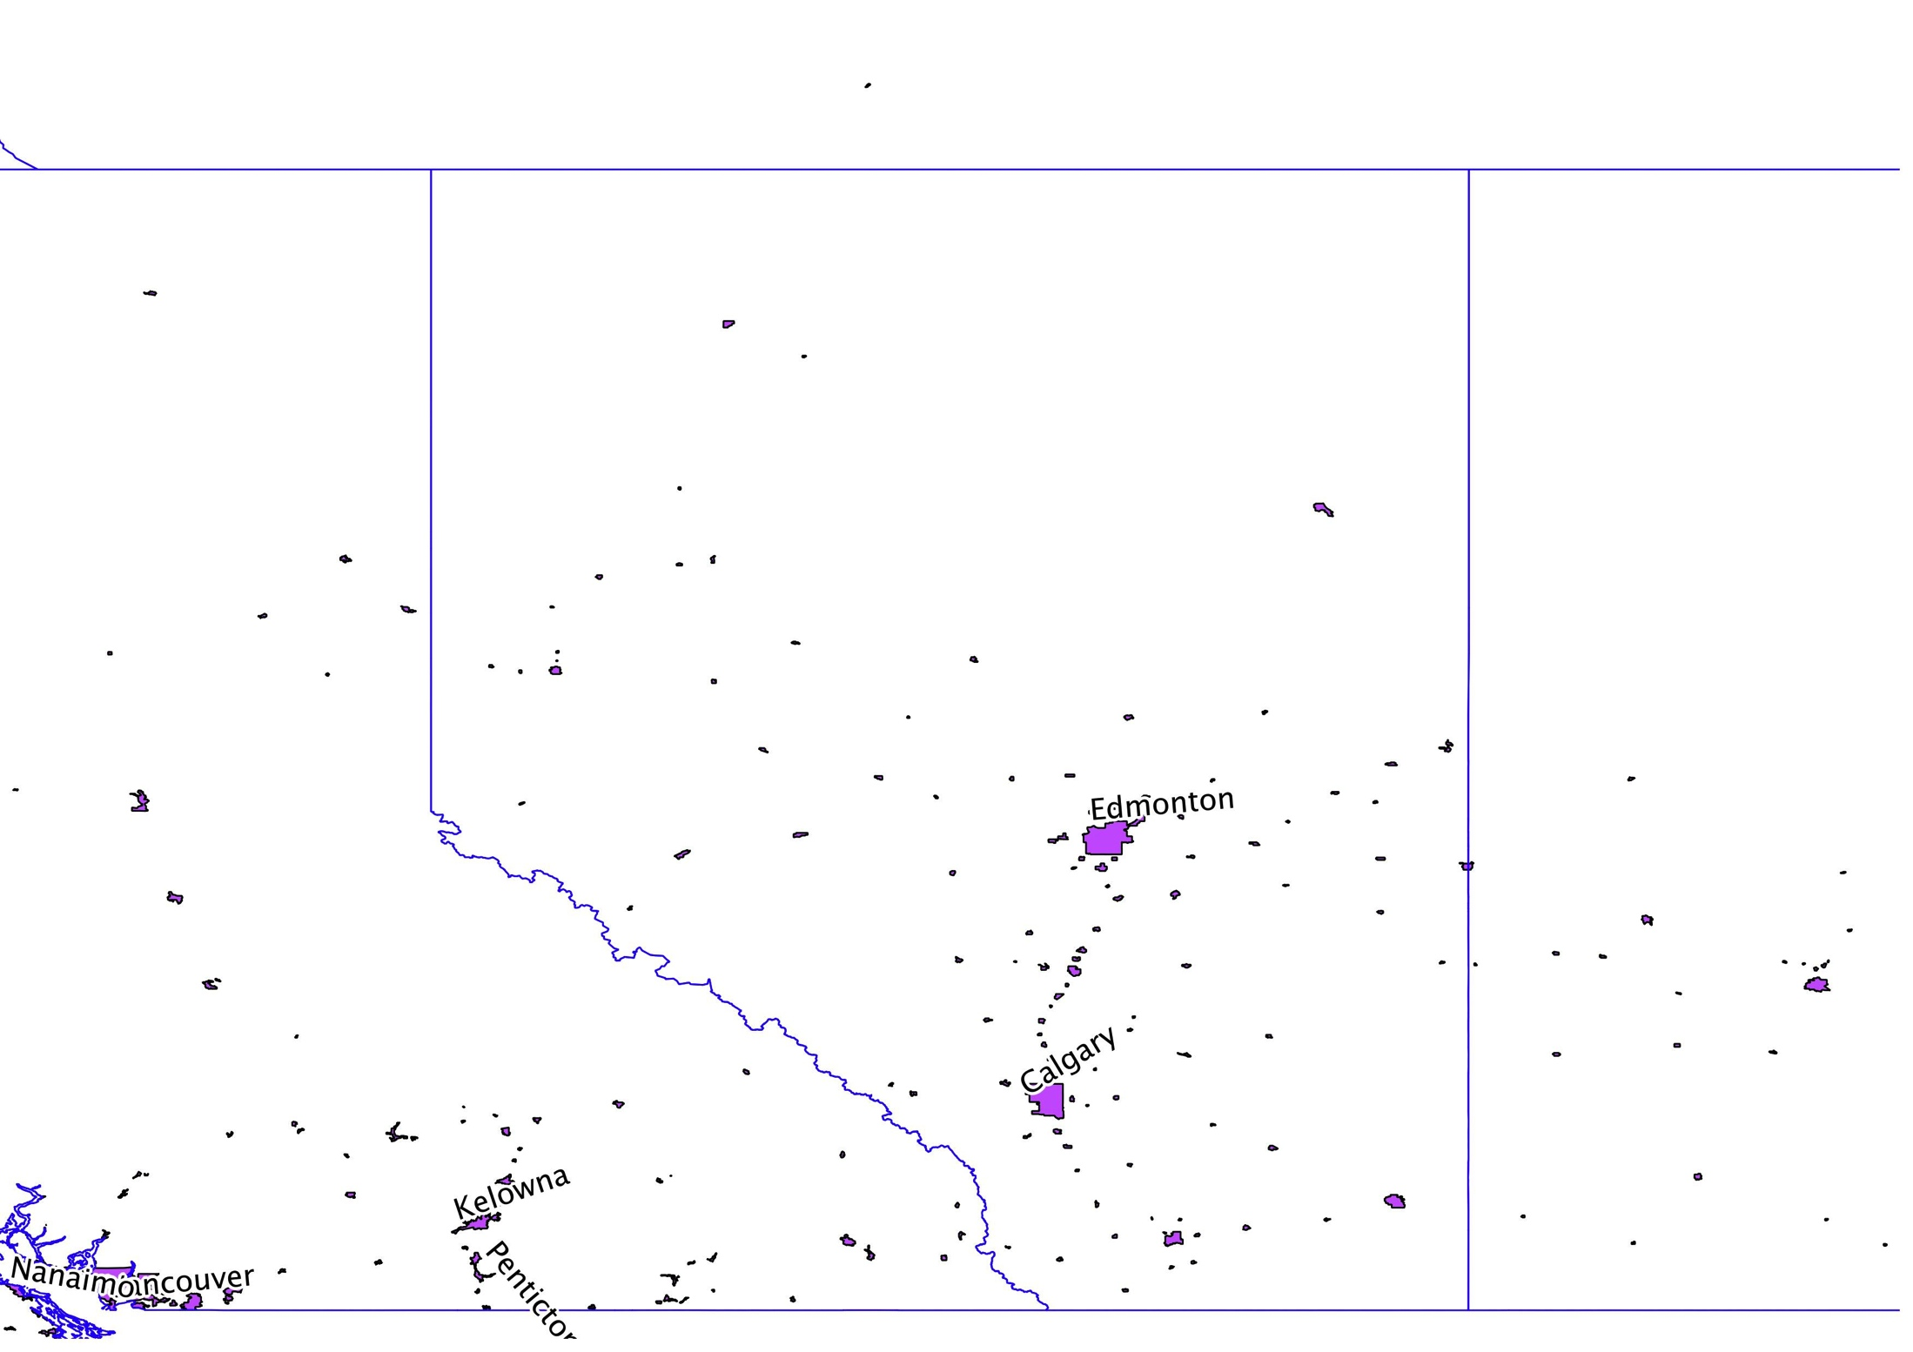
Population Centres in Alberta

Slide 15
Method
Notes:
Using the map and selecting one tier at a time, I compared it to census data tables listing highest population centres by highest population per province (or in this case both Ontario and QB as tier 3-15 spans provincial boundaries)

Slide 16
Calculation Example:
Ottawa - Gatineau
People in Ottawa-Gatineau
People in Tier 3-15
Suggested requirement (before consultation): 50%
Requirement after consultation: 60%

Slide 17
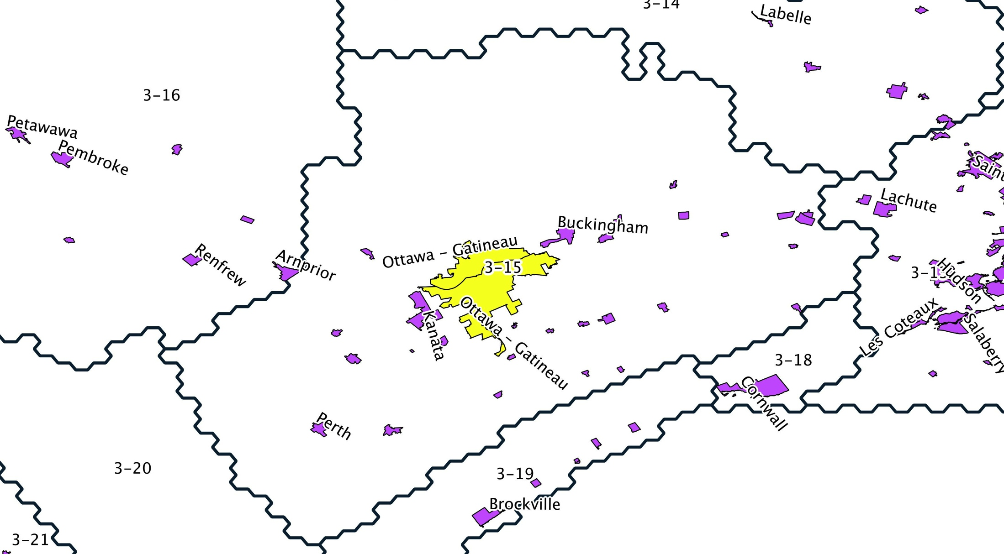
Method
Notes:
So the purple area in the middle, delineating the Ottawa Gatineau population centre, would be the only area that would have provision of services to meet the requirements.

Slide 18
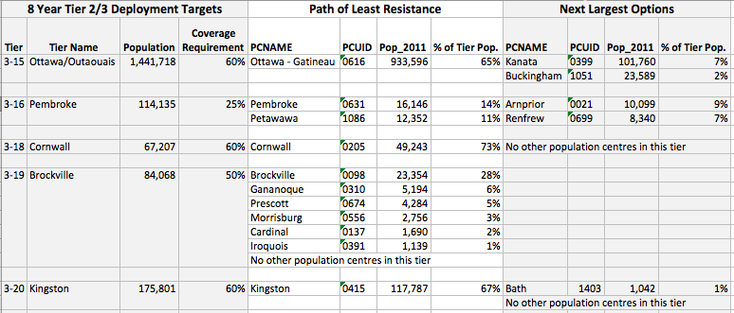
Method

Slide 19
Results
There was a noticeable increase in number of population centres that would require coverage in particular tiers with the new requirements.
36 tiers would require more population centres to receive services.
23 tiers would not require more population centres to be covered.

Slide 20
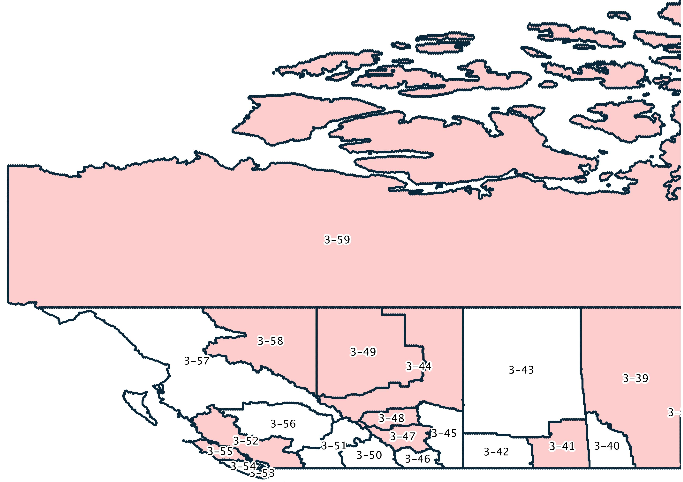
Results

Slide 21
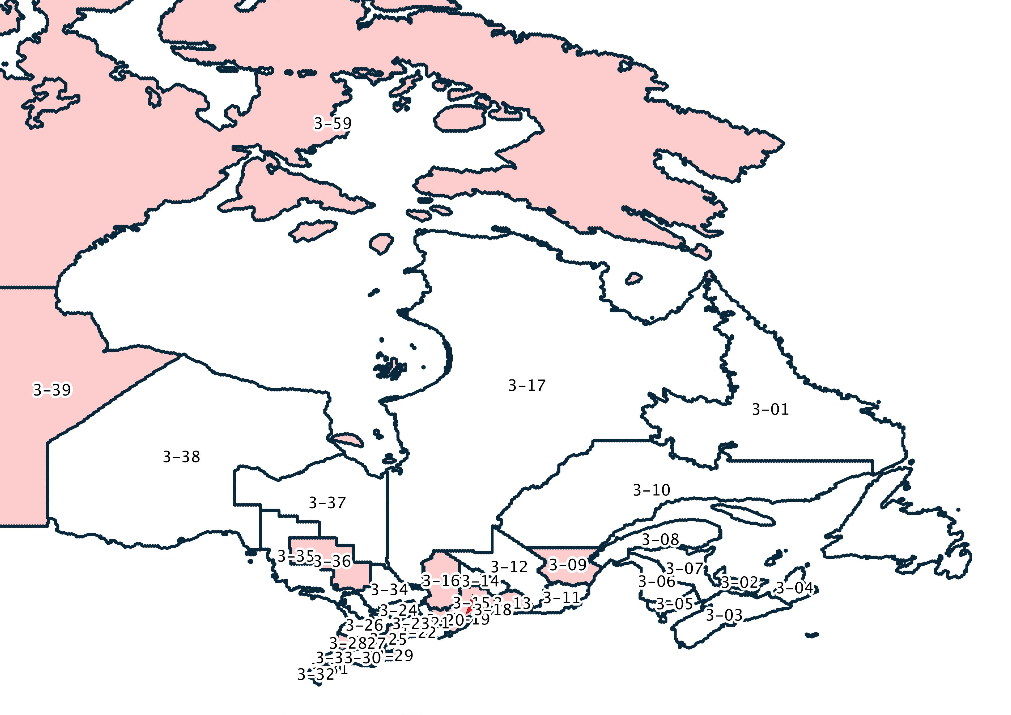
Results

Slide 22
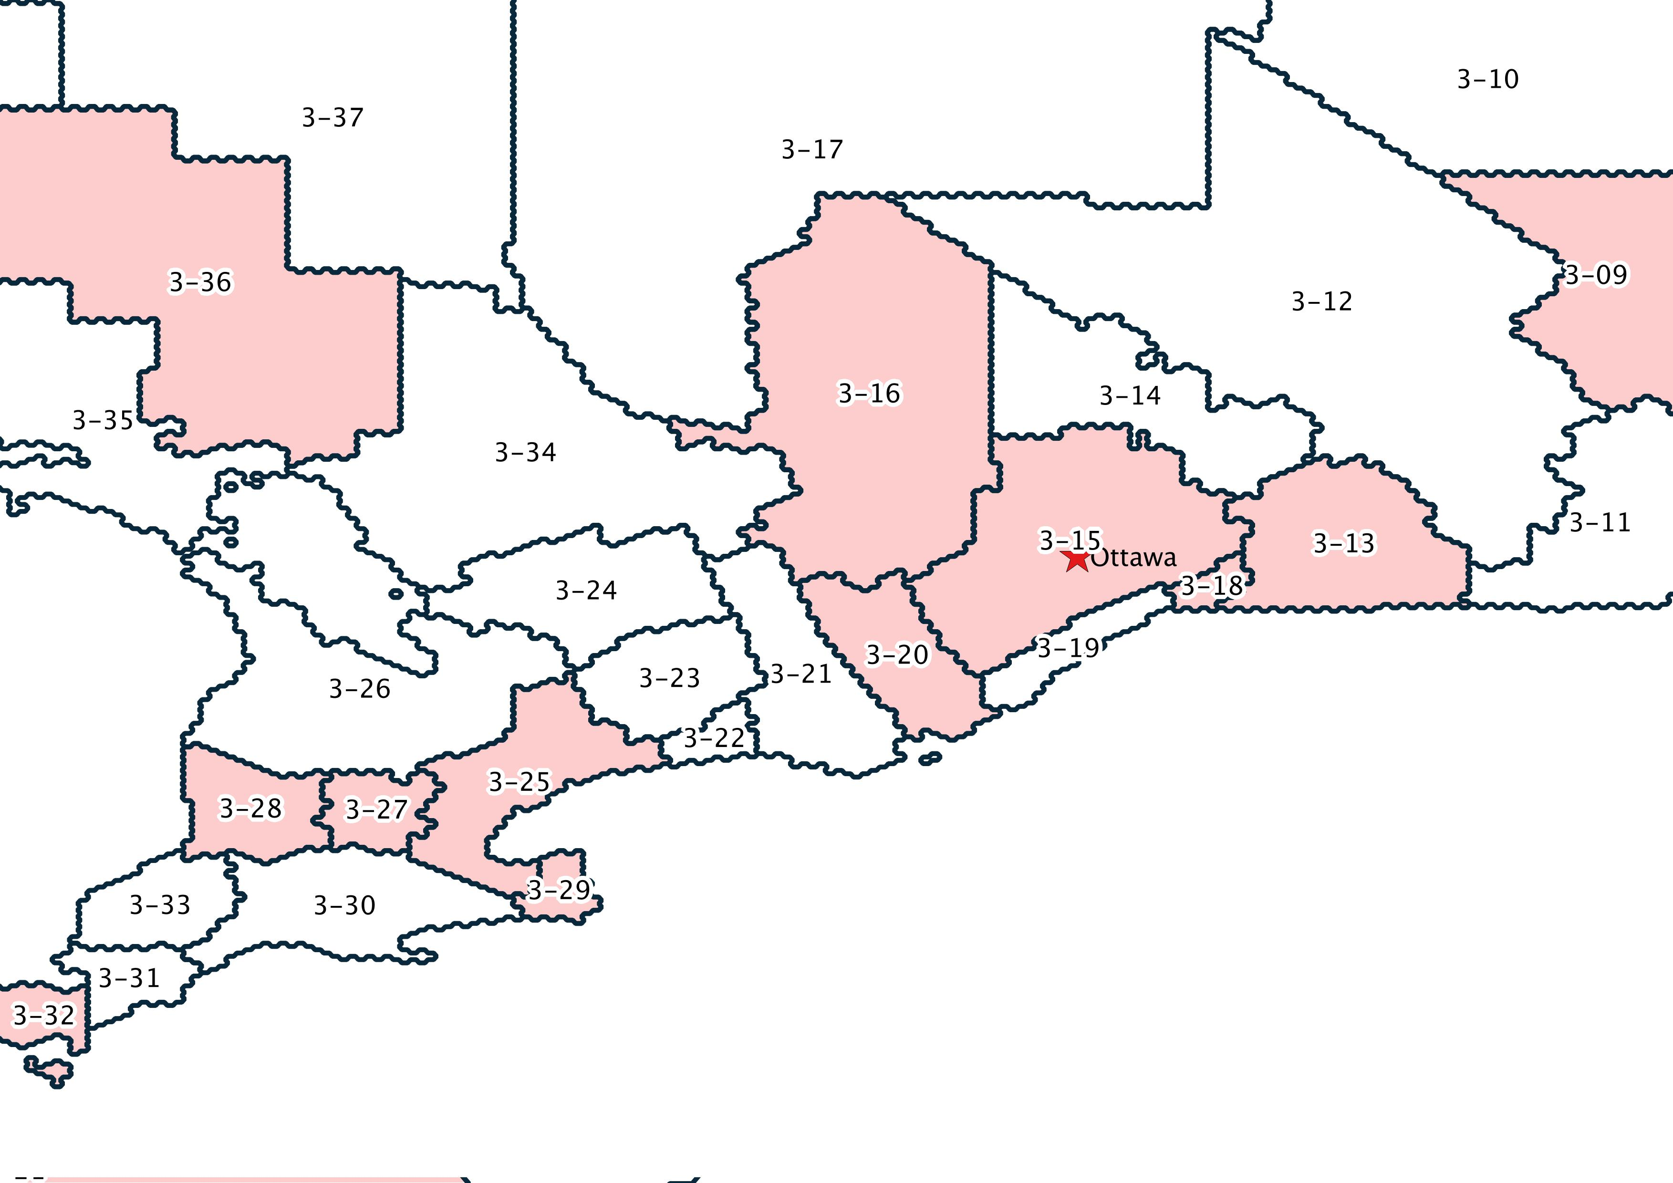
Results

Slide 23
Results – Least Resistant Path
Before Consultation
After Consultation
5/59=8% of tiers require coverage for more than two population centres
25/59=42% of tiers require coverage to population centres that are home to less than 20% of the population of that tier
17/59=29% of tiers require coverage to population centres that are home to less than 10% of the population of that tier
29/59=49% of tiers require coverage for more than two population centres
39/59=66% of tiers require coverage to population centres that are home to less than 20% of the population of that tier
32/59=54% of tiers require coverage to population centres that are home to less than 10% of the population of that tier

Slide 24
Implications & Conclusions
Calculating the least resistant path to meeting the deployment requirements provides a way of measuring their possible effect.
Least resistant paths to meeting deployment requirements can be used to make recommendations for future consultations.
The recent consultation for the AWS 3 auction resulted in increased deployment requirements that require service to more population centres when that is the measure used.

Slide 25
References
Industry Canada. (2015, March 6). Auction of Spectrum Licences for Advanced Wireless Services in the Bands 1755-1780 MHz and 2155-2180 MHz (AWS-3) - Spectrum Management and Telecommunications. Retrieved May 18, 2015, from http://www.ic.gc.ca/eic/site/smt-gst.nsf/eng/h_sf10917.html
Industry Canada. (2014, July 28). Consultation on the Technical, Policy and Licensing Framework for Advanced Wireless Services in the Bands 1755-1780 MHz and 2155-2180 MHz (AWS-3). Retrieved May 18, 2015, from http://www.ic.gc.ca/eic/site/smt-gst.nsf/eng/sf10851.html#s9.3
Industry Canada. (2011, March 14). Framework for Spectrum Auctions in Canada. Retrieved May 18, 2015, from http://www.ic.gc.ca/eic/site/smt-gst.nsf/eng/sf01626.html
Statistics Canada. (2012, December 11). Census metropolitan area (CMA) and census agglomeration (CA) - Census Dictionary. Retrieved May 18, 2015, from http://www12.statcan.gc.ca/census-recensement/2011/ref/dict/geo009-eng.cfm
Statistics Canada. (2012, December 4). Population centre (POPCTR) - Census Dictionary. Retrieved May 18, 2015, from https://www12.statcan.gc.ca/census-recensement/2011/ref/dict/geo049a-eng.cfm

Slide 26
Acknowledgements
This research was supported by the Social Sciences and Humanities Research Council of Canada.

Slide 27
Contact Information
Robyn Stobbs: stobbs@ualberta.ca
Jennifer Evaniew: jennifer.evaniew@ualberta.ca
Dr. Michael McNally: mmcnally@ualberta.ca
Dr. Dinesh Rathi: drathi@ualberta.ca

