Slide 1
Making Videos for
Education and Instruction
Julia Guy & Michael B McNally
Maskwacis Cultural College Micro-Learning Session
Feb. 10, 2021
Except some images
Notes:
Hello and thank you for joining us today. Before we begin I want to acknowledge that although many of us are joining from different places, Julia and I are currently live and work in Treaty Six territory which is also Metis Region Four, which is a gathering place for many First Nations, Metis and Inuit peoples, and of course Maskwacis Cultural College is situated in Maskwacis Alberta, which is comprised of the Louis Bull First Nation, the Ermineskin Cree Nation, Samson Cree Nation and the Montana First Nation. And I want to specifically thank and highlight the incredible roll MCC, its library and Manisha have done for creating an outstanding series free, openly accessible learning opportunities for us over the past several months (and this of course continues a long trend of hosting many events before the pandemic). It is really incredible the work Manisha and her colleagues have taken on. I also want note that as we begin our discussion of making videos today, whether for education or other purposes, video remains a great mechanism for all of us to learn about each other whether that is in large undertaking such as the Indigenous Canada MOOC or even small Tik Tok videos. And with that I’ll turn it over to Julia.

Slide 2
Who we are
Julia Guy
Michael B McNally
BFA in Acting, U of A
MA/MLIS Student, U of A
Associate Professor
Faculty of Education, U of A

Slide 3
Background
DigitalNWT
Opening Up Copyright
… and LIS 526: Instructional Practices in LIS
Notes:
Julia and I have been working together for a few years now on a couple of different projects - both of which have involved the development of instructional videos. DigitalNWT is multi partner project led by the Gwich’in Tribal Council (GTC), the Inuvialuit Regional Corporation (IRC), the Sahtú Renewable Resources Board (SRRB), and the Tłı̨chǫ Government. These organizations are partnering with the University of Alberta, the Smart Communities Society (NWT), Hands On Media Education, and Aurora College to create a series of digital literacy courses and educational resources for communities across the territory. While video wasn’t originally part of the project, as the focus was on hands on interactive, in person digital literacy workshops, because of the COVID-19 pandemic, video has become one important part of curriculum. This has created some challenges which we will touch on in terms of considering video as an instructional medium for learners who may be new to digital devices and communities with poor and very expensive internet.
The other project we are involved in is the University of Alberta’s Opening Up Copyright instructional module series that is creating a set of openly licensing, interactive instructional videos on copyright. Currently have 30 videos available, 15 of which Julia created, and several more in the works, and throughout this project we’ve gained several insights on working in video, considerations around openness and trying to bring to life a subject as dry as copyright.
And I also teach a course on instructional practices in librarianship, which covers video in part, so I bring some insight from that context, and generally teaching in an online as well as face to face environment as well.

Slide 4
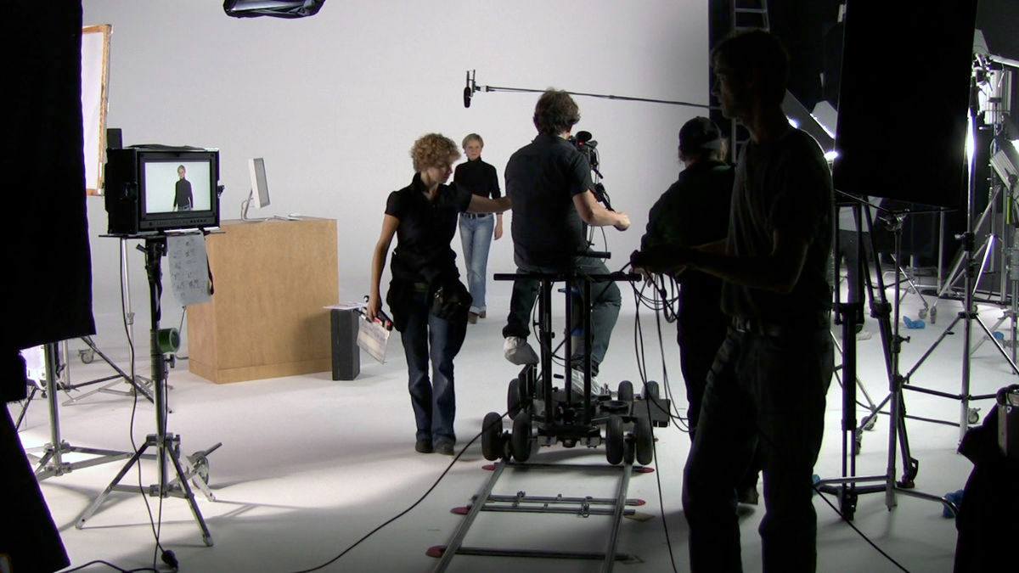
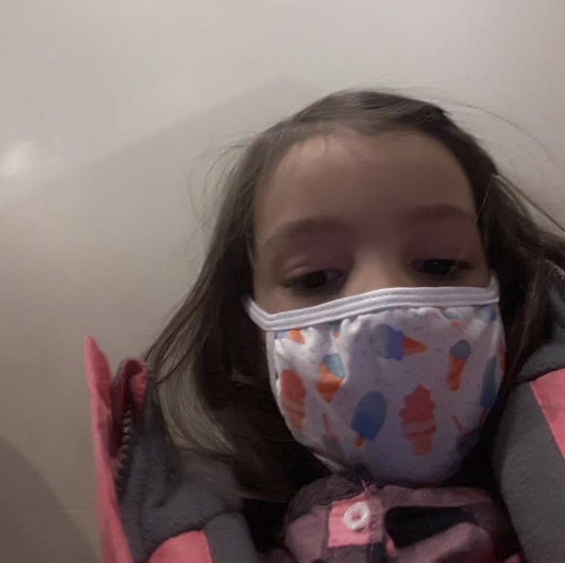
Democratization of Video
What making videos used to look like...
...and what is plausible in 2020.
Notes:
Previously making educational or instructional videos required a wide variety of skills and technologies that were well outside what was commonly available. Over the past 25 a combination of changes have altered and ultimately lowered the barriers to making educational videos. Recording technologies, digital camcorders and now simply smartphones have become increasingly common. Editing tools have also simpler to use and more readily available. And of course the internet serves as a distribution platform - one doesn’t need to mass produce tapes or DVDs, though in some context physical media still plays a role, but more on that later.
While these changes have been taking place over the past two decades, more recently we’ve also witnessed social change in how instructional videos are perceived. Through online video platforms, and YouTube in particular, a short how to video often filmed on a phone by a single individual now meets many peoples’ expectations of what an instructional video can and even should look like. This change of perception includes how the presenters of videos are viewed. Although a filmed instructional video from the 1980s may require a professorial appearing character ‘on the set’ - in a white lab coat in a laboratory, in front of a series of bookshelves, or behind a lecturn, now given the context seemingly anyone might appear in an instructional video, even a child.
Finally, in the current context, where many of us, particularly in the educational sector are still working from home, a ‘film studio quality production’ is beyond most people's’ expectations. Given all these changes anyone can be an educational video maker, but there are still a complicated set of decisions you should think through.

Slide 5
Best Practices
Have learning objectives
Use scripts
Use conversational narrative
Include interactivity
Avoid jargon and chunk content
Keep videos short (~3-4 min)
Avoid text filled blocks
Notes:
There are numerous articles covering best practices for video design, and we’ve included them in the references at the end of the presentation, but several common suggestions emerge including having learning objectives, which can be quite useful for focusing on instruction, and unless your audience is captive, they are not likely interested in a rambling and unfocussed video (though I’m sure the students in my courses would suggest I have yet to take this best practice to heart). We’ll talk more about scripting, narrative and interactivity throughout the presentation.
Chunking of instructional content, is of course a basic behaviourist principle, and does work well in video context. Depending on the size and scope of the project, you may need to consider chunking in terms of how many videos, and also within each videos. You may even want to consider the chunking process storyboarding.
Related to chunking is the idea of length. Ideally videos are short and focused - break longer videos into smaller chunks. Repeated studies have shown that it is hard to keep an audience engaged, and we’ve found that as well in the Opening Up Copyright project - while the suggested 3-4 minute range is where most of the sources in the literature point, we’ve found that that can be pushed to the 6-8 minute range in most cases, but longer than 10 is almost always too long (even for videos using puppets).
Sources for the points:
Have learning objectives (Evans, 2014; Weeks and Davis, 2017; Lo and Dale, 2009)
•Use scripts (Weeks and Davis, 2017; Clossen, 2014)
•Include interactivity (Lo and Dale, 2009; Martin and Martin, 2015; Smith, 2010)
•Avoid jargon and chunk content ( Weeks and Davis, 2017; Lo and Dale, 2009; Clossen, 2014; Martin and Martin, 2015; Smith, 2010)
•Avoid text filled blocks (Clossen, 2014)
•Use conversational narrative (Martin and Martin, 2015)
•Keep videos short (~3-4 min) (Evans, 2014; Weeks and Davis 2017; Smith, 2010)

Slide 6
The Wall of Text
Large blocks of text are highly disengaging. While including a full quotation that is particularly significant is fine, it should be used sparingly as lengthy blocks of text can challenge viewers. Literally reading blocks of text is disengaging, but if there is variation between what is being said and what is written then the viewer ends up splitting their attention between the two and the video becomes less effective.
Given the visual and auditory nature of the medium, and the fact that in most contexts users can go back and ‘rewind’ or replay parts of a video there really isn’t a need for dense walls of text, as this slide has likely shown.

Slide 7
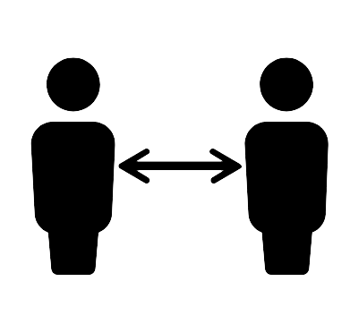
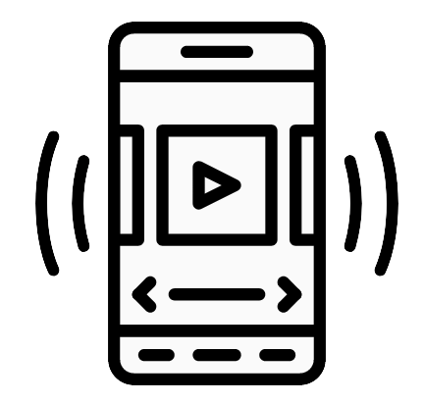
Video Benefits and Challenges
Benefits
Challenges
Visual (and auditory)
Varied medium
Viewer control
Distanced
Demanding
Notes:
When thinking about instructional and educational videos, a good question might be “think about the last time you watched a how to video” not “have you.” Everyday people on earth watch over a billion hours of video (YouTube, N.d.). That is over 100,000 years worth of time, and while certainly not everything on YouTube is instructional or educational, for many problems and particularly younger learners it is the starting point for learning about something.
Video, particularly recorded video, offers many benefits, and of course is not without challenges. For certain performative based subjects, video is a much prefered instructional mechanism. Think about how easily you could make a video of tying shoelaces. Now think about writing that out on paper or drawing a series of visuals. Many activities are well suited for being explained and unpacked in a video format, though there are limitations - things that are really big in scale or really small in scale can be difficult to film without specialized equipment. However, things that take a long time aren’t necessarily problematic, as there are simple workarounds - speeding up recorded film or just filming the beginning and end. For example, for baking videos, a common instructional topic, you really don’t need to film the actual baking part, it is the preparation and final presentation that matters.
Video also allows for a variety of visual and audio elements to appear together. You can have text or images on screen and narration or sound effects can complement this. While this does require some consideration - it is certainly possible to have audio and visual elements out of alignment or simply too busy, these are surmountable problems. We’ll talk more later about different styles of instructional videos.
A key benefit of recorded, as opposed to live only videos and certainly in person instruction, is that viewers can take them in at their own pace. While the term rewinding is certainly archaic in a digital context, this can allow for a quicker pacing of material. While smartphones have facilitated changes in how instructional videos are produced, they have also altered the dynamic of how easily videos can be viewed. Freed from the TV screen or projector, video can often reach remote learners, and thus can help overcome some limitations of geography, though broadband access and smartphone ownership are certainly not universal.
Despite these advantages, there are several reasons why video is not the sole instructional form. It is certainly easy to note that, especially in the current context, being in an in person environment with other learners and a physically present instructor is something that many people still enjoy and value. While interactivity is not impossible with video, it is a more passive medium than an in person classroom with active learning incorporated.
Producing video, as well discuss, can also be a laborious process. The scholarly literature (Martin and Martin, 2015; Saines, 2011) on video making suggests you may spend upwards of several hours creating a minute of video, and based on our experiences, this certainly can be the case. To build something of higher production quality, it takes a lot of time. Concomitantly, editing of video is also a challenge. Editing a textual document is relatively painless. Editing video has become much simpler, but is more work. Relatedly, going back and editing video that was produced a few weeks, months or even longer ago can be extremely challenging. Unlike textual based educational materials, it is much harder to make video timeless.

Slide 8
The Three Parts
Pre-Production
Production
Post-Production
Script
Audience
Interactivity
Delivery
Recording
Purpose
Assessment
Editing
Format
Design
Distribution
Materials
Skills
Notes:
Often when thinking about creating videos, emphasis is put on the step of actually recording the video raising questions such as - what kind of video will it be, how will it be recorded, what kinds of things are needed to be in the video whether that is physical objects or digital assets. [C] Production is certainly a key part, but the steps before, pre-production and post-production are also quite important, with pre-production considerations having a large impact on production and post-production. That said, you also have to consider some elements in post-production as early on as pre-production.
Ultimately the process looks more like this - [C] a complex web of interrelated decisions.
Generally the way the work is split among the three steps is closely related along the rough idea that less time spent in any one step will mean more time spent in another step. Don’t carefully think through pre-production - then your filming or recording and post production will take longer. Conversely, if you do a bunch of work up front, and are aware of some of the downstream considerations, you can save yourself time later on. As a simple example, you can decide early on whether you want to have a video that features narration over slides/images that is scripted, and that will require more work in scripting, but should save time in production and post production. Or you can choose to not script things and record live takes appearing directly in the video, but you may end up having to record parts a few times and do more editing work. There isn’t a right answer or single best approach, though there are some best practices, and thinking through big questions such as audience and purpose are key starting points and can really shape most of the subsequent decisions.

Slide 9
Audience
Precision
Engagement
Accessibility issues and considerations (subtitles, descriptive video etc.)
Does everyone have internet or access to a computer for this?
Is this something others might adapt/improve? (Is there a secondary audience)
Reusability
Joseph’s ‘Iron Triangle’ - an insight from Opening Up Copyright (Joseph et al., 2019)
Notes:
Usually, when people set out to make a video they may have a good sense of audience - be it a class or group of colleagues, perhaps a broader community of practice or maybe the general public. Thinking about who is going to watch the video and their context is a key starting point. However, considering audience involves more than just a quick consideration of ‘who’.
We’ll talk more about accessibility and universal design later, but video for some learners is not an ideal approach. Subtitles, descriptive video, making a transcript available, are all factors to consider here. Another consider is how are people going to watch the video? As we’ve considered with the DigitalNWT project you can’t simply mail a computer and USB to someone who has never had a computer before and expect them to necessarily be able to just start watching a video. Internet is another important consideration. Challenges with internet are three fold, and the pandemic has really helped bring this to the forefront. You should consider not only if viewers will have internet for accessing videos, but also, if they have internet connections that are fast and reliable enough for streaming video, and also if they will run into problems with data caps.
Another device based consideration. Video is effectively always made on a computer with a screen of 11 or more inches, but there are an entire generation of learners whose go to screen is a phone half the size of that at best. Subject also comes into play here. If you are creating an instructional video that might be something geared towards people watching on a phone - you’ll need to keep in mind that you don’t have the same screen real estate, and you will also probably want to keep things shorter in length and a smaller file size.
If you are making educational videos, you might want to consider downstream users. We will talk more about openness and open licensing later, but if you are making videos that others might want to adapt or improve that inserts all kinds of new questions in to the design process from what kind of software do you use to what kind of content you can put in your video.
One of the insights we came upon while working on copyright videos in particular is the relationship among precision or how specific/technical a video is, engagement and reusability - how easy is it for someone else to adapt a video. You can’t get the most out of all three at once - it is much the same as the ‘good, fast, cheap’ project management concept. With video there are always tradeoffs, but how you decide on what option to take, should always be based in consideration of your audiences.

Slide 10
What do you want to accomplish?
OBJECTIVES
Break it down to specific goals.
What are the Learning Objectives for the viewers?
How do you want viewers to feel?
How do you want to come across?
PURPOSE
Why are you making a video?
What should it do?
E.g. warn, prepare, inspire, motivate, welcome etc.
Educate
Entertain
Engage
Notes:
It is very important to be clear about what the purpose of the video is and any other objectives you might have. In this presentation we are talking about educational or instructional videos but there are many different purposes for educational videos. For example a safety video’s purpose would be to warn, prevent, and prepare. You would want to warn people of danger, prevent accidents, and prepare people to respond to emergencies. An educational video on developing educational programing for kids would have totally different (inspire teachers and provide helpful tools for example). The purpose is what is this video for? Why are you making it? You can come back to this as you create the video and it will keep you from getting lost in the weeds.
Once you know the purpose of the video you can determine your specific objectives for the video. These can include learning objectives. What do you want viewers to know after watching? For the safety video once Learning Objective might be something like’ I want them to know what WHMIS is and how to read MSDSs’.
You also want to determine what feeling you want viewers to experience during and after the video. For the safety video you may want viewers to feel serious and focused during the video but feel prepared, comfortable, and informed afterward. You also want to consider how you or your organization want to come across. For example is it more important that you appear authoritative or approachable? Professional or casual?Deciding these things up front can help inform all the other decisions you make going forward.

Slide 11
Universal Design and Open Design
Universal Design
Open Design
Aims at developing barrier free learning contexts
Key considerations:
Support assistive devices
Arrange content to reflect importance
Use navigation guides
Incorporate the work of others, and enable others to adapt your own work
Key considerations:
Open licencing
Making inputs available (e.g. scripts and slides)
Notes:
Another important set of upfront considerations is ensuring that the video can be as accessible as possible, and in some jurisdictions accessible design requirements are exactly that - requirements. The good news is that many of the considerations that make a video more accessible, also make it a better video, and also align with approaches that open up content for others to use.
One key way to approach videos if from the idea of Universal Design for Learning. This approach, pioneered by David Rose calls for eliminating barriers in educational contexts and this is best done by creating multiple means of representation, expression and engagement [Rose and Meyer, 2002]. With specific regards to video key suggestions include arranging content to reflect importance, supporting assistive devices such as text to speech, and using navigation guides such as arrows and highlights. In practice this can mean using closed captioning or providing a transcript and also making underlying components available… so if you have slides that are narrated over, these can also be accessed by the learner separate of the video file. Eliminating barriers, helps broaden potential audiences and should be considered upfront. We’ll discuss scripting in more detail next, but if you want to make a script available, that can be an important argument for making a script in advance, as opposed to having to transcribe the video after it is recorded.
One other thing to consider early on, and it ties directly to Universal Design, is whether you want to openly license materials for others to copy or even modify your work. While video does present some challenges for others to edit and adapt, if you do want to make your work openly available for others to adapt, providing content such as slides and transcripts is beneficial here. Eliminating barriers for other learners also tends to support other educators who might want to adapt your work, if you want that. A few things to keep in mind, while using an open licence may give people certain legal permissions, openness of an educational resource is influenced by all kinds of both technological and pedagogical factors including the language of the material, format, even how it is distributed. Given the challenges of video editing, you can make video based materials more open by providing access to the underlying inputs such as slides and scripts so others can use this to adapt the work
It is important to decide on a licence up front so that if you use third-party content, such as images, in your video, you can make sure these have compatible licences. There is an ever expanding world of images, videos, and music and sound effects that are openly licensed and can be incorporated into videos to make them more engaging. You can even improve a bad joke by adding in crowds booing. And if you want to know more about where to find open content, there is and Opening Up Copyright module on exactly that subject.

Slide 12
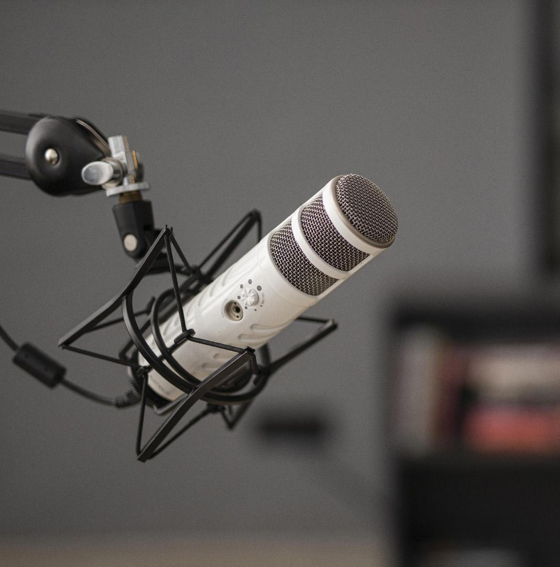
What You need
Required: Microphone and computer (the former may be built into the latter)
Preferred: Camera (could be webcam or phone) and video editing software
Optional: Lighting, backdrop/stage, props
But also consider input content (e.g. images, sounds)
Notes:
[No Script]

Slide 13
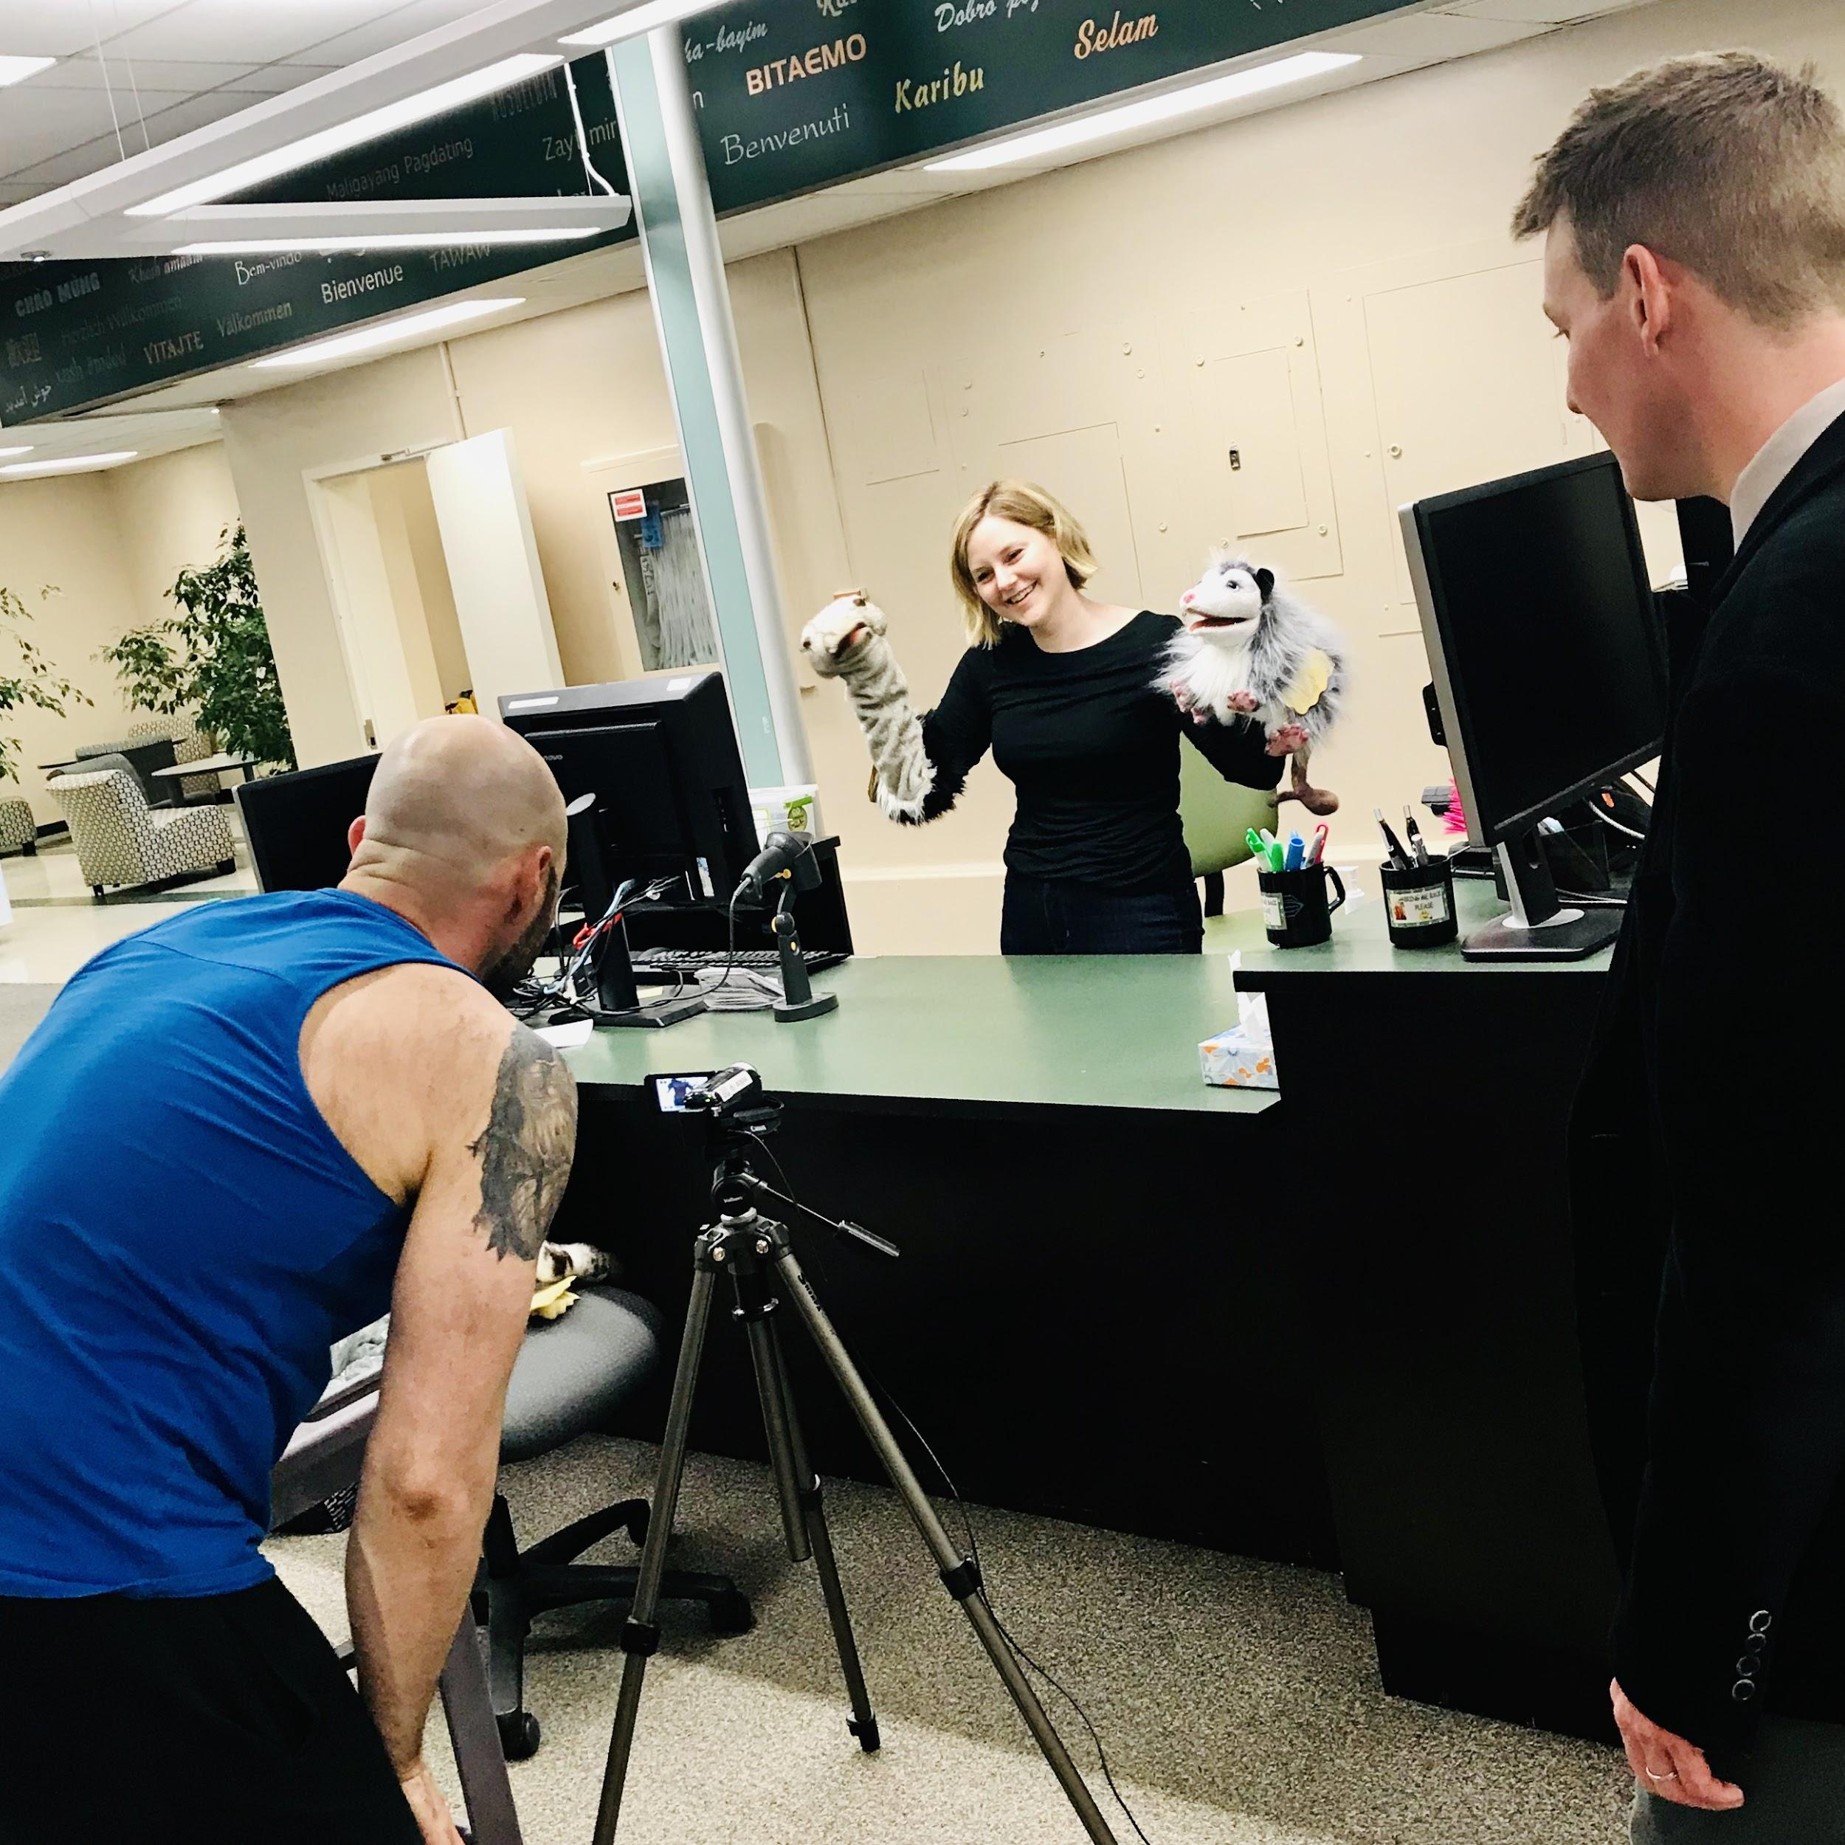
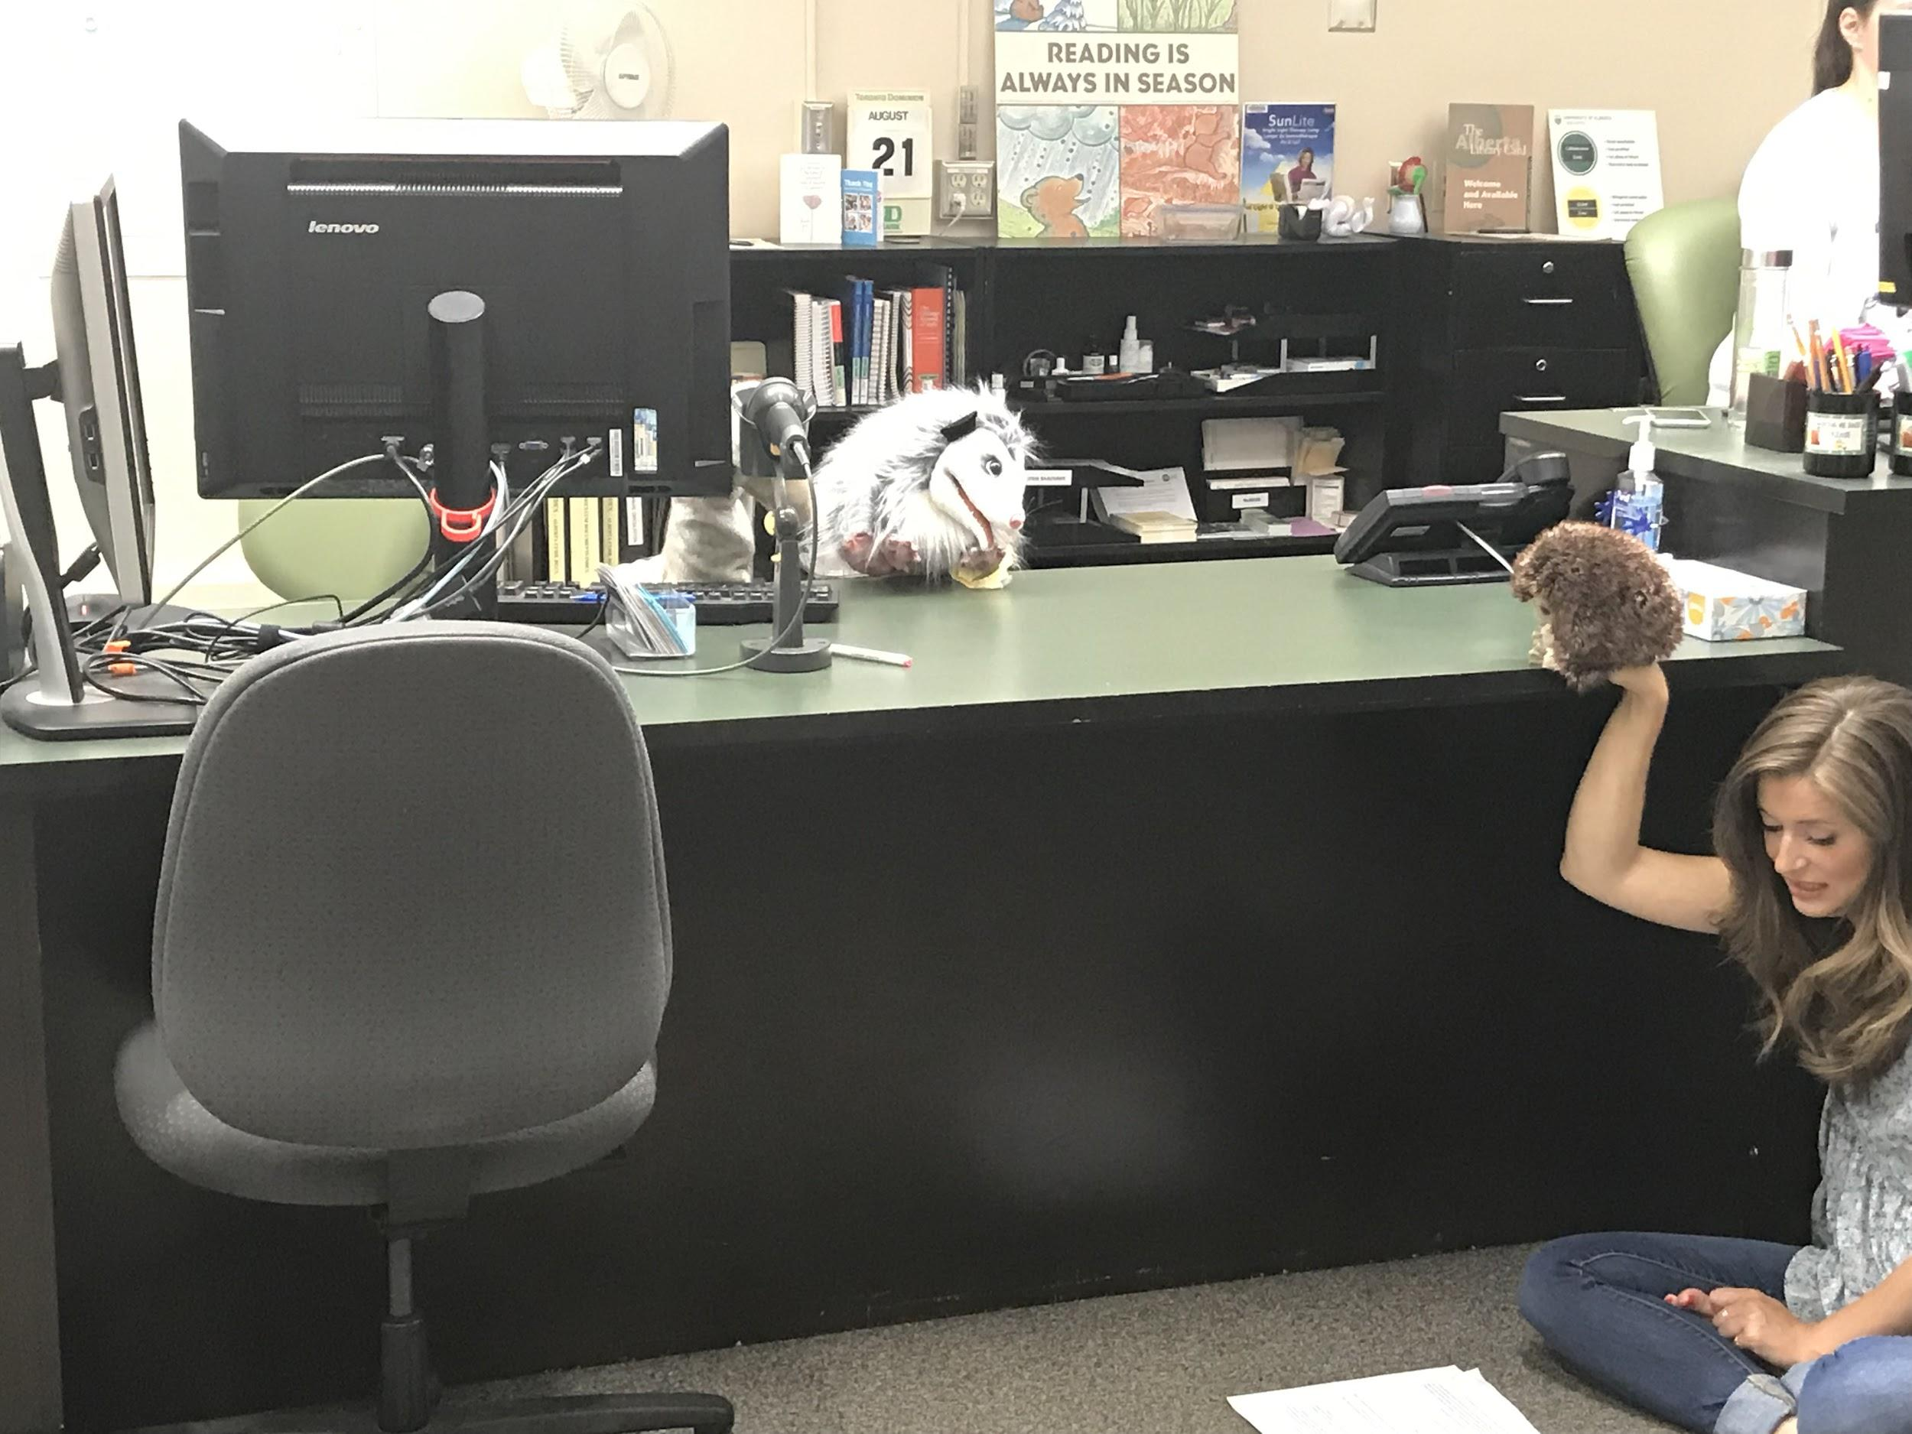
Skills!
Professional Actors
Both photos courtesy Céline Gareau-Brennan
Notes:
This slide shows a couple of behind the scenes pictures from two puppet based instructional videos that Julia and I and as shown a few others, Merran Carr-Wiggin and Kris Joseph, were involved in making. It has been a pleasure to work with all three in various capacities over the past few years, but I can’t underscore enough that htse are professionals [C] and as such they bring an incredible body of skills and knowledge to making videos and with that I’ll let Julia expand on some of her expertise.

Slide 14
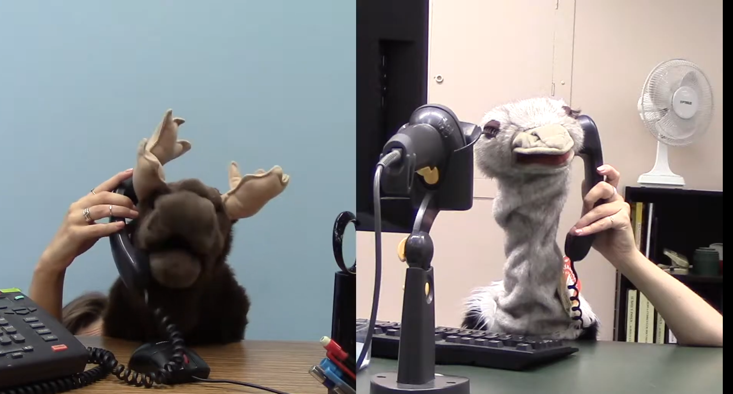
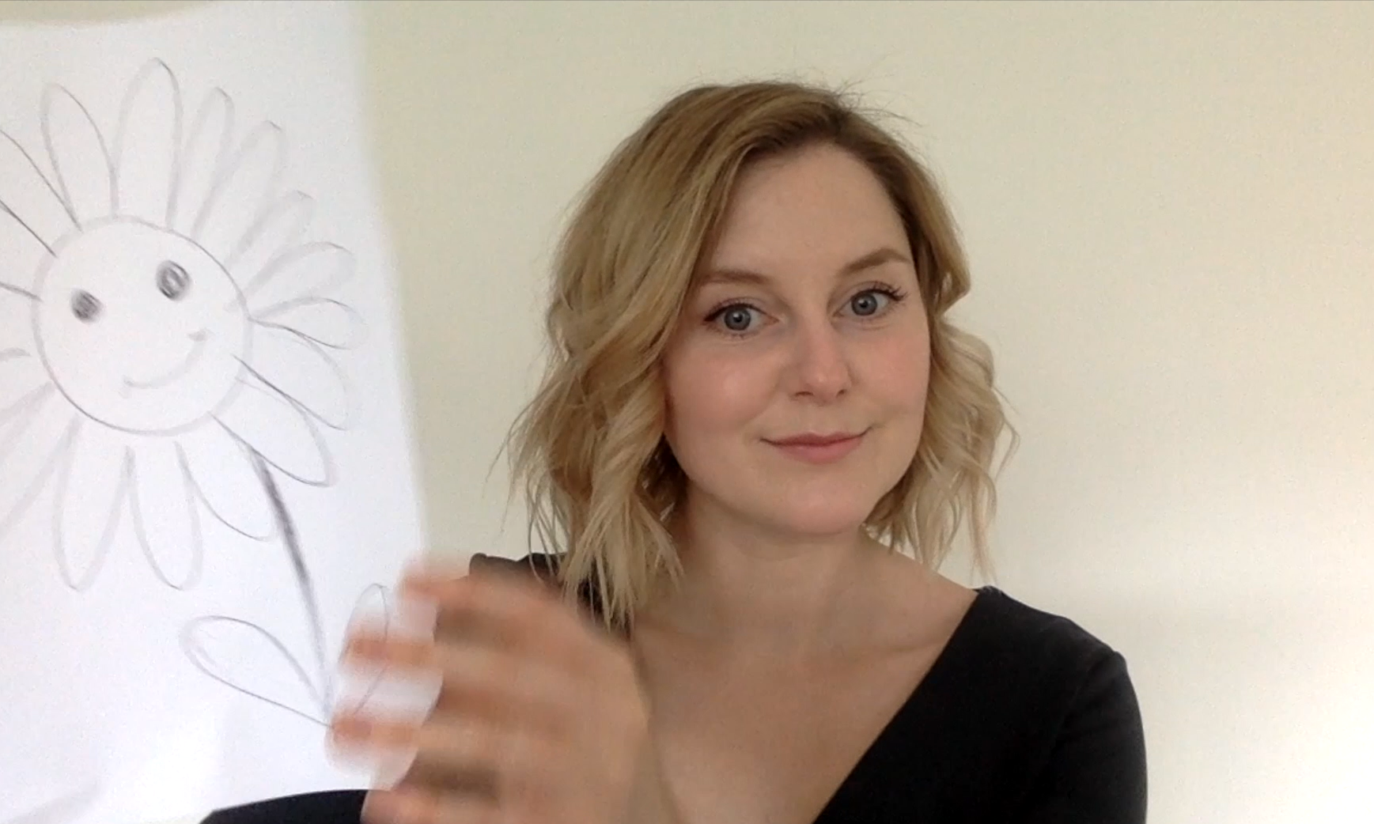
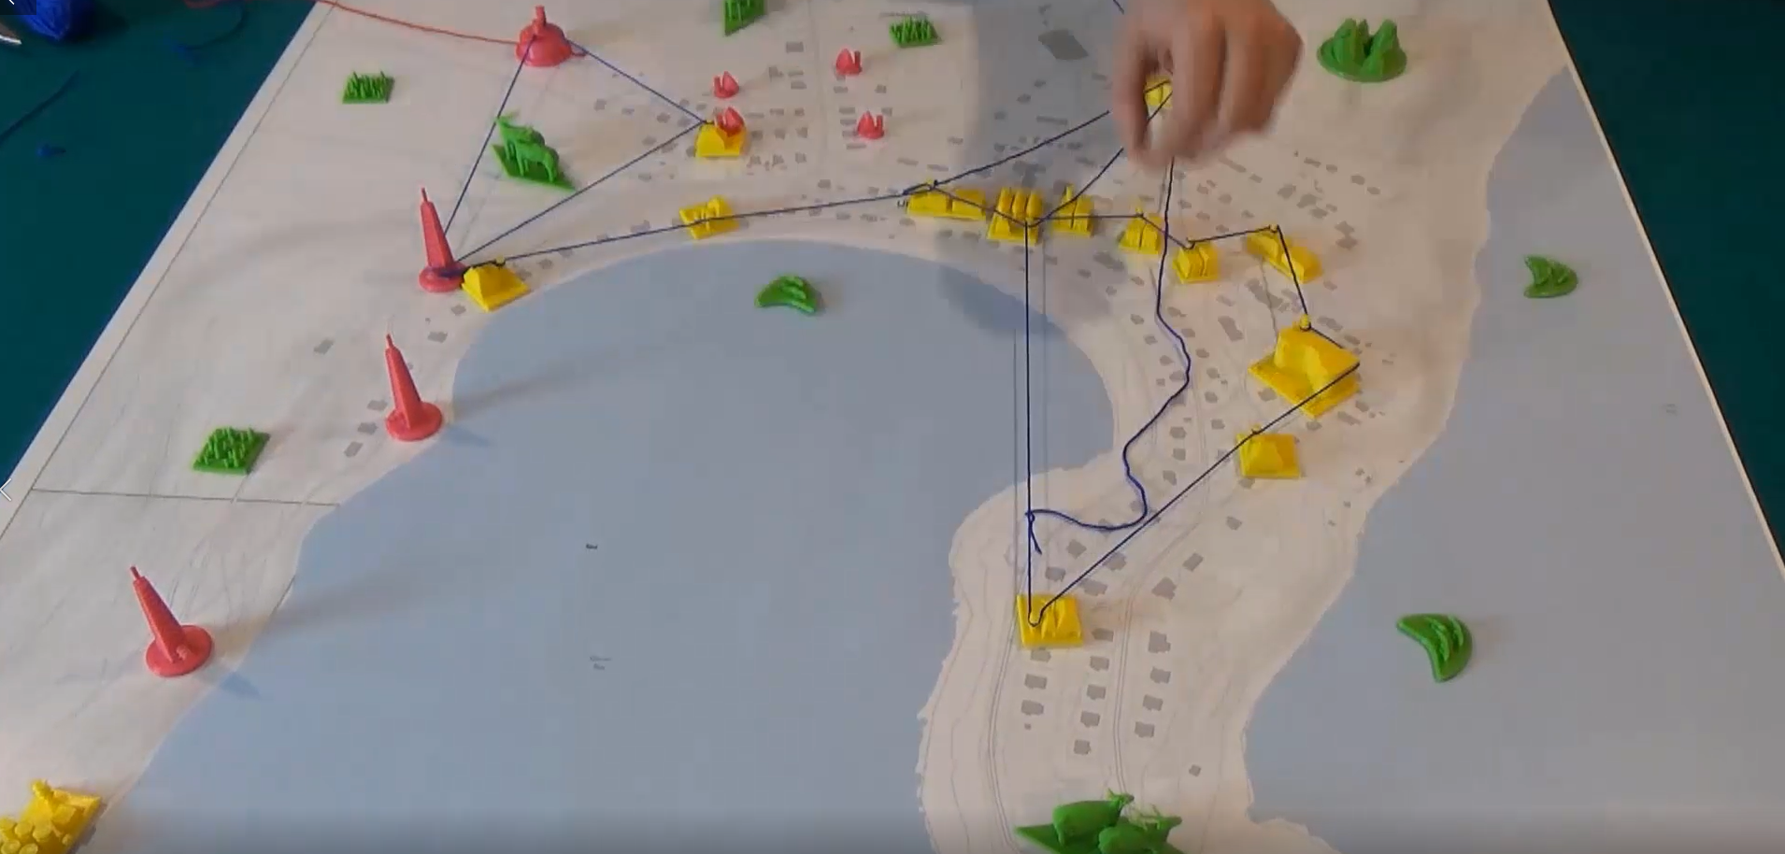
Types of Videos
Notes:
Types of videos:
Direct address: When you are talking directly to the camera and addressing the audience
Screen recording: Whether that’s slides or a how- to video on your computer
Filming a scene with characters and dialogue (we used puppets mostly for this)
Documentary style: Non-fiction and/or interviews
Combining elements like clips, images, text, music or voice over without doing any filming or recording.
Combinations of all of these!

Slide 15
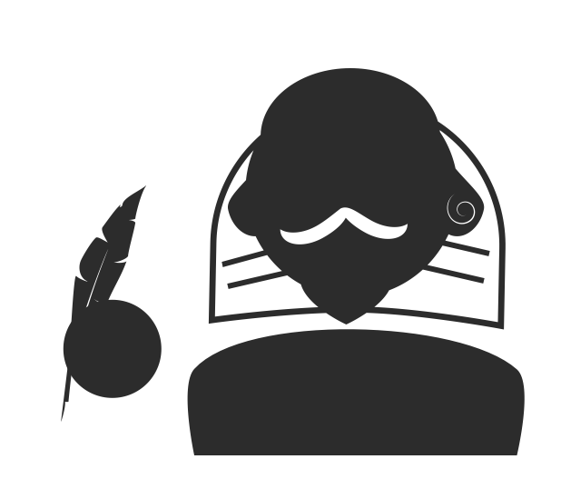
To Script or Not To Script?
Good things about scripting:
You don’t miss anything
Usually more concise
Allows you to plan visuals
You can make them available
Challenges with scripts :
Delivery can sound monotone or rehearsed
Interviews should not be scripted
Time consuming
Notes:
Most of the time it is a good idea to script. Having a script ensures that you don’t forget anything and helps you plan what visuals you want for each part of the video, which can make filming a lot more efficient. Although scripting takes a lot of time it saves time in the editing process. Scripts can also be distributed which can enhance accessibility.
Scripting is likely how most educational videos are made. There are certain situations where it is better not to script. Interviewing is one example. If you are interviewing people for your videos it is best not to have the interviewees script their answers. An interview that goes back and forth where both parties have pre written answers usually comes off as staged and insincere (think politicians). It is better to provide interviewees with a sense of what topics will be covered but not provide them with the exact questions you intend to ask. This will lead to a much more interesting, meaningful and genuine interview. (Another tip for interviewing is to have your interviewee include the question as part of their answer- this means you can edit yourself out if you want and that you won’t have to mic both of you)
Another situation where you may not want to script is if you have a lot of content to produce and not a lot of time to do it. If you don’t mind a few stumbles, or pauses it may be better just to wing it.

Slide 16
Script Writing Tips:
Keep sentences and language concise and straightforward
Consider tone (e.g. authoritative vs. approachable)
Read it aloud
Time it (read aloud) at the actual pace you will be delivering it
Short is always better
Come back to audience and purpose of the video
Think of the visuals as you go
Notes:
When scripting videos it is important to always remember that the viewer will not have the script in front of them. It can be hard to hold a viewers attention and understanding through a long thought or idea when they cannot see the text visually laid out in front of them. Ideally straightforward language should be used and long winded or complex sentences should be avoided.
Tone is also very important when writing a script and you will want to consider if you want a conversational feel, or a more authoritative tone. It is a good idea to read your script aloud as you are writing it and imagine you are talking to a real person.

Slide 17
Filming/Recording
Find a quiet space
Make a schedule (according to light and sound) and a detailed plan
Prepare beforehand (memorize, mark script etc.)
Position the camera slightly above eye level and mic directly in front of you if possible
Maintain vocal volume/ mic location, physical positioning lightning, outfit/hair, background for continuity
Do a test
If you make a mistake go back to the start of the section/shot
If possible only save good takes or use cards to number takes
Record a bit of white noise in case you need it for editing
Notes:
The choices made here will make editing easier
Find a quiet space
Make a schedule (according to light and sound) and a detailed plan
Prepare beforehand (memorize, mark script etc.)
Position the camera slightly above eye level and mic directly in front of you if possible, do not wear jewelry or things that make noise, do not wear small patterns or stripes
Maintain vocal volume/ mic location, physical positioning lightning, outfit/hair, background for continuity
Do a test
If you make a mistake go back to the start of the section/shot
If possible only save good takes to make editing easier if this isn’t possible use cards to number takes

Slide 18
Delivery
Gaze
Look in lens as if looking into eyes
Memorize
Avoid looking down
Hold gaze before and after each section
Clarity
Maintain vocal energy throughout thoughts
Articulate. Especially the ends of words (focus on the Ns)
Determine speed based on audience and complexity
Focus on the meaning of the thought -not the way you sound
Stress only important words
Being Natural
Image you are talking to a real person
Have an intention in mind (E.g. to welcome, to be understood, etc. )
Notes:
The most important thing to keep in mind is that you are not talking to a camera but to real humans.
Gaze - look into the camera as if you are looking into someone's eyes, if that is hard to picture think of looking through and past the lens
For every take you want to remain connected to the audience so memorize chunks of text, big or small and do not read or look away for those sections. Maintain eye contact for a beat before and after each section to make editing easier.
Both as you are writing it and as you are delivering it always imagine you are talking to a real person right in front of you
You want to talk as if you are chatting to someone you know who would laugh at you if you talked to them weirdly).
The biggest downside to scripting for educational videos is that you can end up imitating what you imagine educational videos should sound like as you deliver the text. This is the dreaded Sing-songy effect. The sing-songy effect happens when you read your lines to the familiar tune of people in 90s commercials. Alternatively, scripting can also lead to a robotic, monotone delivery. The best way to avoid both of these is to read your script aloud as you are writing it and to always imagine someone right in front of you
A good idea to keep you from focusing on the sound of your own voice is to have an intention in mind. I am welcoming them or persuading them or making sure they understand this point
Clarity is really important
Maintain vocal energy throughout thoughts
Articulate. Especially the ends of words, ( tip: try focussing on enunciating the the letter n and a lot of the other sounds will follow)
Determine speed based on audience and complexity
Focus on the meaning of the thought -not the way you sound
Stress only important words (hint verbs and new nouns are usually important or things being compared)

Slide 19
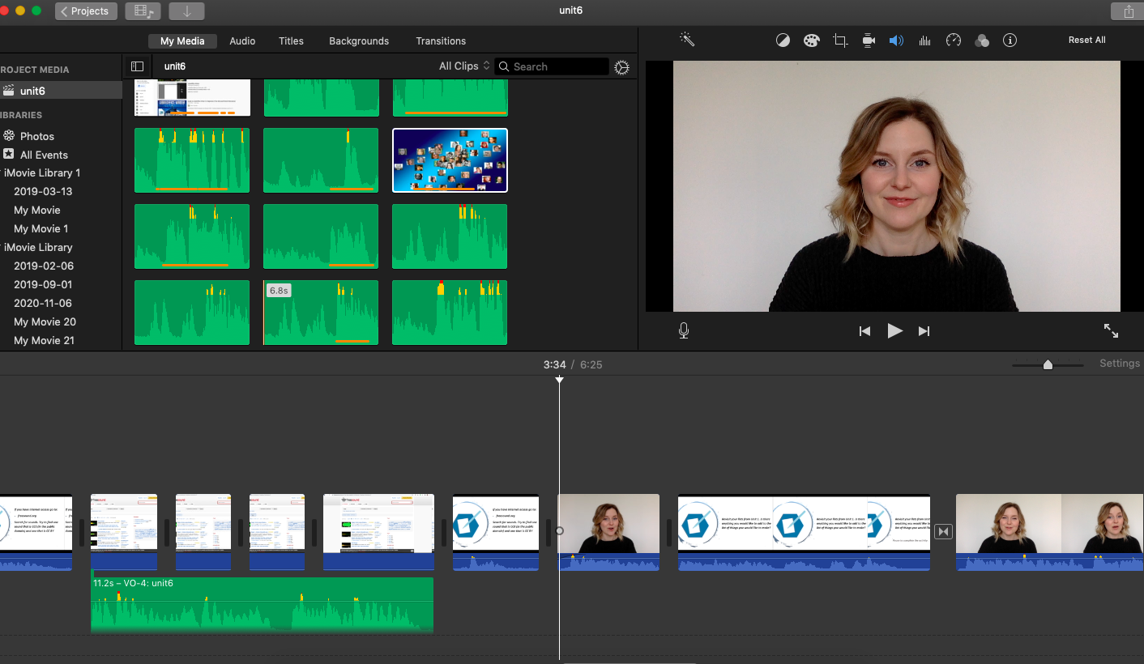
Editing
Keep a file with all of the raw footage in case you delete something by accident
Turn the volume up loudly as you are editing and check for consistency
Cast yourself as the viewer
Cut it if it doesn’t serve the purpose
Keep it dynamic by adding in images, animations etc. to keep people’s attention
Notes:
Keep a file with all of the raw footage in case you delete something by accident
Turn the volume up loudly as you are editing and check for consistency - maybe the mic shifted in recording or your energy levels dropped as you went along, so it is good to make sure the volume of the video is consistent and any elements like background music add rather than detract from the video
Try to cast yourself as the viewer - it’s hard but imagine all the information is new to you
‘Kill your darlings’ if they don’t serve the purpose - even if something took a long time to make or looks really cool it may not actually be needed in the video- killing your darling refers to the act of letting something go even when that is really annoying if it isn’t needed

Slide 20
Interactivity
Notes:
Video, when well done, can be an engaging medium, but it is still passive. That said there are ways to make video interactive. By far the simplest way to make video interactive is to engage the audience with a question. Have your ever seen an episode of Dora the Explorer or other children’s shows where they use this method [intentional long pause]... that’s great, you know exactly how it works then. Of course, while the method is simple to incorporate, it can come off as being designed for children.
Depending on context, you can expand upon this method and use it for some more substantial activities. Here is an example of Julia using the technique from one of our DigitalNWT videos. [Clip]. Depending on the subject and context this may be sufficient to make video much more active, and it can also allow for non-digital tactile elements to be incorporated.
There are of course other means of incorporating interactivity directly into video. Adobe Captivate and Articulate Storyline 360 are both commercial products that can be used to create interactive videos. While both are certainly powerful tools for creating polished interactive videos, there are two important considerations. Neither is particularly cheap, even for an academic licence, and if you are trying to create something open that others might want to adapt, they will also need the same subscription tools.
One tool gaining a fair bit of uptake to address this is H5P, which can best be described as an interactive overlay that sits on top of video. H5P is an open source tool and thus popular in the open education community, and the H5P code, since it is separate from the video can easily be shared as well. The eCampus Ontario H5P studio has over 1600 downloadable H5P elements made available under a range of open licences so there is usually something that can be adapted or even just used as inspiration. One thing to keep in mind though - H5P because it is not directly part of the video file, requires a platform that supports H5P integration. The good news is that this includes major learning management systems Canvas, Blackboard, Moodle, and Brightspace or Desire2Learn, as well as WordPress and Drupal. Considerations around interactivity provide a good point to discuss distribution.

Slide 21
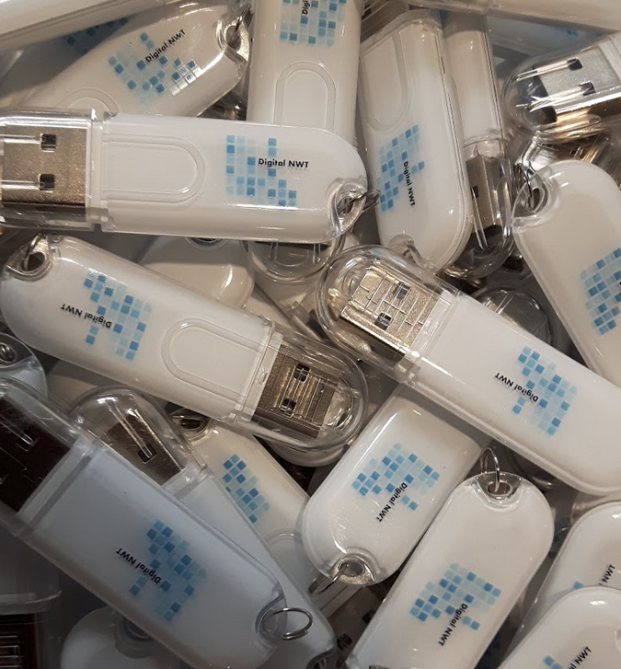
Distribution
Most contexts a video sharing website (e.g. YouTube) or learning management system
For low broadband contexts consider
USB, CD or DVD
Also consider file quality (e.g. 720p v. 1080p v. 4k) and impact on file size
Notes:
In many ways distribution can be an underestimated consideration. Videos in a class context may go out via a learning management system, and of course there is always YouTube and also alternative video sharing platforms. While this will work in many contexts, there are certainly contexts where this won’t work. If you want to open your work up and allow others to edit it or even download it, YouTube is not ideal. While it is possible to download YouTube videos through a variety of means, YouTube isn’t really supportive of easy downloading.
More importantly you may want to consider the connectivity of your users - do they have the internet, is it reliable, are they likely to face data caps and overage fees. For reference, for someone in a satellite dependent community in the NWT who is already at their data cap limit to stream a two hour movie it would cost them roughly $20 in fees. At that price it is literally cheaper to buy and mail them a USB. While physical media such as CDs and DVDs may seem obsolete, in some contexts it may make sense to copy videos to a physical medium and transport them by mail or car.
This brings up another important thing to think about - file size. A fancy new $2,000 smartphone can shoot video in 8k, which is an upgrade from the ultra high definition 4k standard, and of course 4k is an improvement on HD standards that have been common for a decade now. Whether you are creating files to copy on USBs, have viewers download through a learning management system or stream from YouTube file quality and length are the two biggest determinants of the file size the the amount of data to be transfered.
Finally, if you are working at large scale - perhaps copying a couple of hundred USBs with 10 or more Gigabytes worth of video, you may also note that different video formats - mp4 vs mov for example have different file sizes, and even different ways of rendering the same type of video can impact overall file size.

Slide 22
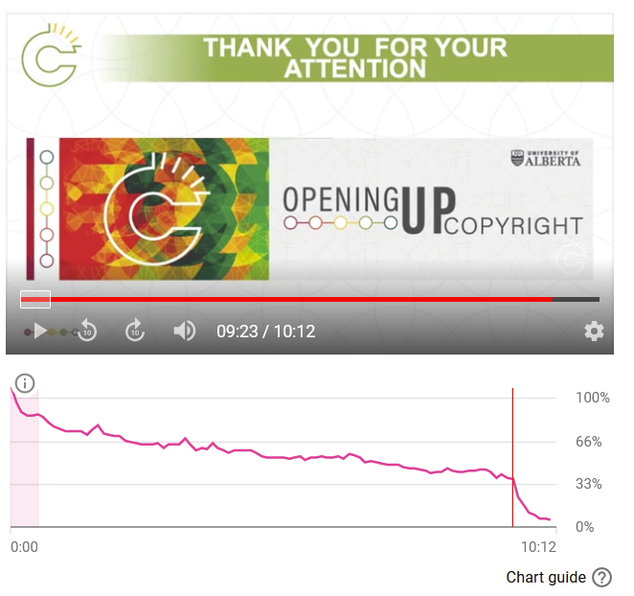
Assessment
Areas for assessment
Effectiveness of the video for instruction
Affective quality of the video
Consider whether distribution platform allows for analytics
Notes:
Now it’s time for the test. Just kidding, and generally having a test at the end of the video doesn’t go over well. From our Opening Up Copyright project we know that once a viewer gets to the end of the video, adding in a bunch of questions is the point at which people stop watching. The image on the right is the YouTube viewer retention stats, and for almost all videos the ‘thank you’ that comes just before the questions is the point at which most people tune out.
That said assessment is something to consider, and has a double context with regard to video. On one hand you may want to consider assessing the effectiveness of the video as an instructional means. This decision is largely driven by context, but also influenced by distribution and other factors. With a captive audience such as a class, or having people watch in a controlled environment such as through a learning management system, you may be able to impose a test. However, as we’ve found in our experiences, optional tests are met by most viewers as a time to tune out.
Assessment’s other meaning is in relation to assessing the video itself. Depending on factors such as audience and context you may have some more formalized means of collecting assessment data (ie. surveys of how people felt about the video), or it may be a simpler process of even just asking some colleagues to provide feedback or self-reflection. As with any teaching/education context, self reflection and asking what could be done better next time is always as good approach.
One other thing to keep in mind is metrics - how many people watch the video, for how long. Learning Management Systems and YouTube can provide quite granular details even beyond views and watch time. These may be useful if your videos have outside funders looking to assess the uptake, or in turn such statistics might be leveraged for future funding. Again, this all ties back into audience and delivery.

Slide 23
Concluding Thoughts on Video

Slide 24
Thanks!
Does anyone have any questions?
jguy@ualberta.ca
mmcnally@ualberta.ca

Slide 25
Questions sent in advance
Video that addresses photocopying copyright
Photocopying at the Library Target audience?
How do you evaluate if the video has:
Had a positive/negative impact on viewers’ behaviours? (E.g. Has there been a decrease in photocopying violations?)
Has been viewed in its entirety, kept audience’s attention? (Do you verify statistical data from YouTube? If so, how is it used?)
What methods of evaluation are you using to assess:
Target audience is viewing material
Audience understands, retains, & implements what is taught
Audience retention: likelihood to want similar videos, come back for more when video is part of a series
Video quality
Do you follow standards for type of format, sound quality, etc. & what are they?
Do you verify various platforms prior to posting videos (e.g. iOS, Mac, PC, Android)?
jguy@ualberta.ca
mmcnally@ualberta.ca

Slide 26
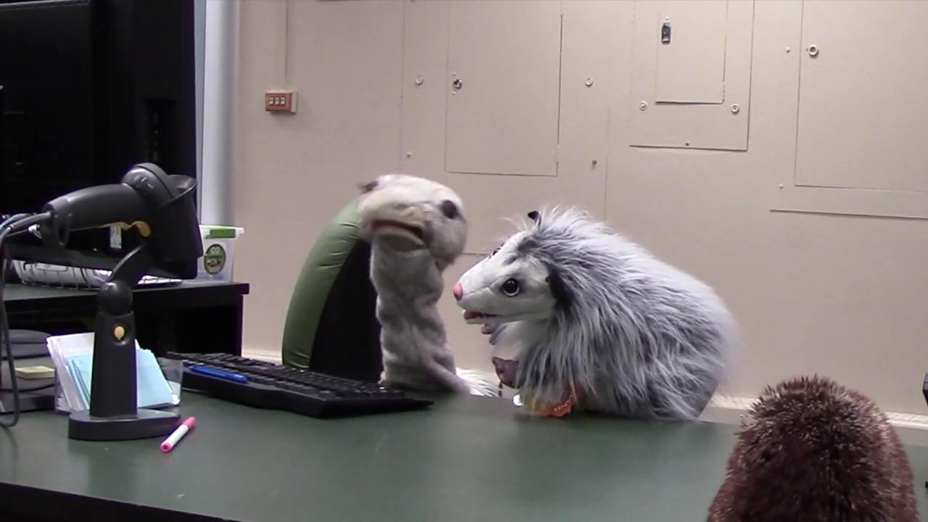
Examples
0:00-0:52 - DigitalNWT
Stock footage, screen recording, direct address
0:52-1:47 - OUC
Slides with narration
1:47-2:52 - OUC
Puppets

Slide 27
Sources and Credits
Image Credits:
Slide 4
Frank Schulenburg. 2008. “Screenshot: Production of the first Wikipedia Video Tutotrials.” https://commons.wikimedia.org/wiki/File:Wikipedia_video_tutorials_-_making-of_(screenshot).jpg
Slide 7
Symbolon, IT. N.d. “All seeing eye.” https://thenounproject.com/term/all-seeing-eye/1473231/
Victografic, ES. N.d. “Various Folder.” https://thenounproject.com/term/various-folder/168974/
Prettycons. N.d. “Video playback.” https://thenounproject.com/term/video-playback/1550944/
Md Saiful Alam Saif. N.d. “Social distance.” https://thenounproject.com/term/social-distance/3381238/
Gilbert Bages, ES. N.d. “Creativity.” https://thenounproject.com/term/problem-solving/194992/
Slide 11
Shashank Singh. N.d. “Unlock.” https://thenounproject.com/term/unlock/2160899/

Slide 28
Sources and Credits
Image Credits:
Slide 13 (Both photos)
Courtesy Céline Gareau-Brennan. 2019.
Slide 15
Daniel Turner, GB. N.d. “Shakespeare.” https://thenounproject.com/term/shakespeare/50024/
Slide 22
YouTube [Analytics]. 2021.
Slide Templates:
Minimal Cham by Slidesgo https://slidesgo.com/theme/minimal-charm#variant-103
Zombie Ideas Debate by Slidesgo: https://slidesgo.com/theme/zombie-ideas-debate
All other materials DigitalNWT, Opening Up Copyright, or Public Domain

Slide 29
Sources and Credits
Sources
Clossen, Amanda S. 2014. “Beyond the Letter of the Law: Accessibility, Universal Design, and Human-Centered Design in Video Tutorials.” Pennsylvania Libraries: Research & Practice, 2(1), 27–37. https://doi.org/10.5195/PALRAP.2014.43
Evans, Rachel S. 2014. “Cooking up cauldrons of content: Recipes for video tutorials.” Articles, Chapters and Online Publications. 32. Retrieved from https://digitalcommons.law.uga.edu/law_lib_artchop/32
Joseph, Kris, Julia Guy, and Michael B. McNally.(2019). “Toward a critical approach for OER: A case study in removing the ‘Big Five’ from OER creation.” Open Praxis, 11(4): 355-367. http://dx.doi.org/10.5944/openpraxis.11.4.1020
Joseph, Kris, Julia Guy, Amanda Wakaruk, Adrian Sheppard, and Michael B. McNally. (2020). “Know your audience(s): Collaborating for copyright education.” International Journal of Open -Educational Resources, 2(1): 79-98. doi:10.18278/ijoer.2.1

Slide 30
Sources and Credits
Sources
Martin, Nichole A., and Ross Martin. 2015. “Would you watch it? Creating effective and engaging video tutorials.” Journal of Library and Information Services in Distance Learning, 9: 40-56.
Rogers-Shaw, Carol, Davin J. Carr-Chellman, and Jinhee Choi. 2018. “Universal Design for Learning: Guidelines for Accessible Online Instruction.” Adult Learning, 29(1): 20-31.
Rose, David H., and Anne Meyer. 2002. Teaching Every Student in the Digital Age: Universal Design for Learning. Alexandria, VA: Association for Supervision and Curriculum Development.
Saines, Sherri. 2011. “Circulation - The Making of: Library Videos and the Real World.” Journal of Academic Librarianship, 37(6): 532-535.
Smith, Susan Sharpless. 2010. Web-Based Instruction: A Guide for Librarians. 3rd Ed. Chicago: ALA.
Weeks, Thomas, and Jennifer Putnam Davis. 2017. “Evaluating best practices for video tutorials: A case study.” Journal of Library and Information Services in Distance Learning, 11(1-2): 183-195.
YouTube. N.d. “YouTube for Press.” https://www.youtube.com/intl/en-GB/about/press/

Slide 31
Fin.

