Slide 1
Engaging Graduate Students with an Images of Research Competition
Alison Henry and Lucinda Johnston
Notes:
Intro: what image comes to mind when you hear the term research? Is it something like this?

Slide 2
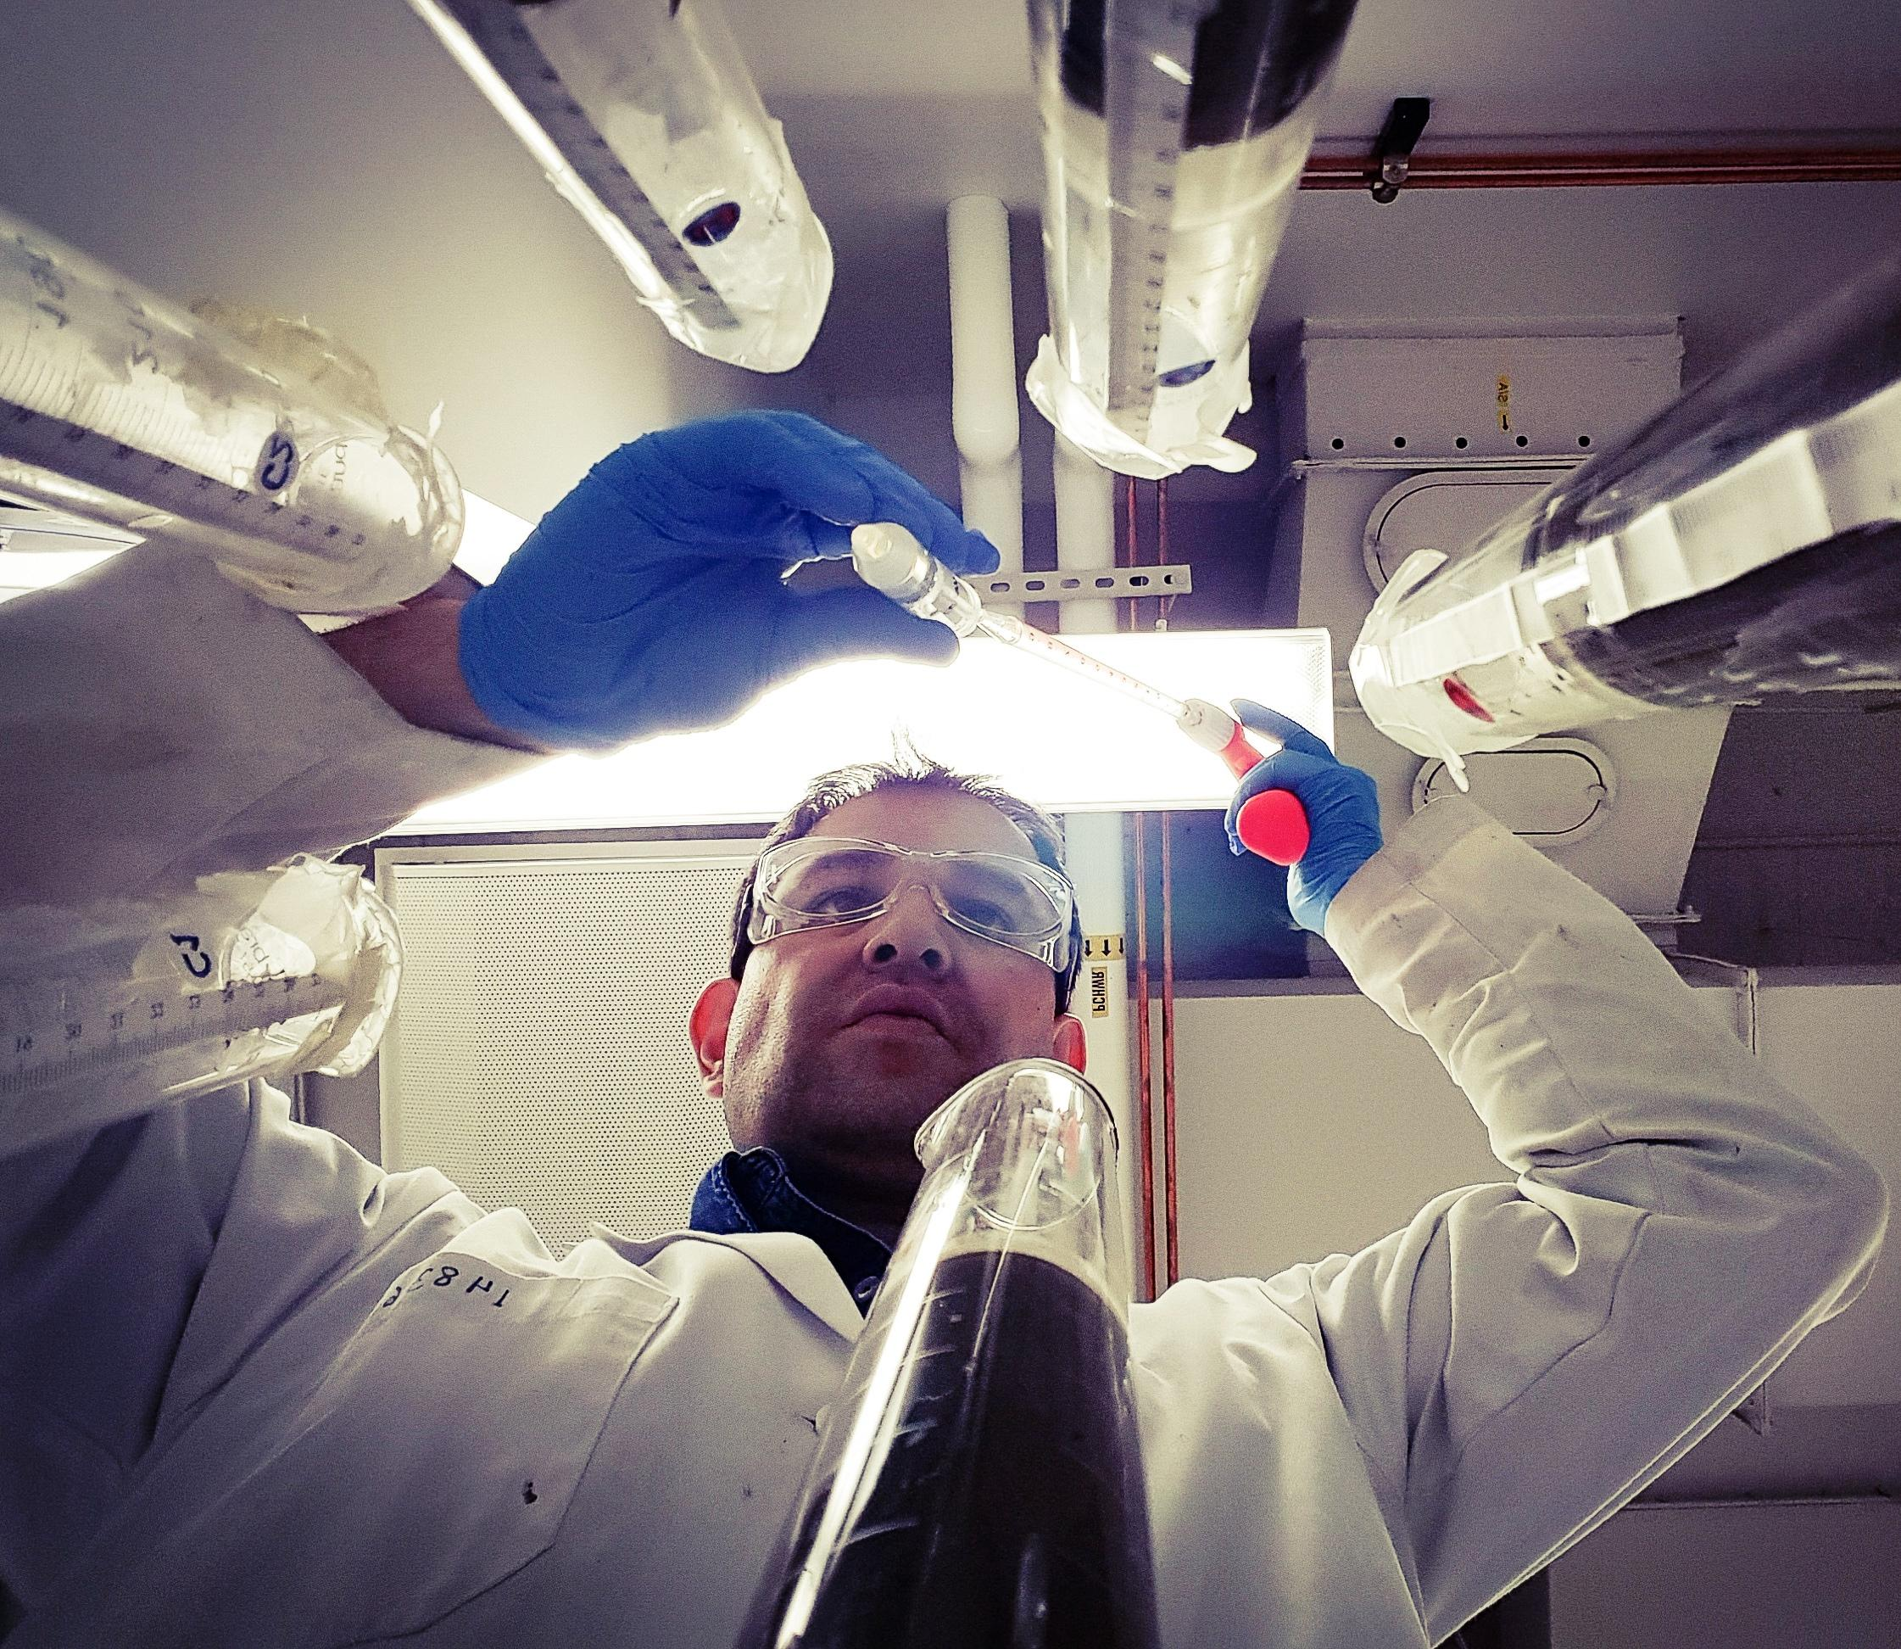
First at the First at the UofA Lab, then in real life:
Bio-based solutions towards treatment of the oil sands tailings Jorge Daniel Grock Pereira
Notes:
For many of us from scientific backgrounds, this lab photo is the quintessential scene conjured up by the word “Research.”

Slide 3
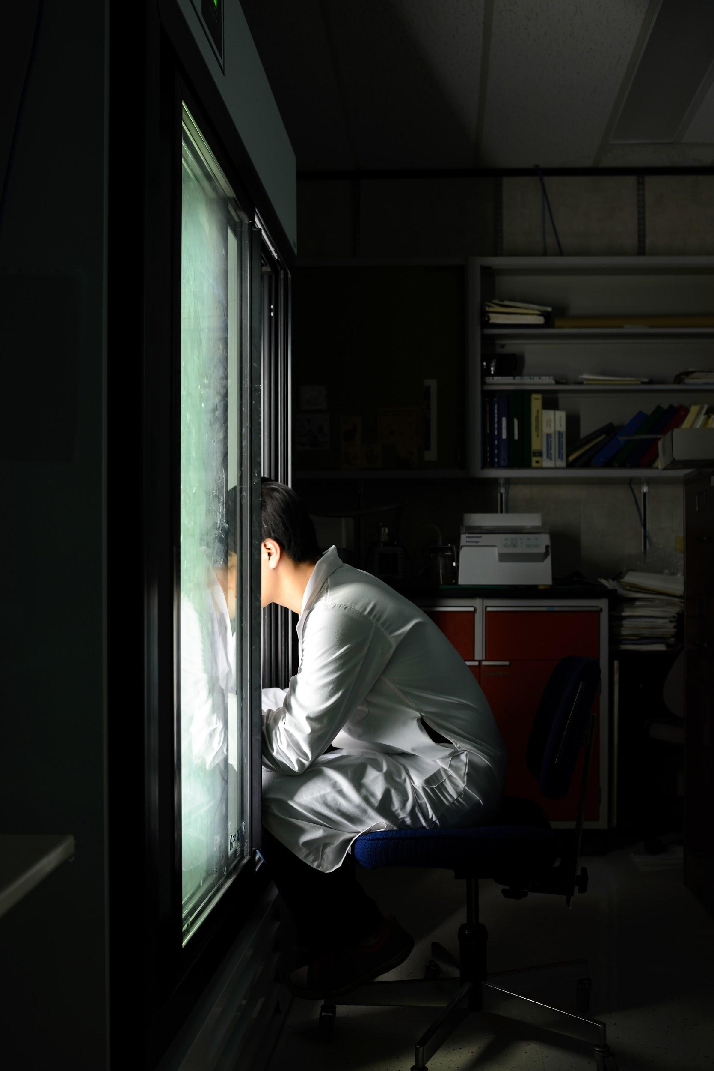
Diving Into Research, Phuwadet Pasarj
Notes:
And for many of our graduate students, working on their research is such an all-consuming process they risk getting caught up in the mindset where their version of research is all they see. The Images of Research competition offers an opportunity to engage with research beyond the student’s own discipline and invite others to understand their work in return.
When most people hear about Images of Research, they have many questions about the logistics of the competition, and I promise I will tell you all about how we run it. But before we get into that, I’d like to take you back to the beginning and discuss some of the motivating factors that led to the creation of this annual event.

Slide 4
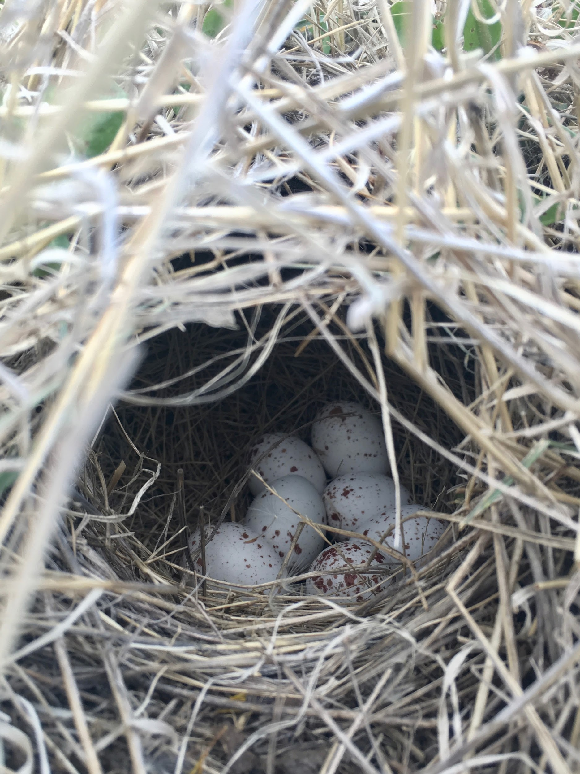
Hidden Eggs, Caroline Martin
Notes:
In 2008, the Canadian Association for Graduate Studies published a report calling for professional skills development for graduate students. While graduate students are broadly understood to be developing academic skills in the course of their research and coursework, there is increasing interest in a set of “transferable competencies of a broader nature [6],” which include interpersonal and communication skills.
Other institutions followed this report with studies of their own; at UAlberta this took the form of an in-house report specifically addressing the skills expected of graduate students as they move on to academic or non-academic employment. We want our graduates to be able to communicate effectively, in written and visual forms, with audiences beyond their academic peers. IOR was launched as part of a broader partnership with the Faculty of Graduate Studies and Research (FGSR) to enhance graduate student professional development (PD) and community building. FGSR implemented PD requirements for graduate students, involving individual plans and a variety of training sessions. Our goal in the Libraries was to encourage graduate students to tell the story of their research to the broader campus community, give them an opportunity to develop professional communication skills, and foster community. The exposure to research topics and methods from many fields encourages students to re-imagine and contextualise their own work.

Slide 5
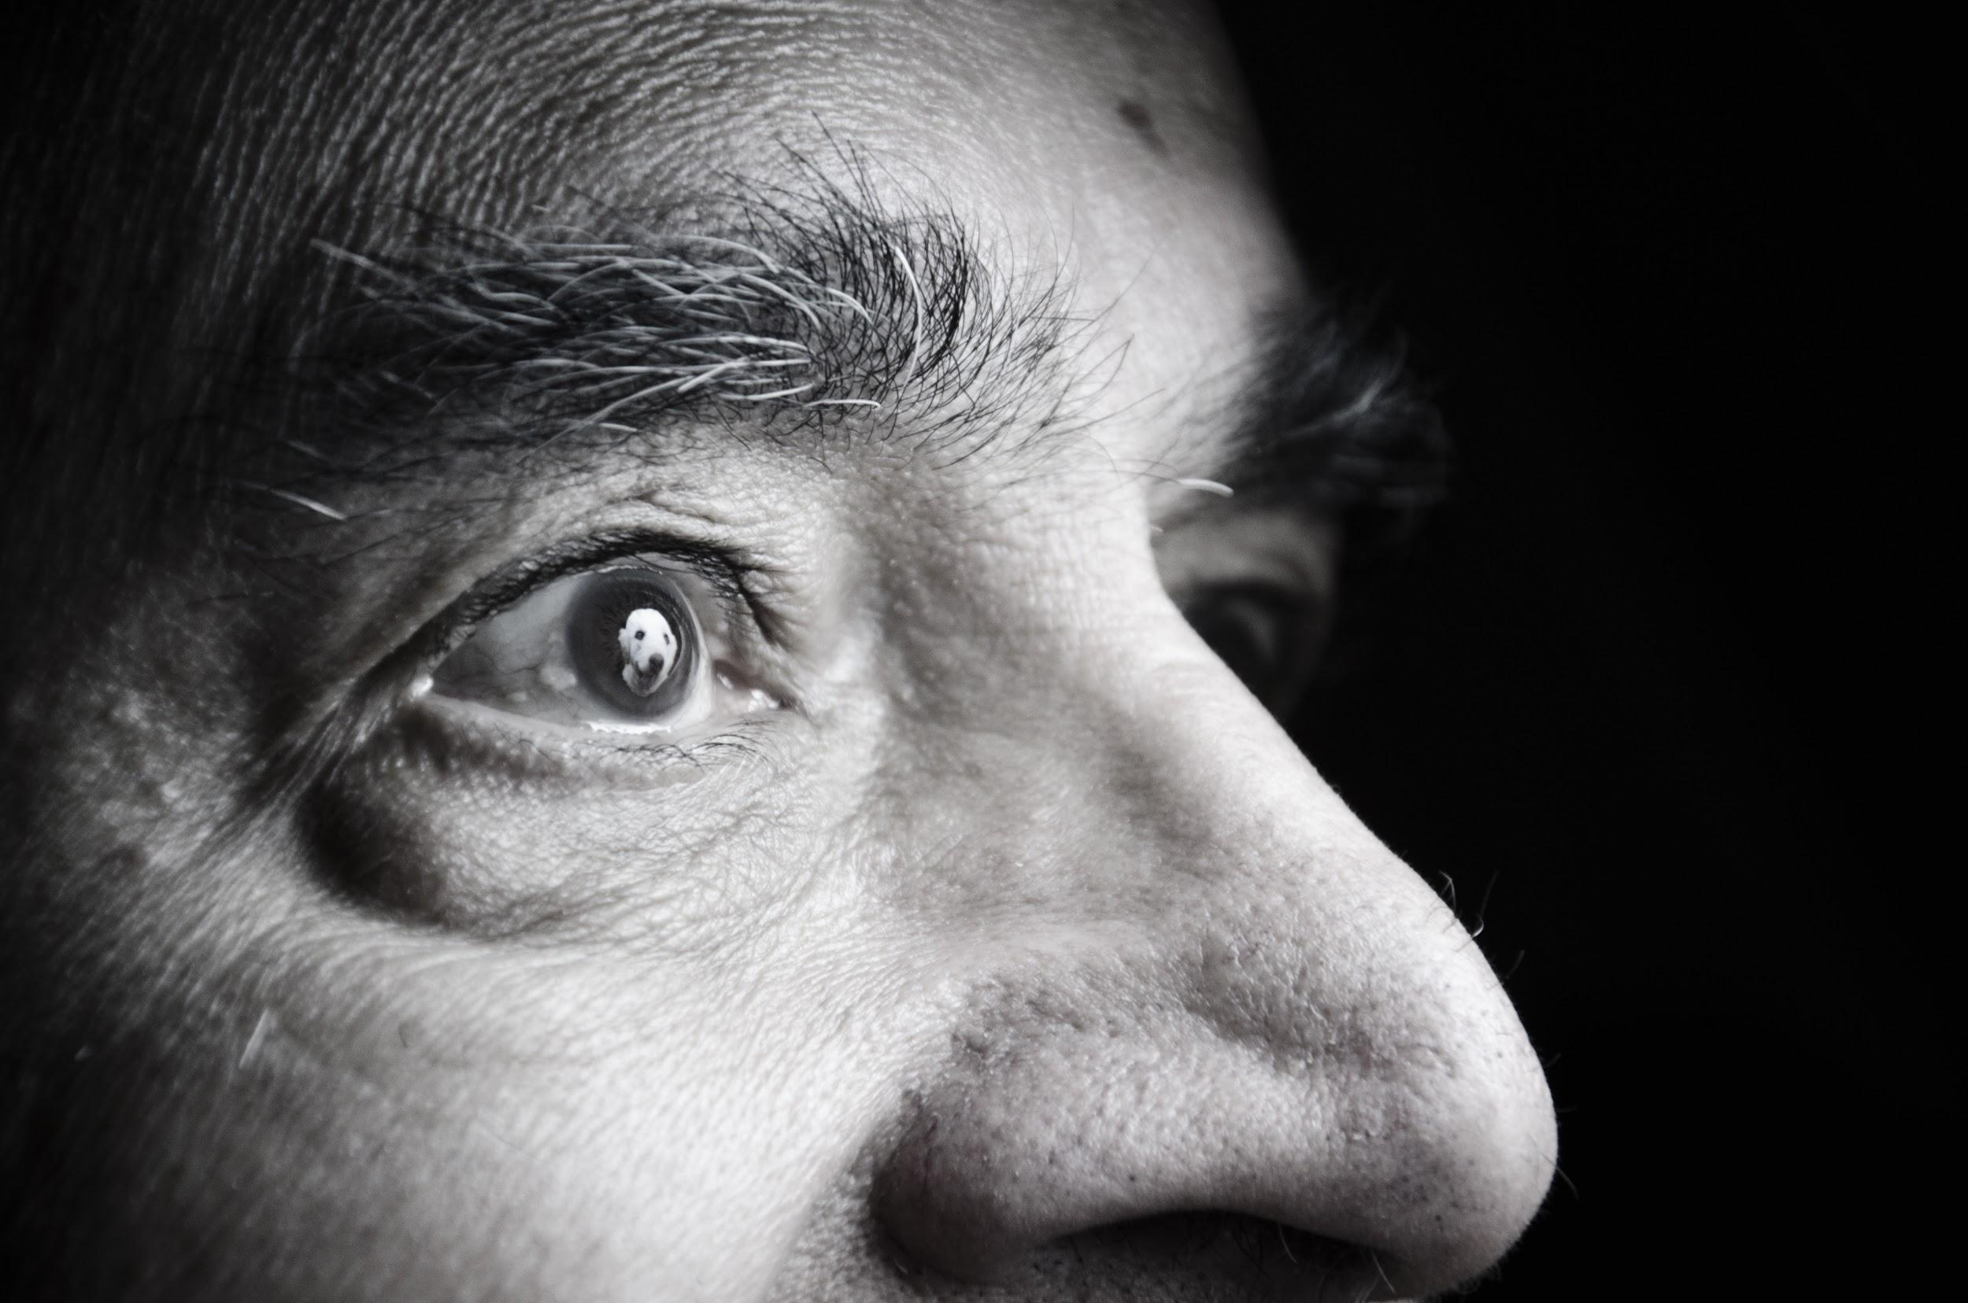
I Am Not Alone,
Camelia Vokey
Notes:
Before launching our inaugural competition, we took a look at similar competitions run at other institutions. We found quite a bit of variety among the events studied. Some schools held separate contests for undergraduate and graduate students, while some were open to alumni, faculty and staff in addition to current students. Competitions were held at different points in the school year, and ranged in duration from one month to six months. While a few institutions awarded prizes in the form of e-readers or gift cards, most gave cash. The organizers of these competitions were primarily university Research Offices, with the help of such campus partners as the library, IT department, and marketing and communications departments.

Slide 6
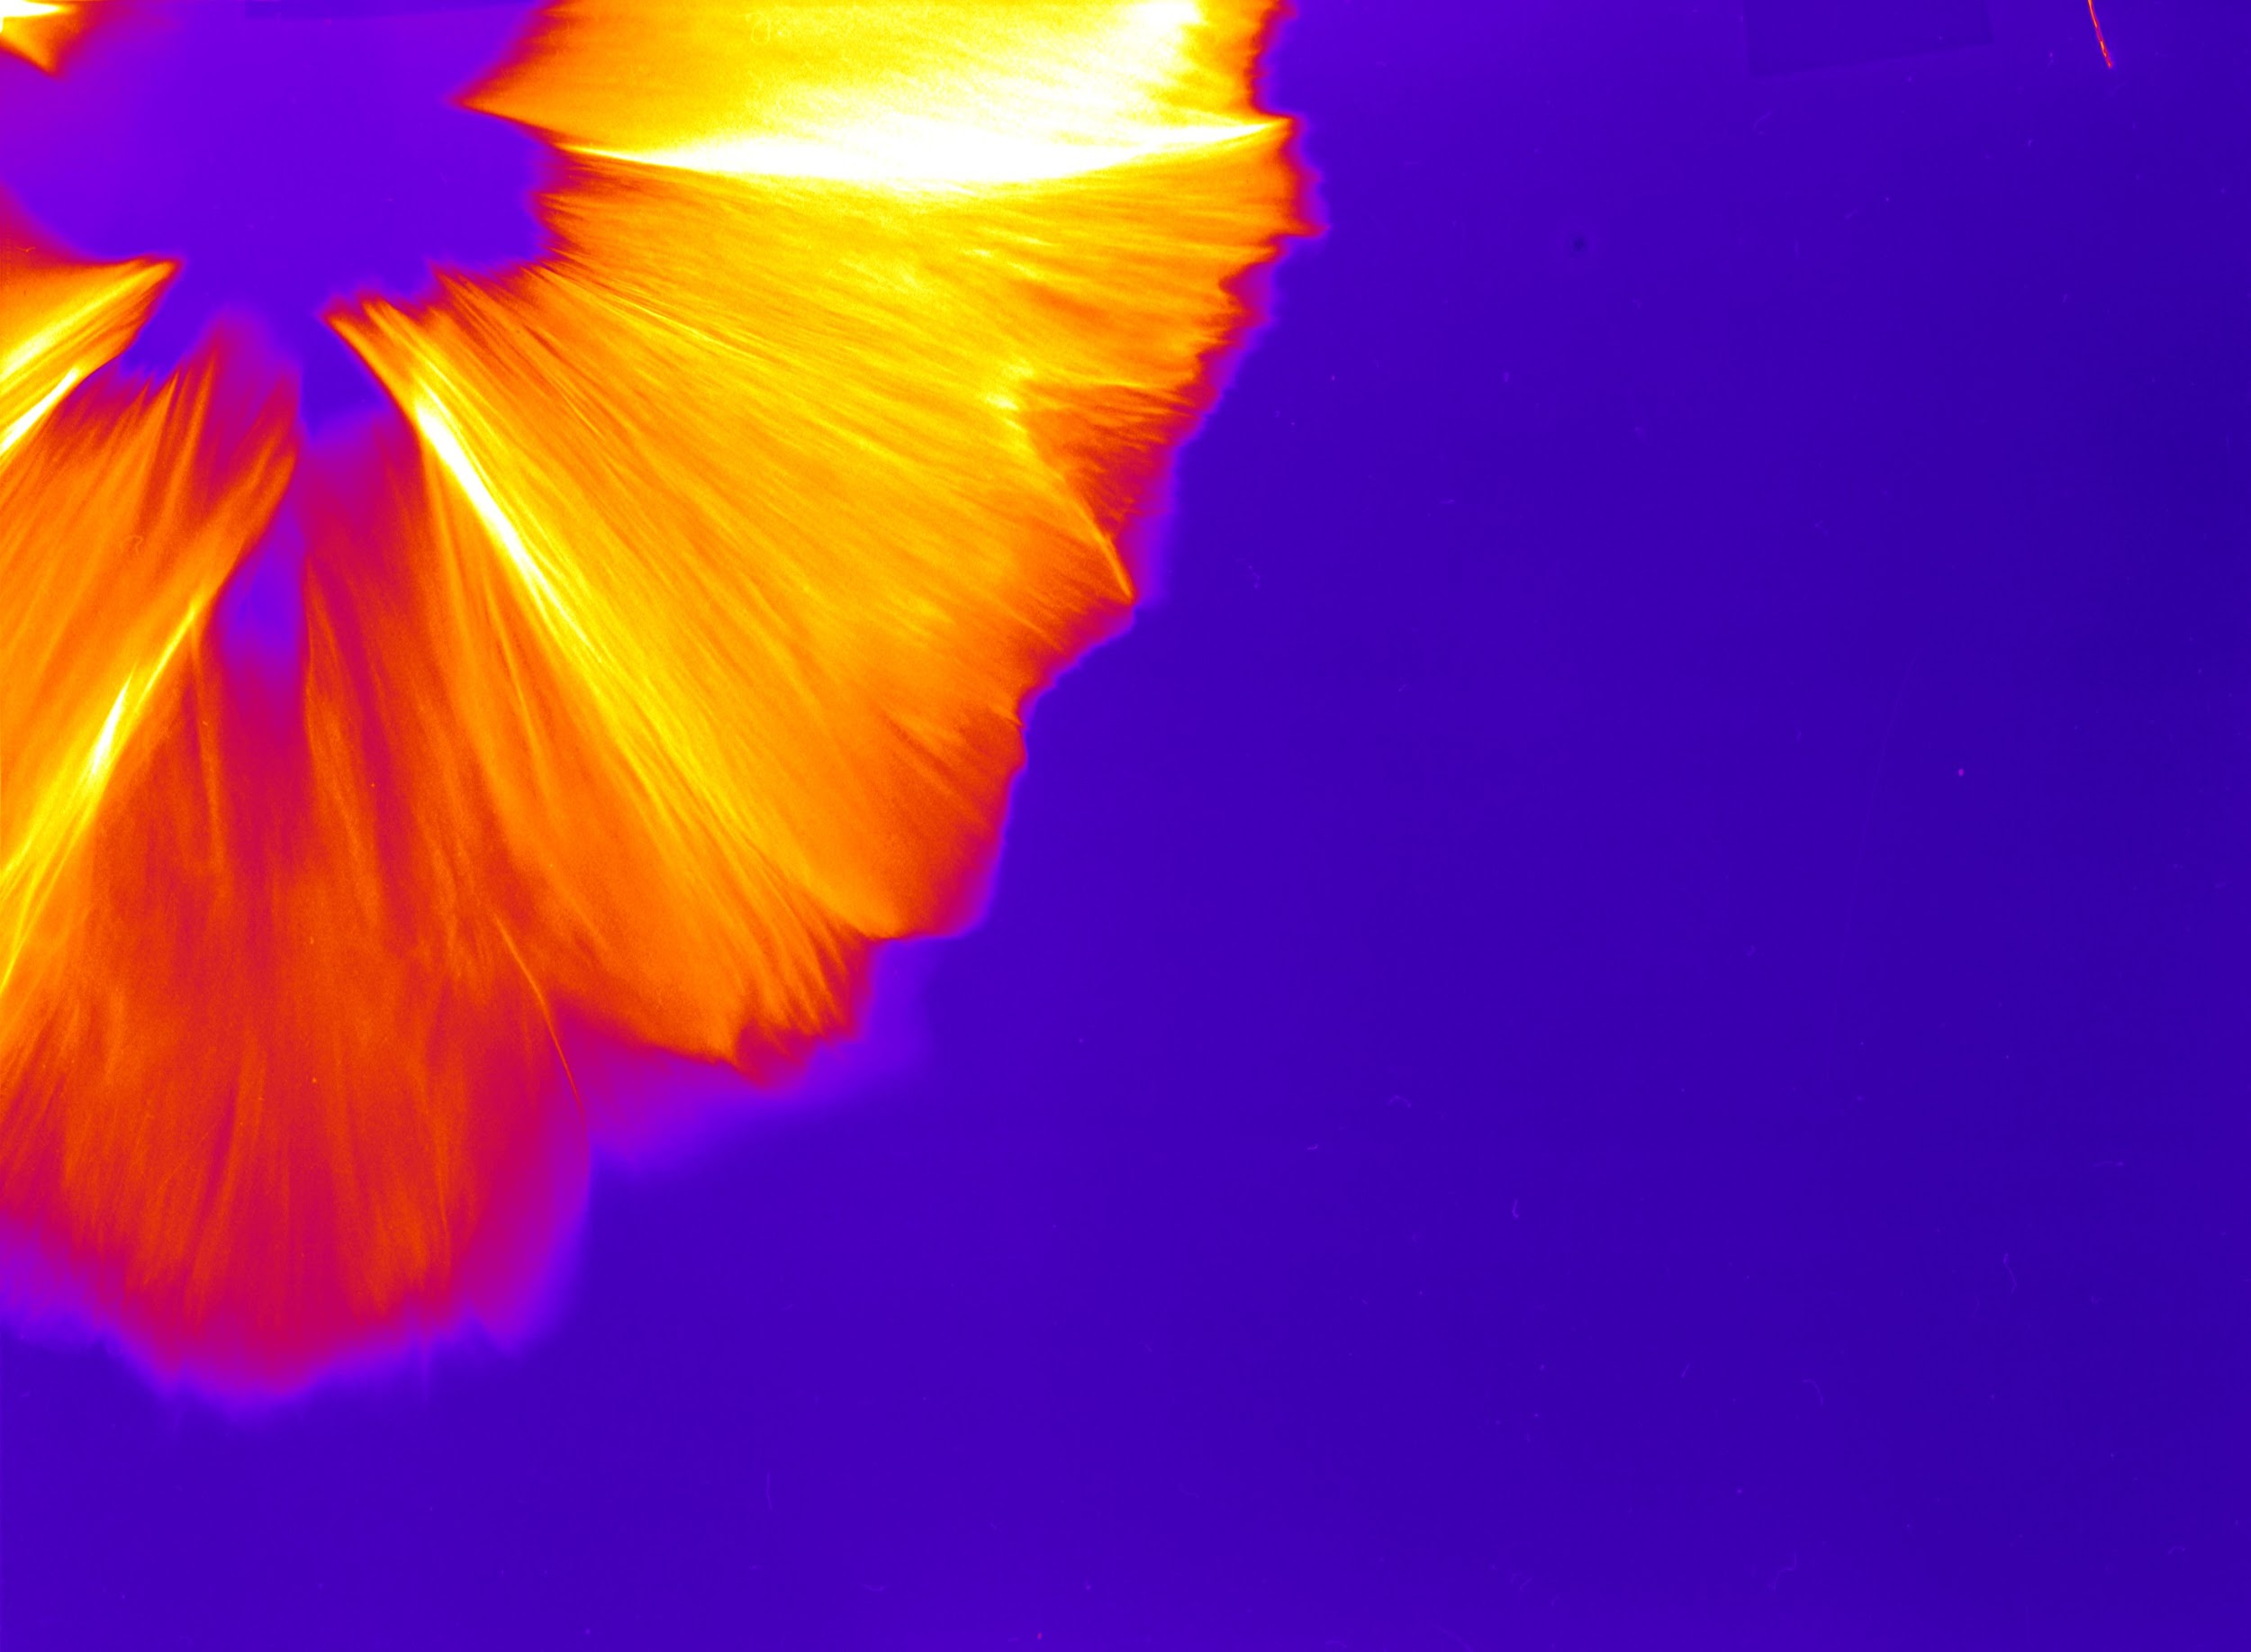
A Proton Flower from the Titan Laser
Shaun Kerr
Notes:
Armed with this information, we hosted our first Images of Research competition in the 2015-2016 academic year.
So, how does it work?

Slide 7
Annual Timeline
New committee formed
Roles assigned, budget confirmed, dates set.
Submission Begins
Workshops, advertising push, troubleshooting
Judging
Adjudication panel and public voting
Wrap-up
Debrief, suggest changes for next year
Fall
February
April
Summer
January
March
May
Prep and advertising
Website updates, workshop planning, Save-the-date invitations to VIPs, adjudication panel selection begins
Submission Ends
Submissions verified, judging survey created
Reception and Exhibition
Winners are announced.
Notes:
The competition is organized by a committee made up mainly of library staff, with one or two representatives from the Faculty of Graduate Studies and Research. We have staggered terms on the committee, so each summer the new group meets to assign roles and confirm dates. At this time, we decide on any rule changes or other procedural changes that may have been suggested by the previous year’s committee. Moving into fall, we confirm dates and bookings for the contest itself, the workshops, and the judging. In December, we begin our advertising which intensifies once students return from winter break in January. Submission preparation workshops are held in January, which is also when our submission period opens. Submissions are accepted over a 3-week period in January and February, judging and public voting take place in March, and the semi-finalists are exhibited and winners announced in April. In May we do any debriefing needed and write up close-out reports with recommendations for the next team to take this on.

Slide 8
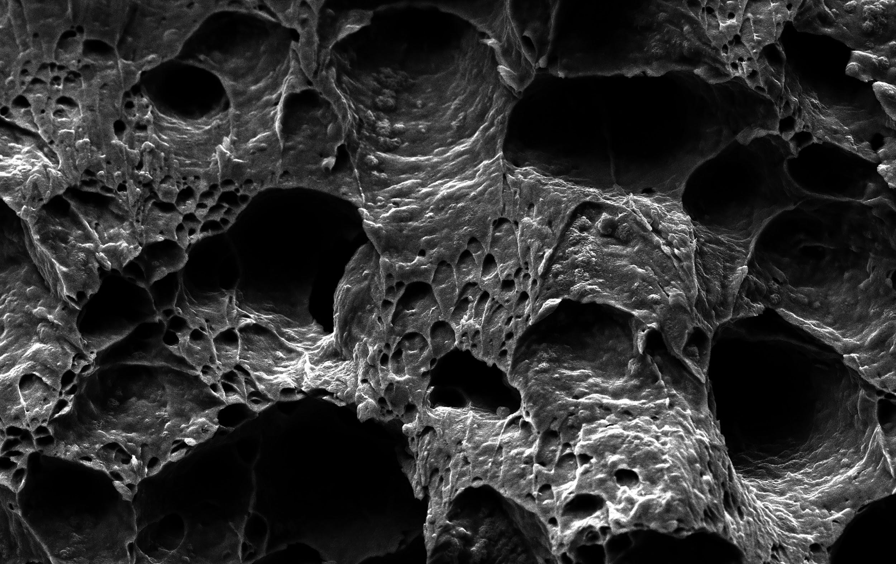
Decoding “Apparitions” in Steel, Yiyu Wang
Notes:
The Details
What exactly are students submitting? What are the rules?
The contest is open to current UAlberta graduate students.
Each participant is invited to submit one image that represents their research, along with a 300-word description of their work.
If the entry is a collaborative work, collaborators must give permission and be named, but prizes are awarded only to the person who submits the entry - they must work out amongst themselves how they will share any prize money.
Images must be in jpg or tiff format, have a resolution of 300 dpi and be 24 inches on the short edge.
Students who have entered previous years of the competition are welcome to participate again with a new image and description, as long as they have not already won a prize.
All participants agree to share their image and description under an Attribution CC license via our institutional repository (which is called ERA).

Slide 9
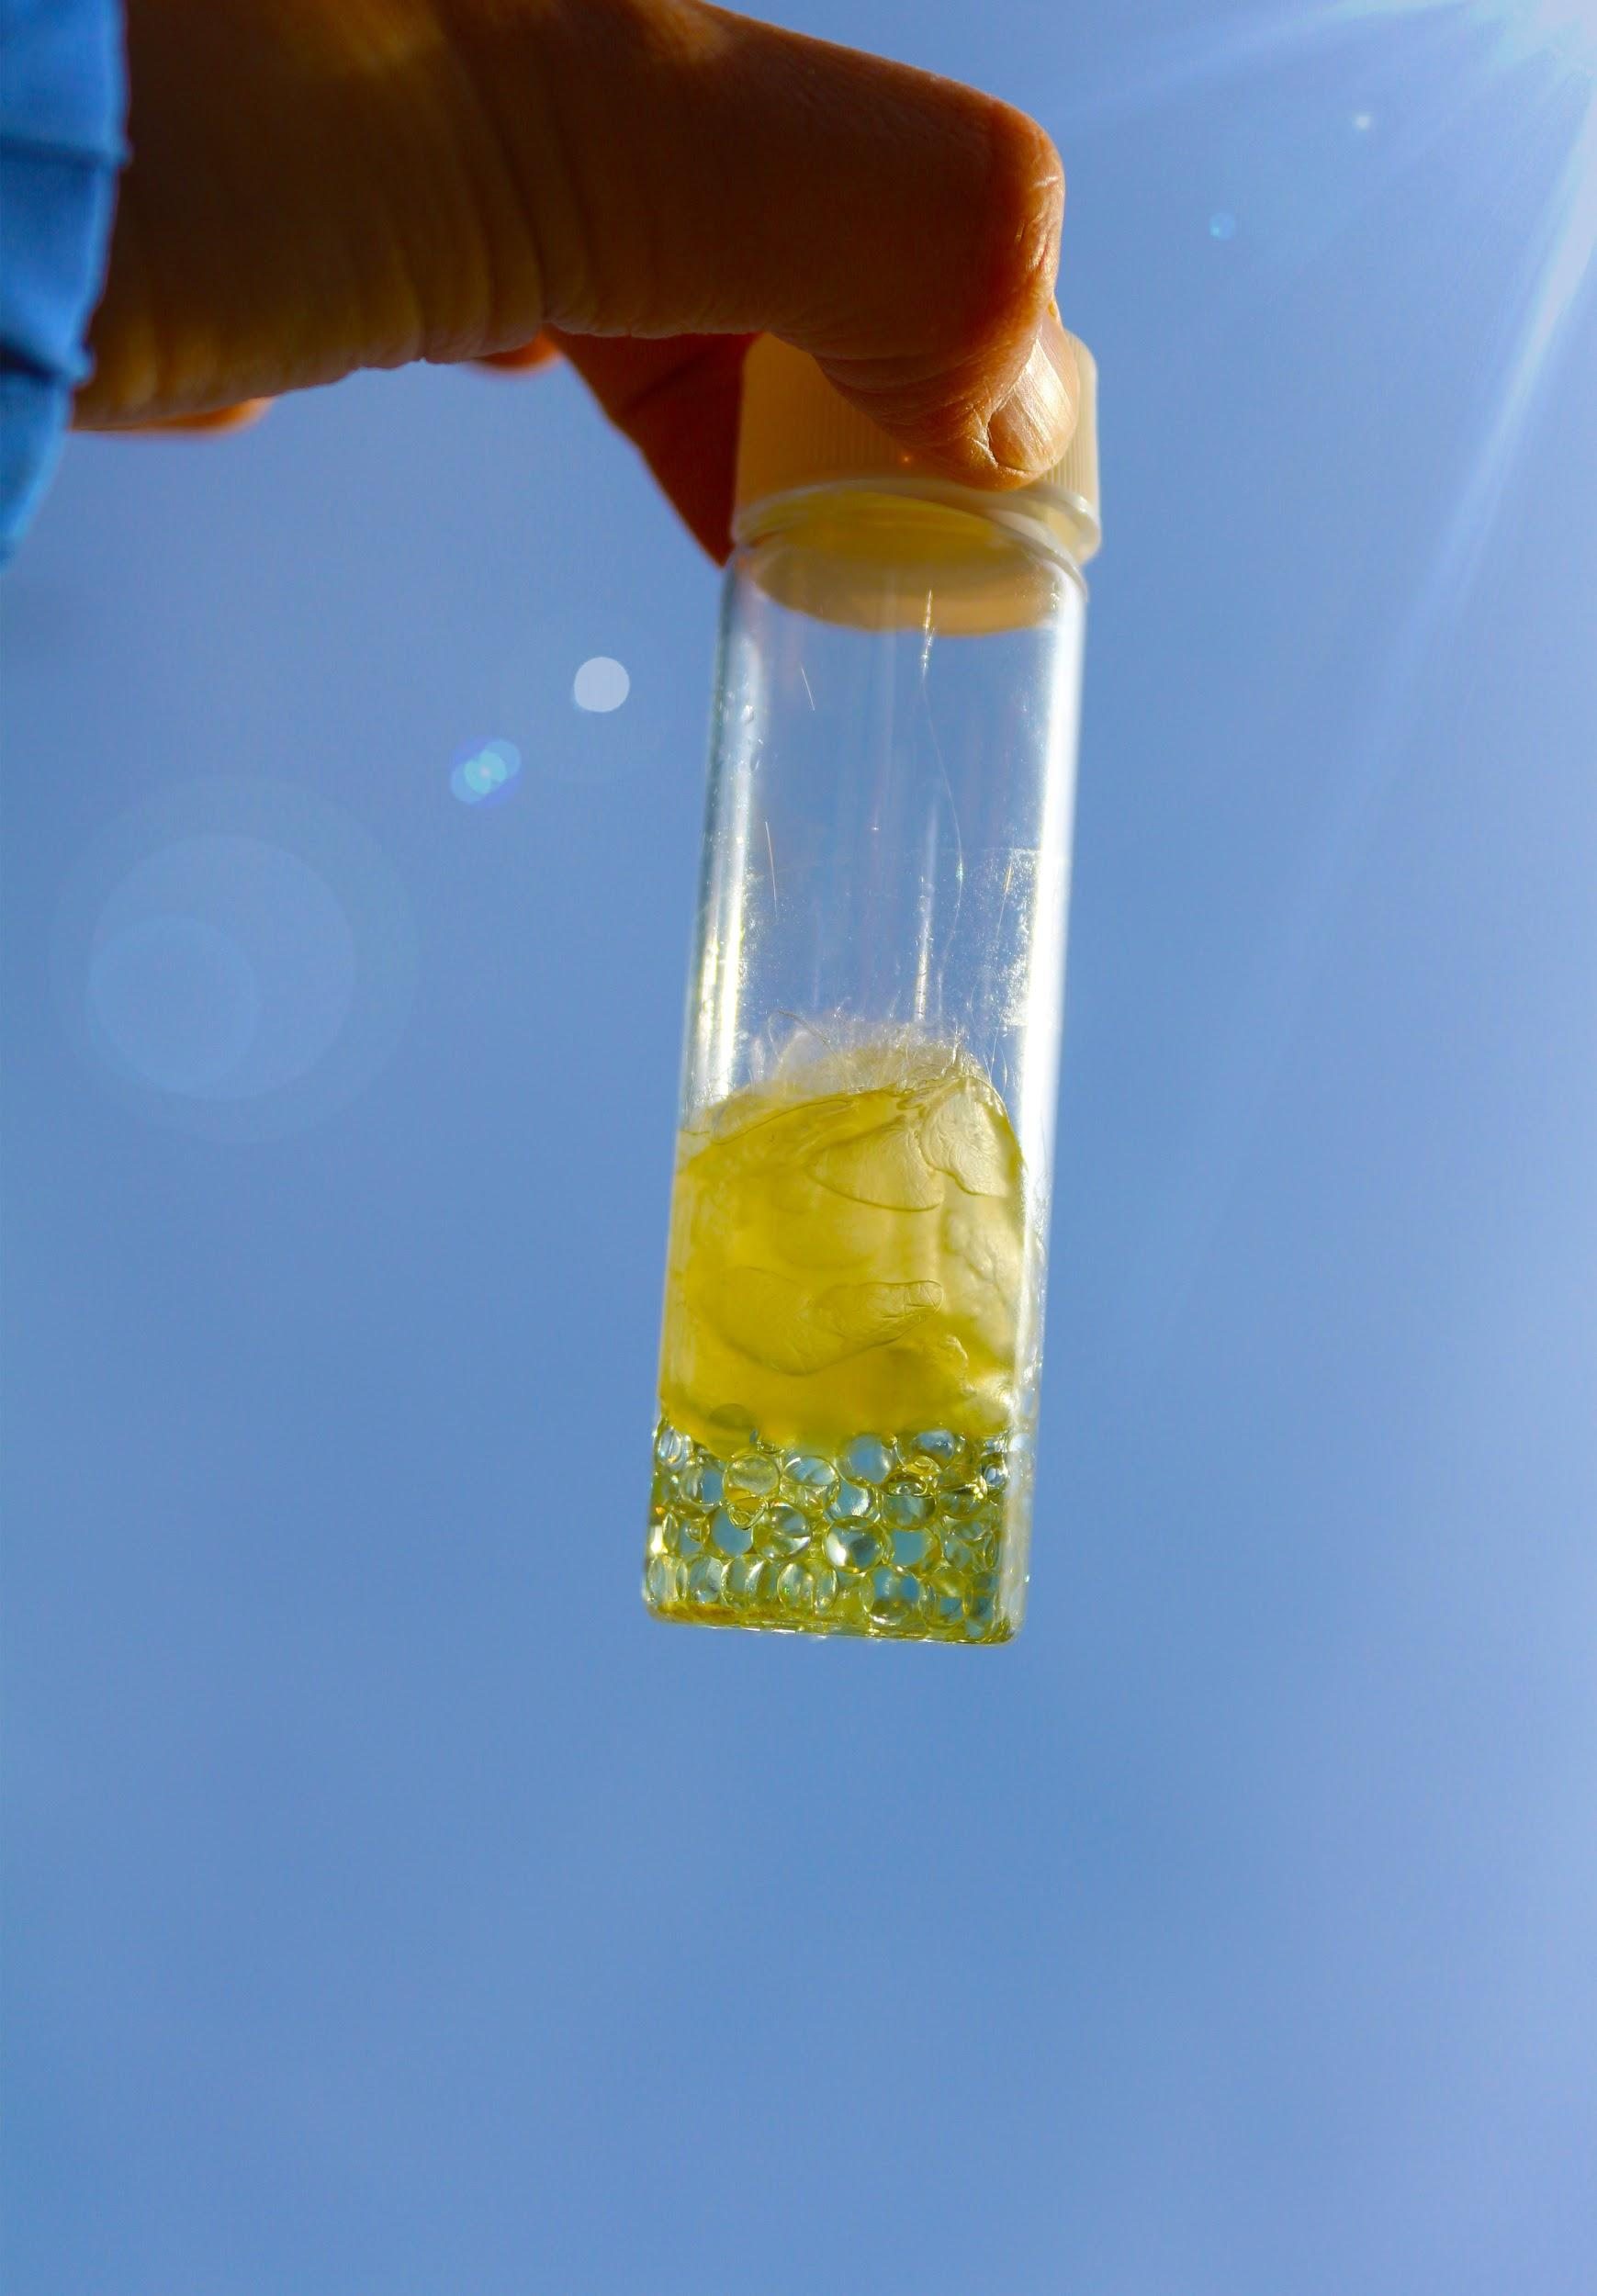
Borrowed Sunshine, Christianne Street
Notes:
Once the submission period closes, we first check with the Faculty of Graduate Studies and Research to confirm that all entries are from currently-enrolled graduate students. Images from eligible students are then shared with a colleague from Campus Design and Print Solutions who checks to see that they meet the technical requirements. Submissions that meet both of those checks are compiled into a Qualtrics survey for our judges to evaluate.
Our adjudication panel consists of 5-7 members of the university and alumni community. The Graduate Students Association provides one or two students to serve on this panel, as we feel the peer evaluation is important to the process. We ask someone from within the Libraries to serve as well, usually one of the library heads. We invite a representative from FGSR, sometimes an associate dean, sometimes a member of one of their advisory boards. We like to make sure we have someone with design or communications expertise, whether that is a faculty member or a working professional. These judges will go through all of the eligible submissions, first choosing a top 10. The are judging the
Originality and creativity;
Aesthetic appeal of the image;
Relationship between the image and the student’s research;
Clarity of written description and title

Slide 10
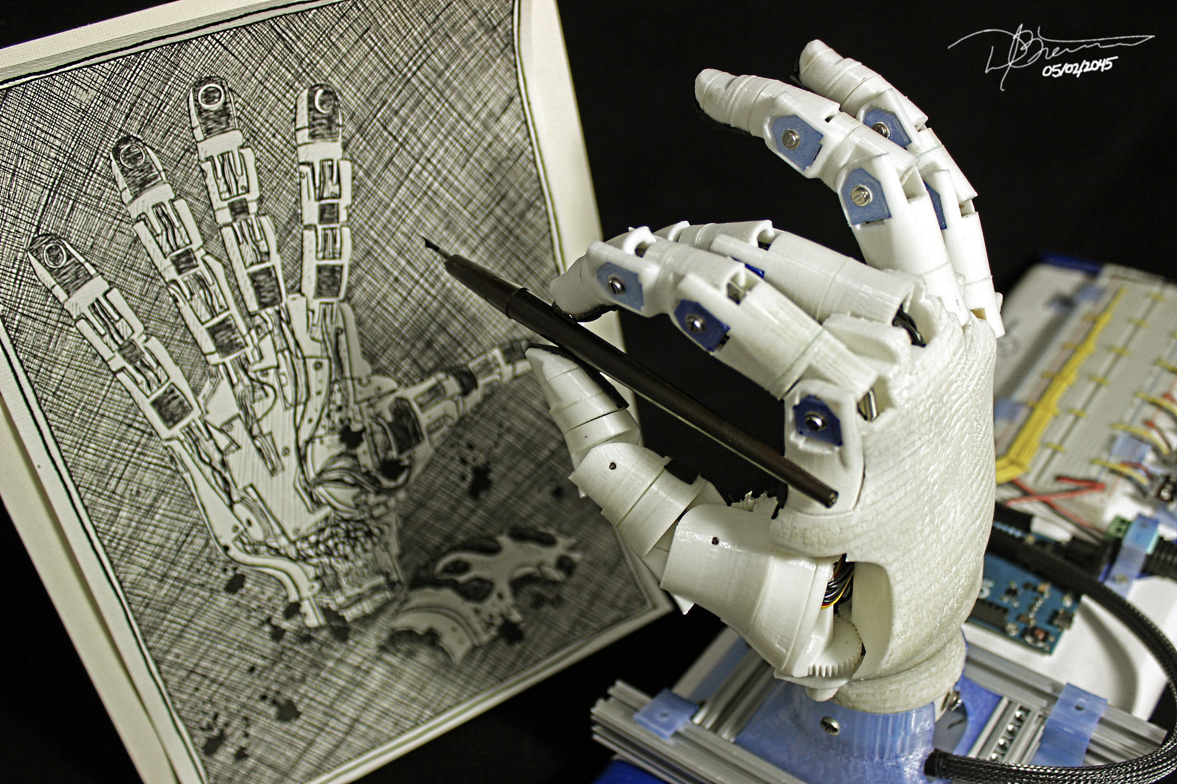
Self Portrait in 2045
Dylan Brenneis
Notes:
Judges are given one week to complete this initial evaluation. Once we have the results, we compile and rank the images, then host the adjudication panel for a three-hour session to determine the semi-finalists and prize winners. This process is one of my favourite parts, as I find it fascinating to see which images and descriptions resonate with the judges, and who is able to make a strong case for their favourite.
After the judges have determined the 24 semi-finalists, including five prize winners, we create a new survey with these images and open it up for the People’s Choice vote. This survey is designed with two options, so voters can choose to cast their vote for a known image, or to browse all the images before making a choice. We tend to get about two thirds of the votes being cast for a known image. At the end of one week, the image with the most votes becomes the People’s Choice winner.
We give cash prizes for this competition:
$800 for first place
$600 for second place
$500 for third place
Two honorable mentions and the People’s Choice winner at $250 each.

Slide 11
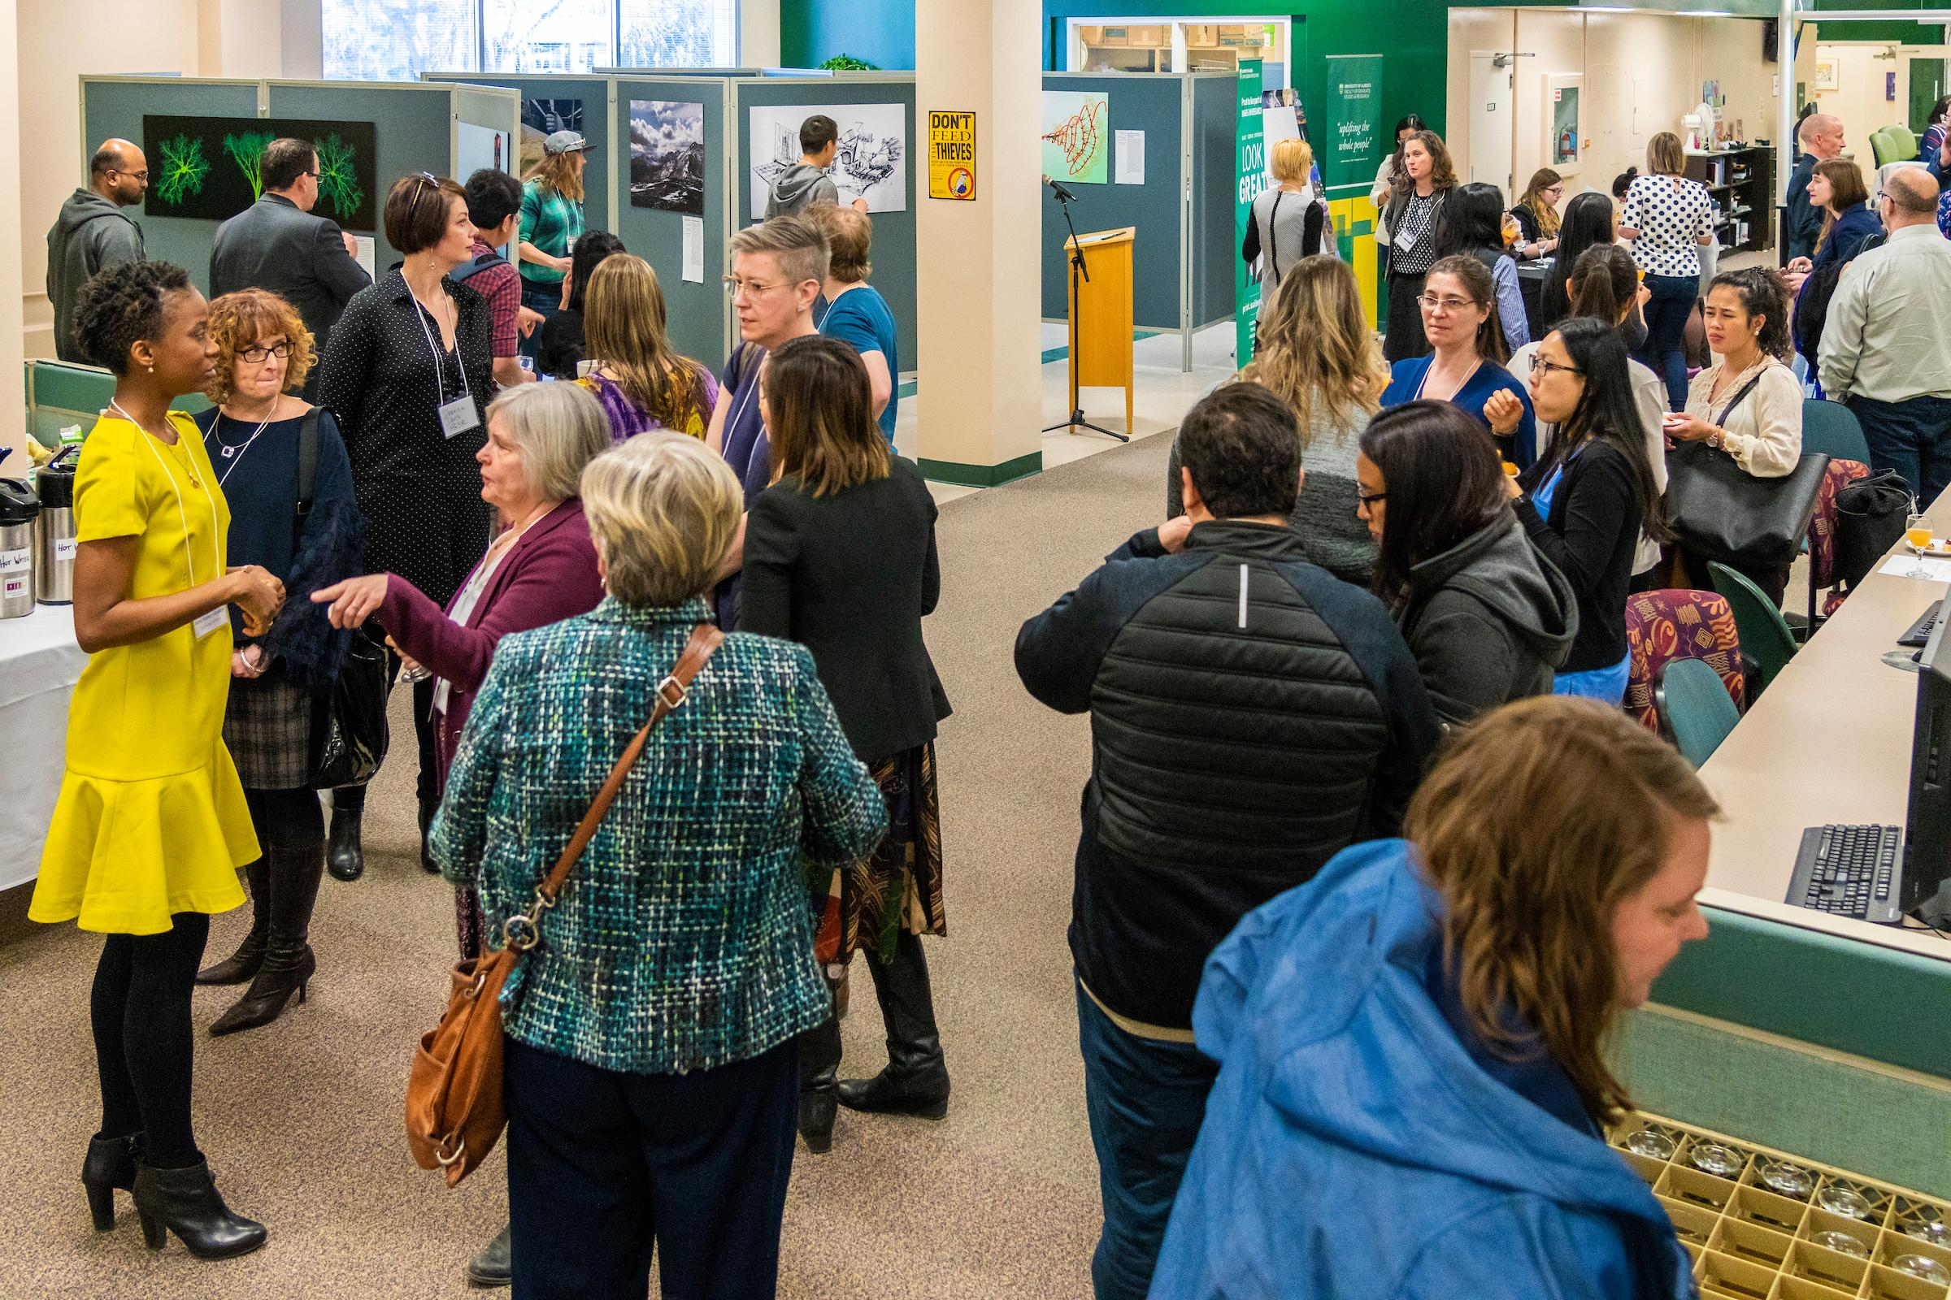
John Ulan
Notes:
Winners are announced at the beginning of April at an invitation-only catered reception in one of our libraries, and the semi-finalist and winning images remain on display for the rest of the month. Once the exhibition closes, we offer the large prints of the images to the semifinalists. We have set a policy to maintain a collection of 35 prints: 20 for the use of the committee (we set up a promo exhibition in January to encourage participation in the competition), and 15 additional images that can be used for temporary displays elsewhere, such as in the FGSR offices, at the local public library, etc.)

Slide 12
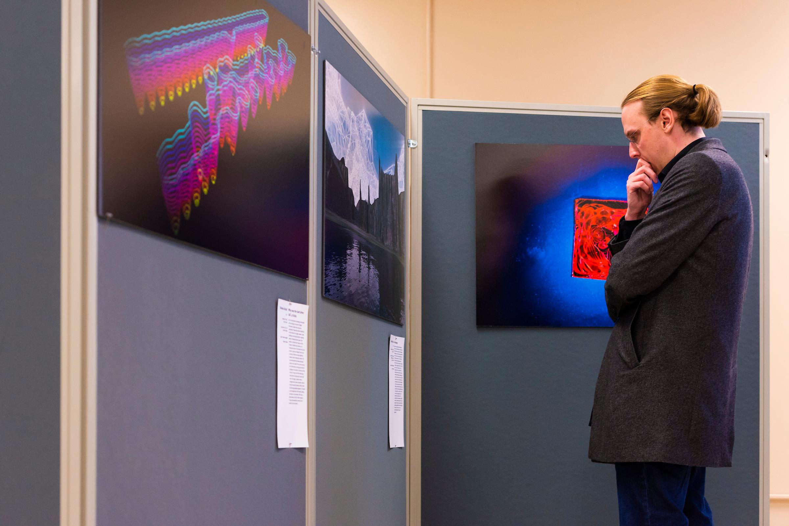
John Ulan

Slide 13
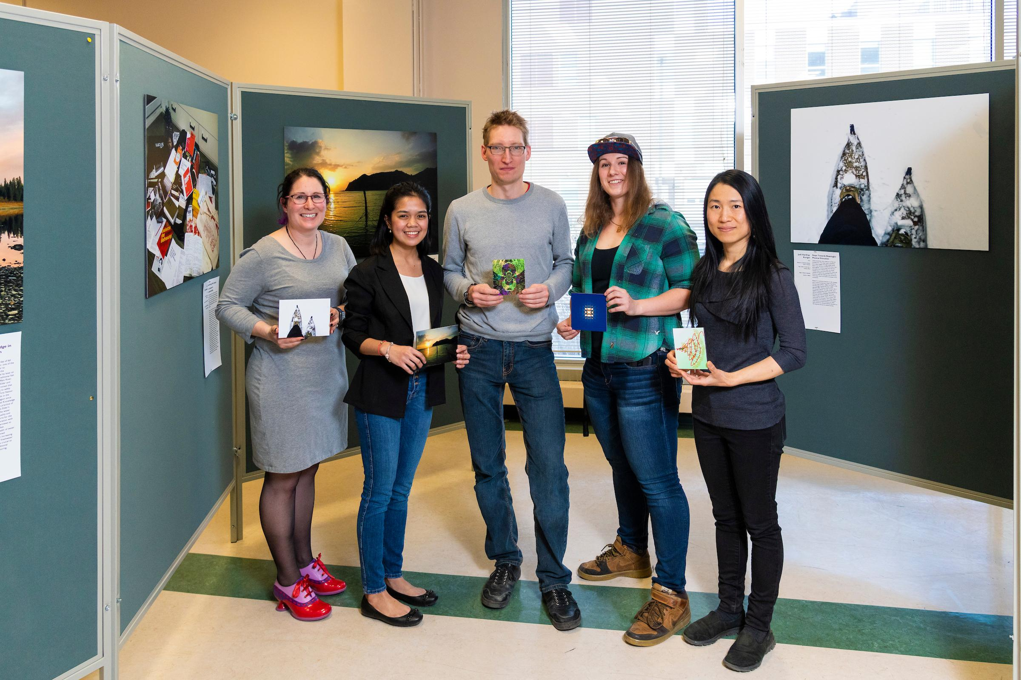
John Ulan

Slide 14
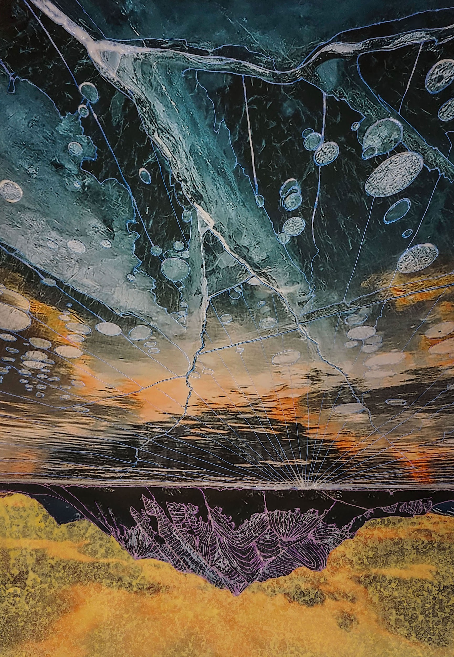
Wonder-trail in Blue and Yellow, Noemi de Bruijn
Notes:
We solicit participant feedback each year with a short Google form, and discuss the results during our wrap-up meetings so improvements can be made to the competition itself and our promotion efforts for future years. For example, due to participant feedback, communication procedures have been improved to keep participants aware of their status as the competition progresses. Judges are asked for their input at the end of the adjudication meeting, when the process is still fresh in their minds. Suggestions are noted by organizers for inclusion in the annual close-out report, and have led to such initiatives as the addition of the clear communication segment of the submission preparation workshop.

Slide 15
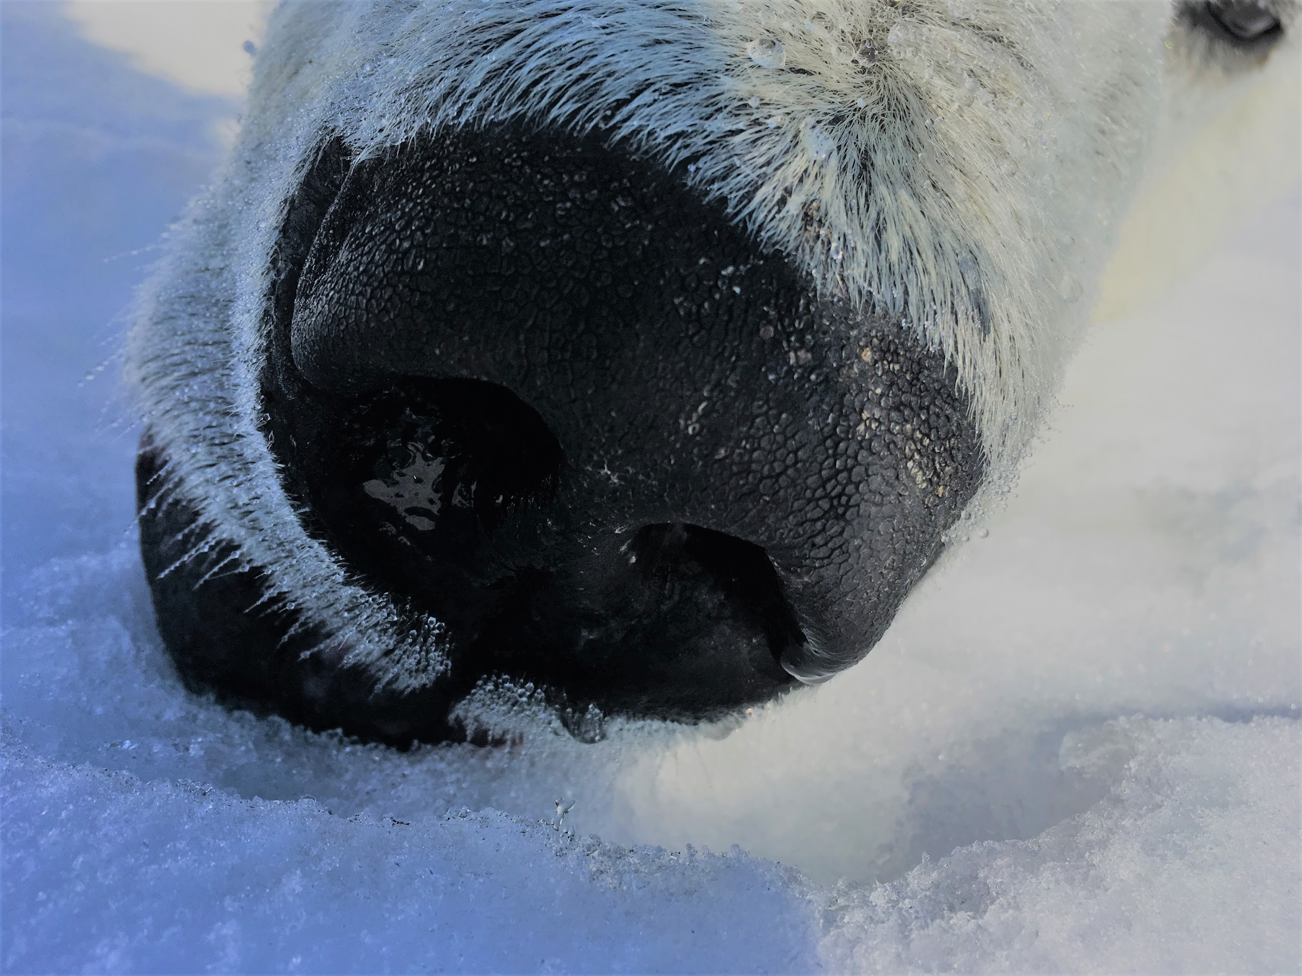
A Cold Breath,
Nicole Boucher
Notes:
Graduate student enrolment at UAlberta is approximately 7,500 students, and we receive about 100 entries to the competition each year. We see some repeat participation (about 7%), including former semi-finalists who have gone on to win prizes. Entries come from across all faculties, and often showcase photographs taken in a range of settings: in the city, in national parks, in the arctic, in the desert and even in space. However, there is no requirement that the entry be a photograph. Submissions have also included other forms of digitally created visual representations of student work.
Certain types of research projects, such as work with vulnerable populations or wildlife cameras, don’t allow for high-resolution photography. Graduate students have shown exceptional creativity in finding ways to create, combine or enhance images to convey the essence of their work. However, after several entries had to be disqualified for lack of compliance with the technical requirements, additional information was added to the online FAQs in an attempt to clarify this aspect of the rules. Examples of disqualified entries include images that were too small (e.g. less than one square inch) or at too low a resolution (e.g. 72 dpi when 300 is the required minimum). Manipulation of images to achieve the required specifications leads to very low-quality prints, and is not allowed.

Slide 16
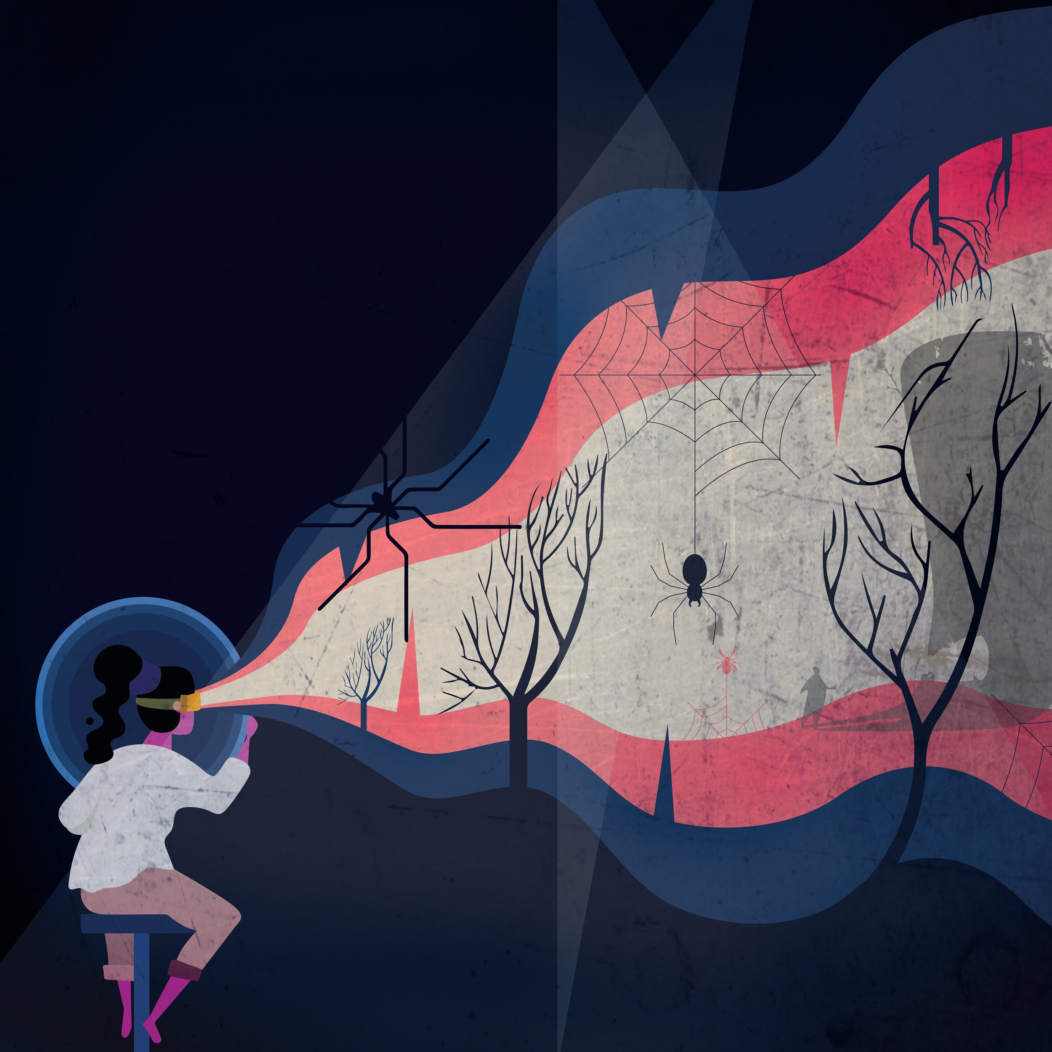
Augmented Phobia, Anna Chakravorty
Notes:
Prior to this most-recent competition, we attempted to contact all previous competitors and judges to gain additional insight into their experience and get an idea of whether they recognized any benefit to their professional development.

Slide 17
“
The creation of the image itself and the supporting documentation prompted me to consider very carefully how I communicate my research to the world. It provided a great outlet to experiment with new forms of communication and has encouraged me to continue scientific communication in other non-traditional ways
Notes:
Responses to the question regarding professional development were split between those who didn’t find value in the process, and those who offered insightful comments on what they had learned. It is rewarding to read responses such as these:

Slide 18
“
...it made me realize that writing is not the only way to disseminate research. There is something powerful about images ... and it made me rethink the way I approach research and my work. Also, having them published with DOI is also a game-changer.

Slide 19
“
It's easy for a graduate degree (in engineering especially) to become overwhelmingly technical, and narrowly specific to a discipline. The competition provided me with an opportunity to step outside of that norm and bring in interdisciplinary ideas and forms of expression. At the very least this provided an escape from monotonous drudgery... but I suspect any foray into interdisciplinary thought has effects more far-reaching and meaningful than that.
Notes:
Participant responses regarding engagement were more consistent, with two thirds of respondents reporting positive experiences.

Slide 20
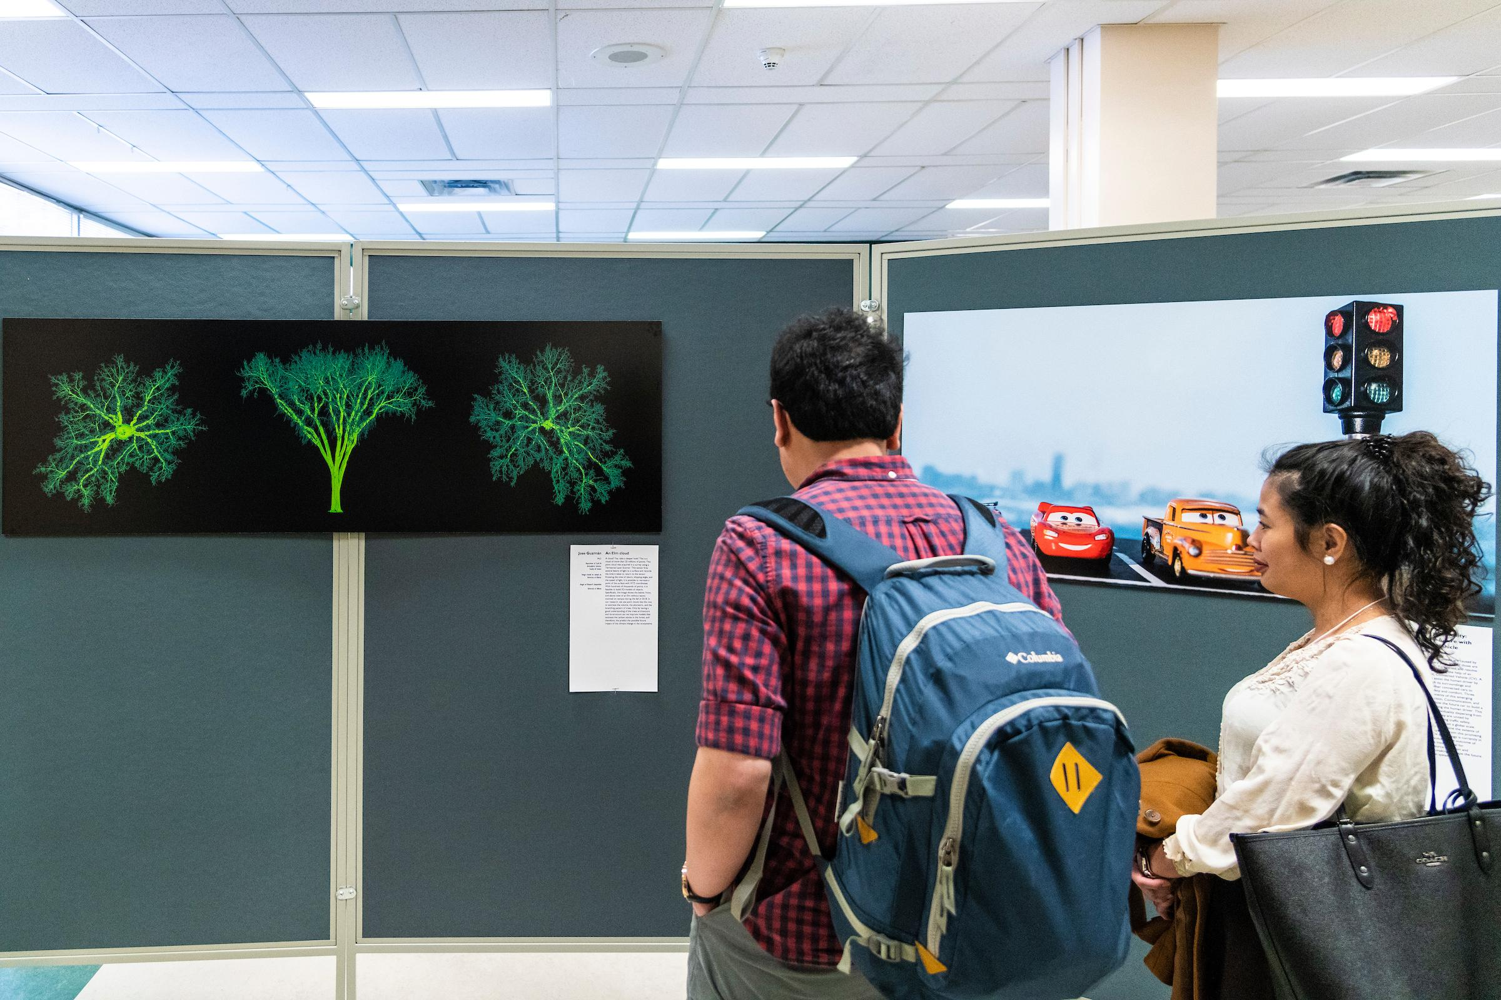
John Ulan
Notes:
In addition to fostering community among the participants, the month-long exhibition in the library offers an opportunity to showcase the variety of research topics being explored on campus to all those who use this space. The Faculty of Graduate Studies and Research is planning an additional reception to highlight the competition to off-campus partners, expanding the reach beyond the campus community.

Slide 21
“
It helped me to better understand the variety of projects and the passions -- both personal and for societal change -- that drive them.
Notes:
Graduate students are not the only ones to benefit from participation in the competition. Adjudicators have different motivations for taking on the role. They come from diverse academic backgrounds and bring experience from different disciplines, but emerge from the process with a new understanding of research on campus.

Slide 22
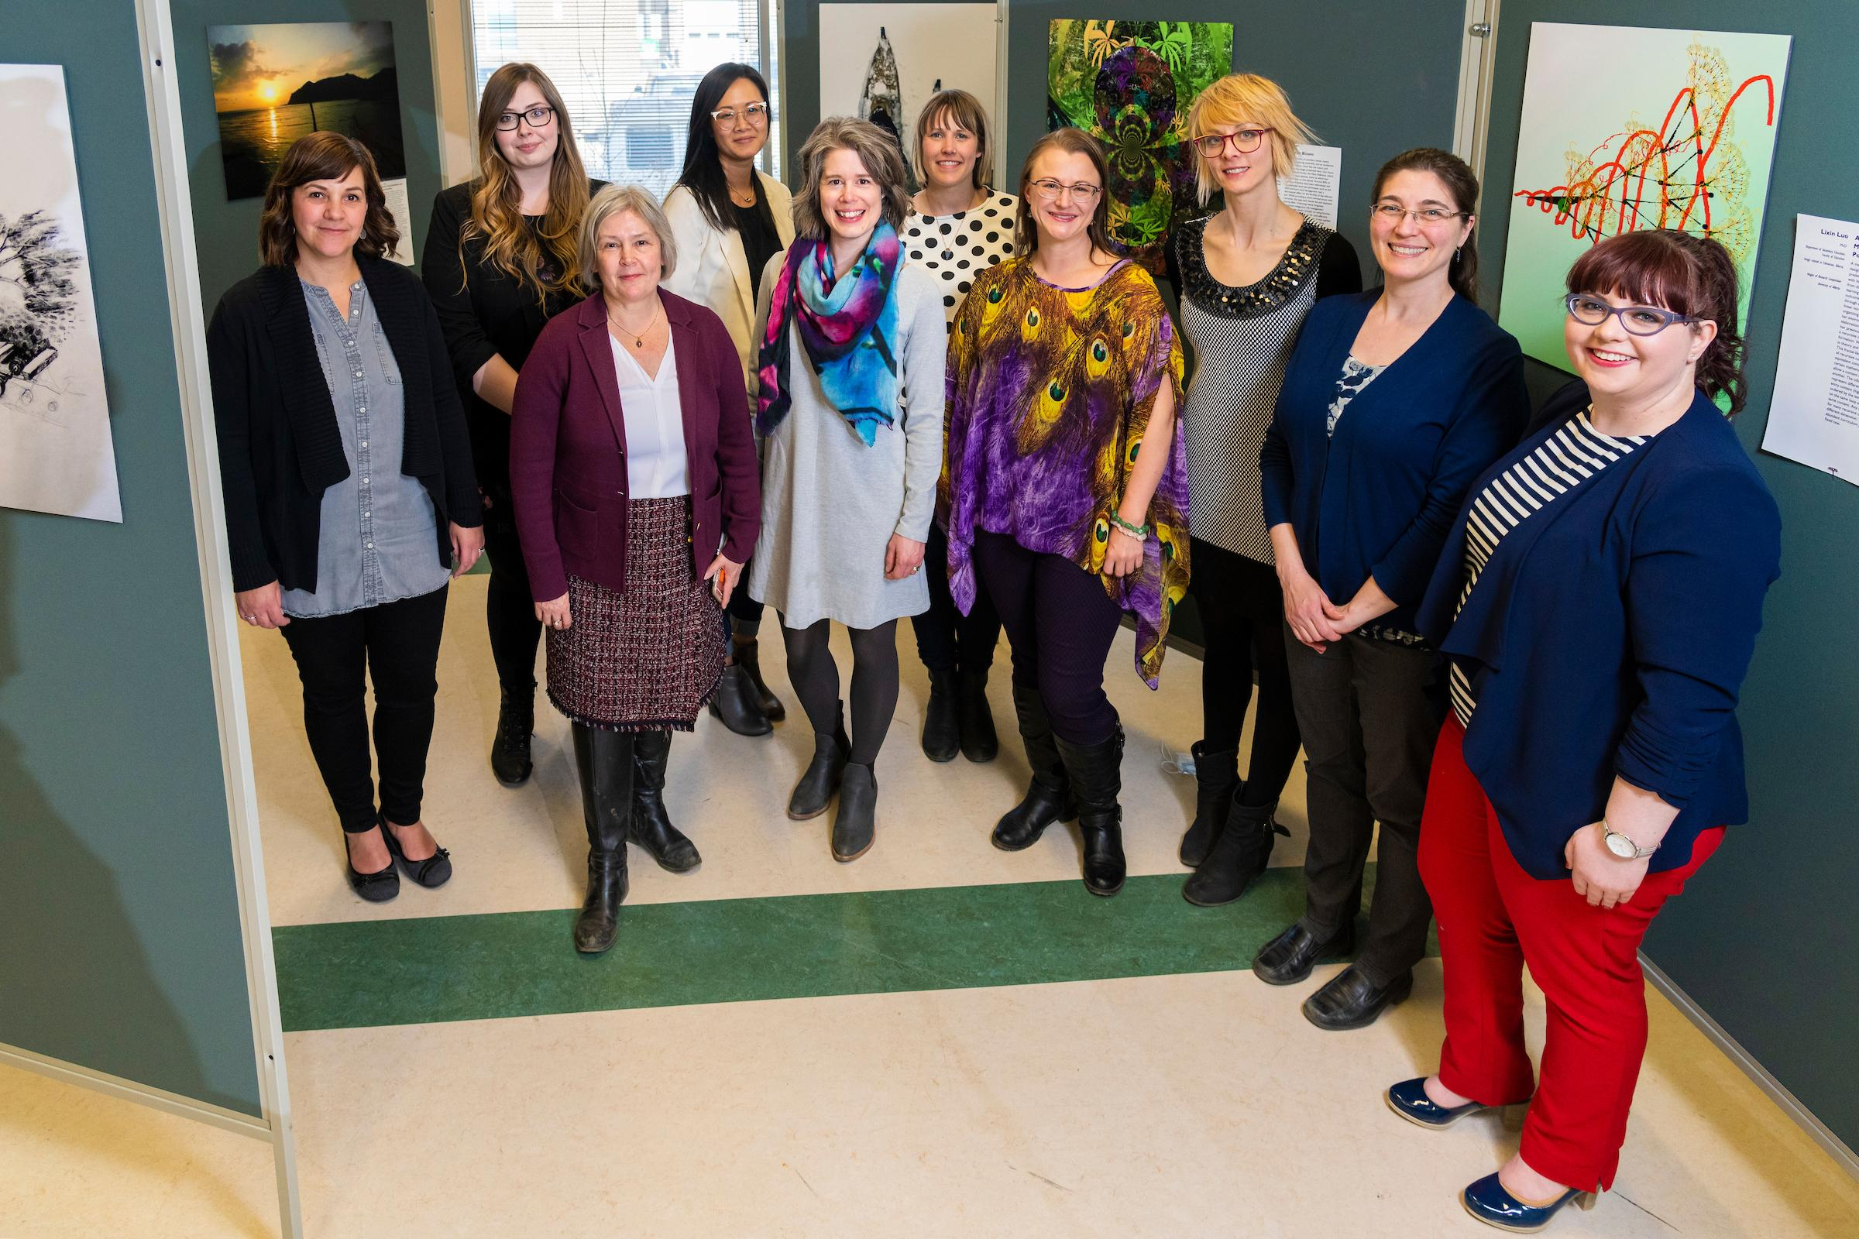
John Ulan
Notes:
UAlberta Libraries takes the lead in organizing and running the Images of Research competition, but it would not be possible without the help of campus partnerships. The organizing committee includes at least one representative from the Faculty of Graduate Studies and Research who helps avoid conflicts with other graduate student events, ensures workshops qualify for PD credit, and provides the means of verifying participant eligibility. Campus Design & Print Solutions is responsible for evaluating compliance with technical specifications, printing and mounting the images for the reception, and assisting in workshop development and delivery. IOR is also building new relationships on campus. After serving as a judge, the editor of New Trail offered her services in leading the clear writing workshop and promoted the use of the openly-licensed images available in ERA.

Slide 23
Notes:
Thank you very much for your attention today, I look forward to discussing this competition with anyone who is interested!

