Slide 1
Open Practices in Project Management
goo.gl/fsBsgQ
Open Practices in Project Management by Krysta McNutt is licensed under a Creative Commons Attribution 4.0 International License.
Krysta McNutt, PMP

Slide 2
goo.gl/fsBsgQ
Open Practices in Project Management by Krysta McNutt is licensed under a Creative Commons Attribution 4.0 International License.
This session will explore open practices and examples that could benefit your project(s). You'll walk away with a few easy tools to help increase the transparency of your project or initiative and some frameworks to apply open leadership to your work no matter what your role on the project is.

Slide 3
Open Leadership
Open Practices in Project Management by Krysta McNutt is licensed under a Creative Commons Attribution 4.0 International License.
Understanding: You make the work accessible and clear.
Sharing: You make the work easy to adapt, reproduce, and spread.
Participation & inclusion: You build shared ownership and agency with contributors through accountability, equity, and transparency to make the work inviting, relevant, safe, and sustainable for all. - Open Leadership Framework, Mozilla
Notes:
What clicked for me when I started reading up on open leadership and discovered the Mozilla open leadership framework is the applicability of these practices with the University’s alignment with social accountability and social responsibility. As a publicly funded educational institution, we are surrounded by work that aims to increase accessibility of knowledge, further discoveries in disciplines of major impact to the public, and push the boundaries of teaching and research in all disciplines.
The open leadership framework orients us to three principles:
Understanding, Sharing, and Participation and Inclusion. Within these three principles, they state that open leaders model openness specifically by making work accessible, easy to adapt and share, and creating shared ownership and agency. In today’s session I want to explore these a little more and apply these concepts to how we manage projects.

Slide 4
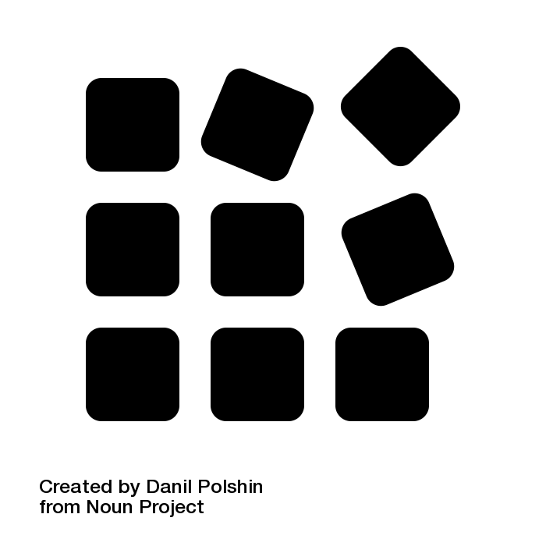
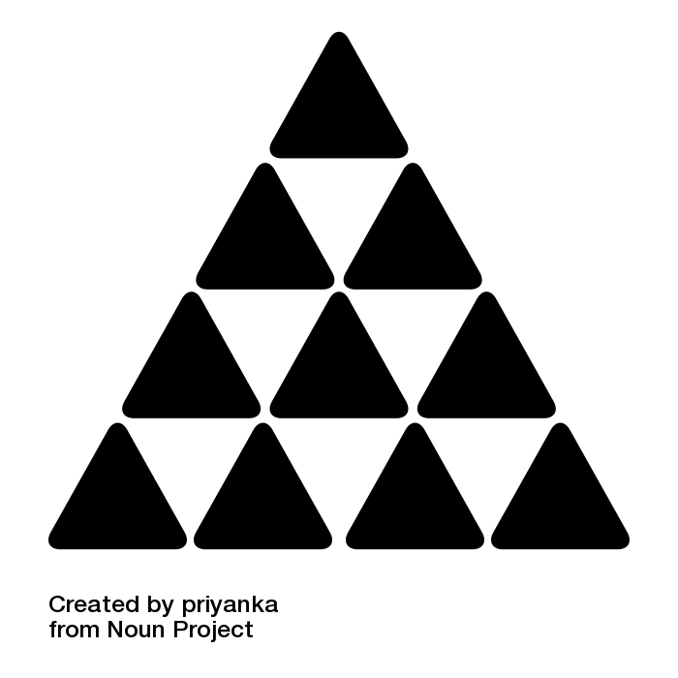
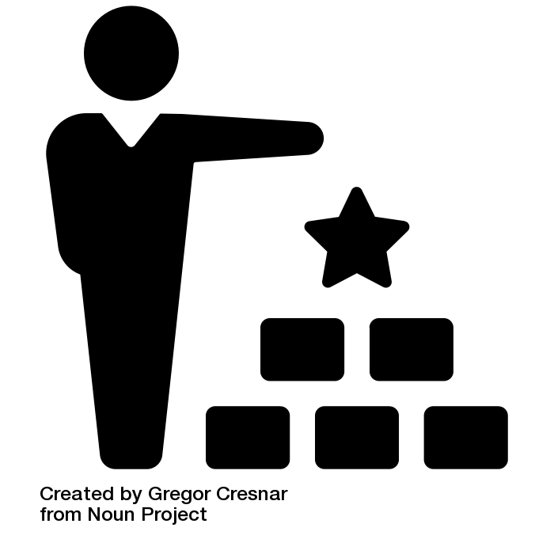
Open Practices
Open Practices in Project Management by Krysta McNutt is licensed under a Creative Commons Attribution 4.0 International License.
Design
Build
Empower
Notes:
To put open leadership into practice, Mozilla gives us three open practices to work from.
Design
deliberate decisions about how and when to be open.
Build
create structures to ensure clarity and process-based management.
Empower
model leadership skills that sustain involvement.

Slide 5
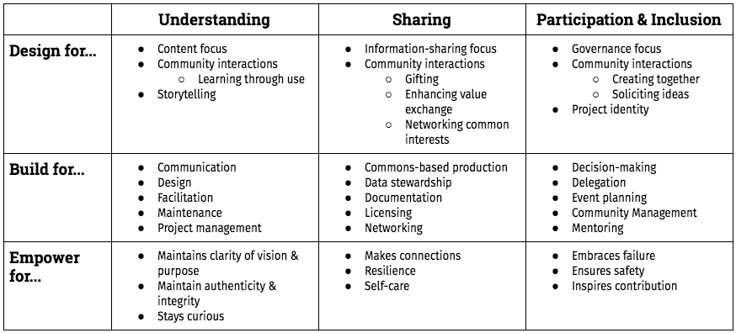
Open Practices in Project Management by Krysta McNutt is licensed under a Creative Commons Attribution 4.0 International License.
open principles
open practices
https://mozilla.github.io/open-leadership-framework/framework
Notes:
This chart aligns the open practices with actions and embedded skills to align your project design with the principles of open leadership.
So, let’s dig into these practices a bit.

Slide 6
Open Practices in Project Management by Krysta McNutt is licensed under a Creative Commons Attribution 4.0 International License.
Open Leadership Framework self-assessment
bit.ly/OLFselfassess
go here!
Notes:
The first thing I want you to do is go to this website and print or make a digital copy of the Open Leadership Framework self assessment. I’m going to walk you through the content of this assessment.

Slide 7
Design
Open Practices in Project Management by Krysta McNutt is licensed under a Creative Commons Attribution 4.0 International License.
open principles
open practices
I include storytelling in the vision document for this project.
I share and tell stories that illustrate multiple ways to contribute to this project and use it.
I share and tell stories that foster group identity among contributors and users.
I share governance with contributors and make decisions publicly as appropriate.
I include feedback loops that let me learn and account for contributors and users’ needs.
I share information on channels that are familiar to contributors and users.
Notes:
(principles, actions, and embedded skills)
Remember - open leaders make deliberate decisions about how and when to be open.
Pulling directly from the Open Leadership Framework Self Assessment, we can prompt some reflection on our own leadership or the design of our project.
Design for…
contribution from others
connection and community
engagement and feedback
people “where they are now”

Slide 8
Build
Open Practices in Project Management by Krysta McNutt is licensed under a Creative Commons Attribution 4.0 International License.
open principles
open practices
I advertise roles and responsibilities for delegation to contributors in this project.
I hold time and space for mentoring contributors or finding them mentorship.
I publish and follow participation guidelines that build a friendly project community.
I work with contributors in ways that maximize access, transparency, and accountability.
I license and publish this project in ways that let others freely use, share, adapt, and study it.
Notes:
(principles, actions, and embedded skills)
Open leaders create structures to ensure clarity and process-based management.
Build for…
participation / collaboration
growth and learning
a life of its own
open licence
enable reuse and sharing

Slide 9
Empower
Open Practices in Project Management by Krysta McNutt is licensed under a Creative Commons Attribution 4.0 International License.
open principles
open practices
I maintain a clear vision and sense of purpose that guides our shared work.
I model self-care by keeping track of my needs and addressing them.
I act to protect community members’ emotional, mental, and physical safety.
I define and regularly review community interactions and value exchanges to ensure equity.
I acknowledge and celebrate contributions and empower others to be leaders.
I embrace failure as an opportunity to learn through use.
Notes:
(principles, actions, and embedded skills)
Open leaders model leadership skills that sustain involvement.
Empower for…
personal and professional growth
equitable access
learning through use (project failure)
other “beta” open leaders!

Slide 10
OL Framework Assessments
Open Practices in Project Management by Krysta McNutt is licensed under a Creative Commons Attribution 4.0 International License.
OL Self Assessment
OL Project Design Assessment

Slide 11
Open Practices in Project Management by Krysta McNutt is licensed under a Creative Commons Attribution 4.0 International License.
Being open by design
...demands clarity on why you’re doing something and what the intended outcomes are. - A Framework of Open Practices, Mozilla
Notes:
Understand the problem at hand. Too often, projects start without an understanding of the problem that is being solved.
Business Analysis (IIBA). Develop a business case to inform the initiation of the project (BEFORE the project is initiated, or at minimum, before the project plan is developed!).

Slide 12
Open Practices in Project Management by Krysta McNutt is licensed under a Creative Commons Attribution 4.0 International License.
Project: a temporary endeavour undertaken to create a unique product, service, or result. (PMI.org, Project Management Institute)
Launching a new service.
Developing or improving processes.
Designing a product or resource.
Notes:
Definition of a project:
a temporary endeavour undertaken to create a unique product, service, or result. (PMI.org, Project Management Institute)

Slide 13
Project Lifecycle (waterfall)
Open Practices in Project Management by Krysta McNutt is licensed under a Creative Commons Attribution 4.0 International License.
Initiation
Planning
Execution
Closing
Notes:
If you’ve been exposed to project management methodologies in the past, you’ll recognize the project lifecycle as Initiation, Planning, Execution, and Closing.
Unfortunately, we often see this standard project lifecycle being applied in such a literal sense that the activities occurring within each phase become siloed and disconnect us from our audience.

Slide 14
Project Lifecycle (waterfall)
Participation
Understanding Sharing
Participation
Understanding Sharing
Participation
Understanding Sharing
Participation
Understanding Sharing
Open Practices in Project Management by Krysta McNutt is licensed under a Creative Commons Attribution 4.0 International License.
Initiation
Planning
Execution
Closing
Notes:
In the context of the open leadership principles we're talking about today, people tend to place the bulk of those efforts in the planning stage of the project, and leave it at that.

Slide 15
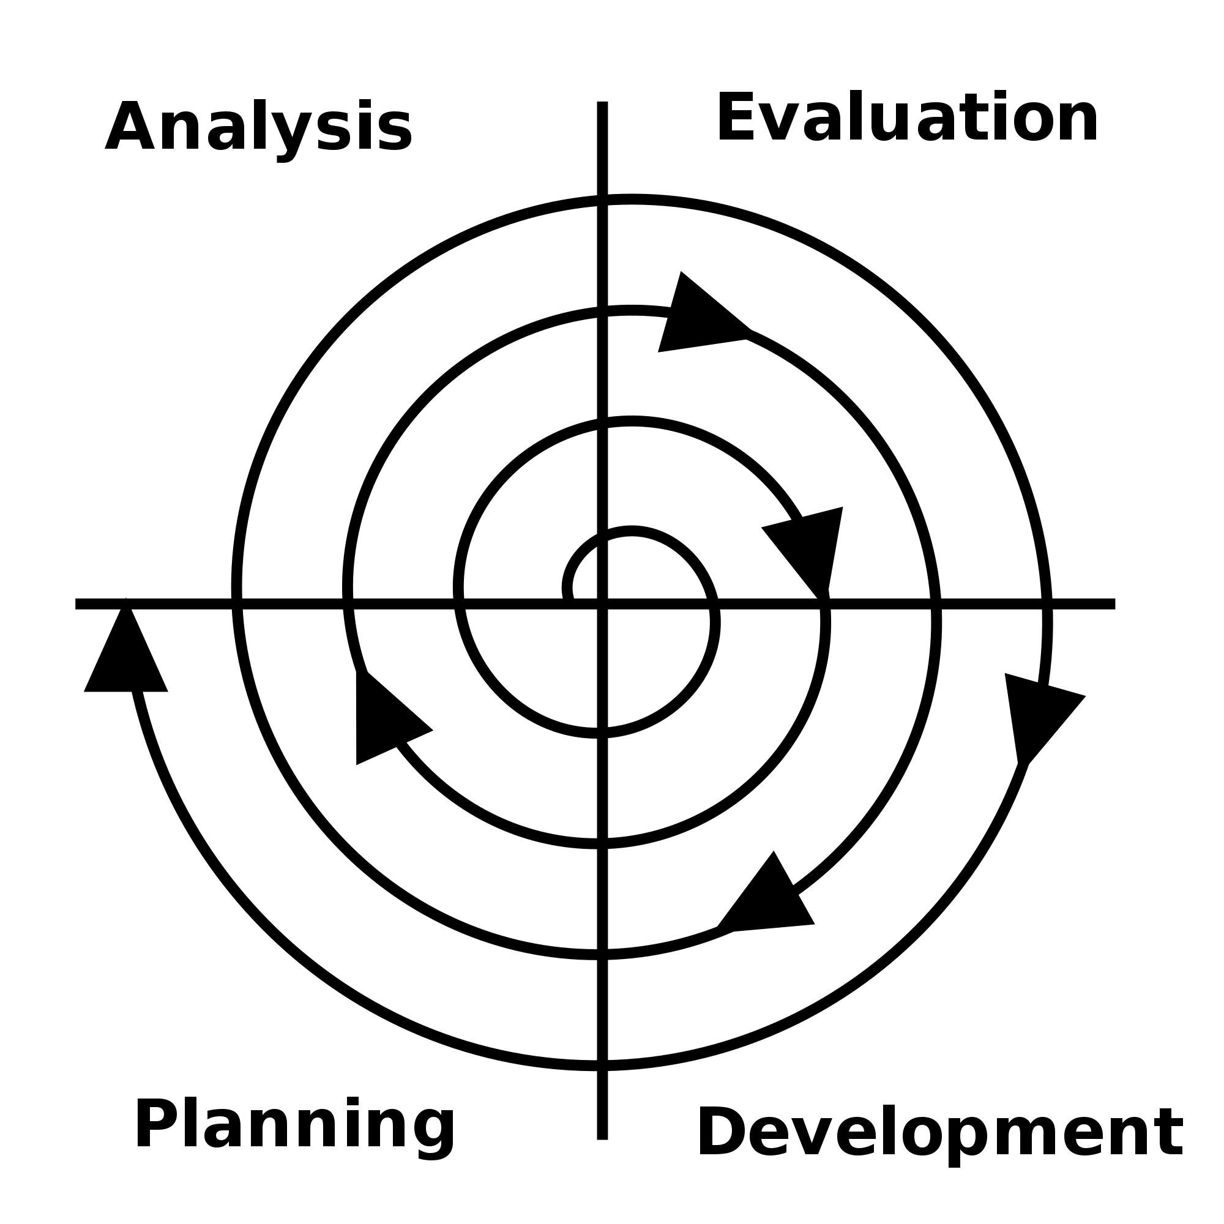
Software Development Lifecycle
Open Practices in Project Management by Krysta McNutt is licensed under a Creative Commons Attribution 4.0 International License.
Notes:
In contrast to how linear the project lifecycle is, here we have the software development lifecycle.
More and more we see processes and methodologies from software development being used in other industries or technologies.
Visually, you can see the the spiral nature of this approach.

Slide 16
Software Development Lifecycle
Understanding Participation Sharing
Understanding Participation Sharing
Understanding Participation Sharing
Sharing
Participation Understanding
Sharing
Participation Understanding
Open Practices in Project Management by Krysta McNutt is licensed under a Creative Commons Attribution 4.0 International License.
Notes:
The takeaway I want for you here is the iterative concept of revisiting the open principles (understanding, sharing, participation, and inclusion) throughout your project
Whether you execute your project as a whole using waterfall or not, you can apply principles from these methodologies

Slide 17
Community Interactions
Open Practices in Project Management by Krysta McNutt is licensed under a Creative Commons Attribution 4.0 International License.
Six major ways of building value together with an outside community or organisation. - A Framework of Open Practices, Mozilla
Notes:
We can integrate the values of open leadership into our project design is through our stakeholder engagement and communication plans.
In other words… community interactions.

Slide 18
Gifting
Open Practices in Project Management by Krysta McNutt is licensed under a Creative Commons Attribution 4.0 International License.
Giving away the work without expecting an equal return.
You get: reach, spread, scale.
Users get: your content or product.
Notes:
e.g.
give it away
creative commons license

Slide 19
Creating Together
Open Practices in Project Management by Krysta McNutt is licensed under a Creative Commons Attribution 4.0 International License.
Making stuff with contributors.
You get: expert, volunteer help.
Contributors get: recognition, thanks, other clearly defined benefits (e.g. delegation, mentorship, profit sharing).
Notes:
e.g.
prototype demos
user testing

Slide 20
Learning Through Use
Open Practices in Project Management by Krysta McNutt is licensed under a Creative Commons Attribution 4.0 International License.
Collecting data about contributors and users’ experiences.
You get: information that helps you improve your work and its uptake
Contributors and users get: improved products and other clearly defined benefits (e.g. attribution, compensation).
Notes:
e.g.
pilot projects
beta releases

Slide 21
Soliciting Ideas
Open Practices in Project Management by Krysta McNutt is licensed under a Creative Commons Attribution 4.0 International License.
Crowdsourcing or crowdstorming ideas with users.
You get: ideas for outcomes and products that meet users needs and wants.
Users get: products that match their needs and wants, recognition, thanks, and other clearly defined benefits (e.g. attribution, profit-sharing).

Slide 22
Enhancing Values Exchanges
Open Practices in Project Management by Krysta McNutt is licensed under a Creative Commons Attribution 4.0 International License.
Refining value exchanges until they attract the contributors and users your project needs to thrive.
You get: committed, helpful contributors and users.
Contributors and users get: equitable returns on their investment of time, talent, and use.
Notes:
e.g.
recruiting new team members through community interactions

Slide 23
Networking Common Interests
Open Practices in Project Management by Krysta McNutt is licensed under a Creative Commons Attribution 4.0 International License.
Connecting your network with contributors and users’ networks.
You get: increased partnerships, reach, spread, scale, and uptake among people and groups with shared interests and passions.
Contributors and users get: social capital, stronger products, and a wider support network.
Notes:
e.g.
encouraging your team to network and openly share progress beyond the direct product network or industry.

Slide 24
A little heads up…
Open Practices in Project Management by Krysta McNutt is licensed under a Creative Commons Attribution 4.0 International License.
It’s difficult to talk about at the beginning of a project. Clarity, equity, and trust are key.
Is the exchange clearly defined?
Is it equitable?
Can you - and do you - consistently follow through on it?
Avoid exchanges you cannot fulfill.

Slide 25
Open and Iterative
Understanding
Participation
Sharing
Participation
Sharing
Understanding
Understanding
Sharing
Participation
Participation
Understanding
Open Practices in Project Management by Krysta McNutt is licensed under a Creative Commons Attribution 4.0 International License.
Notes:
In conclusion, we can embed participation, sharing, and understanding throughout the lifecycle of our project by viewing it in this spiral nature. Even if you are managing your project utilizing the waterfall methodology, you can view your communications plan, your design phase, your user testing, and so many other phases of your project as iterative processes. If you consider when and where you can be open and iterative throughout your work, there will be lots of opportunities to model open leadership.
I encourage you to revisit the Open Leadership Framework self assessment throughout your project, and even ask your team members to self assess, too.

Slide 26
Frameworks
Open Practices in Project Management by Krysta McNutt is licensed under a Creative Commons Attribution 4.0 International License.
“Open Leadership Framework” by Mozilla Foundation https://mozilla.github.io/open-leadership-framework/
“A Framework of Open Practices” by Gitte Jonsdatter (CIID) & Alex Klepel (Mozilla Foundation)
https://medium.com/mozilla-open-innovation/a-framework-of-open-practices-9a17fe1645a3
“How to Work Open” by OpenMatt, Mozilla https://openmatt.org/2011/04/06/how-to-work-open/
“The Open Organizational Maturity Model” by The Open Organization Ambassadors at Opensource.com https://opensource.com/open-organization/resources/open-org-maturity-model
Notes:
This presentation is an adaptation of content from the Mozilla Foundation open leadership framework. For more information, check out these links for additional guidance specific to the framework

Slide 27
Tools
Open Practices in Project Management by Krysta McNutt is licensed under a Creative Commons Attribution 4.0 International License.
Open Leadership Framework self-assessment https://docs.google.com/document/d/1Kg2hR63ZG89pYu0SvhC_FXXLieiZHf65Wz7yRybByE0/edit
Open Leadership Framework project design assessment
https://docs.google.com/document/d/1hd1yPyNCrkqUkq5aAH4uiaXVyhQv5bdlu5onIvbu3bE/edit
Open Canvas template https://docs.google.com/presentation/d/1_eya6vVXpaZOpXFZsZNbVHboROI4IPWy-poCnYTNtnQ/edit
Project Archteypes https://docs.google.com/presentation/d/1ujYh0To0cIw7UrZeCnvLZd3WDzy93Hifu7XgVfN_WUs/edit
Notes:
Or these links for tools and templates.

Slide 28
Further Reading
Open Practices in Project Management by Krysta McNutt is licensed under a Creative Commons Attribution 4.0 International License.
Taxonomy of Open values exchanges https://docs.google.com/document/d/1lWrAfpLYPIz36GN6tjVryDsYeWinu2DyIPm8-yPvRro/edit#
Community Interactions
https://docs.google.com/presentation/d/1_lkpsy2RXaKwfAYbXgr0it-5GB-NAWT3gZv_xoo7AhI/edit#
Contributor personas and pathways https://mozilla.github.io/open-leadership-training-series/articles/building-communities-of-contributors/bring-on-contributors-using-personas-and-pathways/
What, exactly, is Open Science? http://openscience.org/what-exactly-is-open-science/
Notes:
Or, my favourite are these additional readings that pull us into the theory of the open leadership framework.

Slide 29
Thank you!
Open Practices in Project Management by Krysta McNutt is licensed under a Creative Commons Attribution 4.0 International License.
Notes:
Well, this concludes my session today. Thank you so much for listening!

