Slide 1
What can you do in a makerspace? 23 questions and copyright implications
Michael McNally, Holly Arnason, Angela Ashton
Code4Lib Unconference, EPL Stanley Milner Branch
November 6, 2015, Edmonton, AB

Slide 2
What can you do in a makerspace?
Outline
Canadian copyright explained by Michael McNally
Makerspace technology explained by Holly Arnason
Angela Ashton hurts her brain answering 23 questions
Questions
23 questions and copyright implications

Slide 3
Disclaimer
This presentation is intended for discussion purposes only and does not constitute legal advice or legal opinion.

Slide 4
Canadian Copyright Overview
Canadian Intellectual Property (IP) law
Copyright law and jurisprudence overview
Fair dealing
Non-commercial user-generated content
licensing
public domain and de minimis
Michael McNally,
Assistant Professor,
School of Library and Information Studies,
University of Alberta

Slide 5
Canadian IP Law
Intellectual Property protected by a range of IP devices, including:
Copyright
Patent
Trademark
Industrial Design
Integrated Circuit Topologies
Geographical Indications
Copyright is the main issue in makerspaces

Slide 6
Patent, Trademark, and Industrial Design Concerns
Patent concerns are minor (generally can’t make patented objects in a makerspace), but exceptions to patents are very limited (i.e. experimentation (Patent Act s. 55.2(6))
Trademarks concerns are almost always linked to business uses, except uses that are likely to have a depreciating effect on the goodwill of a trademark (Trade-marks Act, s. 22(1))
Industrial Design concerns may arise when an individual is producing more than 50 units of an article (Copyright Act, s. 64(2)(a))

Slide 7
Canadian Copyright Law and Jurisprudence
Canadian copyright is:
long - Copyright Act is 184 pages, doesn’t include case law
complex - e.g. “‘lesson’ means a lesson, test or examination, or part of one, in which, or during the course of which, an act is done in respect of a work or other subject-matter...” Copyright Act s. 30.01
contextual - “[The six fair dealing] factors may be more or less relevant to assessing the fairness of a dealing depending on the factual context of the allegedly infringing dealing. In some contexts, there may be factors other than those listed here that may help a court decide whether the dealing was fair.” CCH v. Law Society of Upper Canada (LCSH), 2004 SCC 13, para. 60

Slide 8
Fair Dealing - First Prong/Factor
Fair dealing (or “users’ rights” (CCH para. 12)) is the broadest category of exceptions to creator's’ rights, and is decided based upon a two prong, six factor test (based on CCH case)
First prong/factor: “Purpose of the dealing” must be one of education, research, private study, criticism, review, news reporting, parody or satire (Copyright Act s. 29)
Courts have tended to interpret research and private study broadly (education is new and there is no case law)
However, Supreme Court has also stated that meeting the first prong/factor is easy and the tough job is weighing the second prong/remaining five factors

Slide 9
Fair Dealing - Second Prong/Remaining Five Factors
“Character of the dealing” - number of copies? range of distribution?
“Amount of the dealing” - amount of the original work copied
“Alternatives to the dealing” - do non-copyrighted equivalents exist that could have been used?
“Nature of the work” - was the original secret/confidential or published?
“Effect of the dealing on the work” - does the reproduction compete with the original?
There is no text-book formula for weighing the remaining five factors, but key is the system must be fair. (CCH v. LCSH, para. 63)

Slide 10
Non-Commercial User-Generated Content Exception
The remix/mashup exception, subject to four conditions:
Resulting work must be non-commercial
Source of original work is provided if reasonable
Original source work not an infringing copy
New work doesn’t have substantial adverse effect on original (including being a substitute for the original) (Copyright Act, s. 29.21)

Slide 11
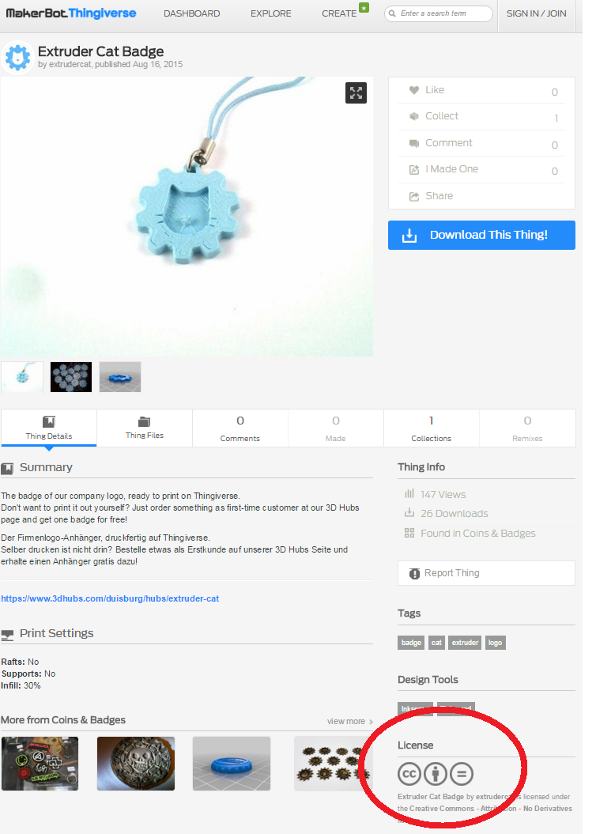
Licenses
Generally open licenses (like Creative Commons) will give users more rights
UGC exception can be used to circumvent the “ND” (no derivatives) CC requirement
However, terms of service/use for various sites may end up restricting use
Disputed question if terms of service/use can restrict user’s rights in copyright

Slide 12
Public Domain and De Minimis
Remember - not everything is copyright protected
Public domain includes works not protected by copyright (e.g. facts, ideas, works produced by the U.S. federal government), and works where copyright has expired (i.e. old stuff)
Copyright also applies only when a “substantial” amount of copying takes place (Copyright Act s. 3); however, threshold for unsubstantial/de minimis copying is generally low
Less than 2.5% of a textual work is a very rough guideline (see Copyright Board of Canada Decision from May 22, 2015, para 204)

Slide 13
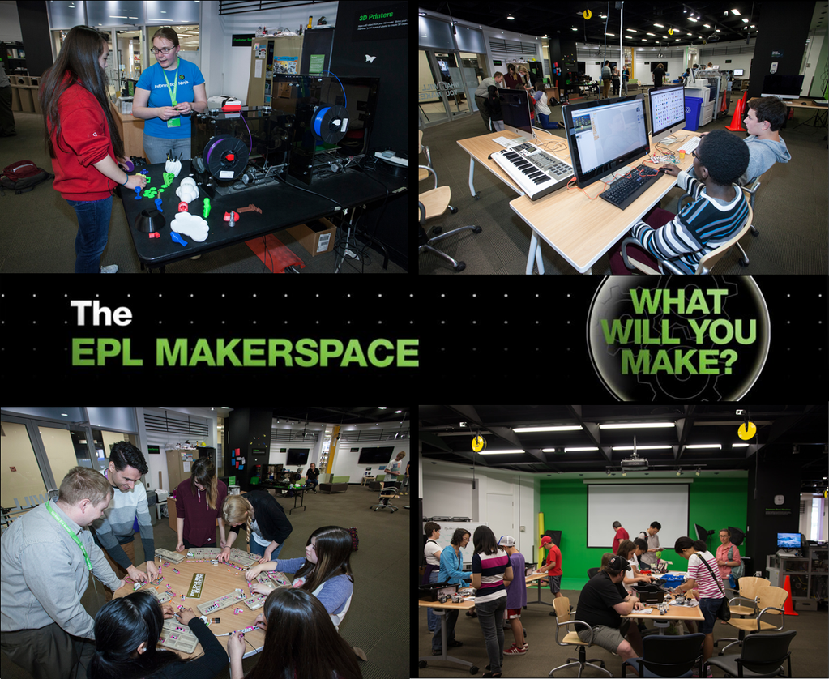
Makerspace technology explained
Holly Arnason, MLIS
EPL DLI librarian & makerspace wrangler

Slide 14
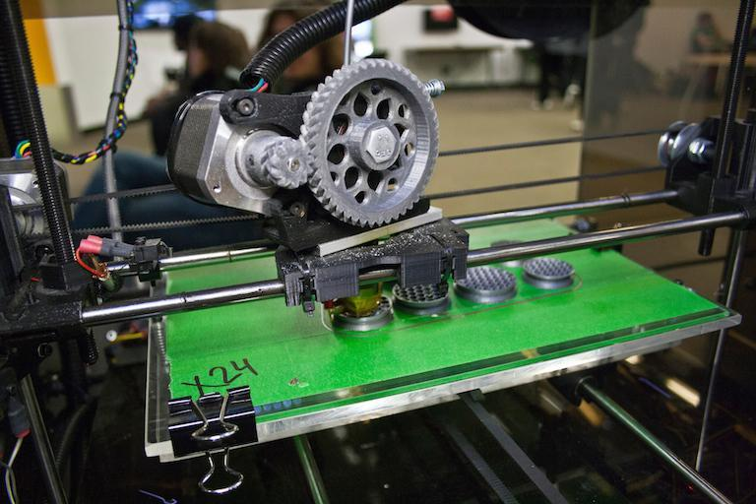
3D Printing and Vinyl Cutting
3D printing is an additive process.
Vinyl cutting is a reductive process.
Both use object files that are ‘sliced’ into lines of machine instructions, sent to printer or cutter.

Slide 15
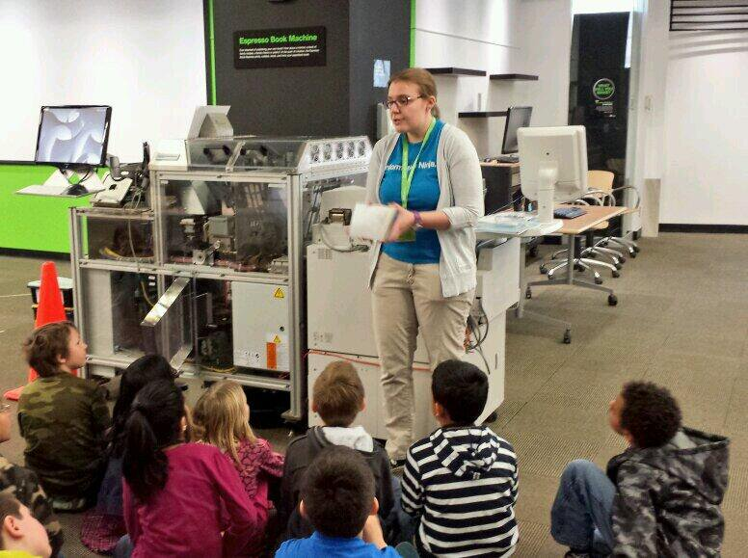
Book Printing
EPL’s Espresso Book Machine prints soft cover books on demand (50 - 800 pages).
Book is generated from two PDF files - block and cover.
The photocopy unit attached to EBM is also a high speed scanner.

Slide 16
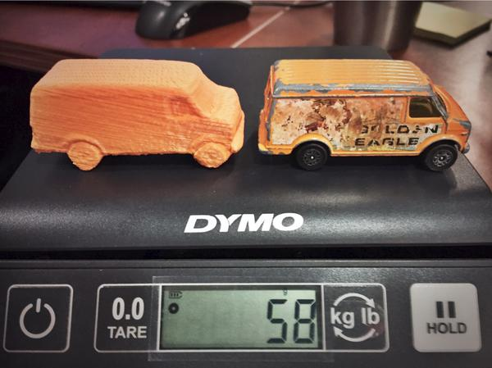
3D Scanning
EPL has two methods.
Table top scanners (Matter & Form, ATLAS)
Kinect scanning.
Consumer grade technology is currently immature.

Slide 17
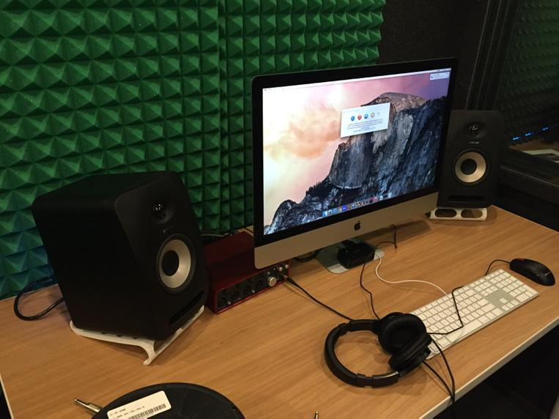
Audio / Video Production
EPL’s sound booths provide instruments, mics, recording, and mixing software.
Video editing software.
Green wall and photo editing software.

Slide 18
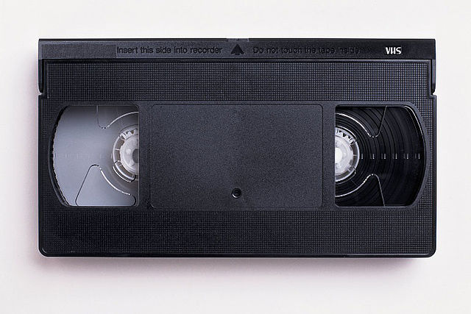
Format Conversion
VHS
Cassette
Photos, documents
Filetype conversion
"VHS-cassette" by Groink - Own work. Licensed under CC BY-SA 3.0 via Commons - https://commons.wikimedia.org/wiki/File:VHS-cassette.jpg#/media/File:VHS-cassette.jpg

Slide 19
What can you do in a makerspace?
Outline
The big three copyright concerns
23 questions asked in a makerspace:
3D Printing & Scanning
Epresso Book Machine
Digital Conversion
Angela Ashton, LL.B.
MLIS student, lo-fi library enthusiast

Slide 20
The big three copyright concerns
Personal use vs. commercial use
Personal use - usually no problem. Commercial use - problem. The act of competing in the marketplace with the existing rights holder is likely to violate existing trademark, patent and copyrights.
Is the design/content legit?
The pre-existing design and/or content must have been legally obtained, and the customer should be allowed to use it or modify the content. The person who shared it must have the rights to do so (i.e. original creator or using it under a licence).
Did the incorporated design or object have a TPM?
Any pre-existing work obtained by breaking a technological protection measure (TPM) violates the Copyright Act.

Slide 21
What can you do in a makerspace?
3D Printing & Scanning
Potential copyright, patent, trademark and industrial design implications depending on answers to the big three questions and if use falls within fair dealing or user-generated content exceptions.

Slide 22
What can you do in a makerspace?
3D Printing
1. I’d like to order this Totoro model from Thingiverse.
2. I created a phone case with the Nike swoosh and I’d like to print it.
3. I’ve created a carpet joining tool prototype and I’d like to print it.
Librarian says...
Sure! Let’s take a look at the file.
No problem. Let’s set you up.
You are amazing! Let’s do this thing.
Notes:
1. Totoro
How was the design file obtained? The Thingiverse Terms of Use place the responsibility for copyright compliance (and dictating how others may use their design) on the creator. If The file was obtained without the permission of the original creator, using it constitutes an infringement of the original creator’s rights under the Copyright Act.
Customers should take a close look at the thing’s license to determine how they can use (and if they can modify) the file.
2. Nike
How is the customer going to use the phone case? In order for a person to violate the Trademark Act they must sell, distribute or advertise wares or services in association with a confusing trademark.
Was the image that the swoosh is based on legally obtained (i.e. in the public domain or that the customer had permission to use it). If commercially used, the phone case may represent an infringement of Nike’s rights under the Trademark Act, and potentially the Industrial Design Act as well.
3. Carpet joining prototype
Is there an existing identical patent? Unlike the Trademark Act, the Patent Act is concerned with personal use. If a customer reproduces a patented item, they are infringing the creator’s rights. If there is an identical existing patent, the customer is violating the creator’s rights, and making the tool represents an infringement of the Patent Act, even if the customer is not doing anything beyond making it.

Slide 23
What can you do in a makerspace?
3D Scanning
4. I found a vector graphic for the logo of my favourite professional hockey team on Google image search. Can you help me turn it into a printable STL file?
5. My Star Wars X wing toy has a broken laser, I’d like to scan the broken part and print a replacement part.
Librarian says…
4. As long as it’s not the Oilers, let’s have at ‘er.
5. Good on you for not throwing the whole thing out! Sure thing.
Notes:
4. Vector graphic logo for favourite sports team
Has the creator authorized use and modification of the graphic? This use would fall under the user-generated content (UGC) exception of the Copyright Act, because the customer is using an existing work to create a new work (assuming the graphic is not copyright protected). If not, by turning the graphic into an STL file the customer is infringing the creator’s rights under the Copyright Act. If the customer then mass produces the item and it competes with the hockey team logo the customer would also violate the logo creator’s rights under the Trademark Act (if this right exists).
3D Scanning
5. Star Wars X wing toy has a broken laser,
Assuming this part is not available for purchase, no problem. Does making replacement parts for toys violate IP law? Not to my knowledge. This is what makes Makerspaces so great! However, creating replacement parts for other types of items may void product warranties.

Slide 24
What can you do in a makerspace?
3D Scanning continued
6. I’d like to scan this Playmobil Snowman and print my own.
7. I’m working on a jewelry design and I’d like to scan this ring.
Librarian says…
6. Unfortunately, you can’t use EPL’s 3D printer to make something you can otherwise buy (and avoid paying for it). This violates the Copyright Act.
7. Only if you make me one too. Just kidding! Of course.
Notes:
6. Playmobil Snowman
Is the customer just trying to avoid paying for a new item? This use does not fall under any of the fair dealing exceptions outlined in the Copyright Act (you can reproduce items when they are being used for one of the eight fair dealing exceptions, including private study and research). 3D printers shouldn’t be used to reproduce items that customers can buy. The customer would infringe the creator’s rights under the Copyright Act by making a copy of the toy. However, this call is bordering on a legal opinion.
7. Jewelry design
Does using an existing ring design violate the Industrial Design Act and the Copyright Act (these two acts provide overlapping protection)? Not for personal use, no.If the customer plans to mass produce and sell the rings based on an identical existing design, this would violate the Industrial Design Act (which specifies that 50 or more items must be made).

Slide 25
What can you do in a makerspace?
Espresso Book Machine (EBM)
Potential copyright, moral rights, and trademark implications depending on answers to the big three questions and if use falls within fair dealing or user-generated content exceptions.

Slide 26
What can you do in a makerspace?
EBM
8. I downloaded this picture from Google, I’d like to use it as the cover of my book. Can you help me create the picture?
9. I’d like to scan and create a new copy of Poli de serpent dent d’araignee by Danielle Marcotte. My copy is almost worn out and it means a lot to me.
Librarian says…
8. Sure, but let’s make sure that you can use the picture for that purpose first.
9. Too bad, so sad. You need to buy a new one. And keep the old copy, or consider creating a super-cool cover using EPL’s 3D printer to preserve it!
Notes:
8. Picture from Google
Does the customer have permission to use the image? Did the customer have to get around a TPM to download the picture? If the image is not in the public domain or licensed for use (Creative Commons license) the customer would be infringing the creator’s rights under the Copyright Act by reproducing the image without their consent. If the customer broke a TPM to download the picture, they are violating the Copyright Act.
9. Poli de serpent dent d’araignee
You need to buy a new one. And keep the old copy, or consider creating a super-cool cover using our 3D printer to preserve it! Same analysis as Playmobil (#6).

Slide 27
What can you do in a makerspace?
EBM continued
10. I’d like to publish my multi-volume My Little Pony/BioShock Infinite crossover fanfiction epic, BioShock: The Price of Friendship is Eternal Sparkles.
11. I’ve got a collection of articles for a class I’m taking; I’d like to print them in one bound book so I can read them on the train.
Librarian says…
10. You are awesome. Seriously. I love you.
11. Sure, but consider just printing each individual article and leaving as is.
Notes:
10. BioShock: The Price of Friendship is Eternal Sparkles
Fanfiction is an extremely complex legal grey area. This use would fall under the user-generated content (UGC) exception of the Copyright Act, because the customer is using existing works to create a new work. BUT if the BioShock and My Little Pony images are registered trademarks [which I am not sure is even possible], or if the creators felt that the work violated their moral rights under the Copyright Act because they did not agree with how their characters were being portrayed, the customer could get into very bad legal trouble. Also, the creators could take legal action if this work competes with original works.
11. Collection of articles
Ask them what school they go to, and if their school has an Access Copyright Agreement. Students at educational institutions are allowed to reproduce works under the fair dealing and educational exceptions (which do not extend to public libraries), and in accordance with their school’s Access Copyright Agreement (which may cover more than EPL’s Access Copyright Agreement). Once the articles are bound the customer has created a compilation, and including the individual articles in a compilation without the creators’ permission violates their rights under the Copyright Act.

Slide 28
What can you do in a makerspace?
EBM continued
12. I lost the manual for my 2008 Chevy Cobalt. I found a PDF version on cobaltforever.com forums - can I make a new copy here?
13. Can I print the latest copy of MagPi magazine?
Librarian says…
12. Yes, but how reliable is cobaltforever.com? Is there a more accurate source, say the Chevy website?
13. Yes. Is this a trick question?
Notes:
12. 2008 Chevy Cobalt manuel
How reliable is the source? Does the customer have permission to copy the manual? Most likely yes, but it is worth checking to be sure. Best practice is to always check that the customer has permission to copy the work. What if the pdf copy has been modified and contains misleading (or dangerous) information. Not an IP issue but a safety issue.
13. Can I print the latest copy of MagPi magazine?
Look at the terms of use on the MagPi website, which say this is fine.

Slide 29
What can you do in a makerspace?
Digital Conversion
Potential copyright implications depending on answers to the big three questions and if use falls within fair dealing or personal use exceptions, and if terms of use/license allow for the use.

Slide 30
What can you do in a makerspace?
Digital conversion
14. I’d like to make a digital copy of my The Lady and the Tramp VHS.
15. I’d like to convert some old yoga videos that I have on VHS and burn them to a DVD so I can use them.
16. I borrowed a DVD from the library. I’m making a copy of the movie so that I can watch it at home.
Librarian says…
14. Not a problem. But just so you know, dogs shouldn’t eat spaghetti.
15. Go for it. Be sure to wear stretchy pants.
16. Jerk! You’re the reason why actors and movie companies can’t make a living! Wait a minute...But seriously, no. You can only make copies for personal use if you own the original in the first place.
Notes:
14. The Lady and the Tramp
The Copyright Act now contains a “format-shifting” exception that allows people to make copies of works for their personal use. No issue really. Although this was technically illegal until the Copyright Act was amended in 2012, Canada’s copyright legislation has finally legitimized what people have been doing for years (copying their music and movies onto other devices and into other formats, hence the “format shifting” nickname).
The Copyright Act allows Canadians to make copies of legally obtained works for their personal use, so long as they did not have to break a TPM to access the work. If the video was stolen, or a copy was made by breaking a TPM, the customer is infringing the creator’s rights under the Copyright Act.
15. Yoga videos
Same as #14 (Lady and the Tramp).

Slide 31
What can you do in a makerspace?
Digital Conversion continued
17. I’d like to make digital copies of all of my Sting/The Police cassettes to put in my iPod.
18. I’d like to make a copy of my rare northern soul vinyl “I don’t really care” by L.V. Johnson.
19. I’m going to sing Happy Birthday to my friend and upload it to SoundCloud. Can you help me with that?
Librarian says…
17. Don’t STAND! Don’t STAND so! Don’t STAND so close to me!
18. Whatever. Makes no difference to me. Seriously though, no problem.
19. Yes, as long as you let me accompany you on my kazoo. Also, you need to know a few things first...
Notes:
17. I Sting/The Police cassettes to put in my iPod
No problem as per #14 and #15 (this is format shifting, which is allowed).
18. Copy of vinyl “I don’t really care” by L.V. Johnson
same as #17 (Sting). Original format doesn’t matter (cassette or LP), the Copyright Act does not make a distinction between formats to shift from.
19. Happy Birthday on SoundCloud
When a customer records songs, they are creating user-generated content (UGC). So long as it is made for personal use, the customer is not violating any Canadian copyright laws. Just so you know, until recently, Happy Birthday was copyright protected. It is owned by an American corporation. The matter is currently being litigated, but Happy Birthday is not in the public domain.

Slide 32
What can you do in a makerspace?
Even more Digital Conversion
20. I’m recording my covers of every song ever by Taylor Swift.
21. Can you help me add this vocal audio sample from Taylor Swift’s ‘Shake it Off’ to my song?
Librarian says…
20. Great! Who’s she dating now?
21. First, let’s have a 2 minute dance party to ‘Shake it Off.’ Then, we will work!
Notes:
20. Taylor Swift
This is user-generated content, as long as the original was obtained legally, same as #19.
21. Vocal audio sample from Taylor Swift’s ‘Shake it Off’
You can only use samples in the non-commercial context, and that if this is something she plans on selling, she will need T. Swift’s permission. See #19 and #10 for more on UGC.

Slide 33
What can you do in a makerspace?
Make it stop already…
22. I’d like to record myself rapping over this J Dilla beat that I downloaded and then post it on Youtube.
23. Can you help me download this song from YouTube?
Librarian says…
22. Yes, let’s, so I can see how YouTube handles this. This could end badly.
23. Depends. Is there a download link? If so, then yes. Otherwise, look at the YouTube Terms of Use. I dare you.
Notes:
22. J Dilla beat
Does uploading a song containing a sample to YouTube violate American copyright laws? I don’t know, but this falls with the UGC exception in Canada. YouTube has it’s own process in terms of how it deals with sampling (because it is an American site, and thus has different practices than Canada with respect to user generated content). If the customer releases the song commercially, J Dilla’s estate hears the song and sues the customer for copyright infringement (if there is commercial use the UGC does not apply) and violation of his moral rights. Given the acrimony over the posthumous use of Dilla’s music, I would say steer clear of any J Dilla beat. Some artists (and estates) are very proprietary, and this example demonstrates how worthwhile it is to do some investigating before posting things.
23. Can you help me download this song from YouTube?
Is there a download link? If so, then yes. Otherwise, look at the YouTube Terms of Use. In other words, does the customer have permission to download the song?
I Googled this issue and located a number of articles explaining how to do this, and there is a YouTube converter online (which is a prime purveyor of malware). YouTube has gone so far as to sue the most popular convertor developer in 2012, so I would say that like many apps out there, just because they exist does not make the practice legit. If the customer does not have permission and downloading the song is an infringement of the Copyright Act.

Slide 34
Concluding Thoughts
UGC exception covers a large degree of the activity in makerspaces
There is also time and format shifting, fair dealing, and de minimis use
Terms of Use/Service and End User Licensing Agreements (EULAs) should be read
“No you can’t do that” is, in many cases, more likely to result from these than the copyright law
Risk avoidance is not a risk management strategy; conversely reckless disregard for the law is not either - aim for a system that is fair (for both fair dealing and UGC)
Train and empower staff; rely on judgement of staff; read the CCH decision (and SOCAN v. Bell (2012 SCC 36, and Alberta v. Access Copyright (2012 SCC 37))

Slide 35
Concluding Thoughts
Never circumvent digital locks
Advocate for law reform of s. 41 of the Copyright Act
Be weary of commercial use
Raises trademark concerns, can’t rely on UGC, may also reduce availability of fair dealing (as it may weigh against the character of the dealing and effect of the dealing on the work)
Post-secondary context is much different than public library context
UGC may have limited applicability; potentially more room for educational fair dealing

Slide 36
Questions?

