Slide 1


CCH v. LSUC
Opening Up Copyright Instructional Module
September 2018

Slide 2
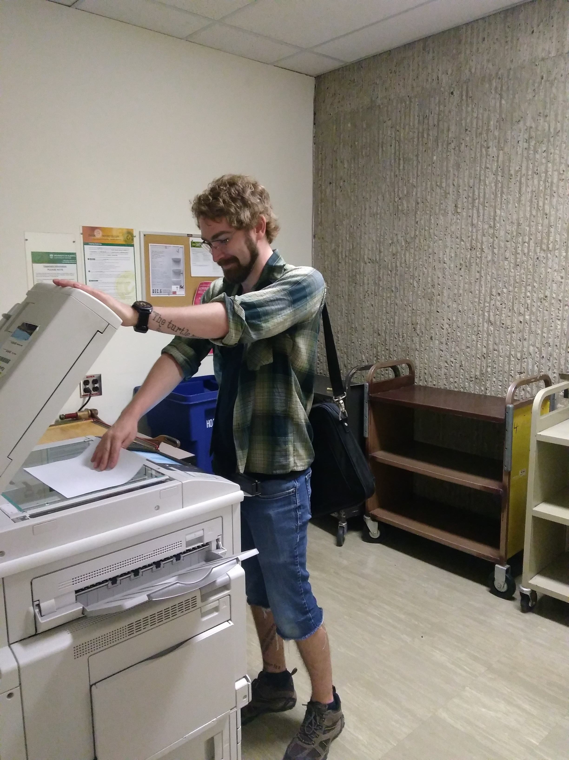
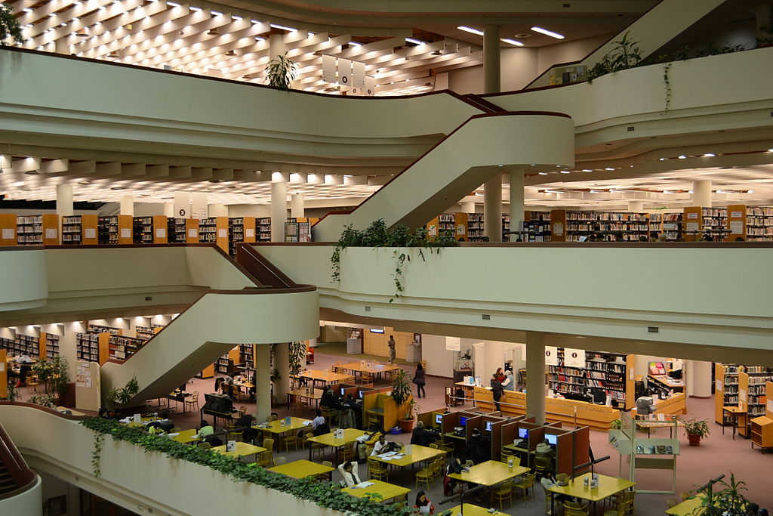
LIBRARIES
Notes:
Libraries are valuable sources of copyright-protected resources, and as part of providing access to the resources in their collections, often they also provide access to photocopiers or provide copying services to better serve their communities.

Slide 3
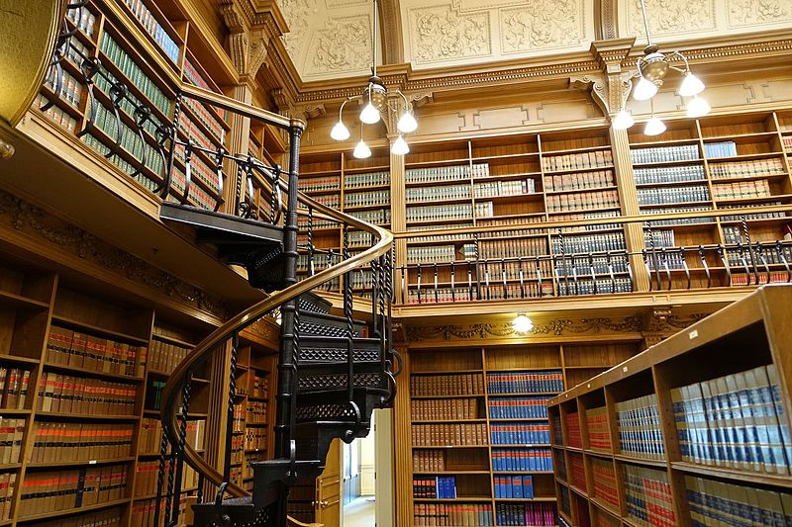


THE GREAT LIBRARY
Offers custom photocopying service
Maintains self-service copiers
Osgoode Hall
Notes:
The Great Library at Osgoode Hall in Toronto is a reference and research library with a large collection of legal materials. This library is maintained and operated by the Law Society of Upper Canada. The Great Library offers a custom photocopying service for Law Society members and other authorized researchers, as well as maintaining self-service copiers for the use of its patrons.

Slide 4



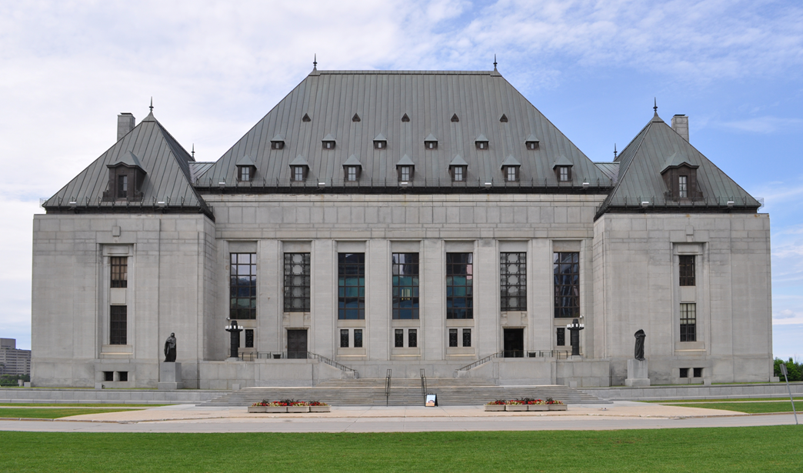

HISTORY
Notes:
CCH Canadian Ltd. is a publisher of legal materials, and in 1993, along with a number of other publishers of similar materials, it commenced an action against the Law Society, claiming that the Law Society had infringed copyright when the Great Library had reproduced copies of excerpts from their works. After the case had been heard by both the Federal Court, Trial Division, and later the Federal Court of Appeal, the matter came before the Supreme Court of Canada in November 2003.

Slide 5
KEY ISSUES
1
Self-service photocopiers –
Breach of copyright?
2
Custom photocopying service –
Breach of copyright?
3
Were the dealings fair?
Notes:
The key issues to be answered in this case are:
Did the Law Society breach copyright by maintaining self-service photocopiers that allowed copies to be made of the publishers’ works at the Great Library?;
Did the Law Society breach copyright by providing its custom photocopying service? and
Were the Law Society’s dealings with the publishers’ works “fair dealing” under s.29 of the Copyright Act?

Slide 6

SELF-SERVICE COPIERS
“The copyright law of Canada governs the making of photocopies or other reproductions of copyright material. Certain copying may be an infringement of the copyright law. This library is not responsible for infringing copies made by the users of these machines.”
Notes:
The Law Society maintains self-service photocopiers for use by patrons in the Great Library. The patrons’ use of the machines is not monitored directly. Since the mid-1980s, the Law Society has posted a notice above each machine indicating the library is not responsible for infringing copies made by users of those machines.

Slide 7
INSUFFICIENT EVIDENCE
Notes:
The Court pointed out that no evidence had been presented that the self-service photocopiers had been used in a manner that was not consistent with copyright law. It disagreed with the Court of Appeal’s finding that posting the notice above the copiers was an acknowledgement that the photocopiers would be used for unlawful copying.

Slide 8
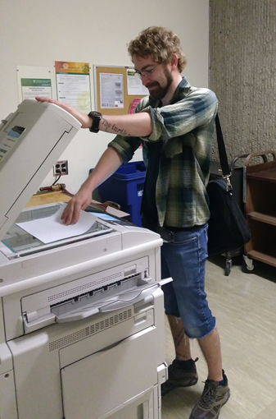

SELF-SERVICE COPIERS
“…lacks sufficient control…” para 5
“…evidence does not establish that the Law Society authorized copyright infringement…” para 46
Notes:
The Court held that, even if there were evidence the photocopiers had been used to infringe copyright, the Law Society lacks sufficient control over the library’s patrons to conclude it sanctioned or approved the infringement. Therefore, the Court concluded the evidence does not establish that the Law Society authorized copyright infringement by providing self-service photocopiers, along with copies of the respondent publishers’ works, for use by patrons of the Great Library.

Slide 9
CUSTOM PHOTOCOPY SERVICE
Exceptions
Fair Dealing
Research, private study, etc.
29 Fair dealing for the purpose of research, private study, education, parody or satire does not infringe copyright. R.S., 1985, c.
Criticism or review
29.1 Fair dealing for the purpose of criticism or review does not infringe copyright if the following are mentioned: …
News reporting
29.2 Fair dealing for the purpose of news reporting does not infringe copyright if the following are mentioned: …
Does this service fall under fair dealing?
Notes:
The Great Library also provides a custom photocopy service. Upon receiving a request from a lawyer, student or other authorized researcher, the Great Library staff photocopies extracts from legal materials within its collection and sends it to the requester. Does this service fall within the fair dealing defence under s. 29 of the Copyright Act ?

Slide 10

FAIR DEALING
Exceptions
Fair Dealing
Research, private study, etc.
29 Fair dealing for the purpose of research, private study, education, parody or satire does not infringe copyright. R.S., 1985, c.
Criticism or review
29.1 Fair dealing for the purpose of criticism or review does not infringe copyright if the following are mentioned: …
News reporting
29.2 Fair dealing for the purpose of news reporting does not infringe copyright if the following are mentioned: …
“In order to maintain the proper balance between the rights of a copyright owner and users’ interests, it must not be interpreted restrictively.” para 48
Notes:
The fair dealing exception, like other exceptions in the Copyright Act , is a user’s right. The Court reaffirmed that,“In order to maintain the proper balance between the rights of a copyright owner and users’ interests, it must not be interpreted restrictively.”

Slide 11
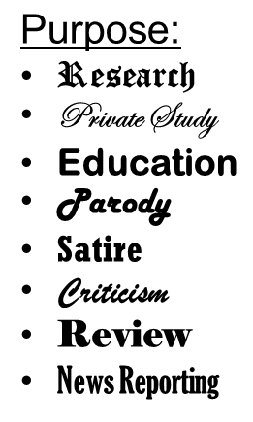
FAIR DEALING – STEP 1: PURPOSE
Exceptions
Fair Dealing
Research, private study, etc.
29 Fair dealing for the purpose of research, private study, education, parody or satire does not infringe copyright. R.S., 1985, c.
Criticism or review
29.1 Fair dealing for the purpose of criticism or review does not infringe copyright if the following are mentioned: …
News reporting
29.2 Fair dealing for the purpose of news reporting does not infringe copyright if the following are mentioned: …
Research
“Lawyers carrying on the business of law for profit are conducting research within the meaning of s. 29 .” para 4
Notes:
The Court made clear that “research” must be given a large and liberal interpretation. The Court agreed with the Court of Appeal that research is not limited to non-commercial or private contexts, and that “[l]awyers carrying on the business of law for profit are conducting research within the meaning of s. 29 ...”

Slide 12
FAIR DEALING – STEP 2 - FAIRNESS
What is fair?
Fair = Case Dependent
Notes:
The Copyright Act does not define what will be “fair”. Whether something is fair is a question of fact and depends on the facts of each case.

Slide 13
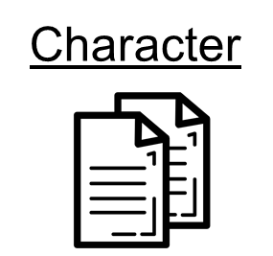
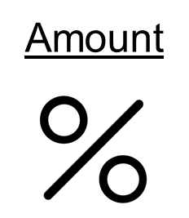




SIX-FACTOR TEST
Purpose
How should fairness be assessed?
Notes:
Following the Court of Appeal, the Court agreed that there is no set test for fairness, and outlined six factors that could be considered to help assess whether a dealing is fair. Although these considerations will not all arise in every case of fair dealing, this list of factors provides a useful analytical framework to govern determinations of fairness.

Slide 14

PURPOSE OF THE DEALING
Do not restrict users rights
Purpose
Less Fair
More Fair
Notes:
The Court made it clear that allowable purposes should not be given a restrictive interpretation or this could result in the undue restriction of users’ rights. However, some dealings, even if for an allowable purpose, may be more or less fair than others. For example, research done for commercial purposes may not be as fair as research done for charitable purposes.

Slide 15

CHARACTER OF THE DEALING
Custom or practice in a particular trade or industry
✓
Notes:
Are multiple copies of works being widely distributed? If so, this will tend to be unfair.However, if a single copy of a work is used for a specific legitimate purpose, it is more likely to be fair dealing. The Court also noted the relevance of the custom or practice in a particular trade or industry to determine whether or not the character of the dealing is fair.

Slide 16
AMOUNT OF THE DEALING
“…the quantity of the work taken will not be determinative of fairness, but it can help in the determination.” para 56
Notes:
The quantity of the work taken will not be determinative of fairness, but it can help in the determination.

Slide 17
ALTERNATIVES TO THE DEALING
“If there is a non-copyrighted equivalent of the work that could have been used instead of the copyrighted work, this should be considered by the court.” para 57
Notes:
Is there is a non-copyrighted equivalent of the work that could have been used instead of the copyrighted work? Is the dealing reasonably necessary to achieve the ultimate purpose?

Slide 18

NATURE OF THE DEALING
“…if a work has not been published, the dealing may be more fair in that its reproduction with acknowledgement could lead to a wider public dissemination of the work…” para 58
Notes:
One of the goals of copyright law is wider public dissemination of works. Therefore, if a work has not been published, but where that work is not confidential, the dealing may be more fair, as its reproduction with acknowledgement could lead to a wider public dissemination of the work.

Slide 19
EFFECT OF THE DEALING
“…it is neither the only factor nor the most important factor that a court must consider in deciding if the dealing is fair.” para 59
Competition in the market
Notes:
How likely is the reproduced work to compete with the original work in the market? The more likely, the less fair the dealing. While this effect of the dealing is an important factor, the Court stated that “it is neither the only factor nor the most important factor that a court must consider in deciding if the dealing is fair.”

Slide 20
SIX FACTORS
Purpose
Notes:
The Court indicated that these six factors may be more or less relevant to assessing the fairness of a dealing depending on the factual context of the allegedly infringing dealing. In some contexts, there may be factors other than those listed here that may help a court decide whether the dealing was fair.

Slide 21
FACTS OF THE CASE
“…is it incumbent on the Law Society to adduce evidence that every patron uses the material provided in a fair dealing manner or can the Law Society rely on its general practice to establish fair dealing?” para 63
Not sufficient evidence
?
Fair Dealing
Notes:
As for the facts of this case, the trial judge concluded that copying for the custom photocopy service was not for the purpose of either research or study and therefore could not be fair dealing. The Court of Appeal held that the Law Society could rely on the purposes of its patrons to prove that its dealings were fair, however, it concluded there was not sufficient evidence to determine whether or not the dealings were fair.
The Court asked: “is it incumbent on the Law Society to adduce evidence that every patron uses the material provided in a fair dealing manner or can the Law Society rely on its general practice to establish fair dealing?”

Slide 22
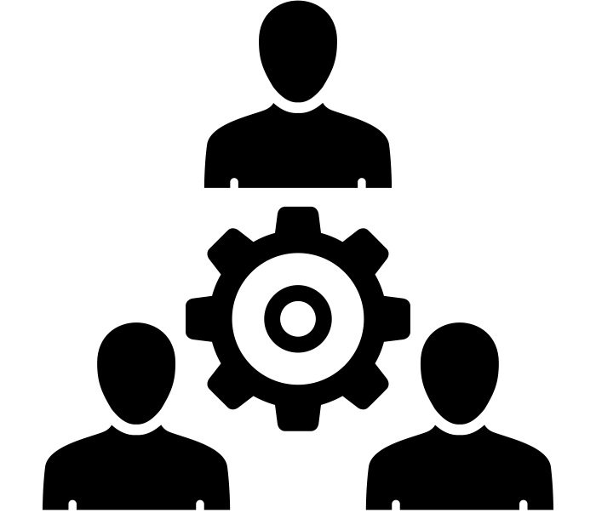
DEALING = PRACTICE OR SYSTEM
Research
Review
Purpose is allowable
Private Study
Notes:
“Dealing”, the Court concluded, connotes not individual acts, but a practice or system. The Law Society’s custom photocopying service is provided for the purpose of research, review and private study. Given that there is no other purpose for the copying and that the Law Society’s custom photocopy service is an integral part of the legal research process, it was held to be an allowable purpose under s. 29 .

Slide 23
APPLYING THE SIX FACTORS - PURPOSE
Access Policy
User requests copy
✓
Library reviews purpose
If concern, referred to Reference Librarian
Notes:
The Great Library’s Access Policy specifies that those requesting copies must identify the purpose of the request for these requests to be honoured. Cases where there are concerns that a request is not for one of the legitimate purposes under the fair dealing exceptions are referred to the Reference Librarian. The Court held that this policy provides reasonable safeguards that the materials are being used for the purpose of research and private study.

Slide 24
APPLYING THE SIX FACTORS - CHARACTER
“There is no evidence that the Law Society was disseminating multiple copies of works to multiple members of the legal profession.” para 67
✓
Notes:
The photocopying service makes a single copy available to an individual for a legitimate purpose, which tends toward fairness. The Court stated “There is no evidence that the Law Society was disseminating multiple copies of works to multiple members of the legal profession.”

Slide 25
APPLYING THE SIX FACTORS - AMOUNT
One case, one article, or one statutory reference
Reference librarian reviews requests for a copy of more than 5% of a secondary source
✓
Notes:
The Access Policy states that the Great Library will typically honour requests for a copy of one case, one article or one statutory reference. It further stipulates that the Reference Librarian will review requests for a copy of more than five percent of a secondary source and that such requests may be refused. This suggests that the Law Society’s dealings with the publishers’ works are fair.

Slide 26

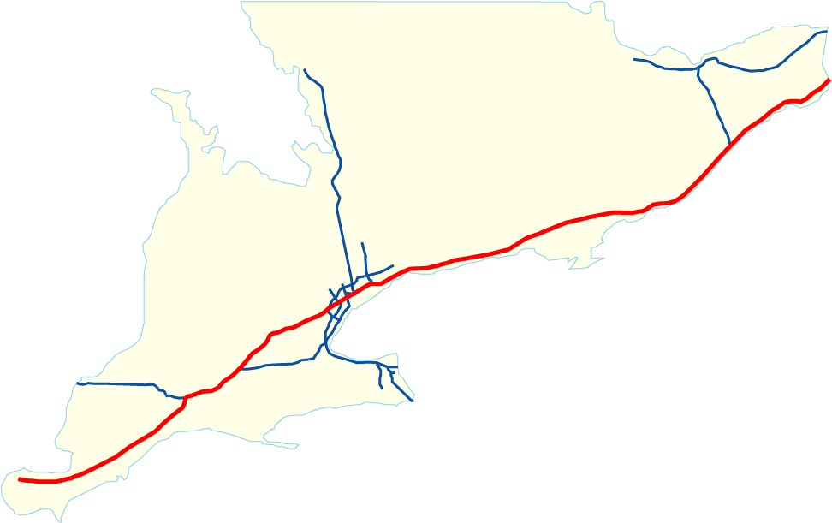

APPLYING THE SIX FACTORS - ALTERNATIVES
“Availability of a licence is not relevant to deciding whether a dealing has been fair.” para 70
✓
Notes:
Twenty percent of the requesters to the custom photocopying service live outside the Toronto area, and it would be burdensome to expect them to travel to the city each time they needed a specific legal source. Therefore, it is not apparent that there are reasonable alternatives to the custom photocopy service employed by the Great Library.
As a general point regarding alternatives to the dealing, the Court made it clear that the availability of a licence is not relevant to deciding whether a dealing has been fair.

Slide 27
APPLYING THE SIX FACTORS - NATURE
“…it is generally in the public interest that access to judicial decisions and other legal resources not be unjustifiably restrained.” para 71
✓
Notes:
The Court found that “[i]t is generally in the public interest that access to judicial decisions and other legal resources not be unjustifiably restrained.”

Slide 28
APPLYING THE SIX FACTORS - EFFECT
No adverse market impact found
✓
Notes:
No evidence was offered of any adverse market impact on the publishers’ works as a result of the copying.

Slide 29
SUPREME COURT DECISION
Dealing = Fair
Purpose
Notes:
Having applied the six-factor test, the Court concluded that, on these facts, the Law Society’s dealings with the publishers’ works satisfy the fair dealing defence and that the Law Society does not infringe copyright.

Slide 30
SUPREME COURT’S DECISION – APPEAL ALLOWED
Library was not infringing copyright
✓
Maintaining a photocopier =
✓
Posted notice =
Notes:
The Court allowed the appeal and issued a declaration that the Law Society does not infringe copyright when a single copy of a reported decision, case summary, statute, regulation or limited selection of text from a treatise is made by the Great Library in accordance with its Access Policy. It also issued a declaration that the Law Society does not authorize copyright infringement by maintaining a photocopier in the Great Library and posting a notice warning that it will not be responsible for any copies made in infringement of copyright.

Slide 31
CONCLUSION
How to determine fair dealing
“…large and liberal interpretation…” (para 51) of the purposes
Endorsing the two-stage approach and six-factor test
Library can act on behalf of its patrons to serve the purpose
Organization can rely on general practice
Notes:
The CCH case is most significant for clarifying how to make a determination of fair dealing, endorsing the two-stage approach and the six-factor test for fairness. It is also important for its emphasis on a “large and liberal interpretation” of the purposes under fair dealing, as well as confirming that the library can act on behalf of its patrons to serve the purposes of those patrons, and for an organization to rely on general practice rather than each individual instance to establish fair dealing.

Slide 32
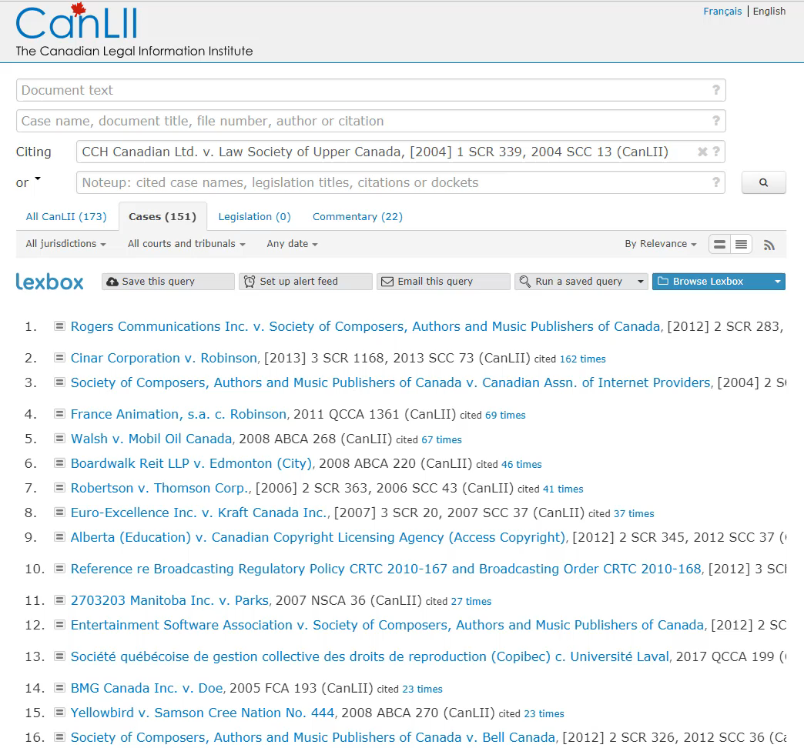
THE SIX FACTOR LEGACY
Notes:
The six-factor test appeared first as part of CCH case and has been used many times since to assist in establishing the fairness of a dealing.

Slide 33
LEARNING OBJECTIVES
You should now be able to:
Recount the circumstances and outcome of the CCH case
Describe the role of fair dealing in the CCH case
Explain the use and interpretation of the CCH six-factor test
Notes:
You should now be able to:

Slide 34

THANK YOU FOR YOUR ATTENTION
Notes:
34. This has been the University of Alberta’s Opening Up Copyright Module on SOCAN v. Bell. Thank you for your attention.

Slide 35
QUESTIONS
Fair dealing is a users’ right. The librarian is not the ultimate user of the copied material, therefore no copying by librarians for their patrons can be fair dealing.
  True
  False
Which of these issues was not addressed in the CCH case?
  Whether the provision of a self-service photocopier constitutes copyright infringement
  Whether the Law Society’s custom photocopying service constitutes copyright infringement
  Whether the Law Society’s copying of the publishers’ works can be considered fair dealing
  Whether the geographic distance between a Law Society member’s office and the Great Library’s print collection is a determinative fair dealing factor

Slide 36
QUESTIONS
Complete the phrase that was included in the majority SCC decision: "In order to maintain the proper ________ between the _______ of a ___________ and ________, it must not be interpreted restrictively."
Word choices: copyright owner, public good, balance, rights
Correct order: balance, rights, copyright owner, public good
The six fair dealing factors used by the SCC in this case set a precedent and must be used by the judiciary in all future copyright infringement claims where the defendant relies on a fair dealing argument.
  True
  False

Slide 37
QUESTIONS
While the SCC made it clear that fair dealing is an important users’ right and has a key role in maintaining the balance of interests between users and rights-holders, this balance can only be maintained through a restrictive interpretation of fair dealing.
  True
  False
Which of the following is NOT one of the six factors for determining the fairness of a dealing?
  The Character of the Dealing
  Alternatives to the Dealing
  Transformative Aspects of the Dealing
  The Nature of the Work

Slide 38
REFERENCES AND RESOURCES
Scassa, T. (2004). Recalibrating copyright law? A comment on the Supreme Court of Canada's decision in CCH Canadian Limited et al. v. Law Society of Upper Canada. Canadian Journal Of Law & Technology, (2), 89.
Chapdelaine, P. (2013). The Ambiguous Nature of Copyright Users' Rights. Intellectual Property Journal, 26(1), 1-45.

Slide 39
CASES AND LEGISLATION
CCH Canadian Ltd v. Law Society of Upper Canada. 2004 SCC 13. [2004] 1 SCR 339.
https://scc-csc.lexum.com/scc-csc/scc-csc/en/item/2125/index.do

Slide 40
IMAGE AND SOUND REFERENCES
  Image Credits (in order of appearance):
  Raysonho. (2010). [Toronto Reference Library]. Wikimedia Commons. CC0. https://commons.wikimedia.org/wiki/File:TorontoReferenceLibrary.jpg
  Daderot. (2015). [Osgoode Hall]. Wikimedia. CC0. https://commons.wikimedia.org/wiki/File:Books_-_Great_Library,_Osgoode_Hall_-_Toronto,_Canada_-_DSC00432.jpg
  Law Society of Upper Canada. (n.d). [LSUC logo]. Family LLB. http://familyllb.com/tag/law-society-of-upper-canada/
  Ghan Koon Lay.(n.d). Copy Machine. The Noun Project. CC BY. https://thenounproject.com/icon/690719/
  Federal Court of Appeal.( n.d.) [Federal Court Coat of Arms]. Federal Court. http://cas-cdc-www02.cas-satj.gc.ca/portal/page/portal/fc_cf_en/Index
  Dig deeper.(2017). [Supreme Court of Canada]. Wikimedia Commons. CC BY 4.0. https://commons.wikimedia.org/wiki/File:Supreme_court_of_Canada_in_summer.jpg
  CCH Incorporated. (2004). [CCH Incorporated Logo]. CCH Incorporated. https://web.archive.org/web/20040326043957/http://cch.com
  Thomson Carswell. (2004) [Thomson Carswell logo]. Thomson Carswell. https://web.archive.org/web/20040224205726/http://www.carswell.com:80/
  Canada Law Books Inc. (2004). [Canada Law Books Inc logo]. Canada Law Books. https://web.archive.org/web/20040209141949/http://canadalawbook.ca/
  Musmellow. (n.d). thumb tack. The Noun Project. CC BY. http://thenounproject.com/icon/1781889
  b farias.(n.d). Desk Icon. The Noun Project. CC BY. https://thenounproject.com/icon/1219414/
  Dev, Nikhil. (n.d). Scales. The Noun Project. CC BY. https://thenounproject.com/icon/15744
  Dezign, Ruslan, ID. (n.d.). Target. The Noun Project. CC BY. https://thenounproject.com/search/?q=purpose&i=1005058
  ATOM, TH. (n.d.). Copy. The Noun Project. CC BY. https://thenounproject.com/search/?q=copy&i=1474212
  Тимур Минвалеев, RU. (n.d.). Percent. The Noun Project. CC BY. https://thenounproject.com/search/?q=percent&i=397874
  Farais, B, CL. (n.d.). Decision. The Noun Project. CC BY. https://thenounproject.com/search/?q=alternatives&i=1074053
  Cresnar, Gregor. (n.d.). Dollar sign. The Noun Project. CC BY. https://thenounproject.com/search/?q=dollar%20sign&i=171145
  AFY Studio, ID. (n.d.). Leaf. The Noun Project. CC BY. https://thenounproject.com/AFYstudio/uploads/?i=1737325
  popcornarts. (n.d). process. The Noun Project. CC BY. https://thenounproject.com/icon/1057868
  Snickerdo. (2005). Highway-401. Wikimedia Commons. CC0. https://fr.m.wikipedia.org/wiki/Fichier:Highway-401.png
  Vladimir Belochkin. (n.d). contract. The Noun Project. CC BY. https://thenounproject.com/icon/869929

Slide 41
IMAGE AND SOUND REFERENCES
Unattributed materials are contributions from the Opening Up Copyright Project Team and placed in the Public Domain
Closing Slides Music: Rybak, Nazar. “Corporate Inspired.” HookSounds. N.d. http://www.hooksounds.com (used under a CC-BY 4.0 Licence)

Slide 42
LICENSING AND ATTRIBUTION
Suggested Citation:
  University of Alberta. 2018. “CCH v. LSUC.” Opening Up Copyright Instructional Module. https://www.ualberta.ca/copyright/resources/opening-up-copyright-instructional-modules
For the project overview and complete list of modules please visit the project website at: https://www.ualberta.ca/copyright/resources/opening-up-copyright-instructional-modules
Questions, comments, and suggestions should be directed to the University of Alberta’s Copyright Office at: copyright@ualberta.ca
This module is made available and licensed under a Creative Commons Attribution 4.0 International Licence

Slide 43
CONTRIBUTORS
Copyright Office
Centre for Teaching and Learning
Technologies in Education
Adrian Sheppard
Amanda Wakaruk
Cosette Lemelin
Graeme Pate
Krysta McNutt
Anwen Burk
Jamie Stewart
Matt Cheung
University of Alberta Libraries
School of Library and Information Studies
Michelle Brailey
Jesse Carson
Toby Grant
Michael B. McNally

Slide 44

ACKNOWLEDGEMENT
Opening Up Copyright modules were initially funded through the University of Alberta, Centre for Teaching and Learning’s Teaching and Learning Enhancement Fund (TLEF) with in kind contributions from the Copyright Office and the School of Library and Information Studies.

