Slide 1
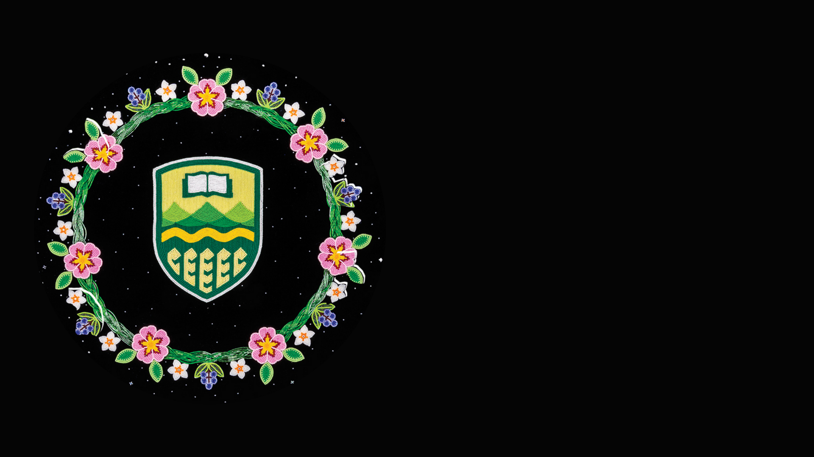
A path toward reconciling Indigenous research with research assessment
Chambers, T., Cuyler, K., LeBlanc, M., Robinson, A., Kung J.
thane@ualberta.ca
Beading designed by Tara Kappo. More information available here.

Slide 2
Institutional and national context

Slide 3
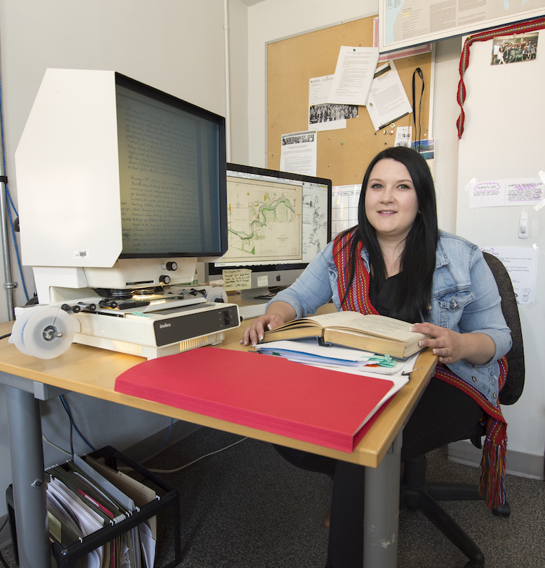
Guiding Questions:
What counts as scholarship and why?
How do we measure research impact?
Impact for whom?
Who determines and how do we determine whose evidence?
And what research is legitimate?
~Public Engagement and the Politics of Evidence in an Age of Neoliberalism and Audit Culture Symposium

Slide 4
Completed actions:
Collaborations with Library's Indigenous Initiatives team, Faculty of Native Studies, Indigenous Strategic Manager (Provost, Vice-President Academic)
Indigenous Interns (Amanda Robinson & Mikaela LeBlanc) completed:
Literature search and review
Environmental scan

Slide 5
Still in planning:
Expanding literature review (currently working on this).
Presenting findings to stakeholders
Figuring out what next steps are with stakeholders (some options):
Perhaps moving towards developing a framework?
Widening conversation?

Slide 6
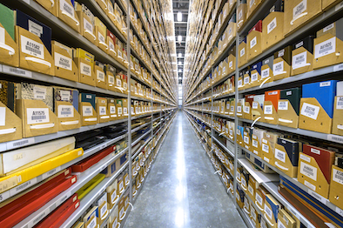

Slide 7
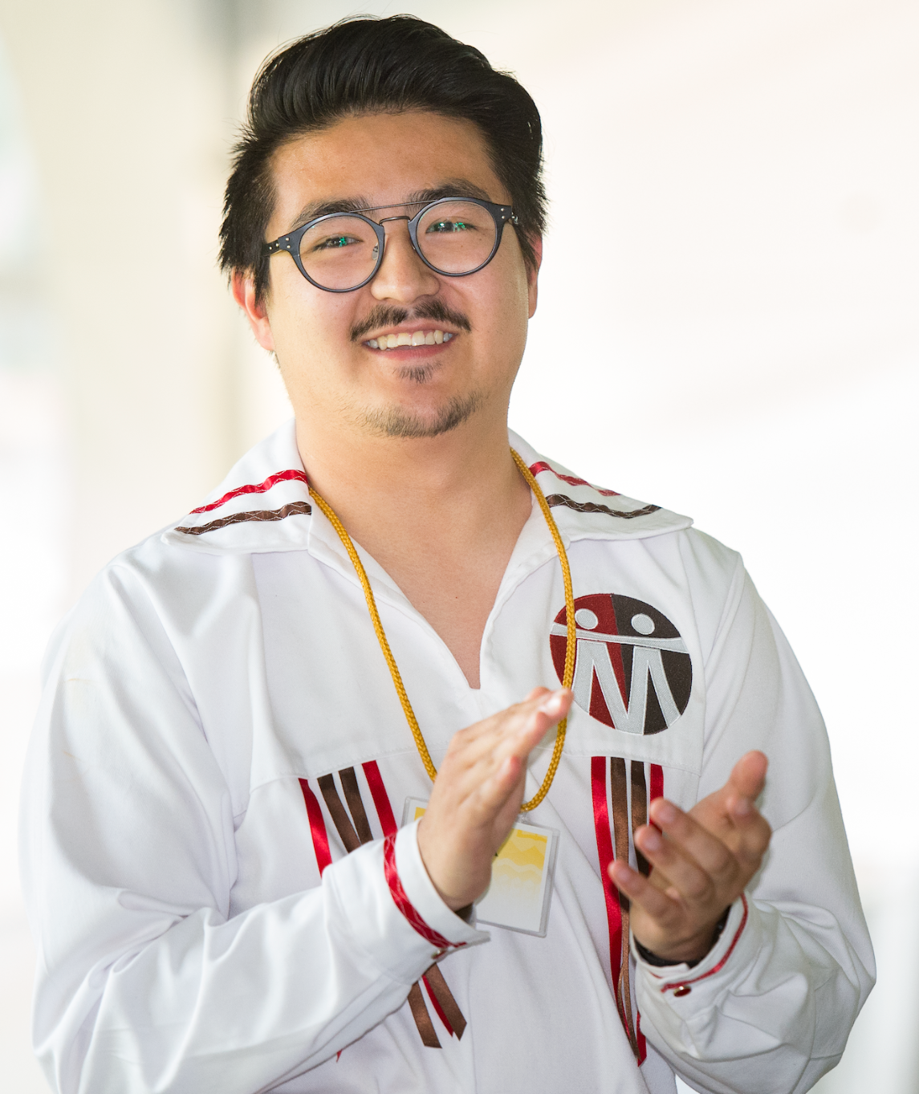
SCOPE Framework?

Slide 8
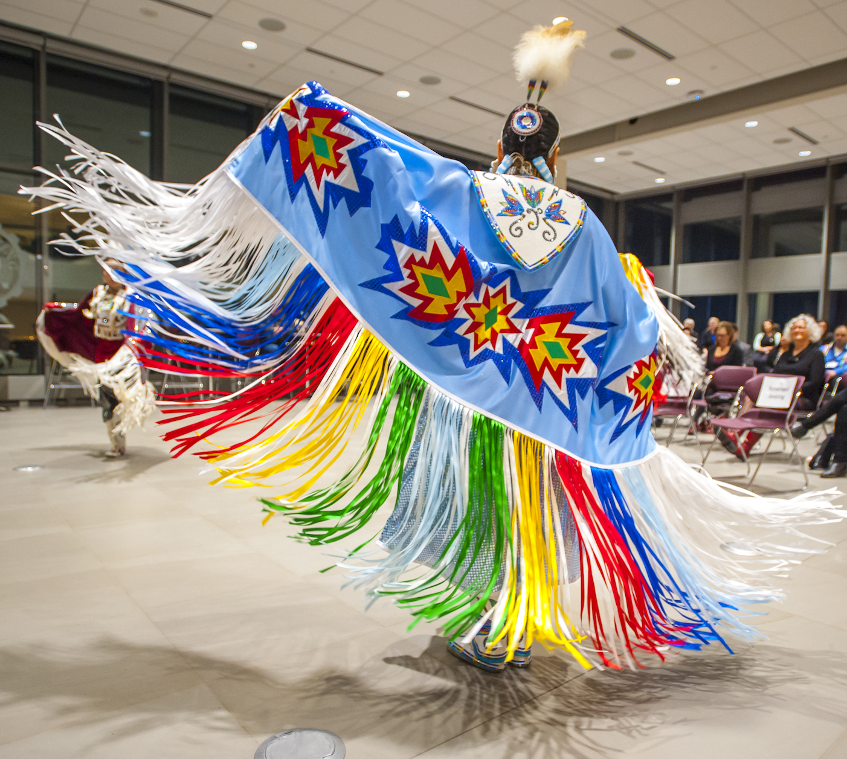

Slide 9
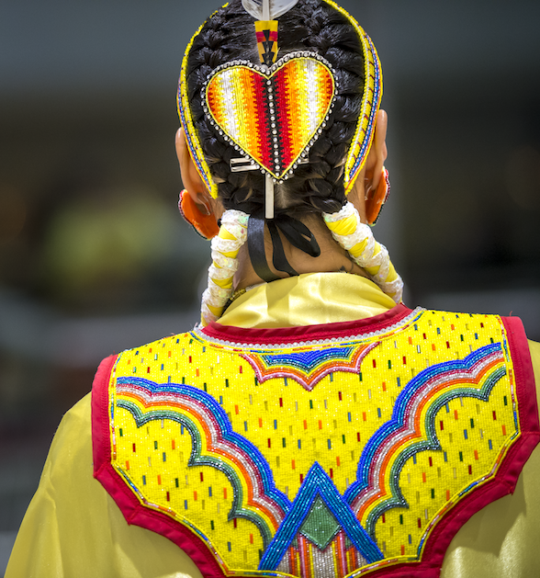
Reminder:
CARL BRI Bibliometric Research Impact Community of Practice
Next event June 13 1-2:30 pm ET
More information: https://www.carl-abrc.ca/advancing-research/scholarly-communication/bibliometrics-and-research-impact/

Slide 10
References & Images
Bullen, J., Hill-Wall, T., Anderson, K., Brown, A., Bracknell, C., Newnham, E. A., Garvey, G., & Waters, L. (2023). From deficit to strength-based Aboriginal health research—moving toward flourishing. International Journal of Environmental Research and Public Health, 20(7), 5395.
Grande, S. (2019). Refusing the university. In: Dissident Knowledge in Higher Education.
Heyeres, M., Tsey, K., Yang, Y., Yan, L., & Jiang, H. (2019). The characteristics and reporting quality of research impact case studies: A systematic review. Evaluation and Program Planning, 73, 10-23.
Kinchin, I., Mccalman, J., Bainbridge, R., Tsey, K., & Lui, F. W. (2017). Does Indigenous health research have impact? A systematic review of reviews. International Journal for Equity in Health, 16.
Smith, T. (2019). The art of the impossible— Defining and measuring Indigenous research? In: Dissident Knowledge in Higher Education.
Tsey, K. (2019). Planning for and tracking research impact: Australian Research Council framework. In: Working on Wicked Problems: A Strengths-based Approach to Research Engagement and Impact, 65-74.
Tuck, E. (2019). Biting the university that feeds us. In: Dissident Knowledge in Higher Education.
Weir, J. K., Morgain, R., Moon, K., & Moggridge, B. J. (2024). Centring Indigenous peoples in knowledge exchange research-practice by resetting assumptions, relationships and institutions. Sustainability Science, 1-17.
All images except for slide 1 came from the University of Alberta's Portal of Images available to University of Alberta Staff and Students at https://www.ualberta.ca/toolkit/downloads.html

