Slide 1
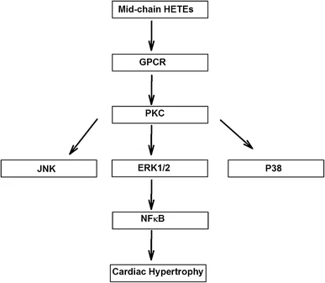
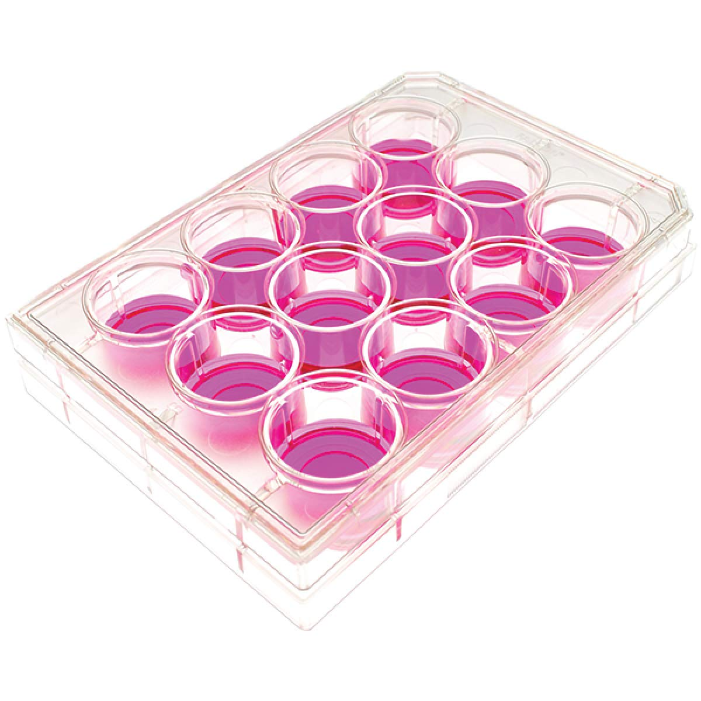
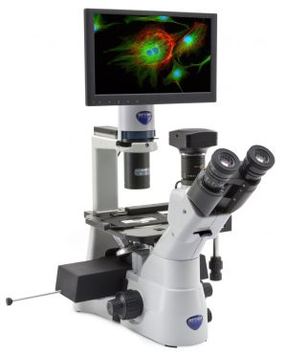
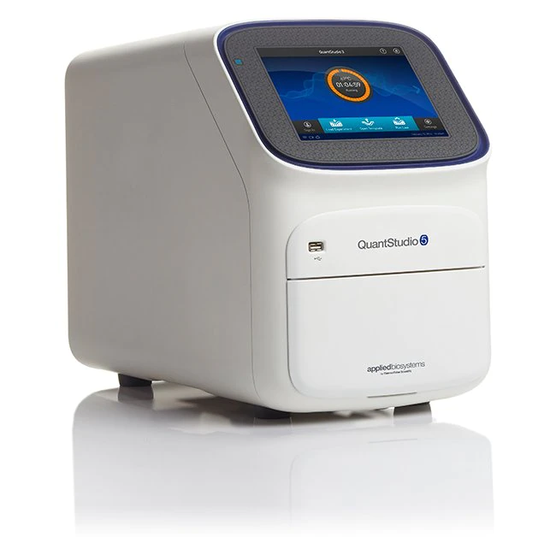
ROLE OF CYTOCHROME P450 1B1 IN INFLAMMATION-INDUCED CARDIAC HYPERTROPHY
Mohammed AW ElKhatib, Ayman O.S. El-Kadi Faculty of Pharmacy and Pharmaceutical Sciences, University of Alberta, Edmonton, Alberta, Canada
INTRODUCTION
RESULTS
RESULTS (Cont’d)
A great deal of research has demonstrated the involvement of cytochrome P450 (CYPs) enzymes and its metabolism of arachidonic acid (AA) in the modulation of cardiac hypertrophy (CH) pathogenesis.
Multiple studies demonstrated that inflammation is a major contributor to CH and is known to modulate the expression of various CYPs in different organs.
Inflammatory cytokines, such as tumor necrosis factor alpha (TNF-α), interleukin-6 (IL-6), and IL-1β are involved in CH pathology.
Enhanced clearance of TNF-α improved cardiac functions in HF. However, the outcomes of two large-scale clinical trials (with infliximab and etanercept) to directly antagonize TNF-α have been rather disappointing, indicating that counteracting this cytokine alone is not sufficient. Also, more mechanisms are required to be unveiled regarding the role of inflammation in CH.
(A)
(B)
Control
TNF
(A)
(B)
(C)
(D)
IL-6
LPS
Figure 1: Effect of angiotensin II (Ang II), TNF-α, IL-6, and lipopolysaccharide (LPS) on the mRNA expression of hypertrophic markers in AC16 cells : AC16 cells were treated with Ang II (10 µM), TNF-α (10 ng/mL), IL-6 (10 ng/mL), and LPS (25 µg/mL) for 24 hours. Then, mRNA levels of atrial natriuretic peptide (ANP) and beta over alpha myosin heavy chain ratio (β-MHC/α-MHC) were quantified using real time-PCR (A and B), respectively. The quantified mRNA levels were normalized to β-actin housekeeping gene. The values are represented as a relative of control ± SEM. *p < 0.05 compared to control. #p < 0.05 compared to Ang II.
(E)
Figure 5: Effect of TNF-α , IL-6 , and LPS on subterminal (R/S) and terminal HETEs metabolites concentration in AC16 cells. AC16 cells were treated with TNF-α (10 ng/mL), IL-6 (10 ng/mL), and LPS (25 µg/mL) for 24 hours. Then, subterminal (R/S)-HETEs and terminal HETE metabolites concentrations were measured using LC-MS/MS (A-E). The values are represented as mean ± SEM (n=6). *p < 0.05 compared to respective control. +p < 0.05 compared to respective antipode in the same treatment.
AA released from cell membrane
(A)
(B)
(C)
(D)
Inflammation
Figure 1: Metabolism of arachidonic acid (AA) by CYP1B1 to mid-chain hydroxyeicosatetraenoic acids (HETEs) and various mechanisms involved in the pathogenesis of cardiac hypertrophy in the context of inflammation. GPCR: G-protein coupled receptor. PKC: protein kinase C. JNK: c-Jun N-terminal kinase. ERK: extracellular signal-regulated kinases. NFκB: nuclear factor kappa B.
CYP1B1
SUMMARY AND CONCLUSIONS
Control
Ang II
TNF
(E)
(F)
Inflammation significantly induced cardiac hypertrophy, as evidenced by increased mRNA expression of hypertrophic markers (ANP and β-MHC/α-MHC ratio) and cell surface area in AC16 cells.
Inflammation-induced cardiac hypertrophy was associated with induction of CYP1B1, which was shown by increased mRNA, protein, and activity levels of CYP1B1 in AC16 cells.
Inflammation-induced cardiac hypertrophy was associated with increased concentration of pro-hypertrophic CYP1B1-derived mid-chain HETEs in AC16 cells.
In conclusion, our finding provides the first evidence that inflammation-induced cardiac hypertrophy is associated with induction of CYP1B1 and its derived mid-chain HETEs metabolites.
IL-6
LPS
Figure 2: Effect of Ang II, TNF-α, IL-6, and LPS on the cell surface area in AC16 cells : AC16 cells were treated with Ang II (10 µM), TNF-α (10 ng/mL), IL-6 (10 ng/mL), and LPS (25 µg/mL) for 24 hours. Then, cell surface area in AC16 cells was quantified by measuring the complete boundary of individual cells (A). The values represent mean ± SEM, (n=30). *p < 0.05 compared to control group. (B-F) Representative images of AC16 cells stained with WGA (green) and DAPI (blue), scale bar = 200 μm from pictures taken with Zeiss Axio Observer Z1 inverted microscope.
HYPOTHESIS AND OBJECTIVES
(A)
(B)
(C)
Hypothesis: Inflammation instigates cardiac hypertrophy through induction of CYP1B1 and its dependent mid-chain HETEs metabolites.
Objectives: To investigate the impact of inflammation on cardiac CYP1B1 and cardiac hypertrophy markers in AC16 cells, along with characterizing the role of cardiac CYPs in enantioselective metabolism of arachidonic acid.
Figure 3: Effect of TNF-α, IL-6, and LPS on CYP1B1 mRNA, protein, and activity levels in AC16 cell line: AC16 cells were treated with TNF-α (10 ng/mL), IL-6 (10 ng/mL), and LPS (25 µg/mL) for 24 hours. Then, mRNA levels of CYP1B1 were quantified using real time-PCR and normalized to β-actin housekeeping gene (A). The protein levels of CYP1B1 were detected using Western blot method. The intensity of the protein band was normalized to the signals obtained from GAPDH protein (B). CYP1B1 catalytic activity level (C), was determined by Promega CYP1B1 kit. The values are represented as a relative of control ± SEM. *p < 0.05 compared to control.
ACKNOWLEDGEMENT
METHODS
This work was supported by the Canadian Institutes of Health Research (CIHR) grant (CIHR PS 168846) to A.O.S.E.
(A)
(B)
(C)
(D)
(E)
The authors declare no conflict of interest.
In vitro model: AC16 cells ( Human adult ventricular cardiomyocytes)
Ang II (10 µM)
MTT assay
TNF-α (10 ng/ml)
Inverted fluorescence microscopy
LPS (25 µg/ml)
RT-qPCR
(F)
Control
Western blotting
TNF
Figure 4: Effect of TNF-α , IL-6 , and LPS on mid-chain (R/S) HETEs metabolites concentration in AC16 cells. AC16 cells were treated with TNF-α (10 ng/mL), IL-6 (10 ng/mL), and LPS (25 µg/mL) for 24 hours. Then, midchain(R/S)-HETEs metabolites concentrations were measured using LC-MS/MS (A-F). The values are represented as mean ± SEM (n=6). *p < 0.05 compared to respective control. +p < 0.05 compared to respective antipode in the same treatment.
IL-6 (10 ng/ml)
CYP1B1 activity assay
IL-6
LC-MS/MS
LPS

