Slide 1

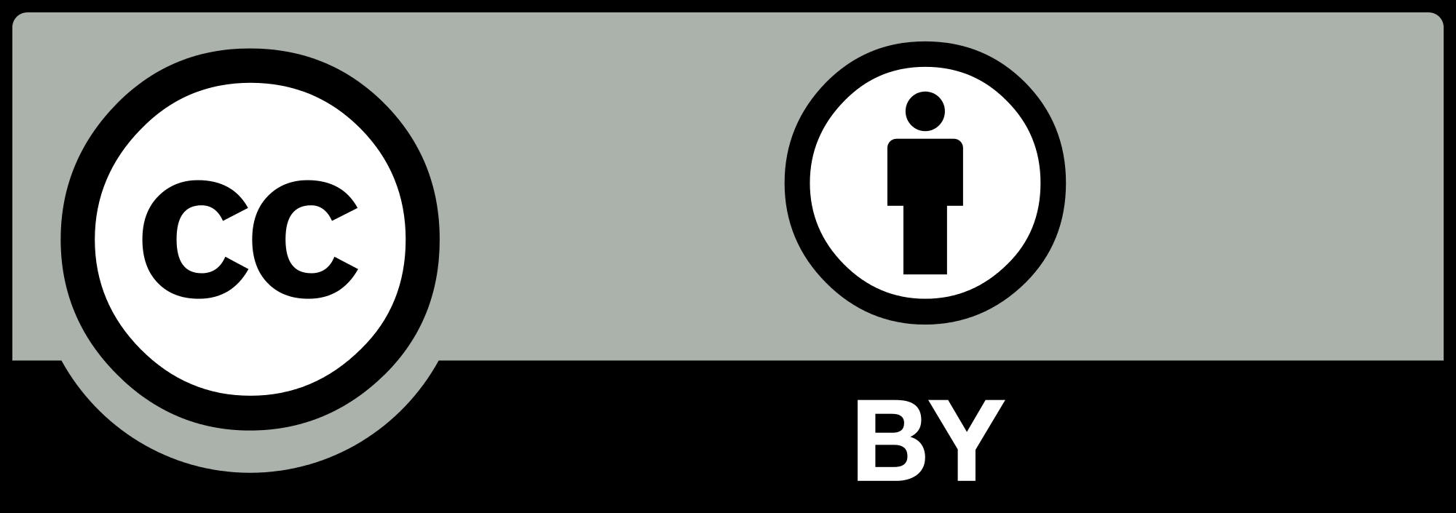
Strengths and Limitations
of
Open Educational Resources
to
Strengthen Copyright Literacy
Julia Guy, Kris Joseph, Michael B. McNally, Adrian Sheppard, & Amanda Wakaruk
University of Alberta

Slide 2
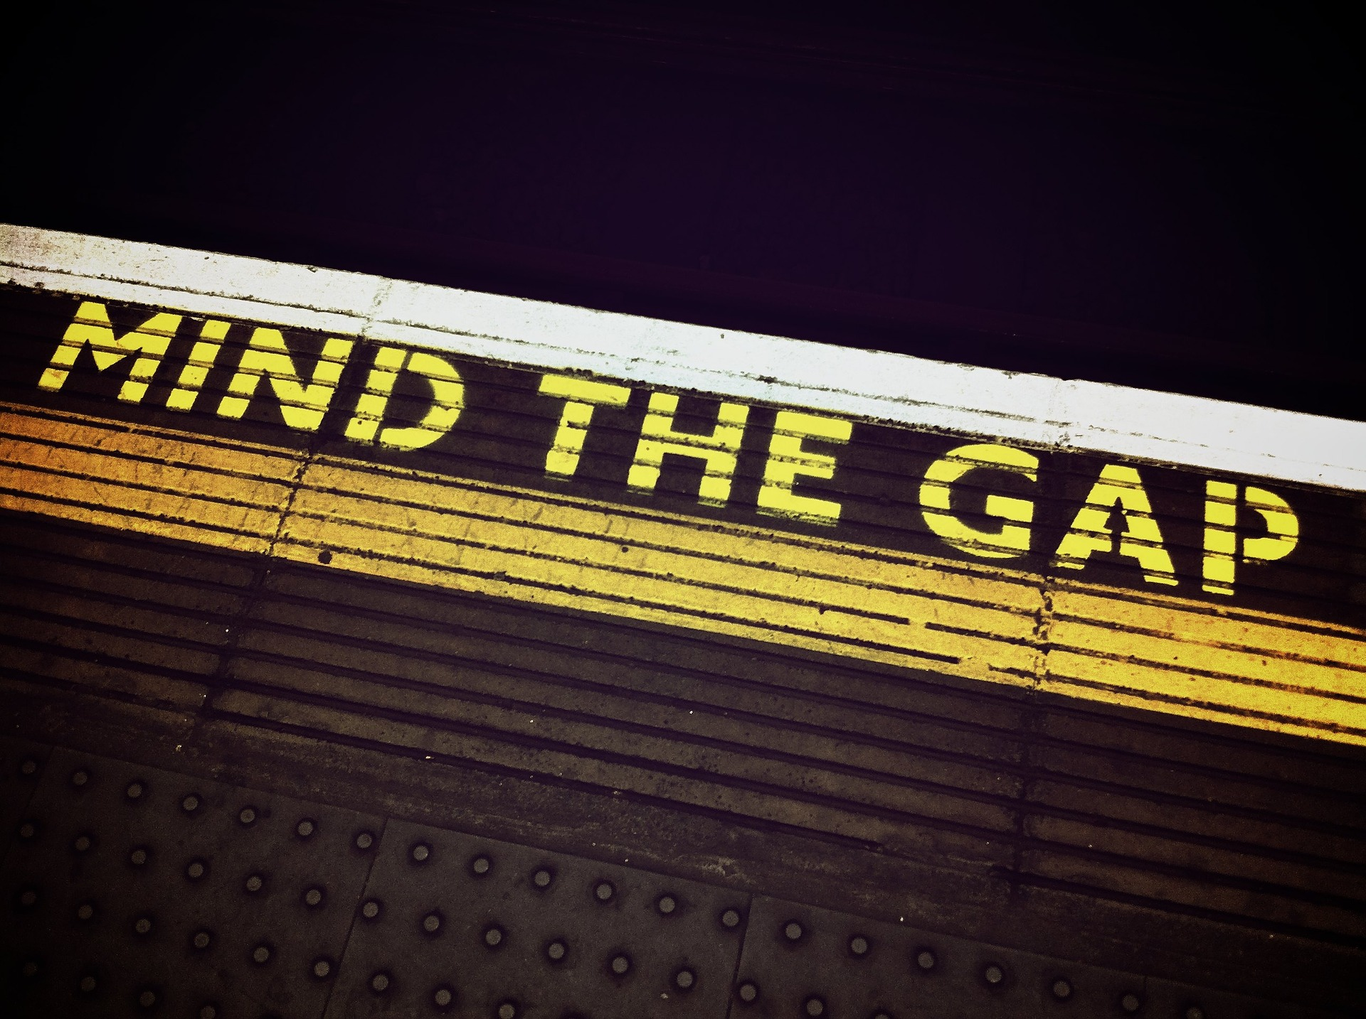
Context
Discourse emphasizes role of OER in democratizing education and lifelong learning (UNESCO, n.d.; OECD, 2007)
Growing emphasis on importance of copyright literacy (Burkell et al., 2105; Morrison, 2018; Benson, 2019(f))
Few educational opportunities for faculty members, LIS students, and the Canadian public (Zerkee, 2016; Di Valentino, 2015; Patterson, 2016; Murray, 2004)

Slide 3
Context (cont’d)
Copyright education in Canada
  Copyright officers often have LIS backgrounds but lack education through copyright-specific courses (Patterson, 2016)
  Many faculty are: (Di Valentino, 2015)
    unaware of training material at their own institutions
    When they are aware, they do not attend
  Copyright instruction is: (Zerkee, 2016)
    rarely required in Canadian post-secondary ed
    Seldom interactive
  Wide range of approaches: (Winter, 2017; Secker, 2018)
    toolkits
    video series
    card games

Slide 4
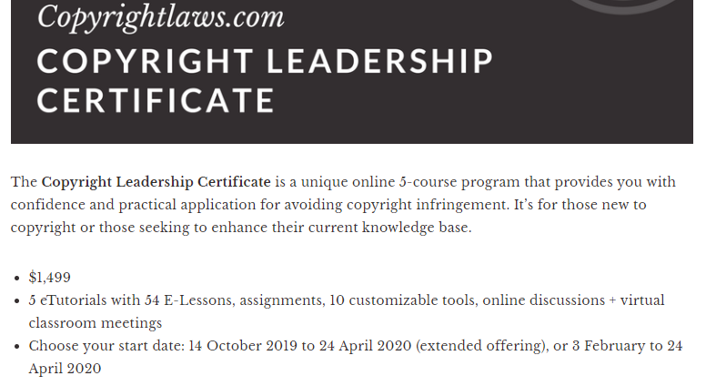
The Problem
Desire and need for copyright education in LIS, but limited opportunities
“… during the past year there were informal discussions between students and the Director and formal discussions at the Curriculum Committee meetings, where students expressed interest in having the topics and issues related to copyright addressed in greater depth.”
McGill - School of Information Studies. 2016. “Master of Information Studies (MISt) Program” [Submitted to the Committee on Accreditation, American Library Association]
https://www.copyrightlaws.com/copyright-leadership-certificate-2019/

Slide 5
Case study
Single case
  Concerns:
    limited generalizability (Gary, 2004)
    proximity to case may introduce bias (Flyvberg, 2004)
  Benefits:
    causal relationships can be examined (Gary, 2004)
    can be useful when cases are unusual (Flyvberg, 2004)
    Proximity can aid understanding when study is undertaken critically (Flyvberg, 2004)
Focus: University of Alberta’s Opening Up Copyright module series

Slide 6
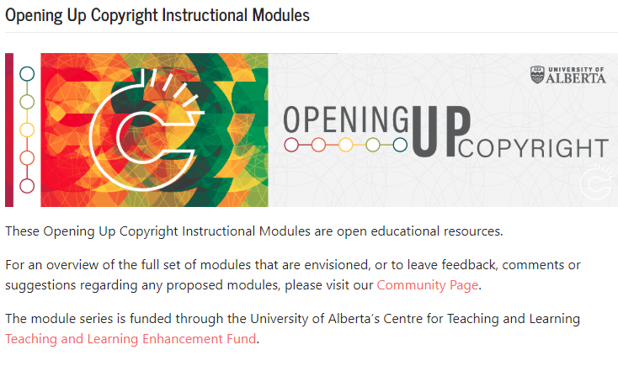
Project Description
Project grant: Teaching and Learning Education Fund (TLEF)
Audience
  Library and Information Studies students
  Post-secondary students and researchers
  General public
Goals
  Improve quality and consistency of copyright instruction for LIS students
  Enhance copyright education for staff, students and faculty
  Facilitate downstream use: remixes, adaptations
Series Website:
https://sites.library.ualberta.ca/copyright/

Slide 7
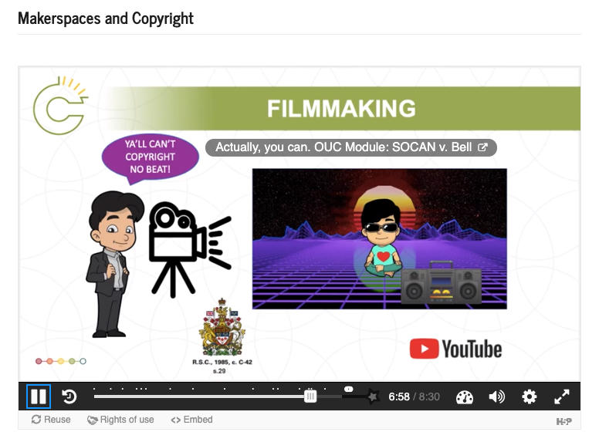
The Content
Collection of video-based instruction modules
Six to ten minutes on each topic
  15 complete and available now
  50 more planned
Core technologies
  Google Docs, PowerPoint, YouTube, H5P, WordPress
Emphasized use of openly-licensed and
public domain content
http://sites.library.ualberta.ca/copyright

Slide 8
Online Instruction
Common considerations for engagement in instructional videos
  Have learning objectives
  Keep ‘em short (unlike this presentation)
  Use scripts but make narration conversational
  Make ‘em interactive
  Minimize cognitive load (chunk, avoid jargon)
  Avoid large blocks of text on-screen (unlike this slide)
  Use multiple formats and ensure accessibility
  Collaborate across disciplines (librarians, faculty, instructional designers)
(Evans, 2014; Weeks & Davis, 2017; Lo & Dale, 2009; Martin & Martin, 2015; Clossen, 2014; Smith, 2010; Courtney & Wilhoite-Matthews, 2015)

Slide 9
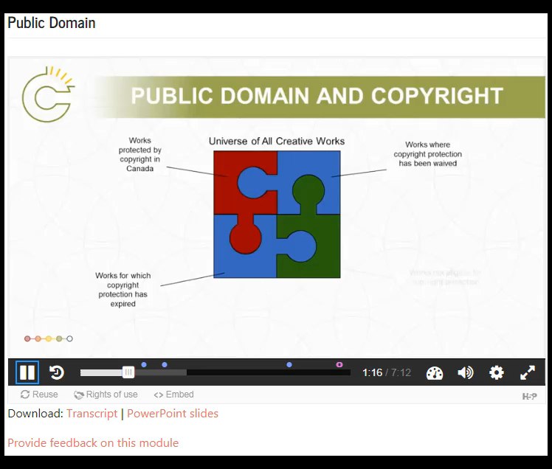
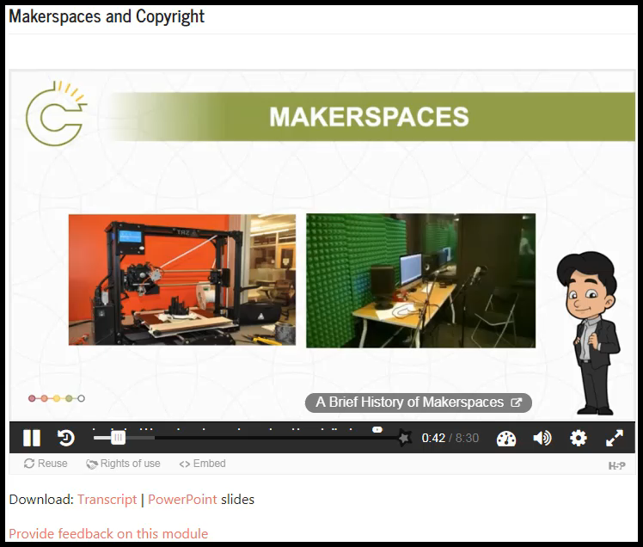
Demos

Slide 10

Tensions for content creation
Model best practices for copyright-compliant use of material
Balance user engagement with precise information on complex subject matter
One format for multiple audiences
Maximize reuse by using open tools and open content to create open material

Slide 11
Findings

Slide 12
Narrative vs. Exactitude
Stories are more compelling but not always obvious to designers
  Modules featuring common issues are easier for story-crafting
  Not much “narrative” in sections of the Copyright Act
Copyright literacy is complex and detail-oriented. Plus, the copyright librarian is picky about licence and license
  Specificity and thoroughness important, but it adds to module length
  Careful scripting is required and can seem stilted when read aloud
Recommendations:
  Spend more time on unique techniques (animation, puppets) for key modules
  Include outside skills and perspectives (such as theatre/performance experience)

Slide 13
Adaptability and Openness vs Engagement
Encouraging reuse places emphasis on:
  Crafting modules with openly-licensed tools, in open formats
  Relying on openly-licensed content (images, sounds, videos) to avoid downstream copyright issues
Open source tools exist but :
  Learning curves are steep
  “Free” software does not always perform as well as commercial alternatives
Open content exists but:
  Appropriate elements may be difficult to find
  We wanted to avoid relying on use of fair dealing exceptions

Slide 14
Recommendations
Acknowledge that maximal openness is not always possible (or even desirable (McNally and Christiansen, 2019))
Rely on additional layers (e.g. H5P tools) for added interactivity

Slide 15
References
Almeida, Nora. 2017. “Open Educational Resources and Rhetoric Paradox in the Neoliberal Univers(ity).” Journal of Critical Library and Information Studies, 1: 1-19.
Ameil, Tel. 2012. “Identifying Barriers to the Remix of Translated Open Educational Resources.” International Review of Research in Open and Distance Learning, 14(1): p. 16-144.
American Library Association (ALA). 2009. ALA’s Core Competencies of Librarianship. http://www.ala.org/educationcareers/sites/ala.org.educationcareers/files/content/careers/corecomp/corecompetences/finalcorecompstat09.pdf
Benson, Sara Rachel. 2019 (forthcoming). Copyright Conversations: Rights Literacy in a Digital World. ACRL Press.
Burkell, Jacquelyn, A., Alexandre Fortier, Lisa Di Valentino, and Sara T. Roberts. 2015. Enhancing Key Digital Literacy Skills: Information Privacy, Information Security, and Copyright/Intellectual Property. https://ir.lib.uwo.ca/cgi/viewcontent.cgi?article=1038&context=fimspub
Clossen, Amanda S. 2014. “Beyond the Letter of the Law: Accessibility, Universal Design and Human-Centered Design in Video Tutorials.” Pennsylvania Libraries: Research & Practice, 2(1): 27-37.

Slide 16
References
Courtney, Michael, and Sara Wilhoite-Mathews. 2015. “From Distance Education to Online Learning: Practical Approaches to Information Literacy Instruction and Collaborative Learning in Online Environments.” Journal of Library Administration, 55: 261-277.
Crissinger, Sarah. 2015. “A Critical Take on OER Practices: Interrogating Commercialization, Colonialism and Content.” In the Library with the Lead Pipe. (Oct 21 2015): http://www.inthelibrarywiththeleadpipe.org/2015/a-critical-take-on-oer-practices-interrogating-commercialization-colonialism-and-content/
Di Valentino, Lisa. 2015. Awareness and Perception of Copyright among Teaching Faculty at Canadian Universities. https://ir.lib.uwo.ca/cgi/viewcontent.cgi?article=1040&context=fimspub
Evans, Rachel. 2014. “Cooking Up Cauldrons of Content: Recipes for Video Tutorials.” Articles, Chapters and Online Publications. 32. https://digitalcommons.law.uga.edu/law_lib_artchop/32
Flyvberg, Bent. 2004. “Five Misunderstandings About Case-Study Research.” p. 390-404. In Qualitative Research Practice. Clive Seale et al. (Eds.). London: Sage.
Gray, David E. 2004. Doing Research in the Real World. London: Sage.

Slide 17
References
Harris, Lesley Ellen. 2018. “Home.” Copyrightlaws.com https://www.copyrightlaws.com/
International Federation of Library Associations and Institutions (IFLA). 2018. IFLA Statement on Copyright Education and Copyright Literacy. https://www.ifla.org/publications/node/67342
Leedy, Paul D., and Jeanne Ellis Ormrod. 2005. Practical Research: Planning and Design. Upper Saddle River, NJ: Pearson.
Lo, Leo S., and Jenny McCraw Dale. 2009. “Information Literacy ‘Learning’ via Online Tutorials: A Collaboration between Subject Specialist and Instructional Design Librarian.” Journal of Library and Information Services in Distance Learning, 3: 148-158.
Martin, Nichole A., and Ross Martin. 2015. “Would You Watch It? Creating Effective and Engaging Video Tutorials.” Journal of Library and Information Services in Distance Learning, 9: 40-56.
McGill University – School of Continuing Studies (McGill). 2019. “Intellectual Property.” https://www.mcgill.ca/continuingstudies/area-of-study/intellectual-property
McNally, Michael B., and Erik Christiansen. 2019. “Open Enough? Eight Factors to Consider when Transitioning from Closed to Open Resources and Courses: A Conceptual Framework.” First Monday, 24(6).

Slide 18
References
Morrison, Chris. 2018. “Copyright and Digital Literacy: Rules, Risk and Creativity.” p. 97-108. In Digital Literacy Unpacked. Katharine Reedy and Jo Parker (Eds.). London, Facet. https://kar.kent.ac.uk/70446/1/Morrison%20-%20Copyright%20and%20digital%20literacy%20-%20rules%2C%20risk%20and%20creativity%20%28in%20Reedy%20and%20Parker%2C%20Digital%20Literacy%20Unpacked%29.pdf
Murray, Laura J. 2004. “Protecting Ourselves to Death: Canada, Copyright and the Internet.” First Monday, 9(10): https://journals.uic.edu/ojs/index.php/fm/article/view/1179/1099
Organisation for Economic Cooperation and Development (OECD). 2007. Giving Knowledge For Free. http://www.oecd.org/education/ceri/38654317.pdf
Patterson, Erin. 2016. “The Canadian University Copyright Specialist: A Cross-Canada Selfie.” Partnership, 11(2): http://dx.doi.org/10.21083/partnership.v11i2.3856
San Jose State University – School of Information (SJSU). 2018. MLIS Skills at Work: A Snapshot of Job Postings: Spring 2018. https://ischool.sjsu.edu/sites/main/files/file-attachments/career_trends.pdf

Slide 19
References
Secker, Jane. 2018. “Copyright the Card Game - A Report from the Canadian Contingent.” UK Copyright Literacy. 1 Jul. 2018. https://copyrightliteracy.org/2018/07/01/copyright-the-card-game-a-report-from-the-canadian-contingent/
Smith, Susan Sharpless. 2010. Web-Based Instruction: A Guide for Libraries. 3rd Ed. Chicago: American Library Association.
United Nations Educational, Scientific and Cultural Organization (UNESCO). N.d. “Open Educatoinal Resourcse.” https://en.unesco.org/themes/building-knowledge-societies/oer
Weeks, Thomas and Jennifer Putnam Davis. 2017. “Evaluating Best Practices for Video Tutorials: A Case Study.” Journal of Library and Information Services in Distance Learning, 11(1-2): 183-195.
Weiland, Steven. 2015. “Open Educational Resources: American Ideals, Global Questions.” Global Education Review, 2(3): 4-22.
Winter, Christina, Brad Doerksen, Kate Langrell, and Tasha Maddison. 2017. “Copyright Education, Copyright Literacy and Information Literacy.” Presented at the ABC Copyright Conference, 30 Jun. 2017. Queen’s University, Kingston, ON, Canada. https://qspace.library.queensu.ca/bitstream/handle/1974/22021/Copyright%20Education%252c%20Institutional%20Literacy%20%26%20Information%20Literacy.pdf?sequence=1&isAllowed=y
World Intellectual Property Organization (WIPO). N.d. “WIPO Academy.” https://www.wipo.int/academy/en/
Zerkee, Jennifer. 2016. “Approaches to Copyright Education for Faculty in Canada.” Partnership, 11(2): http://dx.doi.org/10.21083/partnership.v11i2.3794

Slide 20
Images
Stefan Kellar. (2017). Fantasy Clouds Woman. Pixabay. Pixabay License. https://pixabay.com/photos/fantasy-clouds-woman-castle-sun-3281795/
Greg Plominski. (2011). Mind the gap London. Pixabay. Pixabay License. https://pixabay.com/photos/mind-the-gap-london-underground-1876790/

