Slide 1
Telecommunications Policy
LIS 598 – Information Policy – Winter 2017
Mar. 15, 2017

Slide 2
Outline
A. Telecom Policy and Regulation
B. Canada’s Telecom Environment
C. Looming Issues

Slide 3
A-I. Communications Policy
Communications policy is made up of two bifurcated policy realms
Telecommunications policy – which covers the infrastructure/modes of communication
Broadcasting policy – which covers the content that travels over those modes of communication
While this dichotomy has worked well historically, it is now challenged by convergence of these two realms
In addition to technological convergence and regulatory bifurcation a third major factor is corporate consolidation (and with respect to broadcast audience fragmentation) (CRTC, 2010, 2011)

Slide 4
A-II. Telecommunications Policy and Regulation
Telecommunication Policy in Canada is governed by the Telecommunications Act, and in particular s. 7 of the Act which specifies the Canadian Telecommunications Policy
Other key legislation includes:
Radiocommunication Act (which covers the powers of the Minister of Innovation, Science and Economic Development with respect to radio-spectrum management)
Radiocommunication Regulations (which covers radio-spectrum licenses)
Canadian Radio-television and Telecommunications Act (which governs the CRTC)
The Governor in Council (Cabinet) also has the ability to provide policy direction to the CRTC

Slide 5
A-II(ii). Telecommunications Policy and Regulation
Telecom policy is set by Innovation, Science and Economic Development (ISED)
Telecom regulation is administered by the arms length, quasi-judicial CRTC
However, with regard to wireless telecommunication (spectrum management), ISED has both policy and regulatory functions, and the CRTC also has some regulatory responsibilities
In 2002 the OECD recommended that Canada more formally divide its policy and regulatory functions, with the former being the responsibility of Industry Canada (now ISED) and the latter falling to the CRTC

Slide 6
A-III. Regulatory History
In 1903 the Board of Railway Commissioners was established as an independent, quasi-judicial regulator
In 1908 it was given jurisdiction over telegraph and telephone companies
In 1938 the Transport Act changed the Board of Railway Commissioners to the Board of Transport Commissioners
In 1967 the National Transportation Act created the Canadian Transport Commission, which assumed regulatory control of telecommunications
Canadian Radio-television and Telecommunications Act of 1976
Transformed Canadian Radio-television Commission (created in 1968) into Canadian Radio-television and Telecommunications Commission
Added telecommunication regulation to CRTC’s responsibility

Slide 7
A-IV. Canadian Telecommunications Policy (Telecommunications Act, s. 7)
It is hereby affirmed that telecommunications performs an essential role in the maintenance of Canada’s identity and sovereignty and that the Canadian telecommunications policy has as its objectives
(a) to facilitate the orderly development throughout Canada of a telecommunications system that serves to safeguard, enrich and strengthen the social and economic fabric of Canada and its regions;
(b) to render reliable and affordable telecommunications services of high quality accessible to Canadians in both urban and rural areas in all regions of Canada;
(c) to enhance the efficiency and competitiveness, at the national and international levels, of Canadian telecommunications;
(d) to promote the ownership and control of Canadian carriers by Canadians;
(e) to promote the use of Canadian transmission facilities for telecommunications within Canada and between Canada and points outside Canada;
(f) to foster increased reliance on market forces for the provision of telecommunications services and to ensure that regulation, where required, is efficient and effective;
(g) to stimulate research and development in Canada in the field of telecommunications and to encourage innovation in the provision of telecommunications services;
(h) to respond to the economic and social requirements of users of telecommunications services; and
(i) to contribute to the protection of the privacy of persons.

Slide 8
A-V. 2006 Policy Direction
In 2006, the Harper Government provided a new Policy Direction to the CRTC
1 In exercising its powers and performing its duties under the Telecommunications Act, the Canadian Radio-television and Telecommunications Commission (the “Commission”) shall implement the Canadian telecommunications policy objectives set out in section 7 of that Act, in accordance with the following:
(a) the Commission should
(i) rely on market forces to the maximum extent feasible as the means of achieving the telecommunications policy objectives, and
(ii) when relying on regulation, use measures that are efficient and proportionate to their purpose and that interfere with the operation of competitive market forces to the minimum extent necessary to meet the policy objectives;
….

Slide 9
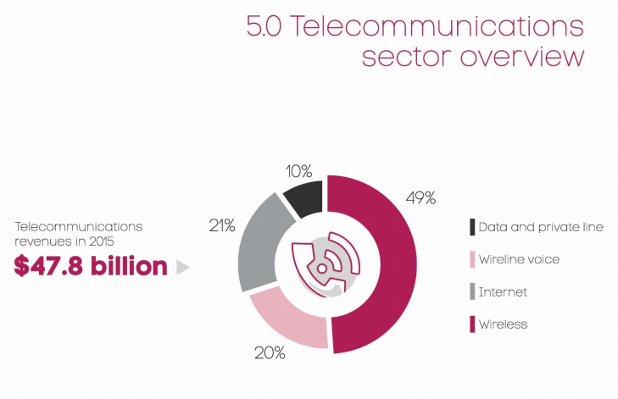
B-I. Telecommunications Sector Overview
CRTC, (2016) Communications Monitoring Report 2016, p. 203

Slide 10
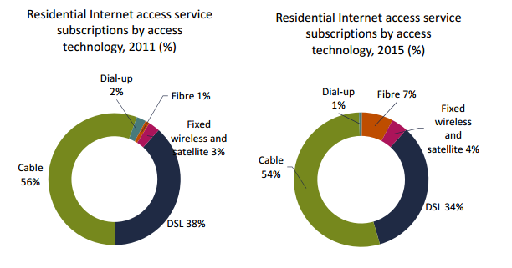
B-II. Internet Access by Type
CRTC, (2016) Communications Monitoring Report 2016, p. 261

Slide 11
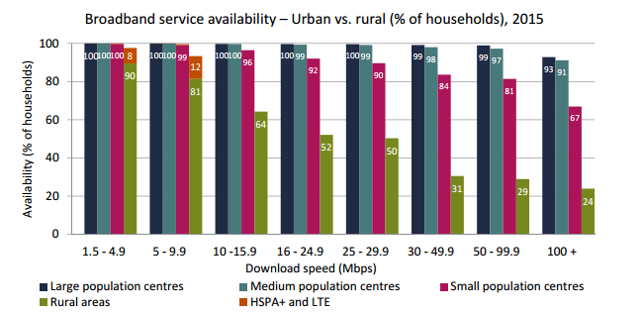
B-III. Rural Digital Divide
CRTC, (2016) Communications Monitoring Report 2016, p. 270

Slide 12
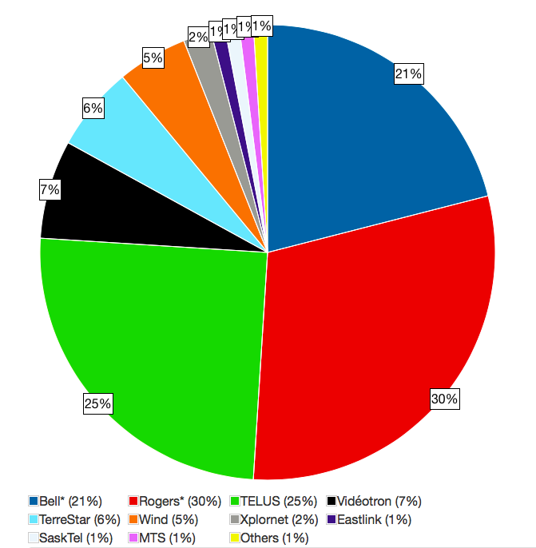
B-IV. Wireless Oligopoly
Source: “Canadian Spectrum Inventory,” (2016), Canadian Spectrum Policy Research: http://canadianspectrumpolicyresearch.org/canada/inventory/

Slide 13
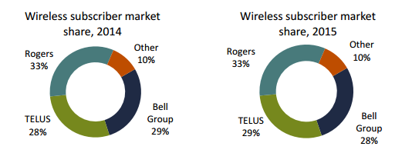
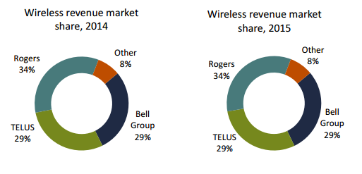
B-IV(ii). Wireless Oligopoly
CRTC, (2016) Communications Monitoring Report 2016, p. 286-287

Slide 14
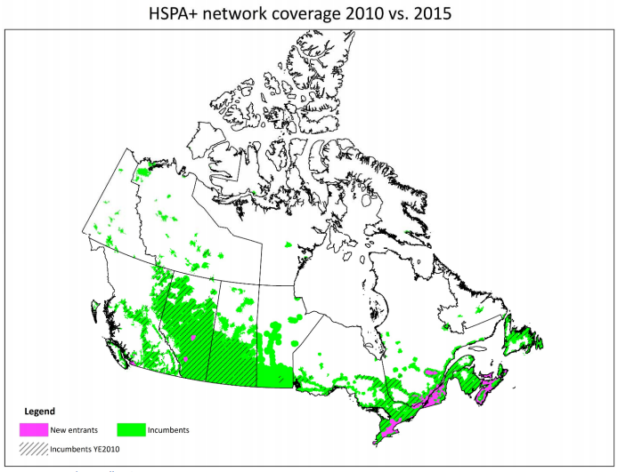
B-V. Rural Wireless Divide
CRTC, (2016) Communications Monitoring Report 2016, p. 314

Slide 15
C-I. CRTC’s Basic Service Objective Review
Review of basic telecommunication services began with April 2015 Notice of Consultation
Multi-phase consultation:
Over 25,000 pages of documents in first phase of written intervention
30,000 respondents to EKOS survey
3 week hearing in April 2016
Decision released at end of 2016

Slide 16
C-II. CRTC’s Basic Service Objective Review
Decision declares broadband a basic telecommunication service (CRTC Telecom Regulatory Policy CRTC 2016-496)
Sets goal of 90% of Canadians having access to broadband at speeds of 50 Mbps download and 10 Mbps upload by 2021
Universal access to come 10-15 years later
Creates new $750 million fund for rural, remote and northern broadband
Affordability and digital literacy issues not directly tackled

Slide 17
C-III. Bottom Up Solutions
Despite the challenges, rural communities across North America (https://www.youtube.com/watch?v=lzaowxri5w0), are developing their own solutions
Canada has also seen successes
EORN – Eastern Ontario Regional Network
K-Net
O-Net (Olds, AB)
A handful of cities in the US are rolling out 10 Gbps connections (10,000 Mbps download and upload speeds)
By contrast my U of A connection is 18.6 Mbps download/3.2 Mbps upload

Slide 18
Discussion Questions and Activity
Discussion Questions
Money, and more specifically, pecuniary incentives, have played a large role in shaping telecom policy in Canada. Has this been an effective way to develop telecom infrastructure in a nation as large as Canada, or is there too much reliance on the profit motive as a means of developing Canada’s telecom infrastructure?
Assess the CRTC’s decision declaring broadband a basic service (Telecom Regulatory Policy 2016-496).
You can comment on the decision itself (what do you agree/disagree with; what is surprising) or the manner in which the decision is written (is the decision primarily written for a general audience or a policy audience; how much prior knowledge is needed to understand the make sense of the decision)
Activity
Test your internet speed (https://cira.ca/cira-internet-performance-test-0) and report and reflect on it. What kinds of speed (both upload and download) did you get? Do you find your internet is often too slow? If you have a difference between up and download speed does this matter to you? What does a focus on the technical element of broadband speed do or not do in discussions about broadband?

Slide 19
Next Week
Internet Policy (Digital Divide and Net Neutrality)
Read Birdsall (2000), CRTC (2015) and van Deursen and Helsper (2015)

Slide 20
Sources
Canadian Radio-Television and Telecommunications Commission (CRTC). 2010. Navigating Convergence: Charting Canadian Communications Change and Regulatory Implications. http://www.crtc.gc.ca/eng/publications/reports/rp1002.pdf
CRTC. 2011. Navigating Convergence II: Charting Canadian Communications Change and Regulatory Implications. http://www.crtc.gc.ca/eng/publications/reports/rp1108.pdf
CRTC. 2016. Communications Monitoring Report 2016. http://www.crtc.gc.ca/eng/publications/reports/PolicyMonitoring/2016/cmr.pdf
CRTC. 2016. Telecom Regulatory Policy CRTC 2016-496. http://www.crtc.gc.ca/eng/archive/2016/2016-496.htm
Canadian Radio-Television and Telecommunications Act. (R.S.C., 1985, c. C-22). http://laws.justice.gc.ca/eng/acts/C-22/
“Canadian Spectrum Inventory.” 2016. Canadian Spectrum Policy Research. http://canadianspectrumpolicyresearch.org/canada/inventory/
Order Issuing a Direction to the CRTC on Implementing the Canadian Telecommunications Policy Objectives. SOR/2006-355. http://laws.justice.gc.ca/eng/regulations/SOR-2006-355/page-1.html
Organisation for Economic Cooperation and Development (OECD). 2002. Regulatory Reform Issues in the Telecommunications Industry: Regulatory Reform in Canada From Transition to New Regulation Challenges. https://www.oecd.org/regreform/1960562.pdf
Radiocommunication Act (R.S.C., 1985, c. R-2). http://laws-lois.justice.gc.ca/eng/acts/r-2/
Radiocommunication Regulations. SOR/96-484. http://laws-lois.justice.gc.ca/eng/regulations/sor-96-484/index.html
Telecommunications Act. (S.C. 1993, c. 38). http://laws-lois.justice.gc.ca/eng/acts/T-3.4/

Slide 21
Comments and Critique
Comments and critique on this presentation and any other material for LIS 598 Information Policy – Winter 2017 can be sent to Michael B. McNally at: mmcnally@ualberta.ca
Comments and critique will be used to improve future iterations of these materials

