Slide 1
SOCAN v. Bell
January 2020
Notes:
Hello and welcome to the University of Alberta’s Opening Up Copyright Instructional Module on SOCAN v. Bell.

Slide 2
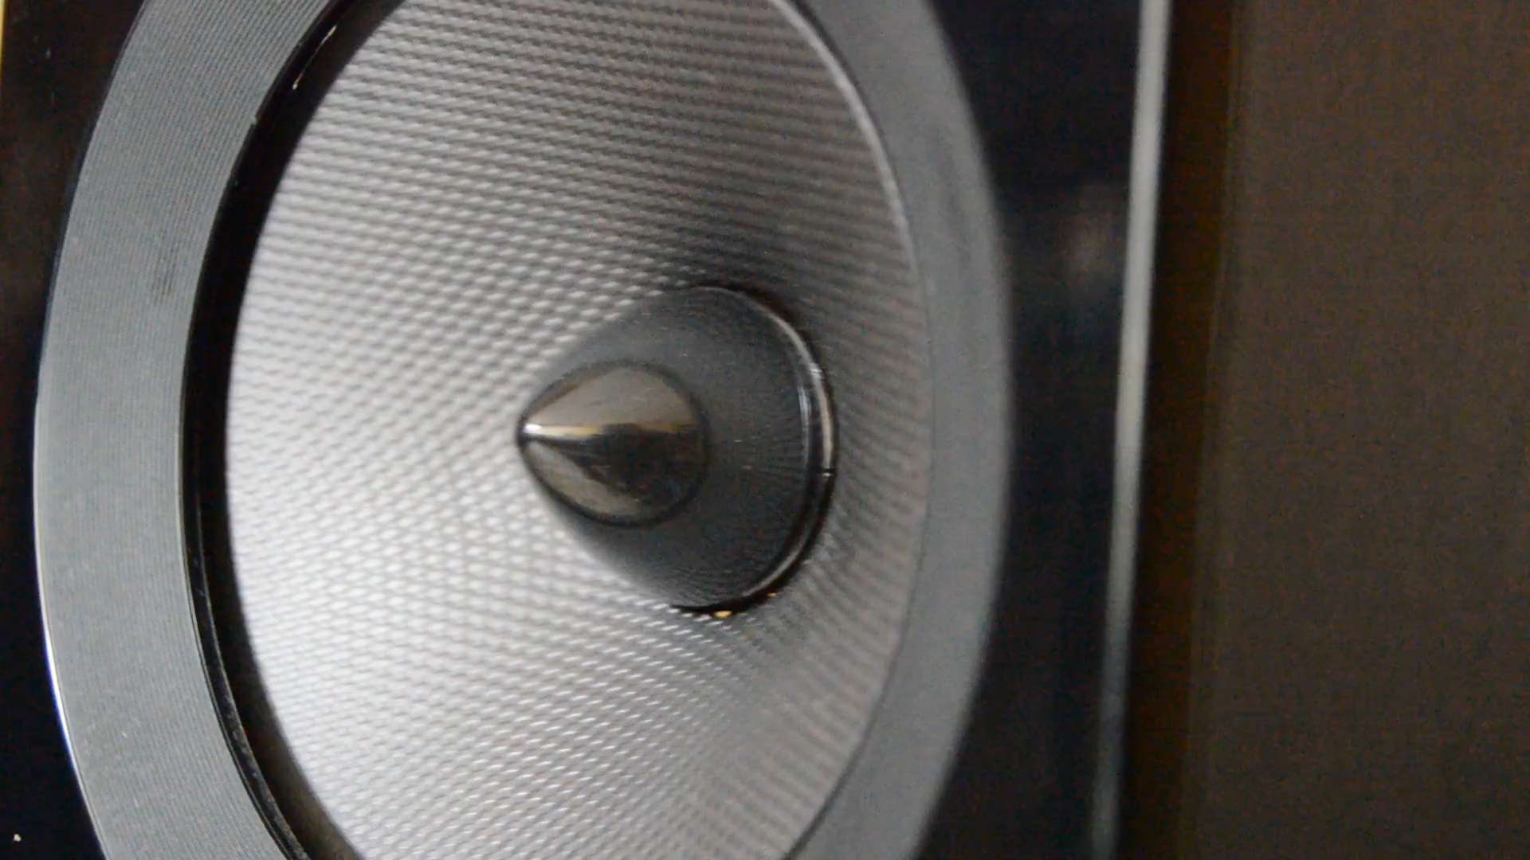
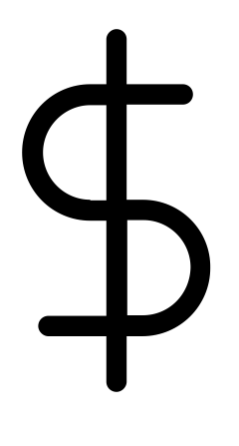
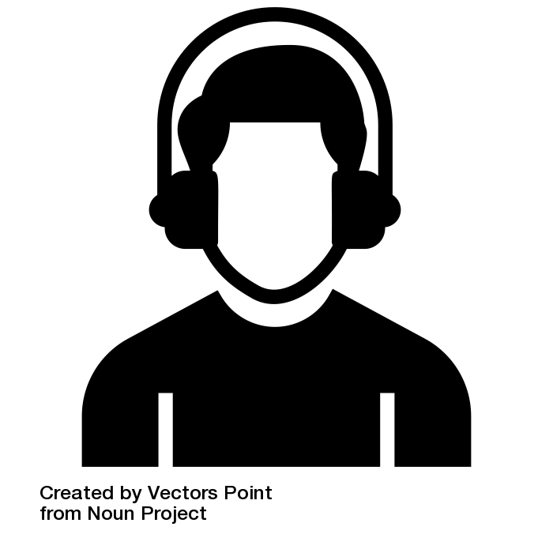

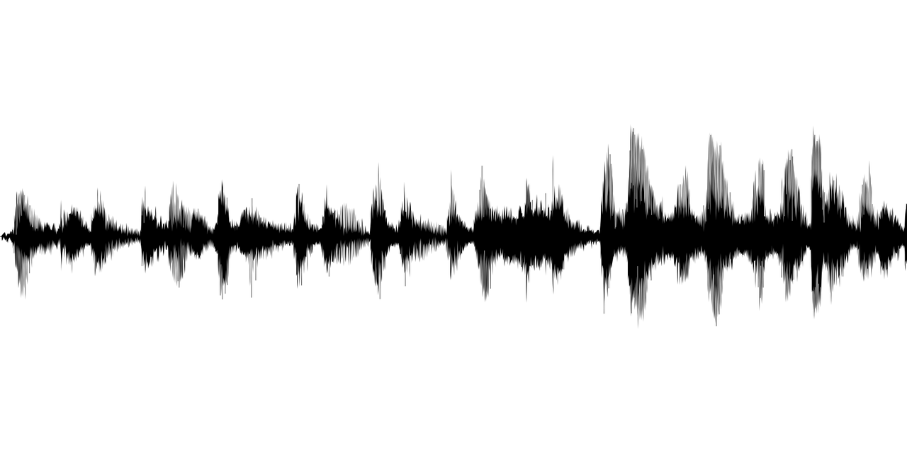
PREVIEWING SONGS
Fair Dealing
0:45
1:30
2:15
3:00
Notes:
When buying music online, we usually have an opportunity to preview a song before we buy it. The song is protected by copyright and a 45-second preview of a 3-minute song is a substantial amount. Should the rights-holders in that song be compensated for the playing of that online excerpt, or should those previews be covered under fair dealing?

Slide 3



SOCAN SEEKS CLARITY
1995: SOCAN asks Copyright Board for tariffs
Notes:
SOCAN is a copyright collective representing the rights of songwriters, and SOCAN held the view that rights-holders should be compensated when their songs are previewed online. So, in 1995, SOCAN asked the Copyright Board to provide a tariff or royalty rate for reproducing music over the Internet, covering not only the downloading of songs, but also the streaming of previews.

Slide 4
COPYRIGHT BOARD
Previews are fair dealing
Notes:
The Copyright Board determined royalty rates for the downloads, but decided that previews were covered by fair dealing since their purpose was for research, and, as such, no royalties should have to be paid.

Slide 5





FEDERAL COURT OF APPEAL
No royalties for previews
Notes:
SOCAN then took the case to the Federal Court of Appeal, as a lawsuit against a group of fourteen companies and agencies. The Federal Court of Appeal agreed with the Copyright Board that royalties did not need to be paid for previews.

Slide 6
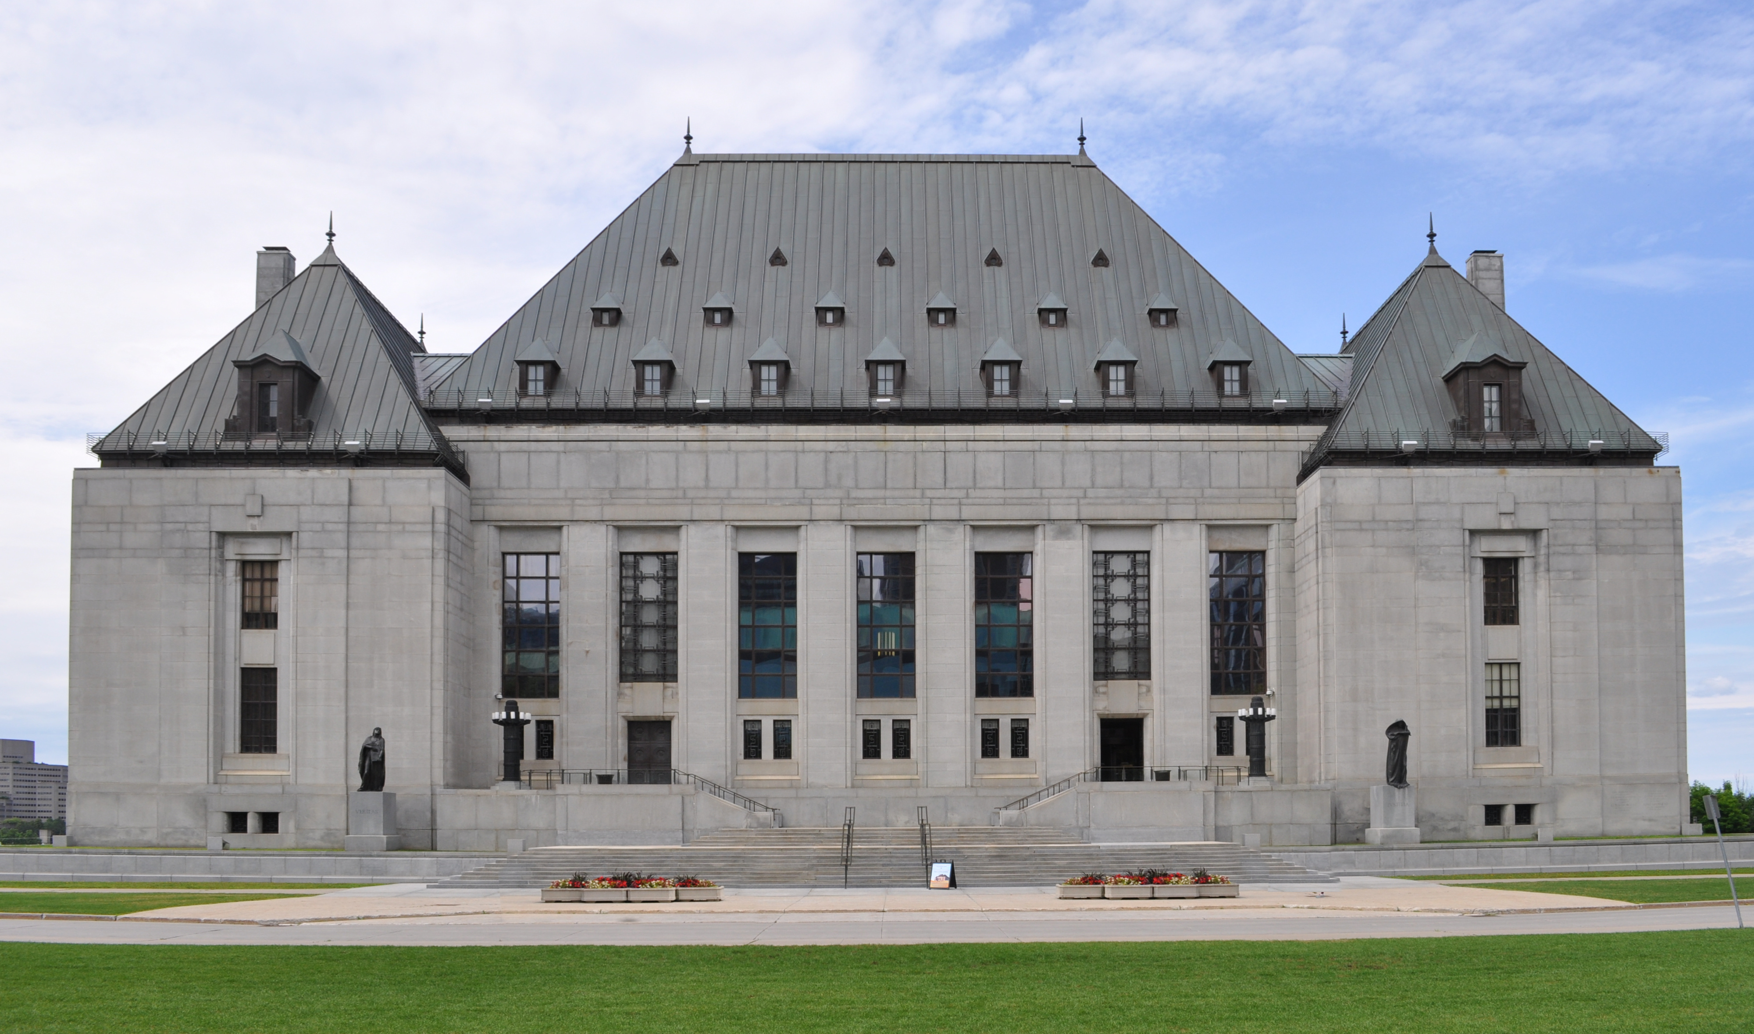
SUPREME COURT HEARS CASE
Eight respondents are named, including Bell
Notes:
SOCAN again appealed the decision, this time to the Supreme Court of Canada, naming Bell and seven other companies and associations as respondents.

Slide 7
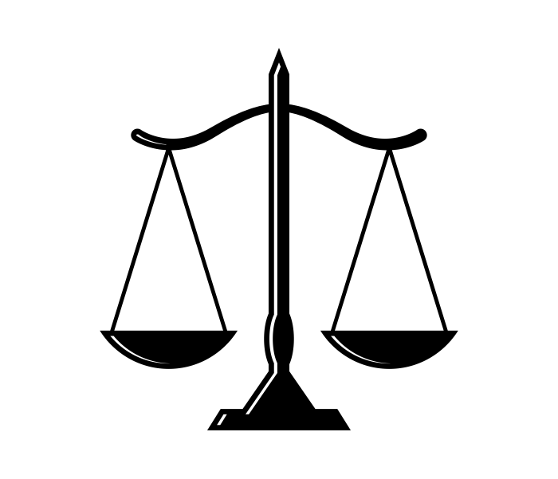

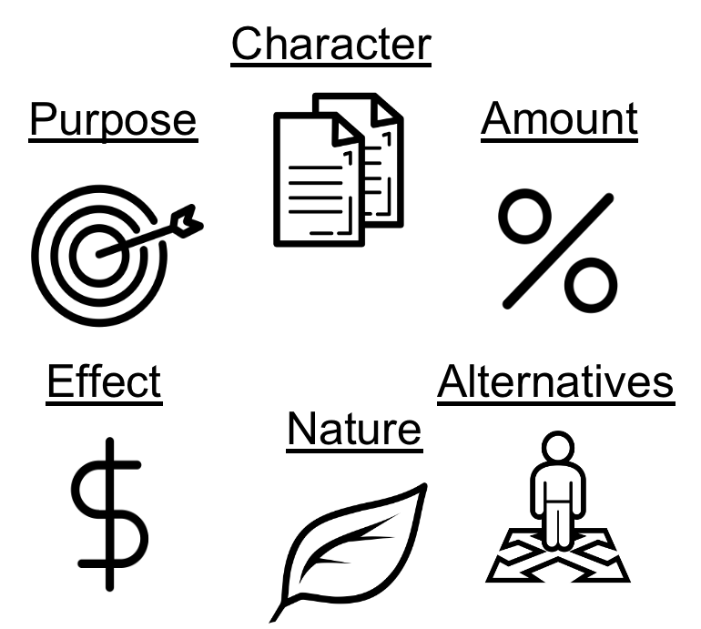
THREE ISSUES
Fair Dealing –
Are Previews Research?
1
Whose Purpose –
ISP or Customer?
or
2
CCH six-factor test –
Does it pass?
3
Notes:
The SOCAN v. Bell case centred on three issues. The first issue concerns whether fair dealing can apply to the playing of the previews. The second issue centers around the appropriate viewpoint for purposes under fair dealing. And, the third issue is, if listening to the previews is considered research for the purposes of fair dealing, whether playing the previews passes the CCH six-factor test.

Slide 8
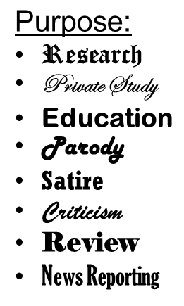


FAIR DEALING – ARE PREVIEWS RESEARCH?
Notes:
For fair dealing to apply, the playing of the previews would have to serve one of the specific purposes under fair dealing. In this case, the issue is whether the streaming of previews constitutes “research.” If it does, this would be said to “pass” the first step of the 2-step fair dealing assessment.

Slide 9
RESEARCH BROADLY DEFINED
“…the systematic investigation into and study of material in order to establish facts and new conclusions…” (para. 20).
“...can be piecemeal, informal, exploratory, or confirmatory. It can in fact be undertaken for no purpose except personal interest” (para. 22).
Notes:
While SOCAN argued that “research” should be defined as “the systematic investigation into and study of material in order to establish facts and new conclusions” (para. 20) the Supreme Court took a much broader view. The Supreme Court held that research “... can be piecemeal, informal, exploratory, or confirmatory. It can in fact be undertaken for no purpose except personal interest” (para. 22).

Slide 10





PREVIEWS ARE RESEARCH
1st Step
2nd Step
Character
Purpose
Amount
Effect
Alternatives
Nature
Notes:
The Court suggested that research should be broadly defined in the first step. The “analytical heavy hitting is done in determining whether the dealing was fair” which takes place in the second step of the process.

Slide 11

PREVIEWS ARE RESEARCH
Previews = Research
Notes:
Therefore, in line with the two earlier decisions of the Copyright Board and the Federal Court of Appeal, the Supreme Court held that the previews did constitute research.

Slide 12
WHOSE PURPOSE: ISP OR CUSTOMER?
?
1
0
0
0
1
1
0
1
0
1
or
0
0
1
0
1
1
Notes:
Having decided that the previews constitute research, the Court turned to the second major issue - whose perspective to use for considering the purpose of the use of a work. Whose purpose should be considered? The party responsible for playing the music is the Internet Service Provider (or ISP), such as Bell, Rogers or TELUS. The party listening to the music is the customer. If research is to be the purpose of streaming the previews under fair dealing, then who must be doing the research? The ISP, who is initiating the stream, or the customer, who is receiving the stream?

Slide 13
SOCAN v. Bell, 2012 SCC 36
“…the predominant perspective in this case is that of the ultimate users of the previews, and their purpose in using previews was to help them research and identify musical works for online purchase” (para. 34).
Notes:
While SOCAN argued that the ISP’s perspective should be used as the viewpoint from which to consider whether the dealing was fair, the Supreme Court again decided that the Copyright Board and the Federal Court of Appeal had been correct in focusing on the end user’s purpose, not the service provider’s.
The Supreme Court clearly stated that “the predominant perspective in this case is that of the ultimate users of the previews, and their purpose in using previews was to help them research and identify musical works for online purchase” (para. 34).

Slide 14
APPLYING THE SIX FACTORS
Does playing the preview pass the CCH six-factor test?
Character
Purpose
Amount
= 2nd step
of fair dealing assessment
Effect
Alternatives
Nature
Notes:
The third issue was, if listening to the previews is considered as research for the purposes of fair dealing, then does playing the previews pass the CCH six-factor test?
This issue relates to the second step of the fair dealing assessment. The Court applied, and thus reaffirmed, both the procedure and the six factors used in CCH.

Slide 15
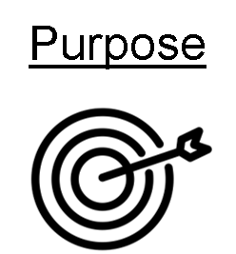
FACTOR 1 – PURPOSE OF THE DEALING
Consumer or other research purposes
Safeguards ensure use was limited to this purpose
Notes:
It was determined that the user was listening to previews for consumer or other research purposes. The Court felt that the presence of safeguards helped ensure that use was limited to this purpose.

Slide 16
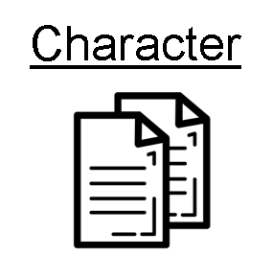
FACTOR 2 – THE CHARACTER OF THE DEALING
Inability to download
Short length and low quality
Deleted after playing
Notes:
Safeguards were also noted when the Court considered the character of the dealing. These included the inability to download the previews, the short length and relatively low quality of the files, and the fact that they were deleted after playing.

Slide 17
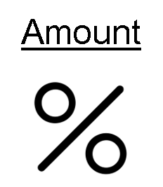
FACTOR 3 – THE AMOUNT OF THE DEALING
}
“The ‘amount of the dealing’ factor should therefore be assessed by looking at how each dealing occurs on an individual level, not on the aggregate use" (para. 41).
Notes:
In assessing the amount of the dealing, SOCAN had argued that the aggregate number of previews should be considered. This diverged from the Copyright Board’s decision to assess the amount of the dealing as the proportion of the work copied, not the aggregate number of copies made.
The Supreme Court again sided with the original arguments of the Copyright Board and stated “The ‘amount of the dealing’ factor should therefore be assessed by looking at how each dealing occurs on an individual level, not on the aggregate use” (para. 41). Furthermore, the Court clarified that the aggregate copying should be considered in the “character of the dealing factor” and not the amount of the dealing factor.

Slide 18
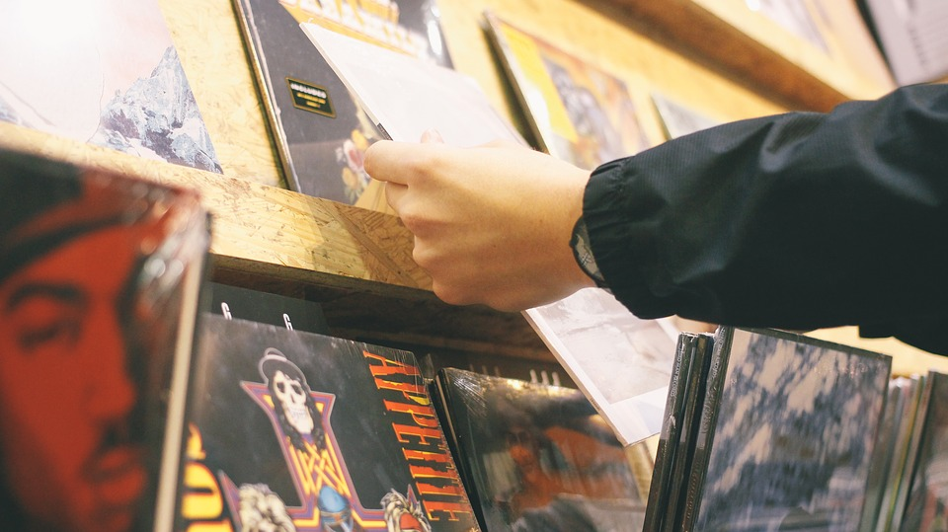


FACTOR 4 – ALTERNATIVES TO THE DEALING
"...none of the other suggested alternatives can demonstrate to a consumer what previews can, namely, what a musical work sounds like" (para. 46).
“The album sounded whimsical and flighty, while still showing a fresh and funky undertone that the band is best known for…”
Notes:
SOCAN claimed that users could rely on a wide number of alternatives to preview when choosing what music to buy. Album artwork, textual descriptions, and user-generated album reviews were offered as alternatives. However, the Supreme Court noted that these options were not true alternatives to previewing the music, as only previews can demonstrate to a consumer what the music actually sounds like.

Slide 19


FACTOR 5 – THE NATURE OF THE WORK
“Unless a potential consumer can locate and identify a work he or she wants to buy, the work will not be disseminated” (para. 47).
Notes:
The fifth factor examines whether the work is one which should be widely disseminated. SOCAN agreed that the works should be widely disseminated, but argued that since the works are already easily purchased and disseminated without previews, previews provide no additional benefit to dissemination. The Court disagreed, pointing out that “[u]nless a potential consumer can locate and identify a work he or she wants to buy, the work will not be disseminated” (para. 47).

Slide 20
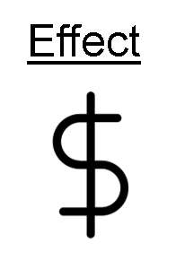
FACTOR 6 – THE EFFECT OF THE DEALING ON THE WORK
"Because of their short duration and degraded quality, it can hardly be said that previews are in competition with downloads of the work itself" (para. 48).
Notes:
Finally, the Supreme Court considered the effect of the dealing on the work. The Court found that since the purpose of the previews was to increase the sale of the originals, the previews could not be said to have a negative impact on the original, nor were they in competition with the original works.

Slide 21
SUPREME COURT DECISION
Dealing = Fair
Character
Purpose
Amount
Effect
Alternatives
Nature
Notes:
Based on the Supreme Court’s six-factor fair dealing analysis, the dealing was found to be fair.

Slide 22
SUMMARY
Are previews research?
Yes
Whose purpose?
Customer
Was the CCH six-factor test passed?
Yes
Notes:
To summarize, in SOCAN v. Bell the Supreme Court found that the previews of songs streamed on the internet were for a research purpose, that the research was conducted by the customer, and that this use satisfied the six-factor test and thus counted as fair dealing. Therefore, SOCAN’s appeal was dismissed.

Slide 23

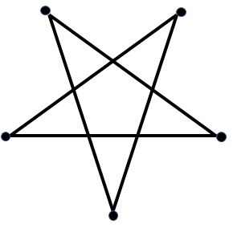
COPYRIGHT PENTALOGY
SOCAN v. Bell
Alberta (Education) v. Access Copyright
Rogers v. SOCAN
Re:Sound v. MPTAC
ESAC v. SOCAN
Notes:
The Court provided its decision in July of 2012, along with the four other copyright cases, which are collectively referred to as the “copyright pentalogy.” This case, along with the closely aligned decision in Alberta (Education) v. Access Copyright, another of the pentalogy, is an important piece of Supreme Court jurisprudence as it reaffirms and further clarifies the application of CCH’s six-factor test.

Slide 24
LEARNING OBJECTIVES
You should now be able to:
Recount the circumstances and outcome of the SOCAN v. Bell case
Describe the role of fair dealing in the SOCAN v. Bell case
Explain the use and interpretation of the CCH six-factor test in the SOCAN v. Bell case
Notes:
You should now be able to:
Recount the circumstances and outcome of the SOCAN v. Bell case
Describe the role of fair dealing in the SOCAN v. Bell case
Explain the use and interpretation of the CCH six-factor test in the SOCAN v. Bell case

Slide 25

THANK YOU FOR YOUR ATTENTION
Notes:
This has been the University of Alberta’s Opening Up Copyright Module on SOCAN v. Bell. Thank you for your attention.

Slide 26
REFERENCES AND RESOURCES
Geist, M. (Ed.). (2013). The Copyright Pentalogy: How the Supreme Court of Canada Shook the Foundations of Canadian Copyright Law. Ottawa, ON: University of Ottawa Press. Retrieved from https://press.uottawa.ca/the-copyright-pentalogy.html
Nitoslawski, M. & Shortt, M. J. (2013). Canada's new copyright: The Supreme Court redefines fair use and technological neutrality. Landslide 5(5), 43-49. Retrieved from https://heinonline.org/HOL/P?h=hein.journals/lndslid5&i=322
Tawfik, M. J. The Supreme Court of Canada and the “Fair Dealing Trilogy”: Elaborating a doctrine of user rights under Canadian copyright law. Alberta Law Review, 51(1), 191-200. https://www.albertalawreview.com/index.php/ALR/article/view/64

Slide 27
CASES AND LEGISLATION
Society of Composers, Authors and Music Publishers of Canada v. Bell Canada, 2012 SCC 36. [2012] 2 S.C.R.326. https://scc-csc.lexum.com/scc-csc/scc-csc/en/item/9996/index.do
CCH Canadian Ltd v. Law Society of Upper Canada. 2004 SCC 13. [2004] 1 S.C.R.339.
https://scc-csc.lexum.com/scc-csc/scc-csc/en/item/2125/index.do

Slide 28
IMAGE AND SOUND REFERENCES
padrinan. (2017). [Speaker]. Pixabay. Pixabay License. https://pixabay.com/videos/horn-sound-noise-vibration-music-9087/
GDJ. (2016). [Sound wave]. Pixabay. Pixabay License. https://pixabay.com/vectors/sound-wave-waveform-aural-audio-1781570/
Vectors Point. (n.d.). sound producer avatar. The Noun Project. CC BY. https://thenounproject.com/search/?q=listener&i=2699902
Cresnar, Gregor. (n.d.). Dollar sign. The Noun Project. CC BY. https://thenounproject.com/search/?q=dollar%20sign&i=171145
Nadir Balcikli. (n.d.). Copyright. The Noun Project. CC BY. https://thenounproject.com/search/?q=copyright&i=453533
Kimmi Studio. (n.d.). Shield. The Noun Project. CC BY. https://thenounproject.com/search/?q=shield&i=874630

Slide 29
IMAGE AND SOUND REFERENCES
SOCAN. (2012). [SOCAN Logo]. The Branding Source. http://brandingsource.blogspot.com/2012/01/new-logo-socan.html
Copyright Board of Canada. (n.d.). [Copyright Board Banner]. Copyright Board of Canada. http://www.cb-cda.gc.ca/home-accueil-e.html
BT Hai. (n.d.). music download. The Noun Project. CC BY. https://thenounproject.com/search/?q=download%20music&i=2006504
Dig deeper. (2017). [Supreme Court of Canada]. Wikimedia Commons. CC BY 4.0. https://commons.wikimedia.org/wiki/File:Supreme_court_of_Canada_in_summer.jpg
Federal Court of Appeal. (n.d.). [Federal Court of Appeal Banner]. Courts Administration Service. https://web.archive.org/web/20191210023015/https://www.cas-satj.gc.ca/en/home.shtml (panel 3)
Stickguy. (2008). [Bell Canada logo]. Wikimedia Commons. https://commons.wikimedia.org/wiki/File:Bell_Canada_2008.png
Rogers Communications. (n.d.). [Rogers logo]. Wikimedia Commons. https://commons.wikimedia.org/wiki/File:Rogers_logo.svg

Slide 30
IMAGE AND SOUND REFERENCES
Canadian Broadcasting Corporation a.k.a. Radio-Canada. (n.d.). [CBC logo 1992-Present]. Wikimedia Commons. https://commons.wikimedia.org/wiki/File:CBC_Logo_1992-Present.svg
Rob Janoff. (n.d.). [Apple logo]. Wikimedia Commons. https://commons.wikimedia.org/wiki/File:Apple_logo_black.svg
Kick. (n.d.). Scale. The Noun Project. CC BY. https://thenounproject.com/search/?q=scale&i=1320645
Telus. (n.d.). [Telus logo]. Wikimedia Commons. https://commons.wikimedia.org/wiki/File:Telus-Logo.svg
Dezign, Ruslan. (n.d.). Target. The Noun Project. CC BY. https://thenounproject.com/icon/1005058/
ATOM, TH. (n.d.). Copy. The Noun Project. CC BY. https://thenounproject.com/search/?q=copy&i=1474212
Тимур Минвалеев, RU. (n.d.). Percent. The Noun Project. CC BY. https://thenounproject.com/search/?q=percent&i=397874
Farais, B, CL. (n.d.). Decision. The Noun Project. CC BY. https://thenounproject.com/search/?q=alternatives&i=1074053

Slide 31
IMAGE AND SOUND REFERENCES
AFY Studio, ID. (n.d.). Leaf. The Noun Project. CC BY. https://thenounproject.com/AFYstudio/uploads/?i=1737325
Cresnar, Gregor. (n.d.). Dollar sign. The Noun Project. CC BY. https://thenounproject.com/search/?q=dollar%20sign&i=171145
Graphic Tigers. (n.d.). Magnifying Glass. The Noun Project. CC BY. https://thenounproject.com/search/?q=magnifying%20glass&i=802240
Zoubir Noureddine. (n.d.). checkmark. The Noun Project. CC BY. https://thenounproject.com/search/?q=checkmark&i=154036
StockSnap. (n.d.). [Albums]. Pixabay. Pixabay License. https://pixabay.com/en/hand-art-design-album-cover-vinyl-2582803/
Unattributed materials are contributions from the Opening Up Copyright Project Team and placed in the Public Domain
Closing Slides Music: Rybak, Nazar. “Corporate Inspired.” HookSounds. N.d. http://www.hooksounds.com (used under a CC-BY 4.0 Licence)

Slide 32
LICENSING AND ATTRIBUTION
Suggested Citation:
  University of Alberta. (2020). SOCAN v. Bell. Opening Up Copyright Instructional Module. https://www.ualberta.ca/copyright/resources/opening-up-copyright-instructional-modules
For the project overview and complete list of modules please visit the project website at: https://www.ualberta.ca/copyright/resources/opening-up-copyright-instructional-modules
Questions, comments, and suggestions should be directed to the University of Alberta’s Copyright Office at: copyright@ualberta.ca
This module is made available and licensed under a Creative Commons Attribution 4.0 International Licence

Slide 33
CONTRIBUTORS
Copyright Office
Centre for Teaching and Learning
Technologies in Education
Adrian Sheppard
Amanda Wakaruk
Cosette Lemelin
Graeme Pate
Krysta McNutt
Anwen Burk
Jamie Stewart
Matt Cheung
University of Alberta Libraries
School of Library and Information Studies
Michelle Brailey
Jesse Carson
Luc Fagnan
Toby Grant
Julia Guy
Michael B. McNally

Slide 34

ACKNOWLEDGEMENT
Opening Up Copyright modules were initially funded through the University of Alberta, Centre for Teaching and Learning’s Teaching and Learning Enhancement Fund (TLEF) with in kind contributions from the Copyright Office and the School of Library and Information Studies.

Slide 35
QUESTIONS
Recount the circumstances and outcome of the SOCAN v. Bell case
  What was not a central issue in the SOCAN v. Bell case?
  Whether a 45-second preview is a substantial amount
  Whether fair dealing can apply to the playing of previews
  Whose perspective to use for considering the purpose of the use of the work
  Whether playing previews passes the CCH six-factor test
  The Supreme Court ruled in favour of SOCAN, deciding that previews did not constitute fair dealing:
  True
  False

Slide 36
QUESTIONS
Describe the role of fair dealing in the SOCAN v. Bell case
  It was decided that previews are covered by fair dealing because:
  Their purpose is research
  A 45-second preview is an insubstantial amount
  The quality of previews is low
  Y’all can’t copyright no beat
If previews are covered under fair dealing:
Customers may listen to them without paying
Rights-holders must be compensated if they are played
The Government of Canada must be compensated if they are played
The previews are placed in the public domain

Slide 37
QUESTIONS
Explain the use and interpretation of the CCH six-factor test in the SOCAN v. Bell case
  Drag the correct factors of the six-factor test into boxes:
  Nature
  Novelty
  Amount
  Cost
  Effect
  Character
  Purpose
  Coolness
  Popularity
  Alternatives
  What is not one of the factors in the CCH six-factor test?
  Transformative use
  The nature of the work
  Purpose of the dealing
  Alternatives to the dealing

