Slide 1
PUBLISHING AGREEMENTS
April 2019

Slide 2
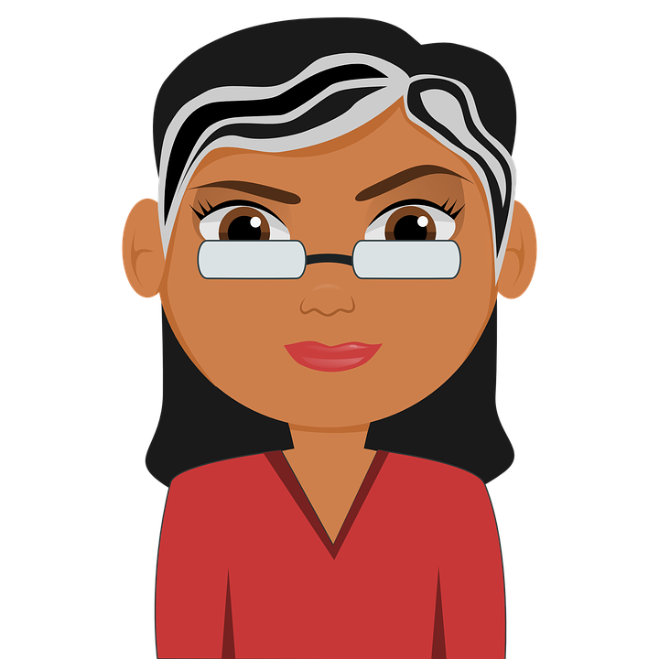
PROFESSOR PAM WROTE A THING
I’M PAM!
NAILED IT, PAM!
GRANT- FUNDED

Slide 3
PROFESSOR PAM WROTE A THING
GRANTS! GET YEH GRANTS!
NO PROBS, GRANTING AGENCY!
ARTICLES MUST BE
OPEN ACCESS,
YEH HERE?

Slide 4
PROFESSOR PAM WROTE A THING
GIVE AWAY MY COPYRIGHT AND LOSE THOUSANDS OF DOLLARS?
HMMM…VERY TEMPTING…
WHAT?!
WHO SAID THAT !?
OKEY DOKEY

Slide 5
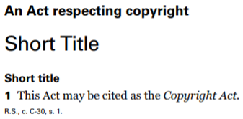
PROFESSOR PAM WROTE A THING

Slide 6
PROFESSOR PAM WROTE A THING
WHAT DOES THAT MEAN, OMNISCIENT VOICE?
PAM’S TO DO LIST:
1. RETAIN RIGHTS
TO MY WORK
2. MAKE MY WORK
OPEN ACCESS
3. LEARN ABOUT PUBLISHING AGREEMENTS

Slide 7
WHAT ARE PUBLISHING AGREEMENTS?
EXPECTATIONS
COMMITMENTS

Slide 8
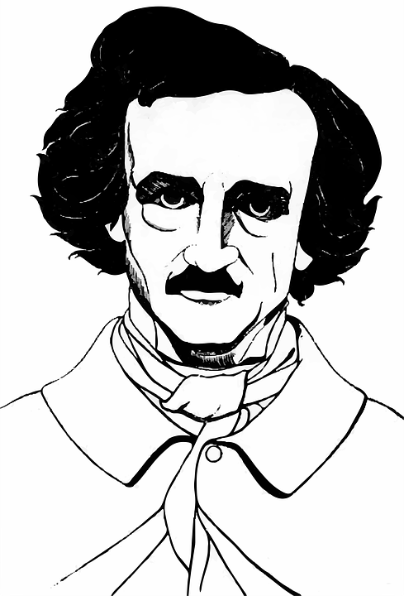
WHAT ARE PUBLISHING AGREEMENTS?
I’M SO POE!
MODEL AGREEMENT

Slide 9
WHAT ARE PUBLISHING AGREEMENTS?

Slide 10
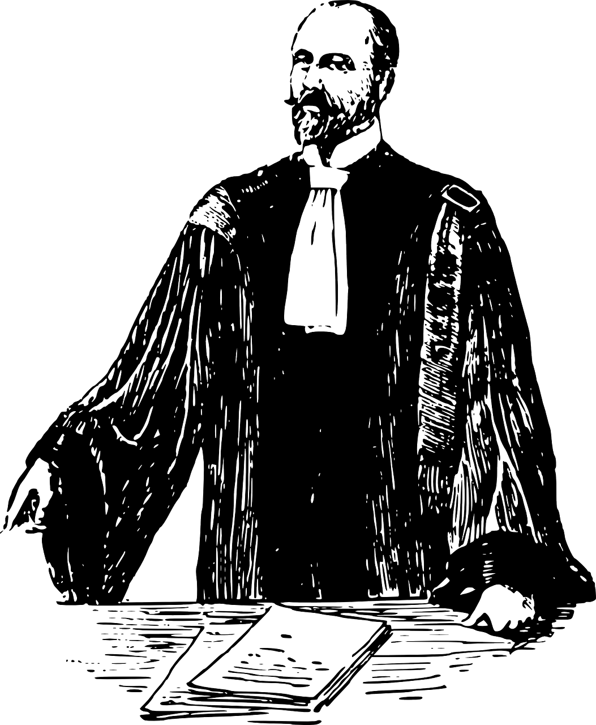
WHAT ARE PUBLISHING AGREEMENTS?

Slide 11
WHAT ARE PUBLISHING AGREEMENTS?
…RUDE.
LIAISON!!
NOOO!!!!

Slide 12
PAM’S PUBLISHING AGREEMENT
“Author’s rights…”

Slide 13
PAM’S PUBLISHING AGREEMENT
PEW
PAM MAKES HER OWN RULES!!
PEW

Slide 14
PAM’S PUBLISHING AGREEMENT
EMAIL

Slide 15
PAM’S PUBLISHING AGREEMENT
PAM’S COMMITMENTS/ NEEDS:
MAKE WORK OPENLY ACCESSIBLE (commitment to granting agency)
RETAIN A NON-EXCLUSIVE LISCENCE (commitment to employer)
DOWNSTREAM USES
(for future conferences, lectures, etc.)
4. GIVE RESEARCH PARTICIPANTS COPY
(commitment to participants)

Slide 16
PAM’S PUBLISHING AGREEMENT
PAM’S NEEDS
V.

Slide 17
PAM’S PUBLISHING AGREEMENT
THAT FULFILLS THE REQUIREMENT!
ZOINKS!
“Author Rights Retained ”
“…sharing it in an open access repository…”
“nominal author copyright”
“…licence to publish…”
“…copyright transfer.”

Slide 18
PAM’S PUBLISHING AGREEMENT
“Author Rights Retained ”
PAM’S COMMITMENTS/ NEEDS:
MAKE WORK OPENLY ACCESSIBLE (commitment to granting agency)
RETAIN A NON-EXCLUSIVE LICENCE (commitment to employer)
DOWNSTREAM USES
(for future conferences, lectures, etc.)
4. GIVE RESEARCH PARTICIPANTS COPY
(commitment to participants)
WHERE DO I SIGN?!

Slide 19
PAM’S PUBLISHING AGREEMENT
"The Publisher’s permission to reuse the Contribution pursuant to this Paragraph 20 does not affect the Contributing Author’s obligation, with respect to any such reuse, to secure permissions for the inclusion within the Contribution of third parties’ copyright-protected material.”
WHO STILL WANTS PRINT?
WHAA….?
“...print... ’’

Slide 20
PAM’S PUBLISHING AGREEMENT
HEY AMANDA! YOU GOT A MINUTE?
THANKS, AMANDA!
I GOT ‘CHU

Slide 21
PAM’S PUBLISHING AGREEMENT
SAVED!
NOT ALONE!!
CONFIRMATION
EMAIL

Slide 22
THE WORLD OF ACADEMIC PUBLISHING
…
$

Slide 23
THE WORLD OF ACADEMIC PUBLISHING
THE END.

Slide 24
LEARNING OBJECTIVES
You should now be able to:
Identify key elements of an academic publishing agreement
Locate support regarding author’s rights and publisher negotiations in a post-secondary context
Understand the evolving scholarly communication ecosystem

Slide 25
THANK YOU FOR YOUR ATTENTION
Notes:
34. This has been the University of Alberta’s Opening Up Copyright Module on SOCAN v. Bell. Thank you for your attention. [C]

Slide 26
QUESTIONS
1. The standard form publishing agreement is:
a. Negotiable, but only with an expensive, fancy lawyer
b. Written in stone
c. Based on an equal partnership between the author and the publisher
d. Negotiable and should be carefully examined
2. When analyzing an academic publishing agreement, it is important to compare your existing commitments, the granting agency requirements, and the ways in which you intend to use your work in the future against the terms of the publishing agreement. True or False?
3. Failure to comply with a granting agency’s open access policy may result in
a. A lawsuit
b. An article not being published
c. It becoming more difficult to receive funding from that agency in the future
d. Increased teaching load

Slide 27
QUESTIONS
4. When interpreting the language of an academic publishing agreement it is critical to review
a. The “Authors Rights Retained” section of the publishing agreement
b. Your employment contract
c. Every detail of the Copyright Act
5. If language in the agreement is unclear, it is a good idea to contact
a. The publisher’s liaison
b. Your institution’s copyright expert
c. Your institution’s copyright expert
d. Any or all of these

Slide 28
QUESTIONS
6. The changing world of scholarly communications is characterized by:
a. Publishers embracing open access
b. Governments no longer funding research
c. Libraries and taxpayers refusing to pay for articles
d. The evolving nature of publishing agreements
7. Granting agencies often require:
a. That articles only be made available in print
b. That authors ensure their articles are made open access
c. That Participants receive a copy of research articles
d. A promise of a first born child

Slide 29
IMAGES AND SOUND RECORDINGS
Images Credits (in order of appearance):
[Pam] https://pixabay.com/en/teacher-bookworm-glasses-professor-359311/
Szymonowicz, Daria (n.d.). Essay. The Noun Project. CC BY. https://thenounproject.com/search/?q=essay&i=1353220#
Wibowo, Setyo Ari.(n.d.). Agency. CC BY. The Noun Project. CC BY. https://thenounproject.com/search/?q=AGENCY&i=1079410
[open access logo] https://commons.wikimedia.org/wiki/File:Open_Access_logo_PLoS_white.svg
Brandify.(n.d.). Computer. CC BY. The Noun Project. https://thenounproject.com/search/?q=computer&i=2137706
Belochkin, Vladimir. (n.d.). Contract. The Noun Project. CC BY. https://thenounproject.com/icon/869929/
Wohlwend, Michael. (n.d.). Gutenberg press. The Noun Project. CC BY. https://thenounproject.com/icon/86670/
Naidenovski, Zlatko. (n.d.). Mouse. The Noun Project. https://thenounproject.com/search/?q=MOUSE&i=115241 ProSymbols. (n.d.). Copyright. The Noun Project. CC BY. https://thenounproject.com/search/?q=COPYRIGHT&i=793324
Alam, Robiul. (n.d.). Contract. The Noun Project. CC BY. https://thenounproject.com/search/?q=CONTRACT&i=1237314contract
[Poe] -https://pixabay.com/en/american-author-drawing-1296393/
Ionescu, Georgina. (n.d.). Contract [Trade Agreement]. The Noun Project. CC BY. https://thenounproject.com/search/?q=contract&i=2077576
[Lawyer} https://pixabay.com/en/lawyer-attorney-barrister-judge-28838/
Magnifying Glass By Presenttas. (n.d.). Maginifying Glass. The Noun Project. CC BY. https://thenounproject.com/search/?q=MAGNIFYING%20GLASS&i=1067096
[Amanda] . https://pixabay.com/de/illustrations/avatar-kunden-kundschaft-ikonen-2191932/
Three Six Five. (n.d.). Phone. The Noun Project. CC BY. https://thenounproject.com/search/?q=phone&i=1354627
[open access logo] https://commons.wikimedia.org/wiki/File:Open_Access_logo_PLoS_white.svg
Crosswell, Rob. (n.d.). Library. The Noun Project. CC BY. https://thenounproject.com/crosswellrob/uploads/?i=1122689
Magicon. (n.d.). Crowd. The Noun Project. CC BY. https://thenounproject.com/search/?q=crowd&i=902535
BomSymbols. (n.d.). Money. The Noun Project. CC BY. https://thenounproject.com/search/?q=MONEY&i=890872

Slide 30
LICENSING AND ATTRIBUTION
Suggested Citation:
University of Alberta. 2018. “Publishing Agreements” Opening Up Copyright Instructional Module. https://www.ualberta.ca/copyright/resources/opening-up-copyright-instructional-modules
For the project overview and complete list of modules please visit the project website at: https://www.ualberta.ca/copyright/resources/opening-up-copyright-instructional-modules
Questions, comments, and suggestions should be directed to the University of Alberta’s Copyright Office at: copyright@ualberta.ca
This module is made available and licensed under a Creative Commons Attribution 4.0 International Licence

Slide 31
CONTRIBUTORS
Copyright Office
Centre for Teaching and Learning
Technologies in Education
Adrian Sheppard
Amanda Wakaruk
Cosette Lemelin
Graeme Pate
Krysta McNutt
Anwen Burk
University of Alberta Libraries
School of Library and Information Studies
Michelle Brailey
Toby Grant
Julia Guy
Kris Joseph
Michael B. McNally

Slide 32
ACKNOWLEDGEMENT
Opening Up Copyright modules were initially funded through the University of Alberta, Centre for Teaching and Learning’s Teaching and Learning Enhancement Fund (TLEF) with in kind contributions from the Copyright Office and the School of Library and Information Studies.

