Slide 1
Publishing Agreements
*April 2019
Notes:
*Updated: June 2024
Welcome to the University of Alberta’s Opening Up Copyright instructional module on publishing agreements.

Slide 2
PROFESSOR PAM WROTE A THING
I’M PAM!
NAILED IT, PAM!
GRANT-FUNDED
Notes:
Professor Pam Peterson has written an article that summarizes the results of a grant-funded research project.

Slide 3
PROFESSOR PAM WROTE A THING
GRANTS! GET YEH GRANTS!
NO PROBS, GRANTING AGENCY!
ARTICLES MUST BE
OPEN ACCESS,
YEH HERE?
Notes:
The granting agency requires that the article be made available in an open access environment within one year of publication.

Slide 4
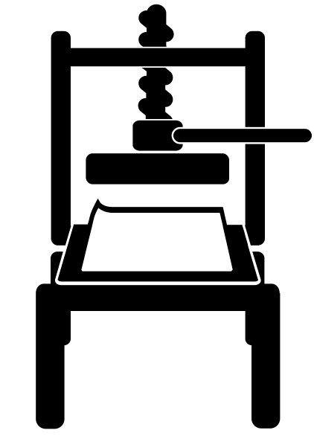
PROFESSOR PAM WROTE A THING
GIVE AWAY MY COPYRIGHT AND LOSE THOUSANDS OF DOLLARS?
HMMM…VERY TEMPTING…
WHAT?!
WHO SAID THAT !?
OKEY DOKEY
Notes:
However, when Pam attempts to upload and submit her article on the publisher’s website, she is directed to an automated process in which she is prompted to click through to accept the terms of a publishing agreement. If the paper is accepted for publication, this agreement will require her to transfer her rights in the work to the publisher. The automated form also suggests that publishing open access will cost her $3000. Pam doesn’t have $3000 to spend on sharing her article and isn’t sure how to interpret the language in the publishing agreement.
STOP, PAM! DON’T CLICK!

Slide 5
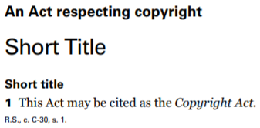
PROFESSOR PAM WROTE A THING
Notes:
As the author of the work, and under the terms of her employment contract with her university, Pam holds copyright in the article she wrote. The Copyright Act gives her the sole right to publish her work, when and how she chooses…. unless and until she transfers this right. If Pam transfers her copyright to the publisher without retaining any rights for herself then she will be left with the same limited rights provided to any other user of a copyright-protected work.

Slide 6
PROFESSOR PAM WROTE A THING
WHAT DOES THAT MEAN, OMNISCIENT VOICE?
PAM’S TO DO LIST:
1. RETAIN RIGHTS
TO MY WORK
2. MAKE MY WORK
OPEN ACCESS
3. LEARN ABOUT PUBLISHING AGREEMENTS
Notes:
That is, she will have to rely on Copyright Act exceptions in order to use her own work without infringing copyright! And she won’t be able to comply with the funding agency requirement to make the work open access, which might make it difficult to receive future funding from that funding agency.

Slide 7
WHAT ARE PUBLISHING AGREEMENTS?
EXPECTATIONS
COMMITMENTS
Notes:
Publishing agreements are contracts that set out the legal relationship between the author and the publisher of a work. These agreements vary by sector, publisher, and type of work, but they should all include information detailing the specific commitments and expectations of both the author and the publisher, as they pertain to that work.

Slide 8
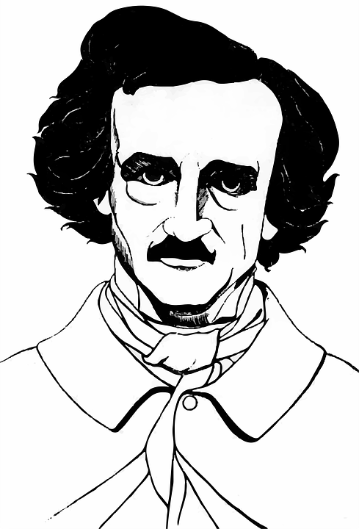
WHAT ARE PUBLISHING AGREEMENTS?
I’M SO POE!
MODEL AGREEMENT
Notes:
Authors who expect to make money from their writing would normally hire a literary agent to help negotiate the terms of a publishing agreement, including advances and royalty payments. They might also use model agreements provided by trade associations to help establish reasonable terms for such a publishing agreement.

Slide 9
WHAT ARE PUBLISHING AGREEMENTS?
Notes:
But this module focuses on publishing agreements that are associated with academic journals to cover the publication of articles written for the purpose of scholarly communication.

Slide 10
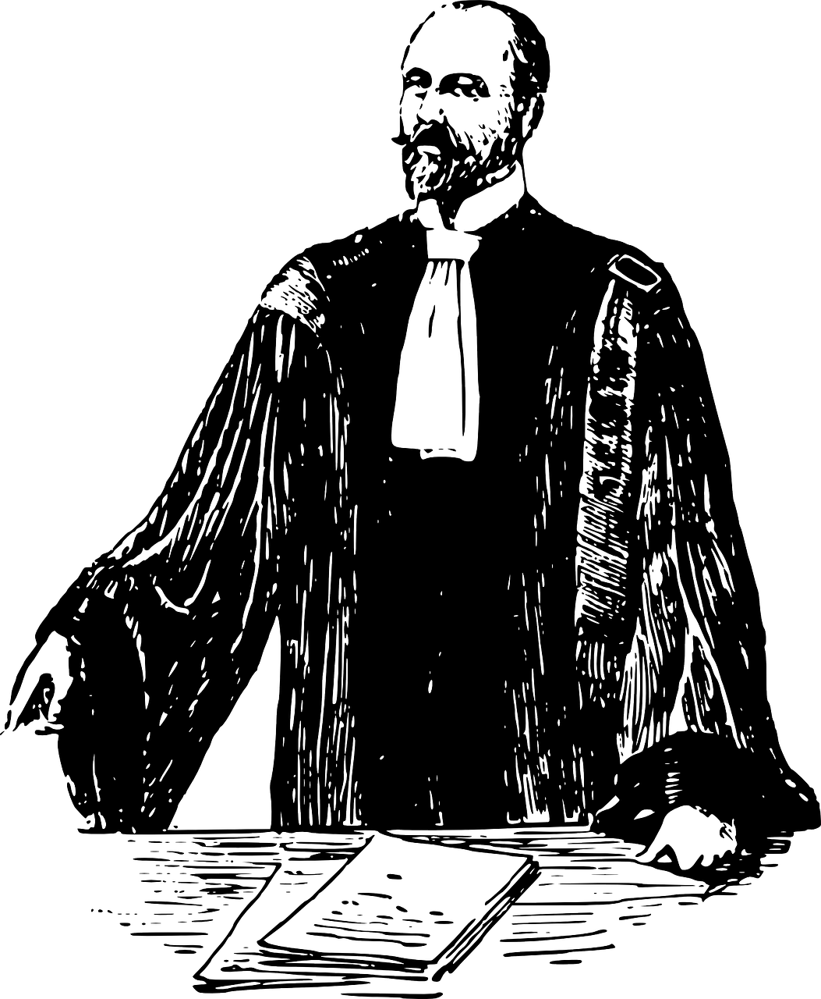
WHAT ARE PUBLISHING AGREEMENTS?
Notes:
Large academic journal publishers have their corporation’s legal team to prepare publishing agreements. These contracts tend to be drafted to maximize the interests of the publisher, and may have little regard for the interests of the author. They usually include statements that both encourage a prompt turnaround time from the author and suggest that the author contacts a lawyer for advice before signing.

Slide 11
WHAT ARE PUBLISHING AGREEMENTS?
…RUDE.
LIAISON!!
NOOO!!!!
Notes:
In most cases, if the author has questions about the contract, including any necessary changes, these can usually be handled by the editor or publisher liaison. If needed, authors can contact their institutional copyright expert for more information about, or a referral to, legal services that might be available.

Slide 12
PAM’S PUBLISHING AGREEMENT
“Authors’ rights…”
Notes:
Pam remembers a conversation she had with her university’s copyright librarian about author rights,

Slide 13
PAM’S PUBLISHING AGREEMENT
PEW
PAM MAKES HER OWN RULES!!
PEW
Notes:
and she chooses not to accept the $3000 open access option or the terms of the online publishing agreement within the automated process.

Slide 14
PAM’S PUBLISHING AGREEMENT
EMAIL
Notes:
Instead, she sends an email to the publisher and is almost immediately provided with a PDF version of the agreement.

Slide 15
PAM’S PUBLISHING AGREEMENT
PAM’S COMMITMENTS /NEEDS:
1. MAKE WORK OPENLY ACCESSIBLE (commitment to granting agency)
2. RETAIN A NON-EXCLUSIVE LICENCE (commitment to employer)
3. DOWNSTREAM USES
(for future conferences, lectures, etc.)
4. GIVE RESEARCH PARTICIPANTS COPY (commitment to participants)
Notes:
Before reviewing the agreement, Pam considers the commitments she knows about and the potential downstream uses for the article she anticipates. She knows that these can change over time, so she creates a list that’s as broad as possible. Her commitments include the funding agency’s open access policy, providing research participants with a copy of the final article, and retaining a non-exclusive licence for her employer to use the work internally. Potential downstream uses include sharing the article with her future students in a classroom setting, with colleagues at professional conferences, and rewriting the article for publication as a book chapter.

Slide 16
PAM’S PUBLISHING AGREEMENT
PAM’S NEEDS
V.
Notes:
Pam is now ready to compare her professional needs for reusing the article against the terms of the publishing agreement. Does the standard agreement allow her to retain the rights she needs to meet her professional commitments?

Slide 17
PAM’S PUBLISHING AGREEMENT
THAT FULFILLS THE REQUIREMENT!
ZOINKS!
“Author Rights Retained ”
“exclusive licence”
“…sharing it in an open access repository…”
“nominal author copyright”
“…licence to publish…”
“…copyright transfer.”
Notes:
Pam does not see the phrase “copyright transfer” anywhere in the agreement but does notice that the publisher requires an exclusive licence to do all the things that the Copyright Act gives her a right to do. Even though the contract is structured as a licence to publish, it is essentially a transfer of all the rights associated with copyright, and it creates something called a “nominal author copyright” situation.
This worries Pam – and it should – until she carefully reads the section of the agreement entitled, Author Rights Retained. This section makes it clear that she will retain the right to use the post-print version of the article in a number of different ways, including sharing it with a Creative Commons licence in an open access repository six months after the final version of the article has been published. This will satisfy her funding agency’s open access requirement without Pam’s having to pay the $3000 fee for immediate open access via the publisher’s website.

Slide 18
PAM’S PUBLISHING AGREEMENT
“Author Rights Retained ”
PAM’S COMMITMENTS /NEEDS:
1. MAKE WORK OPENLY ACCESSIBLE (commitment to granting agency)
2. RETAIN A NON-EXCLUSIVE LICENCE (commitment to employer)
3. DOWNSTREAM USES
(for future conferences, lectures, etc.)
4. GIVE RESEARCH PARTICIPANTS COPY
(commitment to participants)
WHERE DO I SIGN?!
Notes:
The Author Rights Retained section also makes it clear that the final published version of the article can be used internally by her employer, shared with her students in a classroom environment, and emailed to a limited number of research collaborators for personal use. After a bit of digging on the publisher’s website, Pam learns that “research collaborators” includes research participants. There’s even a clause about authors being able to include the article in a non-commercial thesis. This reminds Pam of another article she is writing with a graduate student and she makes a mental note to check the agreement for that publisher for similar language. Pam is feeling a lot better about the possibility of signing this contract.

Slide 19
PAM’S PUBLISHING AGREEMENT
"The Publisher’s permission to reuse the Contribution pursuant to this Paragraph 20 does not affect the Contributing Author’s obligation, with respect to any such reuse, to secure permissions for the inclusion within the Contribution of third parties’ copyright-protected material.”
WHO STILL WANTS PRINT?
WHAA….?
“...print... ’’
Notes:
However, while there is language in the agreement about adapting the article for future publication as a book chapter, the wording is confusing. In addition, the clause that mentions professional conferences seems only to allow for the distribution of print versions of the article. Who still wants print?

Slide 20
PAM’S PUBLISHING AGREEMENT
HEY AMANDA! YOU GOT A MINUTE?
THANKS, AMANDA!
I GOT ‘CHU
Notes:
Pam decides to contact her copyright librarian for advice before emailing the publisher or her journal editor. The copyright librarian suggests that Pam draft an email to the journal editor, asking for the required clarification and changes. The librarian offers to review Pam’s draft email and, if needed, to consult with her colleagues in the Scholarly Communications Office before Pam sends the email response to her journal editor. Pam is grateful that others on campus care about her work – and her need to protect her rights in that work!

Slide 21
PAM’S PUBLISHING AGREEMENT
SAVED!
NOT ALONE!!
CONFIRMATION
EMAIL
Notes:
Within a few days, Pam emails her editor and they confirm that the changes to the agreement are acceptable. Pam receives a new publishing agreement with the modified language and saves a copy to her permanent files. It turns out that Pam’s requests were not only reasonable, they were also frequently asked by other authors. As a result, language allowing for these types of uses could very well be added to future publishing agreement templates.

Slide 22
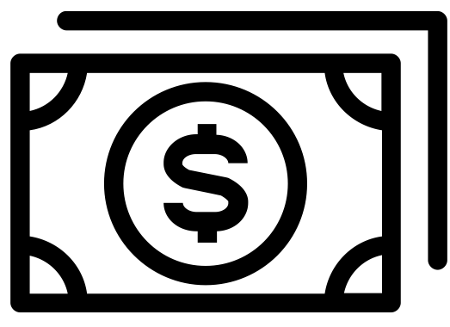
THE WORLD OF ACADEMIC PUBLISHING
…
$
Notes:
The world of scholarly communications and academic publishing is changing quickly. The open access movement, including funding agency requirements, has been motivated by the commercialization and concentration of the academic publishing industry since the 1980s, which have resulted in high profit margins for corporations as changes in technology made production and distribution easier and cheaper. However, academic authors, editors, and peer-reviewers continue, essentially, to donate their intellectual property and volunteer their time and effort as part of this publishing process. Why should Pam, who has been funded by the government to conduct her research, have to pay a private corporation to be able to share the results of her research? Why should her university library, which is also government funded, have to pay to obtain access to Pam’s research articles? Why should the taxpayers who paid for Pam’s research in the first place have to pay to obtain access to Pam’s article? The publishing world’s response to these questions continues to develop…

Slide 23
THE WORLD OF ACADEMIC PUBLISHING
THE END.
Notes:
…and policy changes are often expressed through the evolving terms of their publishing agreements.

Slide 24
LEARNING OBJECTIVES
You should now be able to:
Identify key elements of an academic publishing agreement
Locate support regarding authors’ rights and publisher negotiations in a post-secondary context
Understand the evolving scholarly communication ecosystem
Notes:
You should now be able to:
Identify key elements of an academic publishing agreement
Locate support regarding authors’ rights and publisher negotiations in a post-secondary context
Understand the evolving scholarly communication ecosystem

Slide 25
Notes:
This has been the University of Alberta’s Opening Up Copyright instructional module on publishing agreements. Thank you for your attention.

Slide 26
The standard form publishing agreement is:
Negotiable, but only with an expensive, fancy lawyer
Written in stone
Based on an equal partnership between the author and the publisher
Negotiable and should be carefully examined
When analyzing an academic publishing agreement, it is important to compare your existing commitments, the granting agency requirements, and the ways in which you intend to use your work in the future against the terms of the publishing agreement.
True
False

Slide 27
Failure to comply with a granting agency’s open access policy may result in:
A lawsuit
An article not being published
It becoming more difficult to receive funding from that agency in the future
Increased teaching load
When interpreting the language of an academic publishing agreement it is critical to review:
The “Author Rights Retained” section of the publishing agreement
Your employment contract
Every detail of the Copyright Act
If language in the agreement is unclear, it is a good idea to contact:
The publisher’s liaison
Your institution’s copyright expert
A lawyer
Any or all of these

Slide 28
The changing world of scholarly communications is characterized by:
Publishers embracing open access
Governments no longer funding research
Libraries and taxpayers refusing to pay for articles
The evolving nature of publishing agreements
Granting agencies often require:
That articles only be made available in print
That authors ensure their articles are made open access
That participants receive a copy of research articles
A promise of a first born child

Slide 29
Images Credits (in order of appearance):
chrystalizabeth. (n.d.). [Pam]. Pixabay. https://pixabay.com/en/teacher-bookworm-glasses-professor-359311/
Daria Szymonowicz. (2017). Documents. The Noun Project. CC BY. https://thenounproject.com/icon/documents-1353220/
Setyo Ari Wibowo. (2017). Agency. The Noun Project. CC BY. https://thenounproject.com/icon/agency-1079410/
[open access logo]. (2018). Wikimedia. CC0. https://commons.wikimedia.org/wiki/File:Open_Access_logo_PLoS_white.svg
ibrandify. (2018). Computer. The Noun Project. CC BY. https://thenounproject.com/icon/computer-2137706/
James Smith. (2017). Contract. The Noun Project. CC BY. https://thenounproject.com/icon/contract-869929/

Slide 30
Michael Wohlwend. (2014). Gutenberg press. The Noun Project. CC BY. https://thenounproject.com/icon/gutenberg-press-86670/
Pixel Bazaar. (2015). Mouse. The Noun Project. CC BY. https://thenounproject.com/icon/mouse-115241/
ProSymbols. (2017). Copyright. The Noun Project. CC BY. https://thenounproject.com/icon/copyright-793324/
Mohammed Rabiul Alam. (2017). Contract. The Noun Project. CC BY. https://thenounproject.com/icon/contract-1237314/
[Poe]. (n.d.). Pixabay. https://pixabay.com/en/american-author-drawing-1296393/
Georgina Ionescu. (2018). Contract. The Noun Project. CC BY. https://thenounproject.com/icon/contract-2077576/
[Lawyer]. (n.d.). Pixabay. https://pixabay.com/en/lawyer-attorney-barrister-judge-28838/
[Amanda]. (n.d.). Pixabay. https://pixabay.com/de/illustrations/avatar-kunden-kundschaft-ikonen-2191932/

Slide 31
Presenttas. (n.d.). Magnifying glass. The Noun Project. CC BY. https://thenounproject.com/icon/magnifying-glass-1067096
AceOfSpadesProduc100. (2016). 8-bit few "pew" effects. Freesound. CC BY. https://freesound.org/people/AceOfSpadesProduc100/sounds/333784/
Three Six Five. (2017). Phone. The Noun Project. CC BY. https://thenounproject.com/icon/phone-1354627/
Rob Crosswell. (2017). Library. The Noun Project. CC BY. https://thenounproject.com/icon/library-1122689/
Magicon. (2017). Crowd. The Noun Project. CC BY. https://thenounproject.com/icon/crowd-902535/
BomSymbols. (2017). Money. The Noun Project. CC BY. https://thenounproject.com/icon/money-890872/
Closing Slides Music: Rybak, Nazar. (n.d.). Corporate Inspired. HookSounds. CC BY. http://www.hooksounds.com/
Unattributed materials are contributions from the Opening Up Copyright Project Team and placed in the Public Domain.

Slide 32
University of Alberta. (2019). Publishing Agreements. Opening Up Copyright Instructional Module. https://sites.library.ualberta.ca/copyright/

