Slide 1
Creating and Sharing Copyright-Protected Materials in the K-12 Context
May 2021
Notes:
Hello, and welcome to the University of Alberta’s Opening Up Copyright instructional module on Creating and Sharing Copyright Protected Materials in the K-12 context.

Slide 2

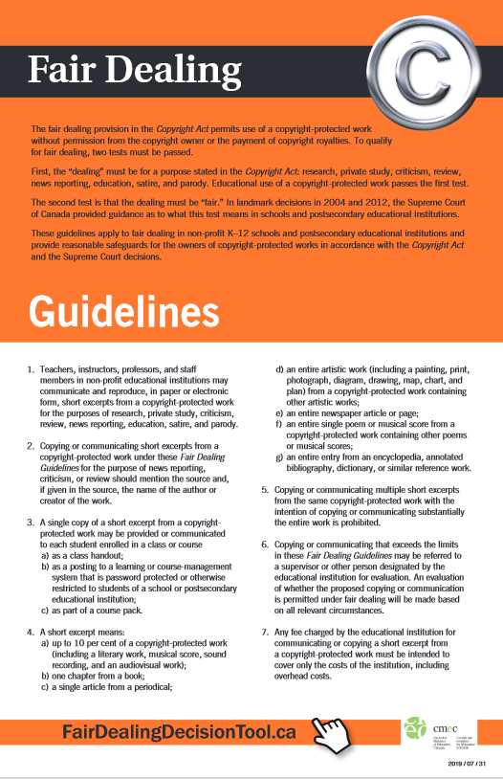





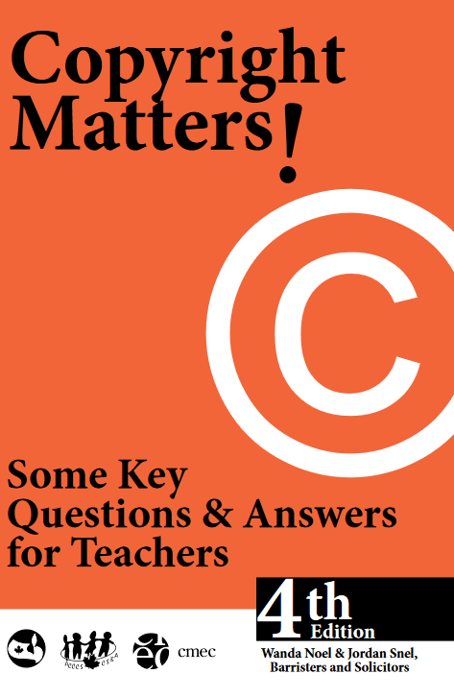

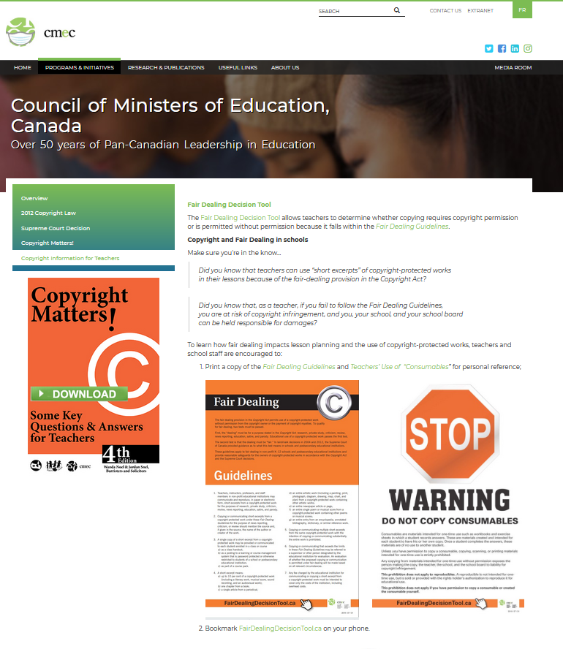


PLAY TIME
©???
It’s even better than Cats!
Woo hoo!
Notes:
Today is a big day for Taylor. As a new drama teacher, they’re excited for the beginning of the school play season. Taylor will be working with some of the other teachers at the school to make the students’ production of the musical, The Music Man, the best it can be. But Taylor is also a bit apprehensive. They have been reviewing the copyright resources that the Copyright Consortium of CMEC, the Council of Ministers of Education Canada, provides for K-12 educators. What copyright rules might apply to the students’ theatrical production, they wonder? And how does copyright apply to students’ creative works more generally?

Slide 3

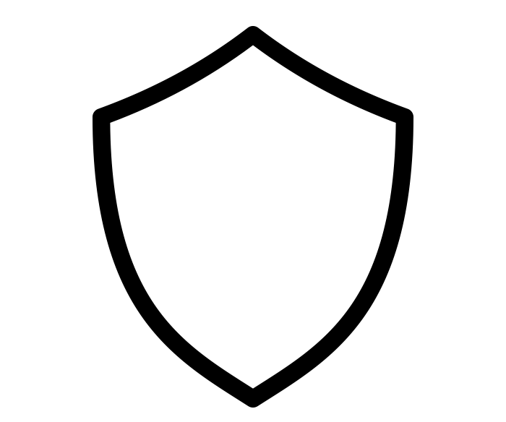





COPYRIGHT CONSIDERATIONS
That guy from 3 doors down
Please, may we…
Mom
© ???
Fair Dealing
Guidelines
……………
……………
$$
My BFF
$$
$$
$$
Notes:
After consulting CMEC’s Copyright Matters, and speaking with the school principal, Taylor discovers that the student production of The Music Man falls outside fair dealing guidelines and the users’ rights defined in the Copyright Act for copying and performing a copyright-protected script, even though the purpose of the production is educational and does not involve a “motive of gain.”
Because the audience will include the students’ families, friends, and other members of the community, in addition to the school’s students and staff, and because a small admission will be charged to cover production expenses, the school needs to obtain permission from the holder of the play’s production rights.
Taylor will also need to make sure that they and their students respect the playwrights’ “moral rights,” deal with the integrity of the work and right of the creator to be associated with it.

Slide 4





MUSIC COPYRIGHTS
Fantastic!!
SOCAN
Re:Sound
Notes:
While the school’s principal works with the school division to obtain the production rights for The Music Man, Taylor goes ahead with planning the production. Jesse, the music teacher, suggests that the school band could provide live music for the production. They need to keep in mind that licences may be needed for performance of live music or playing recorded music from collective licensing agencies such as SOCAN and Re Sound.

Slide 5

DOES FAIR DEALING APPLY?
… nope!
… Fair dealing???
This copyright stuff is trickier than learning how to play the oboe!
Notes:
Jesse informs Taylor that determining when permission or a licence is needed for music is tricky and dependent on several contextual factors.
Jesse reminds Taylor, they will need to make sure they get enough copies of the play’s musical score for the full school band.

Slide 6




SHORT EXCERPT
=
Notes:
Although fair dealing guidelines allow teachers to provide a single copy of a short excerpt from a copyright-protected work to each student enrolled in a class or course - or participating in a school production - a “short excerpt” includes only up to 10 percent of a copyright-protected work and certainly not an entire script! And the same applies to musical scores.

Slide 7

LOOT, PILLAGE AND PLUNDER?
Wait!... Can we?
Pirate’s Cove Music
Notes:
Before Taylor figures out how to get these materials for the school, Jesse shows them a full digital copy of The Music Man’s script and musical score that they found online. Since it’s so easily available, why don’t they just make physical copies of these for the students, Taylor thinks they should first ask Kyle, the school library employee responsible for ordering new school resources, if there is any problem with this plan.

Slide 8
ILLEGITIMATE COPIES = ILLEGITIMATE COPYING
Pirate’s Cove Music
I’m too legit to quit… finding you legitimate copies
Notes:
Unfortunately, both Taylor and Jesse are disappointed when Kyle tells them that this would be an infringement of copyright, since the digital versions Jesse found online are unauthorized copies. Even though some resources, including texts, scores, sound and video recordings, may be freely available online, that doesn’t mean they can be copied or printed. However, Kyle is happy to help Taylor find the right editions of the play’s script and musical score, and to submit the purchase order to the principal.

Slide 9
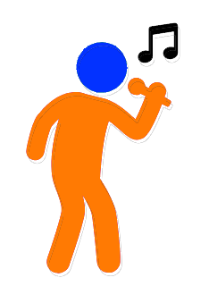


COPYING STUDENT ASSIGNMENTS?
What about ©
It’s fine…fair dealing or non-commercial user-generated content
Notes:
Taylor is also working with Carmen, the head of the English Language Arts department, to design lesson plans and a project during which the students will learn about the play and ultimately create posters and a website based on their interpretations, which will be used to promote the production. Carmen reassures Taylor that these projects, as new works that the students will create on the basis of the copyright-protected work, The Music Man, fall within the Copyright Act’s users’ right.
Students' fair dealing rights and the provision for “non-commercial user-generated content”, while not without limitations, will likely allow for the uses Carmen has in mind for her students.

Slide 10
STUDENTS’ COPYRIGHT
©
©
©
+ original =
✓
???
Notes:
Taylor wonders, though: they’ve been focusing so much on whether the school production of The Music Man meets copyright guidelines, what about the student-created works, like the posters and website being created by Carmen’s students? Are they protected by copyright? Taylor doesn’t wonder for long, however, because Carmen knows that any original work created by a student, whatever the media or form, is protected. They just need to make sure that the students - or more accurately, their parents or legal guardians, since the students are minors - authorize the further use of their works beyond the class assignment.

Slide 11

RECORDING THE PERFORMANCE
Tok-Tik
✓
©???
Don’t tape over Cats!!!
Notes:
But what about the performance itself? Some of the students’ parents have asked if they can record the play on video for their family viewing, and students have expressed the desire to post videos of their performance online. Taylor isn’t sure and checks with the principal to see if this is covered in the performance rights agreement. The principal notes that an extra fee was paid for parents to record the performance for family viewing, but not for distribution online. The principal reminds Taylor that she always checks in detail what rights are and are not included in various agreements.

Slide 12
SHOWTIME
©
They should have done Cats!!!
Notes:
Taylor’s teaching colleagues and their students are all looking forward to taking part in the big school production. And Taylor is even more excited than this morning, now that they are certain that, along with the students’ talents, copyright will take centre stage.

Slide 13
LEARNING OBJECTIVES
You should now be able to:
Identify what copyright protections apply to student works created in the K-12 educational context
Recognize that various licences, royalties, and creator permissions, in addition to Canadian copyright rules, may impact student theatrical and musical performances
Understand how students can create new works from copyright-protected works
Notes:
You should now be able to:
Identify what copyright protections apply to student works created in the K-12 educational context
Recognize that various licences, royalties, and creator permissions, in addition to Canadian copyright rules, may impact student theatrical and musical performances, and
Understand how students can create new works from copyright-protected works

Slide 14
Notes:
This has been the University of Alberta’s Opening Up Copyright Instructional Module on Creating and Sharing Copyright Protected Materials in the K-12 Context. Thank you for your attention

Slide 15
QUESTIONS
Any original work created by a student enjoys copyright protection.
True or False
A student can integrate a copy-protected work into their own creation, but only if the school has obtained explicit permission from the owner to use the work for this purpose.
True or False
A teacher can use a digital copy of a play that they have found online if they obtain permission from their principal.
True or False
Alex, a drama teacher, arranges with the video arts teacher to record the school’s one-act play festival. In subsequent years, the drama teacher may show excerpts of the recording in their classes.
True or False

Slide 16
QUESTIONS
There are various licences and royalty payments from collective licensing agencies, in addition to Canadian copyright rules, that may impact student theatrical and musical performances. Which of the following is a Canadian collective licensing agency?
  CMEC
  NOCanDO
  SOCAN
  None of options are a collective licensing agency
If a theatrical play is performed during school hours before an audience of other students and teachers, the drama teacher would NOT need to seek permission to make copies of a copyright-protected script.
True or False
If a theatrical play is to be performed during school hours before an audience of other students and teachers, the drama teacher would NOT need to seek permission to allow her students to perform a copyright-protected script.
True or False

Slide 17
Council of Ministers of Education Canada. (September, 2016). Copyright, fair dealing, and the
classroom: What teachers can and cannot do. Retrieved from
https://cmec.ca/docs/copyright/CopyrightFairDealingClassroom_EN.pdf
Havill, E.N.G. and Chan, K. (2002). Play copyright: Just whose play is it anyway? Theatre
Ontario. Retrieved from
https://www.theatreontario.org/resources/copyright/play-copyright.aspx
Noel, W. and Snel, J. (2016). Copyright matters! Some key questions and answers for teachers,
4th Ed. Council of Ministers of Education Canada. Retrieved from:
http://cmec.ca/Publications/Lists/Publications/Attachments/291/Copyright_Matters.pdf
Theatre Alberta. (n.d.). The ins and outs of rights and royalties. Theatre Alberta. Retrieved from
https://www.theatrealberta.com/library/the-ins-and-outs-of-rights-and-royalties-2/
Willson, M. and Lacey, F. (1957). The music man.

Slide 18
Coffeebeanworks. (n.d.). [Taylor]. Pixabay. Pixabay Licence. https://pixabay.com/illustrations/avatar-women-girls-faces-portraits-2191931/
Blair Adams. (n.d.) Drama. The Noun Project. CC BY. https://thenounproject.com/term/drama/953398
Bieu Tuong (n.d.). School. The Noun Project. CC BY. Retrieved from: https://thenounproject.com/term/school/1983588/
Made x Made Icons. (n.d.). Theatre. The Noun Project. CC BY. https://thenounproject.com/term/theatre/2909164/
Pro Symbols. (n.d.). Audience. The Noun Project. CC BY. https://thenounproject.com/term/audience/2379643/
Adrien Coquet. (n.d.). Singer. The Noun Project. CC BY. https://thenounproject.com/term/singer/1311428/
Coffeebeanworks. (n.d.). [Carmen]. Pixabay. Pixabay Licence. https://pixabay.com/illustrations/avatar-women-girls-faces-portraits-2191931/
Coffeebeanworks. (n.d.). [Jesse]. Pixabay. Pixabay Licence. https://pixabay.com/illustrations/avatar-clients-customers-icons-2191932/
Coffeebeanworks. (n.d.). [Kyle]. Pixabay. Pixabay Licence. https://pixabay.com/illustrations/avatar-clients-customers-icons-2191932/
Coffeebeanworks. (n.d.). [Principal]. Pixabay. Pixabay Licence. https://pixabay.com/illustrations/avatar-clients-customers-icons-2155431/
Guilherme Fertado (n.d.). Sign. The Noun Project. CC BY. Retrieved from: https://thenounproject.com/term/sign/1859815/
Adrien Coquet. (n.d.). Singer [with audience]. The Noun Project. CC BY. https://thenounproject.com/term/singer/1748413/
Gregor Cresnar. (n.d.). Education. The Noun Project. CC BY. https://thenounproject.com/term/education/182251/
Kimmi Studio. (n.d.). Shield. The Noun Project. CC BY. https://thenounproject.com/term/shield/874630/
Eucalyp (n.d.). Moral. The Noun Project. CC BY. https://thenounproject.com/term/moral/901639

Slide 19
Jesus Puertas. (n.d.). Meeting. The Noun Project. CC BY. https://thenounproject.com/term/meeting/198536/
Bernd Lakenbrink. (n.d.). Music. The Noun Project. CC BY. https://thenounproject.com/term/music/3583421/
Suib Icon. (n.d.). Marching Band. The Noun Project. CC BY. https://thenounproject.com/term/marching-band/1483071/
Edwin PM (n.d.) Agreement. The Noun Project. CC BY. https://thenounproject.com/term/agreements/3373812/
Star and Anchor Designs (n.d.). Building. The Noun Project. Retrieved from: https://thenounproject.com/term/building/164596/
IconMark. (n.d.). Score. The Noun Project. CC BY. https://thenounproject.com/term/score/3515647/
Saishraddha Malage. (n.d.). Highlight. The Noun Project. CC BY. https://thenounproject.com/term/highlight/241534/
Marie Van den Broeck. (n.d.). Kids. The Noun Project. CC BY. Retrieved from: https://thenounproject.com/search/?q=kids&i=235684
Ralf Schmitzer. (n.d.). Script. The Noun Project. CC BY. https://thenounproject.com/term/script/576383/
Crosswell, Rob. (n.d.). Library. The Noun Project. CC BY. https://thenounproject.com/term/library/1122689/
Caesar Rizky Kurniawan. (n.d.). Presentation Slide. The Noun Project. CC BY. https://thenounproject.com/term/presentation-slide/2710348/
Agung Cahyo. (n.d.). Video Record. The Noun Project. CC BY. https://thenounproject.com/term/video-record/3076668/
Closing Slides Music: Rybak, Nazar. “Corporate Inspired.” HookSounds. N.d. http://www.hooksounds.com (used under a CC-BY 4.0 Licence)
Unattributed materials are contributions from the Opening Up Copyright Project Team and placed in the Public Domain

Slide 20
University of Alberta. 2021. “Creating and Sharing Copyright-Protected Materials in the K-12 Context.” Opening Up Copyright Instructional Module. https://sites.library.ualberta.ca/copyright/

