Slide 1

Creating a blended outreach service model for a province-wide health care information service
Yongtao Lin, MLIS
Jeanette Blanchard, MI
Jorden Habib, MLIS
krs@albertahealthservices.ca
https://krs.ahs.ca
May 2017

Slide 2
Outline of the presentation
Background
Library outreach and KRS Outreach Work Group
Our project questions
Literature review and internal audit (an online focus group)
Results
Learnings

Slide 3
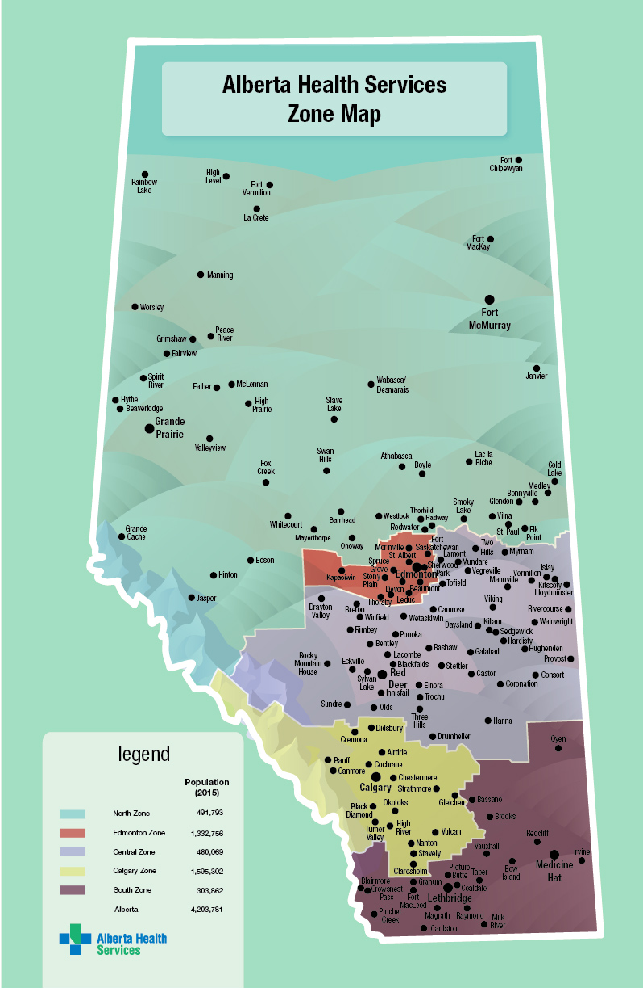

      Alberta Health Services (AHS)
      Knowledge Resource Service (KRS)
      Sites

Slide 4



Who is KRS?

Slide 5

KRS Strategic Directions
Enable easy discovery and access
Enhance evidence informed decision making
Create just in time learning environments
Build centers of excellence to enrich learning and collaboration
Incorporate a customer focus

Slide 6
KRS Transformation Phases
- One core collection
- Launch of KRS Website
- In house management and operation of all library spaces
- Online learning programs
- KRS Strategic Service directions
- Review of KRS sites and services

Slide 7
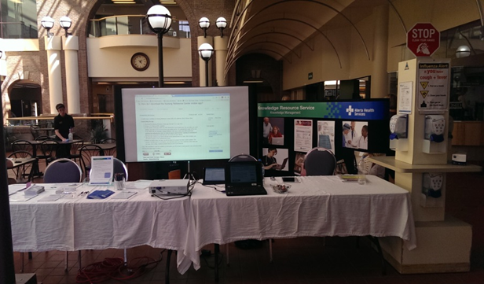
      Library Outreach
      Promote and raise awareness of services and resources
      Potential to reach out to users and non-users
      Engage users in their spaces
      May occur both in-person and online

Slide 8
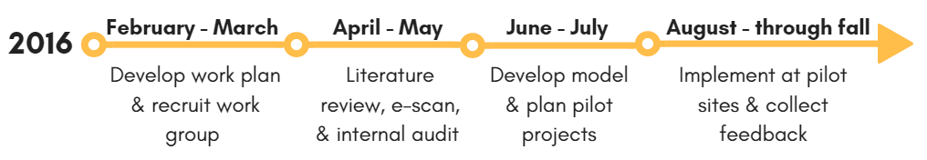
KRS Outreach Work Group

Slide 9
How is outreach defined?
What are the benefits of outreach programs to libraries and organizations?
What are the barriers encountered while conducting outreach programs?
What factors may contribute to the success of outreach programs?
Questions to Answer

Slide 10
Literature Review
A subgroup of five librarians and MLTs
Databases: PubMed, LISA, LISS, ERIC, World of Science Core Collection, Google Scholar, NEOS
Compare models of outreach
Internal Audit
A subgroup of one librarian, one MLT and a coordinator
Poll, white boards and online discussions
Summary of common themes

Slide 11
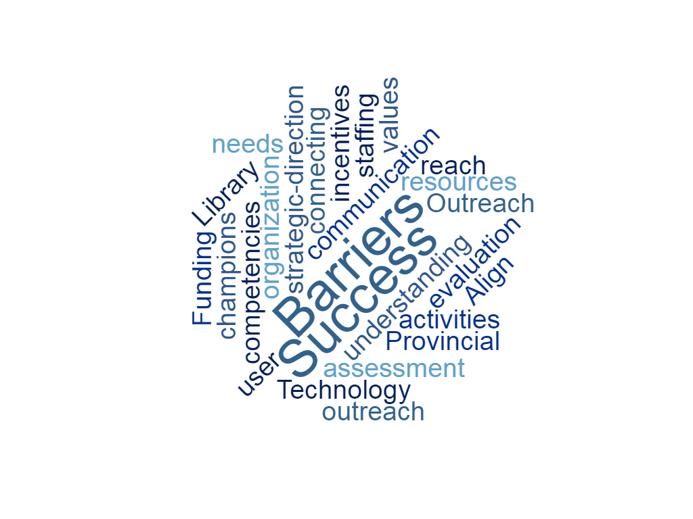
Notes:
Defining outreach
Lit review: Varies according to the institution
Provide services outside of physical site to extend the reach of the services
Education, training, presentations, evidence literacy development
Increase usability and accessibility of library resources
Internal audit:
Reach new users
Connect and understand user needs and communities
Promote and market KRS services (emails and newsletters; meetings and presentations; displays or booths; project work; conferences; 1:1 interactions)
Benefits
Lit review:
Meet users at the point of need
Awareness and visibility of the library
Internal Audit:
Help us better understand users
Awareness

Slide 12
Our 3 Primary Situations
Sites that have recently closed or are closing
Sites with a KRS physical presence
Sites without a physical KRS presence

Slide 13
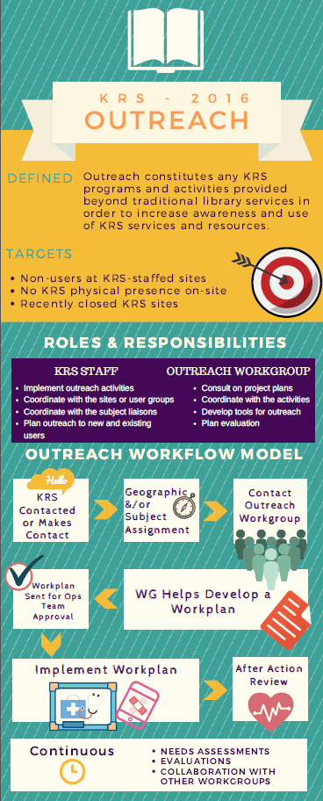
KRS Outreach Model
Embedded
Liaison
Technology enhanced

Slide 14
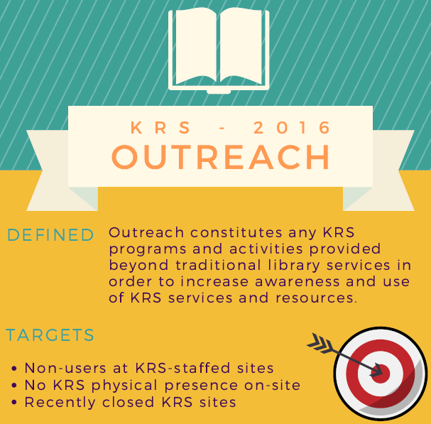

Slide 15
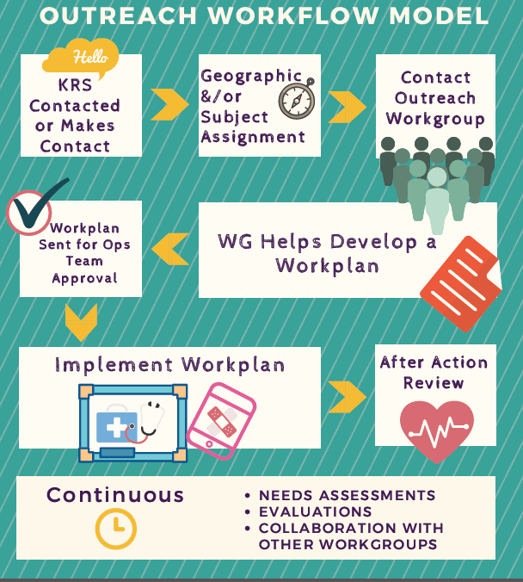

Slide 16
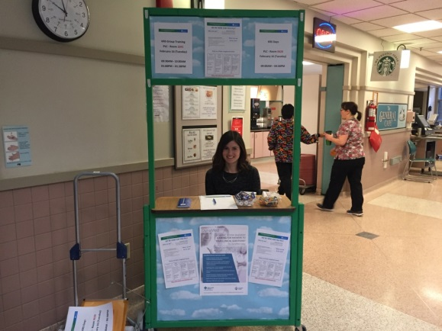
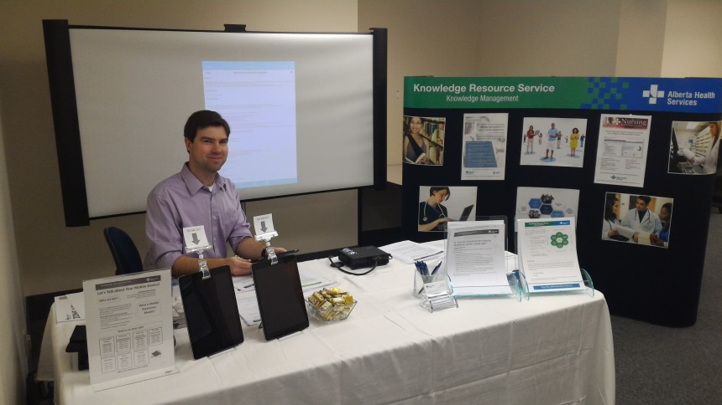
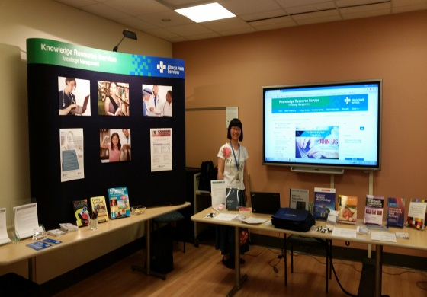
Peter Lougheed Centre
Outreach Program
Mobile Awareness Project
National Nursing Week

Slide 17
“Great to know that we can still access the library services.”
“Didn’t know that we can access so many journals from our own computers.”
“We (nurses) are very busy every day… wonderful to know what are available to us… Love Nursing Reference Centre, so easy to use.”
“Promoting point-of-care apps is a great way to connect us (physician)…”
What did users say?

Slide 18

Communicate, communicate and communicate
Learn about the organization and our users
Develop a means of collecting feedback
Train library staff and provide them with tools
Use technology
“In person” focus for a virtual
success
What are we learning?

