Slide 1

Open Licensing and Creative Commons
Opening Up Copyright Instructional Module
August 2018
Notes:
Hello and welcome to the University of Alberta’s Opening Up Copyright Instructional Module on Open Licensing and Creative Commons.

Slide 2
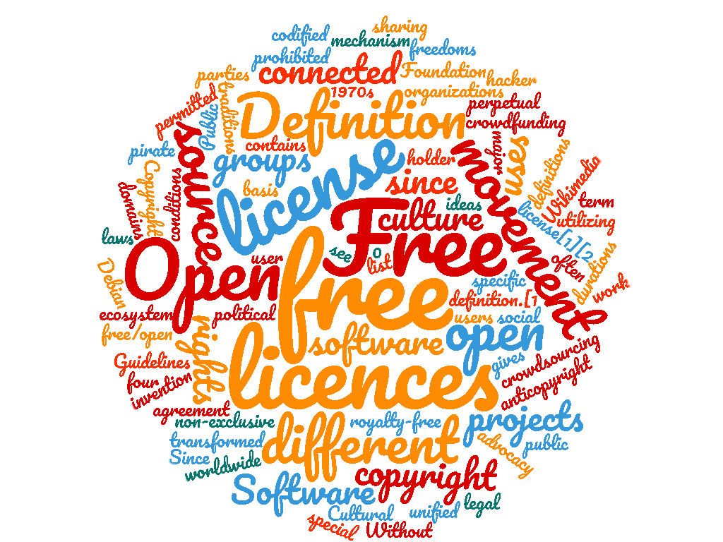
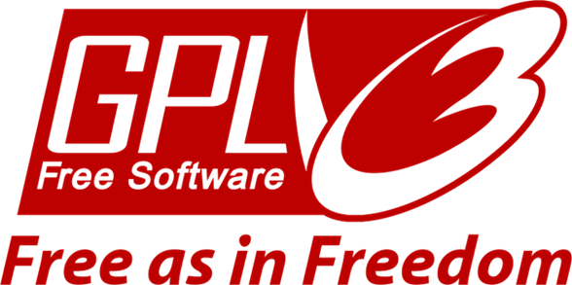




LICENCE SPECTRUM
All-rights reserved
Public domain
Notes:
Licences, including open licences, allow copyright holders to specify the terms of use for their works. Licence terms can cover the full spectrum between the “all rights reserved” approach of copyright and the public domain where there are no conditions or restrictions on the use of a work. With open licences, rights holders grant all users certain rights to copy or use a work.

Slide 3
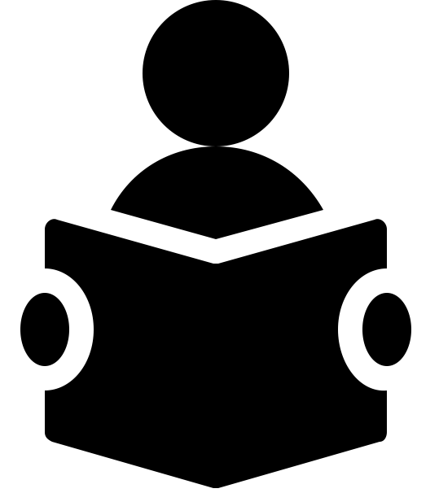


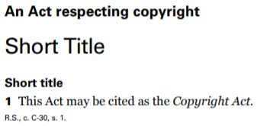
GRANTING RIGHTS TO USERS
Notes:
The Copyright Act grants copyright holders a set of certain exclusive rights in a work, including the ability to authorize others to use the work. While rights holders can authorize different uses to different individuals or groups of individuals through separate licences, open licensing is an efficient way to grant the same set of rights to all users.

Slide 4
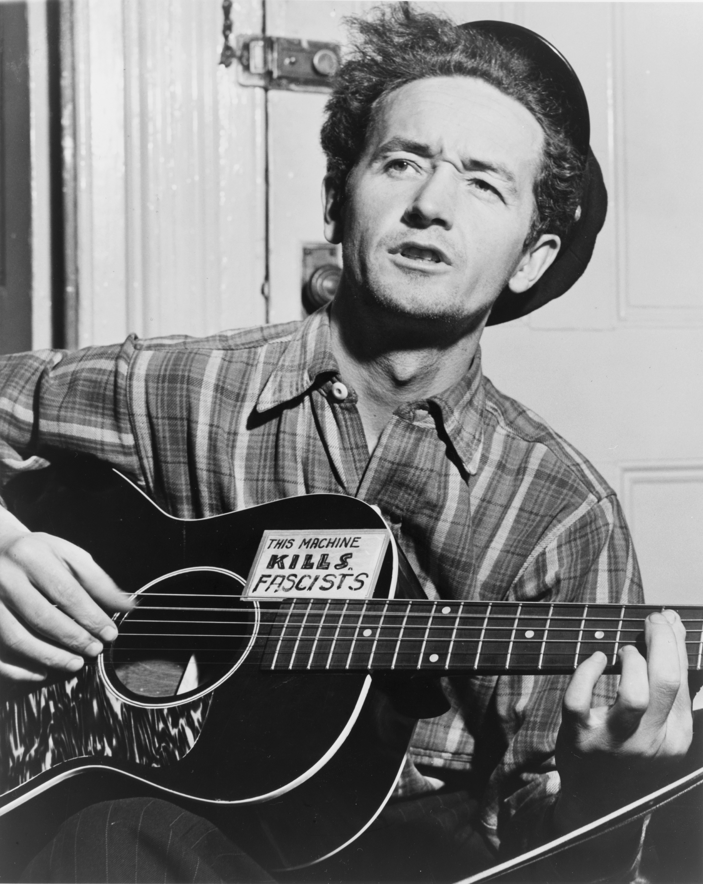
WOODY GUTHRIE
“This song is Copyrighted in U.S., under Seal of Copyright #154085, for a period of 28 years, and anybody caught singin it without our permission, will be mighty good friends of ourn, cause we don’t give a dern. Publish it. Write it. Sing it. Swing to it. Yodel it. We wrote it, that’s all we wanted to do.”
Notes:
For example, as the creator of a work, you may want everyone to be able to copy your entire work without permission, as this may increase the exposure of your work. Rather than separately having to grant permission to every group or individual that asks, an open licence can be used to grant the right to copy to all users.

Slide 5

GRANTING RIGHTS TO ALL USERS
Notes:
As the creator of a work, you may want everyone to be able to copy your entire work without requiring permission, as this may increase the exposure of your work. Rather than having to separately grant permission to every group or individual who asks, an open licence can be used to grant the right to copy to all users.

Slide 6

OPEN LICENSING SYSTEMS
Notes:
Open licensing systems are advantageous for a few reasons. They offer a degree of consistency. It is easier for rights holders and users to deal with a consistent common open licence or open licensing system as opposed to creating new licences for each work.

Slide 7
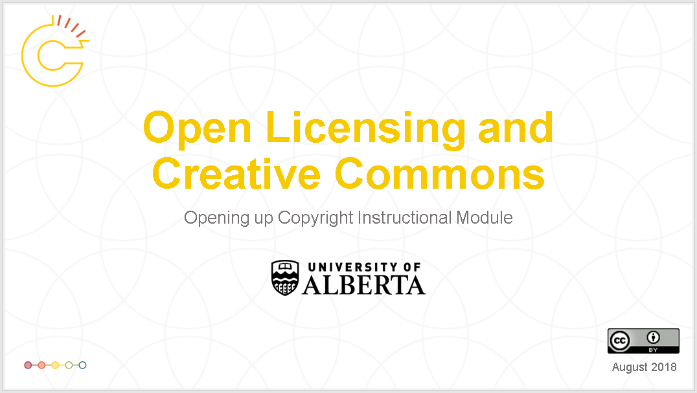

INTEGRATING SIMILARLY LICENSED WORKS
Notes:
More systematic approaches also enable works with similar licensing terms to be integrated, though in some cases a licence may specifically prevent this type of use. For example, this module is licensed under a Creative Commons Attribution (CC-BY) licence, and can be remixed with other CC-BY materials.

Slide 8

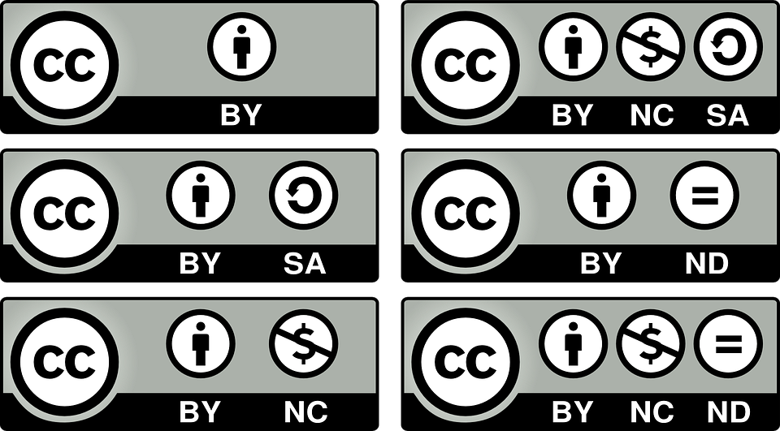

SYSTEMATIC APPROACHES TO OPEN LICENCES
Notes:
While open licences are not new, the systematic approaches to open licensing developed over the last few decades have made it easier for authors to open up their work and for users to better understand the terms and conditions of these licences.

Slide 9
OPEN LICENSING SYSTEMS
All-rights reserved
Public domain
Notes:
Open licensing systems are a set of licences that grant everyone certain permissions. In the same way there is a spectrum between the all rights reserved approach of copyright and the no rights of the public domain, a spectrum of openness also exists. In an open licence, the rights holder allows the material to be copied. “More open” licences allow even more uses of work including, for example, the right to remix or modify a work and the right to sell a work.

Slide 10
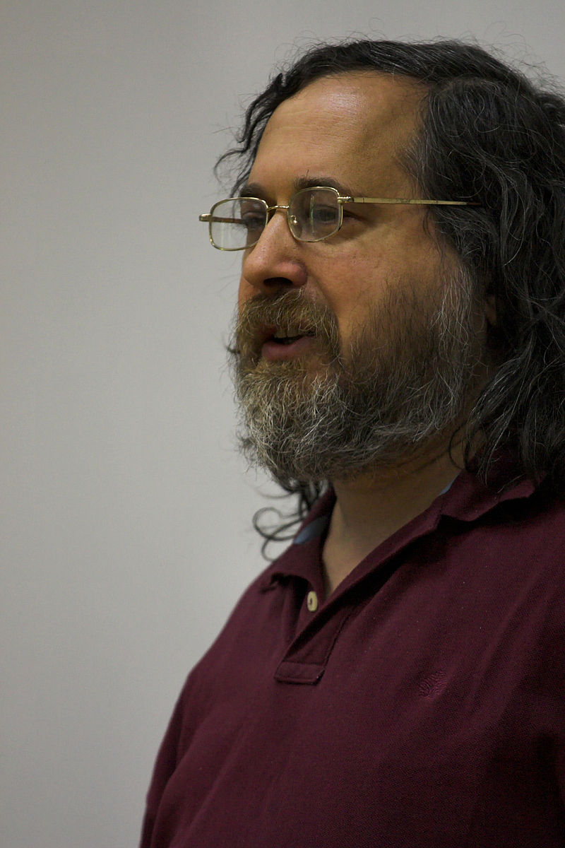
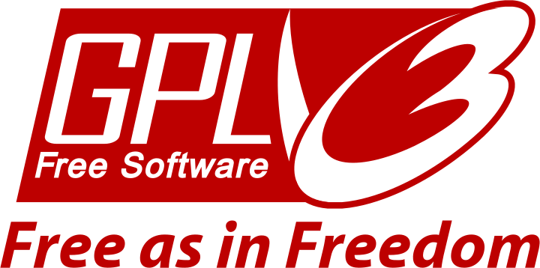
GNU PUBLIC LICENSE (GPL)
Notes:
The first major open licensing system was created by Richard Stallman as the Free Software Foundation's GNU Public Licence (or GPL), which was designed for software. There are also related licences like the GNU Free Documentation Licence.

Slide 11

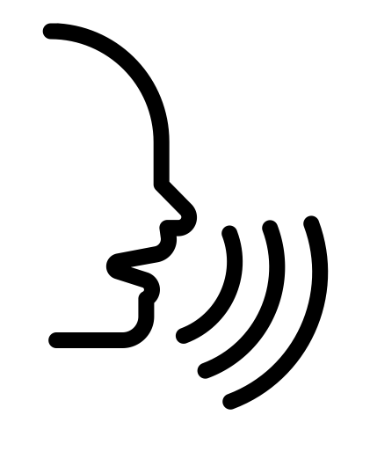
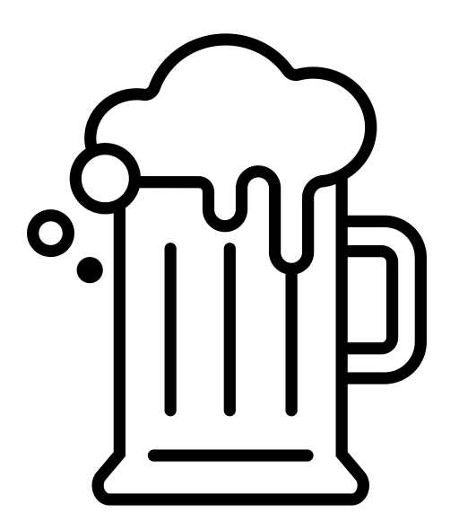
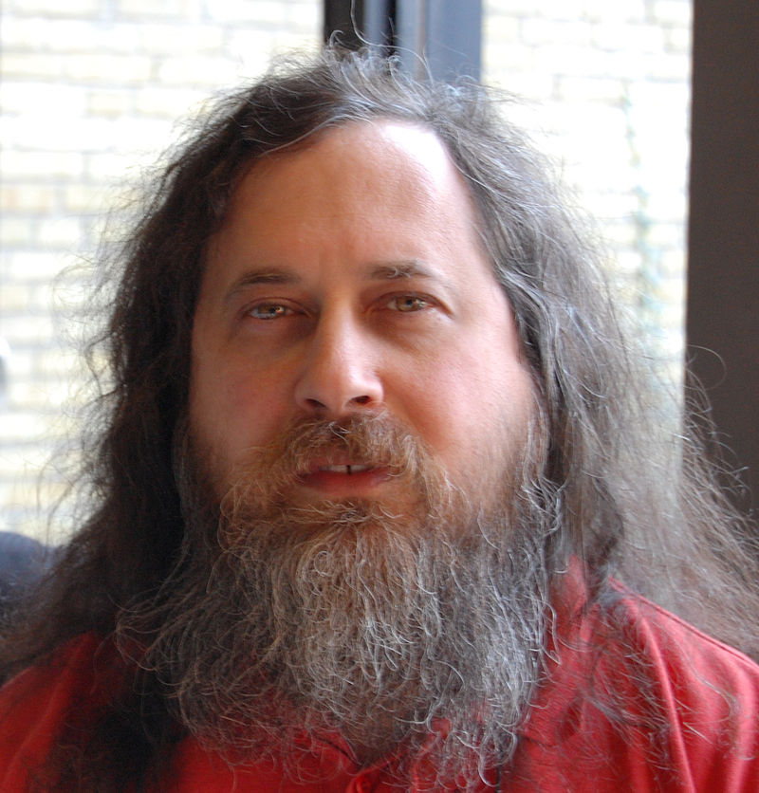

FREE SOFTWARE MOVEMENT
Freedom 0 – The freedom to run the program as you wish, for any purpose
Freedom 1 – The freedom to study how the program works, and change it so it does your computing as you wish
Freedom 2 – The freedom to redistribute copies so you can help your neighbor
Freedom 3 – The freedom to distribute copies of your modified versions to others
Notes:
Richard Stallman was the champion of the free software movement. He viewed freedom in terms of liberty not cost or “free as in free speech, not free beer.” For him, there were four fundamental freedoms his licence provided are:
The freedom to run the program as you wish, for any purpose (freedom 0).
The freedom to study how the program works, and change it so it does your computing as you wish (freedom 1). Access to the source code is a precondition for this.
The freedom to redistribute copies so you can help your neighbor (freedom 2).
The freedom to distribute copies of your modified versions to others (freedom 3). By doing this you can give the whole community a chance to benefit from your changes. Access to the source code is a precondition for this.
These freedoms do not preclude one from selling one’s work for profit.

Slide 12
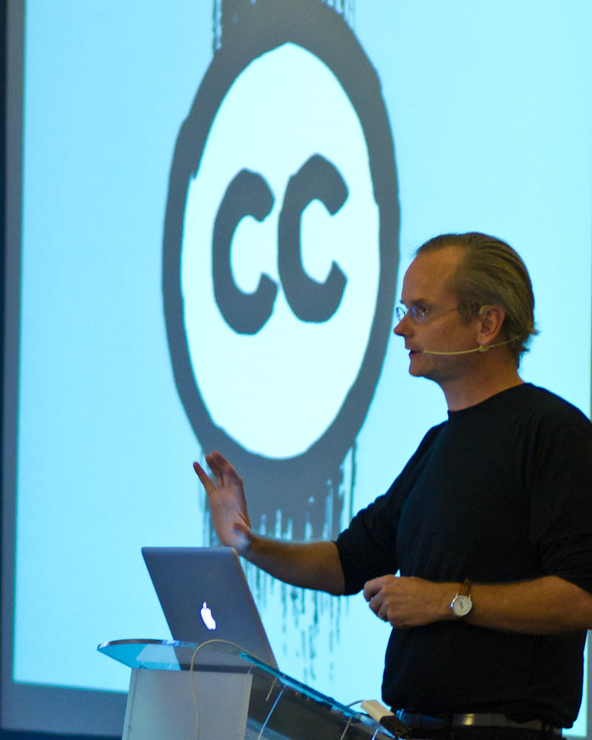

CREATIVE COMMONS LICENCES
Notes:
A second major licensing system is Creative Commons, which is a set of licences, an organization, and a movement. The organization was founded in 2001 by the Center for the Public Domain. A key figure in spearheading the creation of Creative Commons was Stanford law professor, Lawrence Lessig, who was concerned about intellectual property inhibiting economic growth and technological progress.

Slide 13
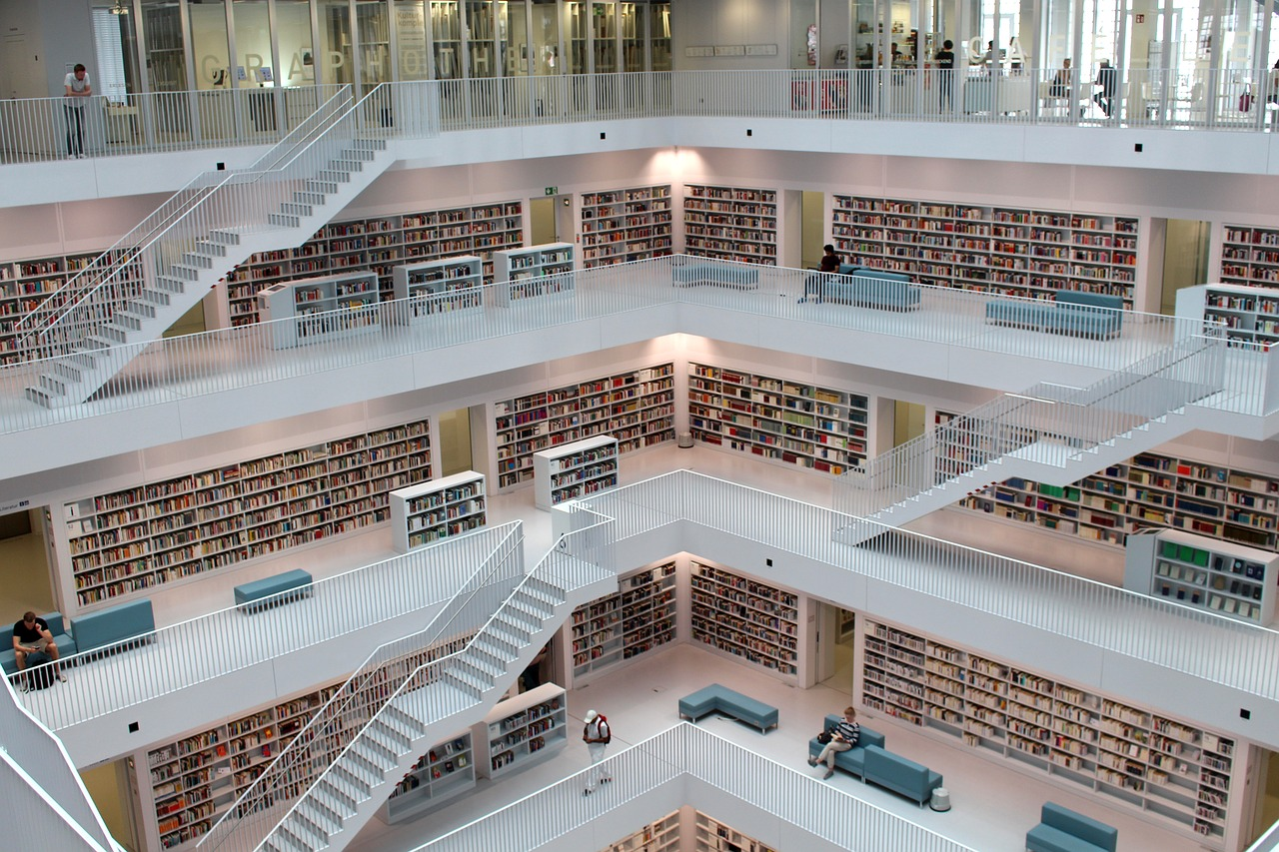
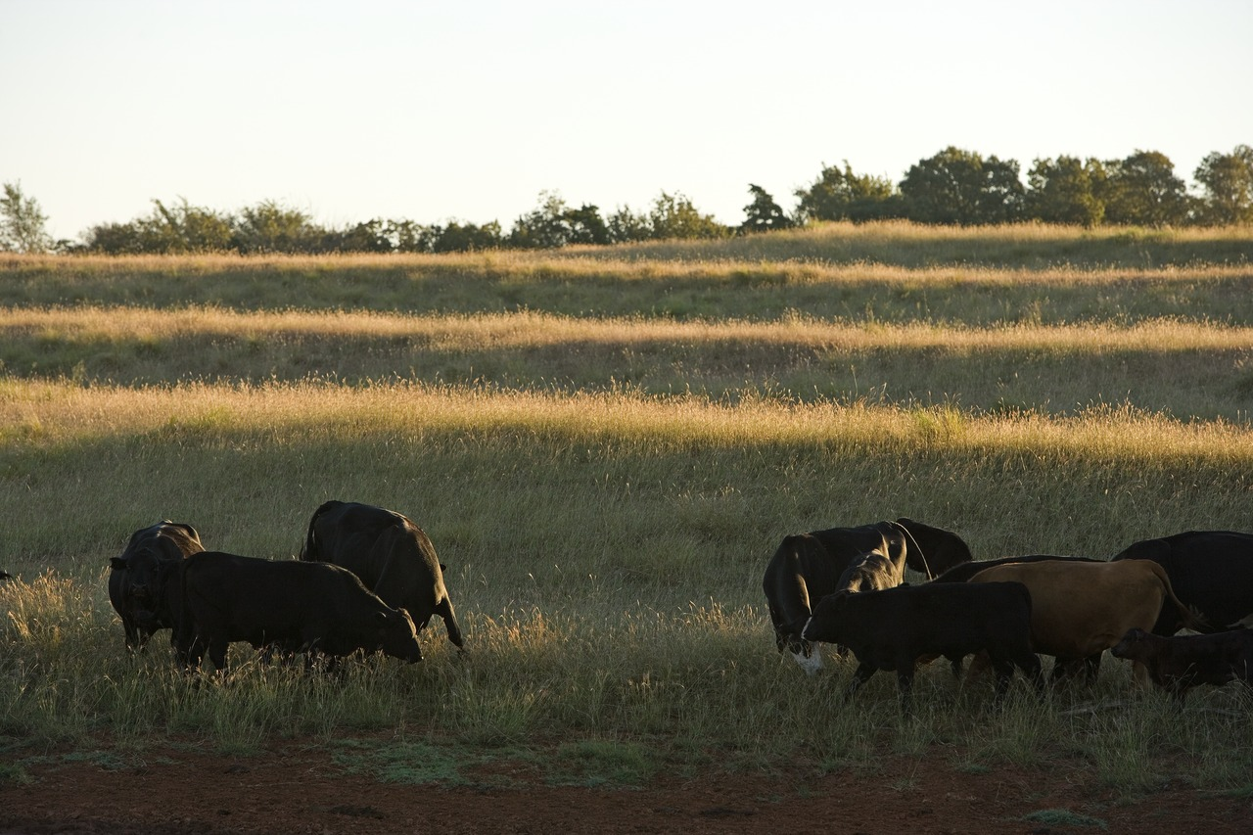
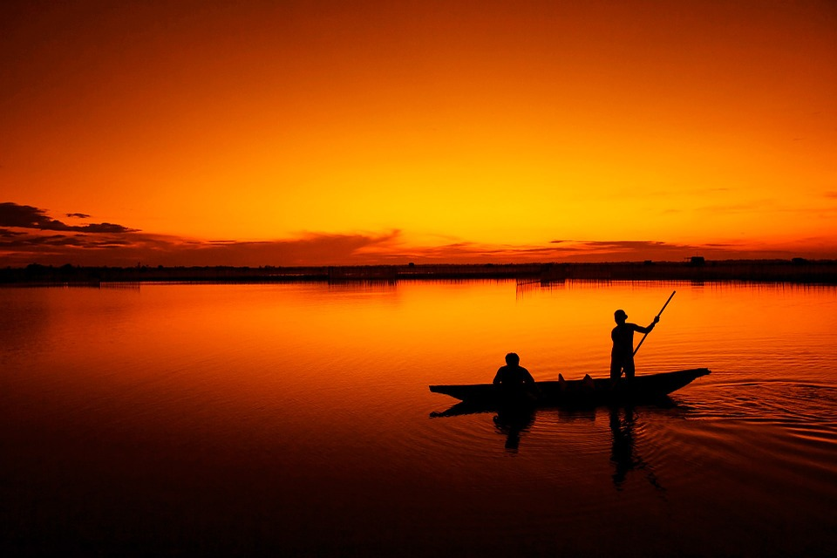
INTELLECTUAL COMMONS
Notes:
Creative Commons was inspired by the idea of an intellectual or knowledge commons. Much in the same way that certain ‘commons’ have existed in the past, such as common grazing land and fishing pools, the intellectual commons is a bastion of ideas and expressions of those ideas that everyone can benefit from. When you openly license your work, you are putting it into the intellectual commons for others to draw on and benefit from.

Slide 14
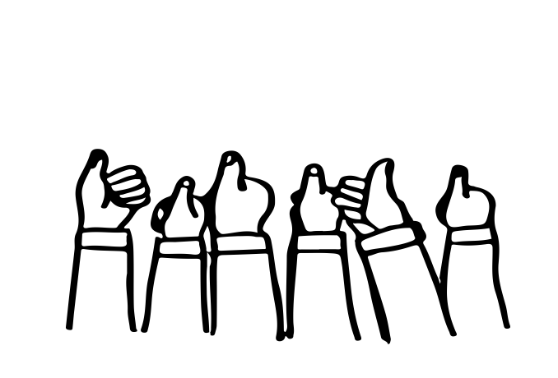
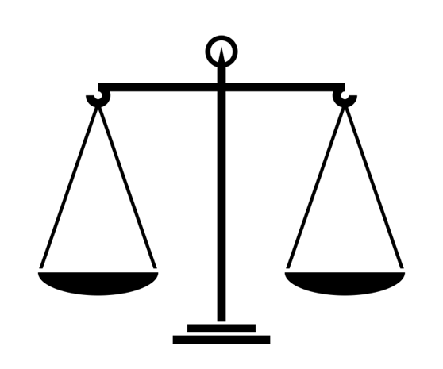
OTHER OPEN LICENSING SYSTEMS
Universal Permissive License
IPA Font License
Adaptive Public License
Sleepycat License
Educational Community License, V. 2.0
MIT License
Apache License 2.0
Notes:
In addition to Free Software Foundation and Creative Commons open licensing systems, there are other open licensing systems and many other types of open licences. While the philosophical underpinnings and specific terms of the licences differ, knowledge and use of open licensing, both as a creator and as a user, broadens access to information.Although there is not an extensive record of legal challenges, there is increasing confidence that these open licences should be considered legally enforceable in all jurisdictions worldwide.

Slide 15
CONCLUSION
Open licences and open licensing systems are valuable because they:
Add a degree of consistency to the open licensing of works
Allow the creator to specify the terms for the use of works
Help users better understand the terms and conditions of use for works
Broaden access to, and visibility of, works by adding them to the intellectual commons

Slide 16
LEARNING OBJECTIVES
You should now be able to:
Describe the nature of open licensing systems
Provide an overview of the GNU Public License and the Creative Commons licensing systems
Explain how open licences can be used to improve the visibility and impact of copyright-protected works
Notes:
You should now be able to: [learning objectives]

Slide 17

THANK YOU FOR YOUR ATTENTION
Notes:
This has been the Opening Up Copyright instructional module on Open Licensing and Creative Commons. Thank you for your attention.

Slide 18
REFERENCES AND RESOURCES
Creative Commons Certificate Resources. https://certificates.creativecommons.org/about/certificate-resources-cc-by/
Creative Commons Videos. https://creativecommons.org/about/videos/
Scharf, N. (2017). Creative commons-ense? An analysis of tensions between copyright law and Creative Commons. Journal of Intellectual Property Law & Practice, 12(5), 376-383. Retrieved from https://doi.org/10.1093/jiplp/jpx023
Stallman, R. (N.d.). Why open source misses the point of free software. Retrieved from https://www.gnu.org/philosophy/open-source-misses-the-point.html
Watercutter, A. (2013, September). Why free software is more important now than ever before. Wired. Retrieved from https://www.wired.com/2013/09/why-free-software-is-more-important-now-than-ever-before/
Notes:
14. You should now be able to: [learning objectives]

Slide 19
IMAGE REFERENCES
Image Credits (in order of appearance)
  Creative Commons. (n.d.). [Creative Commons Logo]. https://creativecommons.org/about/downloads/
  Phrood. (2008). Spectrum-sRGB. Wikimedia Commons. PD. https://commons.wikimedia.org/wiki/File:Spectrum-sRGB.svg
  Lȧstad, Egon. (n.d.). Note-taking. The Noun Project. CC BY. https://thenounproject.com/icon/665382/
  ProSymbols, US. (n.d.). Reader. The Noun Project. CC BY. https://thenounproject.com/search/?q=reader&i=797600
  (1943). Woody Guthrie. Wikimedia Commons. PD. https://commons.wikimedia.org/wiki/Woody_Guthrie#/media/File:Woody_Guthrie_NYWTS.jpg
  Enshia, CM. (n.d.). Book. The Noun Project. CC BY. https://thenounproject.com/icon/1787402/
  Rawpixel. (2017). [Typewriter]. Pixabay. CC0. https://pixabay.com/en/typewriter-old-alphabet-typing-2242164/
  Pezibear. (2015). [Reading]. Pixabay. CC0. https://pixabay.com/en/human-child-girl-sitting-blond-725651/
  Kozák, M. (2009). Richard Stallman at Wikimedia Polska Conference. Wikimedia Commons. PD. https://commons.wikimedia.org/wiki/Richard_Stallman#/media/File:Richard_Stallman,_Wikimedia_Polska_2009,_3.jpg
  Free Software Foundation. (2012). GPLv3 logo. https://en.wikipedia.org/wiki/GNU_General_Public_License#/media/File:GPLv3_Logo.svg
  Ebbesen, Bill. (2007). [Richard Stallman]. Wikimedia Commons. PD. https://commons.wikimedia.org/wiki/Richard_Stallman#/media/File:Portrait_-_Denmark_DTU_2007-3-31.jpg
  Gomez, Oliver. (n.d.). Beer. The Noun Project. CC BY. https://thenounproject.com/search/?q=beer&i=1219375
  Joseph, Kiran. (n.d.). Voice Commands. The Noun Project. CC BY. https://thenounproject.com/search/?q=free%20speech&i=821139
  Tatiana. (n.d.). No Parking. The Noun Project. CC BY. https://thenounproject.com/tatiana.selicka/collection/road-signs/?i=343267
  Geralt. (2014). [Money]. Pixabay. CC0. https://pixabay.com/en/dollar-currency-money-us-dollar-499481/
  Progressor. (2015). [Creative Commons]. Pixabay. CC0. https://pixabay.com/en/creative-commons-licenses-icons-by-783531/
  Symbolon, IT. (n.d.). Protest. The Noun Project. CC BY. https://thenounproject.com/term/protest/983931/
  Kindler, D. (2011). [Larry Lessig]. Flickr. CC-BY 2.0. https://www.flickr.com/photos/dtkindler/6155457139/
  Dev, Nikhil, IT. (n.d.). Scale. The Noun Project. CC BY. https://thenounproject.com/icon/15744
  Bauer, S. (2012). Grazing on farmland. Wikimedia Commons. CC0. https://commons.wikimedia.org/wiki/Category:Grazing_cattle#/media/File:071001_NRCS_Geary_339_-_Oklahoma_(717006)(NRCS_Photo_Gallery).tif
  Public Domain Pictures. (2013). [Fishing]. Pixabay. CC0. https://pixabay.com/en/fishing-boat-fisherman-164977/
  Reginasphotos. (2016). [Stuttgart Library]. Pixabay. CC0. https://pixabay.com/en/library-city-library-stuttgart-1700581/
Unattributed materials are contributions from the Opening Up Copyright Project Team and are placed in the Public Domain

Slide 20
LICENSING AND ATTRIBUTION
Suggested Citation:
  University of Alberta. (2018). Open Licensing and Creative Commons. Opening Up Copyright Instructional Module. https://www.ualberta.ca/copyright/resources/opening-up-copyright-instructional-modules
For the project overview and complete list of modules please visit the project website at: https://www.ualberta.ca/copyright/resources/opening-up-copyright-instructional-modules
Questions, comments, and suggestions should be directed to the University of Alberta’s Copyright Office at: copyright@ualberta.ca
This module is made available and licensed under a Creative Commons Attribution 4.0 International Licence

Slide 21
CONTRIBUTORS
Copyright Office
Centre for Teaching and Learning
Technologies in Education
Adrian Sheppard
Amanda Wakaruk
Cosette Lemelin
Graeme Pate
Krysta McNutt
Anwen Burk
Jamie Stewart
Matt Cheung
University of Alberta Libraries
School of Library and Information Studies
Michelle Brailey
Jesse Carson
Toby Grant
Michael B. McNally

Slide 22

ACKNOWLEDGEMENT
Opening Up Copyright modules were initially funded through the University of Alberta, Centre for Teaching and Learning’s Teaching and Learning Enhancement Fund (TLEF) with in kind contributions from the Copyright Office and the School of Library and Information Studies.

Slide 23
TEST QUESTIONS
Describe the nature of open licensing systems
Open licences:
Allow copyright holders to easily communicate the terms of use of their works
Remove all rights from the copyright holder
Allow the copyright holder to transfer copyright of a work to the user
Add further protection to existing copyright law
Open licensing systems are beneficial to the user because:
They help users understand the terms and conditions for the use of a work
They allow users to do whatever they want with a work
They protect the user from legal action by the creator
They encourage users to create their own, derivative works

Slide 24
TEST QUESTIONS
Provide an overview of the GNU Public License and the Creative Commons licensing systems
The first major open licensing system was created by:
Richard Stallman
Lawrence Lessig
The Government of Canada
Woody Guthrie
A key figure in the creation of Creative Commons was:
Lawrence Lessig
Richard Stallman
Woody Guthrie
The Government of Canada
Richard Stallman views freedom as “free as in free speech, not free beer,” meaning:
Freedom in terms of liberty, not cost
Open licensing systems must promote free speech
Freedom in terms of cost, not liberty
Open licensing systems cannot be applied to recipes, e.g. craft beer recipes

Slide 25
TEST QUESTIONS
Explain how open licences can be used to improve the visibility and impact of copyright-protected works
Open licences allow creators to add their works to:
The intellectual commons
The universe of created works
The public domain
The United States Copyright Registry
Open licences are beneficial to [creators] because they allow them to [specify] the terms of use, and are beneficial to [users] because they help them better [understand] terms and conditions.

