Slide 1
Access to Information and Government Secrecy
LIS 598 – Information Policy – Winter 2017
Jan. 27, 2017

Slide 2
Last Week
Neoliberalism
International influences
Policymaking approaches and evidence-based policymaking
Private ordering
Tension among information policies

Slide 3
Outline
A. Access to Information Act (ATI) versus access to information
B. History and Context of the Act
C. Access to Information Act
D. ATI Requests
E. The Information Commissioner
F. Problems with the Act
G. Government Secrecy

Slide 4
A-I. “Information is the lifeblood of a democracy”
“Information is the lifeblood of a democracy. Without adequate access to key information about government policies and programs, citizens and parliamentarians cannot make informed decisions, and incompetent or corrupt governance can be hidden under a cloak of secrecy.”

Slide 5
A-II. The Access to Information Act (ATI) and Access to Information
The idea of access is a powerful yet ambiguous concept
What does ‘access’ entail?
Are there monetary costs involved or is it free access?
Is everything accessible or just some things?
Are there restrictions on the use of the information?
What kind of process is involved to gain access?
In practice there are several limitations on the access provided by ATI, but the overarching principle is that the Act provides a mechanism for accessing government information
ATI/Freedom of Information legislation necessary but not sufficient element of open, accountable and transparent government (Avle and Abundi, 2015)

Slide 6
B-I. History of Access to Information
Sweden has the worlds oldest access/freedom of information act going back to the 18th century (specifically 1766), and the Declaration of the Rights of Man and the Citizen (1789) provided for access to information relating to the French budget
There is no historical Anglo-American tradition of access legislation
British parliamentary models is based on secrecy (Tate, 1998)
US passed the Freedom of Information Act (FOIA) in 1966
ATI more limited than FOIA (Tate, 1998)
1965 NDP MP Barry Mather introduced a private member’s bill that would have created access to government information, but it died on the order paper – this marked the beginning of a concerted push for access legislation in Canada
Nova Scotia is the first Canadian jurisdiction to pass an access law in 1977

Slide 7
B-II. Legislating Access
In January 1979 the Liberal government declared it would introduce access legislation, but nothing resulted due to the election in May
In October 1979 the Conservative government introduced access legislation (Bill C-15), but it died because of the Feb 1980 election
In July 1980 Bill C-43 was introduced that contained both the Access to Information Act and Privacy Act
Despite reservations from some provinces which favoured national access legislation covering both the federal and provincial governments, the bill was passed in June 1982
Both the Privacy Act and ATI came into force on July 1, 1983

Slide 8
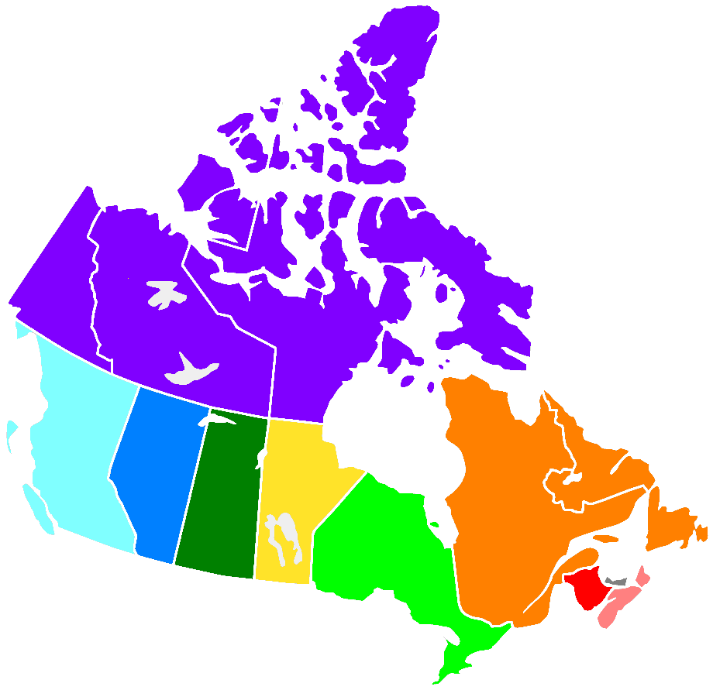
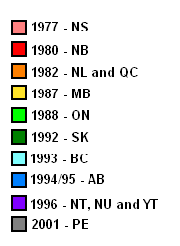
B-III. Access to Information Laws at the Provincial Level

Slide 9
B-IV. ATI and the Privacy Act
The Access to Information Act is directly related to the Privacy Act
Though ATI provides access to a range of government information it specifically excludes personal information
The Privacy Act legislates how the government must handle personal information, and provides a right for individuals to access personal information about themselves held by the government
In Dagg v. Canada (Minister of Finance) ([1997] 2 S.C.R. 403), the Supreme Court examined a case where both acts were at issue, with the dissent opinion noting:
Recognizing the conflicting nature of governmental disclosure and individual privacy, Parliament attempted to mediate this discord by weaving the Access to Information Act and the Privacy Act into a seamless code. In my opinion, it has done so successfully and elegantly. While the two statutes do not efface the contradiction between the competing interests -- no legislation possibly could -- they do set out a coherent and principled mechanism for determining which value should be paramount in a given case.
J. La Forest (dissenting), para 45

Slide 10
C-I. Text of ATI
Key sections of the Act include
Section 2 – Purpose of the Act
Section 4 – Right to access government records
Section 6 – Requesting access
Section 7 – Timeline for government response
Section 11 – Fees
Schedule I – list of all departments and agencies to which the act applies (144 departments and agencies)
Schedule II – list of acts that contains sections which exclude information from ATI

Slide 11
C-II. Major Exemptions
Confidential information from other governments (lower levels, aboriginal, and foreign) and international organizations (s. 13)
Information on federal-provincial affairs (s. 14)
Information on international affairs and national defence (s. 15)
Law enforcement, security and investigations (s. 16)
Records that would threaten the safety of individuals (s. 17)
Records harmful to the economic interests of the country (s. 18)
Trade secrets and confidential business information of Canada Post, Export Development Canada, the Public Sector Pension Investment Board and Via Rail (s. 18.1)
Personal information (s. 19)
Sensitive third party information (s. 20)
Advice to the Crown/government (s. 21)
The act also does not cover exhibit materials held by federal museums (s. 68), non-administrative information of the CBC (s. 68.1) or Atomic Energy of Canada (s. 68.2)
Most Privy Council documents (s. 69)
Finally some information dealing with specific pieces of legislation is restricted (s. 24(1) and Schedule II)

Slide 12
D-I. ATI Requests
Requests are processed in each department that the Act covers by specialized Access to Information and Privacy (ATIP) Offices and Coordinators
The Act requires all departments to maintain statistics on ATI (and Privacy Act) requests
Statistics on AITA and Privacy Act information requests are complied by the Treasury Board Secretariat
The statistics are an excellent source of information on the overall health of the access program (especially when complemented by the Information Commissioner’s statistics on ATI complaints)

Slide 13
D-II. ATI Request Examples
Agency | Request Date (My End) | Acknowledgement Date | Extension Date | Extensions | Response Date | Response Pages | No. of Days to Process
CRA | Apr. 9, 2015 | Apr. 13, 2015 | May. 11, 2015 | 30 days | Nov. 10 2015 | 101 | 211
NRC | Apr. 9, 2015 | Apr. 10, 2015 | May. 7, 2015 | 30 days | Oct. 13, 2015* | 200 | 183
CSIS | Apr. 9, 2015 |  |  |  | May. 5, 2015 | 0 | 26
National Defence | Apr. 9, 2015 | Apr. 10, 2015 | May. 8, 2015 | 30 days | Jun. 3, 2015 | 0 | 54
CBSA | Apr. 9, 2015 | Apr. 23, 2015 (by email) |  |  | May. 11, 2015 | 0 | 18
Foreign Affairs | Apr. 9, 2015 | Apr. 14, 2015 | May. 8, 2015 | 30 days | Jun. 8, 2015 | 203 | 55
Environment | Apr. 9, 2015 | Apr. 10, 2015 | May. 4, 2015 | 60 days | Aug. 3, 2015 | 102 | 115
ESDC | Apr. 9, 2015 | Apr. 27, 2015 |  |  | May. 27, 2015 | 24 | 30
AAND | Apr. 9, 2015 | Apr. 10, 2015 |  |  | Apr. 21, 2015 | 0 | 11
Justice | Apr. 9, 2015 | Apr. 13, 2015 |  |  | Apr. 17, 2015 | 13 | 4
TC | Apr. 9, 2015 | Apr. 17, 2015 |  |  | May. 6, 2015 | 6 | 19
Heritage | Apr. 9, 2015 | Apr. 14, 2015 |  |  | May. 11, 2015 | 23 | 27
Veterans Affairs | Apr. 9, 2015 | Apr. 13, 2015 |  |  | Jan. 12, 2016 | 16 | 274
DFO | Apr. 9, 2015 | Apr. 13, 2015 |  |  | May. 8, 2015 | 161 | 25
Parks | Apr. 9, 2015 | Apr. 10, 2015 |  |  | Feb. 2 2016 | 39 | 274
Agriculture | Apr. 9, 2015 | Apr. 10, 2015 |  |  | May. 5, 2015 | 57 | 26
Finance | Apr. 9, 2015 | Apr. 10, 2015 |  |  | Apr. 22, 2015 | 2 | 12
RCMP | Apr. 9, 2015 |  |  |  | May. 28, 2015 | 72 | 49
 | * Delay caused by communications challenges between myself and ATIP office

Slide 14
E-I. Information Commissioner Statistics
Commissioner’s Annual Report notes the increase in outstanding complaints stems from more complex investigations and a reduction of financial resources (p. 13)
 | 2010-11 | 2011-12 | 2012-13 | 2013-14 | 2014-15
Complaints carried over from the previous year | 2086 | 1853 | 1823 | 1798 | 2090
New complaints received | 1810 | 1460 | 1579 | 2069 | 1738
New Commissioner initiated complaints | 18 | 5 | 17 | 12 | 11
Total new complaints | 1828 | 1465 | 1596 | 2081 | 1749
Complaints discontinued during the year | 692 | 641 | 399 | 551 | 416
Complaints settled during the year | 18 | 34 | 172 | 193 | 276
Complains completed during the year with finding | 1351 | 820 | 1050 | 1045 | 913
Total complains closed during the year | 2061 | 1495 | 1621 | 1789 | 1605
Total inventory at year end | 1853 | 1823 | 1798 | 2090 | 2234

Slide 15
F-I. Problems with ATI
No shortage of problems with ATI
Since 1983, all governments have had some degree of antagonism with ATI (Tate, 1998, Rees, 2012; Larsen and Walby, 2012)
Act is old and outdated – no major changes since 1983
Introduction of online payment was a major step forward in process, but does little to address substantive problems in the Act
Outsourcing and contracting out (“New Public Management”) have reduced effectiveness of ATI (Roberts, 2000)
Numerous cases of political inference (Rees, 2012)
ATI process is comparatively underused in Canada (Hazell and Worthy, 2010), though use has been growing
Special software used to manage ATI request also facilitates flagging of requests (Amber and Red Lighting) for political scrutiny (Roberts, 2002; Rees, 2012; Larsen and Walby, 2012)

Slide 16
F-II. Legislative Reforms
Numerous reforms to the Act in the past 15 years
Since the version in force to Sept. 23, 2002, the Act has been changed over 70 times
Most changes are relatively minor; however, some notable changes include:
2006 changes (effective Dec 12, 2006) included:
Narrowing the time for a complaint to a response from one year to 60 days (s. 31)
Made the definition of record under the Act medium neutral (s. 3)
Changed the appointment and removal process for the Information Commissioner (s. 54)
2007 changes (effective Apr. 1, 2007) that provided additional exemptions for materials relating to investigations and audits (s. 16.1 and 16.3)

Slide 17
F-II(ii). Legislative Reforms
2007 changes (effective Sept. 1 2007) that excluded certain information from Canada Post, Export Development Canada, the Public Sector Pension Investment Board and VIA Rail (s. 18), and the CBC and Atomic Energy of Canada (s. 68)
2008 changes (effective July 2, 2008) that exempted certain records from the Commoner of Lobbying (s. 16.2)
2011 changes (effective Nov. 16, 2011) that included the Communications Security Establishment in Schedule 1

Slide 18
F-III. International Comparison
In 1980s Canada was an early leader in ATI
We were just the 8th country to pass ATI legislation (Rees, 2012)
Now country performs poorly against Anglo-American peers (Hazell and Worthy, 2010)
Halifax based Centre for Law and Democracy produces annual rankings for access/right to know legislation using seven factors
In 2013 Canada scored a total of 79 points out of a maximum of 150
Other scores include:
Australia, 83; USA, 89, New Zealand, 90; UK 100
China 70, Russia 98, Brazil 108, India 128
Germany 52, Italy 57, France 64, Japan 65
Highest score was Serbia (135), lowest was Austria (32)

Slide 19
G-I. Government Secrecy
While access to government information is succinctly contained in ATI, government secrecy is maintained through a variety of laws
Three major laws are:
Security of Information Act (R.S., 1985 c. O-5) (replaces the 1981 Official Secrets Act), and
Canada Evidence Act (R.S., 1985 c. C-5)
Security of Canada Information Sharing Act (S.C. 2015, c. 20, s. 2)
The Security of Information Act criminalizes disclosure of state secrets and espionage, and revisions in 2001 (after 9/11) expand the law to includes provisions against economic espionage and terrorist communications
Security of Canada Information Sharing Act was part of the controversial Bill C-51 (from the previous parliament) and enables sharing of government agencies to share personal information of Canadians for national security purposes
The Act’s main goal is to prevent activities that undermine the “security of Canada”; however, critics argue that way this is defined in the act greatly expands the leeway for information sharing

Slide 20
G-II. Secrecy and Access
Access to Information Act:
15 (1) The head of a government institution may refuse to disclose any record requested under this Act that contains information the disclosure of which could reasonably be expected to be injurious to the conduct of international affairs, the defence of Canada or any state allied or associated with Canada or the detection, prevention or suppression of subversive or hostile activities, including, without restricting the generality of the foregoing, any such information
…
The Information Commissioner has noted that some departments are overly quick in invoking the S. 15 exclusion, even when the requested information has at best a tangential relation to national defence

Slide 21
G-III. Hair Scrunchies – A State Secret?
In July 2007 National Defence received a request for a list of personal grooming items found on Afghan detainees
The Department refused the request arguing that such a release would threaten national security and the detainees personal information had to be protected
After the Information Commissioner’s Office pursued the complaint the list of personal effects was eventually released
The Information Commissioner’s position in the hair scrunchie request contrasts sharply with the position the Office took when individuals have requested detailed information about specific instances of torture (see Attaran v. Minister of Foreign Affairs, 2009 FC 339)

Slide 22
G-IV. Batman Costume – A Personal Safety Threat
s. 17 of the Act excludes information where disclosure could reasonably be expected to threaten the safety of a person
In 2014-15 a request was made to the Canada Revenue Agency (CRA) for video with departmental staff that introduced various parts of the organization
One part was withheld because CRA felt that the clip, which depicted several CRA staff wearing Batman costumes, fell under s. 17
As the Commissioner noted in her Annual Report (2015, p. 24), s.17 “should not be used for the purpose of concealing embarrassing information”
The requester eventually agreed to receiving the clip with the faces of CRA staff blurred out

Slide 23
G-V. Political Interference and Access Requests
Another problem with ATI process is political interference in the request process
The Act states:
Obstructing right of access
67.1 (1) No person shall, with intent to deny a right of access under this Act,
(a) destroy, mutilate or alter a record;
(b) falsify a record or make a false record;
(c) conceal a record; or
(d) direct, propose, counsel or cause any person in any manner to do anything mentioned in any of paragraphs (a) to (c).
Despite the clear provisions against political meddling, governments can have strong incentives to falsify and conceal records

Slide 24
G-IV(ii). Political Interference and Access Requests
In 2009 Dean Beeby, deputy bureau chief of The Canadian Press, made an ATI request for documents dealing with the real estate holdings of Public Works and Government Services (PWGS)
Although Beeby’s initial request was filled and deemed complete, he felt that documents were missing, so he filed a second request for the documents relating to his initial request
Through a series of complaints to the Information Commissioner and an investigation by the House of Commons Standing Committee on Access to Information, Privacy and Ethics, it was determined that ministerial aide Sebastien Togneri directed Access to Information staff at PWGS to suppress certain documents for at least three different ATI requests (Information Commissioner of Canada, 2011)

Slide 25
G-IV(iii). Political Interference and Access Requests
Rees (2012) document her 2006 request for PCO communication on softwood lumber, that was ultimately released in 2010
By doing a follow up ATI request for the log on her first request she found that it went through several offices at the PMO including Director of Issues Management, Jenni Byrne, and then later William Stairs, who replaced Byrne as Director of Issues Management
The Information Commissioner has issued two special reports on political interference – one in 2011, and one in 2014 outlining several investigations into political interference with many ‘positive’ findings

Slide 26
G-V. Canada v. Canada, 2011
Executive secrecy was entrenched into Canadian ATI in the 2011 Canada v. Canada case (Canada (Information Commissioner) v. Canada (Minister of National Defence), 2011 SCC 25, [2011] SCR 306).
Case revolved in part as to whether the PMO and Ministerial Offices are part of the government institution for which they are responsible
Holding up the analysis of the Federal Court, the Supreme Court concluded that ministerial offices and the PMO are not part of the government institutions they are responsible for, and as such not subject to ATI (para. 43)
Interestingly this case went back to a Chretien era ATI request made by the Reform Party (then led by Harper); however, as PM, Harper defended executive secrecy (Rees, 2012)

Slide 27
G-VI. May 2016 ATI Reforms
Full scope of Liberals reform to ATI is yet to be seen
May 5, 2016 an Interim Directive on the Administration of the Access to Information Act was issued, with two key elements:
Waiving of fees beyond the $5 filing fee
Release of information in user-friendly formats were possible
However, the comprehensive review has been put off until 2018

Slide 28
Discussion Questions
Some starting points for this week’s discussion:
Do you have any experience with Access to Information (or provincial Freedom of Information) requests – what was it and what are your thoughts
What should be the key priorities for Access to Information reform at the federal level
What do the Treasury Board’s ATI statistics tell us and not tell us about the health of the Access to Information System in Canada
Examine some of the sample ATI responses uploaded into the eClass site – specifically do the numerous examples of exempted information make such requests meaningful

Slide 29
Next Week
Privacy and Government Information
Read Schwab and the Privacy Commissioner of Canada
Information Policy and Information Workplaces Paper is due Feb. 6 by 23:55 MST

Slide 30
Sources:
Quote on slide A-I: Harper, Stephen. 2005. “Cleaning up the mess in Ottawa: Transparency is the key to preventing scandal.” Montreal Gazette. 7 Jun 2005: A21.
Avle, Seyram, and Omolade Abundi. 2015. “Whose Freedom? Whose Information? Discourses on Freedom of Information Policies.” Journal of Information Policy, 5: 179-203.
Hazell, Robert, and Ben Worthy. 2010. “Assessing the Performance of Freedom of Information.” Government Information Quarterly, 27: 352-359.
Information Commissioner of Canada. 2011. Interference with Access to Information Part 1: A Special Report to Parliament. http://www.oic-ci.gc.ca/eng/DownloadHandler.ashx?pg=70f82b16-ff74-4e4e-822d-6da14dfcfe9b&section=d5a8df8e-48f4-4812-bb47-199a7057ddd4&file=English+125+report+formatted_final.pdf
Information Commissioner of Canada. 2014. Interference with Access to Information Part 2: A Special Report to Parliament. http://www.ci-oic.gc.ca/eng/DownloadHandler.ashx?pg=bf6ec4ed-f431-4b29-987d-b09bfa87a8ac&section=6a229b99-05c8-4068-8766-f323e1628394&file=982+final+English+formatted+2-greyscale.pdf
Information Commissioner of Canada. 2015. Annual Report 2014-15. http://www.oic-ci.gc.ca/telechargements-downloads/userfiles/files/eng/reports-publications/annual-reports/2014-2015/OIC_15-351_AR2015_updates_E_WEB2%20-%20Updated.pdf
Larsen, Mike, and Kevin Walby. 2012. “Introduction: On the Politics of Access to Information.” In Brokering Access: Power, Politics and Freedom of Information Process in Canada. Mike Larsen and Kevin Walby (Eds.). Vancouver, BC: UBC Press. p. 1-32.
Rees, Ann. 2012. “Sustaining Secrecy: Executive Branch Resistance to Access to Information in Canada.” In Brokering Access: Power, Politics and Freedom of Information Process in Canada. Mike Larsen and Kevin Walby (Eds.). Vancouver, BC: UBC Press. p. 35-67.
Roberts, Alasdair S. 2000. “Less Government, More Secrecy: Reinvention and the Weakening of Freedom of Information Law.” Public Administration Review, 60(4): 308-320.
Roberts, Alasdair S. 2002. “Administrative Discretion and the Access to Information Act: An ‘Internal Law’ on Government Information.” Canadian Public Administration, 45(2): 175-194.
Roberts, Alasdair S. 2012. “Access to Information: The Elements of Reform,” Submission to the 2012 Open Dialogue Consultations of the Office of the Information Commissioner.
Tate, Eugene D. 1998. “Access to Information: The Canadian Experience.” Journal of Information Science, 24(2): 75-82.

Slide 31
Comments and Critique
Comments and critique on this presentation and any other material for LIS 598 Information Policy – Winter 2017 can be sent to Michael B. McNally at: mmcnally@ualberta.ca
Comments and critique will be used to improve future iterations of these materials

