Slide 1
Developing Pre-Service Teacher Copyright Open Educational Videos: A Case Study
Presented at OTESSA21, June 2, 2021
Samantha Sheplawy - Master of Library and Information Studies Candidate, University of Alberta
Michael McNally - Associate Professor, Faculty of Education, University of Alberta
Cathy Adams - Professor, Secondary Education, University of Alberta

Slide 2
Land Acknowledgement
We want to begin by acknowledging that the land we work on and call home is in Treaty 6 territory and Metis region 4 and that the University of Alberta is located in Amiskwacîwâskahikan. This land has been a gathering place for First Nations, Metis and Inuit peoples for generations and their histories, languages and cultures continue to positively influence us today. We also want to acknowledge that this year’s Congress theme is Northern Relations.
The focus of our presentation today is on copyright literacy and teacher education. With regard to the former, we want to highlight the particular importance given to education in the process of Reconciliation and Calls to Action, specifically Calls 6 to 12 and 62 to 65, with Call 62 directly addressing the importance of education for reconciliation as part of teacher education. We also want to note that with regard to copyright, the western system of exclusionary rights over intellectual work is fundamentally incompatible with approaches to Indigenous knowledges and cultural expression, and while the copyright literary work we are discussing here today doesn’t focus on this specifically, copyright educators do have a responsibility to address these tensions.

Slide 3
Overview
Context
About Opening Up Copyright (OUC)
Creating a Relevant Narrative
Creating Relevant Characters
Aligning Material with Copyright Matters
Aligning Material with OUC
Sample Clips
Open Education and Teacher Education discussion
Screenshot from “Copyright in the K-12 Content” Module

Slide 4
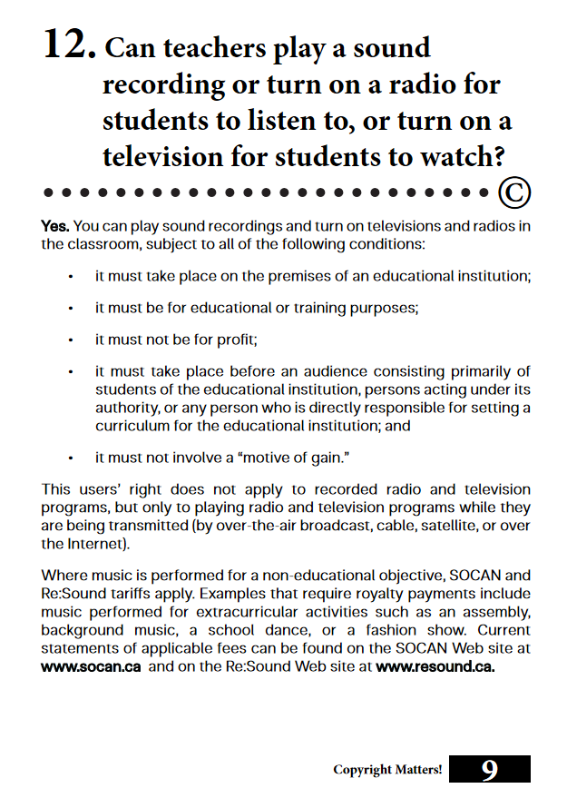
Context
Growing interest in Open Education/OER across education (K-PhD)
Copyright literacy a key 21st century literacy (Burkell et al., 2015; Morrison, 2018)
Copyright in the K-12 context a contested area (e.g. Alberta (Education) v. Access Copyright, 2012)
Most copyright literacy resources are ‘dry’ and overly textual
Debate over reusability of OER (Wiley, 2002; Wiley, 2015; Joseph et al. 2020)
Noel and Snel (2016). Copyright Matters, p. 9

Slide 5
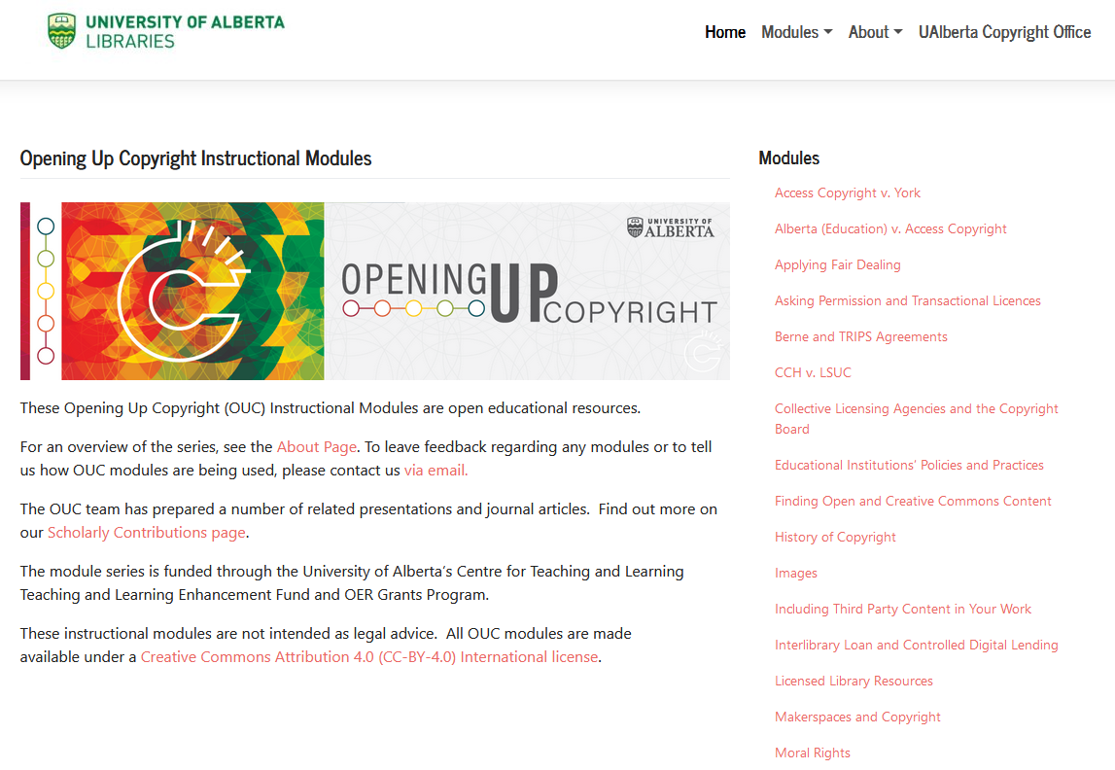
Opening Up Copyright
Grant funded series of openly licensed instructional videos on copyright
30 modules, most 6-8 minutes long
Range from more introductory subjects to ‘advanced modules’ on Copyright Act and key cases
Varied audiences (see. Joseph et al. 2020) including librarian education, but not teacher education (until now)
Opening Up Copyright website:
https://sites.library.ualberta.ca/copyright/

Slide 6
Creating a Relevant Narrative
Narrative must be engaging, relevant, and understandable for pre-service and practicing teacher audience
Response - story arc about a theatrical production of The Music Man musical addressing copyright issues across the four modules
Challenges:
Balancing narrative generalization
with informational precision
Key realization: Simplify complexity
Screenshot from “Creating and Sharing Copyright-Protected Materials in the K-12 Content” Module
Notes:
Narrative Contextualization: Make the K-12 OUC modules engaging, relevant, and understandable for pre-service and practicing teacher audiences.
Present copyright issues and terms in familiar situations,
Link to Copyright Matters! resource,
Be coherent within and between each K-12 module
Solution: Story about a theatrical production of The Music Man musical addressing copyright issues
Challenge: Balancing narrative generalization (relating to diverse issues, activities, and resources) and informational precision (addressing the technical nature, legal significance, and specialized knowledge involved in copyright and fair dealing issues).
Key realization: Simplify complexity

Slide 7
Creating Relative Characters
Develop characters to reflect the identities and experiences of the audiences
Balancing generality and specificity:
Character names and pronouns
Character Avatars
Goal: Audience identification and relevance
Previous OUC characters “rejected” from the K-12 modules:
Character avatars and names for the OUC K-12 Modules:
High School Teacher Sam
Kyle
Jesse
Professor Pam
Taylor
Bismeet
“Principal”
Carmen
Notes:
Concerned to make K-12 OUC modules optimally accessible: Develop characters to reflect the identities and experiences of the audiences.
Different kinds of educators
Different levels of experience with copyright and fair dealing issues
Diverse social, cultural, ethnic, and gender identities, for example through the characters’ names and representational avatars
Balancing generality and specificity:
Character names and pronouns
Character Avatars
Narrative perspective from the characters’ point of view
Goal: Audience identification and relevance

Slide 8
Aligning Material with Copyright Matters
K-12 OUC modules illustrate and enhance the content of Copyright Matters!
Go beyond reiterating the Copyright Matters! information, by supplementing and elaborating
More is not necessarily better! Balance thoroughness with precision:
Limitations on length and user attention: ~ 6 minute maximum run time
Limitations on language and terminology
Screenshot from “Copyright in the K-12 Content” Module
Screenshot from the draft version of “Copying, Using and Distributing Copyright-Protected Material in the K-12 Context” Module (in production)
Notes:
K-12 OUC modules illustrate and enhance the content of Copyright Matters!
Example: Engaging media elements and interactive pedagogical tools - quizzes
Go beyond reiterating the Copyright Matters! information, by supplementing and elaborating
Example: Creating and Sharing Copyright Protected Materials in the K-12 Context
Example: Copying, Using, and Distributing Copyright Protected Materials in the K-12 Context
Example: Libraries’ Copyright exceptions
More is not necessarily better! Balance thoroughness with precision.
Limitations on length and user attention: ~ 6 minute maximum run time
Limitations on language and terminology
Place within the OUC project more broadly.
Advantages: Fill gaps, elaborate, enhance explanations of the Copyright Matters! Content.
H5P links to other OUC modules
Disadvantages: Consistency of established visual and textual norms and narrative vocabulary, while avoiding assuming knowledge
Example: Moral rights conography

Slide 9
Aligning Material with OUC
Relatively enabling rather than constraining
Provided a visual vocabulary and template
H5P links to other modules add context
Some ‘traditions’ questioned - “Thank you for your attention” at the end
Multi-module story arc provides options for new OUC module sub-sets
Screenshot from “Creating and Sharing Copyright-Protected Materials in the K-12 Content” Module

Slide 10
Sample Clips

Slide 11
Open Education and Teacher Education
Modules to be included in Fall 2021 offering of EDU 210 (Introduction to Educational Technology) with 300+ pre-service teachers
Broader impact of modules as means to promote Open Education/OER on teacher education unknown
How best to link teacher education and open education???
Screenshot from “Copyright in the K-12 Content” Module

Slide 12
Thank You and Questions
Thank you
Questions
Follow-up
Michael B. McNally (mmcnally@ualberta.ca)
OUC (general email) (ouc@ualberta.ca)

Slide 13
References
Cited Materials
Burkell, J. A., Fortier, A., Di Valentino, L., and Roberts, S. T. (2015). Enhancing Key Digital Literacy Skills: Information Privacy, Information Security and Copyright/Intellectual Property. https://ir.lib.uwo.ca/fimspub/35/
Joseph, K., Guy, J., Wakaruk, A., Sheppard, A., and McNally, M. B. (2020). “Know your audience(s): Collaborating for copyright education.” International Journal of Open -Educational Resources, 2(1): 79-98. doi:10.18278/ijoer.2.1
Morrison, C. (2018). Copyright and digital literacy: Rules, risk and creativity. p. 97-108. In Digital Literacy Unpacked. Reedy, K. and Parker, J (Eds.). London: Facet Publishing.
Noel, Wanda, and Jordan Snel. (2016). Copyright Matters! Some Key Questions & Answers for Teachers. 4th Ed. Council of Ministers of Education Canada (CMEC). https://cmec.ca/Publications/Lists/Publications/Attachments/291/Copyright_Matters.pdf
Wiley, D. (2002). The reusability paradox. Open Content. http://opencontent.org/docs/paradox.html
Wiley, D. (2015). Forgetting our history: From the reusability paradox to the remix hypothesis. Open Content. 15, Apr. 2015. https://opencontent.org/blog/archives/3854
Additional References
Di Valentino, Lisa. 2015. Awareness and Perception of Copyright among Teaching Faculty at Canadian Universities. https://ir.lib.uwo.ca/cgi/viewcontent.cgi?article=1040&context=fimspub
Joseph, K., Guy, J. and McNally M. B. (2019). Toward a critical approach for OER: A cast study in removing the ‘Big Five’ from OER creation. Open Praxis, 11(4): 355-367. DOI: http://dx.doi.org/10.5944/openpraxis.11.4.1020
Kawooya, Dick, Ferullo, Donna, & Lipinksi, Tomas. (2019). Library and information science curriculum in a changing professional landscape: The case of copyright education in the United States. Journal of Copyright in Education and Librarianship, 3(2): 1-43.
Murray, Laura J. 2004. “Protecting Ourselves to Death: Canada, Copyright and the Internet.” First Monday, 9(10): https://journals.uic.edu/ojs/index.php/fm/article/view/1179/1099
Richter, T., and Veith, P. (2014). Fostering the exploitation of open educational resources. Open Praxis, 6(3): 205-220. DOI: http://dx.doi.org/10.5944/openpraxis.6.3.139
Secker, Jane, Morrison, Chirs, & Nilsson, Inga-Lill. (2019). Copyright literacy and the role of librarians as educators and advocates: An international symposium. Journal of Copyright in Education and Librarianship, 3(2): 1-19.
Zerkee, Jennifer. 2016. “Approaches to Copyright Education for Faculty in Canada.” Partnership, 11(2): http://dx.doi.org/10.21083/partnership.v11i2.3794

Slide 14
Image Sources
Slide 4
Noel, Wanda, and Jordan Snel. (2016). Copyright Matters! Some Key Questions & Answers for Teachers. 4th Ed. Council of Ministers of Education Canada (CMEC). https://cmec.ca/Publications/Lists/Publications/Attachments/291/Copyright_Matters.pdf
Slide 7
Coffeebeanworks. (n.d.). [Taylor]. Pixabay. Pixabay Licence. https://pixabay.com/illustrations/avatar-women-girls-faces-portraits-2191931/
Coffeebeanworks. (n.d.). [Principal]. Pixabay. Pixabay Licence. https://pixabay.com/illustrations/avatar-clients-customers-icons-2155431/
Coffeebeanworks. (n.d.). [Kyle]. Pixabay. Pixabay Licence. https://pixabay.com/illustrations/avatar-clients-customers-icons-2191932/
Coffeebeanworks. (n.d.). [Bismeet]. Pixabay. Pixabay Licence. https://pixabay.com/illustrations/avatar-women-girls-faces-portraits-2191931/
Coffeebeanworks. (n.d.). [Carmen]. Pixabay. Pixabay Licence. https://pixabay.com/illustrations/avatar-women-girls-faces-portraits-2191931/
Coffeebeanworks. (n.d.). [Jesse]. Pixabay. Pixabay Licence. https://pixabay.com/illustrations/avatar-clients-customers-icons-2191932/
Chrystalizabeth. (n.d.). [Professor Pam]. Pixabay. Pixabay License. https://pixabay.com/en/teacher-bookworm-glasses-professor-359311/
Free Clip Art (2018). Senior Guy at the Office Cartoon. Wikimedia. CC-BY-SA-4.0. https://en.wikipedia.org/wiki/File:Senior_Guy_At_The_Office_Cartoon.svg
All other images from OUC modules as noted.

