Slide 1
CHLA / ABSC Conference
Navigating the Sea of Free: Supporting Clinician use of High-Quality Point-of-Care Mobile Applications
krs.libguides.com/mobile/appofthemonth
Pamela Harrison, Rachel Zhao & Marcus Vaska
May 2017

Slide 2
Background
Let’s Talk About Your Mobile Device
Optimization
What other apps do you recommend?
What can you tell me about this app?
How do I know if the app I’ve found is high-quality?

Slide 3
Literature search: Strategy
Mobile apps
Used by health professionals
Assessment
(of individual apps or groups)
Databases: LISS, LISA, Ovid MEDLINE
2 year limit
11 articles

Slide 4
Literature review: Assessor role
Assessors are:
Healthcare practitioners (1, 3, 4*, 6*, 8*, 9) | ✓ | ✓ | ✓ | ✓ | ✓ | ✓
Healthcare researchers (4*, 8*, 10, 12*) | ✓ | ✓ | ✓ | ✓
Students (5, 7, 10) | ✓ | ✓ | ✓
Librarians (2) | ✓
✓ Role reported *, ✓Role inferred from author list

Slide 5
Literature review: Audience
Audience: Apps may target a specialty and/or profession
Travel medicine practitioners (8)
Orthogeriatrics (9)
Oncology (1, 3, 7)
Sports Medicine (4)

Slide 6
Literature review: Purpose
Purpose:
Purpose listed (1)
Number of topics (2)
Comprehensiveness (3)
Selling a product or service (5)
Notes:
Comp: Is the entry a one-stop shop for info on a condition/disease/intervention? Farag asks that info apps have info on Epidemiology, etiology/pathophysiology, histology/pathology, clinical presentation, diagnosis/staging, treatment, etc
# topics: Butcher

Slide 7
Literature review: Evidence
Evidence:
Sources
Citations included (2, 7)
Evidence-based (3, 6, 10, 12)
Grading system (2)
Content updates
Currency (2, 5, 7, 8, 12)
People and organizations
Authors / Editorial Committee (1, 2, 10)
Affiliations (1, 5, 10, 12)

Slide 8
Literature review: Usability
Usability:
Organization of information (3, 9)
Navigation (3, 5, 9)
Customization (6, 10)
Additional usability features (3, 6)
In-app advertisements (5)

Slide 9
Literature review: Evaluation methods used
2 Checklists (3, 12)
 | --------- | ---------
 | --------- | ---------
4 Tables (1**, 5, 6, 8)
4 Rubrics or Rating scales
(2, 4*, 7, 10)
1 Survey (9)
Notes:
* Lee:
** Brouard

Slide 10
Framing our approach
Apps as Grey Literature: Incorporating AACODS (11)
Authority
Accuracy
Coverage
Objectivity
Date
Significance

Slide 11
App of the Month feature
1 app evaluated by 2 librarians each month
Summary and complete evaluation posted
Evaluation combines table, checklist, and rubric methods
Apps selected from resident suggestions

Slide 12
Role of the App of the Month feature
✓
Awareness-building
Starting point for critical appraisal of apps
✗
Evaluation of clinical relevance
Endorsement of featured apps

Slide 13
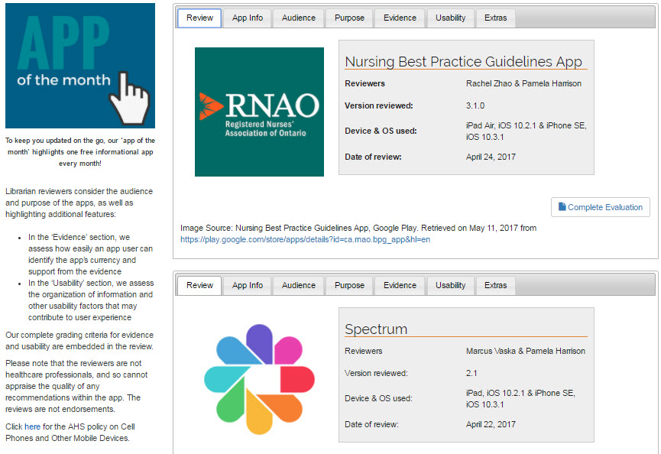

Slide 14
Sample review
Nursing Best Practice Guidelines
By the Registered Nurses’ Association of Ontario
Evaluation at: krs.libguides.com/mobile/appofthemonth
Image source: RNAO Nursing Best Practice Guidelines. (2016). iTunes Canada. Retrieved on May 14, 2016, from https://itunes.apple.com/ca/app/rnao-nursing-best-practice-guidelines/id386783615?mt=8

Slide 15
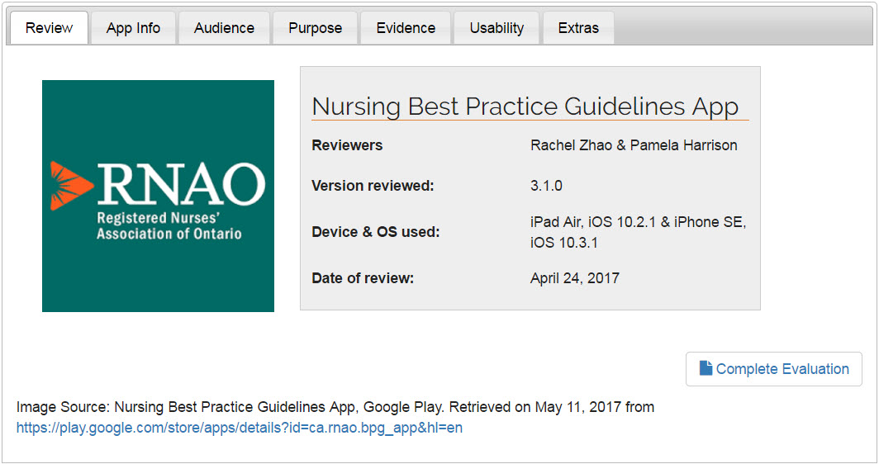

Slide 16
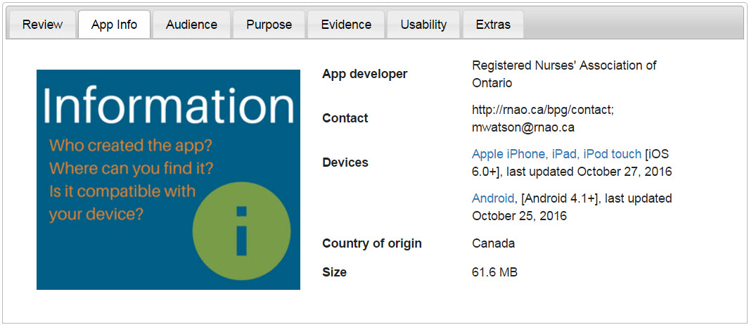

Slide 17
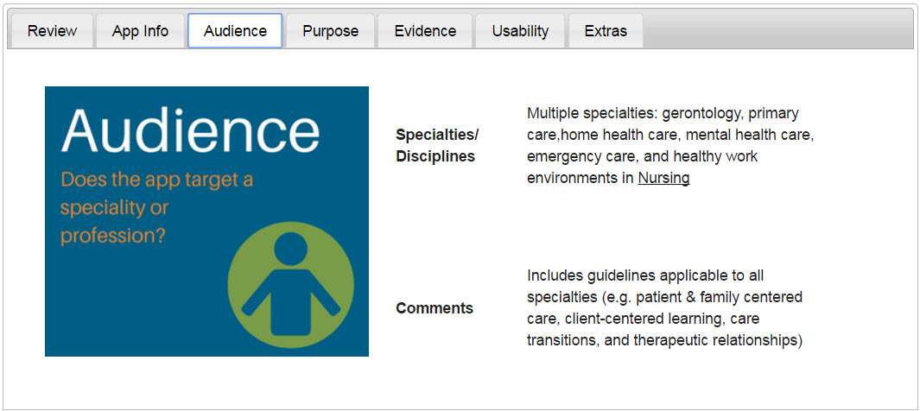

Slide 19
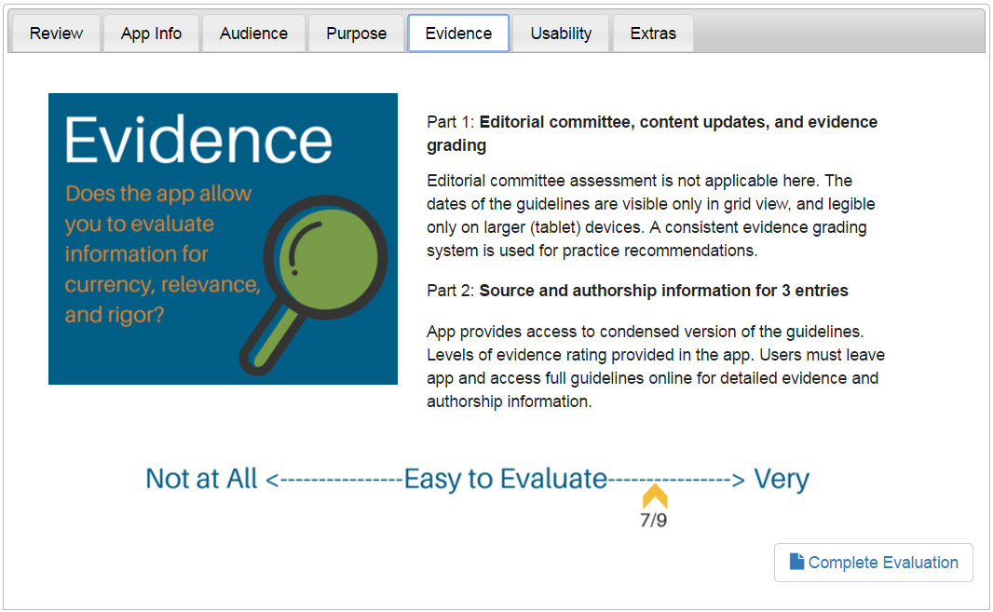

Slide 20
Excerpt from Complete Evaluation (Evidence)
Category | Item | Answer / Supplementary assessment | Rating (if applicable)
Content updates (5, 7, 8, 11, 12) | Entries are clearly dated | Displayed on cover page of guidelines in grid view; not visible in list view | Select: □ 0 pts: No X 1 pt: Yes
 | Comments on update frequency | Version 3.1.0 added new guideline on pressure injuries (October 27, 2016) | N/A

Slide 21
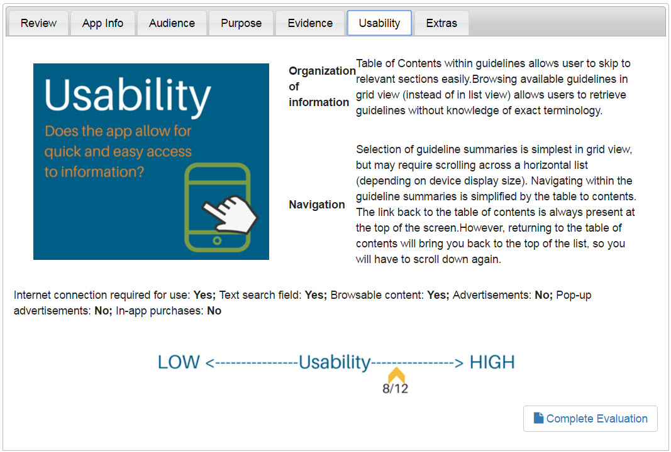

Slide 22
Excerpt from Complete Evaluation (Usability)
Category | Item | Answer / supplementary assessment | Rating (if applicable)
Organization of information scheme (3, 9) | -- | Available guideline list can be viewed as a grid or A-Z list. […] Each guideline summary has a table of contents, with the majority including (as applicable): Background information Practice recommendations […] | Select: □ 0 pts: Unclear or nonexistent organization scheme □ 1 pt: scheme easy to understand after initial learning curve X 2 pts: scheme was intuitive, information clearly organized

Slide 23
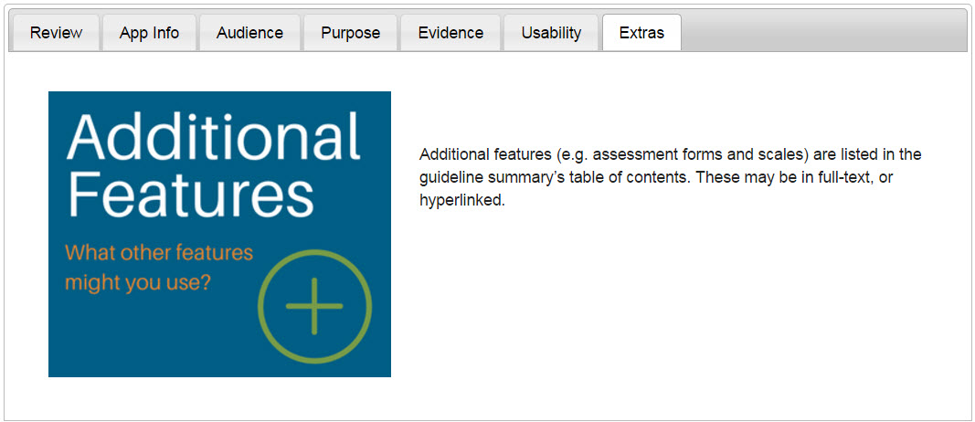

Slide 24
Moving forward
Short-term assessment:
Consult contacts familiar with app appraisal
Convenience sampling of clients
Call for feedback, starting with colleagues
Long-term assessment TBD

Slide 25
Contact us:
Pamela.Harrison@ahs.ca
XurongRachel.Zhao@ahs.ca Marcus.Vaska@ahs.ca

Slide 26
References
Brouard, B., Bardo, P., Bonnet, C., Mounier, N., Vignot, M., & Vignot, S. (2016). Mobile applications in oncology: Is it possible for patients and healthcare professionals to easily identify relevant tools? Annals of Medicine, 48(7), 509-515.
Butcher, R., MacKinnon, M., Gadd, K., & LeBlanc-Duchin, D. (2015). Development and examination of a rubric for evaluating point-of-care medical applications for mobile devices. Medical Reference Services Quarterly, 34(1), 75-87.
Farag, S., Fields, J., Pereira, E., Chyjek, K., & Chen, K. T. (2016). Identification and rating of gynecologic oncology applications using the APPLICATIONS scoring system. Telemedicine and e-Health, 22(12), 1001-1007.
Lee, H., Sullivan, S. J., Schneiders, A. G., Ahmed, O. H., Balasundaram, A. P., Williams, D., et al. (2015). Smartphone and tablet apps for concussion road warriors (team clinicians): A systematic review for practical users. British Journal of Sports Medicine, 49(8), 499-505.
April 29, 2017

Slide 27
References
McNiel, P., & McArthur, E. C. (2016). Evaluating health mobile apps: Information literacy in undergraduate and graduate nursing courses. Journal of Nursing Education, 55(8), 480-480.
Pilcher, J. (2016). Mobile apps for educational purposes. Journal for Nurses in Professional Development, 32(5), E15-7.
Rozati, H., Shah, S. P., & Shah, N. (2015). Smartphone applications for the clinical oncologist in UK practice. Journal of Cancer Education, 30(2), 367-373.
Seed, S. M., Khov, S. L., Binguad, F. S., Abraham, G. M., & Aungst, T. D. (2016). Identification and review of mobile applications for travel medicine practitioners and patients. Journal of Travel Medicine, 23(4), taw034.
April 29, 2017

Slide 28
References
Singler, K., Roth, T., Beck, S., Cunningham, M., & Gosch, M. (2016). Development and initial evaluation of a point-of-care educational app on medical topics in orthogeriatrics. Archives of Orthopaedic and Trauma Surgery, 136(1), 65-73.
Stoyanov, S. R., Hides, L., Kavanagh, D. J., Zelenko, O., Tjondronegoro, D., & Mani, M. (2015). Mobile app rating scale: A new tool for assessing the quality of health mobile apps. JMIR mHealth and uHealth, 3(1), e27.
Tyndall, J. (2010). AACODS checklist. Adelaide Flinders University. Retrieved on May 10, 2017, from https://dspace.flinders.edu.au/jspui/bitstream/2328/3326/4/AACODS_Checklist.pdf
Wyatt, J. C., Thimbleby, H., Rastall, P., Hoogewerf, J., Wooldridge, D., & Williams, J. (2015). What makes a good clinical app? introducing the RCP health informatics unit checklist. Clinical Medicine (London, England), 15(6), 519-521.
April 29, 2017

