Slide 1
Free and open teaching materials:
when, why, and how
CTL Teaching Institute Aug 19, 21 & 22, 2019
All slides are CC BY unless otherwise noted

Slide 2
What are OER?
Notes:
Before we start to explore OER, let’s first lay the groundwork of what is an Educational Resource. What type of materials do we teach with or use to learn? What are some examples of resources you use in your classroom now?
Textbooks
Journal articles
Websites
Videos

Slide 3
What are OER?
Open Educational Resources (OER) are teaching, learning, and research resources that reside in the public domain or have been released under an intellectual property license that permits repurposing by others.
Notes:
How is this different from free resources you find online?
Definition of repurpose: adapt for use in a different purpose.

Slide 4
5 Rs of OER
Notes:
David Wiley

Slide 5
Usage Rights

Slide 6
Creators retain the copyright
in the materials they create.
Copyright status does not change
when you assign an open licence.

Slide 7
Attribution: Creative Commons, https://creativecommons.org/about/downloads/, CC-BY 4.
Notes:
Creative Commons licensing is the most commonly used way for creators to modify their copyright. With Creative Commons licensing, OER carry the permissions for users to freely download, edit, and share the content to better serve all students. The licenses are free, and with easily understandable language and symbols help creators easily navigate through the process of selecting how they want their work to be used by others. It is important to understand that a CC license is not in violation of copyright and does not replace or mean you are giving up copyright; in fact, CC licensing cannot exist without copyright law. Remember, it is taking an “all rights reserved” and making it “some rights reserved”.

Slide 8
Attribution (BY)
No Derivatives (ND)
Share Alike (SA)
Non Commercial
(NC)

Slide 9
When and why

Slide 10
Examples

Slide 11
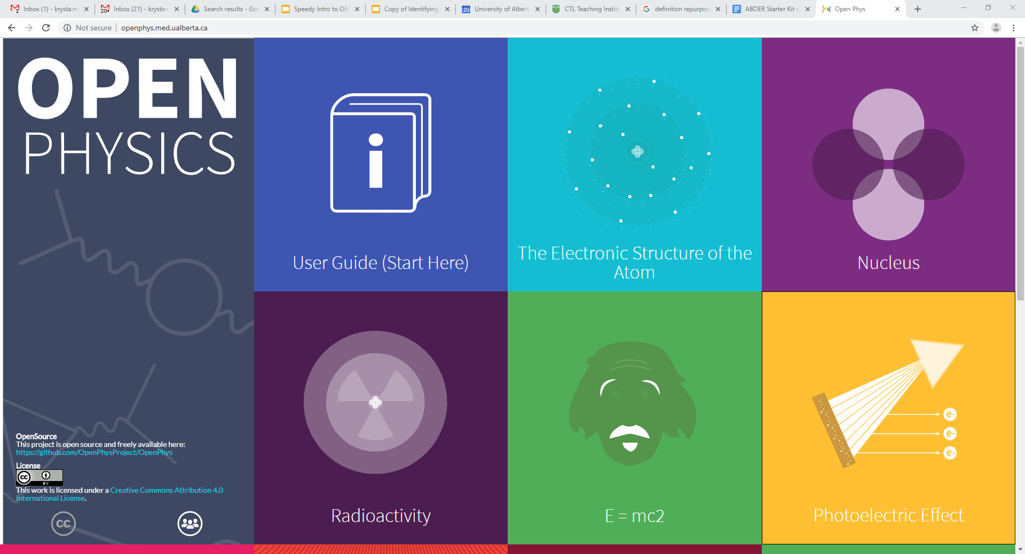
http://openphys.med.ualberta.ca/

Slide 12
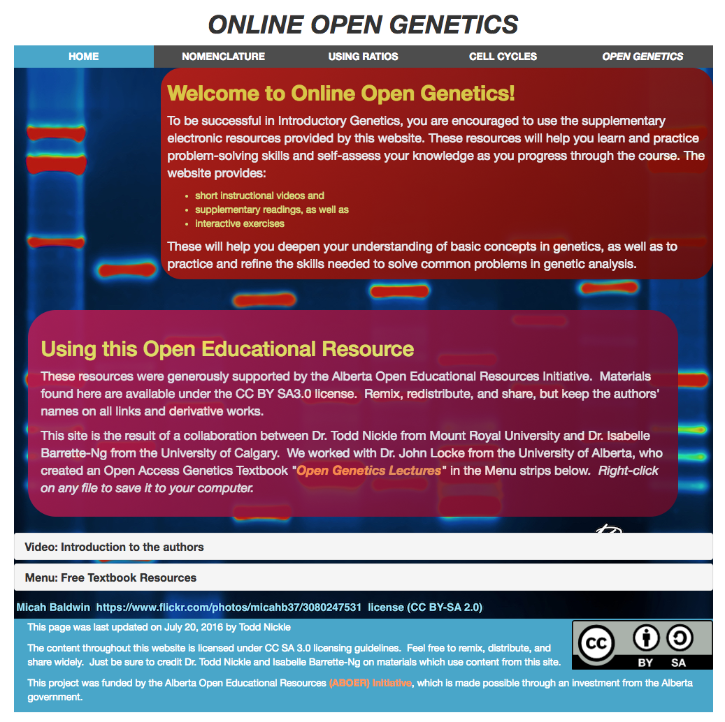
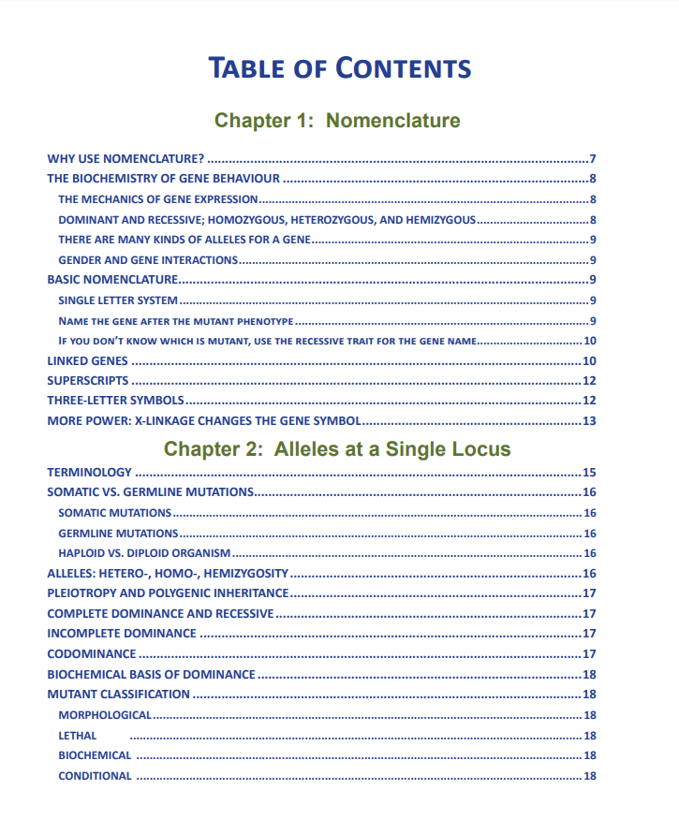
http://opengenetics.net/

Slide 13
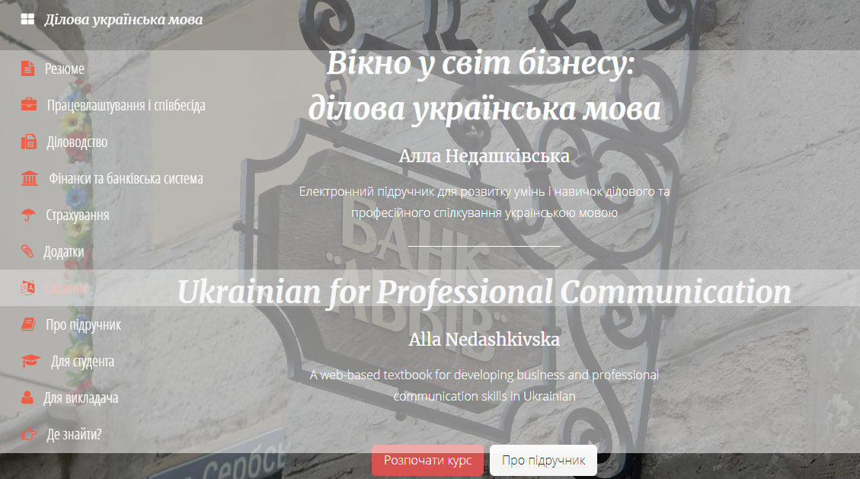
https://businessukrainian.com/

Slide 14
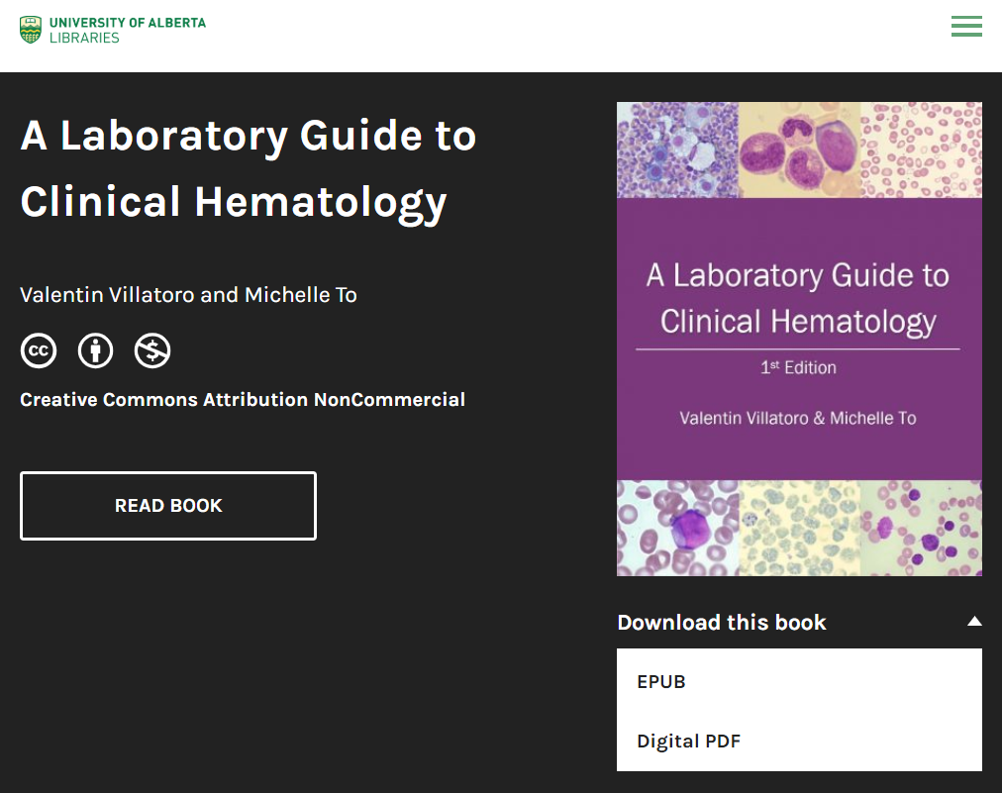
https://pressbooks.library.ualberta.ca/mlsci/

Slide 15
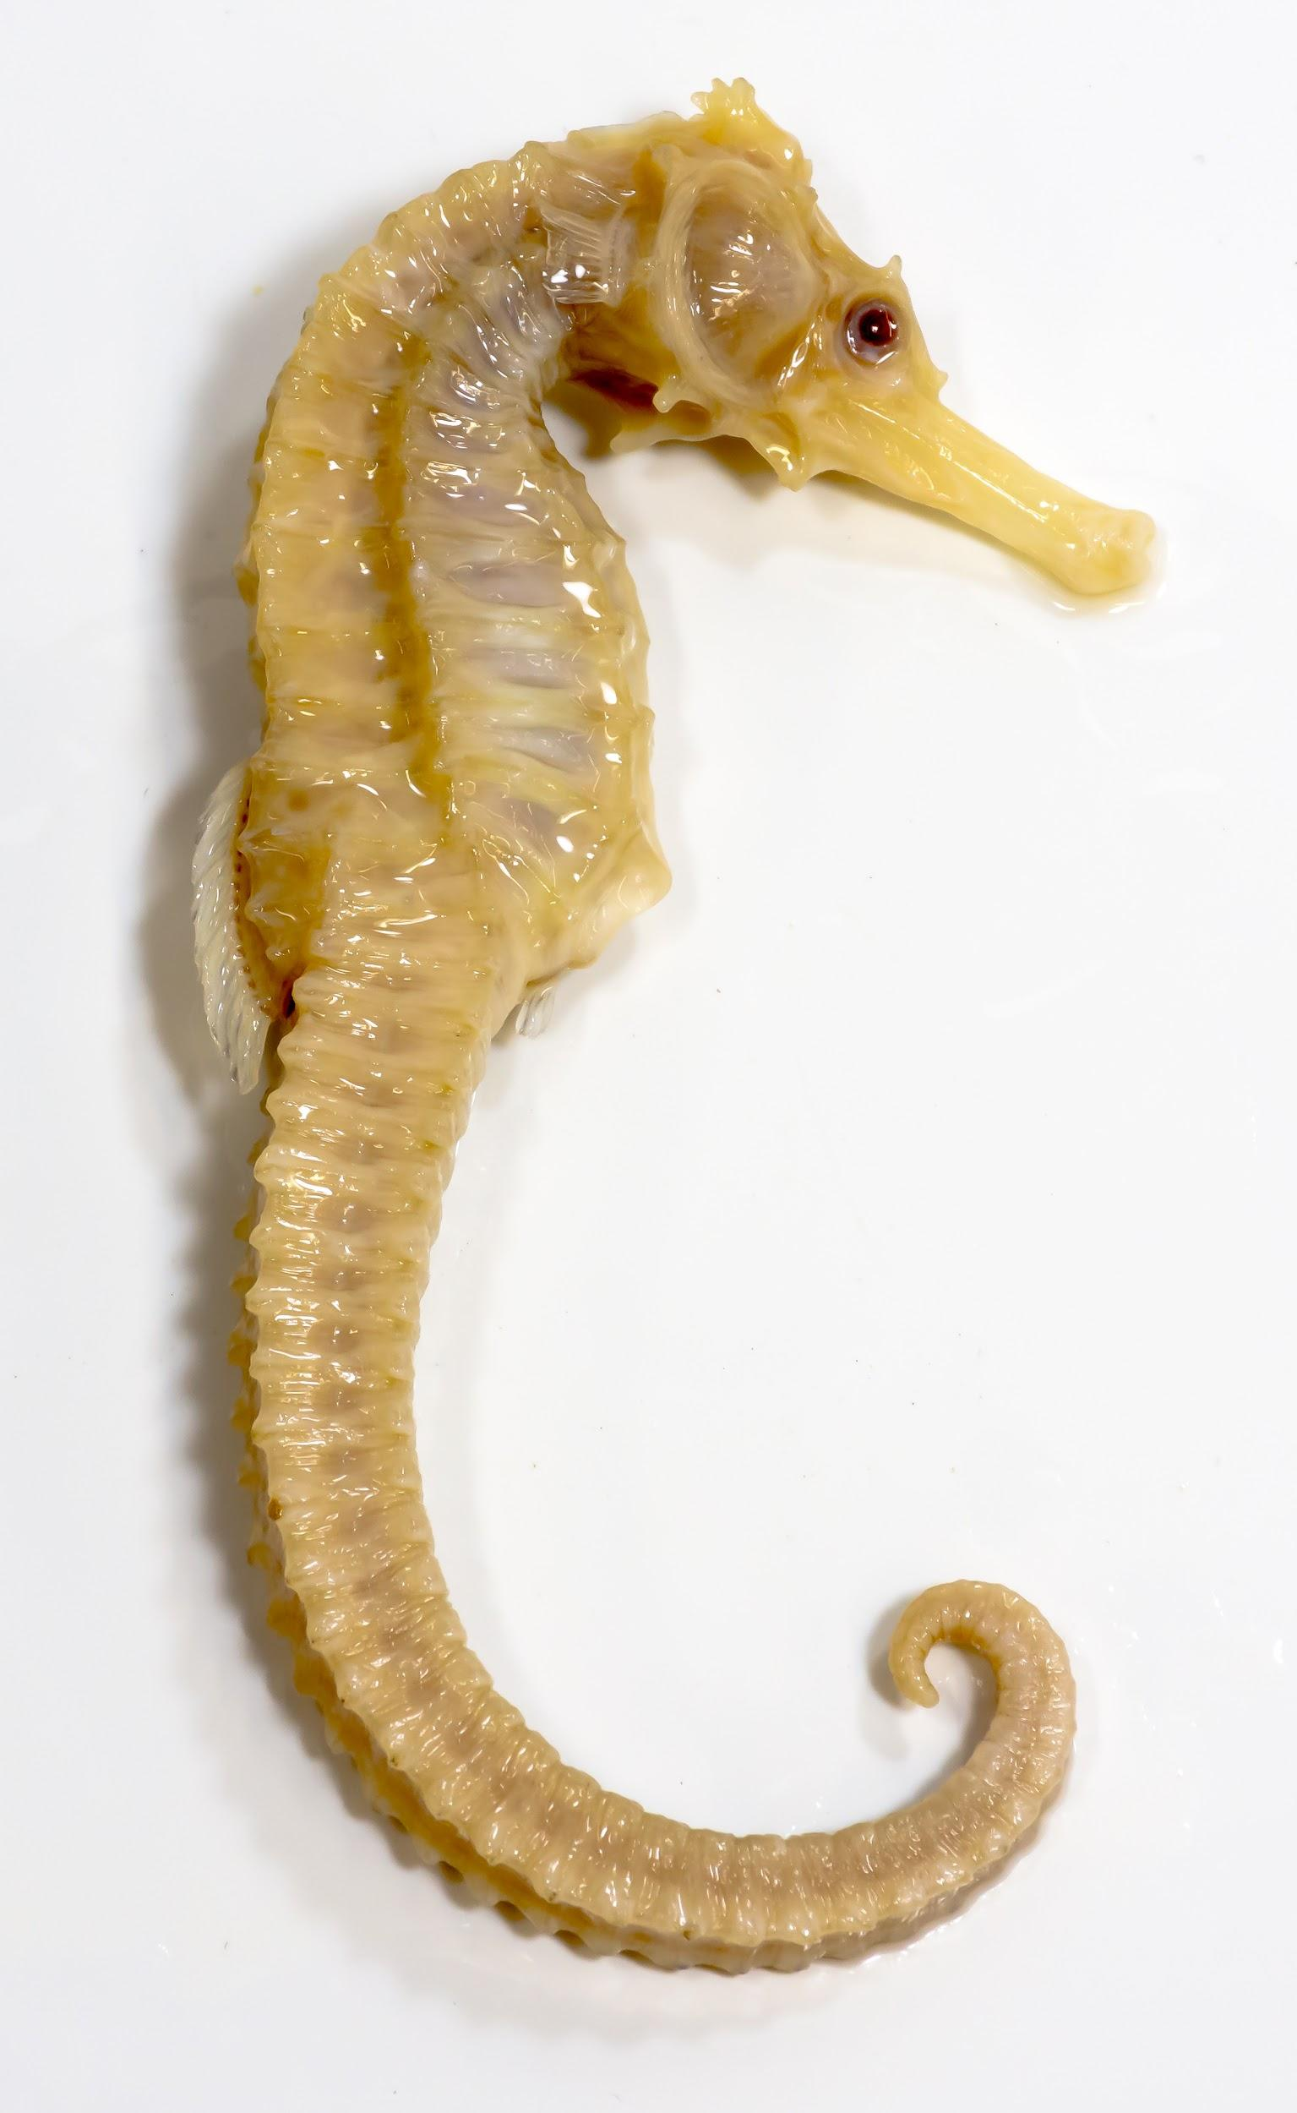
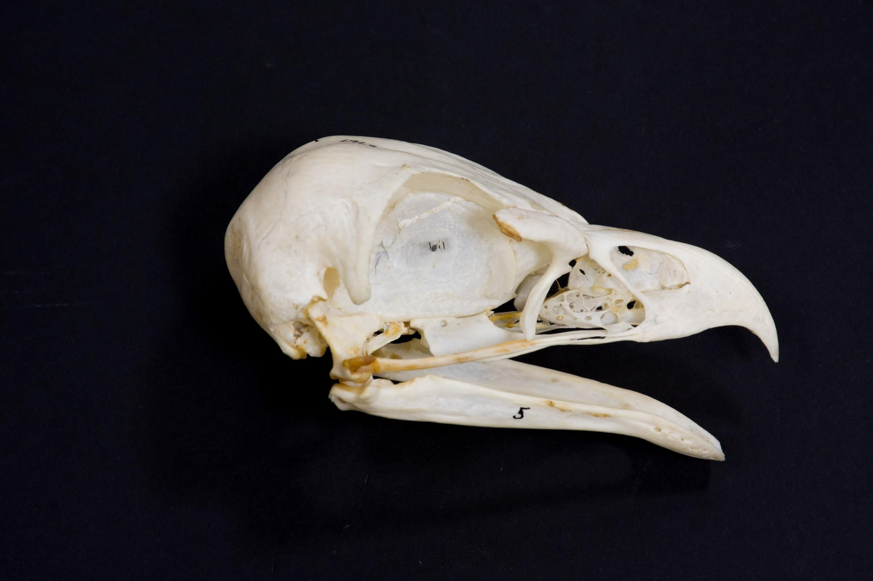
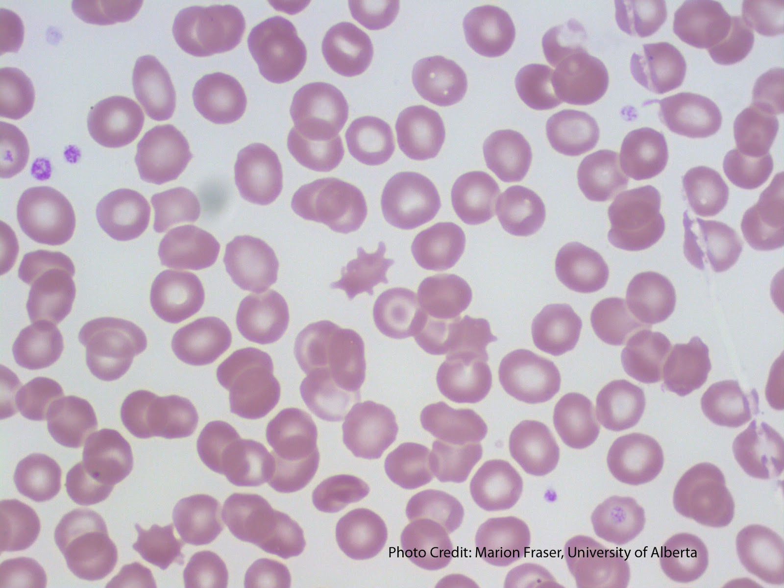
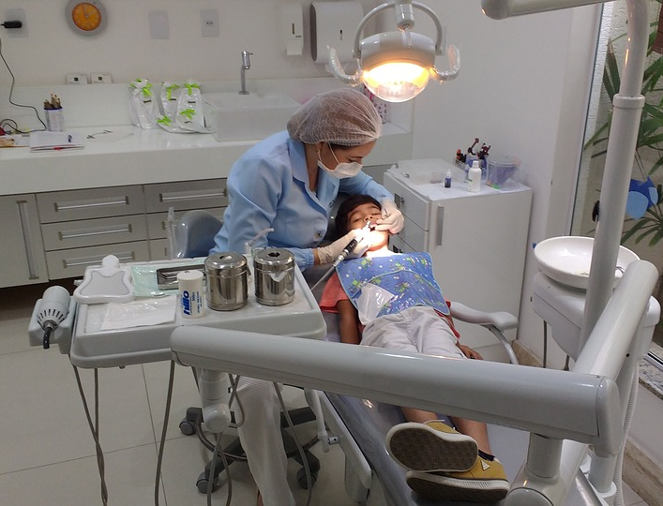
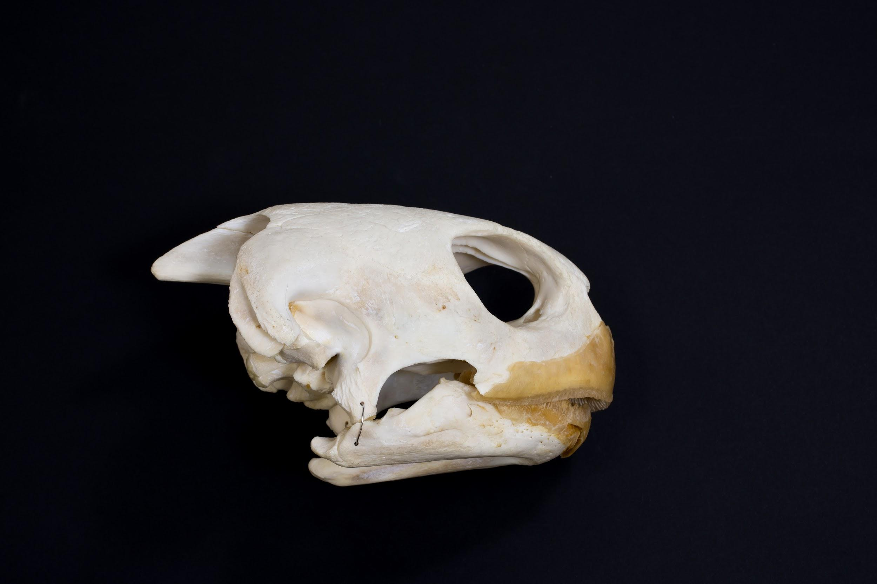
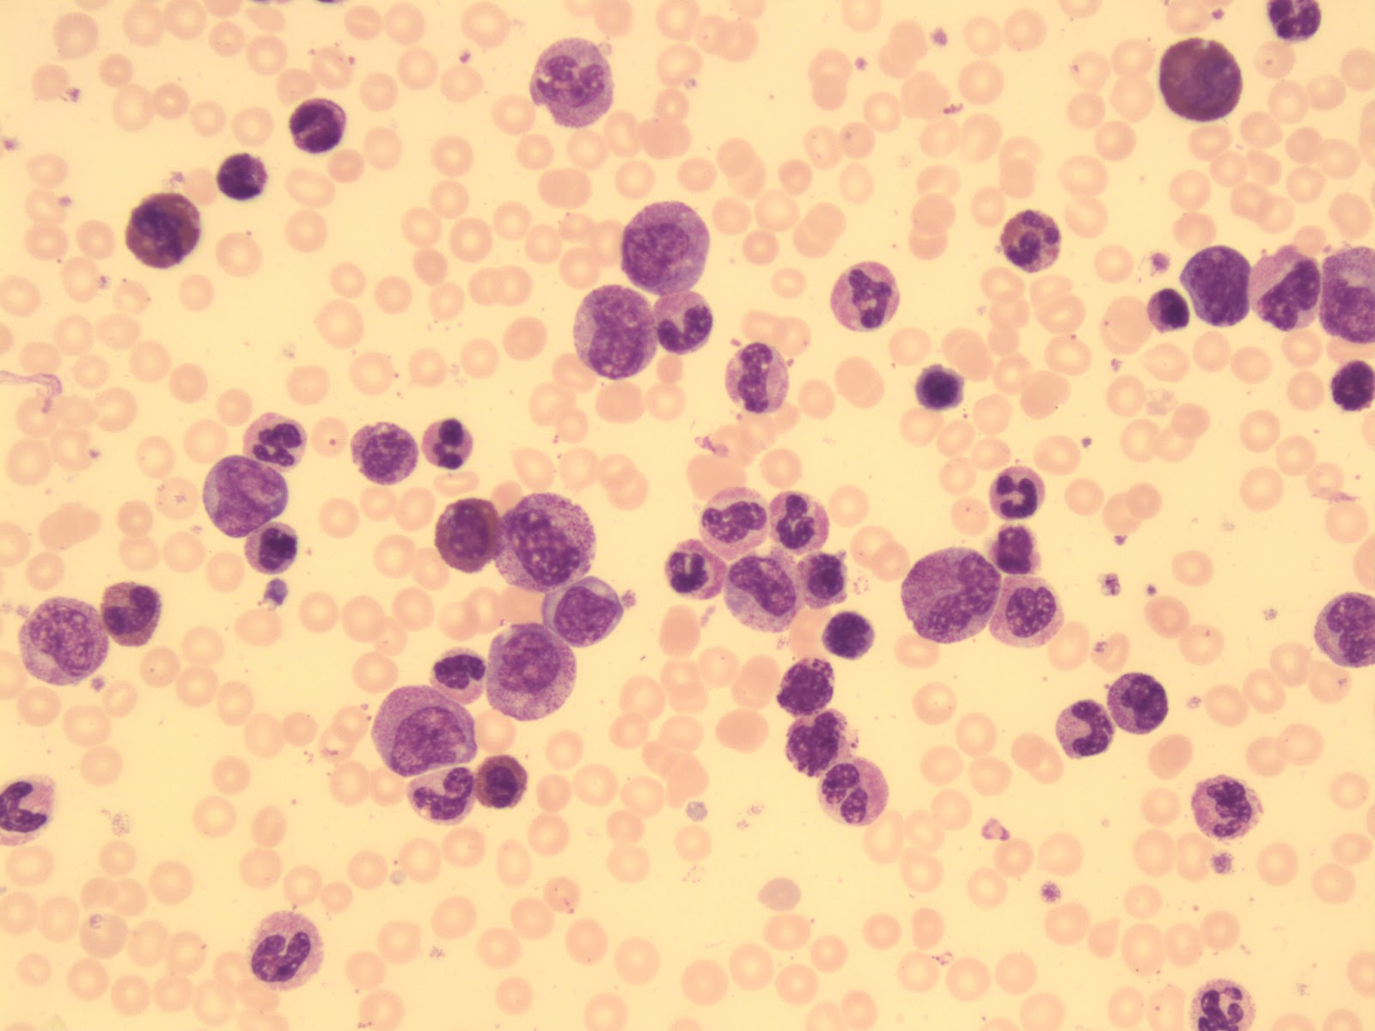
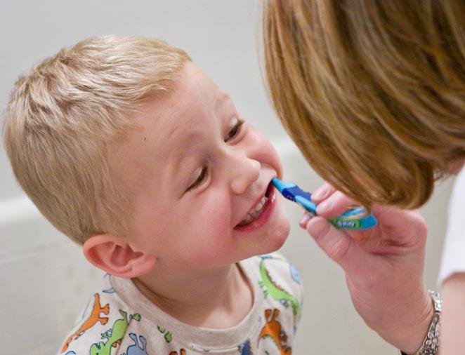
Image Sources: University of Alberta, Faculty of Medicine and Dentistry, School of Dentistry, Pediatric Dentistry Image Collection
Image Sources: University of Alberta, Faculty of Science, Department of Biological Sciences, Open Image Collection

Slide 16
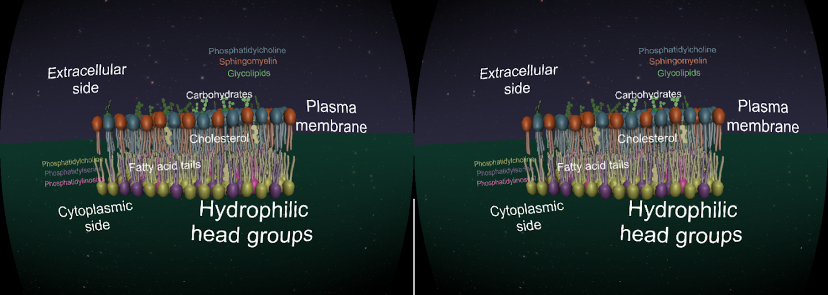
https://www.folio.ca/vr-app-gives-medical-students-a-new-way-to-see-inner-workings-of-cells/
https://cell101.arvr.ca/

Slide 17
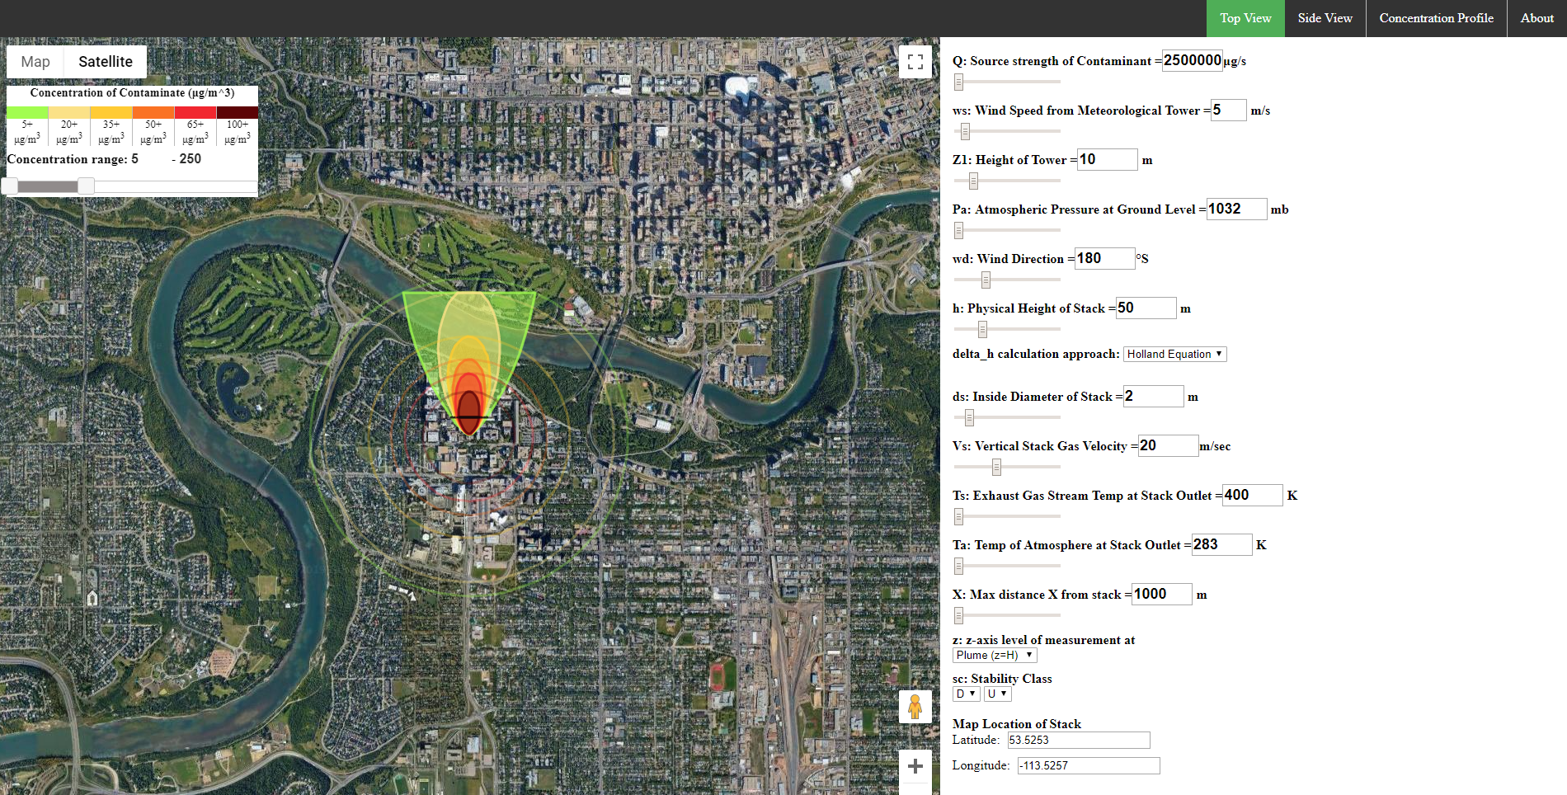
https://falon3.github.io/oer_visualTools/plume.html#top

Slide 18
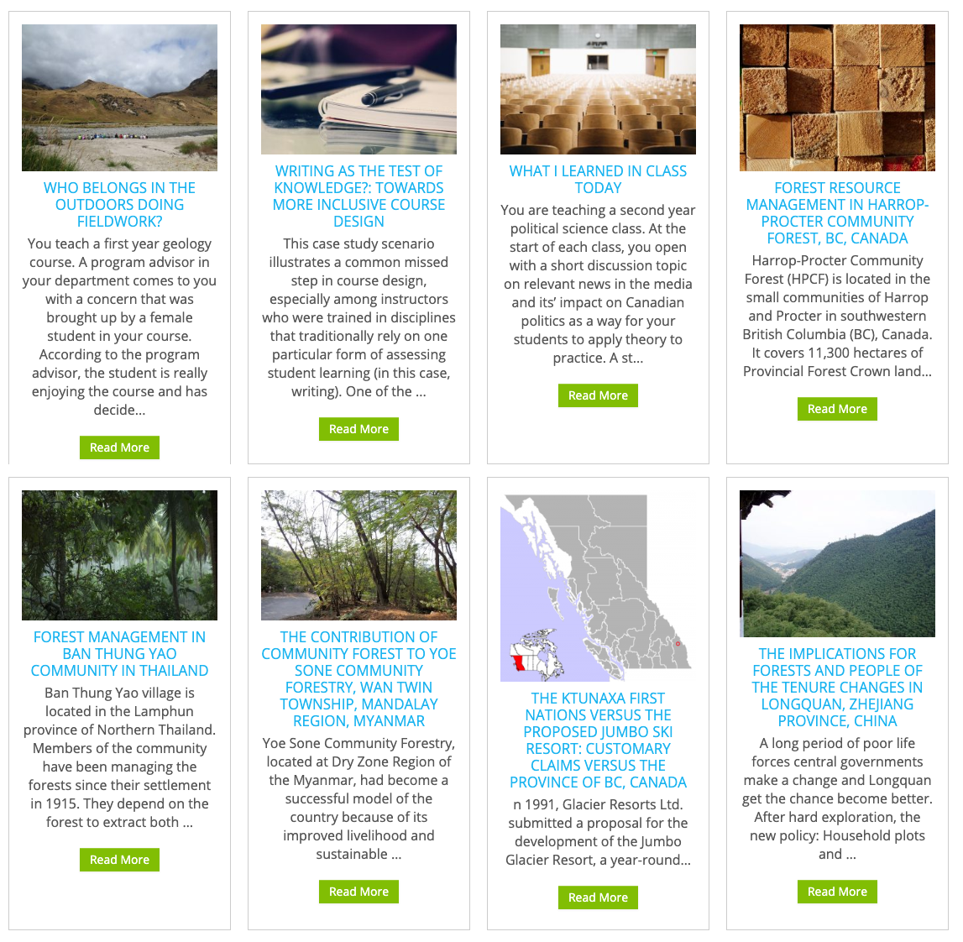
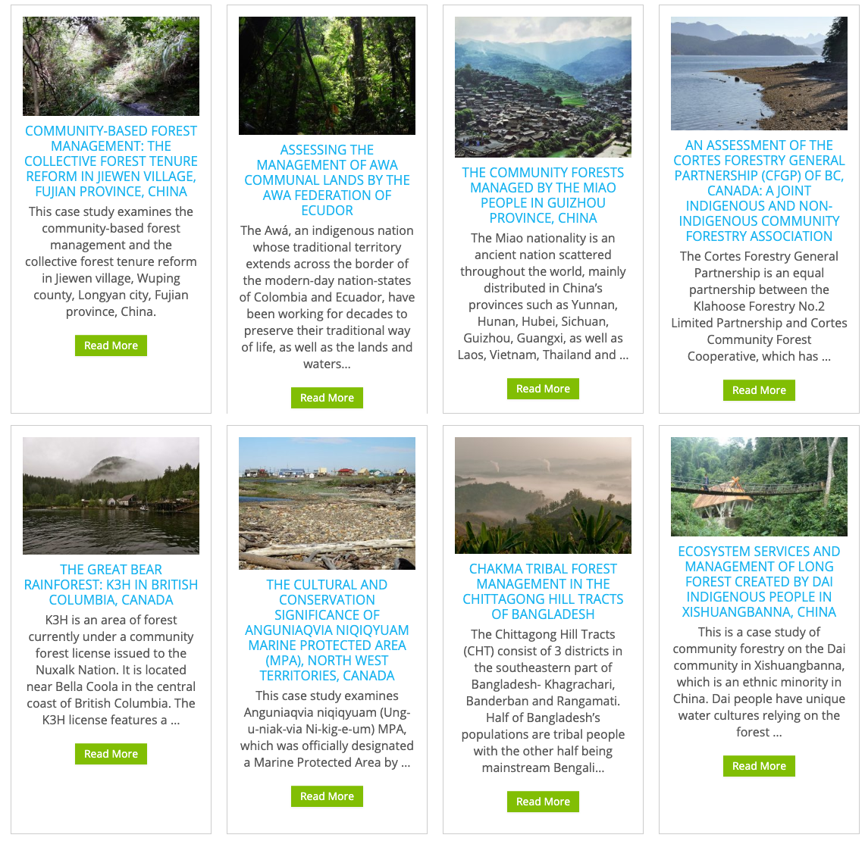
http://cases.open.ubc.ca/

Slide 19
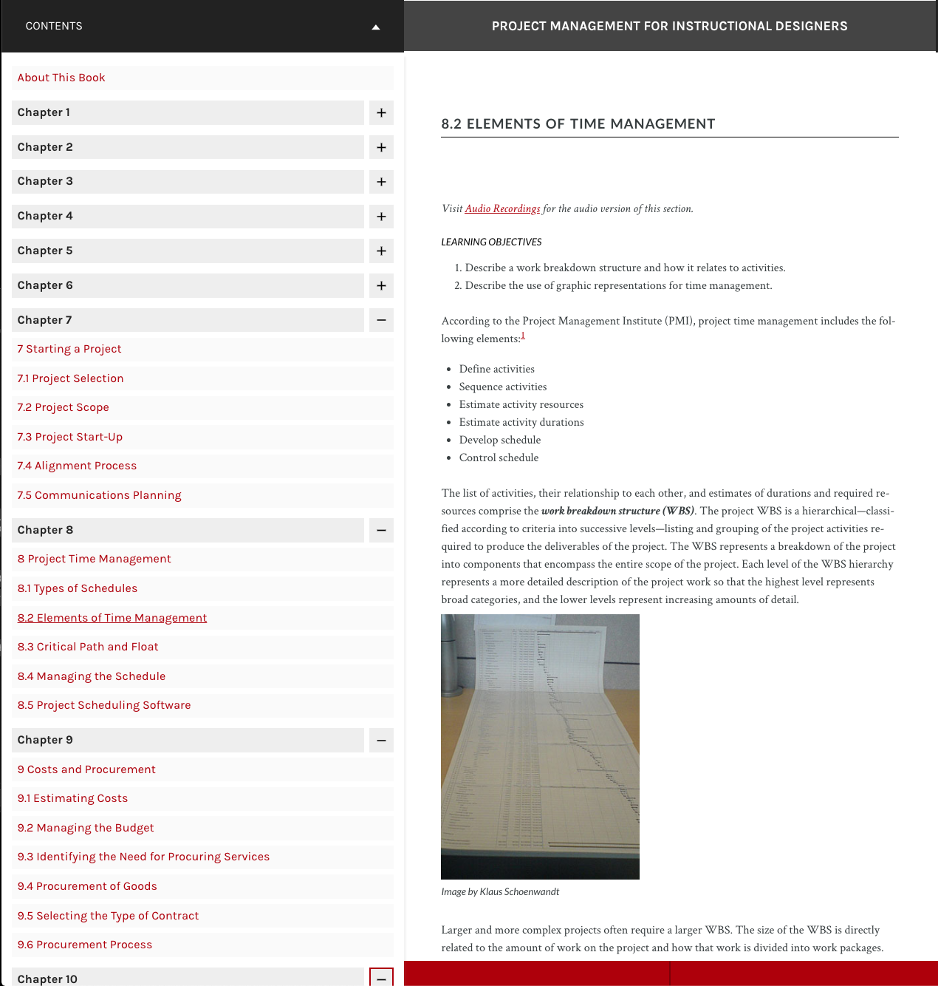
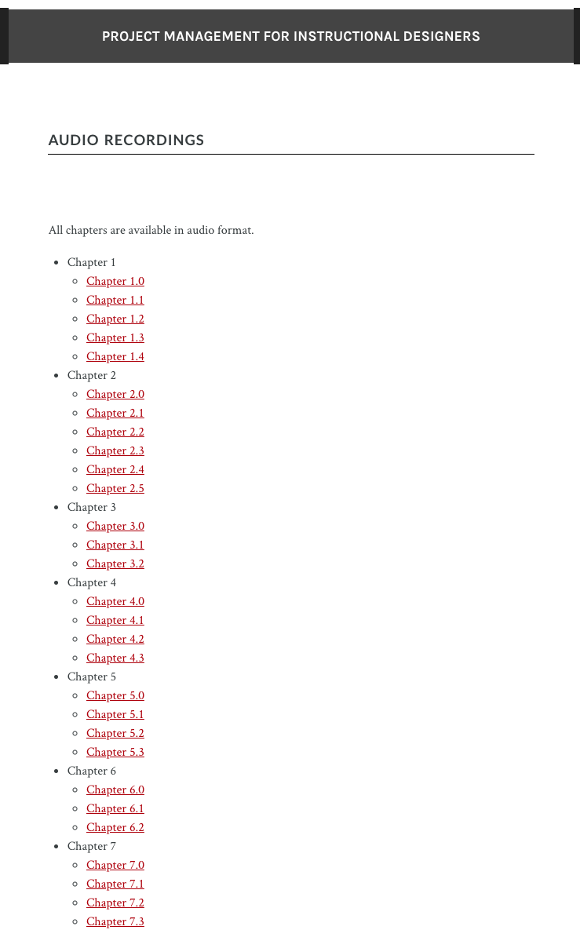
https://pm4id.org/

Slide 20
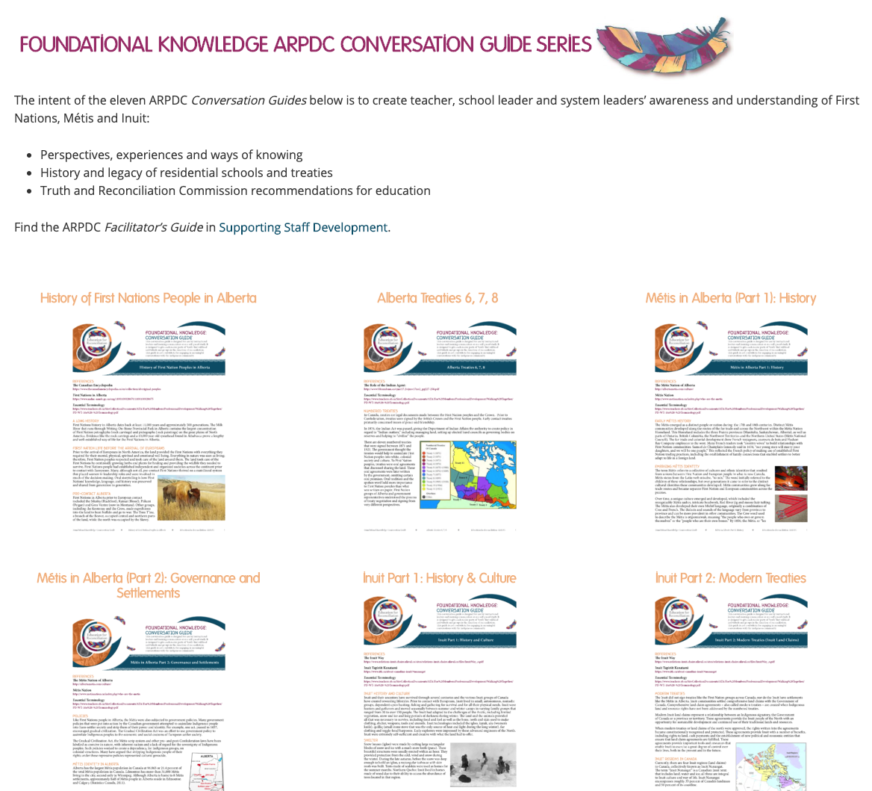
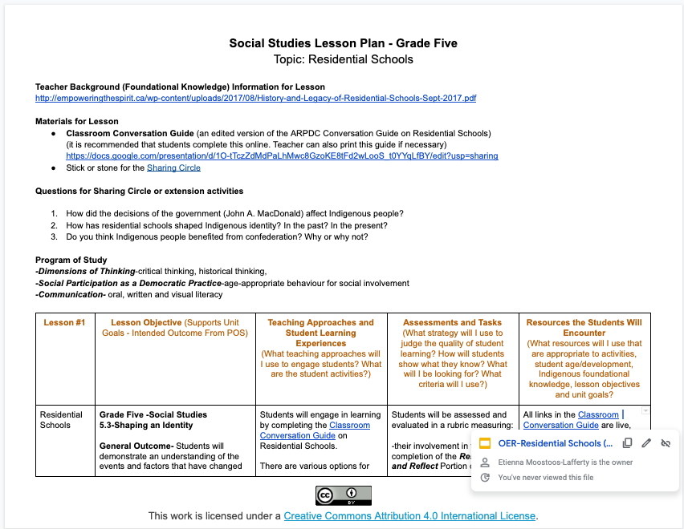
empoweringthespirit.ca | Social Studies Lesson Plan - Grade Five. Topic: Residential Schools

Slide 21
Finding OER

Slide 22
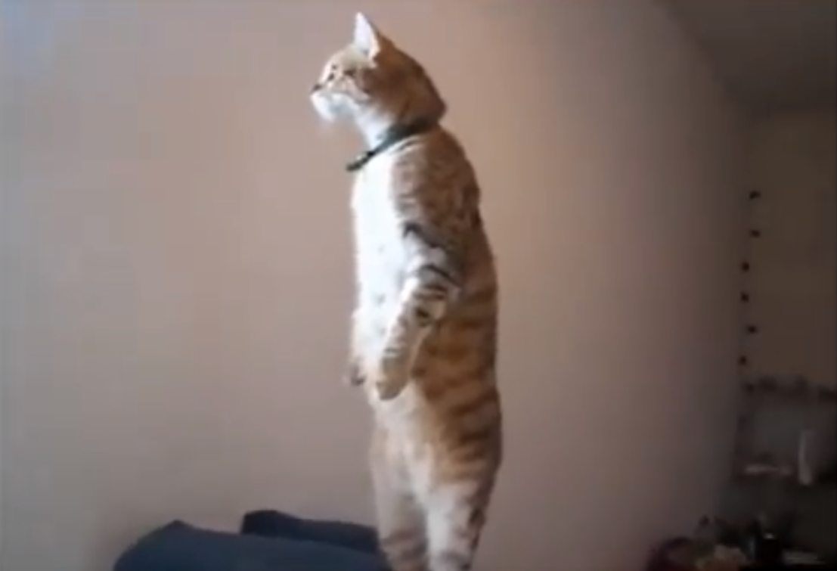
“Crazy and Funny Cats - Creative Commons” by Christian Aceberos is licensed under a Creative Commons CC BY-SA 3.0 license.
Notes:
This image is a screenshot of the video in the next slide. I was able to easily capture the requirements of the attribution statement from viewing the YouTube description of the video and following the instructions on the Creative Commons “best practices for attribution” article here: https://wiki.creativecommons.org/wiki/best_practices_for_attribution

Slide 23
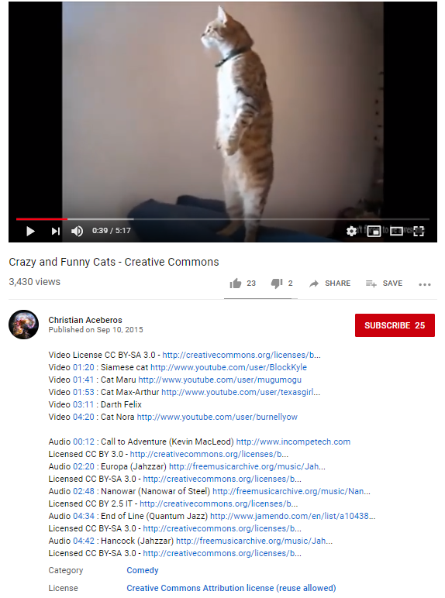
https://www.youtube.com/watch?v=yINjxluMrUA
Notes:
Youtube
In this example, I discovered a video of “funny cats” on You Tube which has a Creative Commons license. I searched for “funny cats” on You Tube and then clicked “filter” and chose “Creative Commons”. Not only can I see that the video overall is licensed as CC-BY-SA.

Slide 24
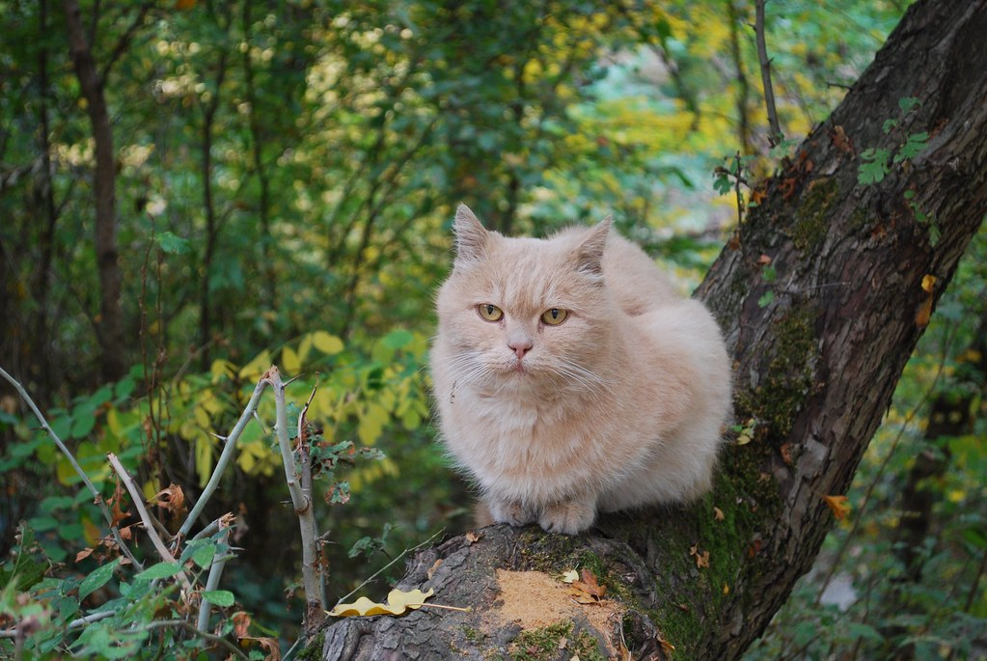
"Cat in the forest" by fettahor is licensed under CC BY-ND 2.0

Slide 25
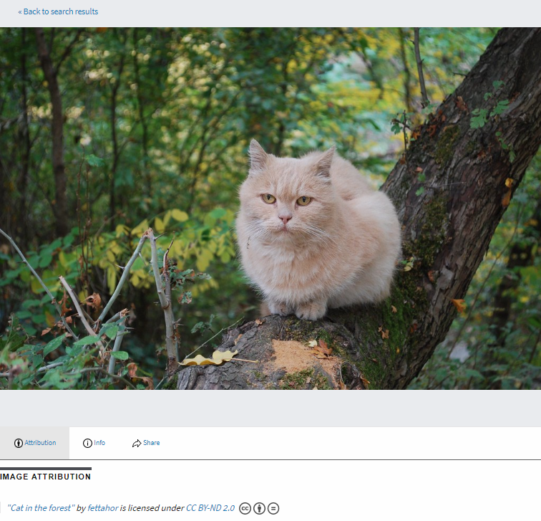
https://search.creativecommons.org/photos/f4589973-a9df-4efa-ab5c-b5c762aa563d
Notes:
Creative Commons Search
In this example I found a similarly orange cat using the Creative Commons search function. I limited the usage rights filter to lead me to an image which is licensed as ND (no derivatives) to remind the audience that Creative Commons licenses are not only applicable to OER (licensed for adaptation) but also for ND content which is licensed for reuse but does not allow for modification.

Slide 26
https://opentextbc.ca/introductiontopsychology/
Notes:
Here I am sharing an open textbook which is localized to Canada. I point out the license and the fact that it is a pressbooks textbook so it allows for cloning, click-to-print, and can be imported to an ereader.

Slide 27
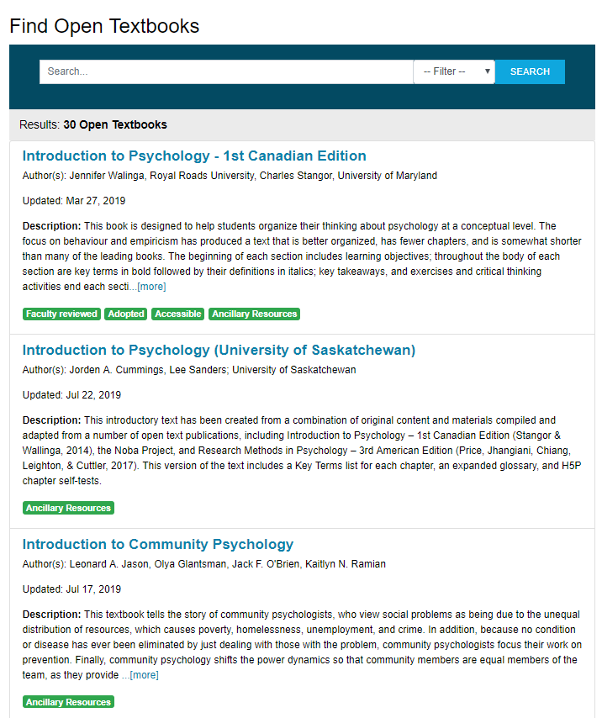
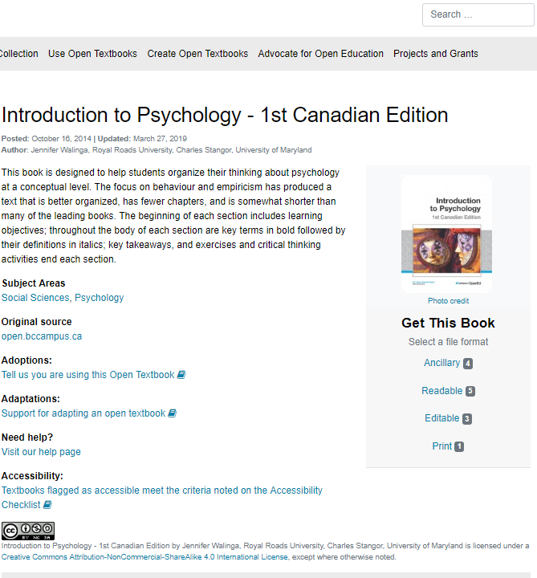
https://open.bccampus.ca/browse-our-collection/find-open-textbooks/
Notes:
Then, I show the BCcampus repository including the search result view to show the tags indicating “faculty reviewed”, “adopted”, “accessible”, “ancillary resources”, etc.

Slide 28
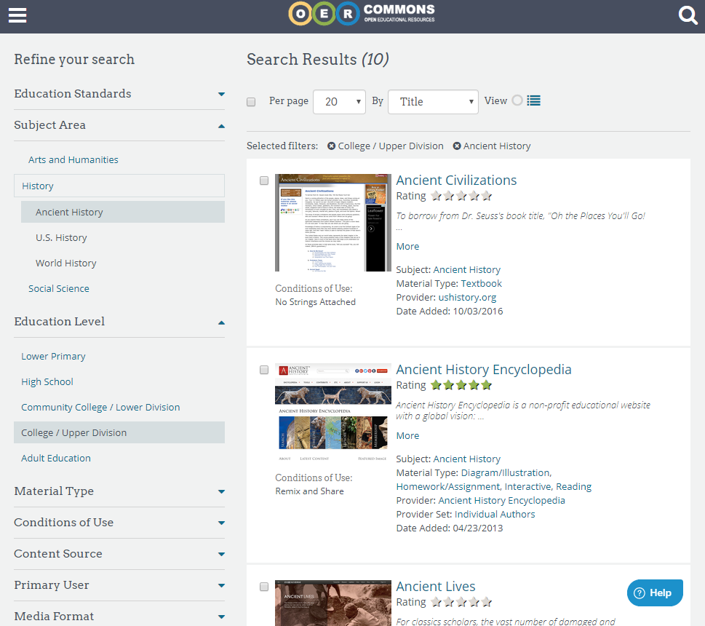
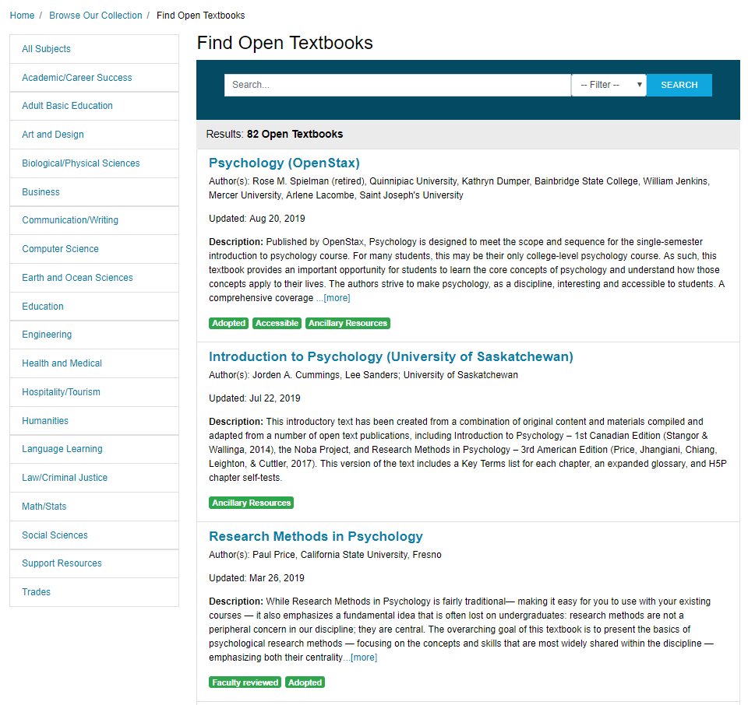
| https://open.bccampus.ca/browse-our-collection/find-open-textbooks/

Slide 29
UA OER Awards Program

Slide 30
UA OER Awards Program
GERM 111, 112, PSYCHO 403, BIO 107/108/207/208, EDEL 316, EDEL 335, SCI 101 Finding and Using OER | Developing OER
EAS 233, CELL 201, DDS 545-2, ENG 423
open textbooks, course packs, class assignments, interactive resources, media collections

Slide 31
Evaluation Criteria
Exploration
Class size & frequency
Student Engagement
Student
Impact
Cost Savings to Students
Transfer- ability
Potential beyond UofA

Slide 32
Project Agreements
Evaluations | Institutional Repository
Student Teams
OERs are stored in the UA Educational Research Archive (ERA)
Course outlines, project team interviews
Funding stays in CTL, staffed by students
CC-BY, CC-BY-SA, CC-BY-NC, or CC-BY-NC-SA

Slide 33
CTL, Libraries, Copyright Office
Workshops / Sessions
Consultations
Teaching and Learning Grants
subject matter librarians, digital initiatives librarians, educational developers, instructional designers, copyright librarians & officers
oer@ualberta.ca

Slide 34
Questions?
Notes:
To close out the workshop, explain the badge that participants will receive.

Slide 35
Thank you!
ctl@ualberta.ca | oer@ualberta.ca Krysta McNutt, OE Program Lead krystam@ualberta.ca

Slide 36
Quick Links
Alberta OER Starter Kit
UA OER Awards Program
UAL Publishing Services
OER Commons
BC Open Textbook Collection
Creative Commons Search

