Slide 1
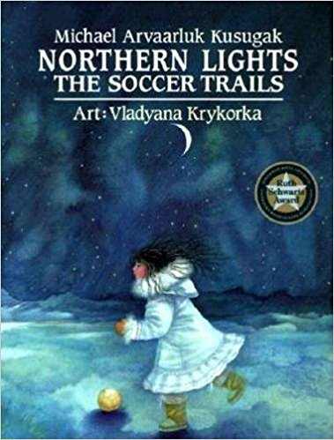
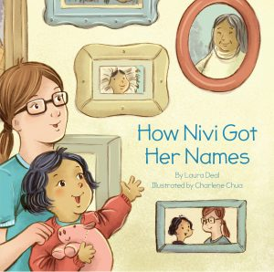
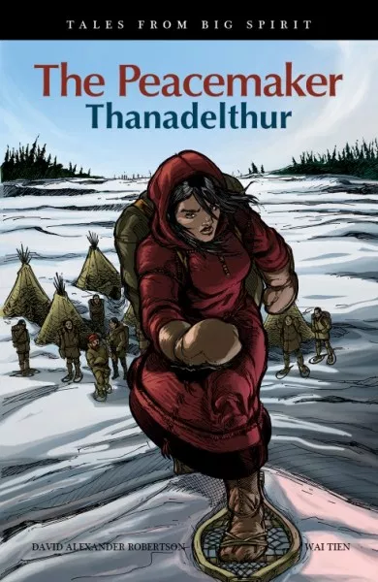
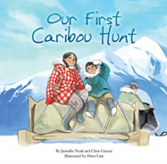
Canadian Indigenous Children’s Books Through the Lens of Truth and Reconciliation
Sandy Campbell¹ , Maria Tan¹ and Andrea Quaiattini ²
  1 John W. Scott Health Sciences Library,
  University of Alberta
  2 Schulich Library of Physical Sciences, Life Sciences, and Engineering , McGill University

Slide 2
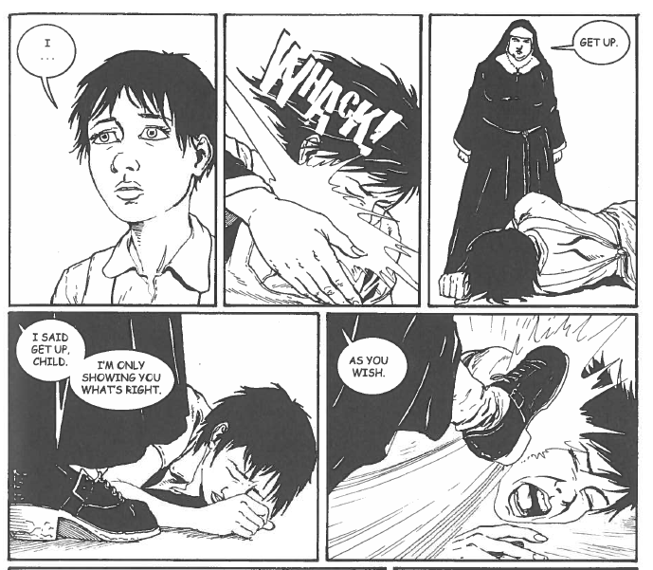
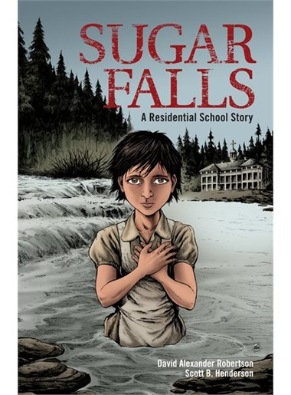
Truth and Reconcilliation Commission
Truth - Survivors’ testimony – horrific conditions at residential schools

Slide 3
Truth and Reconciliation Commission
Reconciliation
  6 volumes – 94 Calls To Action
  High level – difficult to grasp
  How should the average person respond?
Storytelling
  Traditional way of communicating
  If children can understand the content, perhaps we can.

Slide 4
Study Design
Amazon Best Sellers in Children’s Native Canadian Story Books
  7 weeks - August, 2017 – forward.
Public library lists, academic lists, publisher and author websites
More than 460 books identified
More than 150 books selected for list
Identified themes (116), collated themes,
Created book lists

Slide 5
Inclusion/Exclusion Criteria
Fictional works
Written for children (0 – 18)
Written by a Canadian Indigenous person (with some exceptions)
Contains material related to the TRC Calls to Action
No date limit
No place of publication limit

Slide 6
Limitations
Don’t know that we found everything
May have missed some authors
Interpretation of themes influenced by reviewers’ personal backgrounds

Slide 7
Conclusions
Children’s books provide good insight into Truth and Reconciliation
Non-threatening way to learn about Indigenous issues
Products
  List of books about Residential Schools
  List of books about Truth and Reconciliation and the way forward
  This paper/presentation, poster and presentation at Canadian Health Libraries Association to help build knowledge.

Slide 8
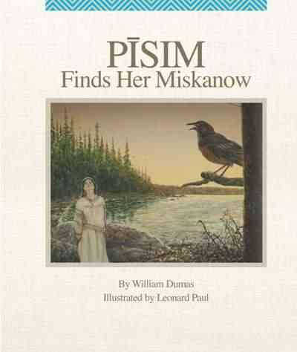
How to Move Forward
“The elders have been telling us for years that in order to move ahead we have to know where we are in the present and where we have been. Once you are grounded in the present and the past, you can move forward.”
Dumas, William. Pīsim Finds Her Miskanow. Winnipeg, Highwater Press, 2013, [p. 1]

Slide 9
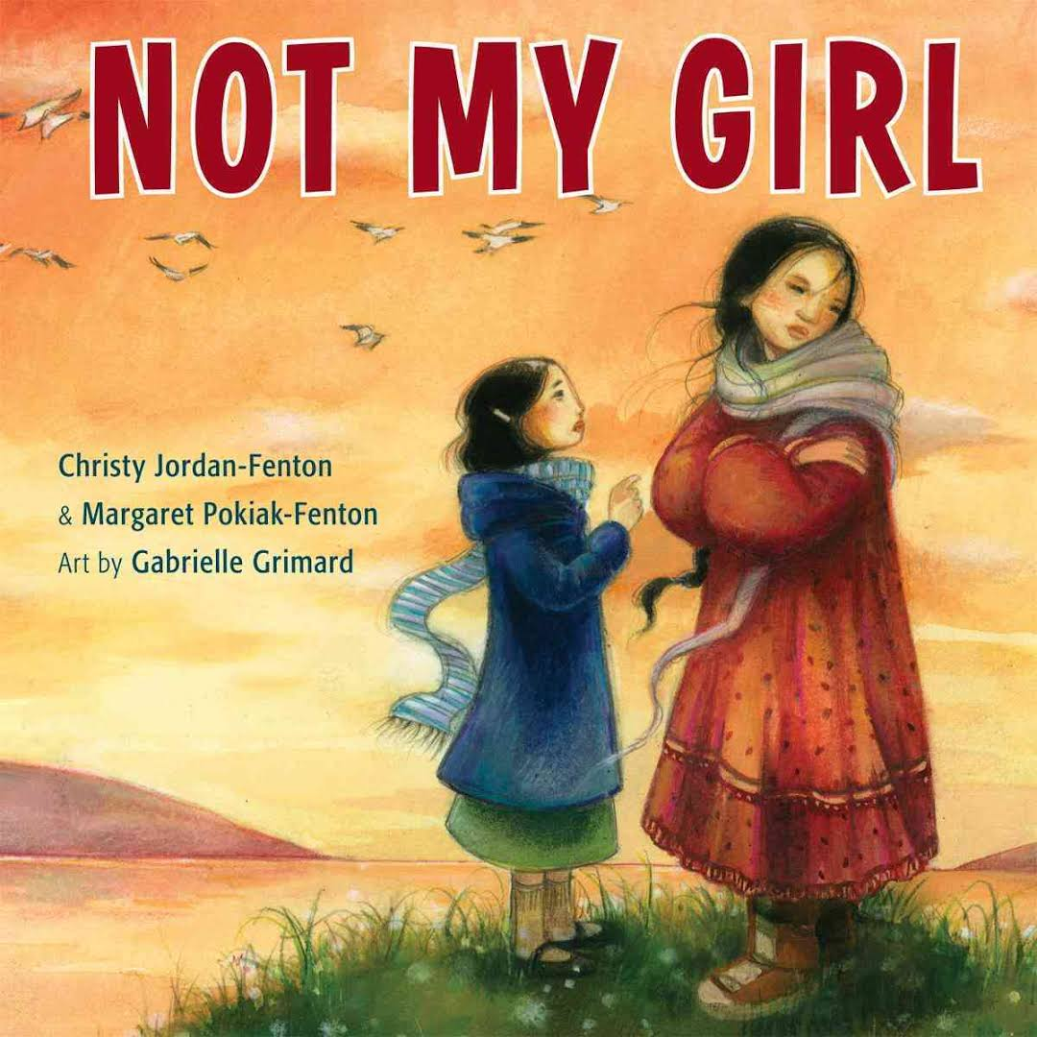
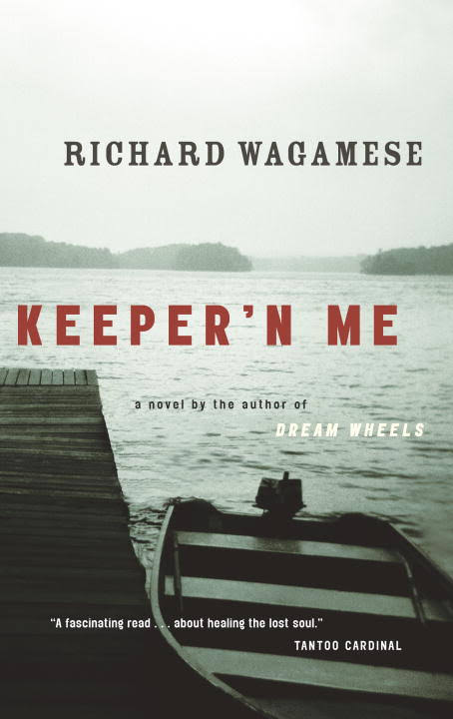
Two-eyed Seeing
Two-eyed seeing “recognizes the benefits of seeing from one eye with the strengths of Indigenous ways of knowing, from the other eye the strengths of the Western ways of knowing, and using both of these eyes together to create new forms of understanding and insight.”
Elder Albert Marshall (Mi’kmaq, Eskasoni First Nation)

Slide 10
Understanding Trauma and Inequity
Intergenerational Trauma
Missing and Murdered Indigenous Women
Health Care
Criminal Justice

Slide 11
Intergenerational Trauma and Legacy of Trauma
“It’s one of our favorite coping strategies. We hurt, we drink, we shoot cocaine, we hurt some more, we drink some more, shoot some more cocaine, and by that time we hurt so much, we hurt someone else. Turns out in the end we are all looking for a way out. And we hurt ourselves. Hurt people hurt people.”
Zeb in White Girl.
Olsen, Sylvia. White Girl. Winlaw, BC. Sono Nis Press, 2004, p.203.

Slide 12
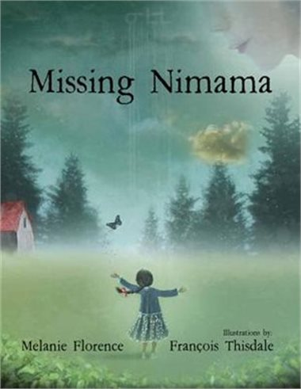
Missing and Murdered Indigenous Women

Slide 13
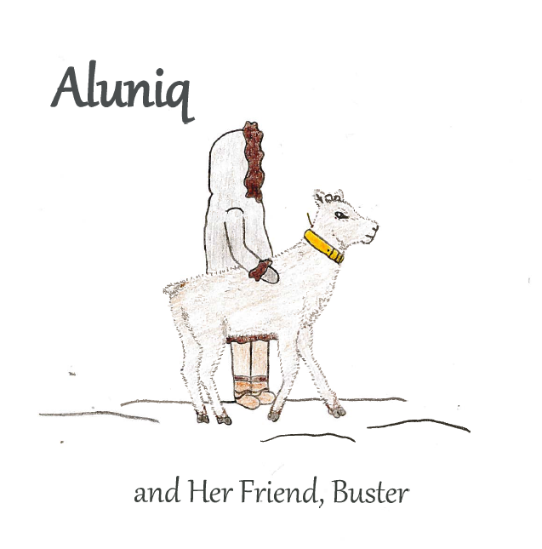
Health Care
Aluniq lives with her grandparents from birth, because her mother had to go south for years for medical treatment.

Slide 14
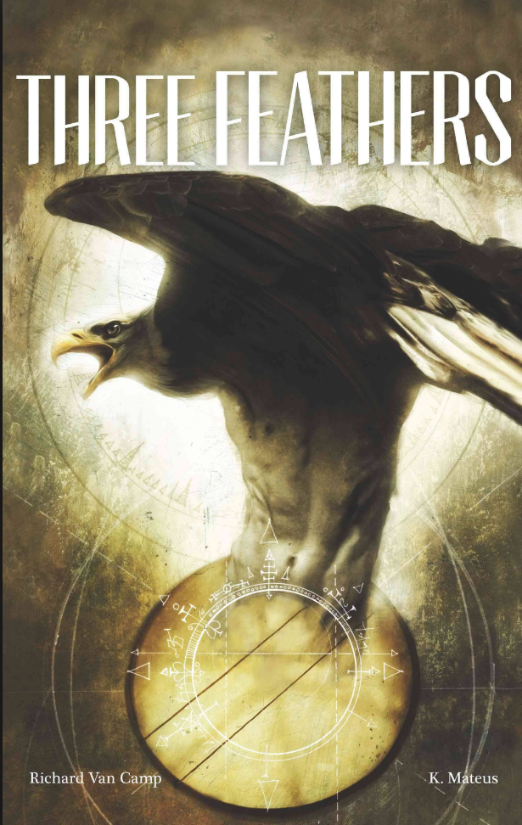
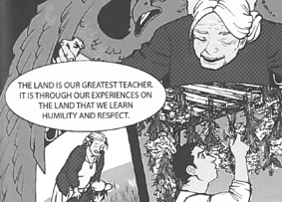
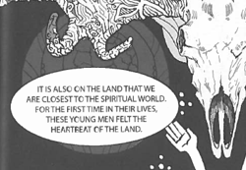
Criminal Justice

Slide 15
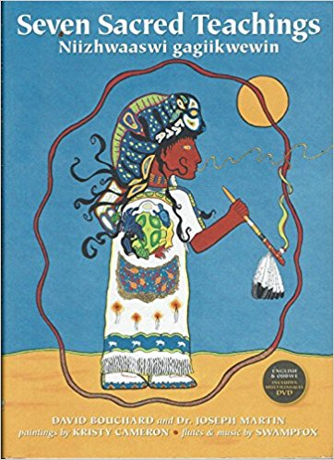
Understanding and Valuing Traditional World Views,
Cultures and Histories
Traditional World Views
  Traditional belief systems
  Relationship with the
  environment

Slide 16
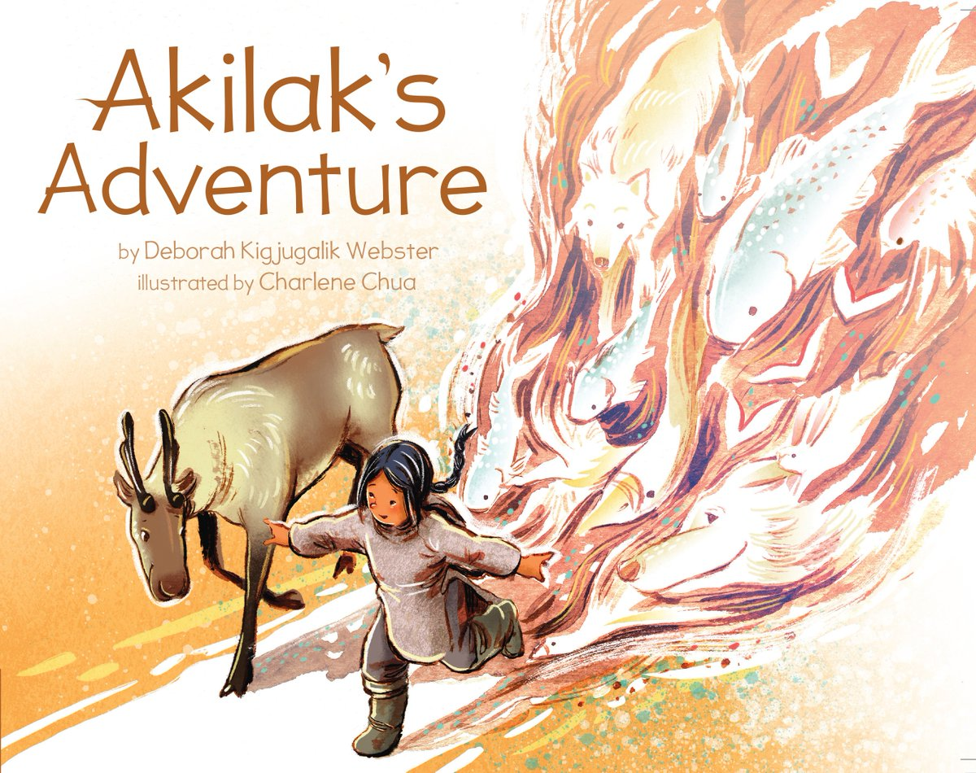
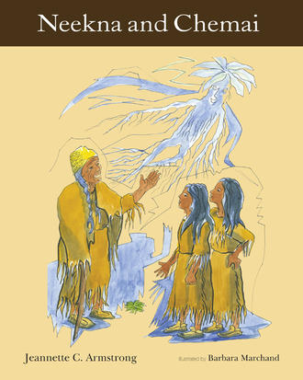
We are the environment and the environment is us.
Mythical ability to shape-shift.
“We must honour our relatives, the animals, the fish, and the plants that share their lives so that we may have life. If we do not honour them and forget how important they are to us, we begin to destroy them. If their lives are in danger, so are ours.”

Slide 17
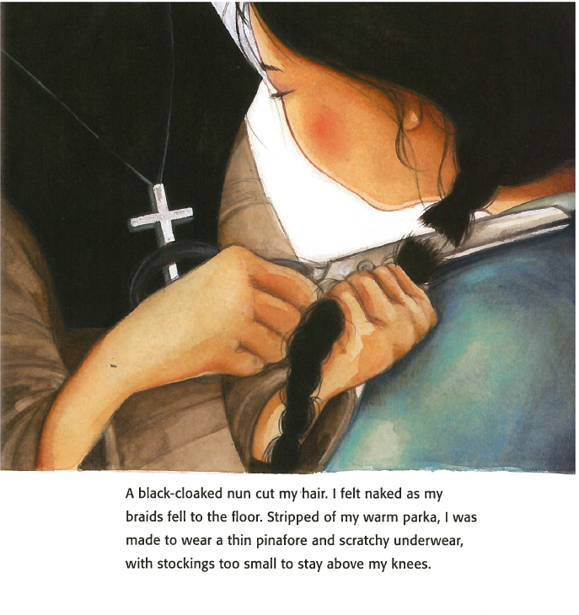
Celebrating and Preserving Indigenous Culture Language and Traditional Knowledge
Hair cutting
“… in our teachings a braid is real important, and (…) wearing two of them means both parents are living. So when that lady cut my braids off, it was like she cut off my connection to my family and to who I was.”
Voice of Billy, a Cree man taken as a child into foster care during the Sixties Scoop
Gray Smith, Monique. Tilly: a story of hope and reslience. Winlaw, BC: Sonosis Press, 2013, p. 168 - 169.
Jordan-Fenton, Christy and Margaret Pokiak-Fenton. When I was Eight.

Slide 18
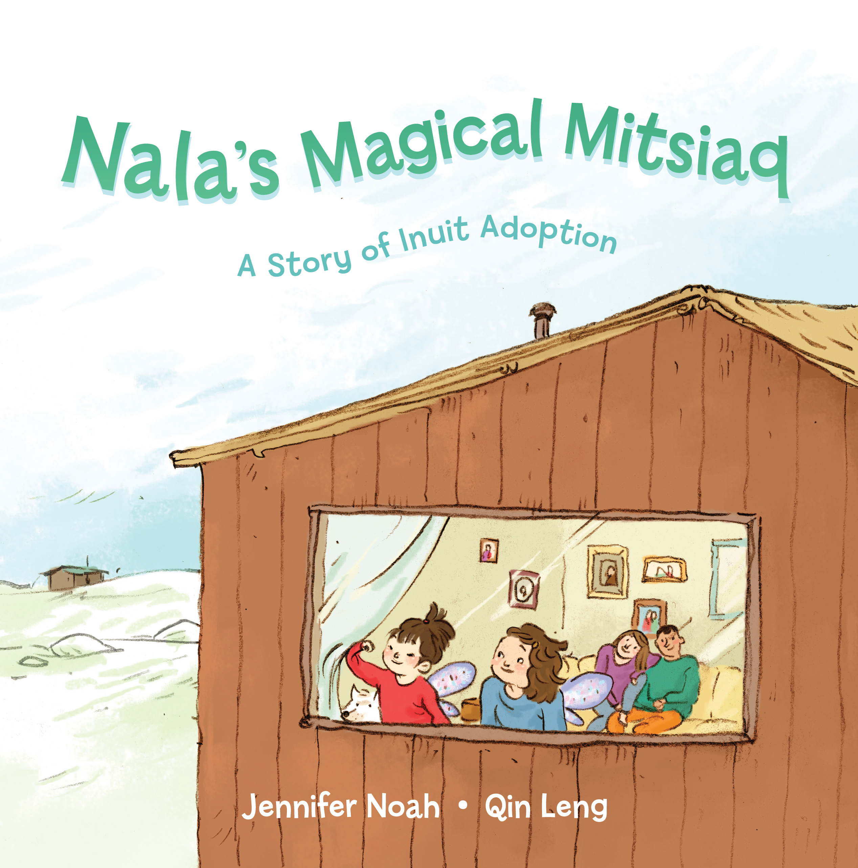
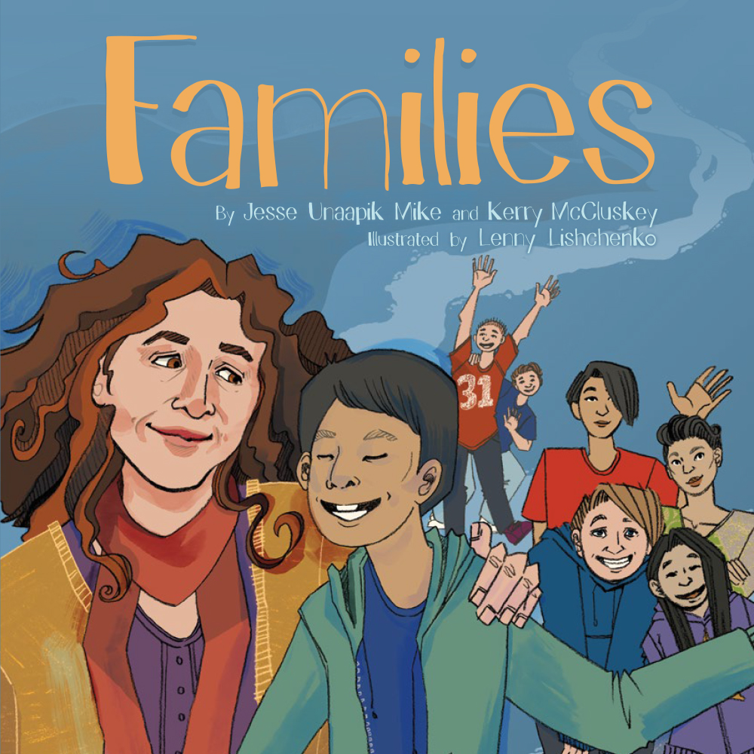
Sixties Scoop and traditional child care structures
Traditional Inuit adoption as an alternative for child care.

Slide 19
Cultural Practices
Dance,
Potlatch
Ceremony
Naming practices
Language recovery

Slide 20
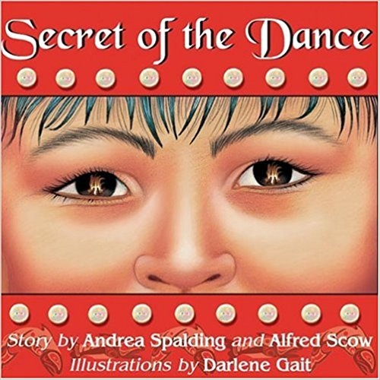
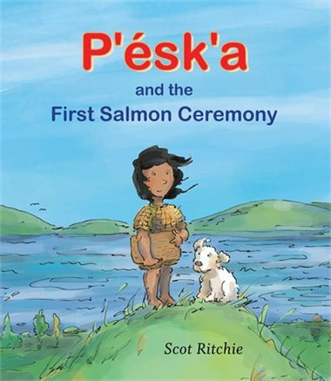
Dance, Potlatch, Ceremony

Slide 21
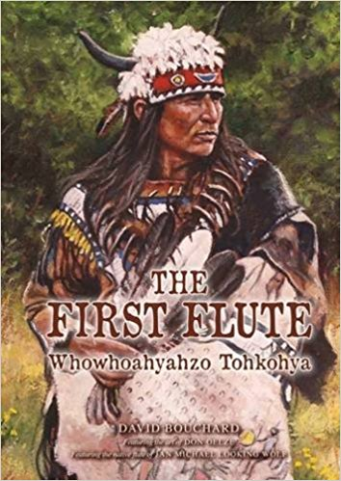
Naming Practices
“Names should be respected. They should be valued. They should be honoured.
When a name is given to an adult, it is often given based on the life that person has lived.
The name is a statement about the person he or she has become.
When a name is given to a child, it foretells what kind of a person that child will become.
If a child is given the name He Who is Kind to Strangers, that child is destined to live a life of kindness.
I know this to be true because I once knew a kind man who as a child was given that name.”
Bouchard, David. The First Flute: Whowhoahyahzo Tohkohya. Calgary, AB: Red Deer Press 2015.

Slide 22
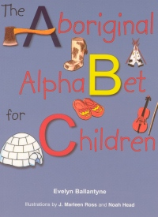
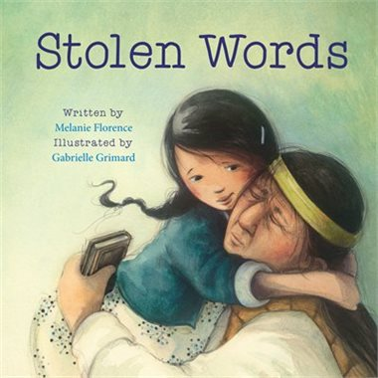
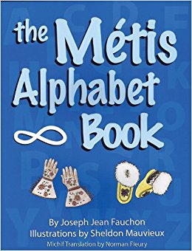
Loss of Language

Slide 23
Traditional Skills
Raising and caring for sled dogs
Preparing food
Hunting
Fishing
Gathering

Slide 24
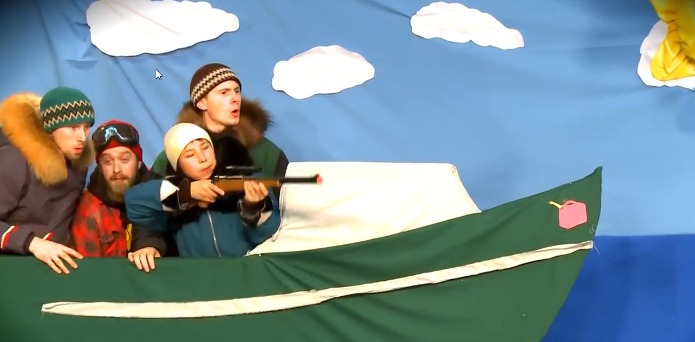
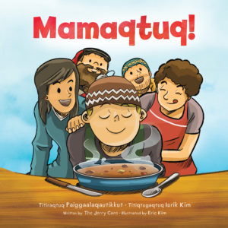
https://www.youtube.com/watch?v=HapT7BjSAYw

Slide 25
Thank you for your attention
Questions?

