Slide 1
INNOVATIONS, CHALLENGES and OPPORTUNITIES within Regional Health Libraries in British Columbia
Elisheba Muturi-Kihara
Shannon Long
May 17, 2017

Slide 2
OUTLINE
Study objectives
Research methodology
Findings
Conclusions
Acknowledgements
Notes:
Health libraries must innovate in order to succeed and thrive.
The recent benchmarking survey of Canadian health facility libraries by Ada Ducas and her team, as reported in JCHLA in 2015, made that clear. *
British Columbia’s regional health authority and ministry of health libraries and information services are no exception. However, they face unique geographic challenges and opportunities that may not have been reflected in the benchmarking report which looked at the entire health library sector across Canada.
*Ducas, Ada, Lisa Demczuk, and Kerry Macdonald. "Results of a Survey to Benchmark Canadian Health Facility Libraries." Journal of the Canadian Health Libraries Association 36.1 (2015): 3-10. https://ejournals.library.ualberta.ca/index.php/jchla/article/view/24356/18043

Slide 3
Study objectives
1) Describe and compare Health Authority and Ministry of Health Library and Information Services (LIS)
2) Analyze how these LIS are evolving and innovating in order to deliver value
3) Identify gaps and opportunities in the current landscape
Notes:
To understand how these BC libraries deliver innovative services to their geographically spread users, this study aimed to:
1) describe and compare the Regional Health Authority and Ministry of Health Libraries, 2) analyze how these libraries are evolving and innovating in order to deliver value, and 3) identify gaps and opportunities that are available in the current landscape. To our knowledge, this is the first snapshot of BC health authority and health ministry libraries, which includes the newly formed First Nations Health Authority.
The results of this study may help library and information services to share successful innovations and best practices, and identify opportunities for future collaboration in research and practice within British Columbia and potentially across Canada.

Slide 4
Methodology
Research design: online survey, telephone interviews and focus group
Population: all Health Authority and Ministry of Health Libraries
(Island, Vancouver Coastal, Fraser, Interior, Northern, Cancer Agency, Children’s & Women’s, First Nations, Ministry of Health)
100% participation rate!
Notes:
Our study population included representatives from the five geographically based health authority libraries, and four libraries with province-wide mandates.
We succeeded in getting a 100% participation rate by engaging the participants in advance and asking for their input regarding themes of interest.
We utilized a qualitative research design, including an online survey, telephone interviews and a focus group. We felt that the qualitative dimension added valuable insights that couldn’t be captured using a quantitative approach alone.
Sheba and I are happy to share our survey instruments and the focus group moderator guide with anyone who might be interested in carrying out similar research in other provinces.
Our research questions were linked to eight themes drawn from the literature:
· * library environment,
· *research services,
· *instruction and training,
· *centralized vs distributed service delivery models,
· *patron and service prioritization,
· *needs assessment and evaluation,
· *innovative services, and
· *the provincial landscape.

Slide 5
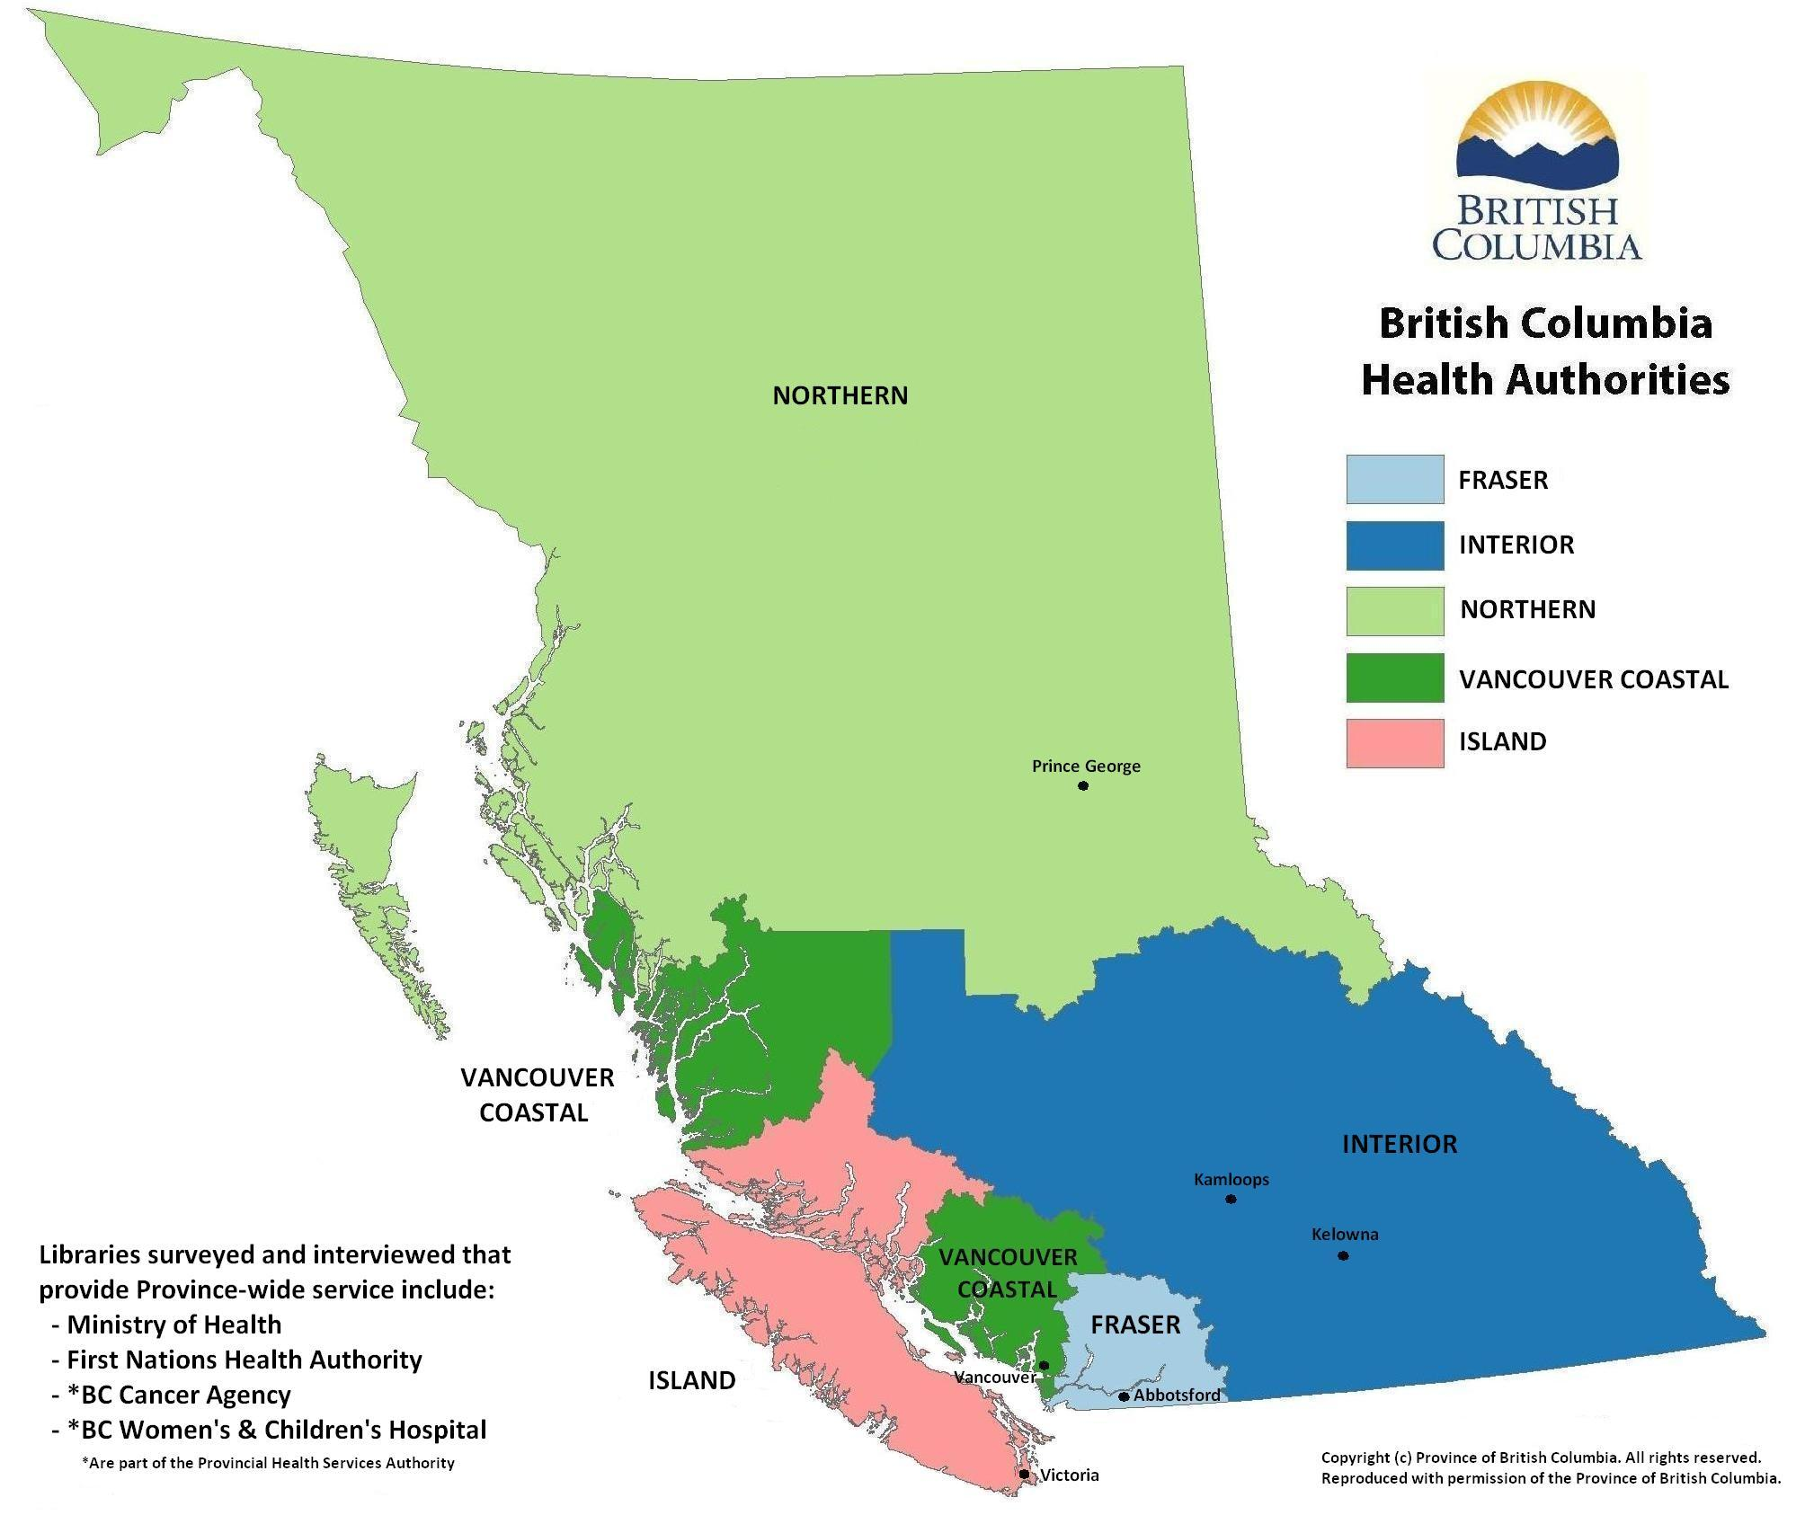
Notes:
Before we present some of the research findings, we want to show you the location of the regional health authorities and a few of the province’s cities.
We found that the vast geographical areas that the libraries serve had a significant impact on how their services were organized and delivered.
Sheba and I wanted to include this map as it helps to put almost everything we present in context.

Slide 6
Key findings
Service prioritization
Research and reference services
Instruction
Liaison
Service delivery models
Innovations and barriers
Evaluation and needs assessment
Barriers and opportunities
Notes:
We now turn to the key findings as outlined on this slide, starting with service prioritization.

Slide 7
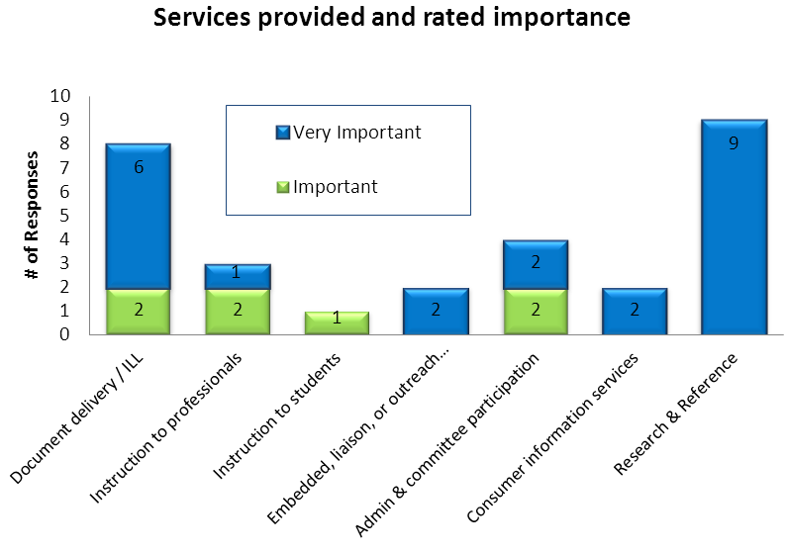
Notes:
In the online survey we asked which services were offered by the library and how important they believed those services were on a scale from 1 to 5, with 1 being lowest and 5 being highest. This graph shows the services that were identified as being a 4 or a 5.
All libraries stated that research, reference and literature searches is the most important service they provide to patrons.
While over half the libraries do NOT offer consumer information services, those that do rated this as very important.
Document delivery and article retrieval services were also rated highly.
As to be expected with non-academic libraries, instruction to students was not a high priority.

Slide 8
Key findings
Service prioritization
Research and reference services
Instruction
Liaison
Service delivery models
Innovations and barriers
Evaluation and needs assessment
Barriers and opportunities
Notes:
Our next results focus on research and reference services.

Slide 9
Research and Reference
Requests for services are prioritized by urgency and purpose, with direct patient care taking top priority
Direct patient care questions↓ Administrative/policy topics↑ In-depth requests ↑
Systematic reviews expertise there but not a priority
Notes:
Our online survey, phone interview and the focus group had multiple questions about research and reference services.
Requests for research assistance and literature services are prioritized by urgency and purpose, with direct patient care taking top priority. Requestor’s role and rank is also a factor.
All of the libraries receive a mix of clinical and administrative requests, and have experienced a noticeable increase in the number of in-depth research requests for organizational strategic planning, program or service planning and evaluation, and policy development purposes.
There were reports of declining direct patient care questions as well as the types of questions that can be answered quickly. This is likely a results of available point-of-care tools and patrons’ abilities to find quick information on their own.
We asked about the demand for and expertise needed to participate in systematic reviews. Responses indicated that librarians felt they had the expertise to be involved in systematic reviews, but it was not a high priority for their patrons. Some reported that they would like to do this but lacked the staffing resources that would be required.

Slide 10
Key findings
Service prioritization
Research and reference services
Instruction
Liaison
Service delivery models
Innovations and barriers
Evaluation and needs assessment
Barriers and opportunities
Notes:
Our next findings have to do with bibliographic instruction and training. This is one area where the geographic landscape had a big impact.

Slide 11
Instruction
Methods and means of offering instruction & training to remote clients was a universal challenge
Some libraries use Skype, WebEx, or shared desktop/ Microsoft Lync to reach remote clients
No use of recorded video tutorials despite the geographical spread and remote users.
Notes:
Instructional services are offered by all libraries, mostly on an informal and ad-hoc basis. Training sessions are typically customized for different user groups or health teams, and may be linked to specific initiatives or projects.
However, the need to offer training to remote users and those in underserved areas was found to be very challenging due to geographic distances and technological limitations.
For example, in the Northern Health Authority, with a single library in the city of Prince George, the librarian must provide instruction to health professionals working in small remote communities that are spread throughout more than half of the province.
Similar challenges were reported by other study participants.
In order to carry out training to rural and remote clients, 4 libraries use technology to offer 1:1 instruction, including the use of Skype, WebEx, or shared desktop/Microsoft Lync.
Not all libraries in our survey had the technology to offer this kind of live training. Internet connections were spotty in some areas, and information technology services and equipment were insufficient or out of date.
Surprisingly, no libraries reported using pre-existing online tutorials or had created their own in-house recorded video tutorials, using programs such as captivate, copernicus or camtasia, in order to reach these user groups.

Slide 12
Key findings
Service prioritization
Research and reference services
Instruction
Liaison
Service delivery models
Innovations and barriers
Evaluation and needs assessment
Barriers and opportunities
Notes:
We also asked our participants about their degree and type of liaison, outreach and embedded activities they participate in.

Slide 13
Liaison and outreach
Most libraries provide liaison support.
Over half are involved in committees:
conducting literature searches
raising awareness
knowledge brokers
chairing committees
editorial experts
providing content
Notes:
Almost all of the libraries engage in some degree of liaison support, described as linkages and involvement with specific teams, departments or initiatives with an intention of providing enhanced library and information service.
Librarians also reported contributing to their organizations by serving on various committees such as ethics, research, patient education, professional practice, continuing medical education, quality and innovation, and electronic health records.
Their roles and activities on these committees, as described by the study participants, is presented on the slide.
In the surveys, interviews and focus group, librarians indicated a desire to engage in more liaison, outreach and embedded services, but were limited due to capacity and staffing issues.

Slide 14
Key findings
Service prioritization
Research and reference services
Instruction
Liaison
Service delivery models
Innovations and barriers
Evaluation and needs assessment
Barriers and opportunities
Notes:
7 of the 9 libraries included in the study have multiple branches and service locations, sometimes hundreds of kilometers apart.
We were curious about how their services were organized. Did they have a clearly centralized or a distributed service model, or a combination..?

Slide 15
Service delivery models
Seven of the nine library systems have multiple sites.
Service requests sent to central intake email or directly to specific librarians based on location, expertise and preference.
Collection development mostly done at site level.
The degree of standardization in multi-site libraries varied considerably and merits further investigation
Notes:
All libraries surveyed, even those with only a single branch, have a central intake or generic email address to which their patrons can send requests for research assistance, instruction, loans and articles. Patrons were also able to send requests directly to a specific librarian based on geography or expertise. It was reported that most clinicians prefer to deal with the same library staff member repeatedly, even if they could get service from someone else on the library team by submitting requests to a central intake generic email. This demonstrates that the personal relationship between library staff and their patrons is very important, but it is equally important to ensure equitable access irrespective of users’ geography or where they work. Libraries are seeking to strike a balance between the convenience and necessity of central intake for their remote patrons, and the option for clients to connect directly with specific librarians for personalised service. *** We also asked the libraries with multiple service locations if collection development, inter-library loans and article requests were managed centrally or run primarily by each local site independently. For the most part, these services are done at a site or branch level. We received inconsistent responses when we asked about the need to standardize how requests are filled and delivered, or if there were concerns over service quality from libraries with multiple sites. Standardization is not necessarily a concern for all participants – one respondent said that since all sites in that health region had proficient librarians, there wasn’t a need for strict standardization. Meanwhile, another respondent expressed frustration about the lack of standardization both within their own library system and across the province.

Slide 16
Key findings
Service prioritization
Research and reference services
Instruction
Liaison
Service delivery models
Innovations and barriers
Evaluation and needs assessment
Barriers and opportunities
Notes:
I will now pass the podium on to Sheba who will discuss innovative services and other topics.

Slide 17
Innovative services
Organizational website (4) Organizational newsletter (2) Archives management (3) | Social media for : current awareness(3) library marketing and promotion (2) providing reference (1)
Twitter and instant messaging (2) Library blog, RSS feeds, Facebook (1) No social media use (3) | Mobile library website (3) Mobile catalogue (4) Mobile devices used for clinical info services (1) Training/tech support for mobile device use (6)
Considering purchase of an EHR system (8) May link EHR to knowledge based resources (7) May link EHR to patient education/consumer information (5)
Notes:
We asked participants about innovative tools and technology they are currently using (online survey and additional clarification sought in interview)
- The numbers in brackets indicate the number of participants with this response out of 9.
-Use of social media tools and support for mobile technologies varies significantly - several libraries do not use these tools at all, while others use them for marketing, promotion, reference and information services, and current awareness.
-The mobile platform was acknowledged as being important but only a minority of library systems have optimized their website and catalogue for mobile access. Only one reported using mobile devices to deliver clinical info. The libraries fared better in offering training and technical support for mobile devices but there is room for improvement.
-Turning to Electronic Health Records, it is noteworthy that they are a key innovation across the board. This clearly represents an opportunity for librarians to add value
-Optional: In addition to the question about innovative services, we also asked about innovative roles recently added or planned within two years. The top roles mentioned were authorship support (56%), support for systematic reviews (33%) and mobile devices (33%)"

Slide 18
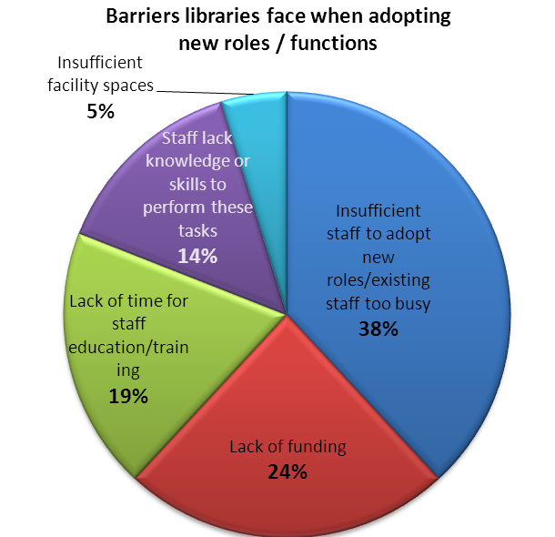
Notes:
The most common barrier to adoption of innovative services and roles was staff capacity and high existing workload.
The second one was lack of funding: most mentioned CE and professional development as key enablers but out‐of‐province travel ban hampers some librarians from taking part in conferences.

Slide 19
Key findings
Service prioritization
Research and reference services
Instruction
Liaison
Service delivery models
Innovations and barriers
Needs assessment and evaluation
Barriers and opportunities
Notes:
We wanted to know how libraries are conducting evaluation and needs assessment.

Slide 20
Needs assessment
Half of the libraries either conduct their own needs assessment surveys (or participate as part of larger department) every 3-5 years.
All libraries do informal information gathering / obtain constant feedback
Is there a benefit or interest in all HAs using the same needs assessment survey and methodology?
Notes:
Half of the libraries either conduct their own needs assessment surveys or participate as part of a larger department) every 3-5 years for strategic planning purposes.
All libraries also do informal information gathering / obtain constant feedback.
There was an interest in advisory committees - Only 1 library had an established advisory committee while a few others were trying to set them up but experiencing challenges: lack of buy-in, a committee that took on a censorship role and concern about setting up expectations that may be difficult to meet due to budgetary constraints.
***
Optional: Two mentioned trying to set up advisory committees but one had no buy-in while the other found that the committee sought to censor the collection by excluding certain perspectives. One was concerned that carrying out a needs assessment may set up expectations that cannot be met due to budgetary constraints. Respondents reported that the value of needs assessment included: a wish-list to inform collection development decisions, providing input that changed the library’s direction, supporting a case for hiring new staff and increased marketing and promotion.
Could there be a benefit or interest in all HAs using the same needs assessment survey and methodology?

Slide 21
Evaluation of services
Libraries are evaluating and tracking many aspects of their services and resources
Tools include: Key Performance Indicators; annual reports; Return On Investment calculators
Only two track literature search feedback
Notes:
Questions included:
-We asked about the tools libraries are using to evaluate their services on a regular or annual basis to ensure alignment with institutional priorities and strategic directions (optional - such as enhancing patient safety, reducing readmissions, and improving patient satisfaction scores, supporting evidence-based policy making)?
- We found libraries are evaluating and tracking many aspects of their services and resources. Key Performance Indicators, annual reports and Return On Investment figures were mentioned..
- Surprisingly, only two reported tracking the literature search feedback and only one does a meaningful evaluation of their training.
-Need to investigate methods to map what we evaluate/measure/include in annual reports, and ensure the information is presented in a way that is meaningful to upper management.

Slide 22
Evaluation - reference/research
Great variation in how reference and research requests are tracked, ranging from great detail to minimal information
Many libraries with multiple sites do not have consistent, centralized approaches to tracking
Complexity is not being captured
As reference was considered by ALL libraries to be the most important service, there is room for improvement
Notes:
-We asked how libraries track and classify their reference inquiries.
- We observed great variation in how reference and literature search requests are statistically tracked and measured by each library system. Some track great detail for example, on topic, requestor and purpose of information while others keep minimal information. - Regarding what meaningful reporting is being done with these metrics, one library reported that search topics list are submitted to larger Quality and Innov team and another creates an annual report.
- We also noted that many libraries with multiple sites lacked consistent approaches to their tracking
-One thing that stood out is that tracking has not kept pace with the changes in reference/research question types and their complexity. Some initially tracked more detail but later simplified and moved away from the systematic tracking of time spent, purpose...but this means that complexity is not being captured. As Shannon noted earlier, in-depth questions have increased so this is an important finding to address.
-As reference and research was considered by ALL libraries to be the most important service provide, perhaps there is room for improvement in tracking so we can demonstrate the worth/impact of this service to our employers
.

Slide 23
Evaluation – institutional alignment
Most libraries align their short-term service goals with organizational priorities.
It is more challenging to demonstrate library’s contribution to org success through concrete indicators/outputs/outcomes.
Only one has a robust evaluation framework that goes beyond outputs (number of searches) to outcomes (impact of info).
Notes:
-Most libraries reported success in aligning their short term goals with organizational priorities.
-However, they had difficulty structuring or fitting their assessment within the larger organizational strategic reporting framework eg. balanced scorecard - to demonstrate library’s contribution through concrete indicators/outputs/outcomes. All recognized how valuable this is.
-Only one reported a robust evaluation framework, going beyond outputs (number of searches) to outcomes (impact of info).

Slide 24
Key findings
Service prioritization
Research and reference services
Instruction
Liaison
Service delivery models
Innovations and barriers
Evaluation and needs assessment
Barriers and opportunities
Notes:
We now turn our attention to the barriers and opportunities that emerged, particularly from the focus group discussion.

Slide 25
Barriers and opportunities
Limited awareness of library services | Collaborating on engagement and outreach strategies
Technological limitations | Creative problem solving
Inconsistent approaches to reporting and evaluation | Enhanced consistency and sharing where possible
Participants identified a need for regular knowledge sharing
Notes:
This slide outlines barriers and corresponding opportunities.
•Awareness of library services is a key barrier identified by participants, particularly for geographically remote locations. Roadshows for building awareness are effective but expensive. The corresponding opportunity is how librarians can share notes on effective outreach strategies and tools (eg templates). Some participants reported success in leveraging HR communications to engage staff.
•Technological limitations: These included lack of consistent internet access and even printers in some remote sites; outdated technology and browsers incompatible with library software; inconsistency of software tools across HAs. To address this, strategic librarian problem solving was suggested to help users access services eg. print and mail materials to users with with poor internet connectivity. Another idea was a business case for standardization of software tools and systems across the HA systems (already done successfully by two HAs who share the same catalogue system.)
•The third key issue was inconsistent approaches to evaluation within HAs due to different data collection and reporting requirements. It would be beneficial to have consistency in reporting measures, data collection tools, RoI calculators, as well as messaging in reports aimed at decision-makers. Standardizing metrics for value add services is more challenging than process measures such as number of lit searches but would provide the most benefit eg. determining the impact of lit searches on patient diagnosis or treatment
•Participants identified a need for regular knowledge sharing. What could this look like? This may take the form of formal moderated discussions, but may also take the form of a regular conference call or email group to share challenges and strategies
Optional (if there’s time)***
- Many geographical areas are isolated and underserved. There are some agencies without a library for their staff.
There is need for broader strategies for how to best reach under-serviced regions or centres within each health authority, and how to cooperate with agencies or locations who do not currently have internal access to health library services. Are librarians in different HAs are able to provide information and guidance on how to minimize those gaps or highlight the gaps to other agencies who might help?

Slide 26
Conclusions
Lack of robust evaluation of most important value-add services
Direct patient care requests declining
Challenges reaching geographically remote clients
Innovative roles are not necessarily linked to Web 2.0+ or mobile usage
EHRs in all HAs present an opportunity for librarian value-add
Knowledge sharing is key in addressing identified gaps and barriers across the HAs
Notes:
Lack of robust evaluation of most important value-add service (complexity not captured) but a minority of respondents doing well and there was interest in how this can be shared
Direct patient care requests declining. Since traditional value assessment is based on clinically meaningful outcomes such as time saved for clinicians, impact on safety, readmissions...given that the direct patient care requests are declining as reported by some respondents, what would be more meaningful impact measures?
Geographically remote clients present a big challenge and it was surprising that no libraries are using using recorded video tutorials to reach these user groups but there was an interest in creative work-arounds.
Innovative roles are not necessarily linked to Web 2.0+ or mobile usage eg. revenue generation; but are all about facilitating improved access to valuable content.
Collaboration and knowledge sharing is key in addressing identified gaps and barriers across the HAs. Libraries across the province would benefit greatly from more opportunities to share strategies or tools that work for them eg. standardization of evaluation and reporting tools.

Slide 27
Acknowledgements
The leadership at the Health Authority and Ministry of Health libraries
Health Libraries Association of BC for focus group funding
Development and review of data collection instruments: C. Jack (co-researcher), D. Greyson, D. Giustini, R. Melrose, R. Raworth, B. Bonsu (UBC library student).
Notes:
(benefitted from substantial input from Devon Greyson, Dean Giustini, Rebecca Raworth and Robert Melrose)

