Slide 1
E-Serials Management at
the University of Alberta
NEOS Miniconference 2018
Breakout Session 2B

Slide 2
Your Presenters...
Abigail Sparling
Serials Metadata Librarian, University of Alberta Libraries
abigail.sparling@ualberta.ca
@abbisparling
Carol Ma
Discovery and Cataloguing Librarian, Edmonton Public Library
carol.ma@epl.ca
@carolma46

Slide 3
With help from the U of A Serials Team!
Lily Song
Tracy Kitagawa (on leave)
Scott Davies (former member)
Jordan Serben
Felicia Liu
Notes:
We have to give credit to the members of the UAL serials team past and present! Lily Song, who has been holding down the fort so that we can work on this presentation, and who helped train us.
Tracy Kitagawa, who is currently on leave, but has also given us guidance before she left, especially around SFX!
Scott Davies, who was (and still is) instrumental to the serials team.
Jordan Serben and Felicia Liu, who are newer team members, and who were our test audience.
*Parts of this presentation are adapted, with Scott’s permission, from his U of A presentation called “Let’s Talk About SFX!”

Slide 4
Presentation Outline
SFX in a Nutshell
How does SFX interact with our catalogue?
How do users interact with the SFX link resolver?
How do we manage SFX and the catalogue?
Challenges, Tips & Tools, and NEOS
Questions
Notes:
A note: we’ll be using “e-serial” and “e-journal” interchangeably. At the U of A, we tend to refer to them as e-journals, but e-serials is the term that better captures the various types of electronic serials and periodicals.
We realize that this presentation was titled ‘E-Serial management at the U of A,’ but a large part of this is dependent on SFX.
As a result, our presentation will be heavily focused on our use of the SFX link resolver and the associated knowledge base.
We will have some more slides at the end regarding e-journal management and e-journal cataloguing in general.

Slide 5
SFX in a Nutshell
What is it?
An Ex Libris Product
A knowledge base containing title-level metadata, organized by publisher/aggregator packages, and maintained by various parties.
“Data accuracy and continuous updates are ensured by our team of librarians, close collaboration with publishers, and automatic update services.” (source)
What does it do?
SFX holds metadata, and also serves as our link resolver.
Notes:
So what is SFX? SFX is a proprietary product by Ex Libris (ProQuest). It acts as a link resolver that connects users to articles and journals, but it also functions as a knowledge base.
SFX is a knowledge base that holds title-level metadata. This metadata is organized according to how we acquire our e-journals (e.g. by publishers/aggregator packages, collections, or products). Each library has their own local instance of the SFX knowledge base which they customize to reflect their title access and subscriptions. For example, the U of A’s SFX Knowledge Base looks different from Grant MacEwan’s Knowledge Base, since our institutions have different titles, and means of access.
SFX is maintained by librarians, publishers, and vendors.
SFX can also be used to manage ebooks, but at the U of A, we only use it for e-journals.
(If you want to learn more about ebook management, you can attend Breakout Session 4A-- “Ebooks: The Questions & The Answers” by Michael Betmanis and Amanda Nagyl later on in the afternoon!)

Slide 6
Link Resolvers and OpenURLs
Link Resolvers
Links resolvers connect users (from a source, such as our OPAC, a list of journal titles, a footnote, etc.) to where they want to go (a full text article or a citation).
OpenURL
A standardized form of a link, which communicates with the library’s link resolver to see whether or not the institution has access to the desired resource.
Notes:
A link resolver connects users to what they want, through an OpenURL.
The Consortium of Academic and Research Libraries in Illinois describes how link resolvers and OpenURLs interact to provide access. What is a link resolver? (from the Consortium of Academic and Research Libraries in Illinois)
“A link resolver is a product that, figuratively speaking, sits between a “source,” where a user begins the search process, and a “target,” where the user goes next. The “source” might be an abstracting and indexing database, an A-Z list of journal titles, an OPAC, or a footnote in an electronic full text article. If the source system can build a standards-compliant OpenURL containing metadata (typically bibliographic citation information) about the “object” the user is interested in, then a link resolver like SFX can generate a list (or menu) of relevant targets. Targets might be the electronic full text of the cited article (perhaps available from a provider other than the source where the user found the citation), or a document delivery request form.”
The U of A’s instance of the link resolver is Get It! Window.

Slide 7
SFX in a Nutshell
Offers an alternative approach to direct linking from the catalogue
Allows us to manage our electronic serials subscriptions according to how we have acquired each serial
Additional features beyond the knowledge base & link resolver (eg. citation linking, collection and usage stats)
SFX uses a specific vocabulary for their product!
Notes:
SFX is a large part of how we manage our ejournals at UAL. As a link resolver SFX is an important part of discovery, however today we’ll be focusing on how the serials teams uses SFX as a tool for e-journal management at the title level.
An important aspect of the SFX Knowledge Base is that it allows us to manage our electronic serials subscriptions based on how we have acquired each serial. The KB is organized by publisher collection and package which means that when we have access to a title through two subscriptions, for example an aggregator database and a consortial collection, the SFX KB allows us to represent both these forms of access and provides the coverage and linking information according to what it is in each collection.
To give you some rough figures of the size of our SFX KB, we currently have over 1400 collections by 463 publishers/vendors. Within these collections there are over 171,000 serial titles, with many of them included in multiple collections.
Though we won’t be talking about them today, SFX does provide some features beyond acting as a KB and a link resolver, these include citation-linking, and the ability to pull collection and usage stats, these are important to note if your institution is considering using SFX.
Before we take a deeper dive into the SFX, Knowledge Base, I should also note that SFX uses a very specific technical vocabulary for their product.

Slide 8
SFX in a Nutshell - Key Terms
Targets: Vendors or Providers of services. These can be full‐text providers, publishers, aggregators, and databases.
Objects: SFX created bibliographic records for journal titles. Each object has a unique object ID as the primary identifier.
Object Portfolios: Refers to a journal in relation to a specific target. The object portfolio relates information about an object to information about a target service.
Thresholds: Specify access conditions for an object portfolio. Conditions typically consist of publication information such as year, volume and issue access begins. The threshold can also contain other information such as embargos, and ending dates for access.
Active/Inactive: Refers to whether a target or object portfolio has been turned on in SFX by the serials team
SFX in action
Notes:
Here is an overview of some of the key terms and components that make up the SFX KB.
First we have targets, which are the vendors or provider of services, such as publishers like EBSCO or PROQUEST and the individual collections they offer.
Next there are objects, which represent individual serial titles. Each object or title in SFX has its own brief bibliographic record. An important piece of this record is the object ID, which acts as the object’s primary identifier
Next there are object portfolios. Object portfolios represent a specific instance of a title within a publisher collection and include specific information about that title such as the coverage and linking information specific to the publisher’s platform.
To make things more confusing, SFX also provides a different term for coverage information, which they label the threshold. The threshold states the specific access conditions for the object portfolio.
Finally, another term you’ll here us throwing around is active/activate. If a target or object portfolio is activated, or active, it means the serials team has turned it on in the knowledge base because UAL subscribes to it.
So now I’m going to take you on a brief tour of SFX to show you these components in action.

Slide 9
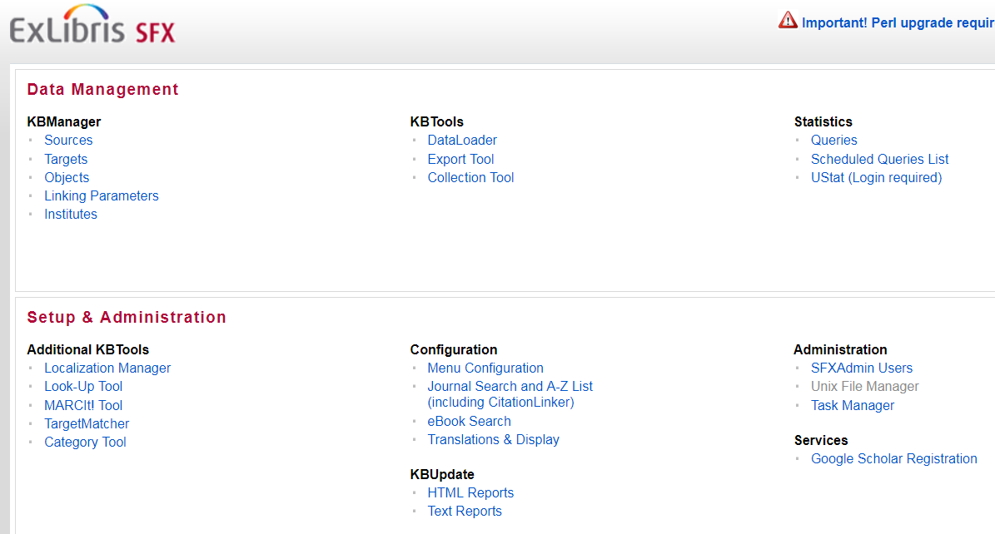
Notes:
TARGET: Here we have the SFX landing page. If we navigate to the target tab we’ll see a list of the available collections in the knowledge base.

Slide 10
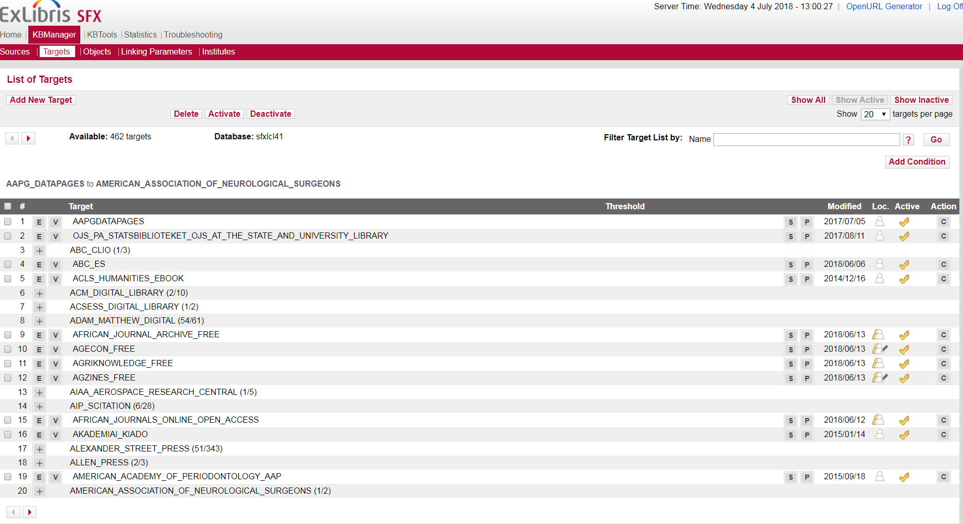
Notes:
TARGET: If we then click show active, we’ll see all the collections that UAL currently subscribes to. The yellow checkmark to the side of the collection title signals that we have this collection turned on. Here you’ll see some recognizable vendor names such as Adam Matthews and Alexander Street Press.

Slide 11
Notes:
OBJECT: Next we’ll take a look at the object search. I’m going to do a search for a specific journal title. The search brings up a title, which if we click on it we’ll see the brief record provided by SFX. Here we also see the object ID I mentioned earlier which is the primary identifier for each title in the knowledge base and a key component of our e-serial management workflows.

Slide 12
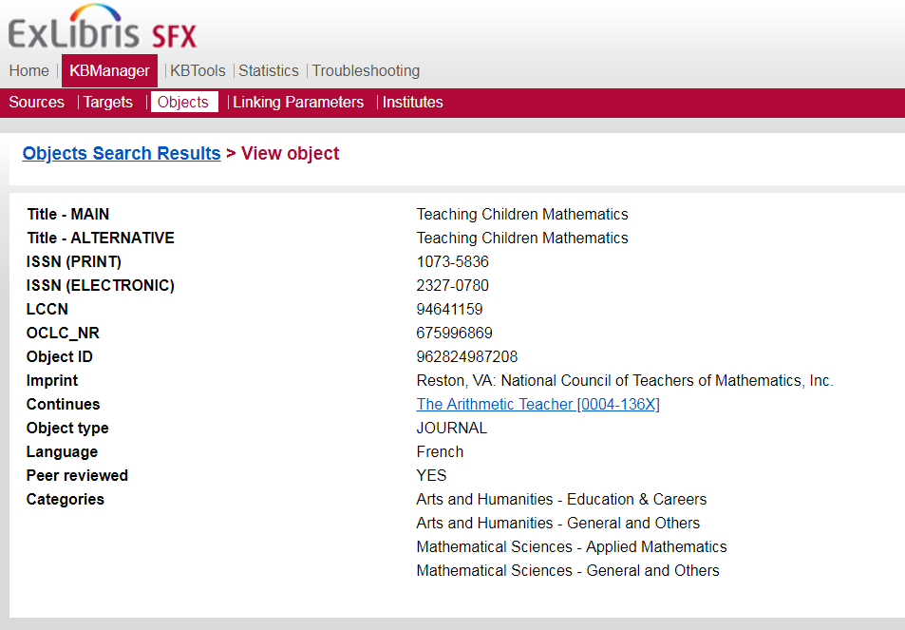
Notes:
OBJECT: Next we’ll take a look at the object search. I’m going to do a search for a specific journal title. The search brings up a title, which if we click on it we’ll see the brief record provided by SFX. Here we also see the object ID I mentioned earlier which is the primary identifier for each title in the knowledge base and a key component of our e-serial management workflows.

Slide 13
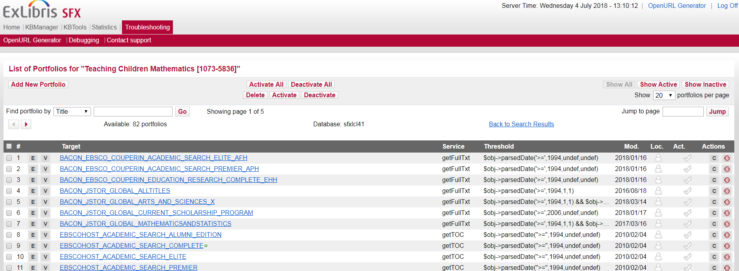
Notes:
OBJECT PORTFOLIOS: If I go back to the original view, we’ll then be able to see all the collections (or targets) that this title is included in by clicking on the P which stands for object portfolios.
Each of these is an object portfolio that includes a unique threshold and link the title on each vendor’s platform.

Slide 14
Notes:
OBJECT PORTFOLIOS: If we click on the “show active” we will be able to see the collections that U of A subscribes to that include this journal. The yellow check mark beside each target tells us that we have these collections turned on.

Slide 15
How do we set up new e-journal purchases in SFX?
The publisher’s title list drives SFX activations and cataloguing.
Title list = SFX activations = Access via catalogue records
Notes:
Activating packages and titles in SFX is typically the serial team’s first step to providing access to ejournals. When we receive notifications of new subscriptions from our collection strategies unit, we will received a title list. The serials team then works from this title list to set up access in the SFX knowledge base by activating the entire corresponding target collection or specific titles within a target collection depending on the subscription. In this process we reconcile the content of the target with the title list information, which can involve making edits to coverage statements, adding new titles to a target if they are not currently included, and making sure all title links are working. Once this work is done we then move on to cataloguing these titles in Workflows.
This process is mirrored when when we lose access to a title, package, or collection, in which case we deactivate the objects/targets in SFX, and set the catalogue record to discard.

Slide 16
Connecting SFX to the catalogue
Each journal’s SFX object ID is embedded in an OpenURL within the 856 (Electronic Location and Access field). The URL links to the Get It! Window, displaying various access points for the title.
E-journal records in Workflows have a local 940 field, which we populate with the journal’s object ID.
Notes:
It’s all well and good to maintain this external database of title and subscription information, but the important question is how does SFX communicate with our catalogue?
First and foremost the SFX knowledge base provides an alternative to linking through direct links in the catalogue. Linking through SFX relieves some of the pressure that comes with managing direct links since the knowledge base (including linking) is maintained by Ex Libris.
To link through SFX instead of a direct link, we enter a custom OpenURL in the 856 field which contains the title’s unique object ID. This link then directs the user to a GetIt! Window that lists the access options for the title that have been activated in SFX.
In each catalogue record we also include a local 940 field that contains the title’s SFX object ID. This is a key piece of information that allows us to build custom programs and reports that make the SFX knowledgebase and our Symphony catalogue to speak to one another.

Slide 17
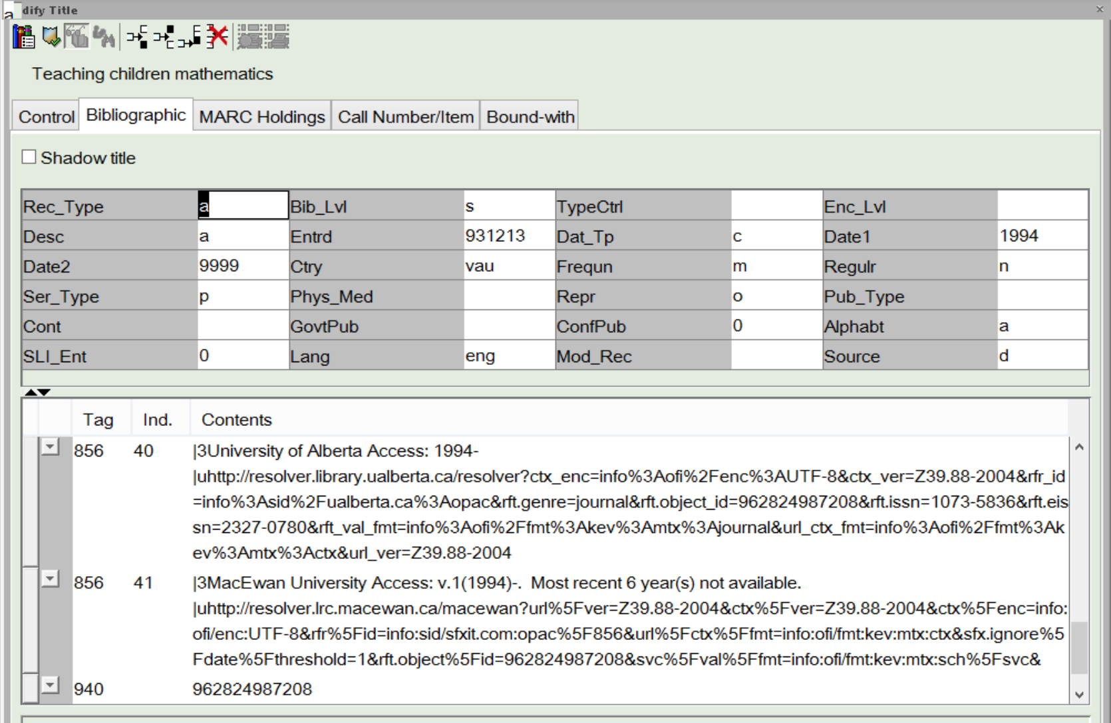
Notes:
A visual of these key pieces of information in the WorkFlows desktop application.

Slide 18
How do users interact with SFX?
Notes:
Our users mainly interact with SFX in our Blacklight discovery layer, and in the Get It! Window.

Slide 19
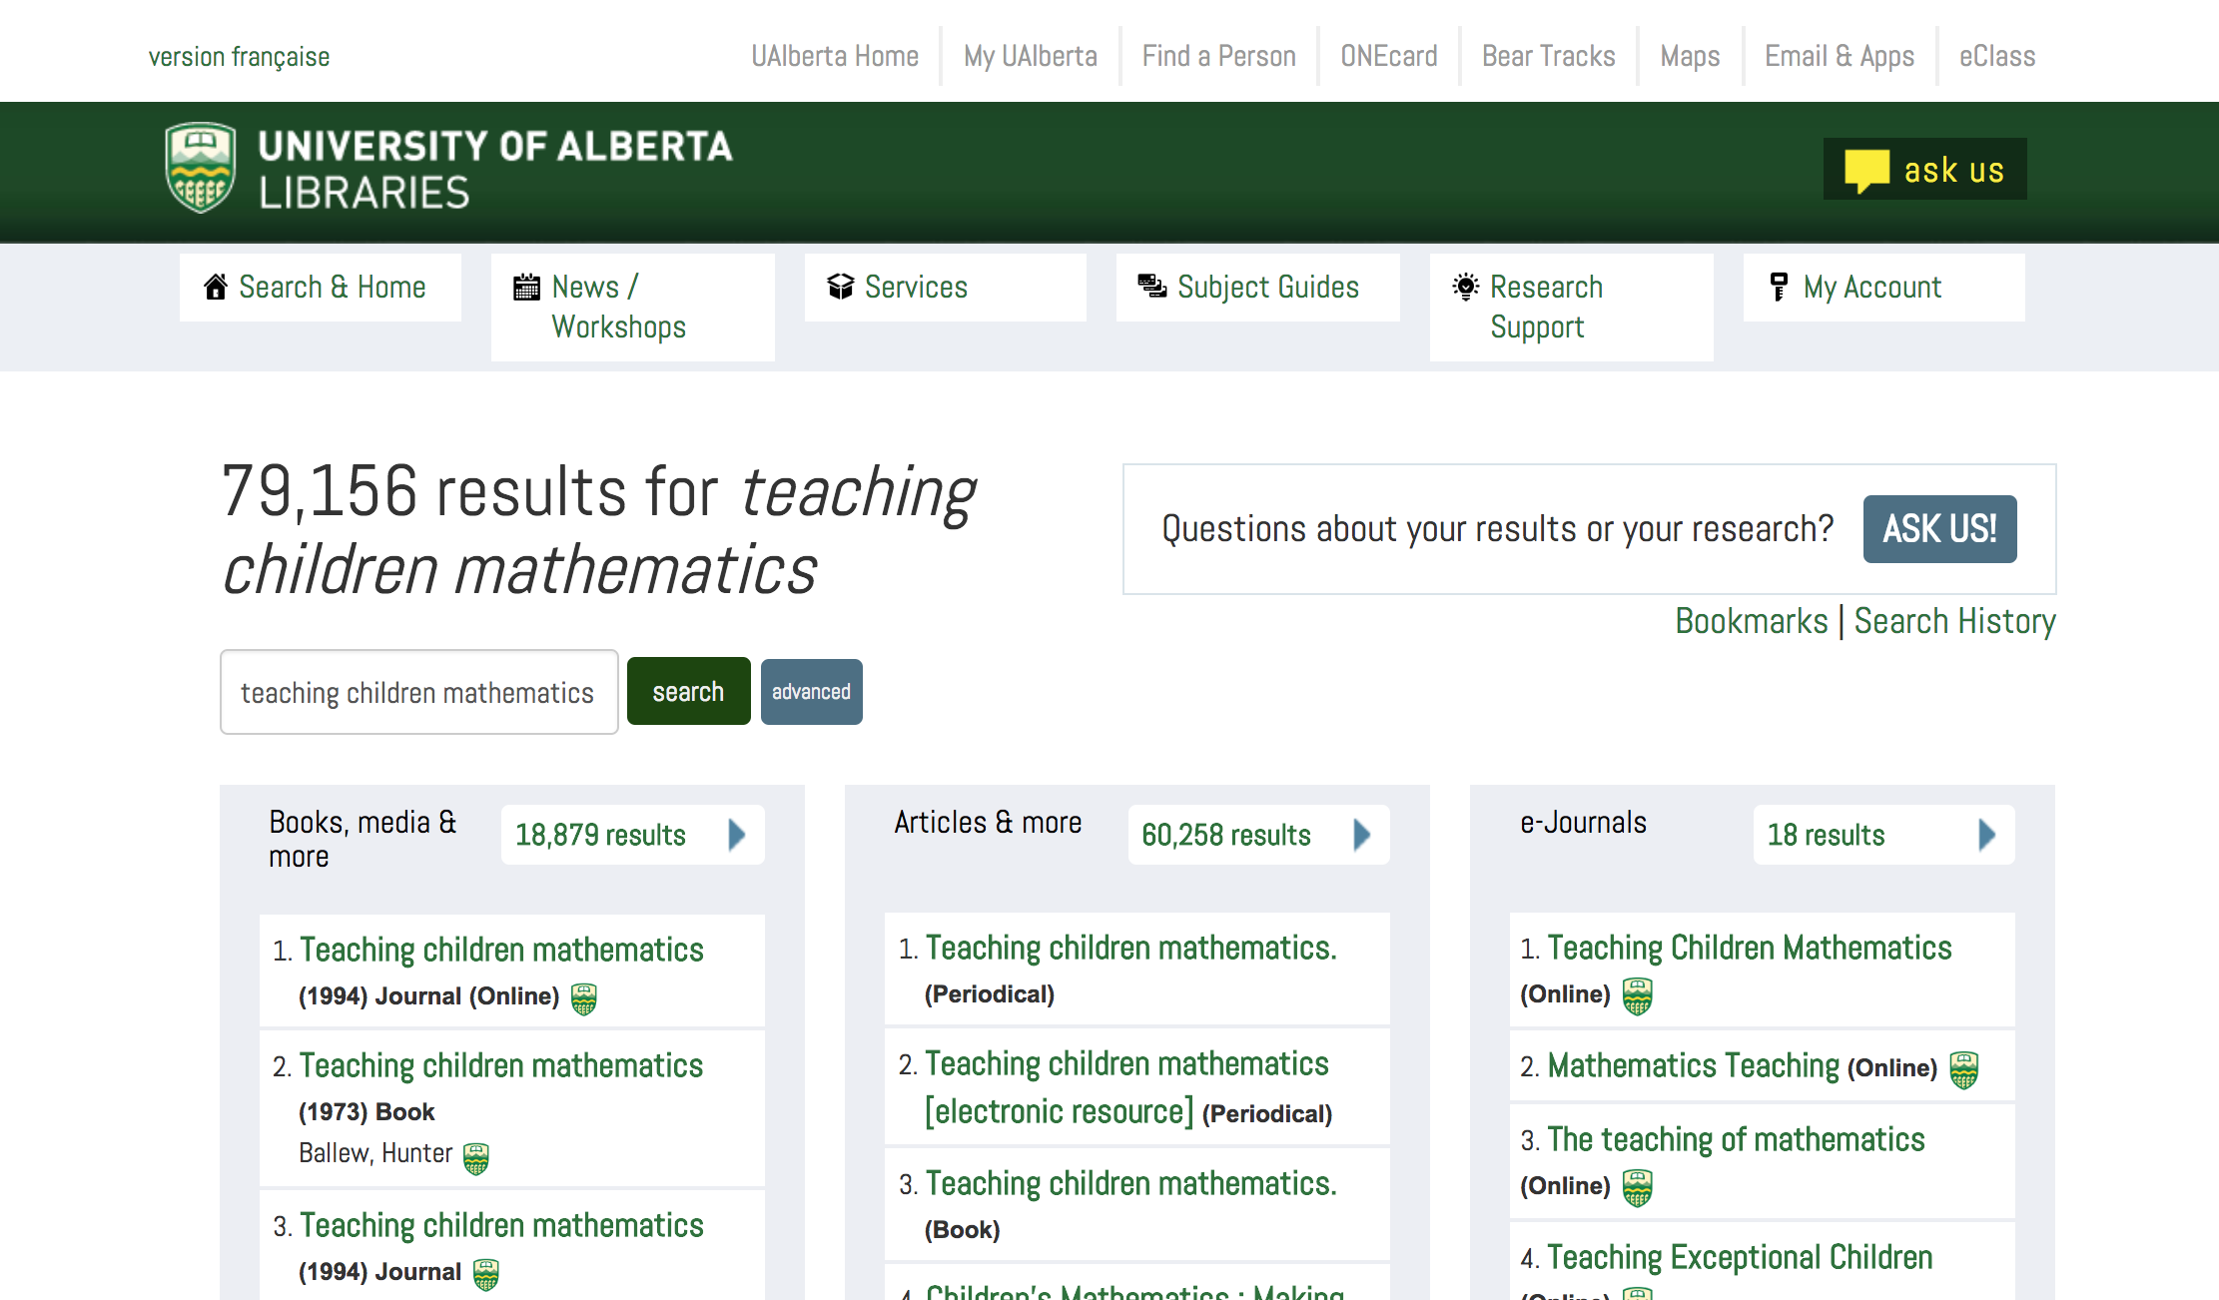
Notes:
Our discovery layer is powered by Blacklight. Through our discovery layer, e-journals can be accessed in several areas. If we conduct a general search for “teaching children mathematics” on our library homepage, we reach this page of search results.
There are two ways that e-journals can be accessed here. The first one is in the “Books, media & more” column on the far left.
This column is populated by records in our shared NEOS Symphony catalogue.
If we click this link...

Slide 20
Notes:
We land on this page, which displays some key bibliographic information, such as the ISSN, publisher, year of publication, and related titles.
This data is all pulled from our MARC record.
You can also see that this page shows institutional access on the bottom-- the University of Alberta, Red Deer College, and Grant MacEwan all have access to this e-journal.
To access this title, our users have to click the “Click Here for University of Alberta Access (1994-)” button at the top of the page.

Slide 21
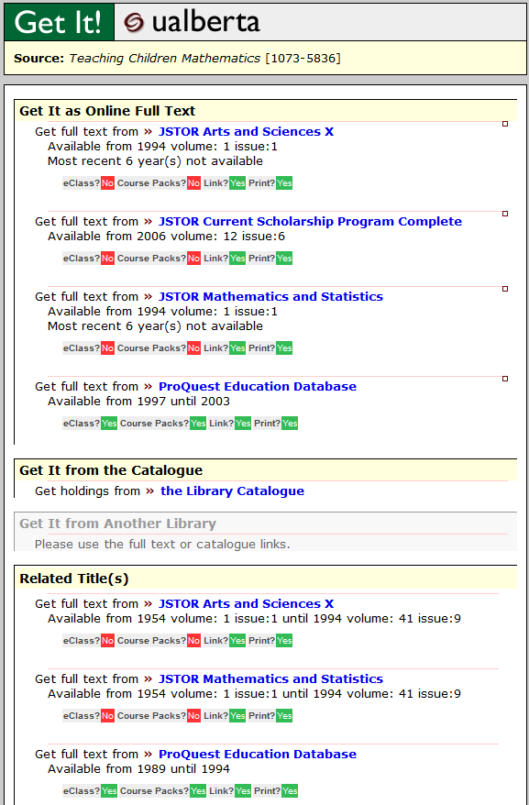
Real-time list of all active targets and threshold statements for this title
Links for earlier/later titles and supplements
Notes:
This opens a Get It! Window, which is powered by SFX.
The Get It! Window features a real-time list of active targets (e.g. JSTOR Arts and Sciences X, JSTOR Current Scholarship Program Complete), with their thresholds written in layman terms (e.g. Available from 1994, volume 1; issue 1 ; Most recent 6 year(s) not available). There is also licensing information listed for each target (e.g. eClass? Course Packs? Link? Print?).
The “Related Titles” section has earlier or later titles. This section is also pulled from SFX objects that are linked with preceding or succeeding relationships in the SFX Knowledge Base.
This is just one way of accessing e-journals through the U of A.

Slide 22
Notes:
If we return back to Blacklight’s search results for “teaching children mathematics,” we can access the e-journal through another column: the “E-Journals” column on the far right.
This column is populated by SFX. Why is this column separate from the “Books, media & more” column?
Sometimes, we will activate objects or targets in SFX, but we choose not to catalogue them in our shared catalogue. This is often the case for open-access journals and open-access collections. We can set targets (e.g. DOAJ) to auto-activate, and whenever a new object is added to the target, it is activated in SFX.
This e-Journals column, populated by SFX, allows users to discover these resources, even if we don’t have a record in the shared catalogue for the title.
If we click through this link...

Slide 23
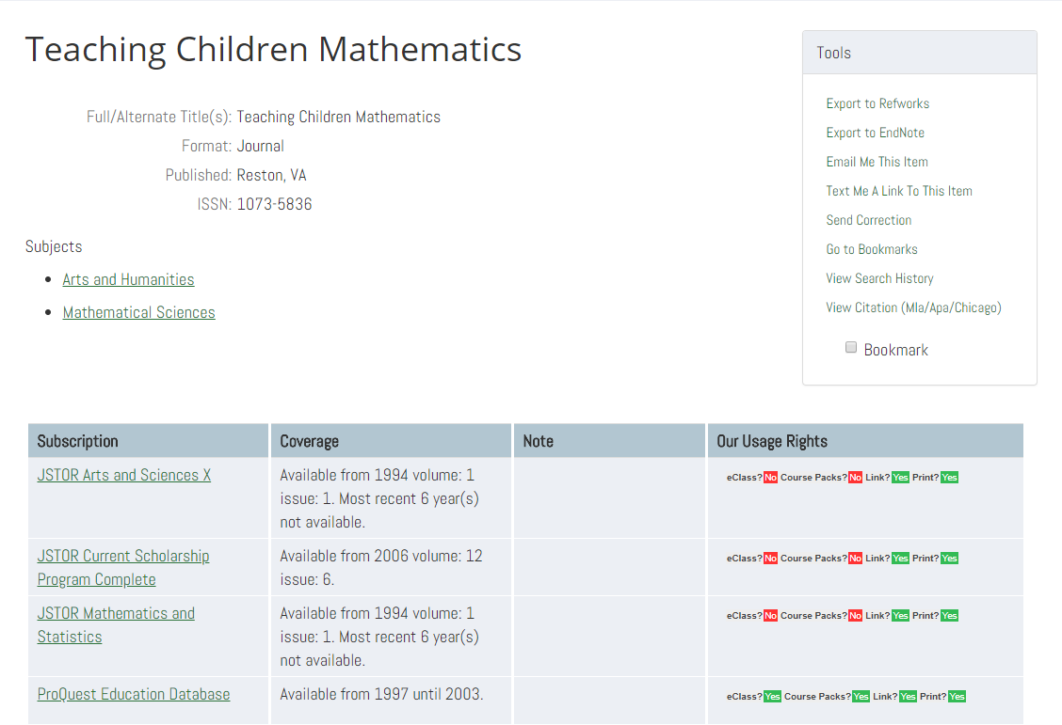
Notes:
We land on this page, which is a bibliographic record pulled from SFX.
This page has significantly less bibliographic information as compared to the other page-- that is because the SFX Knowledge Base has less metadata, as compared to a full level MARC record from our catalogue.
Looking back at the Get It! Window that we had generated earlier, we can see that this page displays almost the exact same information.
The target names are listed in the “Subscription” column, the threshold statements are in the “Coverage” column, and the licensing information is seen in “Our Usage Rights.”
To access the e-journal, clicking on the target names in the Subscription column will bring you to the landing pages for each target.

Slide 24
How do we manage SFX and the catalogue?

Slide 25
SFX2Sirsi
The SFX2Sirsi program is a locally-developed program that works with matching active object IDs in SFX and the catalogue (940 field) to perform catalogue maintenance:
Updates catalogue coverage statements (856/summary holdings) to reflect changes in the SFX KB
Adds UAINTERNET holdings and local information to existing NEOS records (when a new object ID is activated in the SFX KB)
Removes UAINTERNET holdings and local information or sets records to discard if no other holdings (when the last active object ID for a title is deactivated in the SFX KB)
Identifies duplicates in the catalogue
*Thanks to Peter Binkley, Jeremy Hennig, Jim Hamilton, and Marcel Gee for their continued work on these reports!
Notes:
Outside of the manual work done by the serial team to setup electronic journal access in SFX and the catalogue, we’ve been lucky enough to have the support of library ITS to create a local program called SFX2Sirsi that help us automatically manage both SFX and catalogue data and make sure the two systems are in sync.
As we know, vendor and publisher packages are not always static. As a result the SFX KB is by virtue a living organism where titles can come and go from a specific target collection, date entitlements can change, and platforms can migrate. We initially created the SFX2Sirsi program to help us manage the ever changing coverage information for our electronic serials, however, the program has since grown and allows us to manage numerous aspects of SFX and the catalogue:
One of the primary functions of SFX2Sirsi is updating coverage statements in the catalogue record when they change in SFX, for example when a publisher releases the backfile of a title they previously only offered the front file for the coverage statement in SFX will be updated by Ex Libris and we then want to reflect our new entitlement in the catalogue record. This is where the title’s object ID in the catalogue record comes in useful as an identifier to match on.
Another benefit is that SFX2Sirsi will add an UAINTERNET item (including summary holdings and relevant local fields) to an existing NEOS record with when there is a matching object ID in the 940 field (we should note that these will always be MacEwan records since they are the only other NEOS library to manage their e-journals through SFX).
In the reverse, the program will also remove UAL holdings from a record or set a record to discard if the object ID is no longer active in the knowledge base.
Finally, it will also compare all 940 fields in our catalogue records daily to see if an object ID is in a record twice - this typically signals a duplicate record, or a metadata issue in the SFX knowledge base that we need to go in and fix.

Slide 26
SFX2Sirsi Reports
SFX2Sirsi generates two reports: SFX Not in Sirsi, and SFX Pub Diff, which help the serials team prioritize our work, and catch errors in our e-serials management and metadata.
Notes:
Aside from the automated management of catalogue records, the SFX2Sirsi program also generates two useful reports that help us prioritize our catalogue work and ensure complete and accurate metadata in both SFX and the catalogue.

Slide 27
SFX Not in Sirsi Report
The SFX Not in Sirsi report lists active object IDs in SFX that aren’t present in our catalogue.
Report is arranged by target
Allows us to prioritize our work
Notes:
The first report is the SFX Not in Sirsi report, which checks for object IDs that are active in SFX, but not present in our Sirsi catalogue in a 940 field. This gives us a list of electronic serials that need cataloguing each month. The report is arranged by target collection and shows how many titles are uncatalogued in each target. This allows us to prioritize our work by focusing on cataloguing titles from our most important or expensive collections as identified by our collection strategies unit.

Slide 28
SFX Pub Diff Report
Checks SFX thresholds against fixed field dates in the catalogue.
Updates thresholds listed in the catalogue record and summary holdings when they are edited in the SFX knowledgebase by cataloguers or by SFX updates.
SFX Pub Diff provides a list of electronic serials that have incompatible date spans.
Often involves local edits within SFX (correcting thresholds)
Can point to issues with preceding/succeeding titles
Notes:
The next report is our Pub Diff report, which is a byproduct of the SFX2Sirsi program when it attempts to automatically update coverage statements in the catalogue. If the stated coverage for a title in SFX falls outside of the fixed field dates in the catalogue record, it is included in this report. This list of titles signals the need for further investigation and local edits in SFX. Typically this work will include correcting threshold coverage statements, or adding earlier or later titles to SFX because a publisher is representing multiple titles using one object.

Slide 29
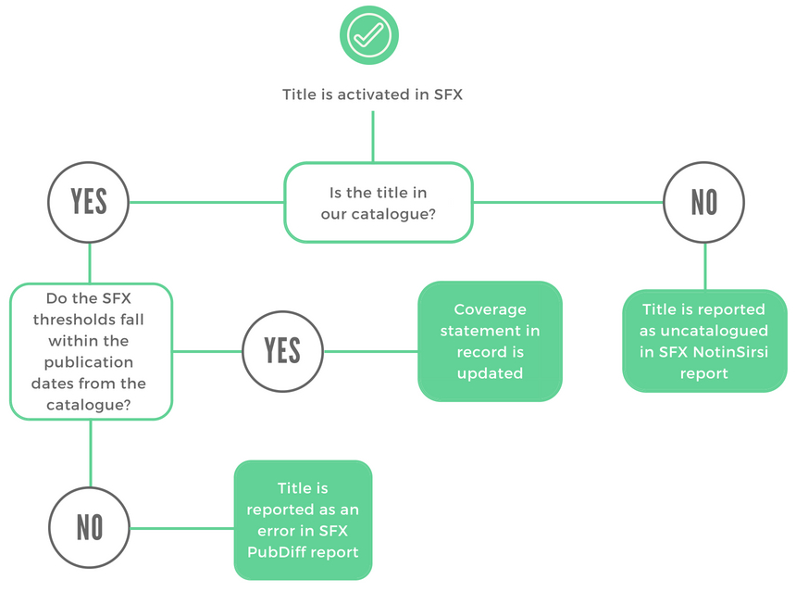
SFX2Sirsi In Action
Notes:
This flow chart displays how SFX2Sirsi works with SFX and our Sirsi catalogue, and how it generates our SFX Not in Sirsi and SFX PubDiff reports.
Now, you’ve had a brief introduction to SFX in a nutshell, and how users interact with SFX through the library catalogue.
It should be noted that SFX isn’t a perfect e-journal management system/link resolver...

Slide 30
Challenges, Tips & Tools, and NEOS
Notes:
While the U of A uses SFX for e-serial management, it is not a perfect product. Here we’ll discuss some of the challenges that come with using SFX, explore some tips and tools that our serials team uses to maintain our e-journal collection (and for serials cataloguing, in general), and some challenges in cataloguing electronic serials in a consortial environment like NEOS.

Slide 31
Common issues with e-journal management in SFX
Discovery
Get It! can be confusing
Duplicated information in discovery
Unintuitive SFX Admin interface and confusing vocabulary
Access
Publisher-provided metadata
Links not resolving properly
Notes:
When planning this presentation, we realized that most challenges fell into two major categories: Discovery and Access.
Regarding discovery, Get It! can be confusing for users.
The Get It! Window is not seamlessly integrated into our Blacklight discovery system, and this can be jarring for users. Furthermore, having dozens of links to the same resource in the Get It! Window confuses users, and leads to information overload.
While displaying links according to how we have access is useful to librarians and technical services because it lets us troubleshoot issues, it’s confusing for users, who don’t care about how we have access-- they just want a single link (the best link) to a resource.
Users may select the first link available in the Get It! Window, with the understanding that the first link is the best link (similar to relevancy ranking in Google). This may not be the case-- the links are listed in alphabetical order by target name.
Another problem with Get It! Is the misleading branding of our link resolver. Many users think “Get It!” means “the U of A doesn’t have this, and I can request them to purchase this title/article by clicking the Get It button.”
Another challenge that we face is around duplicated information in our Blacklight discovery layer.
As mentioned earlier, e-journals can be accessed in two different areas of a search results page-- the “Books, media & more” column, and the “E-journals” column. Because this information is duplicated in the discovery layer, and because it’s not made clear to users why the e-journal appears twice (and why each method of access results in different interfaces), this can also be confusing for users.
This also makes it difficult for users to replicate their searches, especially if they don’t remember which column they clicked.
We should be noted that these two discovery issues were mentioned in the Discovery Usability Study Report that was recently published by the U of A’s Discovery Testing and Training Team, and the Web Architecture Team. The U of A’s Get it! Window and our instance of Blacklight are both under review, and efforts are underway to address these issues.
There are also numerous common issues related to access that come within managing e-journals through SFX
The largest, and most frustrating issue is having to rely on publisher-provided metadata in the knowledgebase
Sometimes the publishers provide incomplete or incorrect metadata, or they don’t provide any metadata at all. Because of this, we often have to use the Ex Libris Support Portal to ask SFX to create new objects for earlier titles, to change ISSNs, to globally update title thresholds, to merge duplicate objects. We will also contact publishers directly to request that they make their collection metadata available to SFX.
There is also typically a delay from when the metadata is made available to SFX by the publishers, and when SFX updates their KB with the metadata which can create access gaps between the time we purchase a package and the time it’s actually available to our users
OpenURL fails
Indexing and abstracting services may have more recent, and better (more granular) metadata in their indices than what the publishers submit to SFX. If this is the case, the OpenURL may not be able to match, and a link can’t be established. This is often the case with pre-publication articles
Links not resolving properly
Ideally, a link will take the user to the journal’s landing page, but sometimes it’ll simply resolve to the publisher’s homepage, or a specific page within the journal. This means the user will have to navigate to properly access the journal’s volumes/issues. We can troubleshoot these problems and try to fix linking locally, but sometimes the linking structure is too complex and needs to be resolved by Ex Libris and the publisher.
SFX Admin Interface
Finally there is also the SFX Admin interface, and this doesn’t necessarily relate to access or discovery, but usability – the interface is not intuitive, nor is the language and terminology used, which makes it a more difficult tool to teach.

Slide 32
Tips & Tools!
serials@ualberta.ca
Team Rotations
SFX Listservs and Release Notes
Ticket Systems
U of A’s OTRS (helpdesk)
Ex Libris Support Portal
OCLC WorldCat, Record Manager and ISSN Portal
Documentation, documentation, documentation!
CONSER resources (see slide deck for links)
Notes:
Here are some tips and tools that the serials team uses to stay on top of e-journal management.
Many of these are simple and straightforward, but all of them are useful, and contribute to the serial team’s success!
Joint email (serials@ualberta.ca)
All team members have access to this email, and it helps keep everyone on the same page.
This email acts as a centralized point of contact, which helps us keep track of serial acquisitions (from CSU/bibhelp), SFX reports, listservs, helpdesk tickets, vendor outages, platform migrations, etc.
This is also the serials team’s main point of contact for unit libraries within the U of A, and for other NEOS libraries. If you have questions about serials, you can always shoot an email to serials@ualberta.ca!
Serials team rotations
Helps the team delegate responsibilities every week. Our weekly print and helpdesk/email rotation allows a single person to act as the point of contact for e-journals (or print) for the week.
Allows the team to keep track of regular e-journal and SFX maintenance each week.
The team member on rotation is also responsible for follow-up, should an issue take over a week to resolve.
Listservs & Release Notes
Allows the team to stay up-to-date with common issues in SFX. The listserv provides a community of other SFX users where we can pose questions and seek input on how other libraries respond to issues.
SFX Release Notes are published weekly by Ex Libris on the SFX Portal. These include information about upcoming changes to targets within SFX.
E.g. New targets, target deletions, title transfers between publishers or targets
These changes are applied to our local instance of SFX every week by our ITS team.
Every week, the serials team member on the helpdesk/e-journal rotation will download the release notes and reconcile the upcoming changes with our instance of SFX. This helps us maintain our instance of SFX, and ensures that our Knowledge Base is accurate.
Ticket Systems
U of A OTRS (Open Source Ticket Request System), also known as the helpdesk
Allows us to deal with local access/cataloguing issues.
The serials team mostly works out of two queues:
Bib Services - E-Resource Issues
Bib Services - Cataloguing
Serials team works with the Bibhelp team (part of the Collections Strategies Unit; Bibhelp is in contact with the vendors/publishers, and manage our EZProxy) to answer tickets and manage issues. Most ticket-related work for the serials team is regarding SFX access issues, and cataloguing titles for the shared NEOS catalogue.
Ex Libris Support Portal allows us to submit tickets to SFX.
We report problems or broken links, report incorrect ISSNs, ask questions, request for new objects to be created, etc. through this channel.
Ex Libris also has an Idea Exchange, in which users can vote for certain ideas (e.g. creating a target/collection for UA’s OJS collection). When an idea gains enough traction, Ex Libris will review it.
OCLC WorldCat, Record Manager, ISSN Portal
Some of the tools most cataloguers are familiar with. The U of A is fortunate to have subscriptions to these tools.
ISSN Portal is more specific to serials, and helps verify start/end dates,earlier/later titles, and ISSNs/eISSNs.
Documentation
The U of A uses Google Suites for our emails, shared documents, etc. This allows multiple people to work on the same document at the same time
Some examples of serials documentation: training documents, procedures, priorities documents, monthly progress tracking, project documentation.
Our recent turnover of staff on the serials team has made us more aware of the areas in which our documentation can improve
Documentation helps build capacity and disseminate information within a team :)
This was not included in our NEOS presentation, but it’s worth sharing:
The serials team also relies heavily on CONSER (the Cooperative Serials Program; part of the PCC (Program for Cooperative Cataloging)) resources.
The SCCTP (Serials Cataloging Cooperative Training Program) provides free, standardized training materials for serials cataloguing here: https://www.loc.gov/aba/pcc/conser/scctp/scctp-materials.html
CONSER Cataloging Manual (CCM): https://www.loc.gov/aba/pcc/conser/more-documentation.html
CONSER Standard Record (CSR): https://www.loc.gov/aba/pcc/conser/documents/CONSER-RDA-CSR.pdf
NOTE: the CSR is mentioned in the NEOS Document 1 Cataloguing Standards as the recommended record requirements for serials cataloguing. It is also linked in Appendix A of Document 1 (alongside other cataloguing resources, such as the BIBCO Standard Record, and LC RDA core elements).
CONSER - Cataloging Electronic Serials: https://www.loc.gov/aba/pcc/conser/issues/E-serials.html

Slide 33
E-journal Cataloguing Challenges in a Consortial Environment
Major considerations:
Financial/staffing means
Collection needs
Management workflows
Notes:
We’re going to close with a brief discussion of some of the challenges that accompany e-journal cataloguing in a consortial environment such as NEOS
The first is varying financial and staff means:
The U of A Libraries are fortunate to have a team of cataloguers that are solely devoted to serials, which isn’t the case for many NEOS libraries.
We also acknowledge that SFX is an expensive product to license, and once you opt in, it’s hard to opt out. It also requires a lot of IT capacity to use and maintain.
Within the consortium there are also many varying e-serial management workflows
The scope, complexity and stability of a libraries collection can determine how they decide to manage their e-journals, and for this reason, many libraries don’t catalogue their individual e-journal titles (but rather, provide access through an e-journal A-Z title list).
Even when libraries do use the same e-journal management software, they can still approach management from very different angles. For example, MacEwan also uses SFX as a link resolver, however, their management workflows look very different from ours at UAL. To catalogue their e-journals MacEwan uses the MARCit! Service - a vendor service that supplies MARC records for e-journals that MacEwan activates in their local SFX knowledgebase. Once activated the MARCit! Service attempts to match activated SFX titles with corresponding CONSER records, if no record is found, the MARCit! Service provides a very brief record for the title. MacEwan also has their own locally created scripts that work to automatically update, add or delete records in our shared ILS based on their changes to the SFX KB that week. For more information on their process you can refer to the slide deck or contact a MacEwan rep.
Brief description of MacEwan’s MARCit! Service as provided by Vanessa Bangay:
“The MARCit! service supplies MARC records for e-journals (not e-books) activated by MacEwan in SFX. The MARCit! database is comprised of CONSER records obtained from the Library of Congress Cataloging Distribution Service. MARCit! attempts to match activated SFX titles with corresponding CONSER records. Institutions can indicate a preference for records that describe either print or electronic formats when the choice exists. MacEwan has chosen to have electronic records delivered whenever possible. MARC data from matching CONSER records is used to enhance the records that MARCit! creates. In cases where a matching CONSER record is not found (print or electronic), a very brief record is provided.
On a weekly basis, MacEwan generates a MARCit! file that is compared to the previous week’s file and results in a file of new, changed, and deleted records. MacEwan’s SFX script modifies the records in the file (removing print format fields and coding, adding electronic fields and coding) where appropriate.
The SFX script examines each record in the file and tries to find a matching electronic record in Symphony (match points: SFX ID, OCLC number, ISSN). If a match is found, the following elements are added/updated in Symphony: 090, 856, and 940 fields, MARC Holdings record, and the item record. If no match is found, the record is loaded into Symphony as new. If the record is coded as a delete, the following elements are removed in Symphony: 090 and 856 fields, MARC Holdings record, and the item record.”

Slide 34
E-journal Cataloguing Challenges in a Consortial Environment
Coordinating amongst various libraries
Record duplication
Conflicting treatment for serials
NEOS Cataloguing Standards (Document 1)
Notes:
Another challenge that accompanies E-journal management is the need for coordination between all consortial libraries:
For example, we will on occasion encounter multiple records for the same resource
Record duplication is a common problem. As I mentioned before, we do have a daily report that identifies duplicate records using the 940 field; however, this report can only catch duplication between UAL and MacEwan who also manage e-journals through SFX. If multiple records exist for titles that link with a direct link instead of through SFX, duplication is only caught at the time the record is created. This is an issue specifically when another library has uploaded a stub record for a journal title, because if the existing record doesn’t include important identifiers duplication can go unchecked.
Next we also have the issue of conflicting serial and monograph treatment for continuing resources.
Some institutions may treat certain titles (say for instance yearbooks, or conference proceedings) as monographs, which can make sense for their library’s needs. Cataloguing each year as a separate entity increases discoverability of the title in general. However, because UAL uses SFX to manage electronic access, we prefer having all of our access on one e-serial record. Because the NEOS catalogue has all of the records from member libraries, the monograph records can clutter our search results, and the U of A’s e-serial records with electronic access can sometimes be obscured from the user.

Slide 35
Questions?

Slide 36
Still have questions?
serials@ualberta.ca
Thanks for listening!
Or:
abigail.sparling@ualberta.ca
carol.ma@epl.ca

