Slide 1
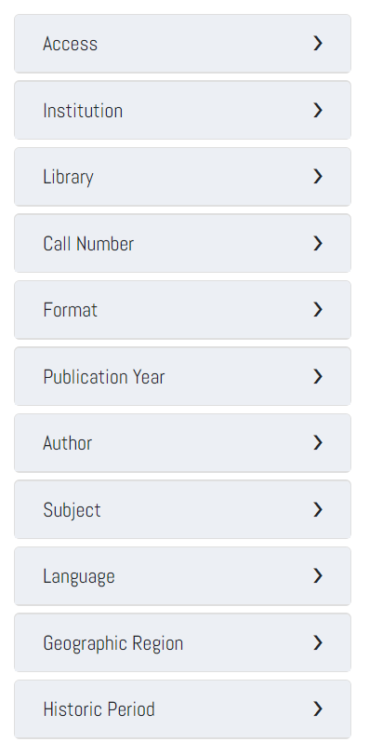
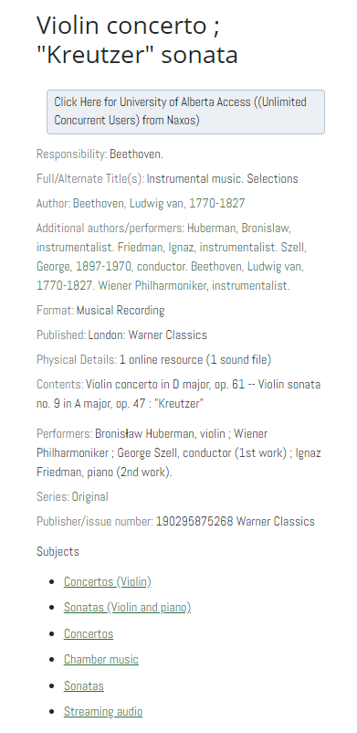
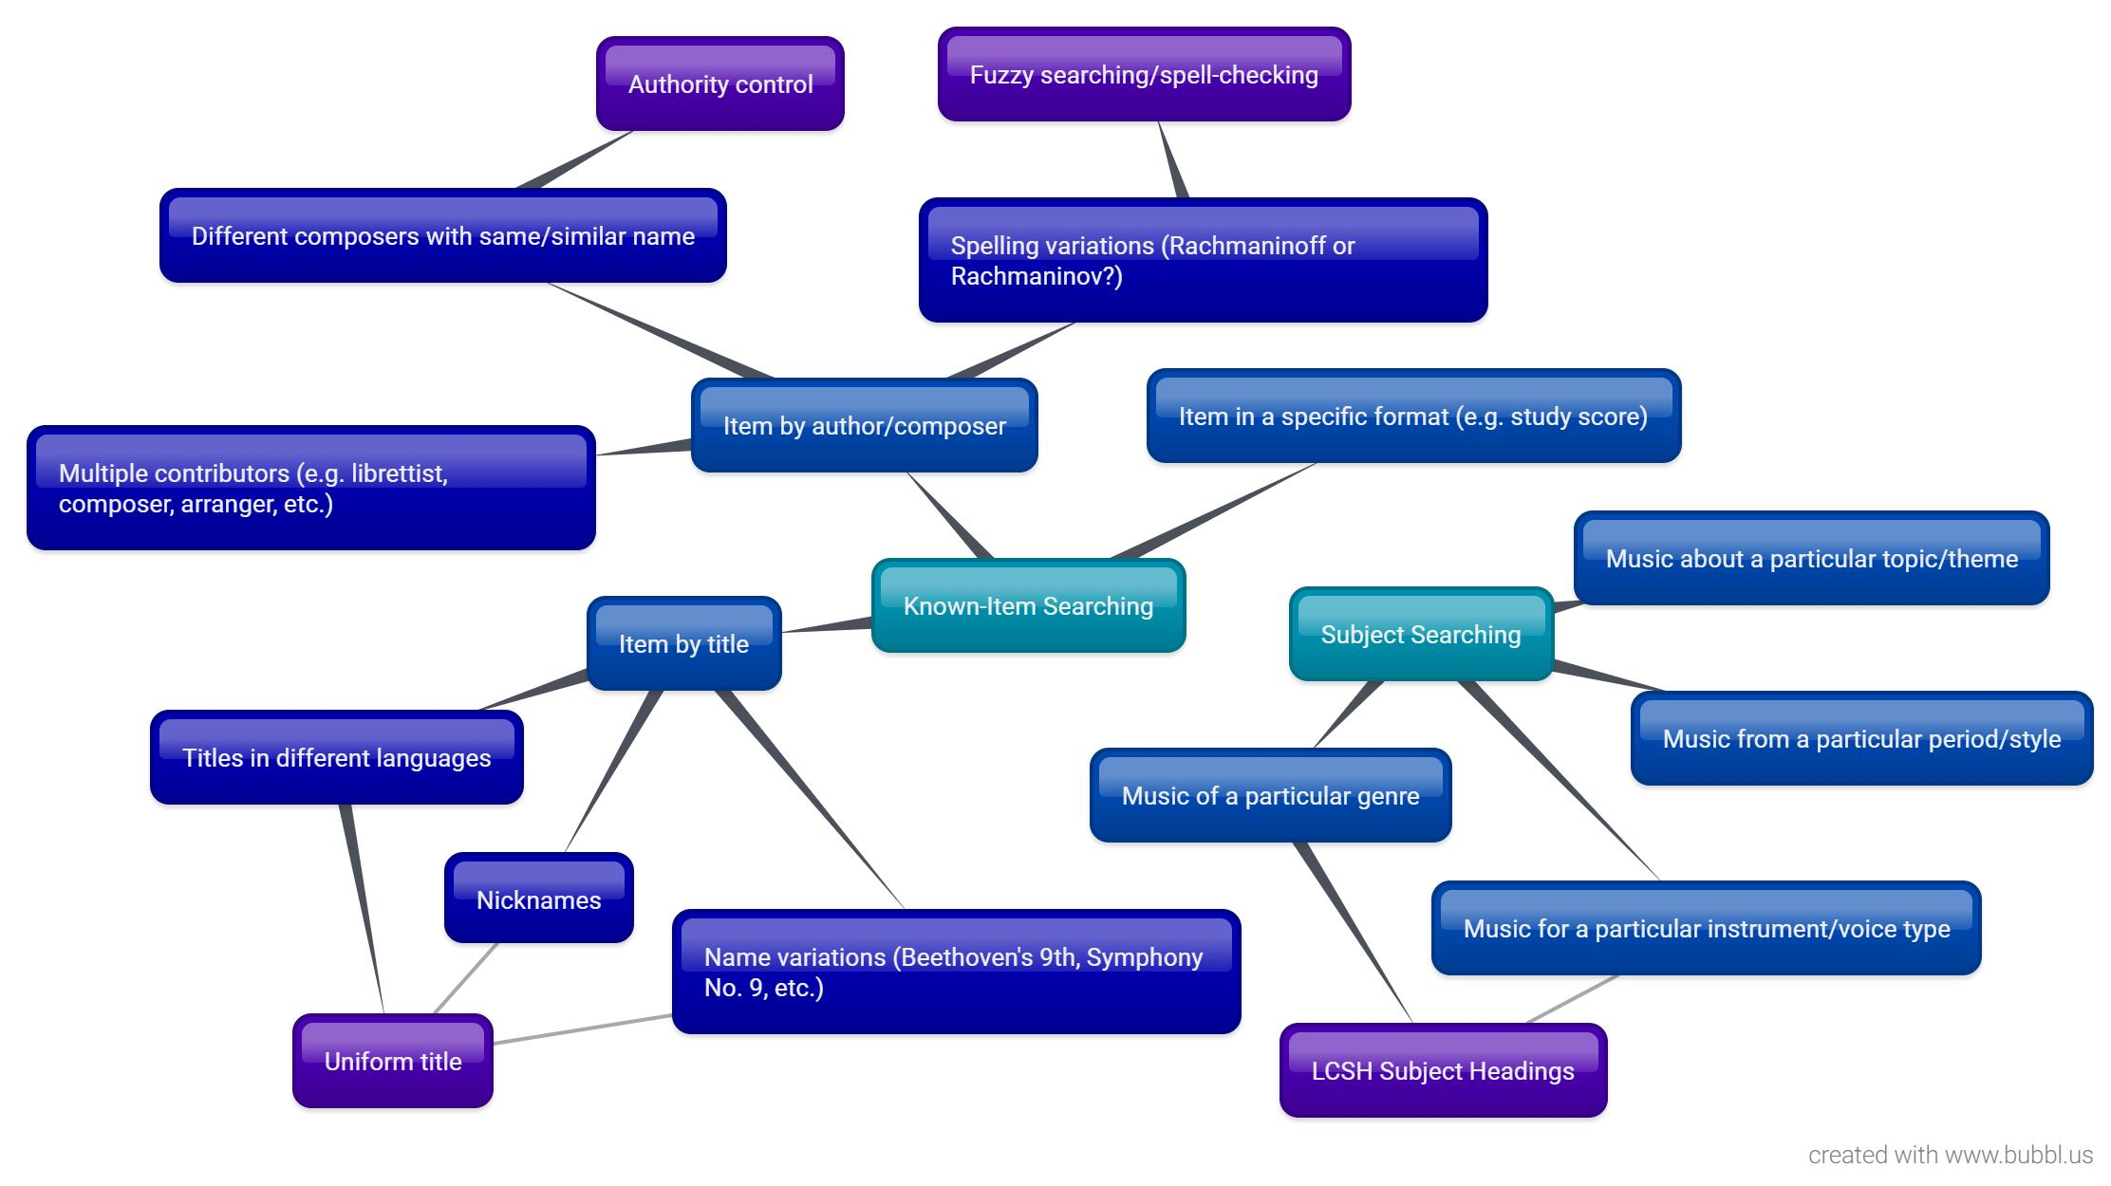
In Need of a Tune-Up? Improving Findability of Music Materials in the Library Catalogue
Katie Maxfield, University of Alberta School of Library and Information Studies, MLIS Candidate
Email: kmaxfiel@ualberta.ca
Introduction & Research Question
Sample Records
Methods
Introduction:
Next-generation library catalogues and discovery systems have transformed the way library users search for materials, but music materials (defined here as score and sound recordings) pose special challenges because of their unique attributes. This study will bring together literature about the information needs of music students and the obstacles that they may face in finding the music materials that they require. Drawing on recommendations in the literature as well as my own observations, I will evaluate the challenges facing discovery of music materials in the University of Alberta library catalogue as viewed through the Blacklight discovery platform.
Research question:
What are the main challenges facing music discoverability in the University of Alberta library catalogue, and how can it be improved to better meet the needs of music students?
Common Challenges:
Musical works are often known by many names, including nicknames and titles in foreign languages (King, 2007)
Lack of distinctive titles for classical works. Many pieces are named according to their genre and an additional identifier (e.g. “String Quartet in F minor”) – this may produce many false hits for similarly-named works by different composers (Majors & Mantz, 2011)
Finding a particular work that is included in a larger collection (e.g. a single art song that may only appear on a CD and thus is not catalogued individually) (Gracy, Zeng, & Skirvin, 2013)
A single work may have many different manifestations, each serving a different purpose. Users must be able to distinguish between a miniature “study” score, a score for a specific instrument, and a full conductor’s score. (Hofmann & Wiermann, 2014)
Five Core Elements of Music Materials:
Ran sample searches for musical works (selected by purposive sampling) and noted the challenges/problems that I came across in the search process
Noted the facets that are available for filtering during the search process and analyze their usefulness for searching for music materials
Examined both the MARC record (“Librarian View”) and the user view of catalogue records to determine which metadata elements are being used to describe music materials
Findings
Lack of consistency across bibliographic records remains a serious issue; unfortunately, there is not an easy or inexpensive solution that has been identified for addressing this problem
Uniform titles can be displayed more prominently (with hyperlinks or prompts to “see [uniform title]”) to allow users to easily gather all manifestations of a given work
Faceted searching is key to helping users find what they need (Salaba & Zhang, 2012). Customized facets such as musical presentation (i.e. type of score) and instrumentation would be especially useful, and have been used in other libraries’ catalogues
Creating a specialized music search interface could make music searches easier without affecting the search experience in the catalogue as a whole
Title
Author(s) (including composers, performers, etc.)
Genre/instrumentation
Other subject/topic (e.g. subject of a song or symphonic poem)
Format (whether audio/video recording or score, as well as specific types of recordings or scores)
User Search Strategies and Common Obstacles
Key
Top left: facets that are available to limit searches
Bottom left: abbreviated view of a sound recording on the search page
Right: full record of a sound recording in the catalogue (user view)
Search Strategy
Limitations/Future Research
Element Searched For
Possible Obstacles
Possible Solutions
This study provides only a brief snapshot of some of the issues in the library catalogue
Further research may involve a more comprehensive survey or statistical analysis to ascertain the prevalence of the identified challenges, as well as user studies or interviews to obtain input from music students and other users
Research is needed on the needs of students selecting music materials for performance, particularly for vocal recitals organized around a topic or theme
References:
Gracy, K. F., Zeng, M. L. ed., & Skirvin, L., ed. (2013). Exploring methods to improve access to music resources by aligning library data with linked data: A report of methodologies and preliminary findings. Journal of the American Society for Information Science & Technology, 64(10), 2078–2099. https://doi-org.login.ezproxy.library.ualberta.ca/10.1002/asi.22914
Hofmann, A., & Wiermann, B. (2014). Customizing music discovery services: Experiences at the Hochschule für Musik und Theater, Leipzig. Music Reference Services Quarterly, 17(2), 61-75. doi:10.1080/10588167.2014.904699
King, D.M. (2007). Catalog User Search Strategies in Finding Music Materials. Music Reference Services Quarterly, (9)4, 1-24. DOI: 10.1300/J116v09n04_01
Majors, R. & Mantz, S. (2011). Moving to the patron's beat. OCLC Systems & Services: International digital library perspectives. (27)4, pp. 275-283. https://doi.org/10.1108/10650751111182588
Salaba, A., & Zhang, Yin. (2012). Searching for music: End-user perspectives on system features. In D. Rasmussen Neal (Ed.), Indexing and retrieval of non-text information (pp. 137-159). https://doi-org.login.ezproxy.library.ualberta.ca/10.1515/9783110260588.137

