Slide 1
Legal And Ethical Contexts for Collaborative Research
Catherine Bell
University of Alberta
Faculty of Law

Slide 2
Broader Research Program
Western (Canadian and international) and Indigenous legal traditions
Ethical norms influencing Canadian institutions
Institutional governance, policies and processes Articles, judicial decisions, Indigenous laws and protocols for research and traditional knowledge
Research agreements and other legal arrangements to structure collaborative research among and between institutions, Aboriginal governments, researchers and individuals
Experience in national and international collaborations

Slide 3
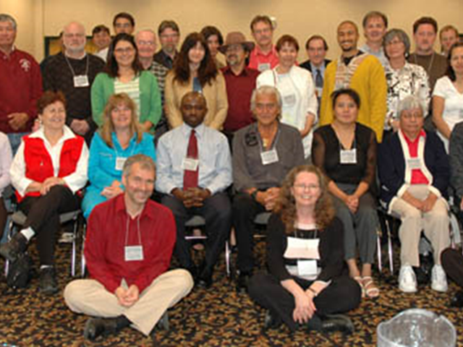
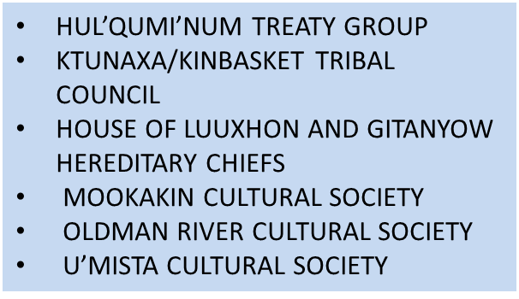
First Nation Cultural Heritage and Law
Communicate concerns relating to respect for Indigenous laws, and processes
Facilitate greater understanding about diverse First Nation experiences and cultures
Develop practical resources related to issues of concern to Indigenous partners
Generate reports with the potential for diverse uses and means of dissemination
Disseminate information about the operation, impact and limits of the existing Canadian legal regime
Critically analyze domestic law and policy within a broader international, social, political and legal context

Slide 4
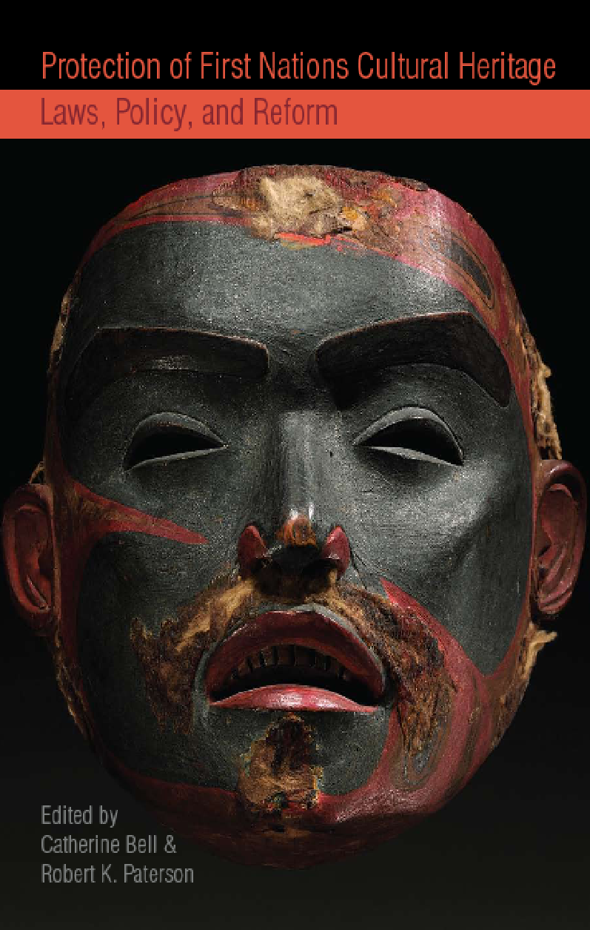

First Nations Cultural Heritage Project
FN Cultural Heritage and Law
Case Studies, Voices and Perspectives
Catherine Bell &
Val Napoleon

Slide 5

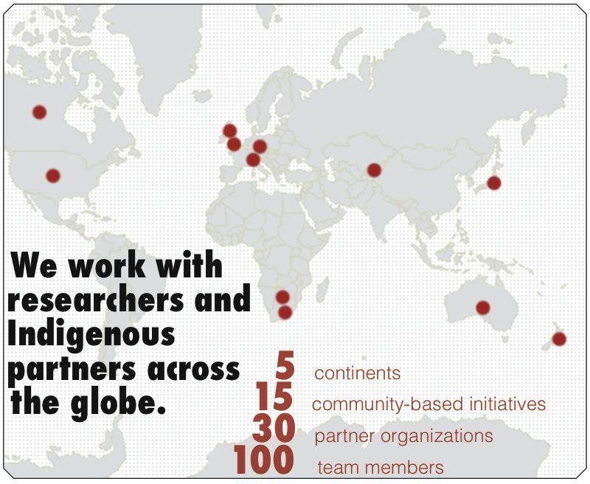
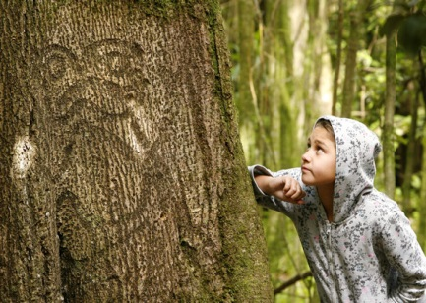
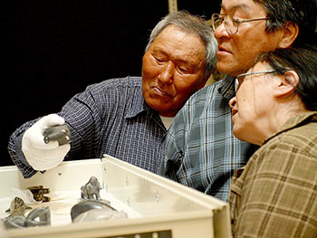
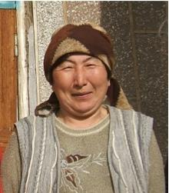
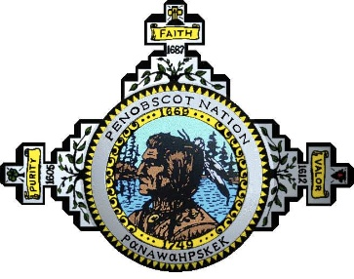
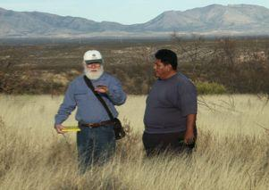
INTELLECTUAL PROPERTY ISSUES IN CULTURAL HERITAGE
Theory, Practice, Policy, Ethics

Slide 6

INTELLECTUAL PROPERTY ISSUES IN CULTURAL HERITAGE
Theory, Practice, Policy, Ethics
Some of Our IPinCH Partners
Arctic Studies Center, Smithsonian (Washington, DC) with links to the Tshikapisk Foundation
(Innu) and Labrador Inuit Association
Barunga Community (Australia)
Center for Ainu and Indigenous Studies, Hokkaido University (Japan)
Champagne and Aishihik First Nation (Haines Junction, YT)
Gwich’in Social and Cultural Institute (Yellowknife, NT)
International Journal of Cultural Property (West Nyack, NY)
Inuit Heritage Trust (Iqaluit, NU)
Left Coast Press (Walnut Creek, CA)
Mookakin Cultural and Heritage Foundation (Standoff, AB)
National Association of Tribal Historic Preservation Officers (Washington, DC)
Parks Canada (Ottawa. ON)
Prince of Wales Northern Heritage Centre (Yellowknife, NT)
Sealaska Heritage Institute (Juneau, AK)
Social Science Research Council (New York, NY)
Society for Applied Anthropology, Intellectual Property Rights Interest Group (Columbia, SC)
Sto:lo Research and Resource Management Centre (Chilliwack, BC)
Tr'ondek Hwech'in Heritage Department (Yukon, YT)
White Mountain Apache Tribe (Whiteriver, AZ)
World Archaeological Congress (Adelaide, Australia)
World Intellectual Property Organization (Geneva, Switzerland)
Ziibiwing Cultural Society (Saginaw Chippewa, MI)

Slide 7
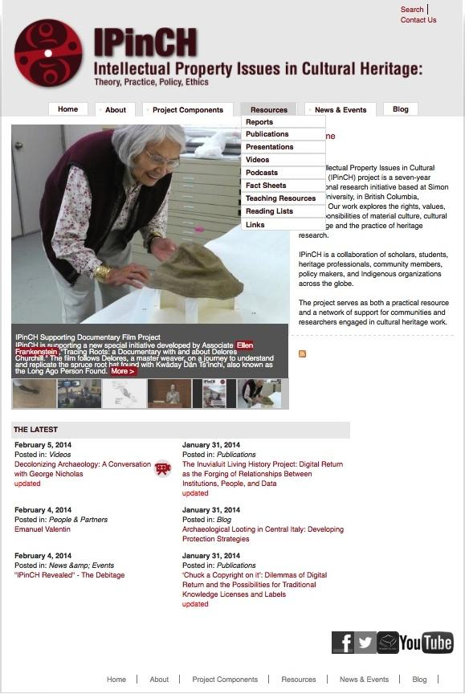
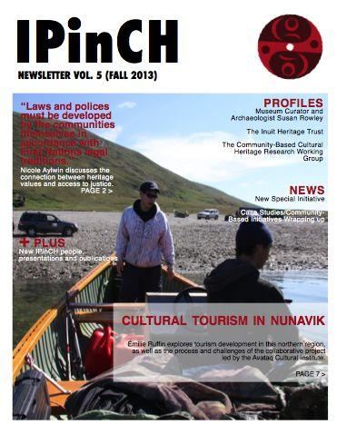
Our Web Site
www.sfu.ca/ipinch
and Newsletter

Slide 8

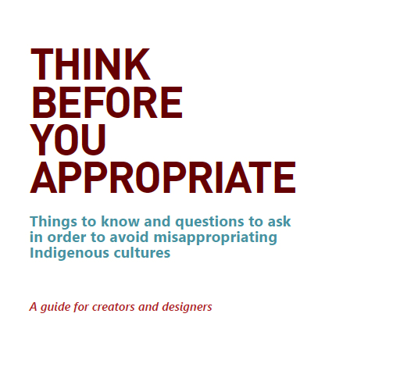
IPinCH Resources
Educational Resources
Labeling and Licensing
TK
Women
Restricted
Licenses - commercial, education,
Single use
http://localcontexts.org/tk-licenses/

Slide 9
Themes
Academic ethical guidelines and policies for research and products of research do not adequately address respect for Indigenous legal traditions concerning collective stewardship, validation, use and attribution of intangible heritage including ideas and images.
Respect and reciprocity in collaboration means more than addressing issues of consent and copyright. It requires acknowledging, understanding and addressing interests and experiences informing reluctance of Indigenous peoples to enter collaborative arrangements.
  Reparation for past injustices
  Response to lack of protection in Canadian law (legal disenfranchisement )
  Respect for dignity and human rights
  Right for self-determination ( empowerment and Indigenous legal traditions)
Agreement on processes and fundamental principles to guide and maintain relationships, including concerns or disagreements, is as important as agreement on methodology, control of data and project outcomes.

Slide 10
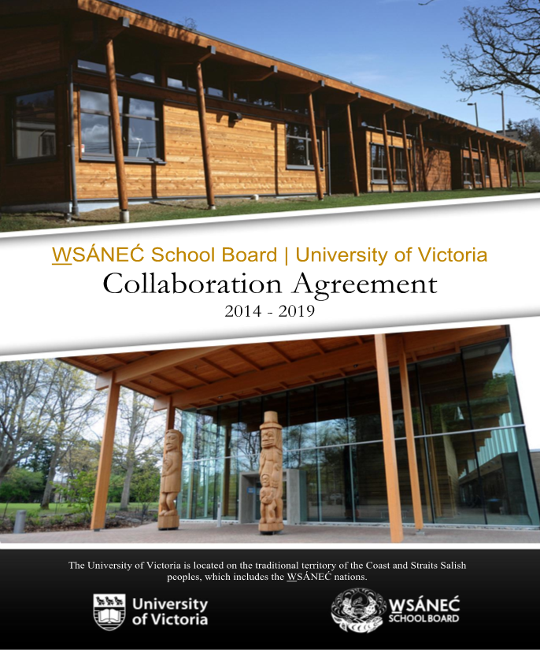
# 3 Insufficient Attention to Relationship
“How to know how to lead a good life” (Margaret Lavallee)
ÁMEḴT TŦEN ÍY, ŚḰÁLEȻENS | Bring in your good feelings
ĆȺNEUEL OL | Working Together
TU LÁTES MEQ EN SĆȺ SE | Be prepared for all work to come
HÁEQ ȽTE OL TŦE ĆELÁṈEN ȽTE | Remember our ancestors/birthright (laws, protocol and protection of customary intangible property).

Slide 11
Themes
4. The challenge of intercultural communication and the importance of language, words and explanations in constructing legal relationships.
5. Inherent limits of western legal protections and instruments such as copyright law and confidentiality clauses for controlling using of sensitive information.
6. There is a need to re-examine institutional policies and contractual relationships constraining academic researchers and Indigenous communities that are grounded in dated hierarchies of knowledge, governance and ethics (e.g. financial transfer agreements).

Slide 12
Themes
7. The concept of consent as free, informed, prior and ongoing is difficult to achieve without sufficient institutional and financial support and flexibility to enable fulsome discussion among researchers, institutions and Indigenous individuals and/or groups and the appropriate authorities within their communities before and during the project through to publication and other forms of dissemination.
8. Content heavy documentation (e.g. consent forms) is often a barrier to communication and participation.

Slide 13
Questions to Consider
What information and understandings from Indigenous and Western legal traditions are necessary for fully informed consent?
What are the obligations of researchers to discover and respect Indigenous laws that apply to material that is accessible to the public?
What steps are necessary to “decolonize” institutional research and authorship policy and norms?
How do we ensure we pay sufficient attention to the relationship and not just the research and its outcomes?
Are there more accessible ways to present information and ensure protection other than through cumbersome legal language and instruments?
What needs to be in place for academic institutions and funders to feel comfortable for Indigenous research approval processes to prevail over REBs?
How do we structure financial arrangements in a way that respects Indigenous people as experts and as knowledge partners not subjects?

