Slide 1
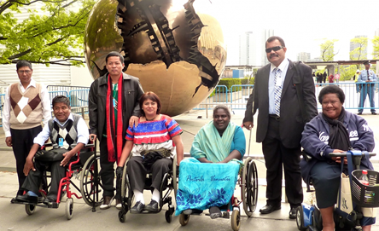
Disability in the Academy and the Academic Library Profession
Anna Wilson MEd. MLIS
amw2@ualberta.ca
9-3 Nothing About Us, Without Us – Indigenous Persons with Disabilities
Demand Action (Agnes Portalewska, 2015)

Slide 2
This research study explores how the social capital of people with disabilities is valued beyond theory into practice within universities.
1. Disability discrimination will be deconstructed and researched in the academic workplace.
2. Research librarians’ intersections with students with disabilities
and faculty members with disabilities will be examined.
3. Common myths about hiring people with disabilities will be deconstructed.

Slide 3
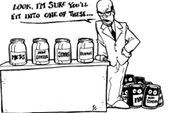
Research Questions
1. What are the common themes and experiences of people in the academy who also have
disabilities?
2. How do these themes and experiences contribute to understanding disability?
3. How do these themes and experiences inform my practice as a librarian with a disability?
(Durst, & Bluechardt, et. al., 2001).

Slide 4
The United Nations guiding principles of the Convention on the rights of persons with disabilities (UNCRPD) includes:
non-discrimination,
full participation
inclusion in society
Conceptualization of Ableism
Critical disability theory represents people with disabilities on a continuum of human variation.

Slide 5
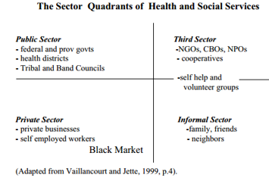
Dr. Catherine Frazee of Ryerson University’s Disability Studies program states:
“The problem is not that I cannot walk, the problem is that I live in a society that believes that the people who matter in this world do walk” (as cited in Klein, 2006, NFB).
Just as race is considered a social construction of disenfranchisement, disability is considered a social construction of marginalization (Hooks, 1968, as cited in Michalko, & Titchkosky, 2009).
Critical disability theory (CDT) circulates between
the social model of disability and
the medical model of disability.
This research explores how people with disabilities
occupy the spaces between
the social and medical model (Titchkosky, 2003).

Slide 6
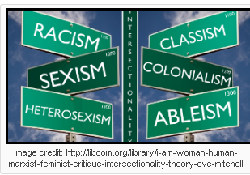
The Intersectionality of Discrimination Focuses on the Deficit Model of Disability
Most public policy on disability identifies people with disabilities according to their diseases, injuries or chronic illnesses creating policy barriers for education and employment.
Critical disability theory examines the World Health Organization’ s (WHO) classification of disability colonizing people with disabilities into medical categories (Titchkosky & Aubrecht, 2009, p. 179).
Abdelhadi, A. (2013). Addressing the Criminalization of Disability from a Disability Justice Framework:
Centring The Experiences of Disabled Queer Trans Indigenous and People of Colour. The Feminist Wire.

Slide 7
Societal Perceptions of Disability
Franz Fanon examines how the colonial system views people with disabilities as a monetary burden to taxpayers.
Some public libraries use the word “agile” in job requirements for library professionals. Agile is used as an ambiguous adjective that could refer to agile thinking or agile movement.
Applicants with disabilities are left to interpret their intended meaning and demonstrate their agility.
Researchers are plagued with the question of what forms of mediation do we have that do not devalue mental and bodily differences?
How could mediated alternatives expose the capitalistic interests of the profit-driven vision, challenging the presumption that the non-disabled version of life is the only life worth living?
(Titchkosky & Aubrecht, 2009, p. 197)

Slide 8
University students with disabilities examine education policies’ capacity to address differences in ability.
Their stories identified 5 themes:
1. hegemonic voice - best workers are non-disabled people
2. voice of the body – workers in pain with medical equipment are mentally incompetent
3. voice of silence – Cognitive Diversity is cognitive incompetence/ invisible disabilities
4. voice of assertion – recognize social capital of disabilities
5. voice of change – platforms for workers with disabilities
(Hutcheon & Wolbring, 2012, p. 43)

Slide 9
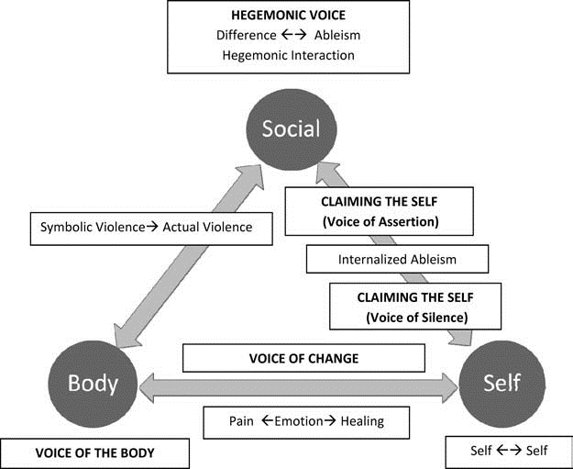
These themes were explored within a body-social-self framework in Figure 1:
Figure 1. Emergent themes and sensitizing concepts within body-social-self framework.
Hutcheon, E. J., & Wolbring, G. (2012). Voices of "Disabled" Post-Secondary Students: Examining Higher Education "Disability" Policy Using an Ableism Lens. Journal Of Diversity In Higher Education, 5(1), p. 42.

Slide 10
General Observations of Disability in the Academy and the Workplace
Library staff and academic staff may have misconceptions about employing students with disabilities. The Alberta Government challenges ableism myths employers may have, for example: employees with disabilities:
· 1. require expensive specialized equipment
· 2. are frequently absent from work or late
· 3. increase Worker’s Compensation premiums
. 4. are exempt from discipline or termination if they cannot perform duties
. 5. are accident prone and will always need help
. 6. can use human rights laws to obtain or keep a job- too risky to interview them
. 7. are not as productive or don't work as hard as employees without disabilities

Slide 11
Myths | Reality
1. expensive specialized equipment | 80 % of accommodations cost less than $500 ( Job Accommodation Network Canada). The Alberta Government’s Disability Related Employment Supports (DRES) program funds this equipment.
2. absent from work or late | U.S. Chamber of Commerce report an 80% lower turnover rate with workers with disabilities (Brite, Nunes, & Souza, 2015).
3. increase Worker’s Compensation premiums | National Association of Manufacturers report 90% of 279 companies had no effect on insurance costs.
4. exempt from discipline or termination if they cannot perform duties | Alberta’s Human Rights Act requires employers to accommodate employees with disabilities, but only if accommodations do not cause undue hardship to employers.
5. accident prone and will always need help | U.S. Department of Labor report workers with disabilities have fewer disabling injuries than nondisabled workers exposed to the same hazards.
6. can use human rights laws to obtain or keep a job- too risky to interview them | Employers focusing on Job requirements are protected by law.
7. are not as productive or don't work as hard as employees without disabilities | People with disabilities are experts in adapting to challenging environments to complete daily tasks.

Slide 12
Emily Weak’s blog on Hiring Librarians posted Terry Lawler’s responses to these questions. Lawler is an assistant manager and children’s librarian at Palo Verde Branch Phoenix Public Library. Lawler states that:
I would always hire the person I thought could best do the job, had the best qualifications AND would be a good fit for our staff, regardless of other issues like spectrum disorders or disabilities. There are very strict laws regarding ADA and what one is allowed and not allowed when hiring. Of course, I would follow any law to the letter and I can’t recommend that someone disclose any disability. As a hiring supervisor, I would not feel that mentioning an issue or disability is strange or inappropriate or manipulative behaviour.
(Weak, 2012, para. 15)
In Canada, disability labour laws are governed provincially allowing employers the discretion to determine if the employees’ requested accommodations cause undue economic hardships on them justifying their right not to hire applicants with disabilities.

Slide 13
The following table reveals risks and benefits of disclosing a disability:
Alberta Learning Information Service. TIP Sheet Talking About Invisible Disabilities. Alberta Government. Retrieved From: https://alis.alberta.ca/ep/eps/tips/tips.html?EK=7371.
Risks of Disclosing | Benefits of Disclosing
You may not be hired | Employer may be recruiting for diversity
You may be labelled | The employer may value your openness
You may give up your privacy | The employer can provide accommodations If you disclose
You may face discrimination, subtle or direct | Discrimination can be counteracted by positive work ethics, abilities & success. You could be an ambassador for people with disabilities.
You may face envy or resentment from co-workers if you ask for special treatment | Your openness can create understanding among your co-workers
You may face anger from employer who finds out about disability later and feels mislead. | Your openness and cooperation may create a win-win situation so you and your employer get needs met.

Slide 14
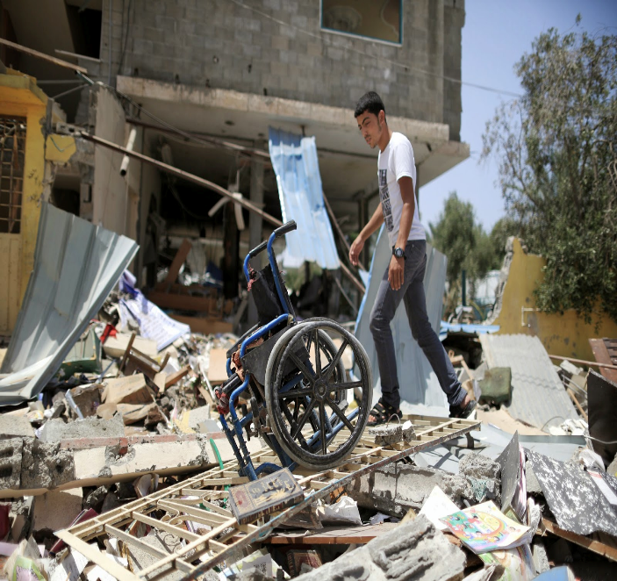
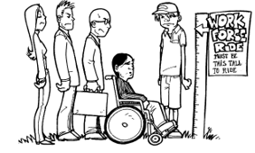
In Canada’s richest province the Homeless Connect library book give away was only accessible by stairs, escalator or elevator.
The escalators were broken so there was 1 elevator to share. Many homeless people carried their homes on their backs or used mobility devices.
As I waited hours to arrive and depart from my volunteer shift – I listened to many stories of people with disabilities who struggled with unemployment, many who had children.
As I rode the elevator watching the masses of homeless people with disabilities struggle, I wondered about the building’s evacuation procedures which requires disabled people to wait at a designated stairwell while firemen evacuate others first, which is the same policy elsewhere.
Then I realized that……….
(Durst, Bluechardt, Morin, & Rezansoff, et. al., 2001, p.11).

Slide 15
In emergencies evacuating people with disabilities last enables rescue personnel to save more lives by rescuing able-bodied people first.
The needs of many non-disabled people, outweigh the needs of
a few disabled people.
Justifiable practices are NOT above investigation:
If there were an equal number of people with disabilities as people without disabilities, would these evacuation procedures be ethical?
If there were an equal number of employees with disabilities as employees without disabilities, would these evacuation procedures be ethical?
If there were an equal number of qualified applicants with disabilities as qualified applicants without disabilities, would current hiring procedures be ethical?
Creative problem-solving can tailor solutions enabling people with disabilities to evacuate simultaneously as their able-bodied counterparts, without compromising the safety of either group.
(Titchkosky & Aubrecht, 2009, p. 198)

Slide 16
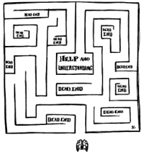
Re-claiming the self through vocalizing the voice of silence. Vocalizing the emotions releases the pain to heal from hegemonic ableism in the academy and workplace as indicated in Figure 2:
Figure 2: Adapted conceptual framework of Hutcheon, E. J., & Wolbring, G. (2012). Voices of "Disabled" Post Secondary Students: Examining Higher Education "Disability" Policy Using an Ableism Lens. Journal Of Diversity In Higher Education, 5(1), p. 42.
Voice
Of
Soul
Voices of
Diverse
community
Voice of
workplaces
Voice of body
Voice
of
Silences
Voice of change
Voice of
mind

Slide 17
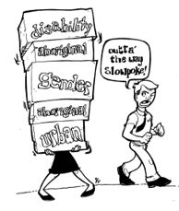
The Social Capital of Library Professionals with Disabilities
Advances in medical science have resulted in people living longer and making up a larger elderly population of people who will experience some form of disability (Kinsinger, 2009). As the workforce ages, older workers may continue employment past an age of previous physical agility and they may have disabilities related to aging (Kinsinger, 2009).
Employers who recognize disability as an asset in the humanity of their workforce will realize the potential strengths employees with disabilities can use to enhance the workplace.
For example, my employer noticed that my body mechanics in lifting books was
safer than my able-bodied co-workers.
The economy of exerting my back carefully to prevent a fall requires me to bend my knees
while lifting three or five books instead of bending my back to lift 10 books.
Therefore, my careful body mechanics can serve as a role model to my co-workers to prevent
workplace injuries. Economizing on the exertion and stress of employees’ bodies and
energy preserves their health.

Slide 18
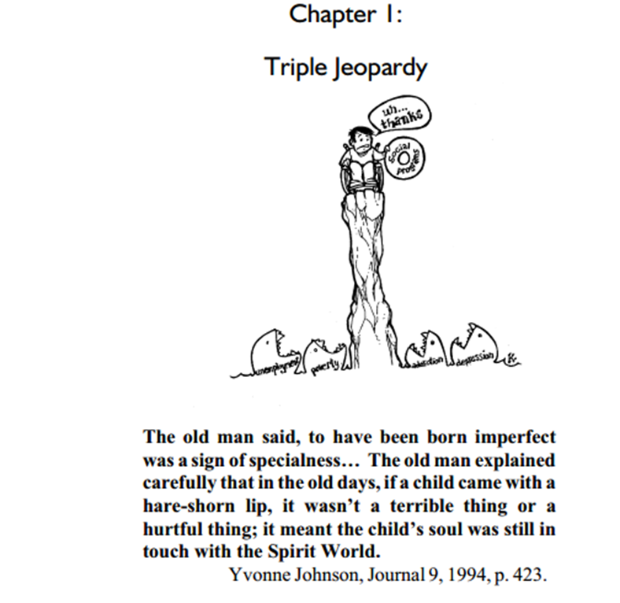
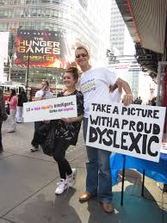
The Social Capital of Students & Professors with Disabilities
Relationships between people who are able-bodied and people with disabilities can identify, confront, and change their own ableist views of disability.
The common thread in carefully considering the role of disability in the academy and the library profession is re-defining the philosophy of inclusion when employing people with disabilities.
Concepts of “normal” and “typical” can challenge able-ism with the voices of students and employees with disabilities.
This deconstruction can be utilized to improve practicum and employment experiences of students with disabilities in universities.

Slide 19
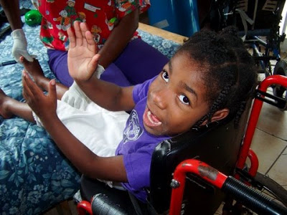
Future Implications for Informed Practice
Advancing the inclusion of citizens with disabilities requires research on ableism hidden in policies.
The Canadian policies governing the distribution of social inclusions and exclusions in health, emergency services, education and employment equity for people with disabilities should be publicly unveiled and re-evaluated.
People with disabilities would work with emergency personnel to create evacuation plans involving building adaptations for inclusive evacuations. Emergency elevator keys can be given to people with disabilities.

Slide 20
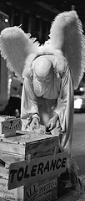
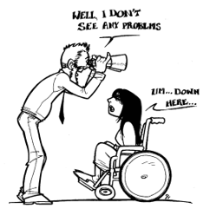
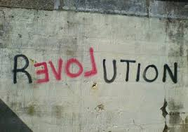
Conclusion
Librarians can facilitate changes in Library of Congress Subject Headings (LCSH) of “idiot savant, retard, and invalid” through inclusive subject headings and classification systems that define disability through culturally sensitive language (Titchkosky, 2007).
Inaccessible environments, and non-inclusive employment policies are indicators that policymakers must recognize the social capital that people with disabilities bring to workplaces by creating accessible buildings and careers.
Library professionals can light the way to the “promised land” through
inclusive education and hiring policies that illuminate the strengths of people
with disabilities (King, 1963, p. 9).

Slide 21
References
Abbas, M. m. (2015). Employing Disability: Deconstructing Insufficient Protections for "Non-Mainstream" Disabilities. Western Journal Of Legal Studies, 5(2), 1-17.
Abdelhadi, A. (2013). Addressing the Criminalization of Disability from a Disability Justice Framework: Centring The Experiences of Disabled Queer Trans Indigenous and People of Colour. The Feminist Wire. Retrieved From: http://www.thefeministwire.com/2013/11/addressing-the-criminalization-of-disability-from-a-disability-justice-framework-centring-the-experiences-of-disabled-queer-trans-indigenous-and-people-of-colour/.
Alberta Human Services. (2011). People with Disabilities Top 10 Myths of Hiring. Alberta
Government. Retrieved From:
http://humanservices.alberta.ca/disability-services/myths-of-hiring-people-with-disabilities.html
Alberta Learning Information Service. TIP Sheet Talking About Invisible Disabilities. Alberta Government. Retrieved From: https://alis.alberta.ca/ep/eps/tips/tips.html?EK=7371.
Asselin, K. C. (2014). Martin Luther King Jr.: civil rights leader. North Mankato, Minnesota: Abdo Publishing Company, [2014].
Balfour, A. C. (2008). Top 3: CCC trails: during the Great Depression, President Franklin D. Roosevelt established the Civilian Conservation Corps, a quarter-million-strong workforce that created or upgraded 800 state parks and built 28,087 miles of trails. Backpacker, (7). 30.

Slide 22
References Continued
Barlow, C. (1995). Don't just serve people with disabilities—hire them. American Libraries, 2(6), 772-773.
Brown, M. E. (2015). Invisible Debility: Attitudes toward the Underrepresented in Library Workplaces. Public Library Quarterly, 34(2), 124-133.
Convention on the Rights of Persons with Disabilities: first report of Canada. (2014). Ottawa, Ontario: Her Majesty the Queen in Right of Canada, 2014.
Driedger, D. L., & Owen, M. K. (2008). Dissonant disabilities: women with chronic illnesses explore their lives. Toronto: Canadian Scholars' Press/Women's Press, 2008.
Durst, D., Bluechardt, M., Morin, G., & Rezansoff, M. (2001). Urban aboriginal persons with disabilities : triple jeopardy. Regina, Sask. : Social Policy Research Unit, University of Regina, [2001].
Erevelles, N. (2011). Disability and difference in global contexts. [electronic resource]: enabling a transformative body politic. New York: Palgrave Macmillan, 2011.
Frazee, C. (2009). Disability in Dangerous Times. Journal on Developmental Disabilities. 15 (3), 118-124.
Faucheux, D. (2003). Is there a place for us? toward the full inclusion of blind and other librarians with disabilities. Interface, 25(1), 4-7. Retrieved from http://login.ezproxy.library.ualberta.ca/login?url=http://search.proquest.com/docview/57557276?accountid=14474.
Geisen, T., & Harder, H. G. (2011). Disability management and workplace integration. [electronic resource]: international research findings. Farnham, England; Burlington, Vt.: Gower, c2011.
Weak, E. (2012). Further Questions: Would you hire a person who has an autistic spectrum disorder for a reference librarian position? Hiring Librarians. Retrieved From: http://hiringlibrarians.com/2012/06/29/ Further-Questions-Would-you-hire-a-person-who-has-an-autistic spectrum-disorder-for-a-reference-librarian-position/.

Slide 23
References Continued
Hutcheon, E. J., & Wolbring, G. (2012). Voices of "Disabled" Post-Secondary Students: Examining Higher Education "Disability" Policy Using an Ableism Lens. Journal Of Diversity In Higher Education, 5(1), 39-49.
Klein, B.S. (2011). Shameless: the art of disability. [electronic resource]. (2011). [Montreal]: National Film Board of Canada, [2011].
Kinsinger, L. (2009). Issues with Older Workers and Employees with Disabilities. Journal of
Access Services, 6:153–157, 2009.
Kulkarni, M., & Lengnick-Hall, M. L. (2014). Obstacles to Success in the Workplace for People With Disabilities: A Review and Research Agenda. Human Resource Development Review, 13(2), 158-180. doi: 10.1177/1534484313485229.
McLean, M. A. (2011). Getting to know you: The prospect of challenging ableism through adult learning. New Directions For Adult & Continuing Education, 2011(132), 13-22. doi:10.1002/ace.427.
Michalko, R., & Titchkosky, T. (2009). Rethinking normalcy: a disability studies reader. Toronto: Canadian Scholars' Press.
Peterson, B. B. (2009). Franklin Delano Roosevelt, Preserver of Spirit & Hope. New York: Nova Science Publishers, Inc.
Prince, M. J. (2009). Absent Citizens: Disability Politics and Policy in Canada. Toronto [Ont.]:
University of Toronto Press.
Rethinking disability in the private sector. [electronic resource]: we all have abilities: some are just more apparent than others. (2013). Ottawa, Ont.: Human Resources and Skills Development Canada, c2013 (Beaconsfield, Quebec: Canadian Electronic Library, 2013).

Slide 24
References Continued
Roberts, J. a. (2006). An Area of Refuge: Due Process Analysis and Emergency Evacuation for People with Disabilities. Virginia Journal Of Social Policy & The Law, 13(1), 127-178.
Rocco, T.S. (2012).Challenging ableism, understanding disability, including adults with disabilities in workplaces and learning spaces. (2012). San Francisco, CA Jossey-Bass 2011.
Tanya Titchkosky, T. and Katie Aubrecht, K. (2009). Chapter 9
The Anguish of Power: Remapping Mental Diversity with an Anti-colonial Compassion In Kempf, A. (2009). Breaching the colonial contract. [electronic resource]: anti-colonialism in the US and Canada. [Dordrecht. The Netherlands]: Springer, c2009.
Titchkosky, T. (2003). Disability, Self and Society. Toronto: University of Toronto Press Incorporated.
Unforgotten. [electronic resource] : 25 years after Willowbrook. (2012). New York, N.Y. : Films Media Group, [2013], c2012.
Wilson, M.L. (2013). Texans and the Civilian Conservation Corps: Personal Memories. Southwestern Historical Quarterly, October, 2013. Vol. CXVII No. 2.

