Slide 1
Speedy Intro to OER
Krysta McNutt, Centre for Teaching and Learning, University of Alberta, krystam@ualberta.ca Michelle Brailey, Digital Initiatives, University of Alberta Libraries, brailey@ualberta.ca
Unless otherwise noted, this work is licensed under a Creative Commons Attribution 4.0 International License.

Slide 2
Positive Experiences | Barriers to Education
Cost
Quality & Pedagogy
Access & Discovery
Unless otherwise noted, this work is licensed under a Creative Commons Attribution 4.0 International License.
Notes:
Krysta - 5 min

Slide 3
Defining Open Education
Unless otherwise noted, this work is licensed under a Creative Commons Attribution 4.0 International License.
Notes:
Krysta - 3 min

Slide 4
Defining Open Education
Scholarly Publishing and Academic Resources Coalition (SPARC)
“Open Education encompasses resources, tools, and practices that are free of legal, financial and technical barriers and can be fully used, shared and adapted. At the core of Open Education is open educational resources (OER), which are teaching, learning, and research resources that are free of cost and access barriers, and carry legal permission for open use.”
Open Education Consortium "sharing is probably the most basic characteristic of education: education is sharing knowledge, insights and information with others, upon which new knowledge, skills, ideas and understanding can be built."
The William and Flora Hewlett Foundation
"...is the simple and powerful idea that the world’s knowledge is a public good and that technology in general and the Web in particular provide an extraordinary opportunity for everyone to share, use, and reuse knowledge.
Unless otherwise noted, this work is licensed under a Creative Commons Attribution 4.0 International License.

Slide 5
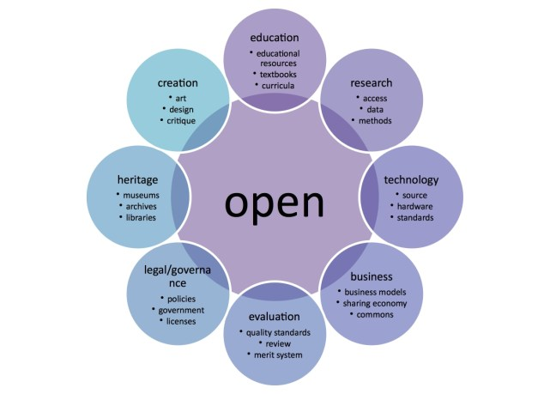
"Open Model" Graphic by Katja Mayer, is licensed under CC BY 4.0
Unless otherwise noted, this work is licensed under a Creative Commons Attribution 4.0 International License.
Notes:
Introduce that “open” is a movement occurring in education and beyond

Slide 6
"Open Model" Graphic by Katja Mayer, is licensed under CC BY 4.0
Unless otherwise noted, this work is licensed under a Creative Commons Attribution 4.0 International License.
Notes:
Today we are talking about ONE of these circles: Education, meaning Teaching.

Slide 7
Open Education
Open source software
OEP
Open
Content
(images, videos,
articles, music...)
OER
OCW
Open Access Publishing
Adaptation of "OER Mobile Course Open Diagram" by Classroom Aid is licensed under CC BY-NC-SA 3.0 Unported
Unless otherwise noted, this work is licensed under a Creative Commons Attribution 4.0 International License.
Notes:
This one is overwhelming but it helps us focus our attention today…

Slide 8
Open Education
Open source software
OEP
Open
Content
(images, videos,
articles, music...)
OER
OCW
Open Access Publishing
Adaptation of "OER Mobile Course Open Diagram" by Classroom Aid is licensed under CC BY-NC-SA 3.0 Unported
Unless otherwise noted, this work is licensed under a Creative Commons Attribution 4.0 International License.
Notes:
All of these circles are activities we see at UofA. Today, we’re going to talk about Open Education specifically in the context of TEACHING. OER, OEP. “open course ware” applies to teaching, too, but it’s a little technical for our taste today, so let’s leave that alone. ;)

Slide 9
Figure 2. Interpretations of "Open" (Credit: Image by Catherine Cronin. CC BY-SA)
Unless otherwise noted, this work is licensed under a Creative Commons Attribution 4.0 International License.

Slide 10
Defining Open Educational Resources
Unless otherwise noted, this work is licensed under a Creative Commons Attribution 4.0 International License.
Notes:
Krysta - 3 min

Slide 11
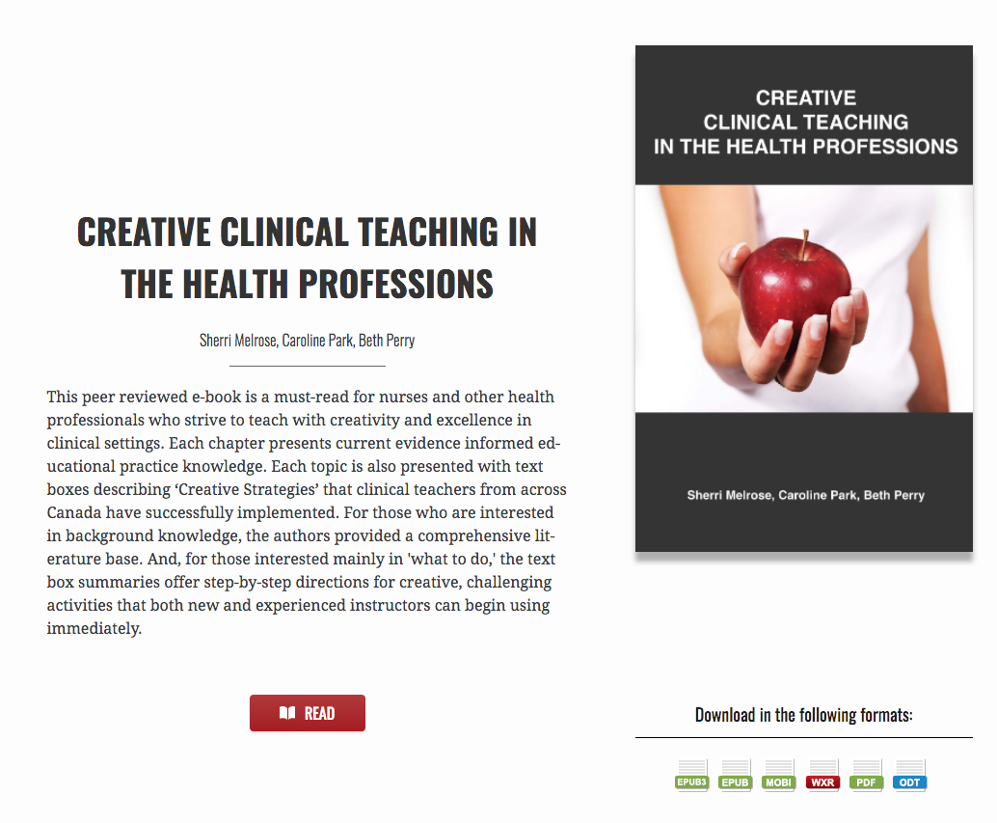
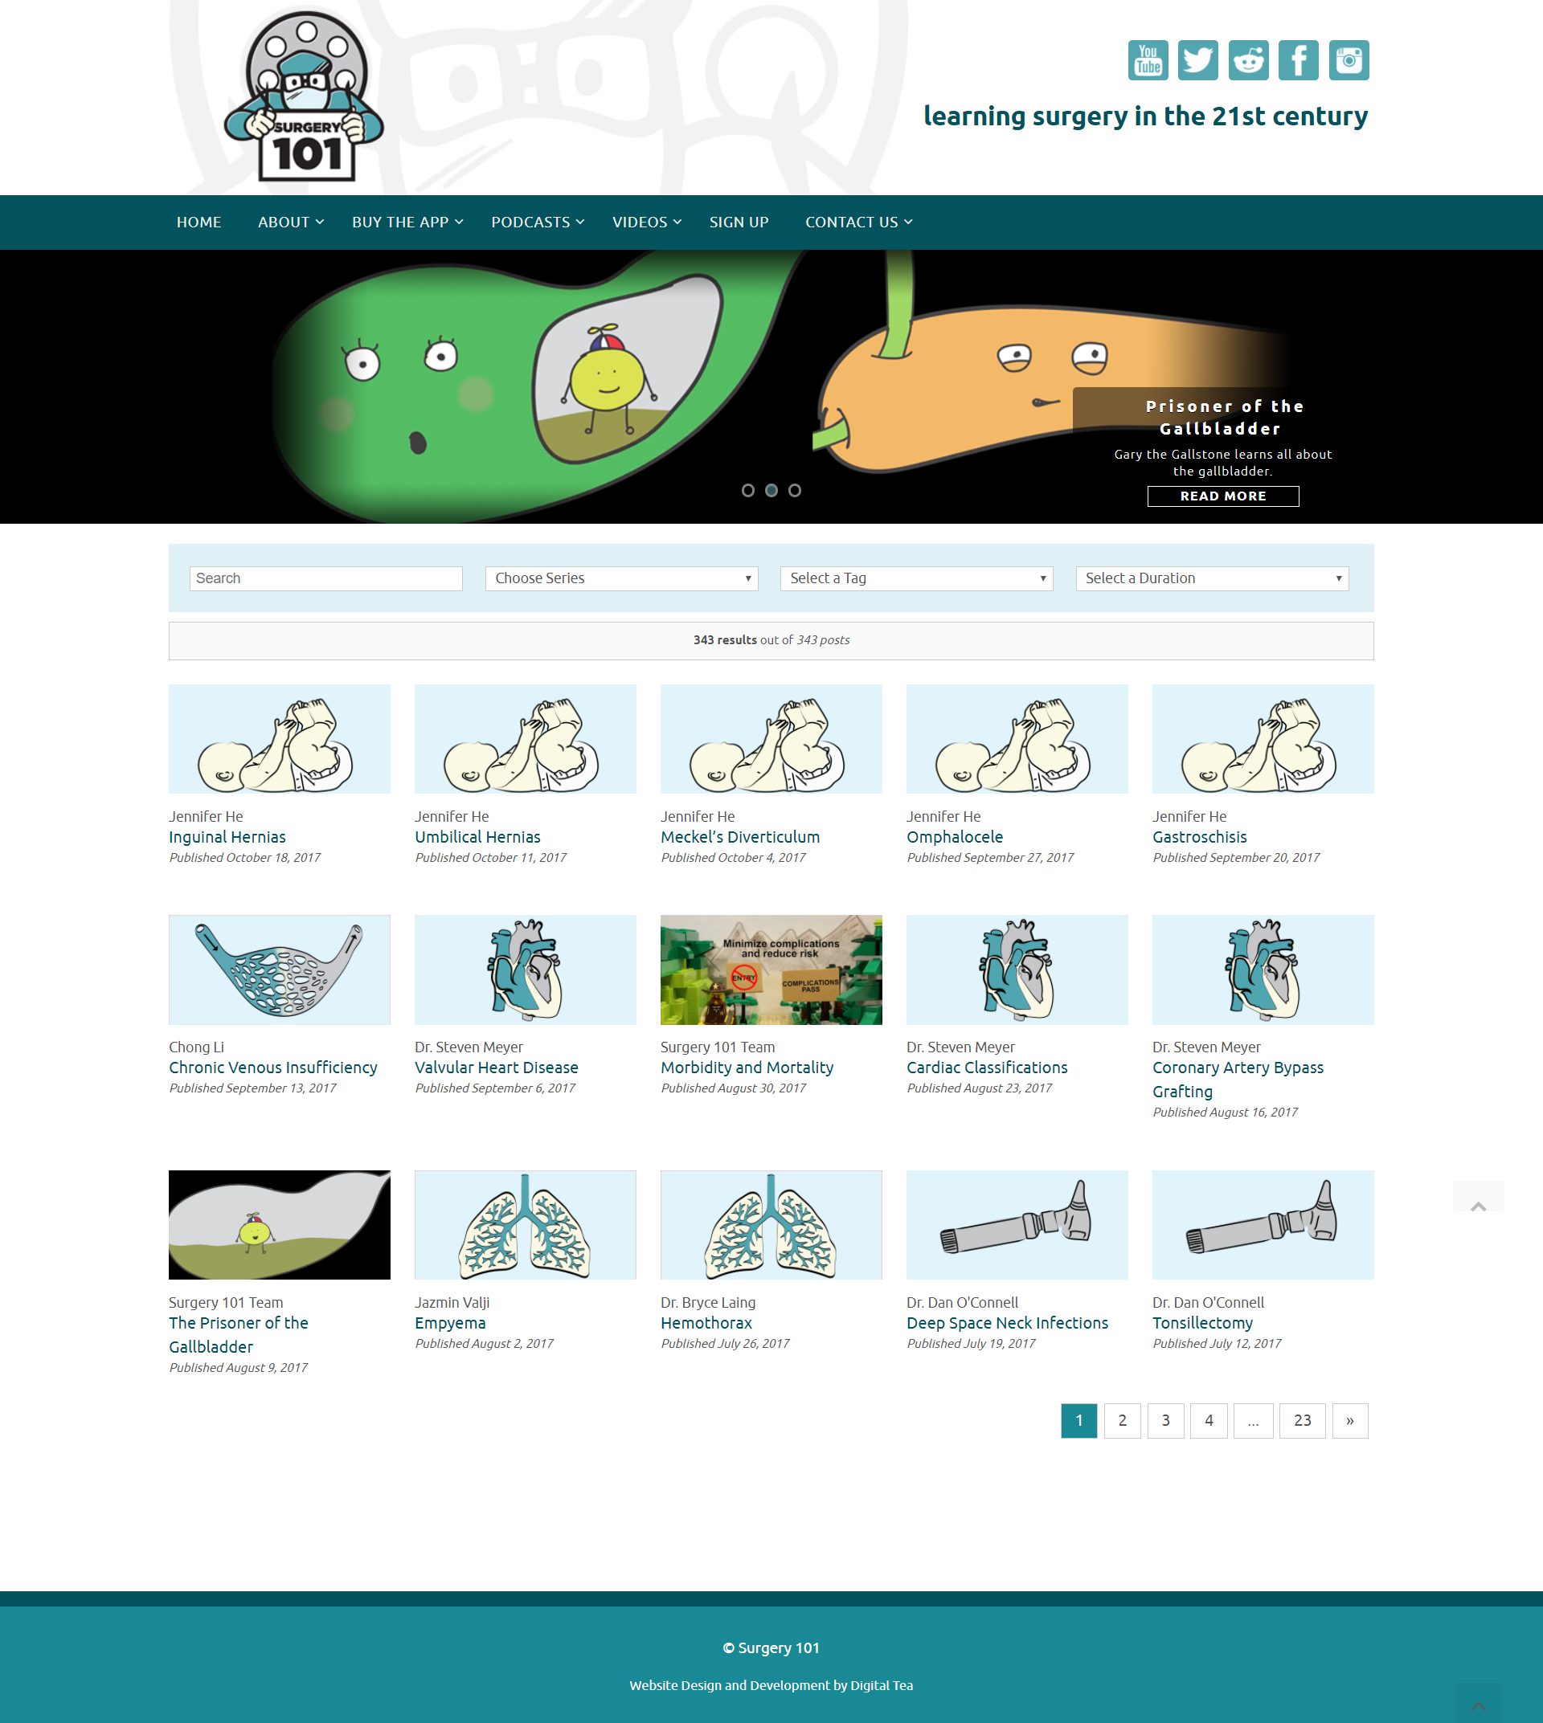
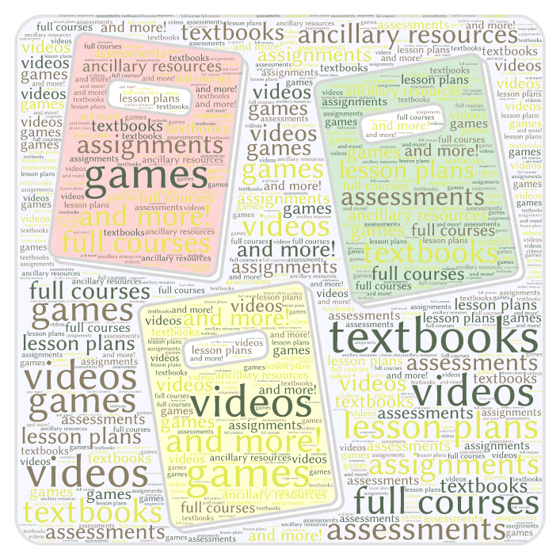
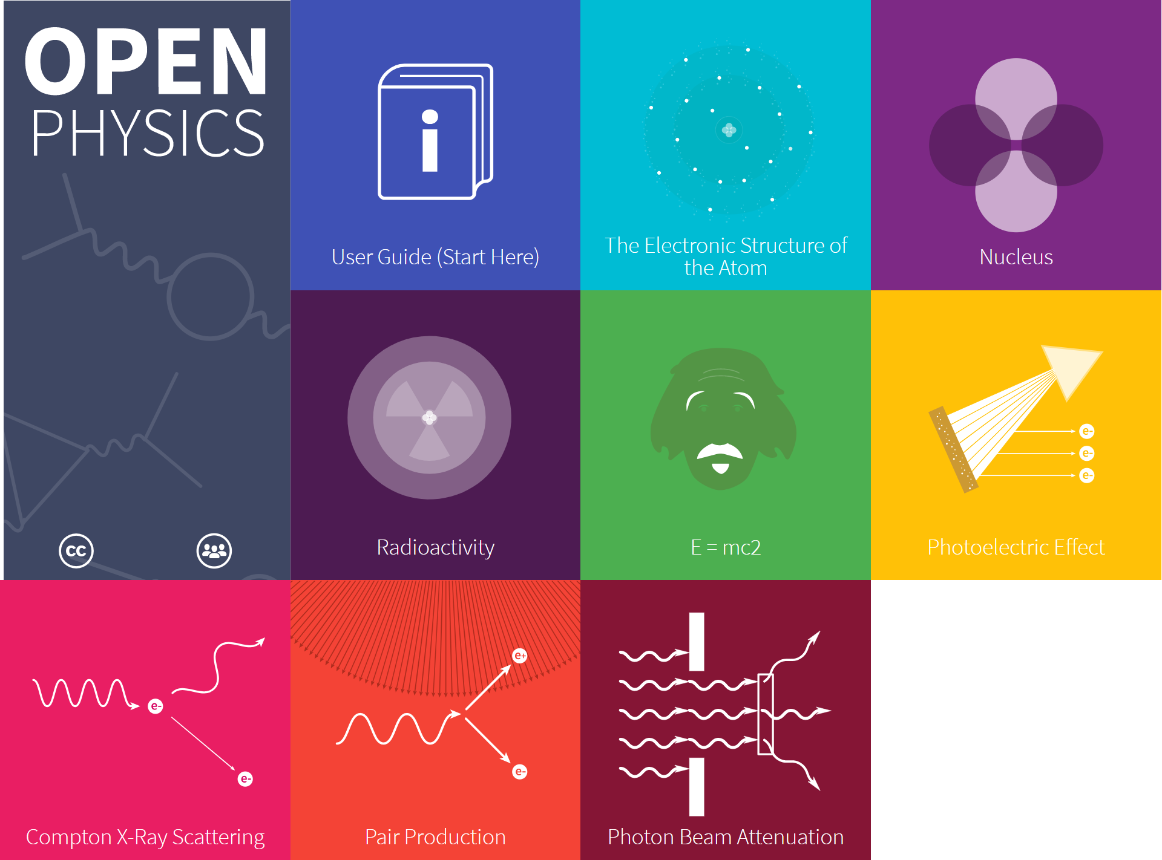
Open Educational Resources (OER)
Unless otherwise noted, this work is licensed under a Creative Commons Attribution 4.0 International License.

Slide 12
5 Rs of OER
Unless otherwise noted, this work is licensed under a Creative Commons Attribution 4.0 International License.

Slide 13
Open licences grant permission to use a copyright-protected work with few or no restrictions.
Unless otherwise noted, this work is licensed under a Creative Commons Attribution 4.0 International License.
Unless otherwise noted, this work is licensed under a Creative Commons Attribution 4.0 International License.
Notes:
Differentiating between OER, OEP, and “Open Admission”. What do we plan to focus on right now? OER and OEP.

Slide 14
Open licences grant permission to use a copyright-protected work with few or no restrictions.
Creators retain the copyright in the course materials they create.
Copyright status does not change when a standard open licence is assigned.
Unless otherwise noted, this work is licensed under a Creative Commons Attribution 4.0 International License.

Slide 15
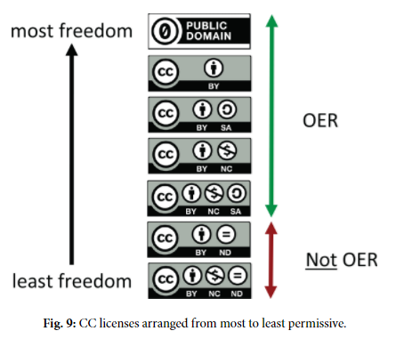
Copyright, Open Licensing, and OER
Creative Commons licences are the most common OER open licences.
Choose a licence.
Mark the work with CC icon & statement. (copy & paste)
by Cable Green is licensed under CC-BY 4.0
Unless otherwise noted, this work is licensed under a Creative Commons Attribution 4.0 International License.
Notes:
Know their rights as an instructor
Relationship of IP, copyright, public domain and creative commons
Walk through of creative commons licensing
Send

Slide 16
Wiley’s 5Rs and Creative Commons Licensing
 | Retain | Reuse | Revise | Remix | Redistribute
 | Make and own a copy | Use in a wide range of ways | Adapt, modify, and improve | Combine two or more | Share with others
Public Domain
CC-BY
CC-BY-SA |  |  | same license | same license
CC-BY-NC |  |  |  |  | non-commercial
CC-BY-NC-SA |  |  | same license | same license | non-commercial
CC-BY-ND |  |  | personal use only | personal use only
CC-BY-NC-ND |  |  | personal use only | personal use only | non-commercial
OER
Not OER
Give appropriate credit, provide a link to the license, and indicate if changes were made.
Unless otherwise noted, this work is licensed under a Creative Commons Attribution 4.0 International License.
Notes:
Copyright Office
Handout pamphlets - trifold
Handout - 5R licensing

Slide 17
How to find OER
Library guide
Notes:
Michelle Instructors can find OER in a variety of resources. Most OER organizations or collaborations have a database or central list of resources that faculty have added. Some databases also feature annotations or faculty feedback. Additionally, many disciplines have their own OER websites. The list below is not comprehensive but can instead be used as a starting point for faculty doing interdisciplinary work or work in any discipline. Remember that not all of the learning materials in these repositories and sources are OER for modifying but most of the content is freely available under Fair Use and/or with attribution.
Librarians are experts in finding and evaluating resources. This includes Open Educational Resources (OER). The library has copyright/ author rights experts as well as librarians with subject expertise that can help you navigate this new and growing area. Please contact your subject librarian or the Scholarly Communications and Publishing for more information. They will help you or direct you to someone that might know more about the resource.

Slide 19
Why OER?
Unless otherwise noted, this work is licensed under a Creative Commons Attribution 4.0 International License.
Notes:
Michelle - 5 min

Slide 20
Why OER?
Government
Students
Cost
Institutional Leadership
There are three key objectives that motivate people to participate in the promotion of OERs:
to reduce student costs
to increase quality of teaching materials and opportunities for creative pedagogy (e.g. OER-enabled pedagogy)
to make educational material more accessible and discoverable
Quality and Pedagogy
Access & Discovery
Instructors
Library and
Bookstore
Centres for Teaching and Learning
Diagram by Michael McNally is licensed under CC-BY 4.0
Unless otherwise noted, this work is licensed under a Creative Commons Attribution 4.0 International License.
Notes:
Facilitator - provide overview of Cost, Quality/Pedagogy (how are we teaching and learning), and Access/Discoverability and different stakeholder groups with one or more of these perspectives
So, why is this even a thing? Here you see the venn diagram Krysta referenced at the beginning of the workshop, and these three areas are what we consistently see as the key motivators for people to participate in the use or promotion of OERs. I’ll talk through each point a bit for you, but I’m sure if you think back to the beginning of the workshop you were able to see where your own educational experience fits into one of these categories.

Slide 21
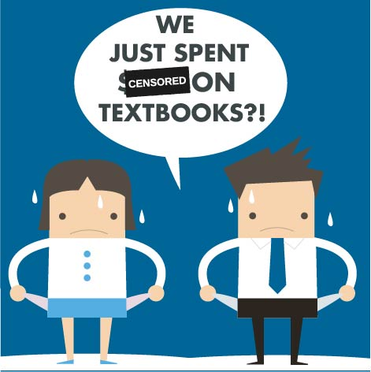
Why OER?
to reduce student costs 1 in 2 students say they have at some point taken fewer courses due to the cost of textbooks (Source: Florida Virtual Campus) < 1 in 2 students purchase a current edition of their textbook (source: Book Industry Study Group)
Only ⅕ of students are legally obtaining all course textbooks (Czerniewicz 2016).
University of Saskatchewan estimates its OER initiatives have saved students $400,000 from 2014-2017 (Bowness, 2017)
University of Toronto’s “Zero-to-Low Cost Course Project” running since spring 2015 has estimated total student savings of over $435,000 (University of Toronto Libraries, 2017)
Campus Alberta OER program realized savings of $482,258 in the Fall semester of 2016, and if the open resources produced are reused over a five user period projected cumulative savings will reach $5.5 million (McNutt and Brailey, 2017)
Unless otherwise noted, this work is licensed under a Creative Commons Attribution 4.0 International License.
Notes:
BCcampus Initiative, has generated estimated savings in the range of $3.7 to 4.4 million (BCcampus, 2017)
(K) “Cost savings are a big value proposition of OER and the numbers are hard to ignore. For example, in BC the provincial work of promoting the use and development of OER over the last (x) amount of years has led to an estimated savings of $3.7 to $4.4 million. A provincial program in Alberta saved students $480k in just one term by funding adoption pilots across the province. With statistics showing that half of students have taken few courses at some point in their studies due to the cost of textbooks and less than half purchase the edition required by their course, cost of course materials is definitely a barrier to our students’ success”

Slide 22
Why OER?
to increase quality of teaching materials and opportunities for creative pedagogy (e.g. OER-enabled pedagogy)
Cost
“Open pedagogy takes OER as a jumping-off point for rethinking the relationship between teachers, students, and knowledge. If teachers and students can now modify their textbooks and learning materials, we shift the student emphasis to contribution to knowledge as opposed to simple consumption of knowledge.” DeRosa
Quality & Pedagogy
Example: Open Case Studies at UBC This project brings together faculty and students from across departments and Faculties to co-create an interdisciplinary, open educational resource with case studies that can be used by anyone, at UBC or elsewhere.
Unless otherwise noted, this work is licensed under a Creative Commons Attribution 4.0 International License.
Notes:
OER support open pedagogy practices - they are not NECESSARY to practice open pedagogy but they are one way to facilitate it. Will pull in some examples from student evaluation results achieved in ABOER.
(K) “Flexibility to remix and revise course materials is one of the biggest draws to OER for instructors. In addition to customizing their own teaching materials, they can bring that customization into their classroom activities to enrich their student’s learning, too. A great example is UBC open case studies where students and instructors co-create interdisciplinary case studies. Not only does this allow for the class to dig into the content in new ways, but for others to use the students’ work, and build upon it for further localization and context of the materials” .

Slide 23
Why OER?
to make educational material more accessible and discoverable
Freely available online
Customizable (editable)
Editable for relevancy
Reduce technical barriers
Reduce legal barriers
Reduce accessibility barriers
Cost
Quality & Pedagogy
Access & Discovery
Unless otherwise noted, this work is licensed under a Creative Commons Attribution 4.0 International License.
Notes:
Adding more context. Examples. Library language.
(K)

Slide 24
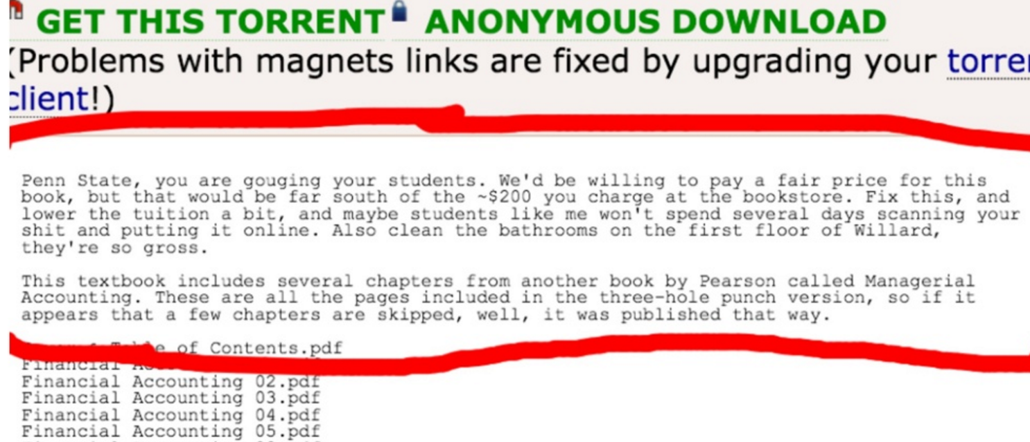
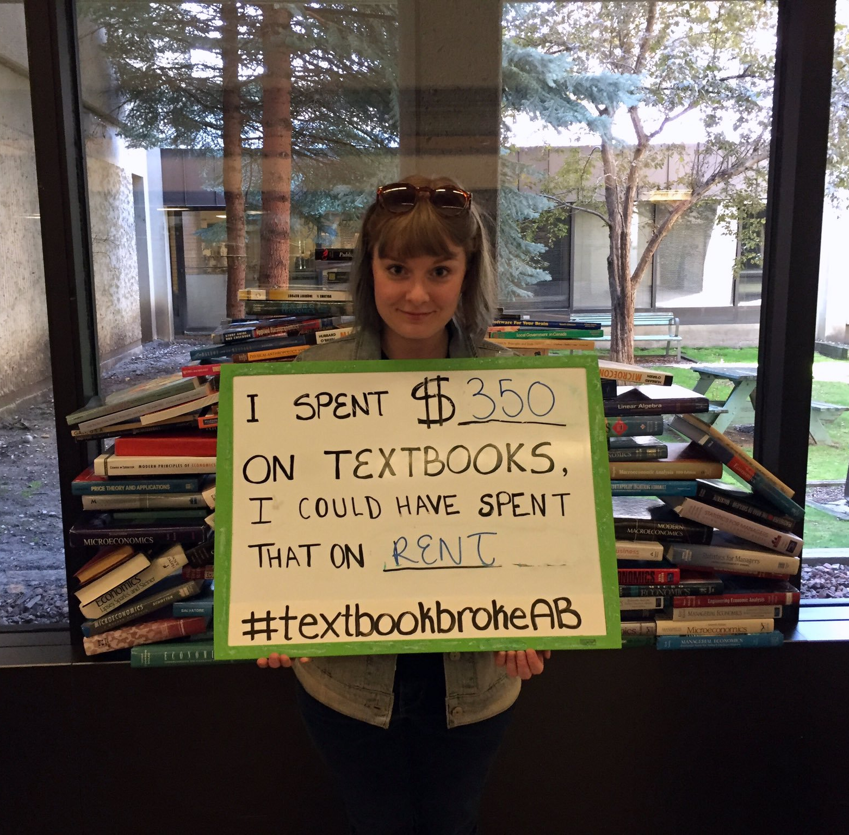
Why OER at the University of Alberta
Students are asking for It

Slide 25
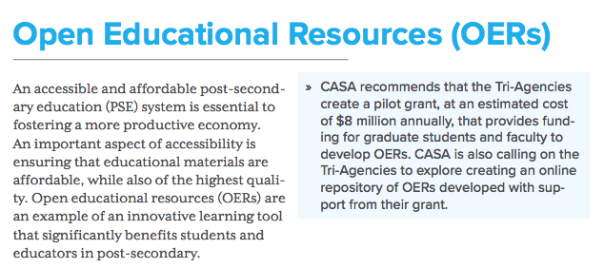
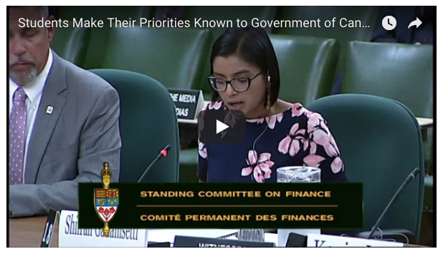
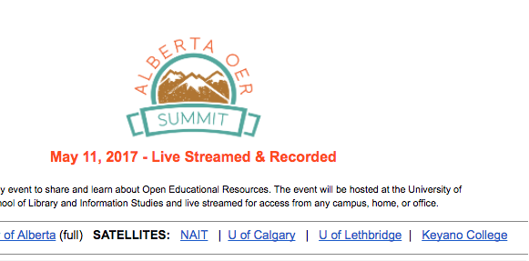
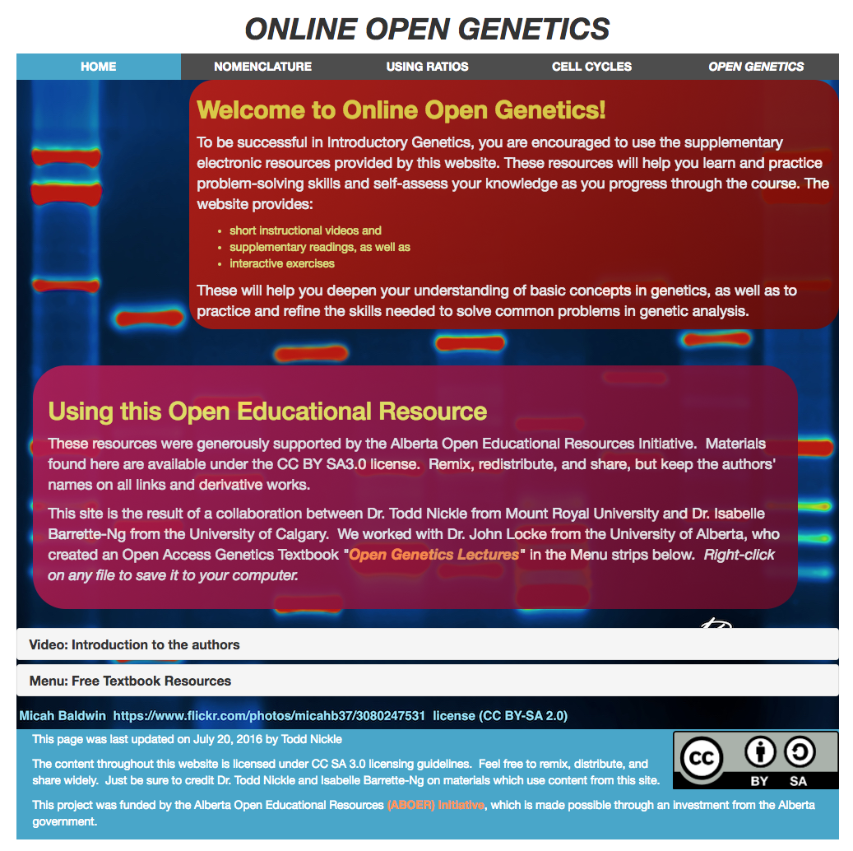
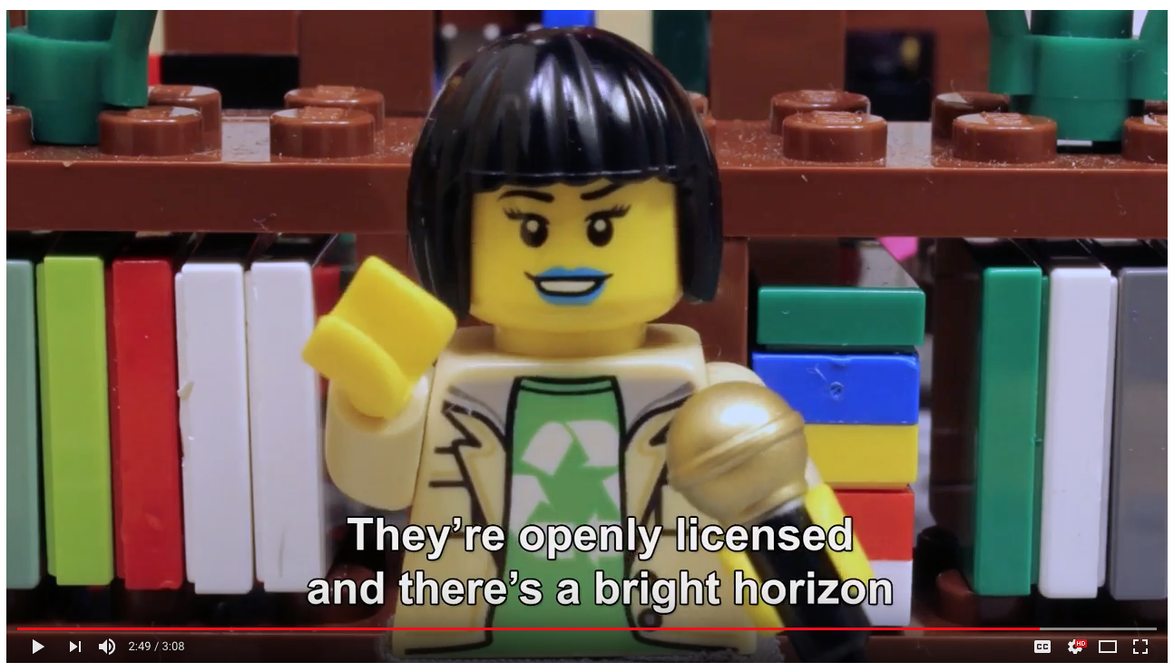
Why OER at the University of Alberta
Instructors already do it
Students are asking for It
Unless otherwise noted, this work is licensed under a Creative Commons Attribution 4.0 International License.
Notes:
CASA recommended funding from the federal budget
Every year there is a textbook broke campaign across the province
It is now included in the undergraduate students policy of official positions and goals for the SU (K) “and the new SU VPA has clearly stated “affordability of course materials” as one of her platforms.” Supporting colleagues and world recognized examples that are being used to teach.
Let’s keep the movement going because people are looking for it and it's going somewhere!
(K) “Instructors on our campus are already doing this. These are just three of so many examples across our campus. These instructors are using OER to either enrich their students’ learning, reduce the cost to their students, or both. With the workload and modesty of these caring instructors, we often have to go about interviewing and asking questions to discover this great work and we are discovering more and more as we continue this work on campus. It’s heartwarming and very exciting. The core value behind OER is sharing and collaboration, so we aim to create awareness for the OER work being done on campus, provide the support they need to go the next step, and help these instructors connect, create community, and share their work.”

Slide 26
Activity
Unless otherwise noted, this work is licensed under a Creative Commons Attribution 4.0 International License.
Notes:
Krysta - 30 min

Slide 27
Wiley’s 5Rs and Creative Commons Licensing
 | Retain | Reuse | Revise | Remix | Redistribute
 | Make and own a copy | Use in a wide range of ways | Adapt, modify, and improve | Combine two or more | Share with others
Public Domain
CC-BY
CC-BY-SA |  |  | same license | same license
CC-BY-NC |  |  |  |  | non-commercial
CC-BY-NC-SA |  |  | same license | same license | non-commercial
CC-BY-ND |  |  | personal use only | personal use only
CC-BY-NC-ND |  |  | personal use only | personal use only | non-commercial
OER
Not OER
Give appropriate credit, provide a link to the license, and indicate if changes were made.
Unless otherwise noted, this work is licensed under a Creative Commons Attribution 4.0 International License.
Notes:
Copyright Office
Handout - 5R licensing

Slide 28
Activity
Scenarios:
Teaching activity
3 OER w/ varied licensing
CC to 5R chart
Assess opportunities and limitations
Unless otherwise noted, this work is licensed under a Creative Commons Attribution 4.0 International License.

Slide 29
Examples
Students and Instructors → remix / create:
Remix audiovisual materials to both entertain and inform
Create or revise/remix entire textbooks
Create their own assignments
Create test banks
Remix/create tutorial videos
Remix/create summaries
Connect principles with popular culture
Create games
Remix/create create guided notes
Remix/create guides to direct other students through readings or lecture.
Select an activity based on the resource pack provided. What are the opportunities and limitations for student learning?
Unless otherwise noted, this work is licensed under a Creative Commons Attribution 4.0 International License.
Notes:
Split into groups. Hand out “course packs” (3 resources per group, here: https://docs.google.com/a/ualberta.ca/presentation/d/1MK_bm_8_HiqtSCfkkcUihu9oMr1cGaQEoJjvg7rLvck/edit?usp=drive_web)
Scene: “I am an instructor and you’re filling in to teach my class. Since this is fiction, you can choose the subject matter and the length of the class. The three sheets you have in your hand represent the resources I wnat you to teach my students. You have nothing else. Choose one of the activities on the slide based on the licensing of the resources I have given you. Use the 5R-CC chart as reference for your decision making”
Share with the group: what resources did you have to work with (everyone has different packs), what activity did you choose and why? What opportunities and limitations does this create for student learning?

Slide 30
Call to Action
Cost
Quality & Pedagogy
Access & Discovery
Unless otherwise noted, this work is licensed under a Creative Commons Attribution 4.0 International License.

Slide 31
Resources and References
Wiley, David. “Defining the "Open" in Open Content and Open Educational Resources.” Iterating toward open, opencontent.org/definition/
Christiansen, E., McNally M., Lock, J., Welch, J., Sou, L. (2016). The starter kit. Retrieved from http://albertaoer.com/content/resources
Navigating open pedagogy, part 1 / You're the Teacher by Christina Hendricks is licensed under a Creative Commons Attribution 4.0 CC BY
Hendricks, Christina. “Navigating open pedagogy, part 1.” You’re the Teacher, 22 May, 2017, http://blogs.ubc.ca/chendricks/2017/05/22/navigating-open-pedagogy-pt1/
McNally, Michael B. “ERA.” LIS 598 Information Policy, Winter 2017 - ERA, era.library.ualberta.ca/collections/8s45qc73c
McNally, M.B. (2016). Open educational resources (OER): Background and some considerations [PowerPoint slides]. Retrieved from https://era.library.ualberta.ca/files/b5q47rn818#.WCS79S0rL4Y
Cronin, Catherine. (2017). “Open Education Open Questions”. EDUCAUSE. Retrieved from: https://er.educause.edu/articles/2017/10/open-education-open-questions
Unless otherwise noted, this work is licensed under a Creative Commons Attribution 4.0 International License.

Slide 32
Resources and References
Source of ‘Figure 9’: Green, C. 2017. Open Licensing and Open Education Licensing Policy. In: Jhangiani, R S and Biswas-Diener, R. (eds.) Open: The Philosophy and Practices that are Revolutionizing Education and Science. Pp. 29–41. London: Ubiquity Press. DOI: https://doi.org/10.5334/bbc.c. Licence: CC-BY 4.0
“Creative Commons Guide.” Copyright at UBC, copyright.ubc.ca/guidelines-and-resources/support-guides/creative-commons/
Wakaruk, Amanda. “Do it right the first time: Copyright, Creative Commons, and OER.” Alberta OER Summit. May 11, 2017. https://doi.org/10.7939/R3571809V
http://classroom-aid.com/oer-mobile-course-open-diagram/
"Open Model" by Creative Commons is licensed under CC BY 2.0
Creative Commons (CC) https://creativecommons.org/ CC Wiki https://wiki.creativecommons.org/
Wiley, David. “OER-Enabled Pedagogy.” Iterating toward openness, 2 May 2017, opencontent.org/blog/archives/5009
Unless otherwise noted, this work is licensed under a Creative Commons Attribution 4.0 International License.

