Slide 1
Fair Dealing’s Future
Artificial Intelligence or Willful Ignorance
Dr. Meera Nair, Copyright Specialist
23 February 2022

Slide 2
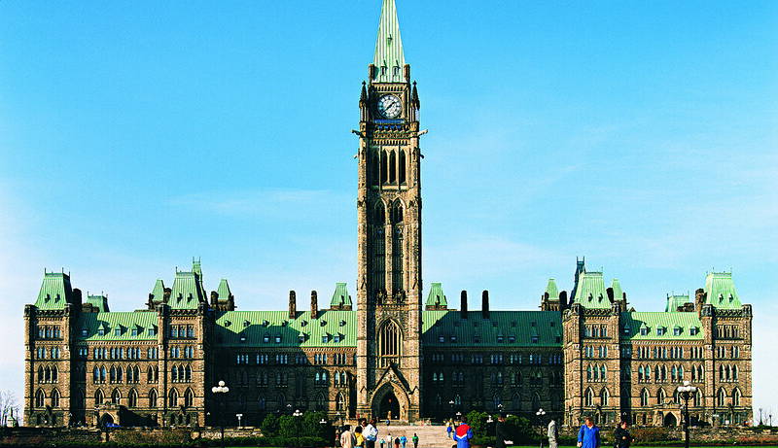
“Budget 2021 proposes to provide up to $443.8 million over ten years, starting in 2021-22, in support of the Pan-Canadian Artificial Intelligence Strategy”

Slide 3
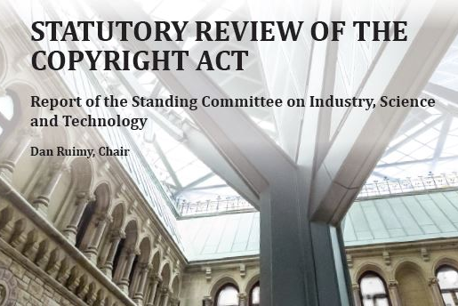
“facilitating the informational analysis of lawfully acquired copyrighted content could help Canada’s promising future in artificial intelligence to become reality.”
INDU Committee Report, presented to the House of Commons on Monday, 3 June 2019

Slide 4
“… copyright owners may find it difficult to enforce their rights and seek remuneration in the context of TDM, particularly for their works or other copyright subject matter that are publicly available online…
What kind of copyright licenses for TDM activity are typically available, and how do these licenses meet the needs of those conducting TDM activity? …
Are rights holders facing challenges with TDM activity and in licensing their works for TDM activity? If so, what is the nature and extent of those challenges? …”
Canada. A Consultation on a Modern Copyright Framework for Artificial Intelligence and the Internet of Things (2021)

Slide 5
“The Committee recommends that the Government of Canada amend the Copyright Act to allow for extended licensing of Internet material used for educational purposes. Such a licensing regime must recognize that the collective should not apply a fee to publicly available material…
… available on public Internet sites (sites that do not require subscriptions/passwords and for which there is no associated fee or technological protection measures which restrict access or use) and is accompanied by notice from the copyright owner explicitly consenting that the material can be used without prior payment or permission.”
Standing Committee on Canadian Heritage, Interim Report on Copyright Reform (May 2004)

Slide 6
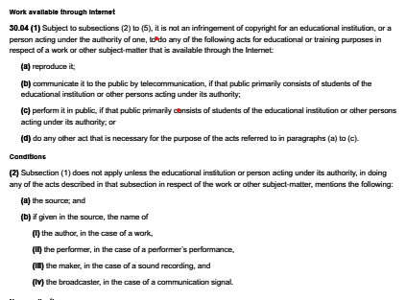
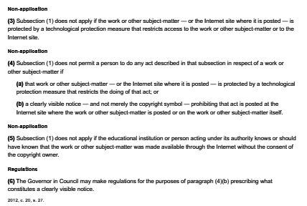
(4) Subsection (1) does not permit a person to do any act described in that subsection in respect of a work or other subject-matter if… a clearly visible notice — and not merely the copyright symbol — prohibiting that act is posted at the Internet site where the work or other subject-matter is posted or on the work or other subject-matter itself.
Copyright Act (R.S.C., 1985, c. C-42), Work Available Through The Internet Section 30.04

Slide 7
Value of the American Player Piano Industry
Year # player pianos total value
1902 ~73,000 unknown
1909 364,545 $58,493,846
1921 221,210 $66,267,751
1923 347,589 $104,362,578
1935 61,198 $11,668,531
White-Smith Music Publishing Co. v. Apollo Co. 209 U.S. 1. 21 (1908)
Harvey Roehl, Player Piano Treasury (1961) p. 43
Richard Dowling, Kicking the Clouds Away: Gershwin at the Piano

Slide 8
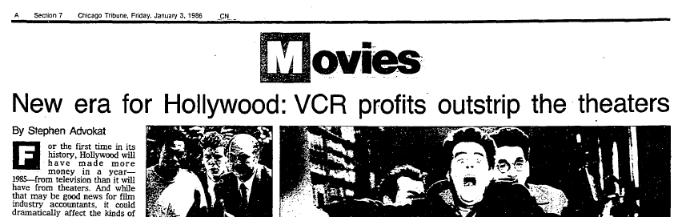
“Considering that VCRs are in only about a third of U.S. households, home video will likely be Hollywood`s dominant revenue source by as early as next year.”
“…the film industry will have made about $1.5 billion in profits on domestic movie ticket sales, slightly less than 1984. The sale of pre-recorded video cassettes, however, will have generated about $1.5 billion, twice the amount of video cassette revenue in 1984. Add the estimated $700 million the film industry will tote up from the cable television industry and $500 million from network and syndicated television in the past year, for a total of $2.7 billion in television-related film revenues--and 1985 will have been the first year Hollywood earned more money from the small screen than the big screen.”
Stephen Advokat, 3 January 1986, New era for Hollywood; VCR profits outstrip the theatres, Chicago Tribune
“I say to you that the VCR is to the American film producer and the American public as the Boston strangler is to the woman home alone.” Jack Valenti, President MPAA, testimony to Congress (1982).

Slide 9
“Phonograph records supplanted both piano rolls and sheet music with the aid of the compulsory license for mechanical reproduction; the juke box was created to exploit the copyright exemption accorded to the ‘reproduction or rendition of a musical composition by or upon coin-operated machines’ … Radio invaded everyone’s living rooms before it was clear whether unauthorized broadcasts were copyright infringement; television took over our lives while it still seemed unlikely that most television programs could be protected by copyright …”
Jessica Litman, Digital Copyright (2001) p. 173. Re-released under CC-BY-ND license in 2017 under Maize Books
Brian Fauteaux, Andrew deWaard, Brianne Selman, “Artists Spotify Criticism…” 21 Feb. 2022
Pamela Samuelson, the U.S. Digital Agenda at WIPO, 1996.

Slide 10
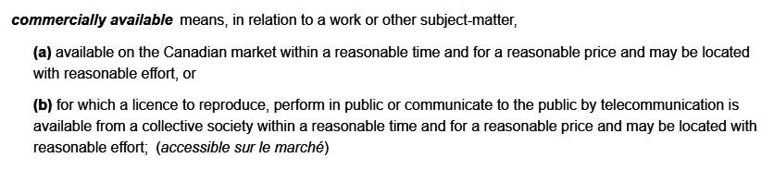
Vaver: “The Bill originally gave some exemptions to the nonprofit educational sector and to non-profit libraries, archives and museums, to recognize long-standing copying practices. Many of these exemptions are now gone if a collecting society is around to sell a licence.”
Rushton: “In committee stage the exceptions were reduced, especially regarding any reproduction or display of material that is ‘commercially available.’ This term now means that authorization for its use is available from the Collective Society, not that it is necessarily on the market.”
Copyright Act (R.S.C., 1985, c. C-42), Interpretation
David Vaver, The Copyright Amendments of 1997 (1997).
Michael Rushton, When in Rome – Amending Canada’s Copyright Act (1997).

Slide 11
“Unauthorized copying [is viewed] as inherently sinful and regards prior permission as the means to avoid and absolve that venial sin of copying. … This resembles some aspects of Catholic dogma in the Middle Ages; the Catholic Church realized that if it could not prevent sin altogether, it might as well monetize the sin through the sale of indulgences.”
Ariel Katz, The Orphans, the Market, and the Copyright Dogma: A Modest Solution for a Grand Problem, (2013).

Slide 12
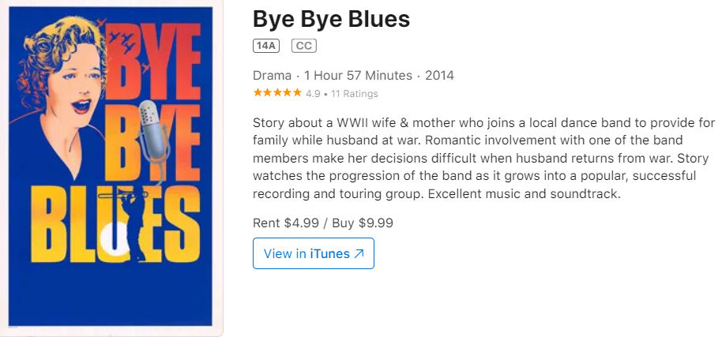
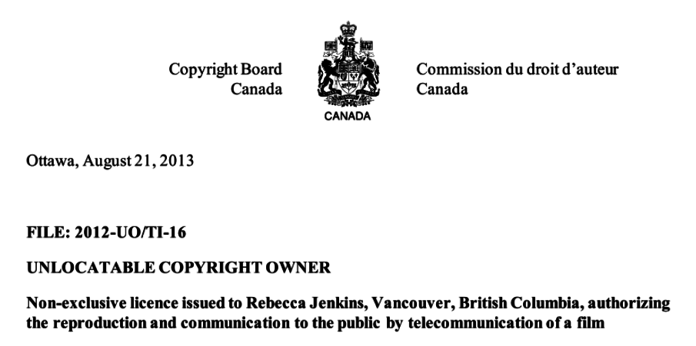
Copyright Board of Canada. Unlocatable Copyright Owners, Approved Application (Jenkins) 21 August 2013.
Michael D. Reid, “Big Picture: Hello Again, Bye Bye Blues,” Times Colonist, 29 May 2015,

Slide 13
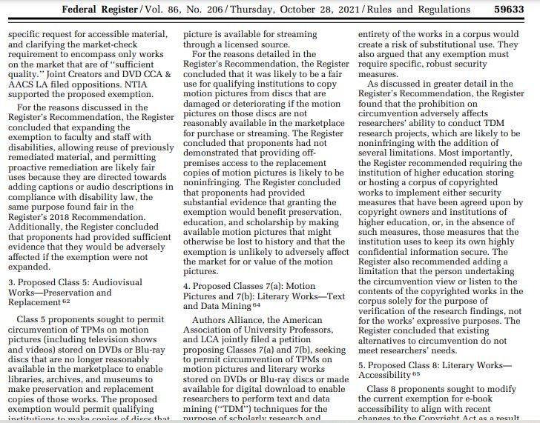
4. Motion Pictures and Literary Works
“The Register found that prohibition on circumvention adversely affects researchers’ ability to conduct TDM research projects [that are likely noninfringing] …”
Federal Register, Vol. 86, No 206, 28 October 2021

Slide 14
“The Canadian bill envisions the possibility of establishing additional fees payable by the non-profit organization to copyright collectives. The Marrakesh Treaty does not require adding royalty payments and many countries (including the United States) do not have such a provision. … The Canadian approach to exporting accessible works to other countries is also unnecessarily complex. The export exception does not apply to works that are ‘commercially available’ ‘within a reasonable time and for a reasonable price’ in the other country. [Again, unnecessary.]”
Michael Geist, Canadian Copyright Bill for the Blind in Need of Fine Tuning, 19 April 2016.

Slide 15
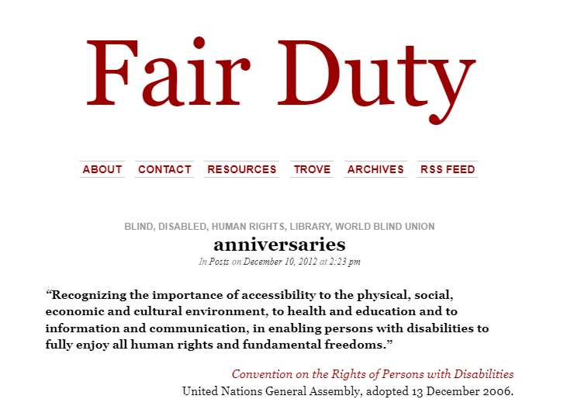
“The principal concern voiced by the publishing sector today was as much in evidence in 1982: that a special provision would undermine the exclusive right of authors.”
See also Blake E. Reid, “Copyright and Disability,” Dec. 2021

Slide 16
“The Google Books and HathiTrust cases held, in effect, that copying expressive works for non-expressive purposes was justified as fair use. This addresses the most significant issue for the legality of text data mining research in the United States; …
The term ‘non-expressive use’ … refers to any act of reproduction that is not intended to enable human enjoyment, appreciation, or comprehension of the copied expression as expression (6).”
Matthew Sag, The New Legal Landscape for Text Mining and Machine Learning, (2019)

Slide 17
“The Authors Guild’s separate cases against HathiTrust and Google were heard by different trial judges in the Southern District of New York and appealed to differently constituted (but overlapping) panels of judges on the Court of Appeals for the Second Circuit. Thus, the Guild presented its arguments with respect to fair use to six different judges on four different occasions. It lost every time (16).
Matthew Sag, The New Legal Landscape for Text Mining and Machine Learning, (2019)

Slide 18
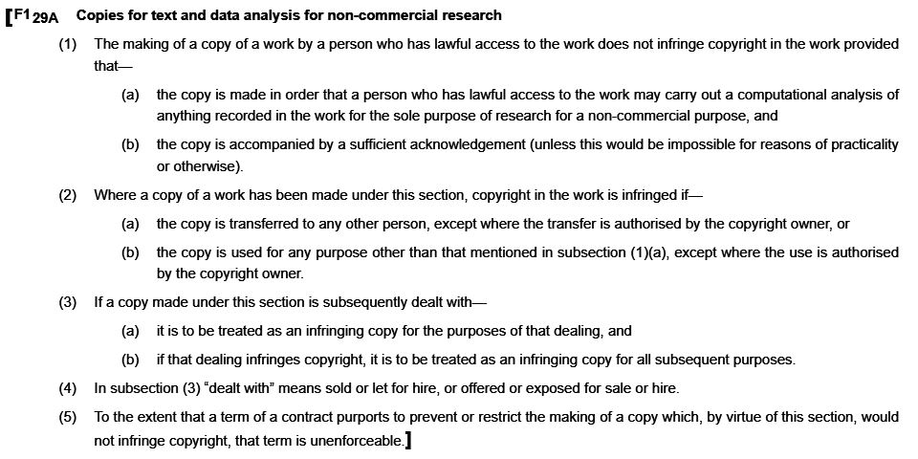
(U.K.) Copyright Design and Patents Act 1988 c. 48, S29A
Benjamin White, Copyright Exception for Text & Data Mining, January 2022; begins at the 5 minute mark.

Slide 19
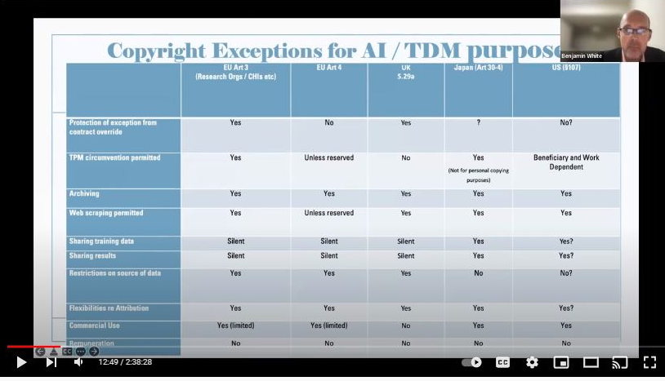
Benjamin White, Copyright Exception for Text & Data Mining, January 2022; begins at the 5 minute mark.

Slide 20
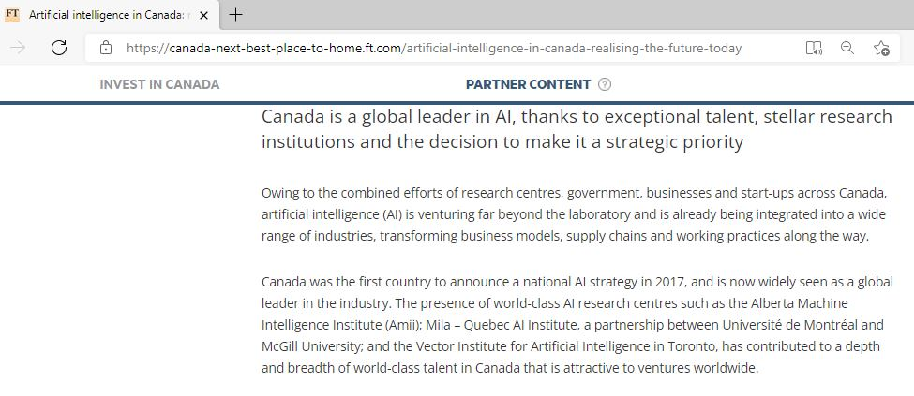
“Canada was the first country to announce a national AI strategy in 2017, and is now widely seen as a global leader in the industry.” - as said by Invest in Canada

Slide 21
“For the purpose of information analysis (‘information analysis’ means to extract information, concerned with languages, sounds, images or other elements constituting such information, from many works or other such information, and to make a comparison, a classification or other statistical analysis of such information; the same shall apply hereinafter in this Article) by using a computer, it shall be permissible to make recording on a memory, or to make adaptation (including a recording of a derivative work created by such adaptation), of a work, to the extent deemed necessary(…).”
Trialle et al., Study on the legal framework of text and data mining (TDM), 2014.

Slide 22
Article 30-4. Exploitations not for enjoying the ideas or emotions expressed in a work
“It is permissible to exploit work, in any way and to the extent considered necessary, in any of the following cases or other cases where such exploitation is not for enjoying or causing another person to enjoy the ideas or emotions expressed in such work; provided, however that this does not apply if the exploitation would unreasonably prejudice the interests of the copyright owner in light of the natures and purposes of such work, as well as the circumstances of such exploitation (54).”
Flynn et al., Research Exceptions in Comparative Copyright Law, 2021

Slide 23
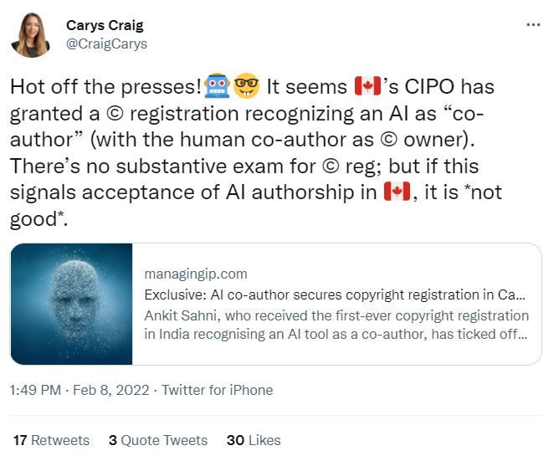
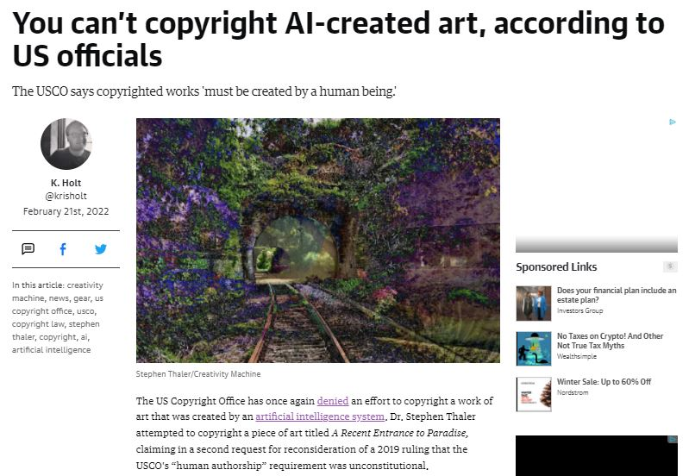
Carys Craig, Death of the AI Author, 2021
Carys Craig, “AI and Copyright” in Artificial Intelligence and the Law in Canada, 2022
K. Holt, “You can’t copyright AI-created art, according to US officials,” engadget 21 February 2022

Slide 24
_{Thank you}
Dr. Meera Nair - meeran@nait.ca
23 February 2022

