Slide 1
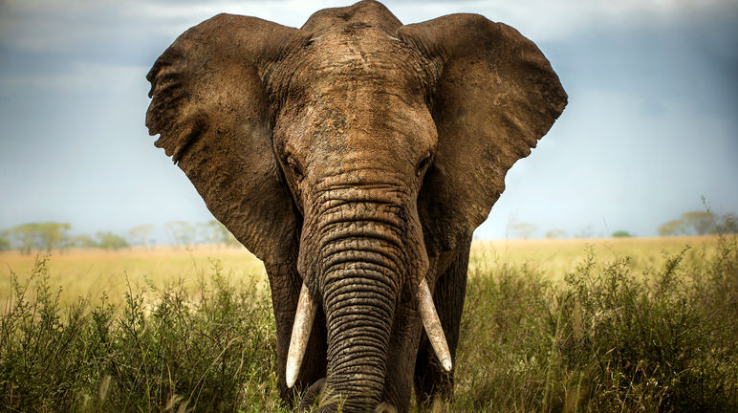
The Significance of Body Size in the Wildlife Trade: A Comparative Analysis in Mammals
https://www.onekindplanet.org/animal/african-bush-elephant/
Jocelyn Kublik, Ivana Schoepf & C.H. Yuen

Slide 2
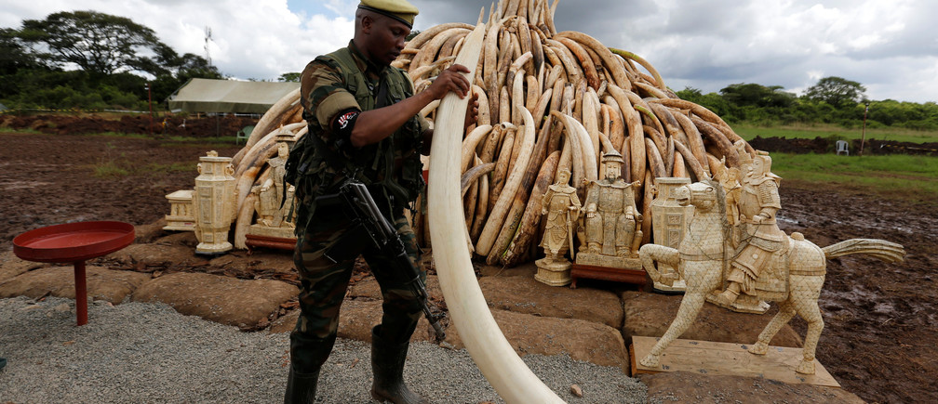
What is the Wildlife Trade?
https://www.weforum.org/agenda/2016/09/fighting-illegal-wildlife-and-forest-trade/

Slide 3
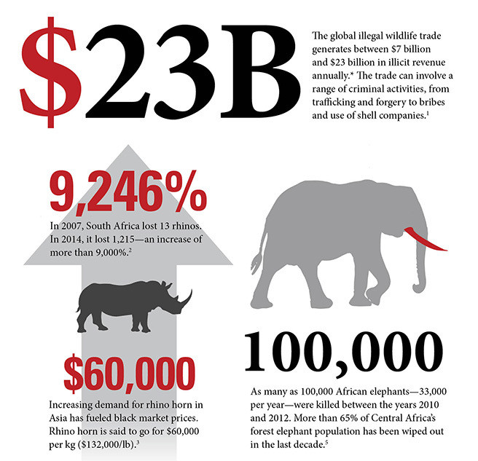
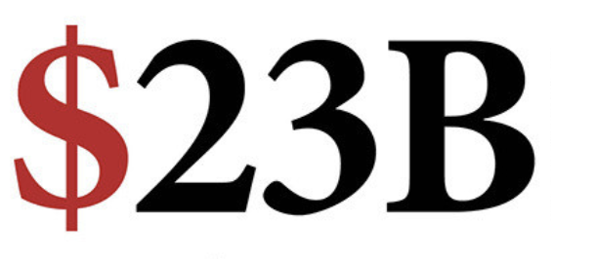
https://www.weforum.org/agenda/2016/09/fighting-illegal-wildlife-and-forest-trade/

Slide 4
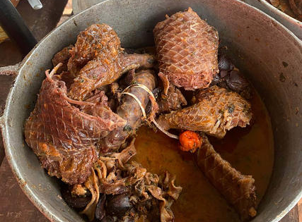
TROPHY
FOOD
https://www.usip.org/publications/2023/04/peace-poaching-and-pangolins-central-africa
https://www.worldwildlife.org/threats/illegal-wildlife-trade
MEDICINE
PET
https://en.blueislandrecipes.com/?k=on-the-trail-of-asia-s-shifting-rhino-horn-kk-0z7KeAT8
https://spca.bc.ca/news/curbing-the-wildlife-trade/

Slide 5
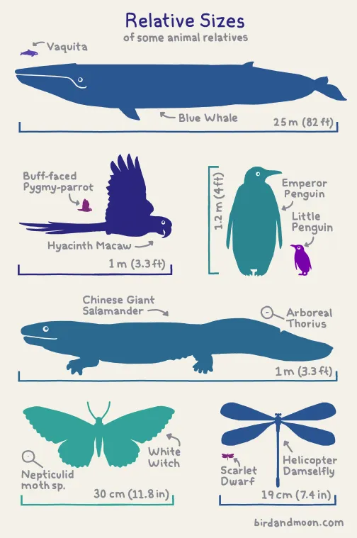
Mass?
Length?
Body Size
Condition?
Other?
https://laughingsquid.com/a-handy-chart-featuring-the-relative-sizes-of-animal-relatives/

Slide 6
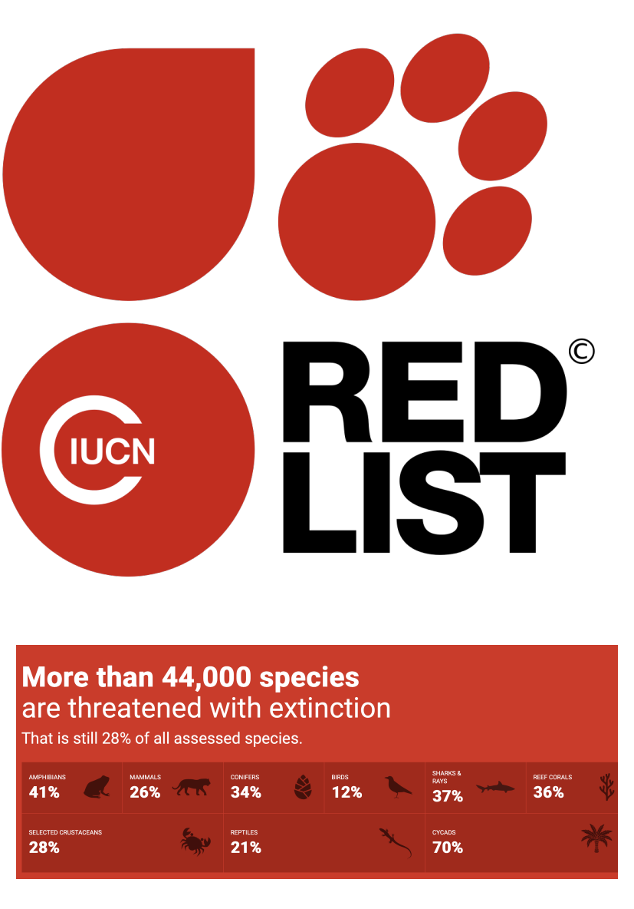
Body Size
Mass (g)
Length (mm)
LM residuals
Fulton’s K
Scaled-Mass-Index (SMI)
https://en.wikipedia.org/wiki/IUCN_Red_List
https://twitter.com/IUCN/status/1747289610269364634

Slide 7
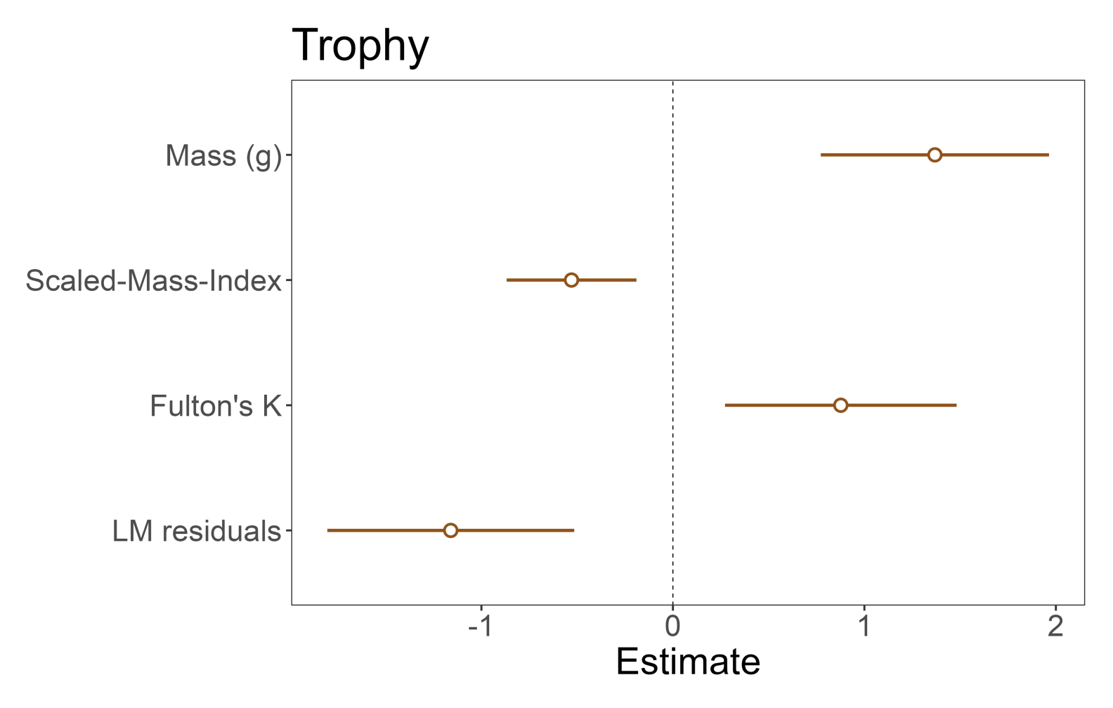
All body size measures were good, but LM residuals was best

Slide 8
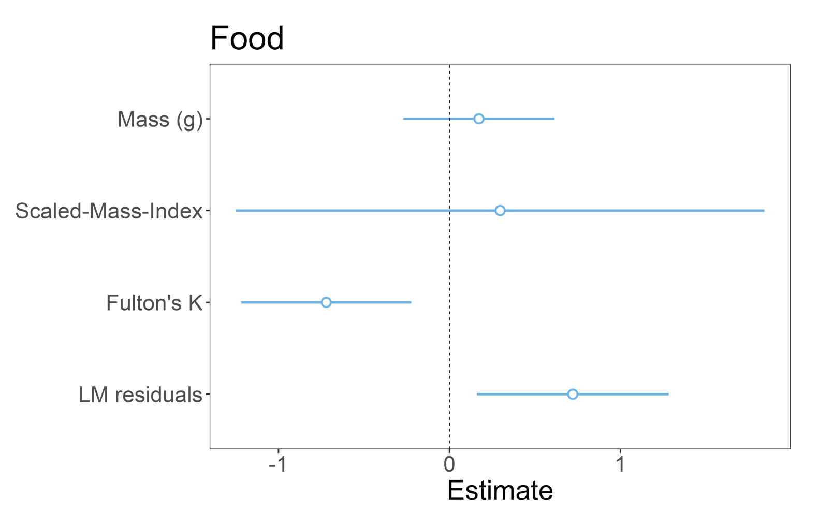
Fulton’s K and LM residuals predicted food well

Slide 9
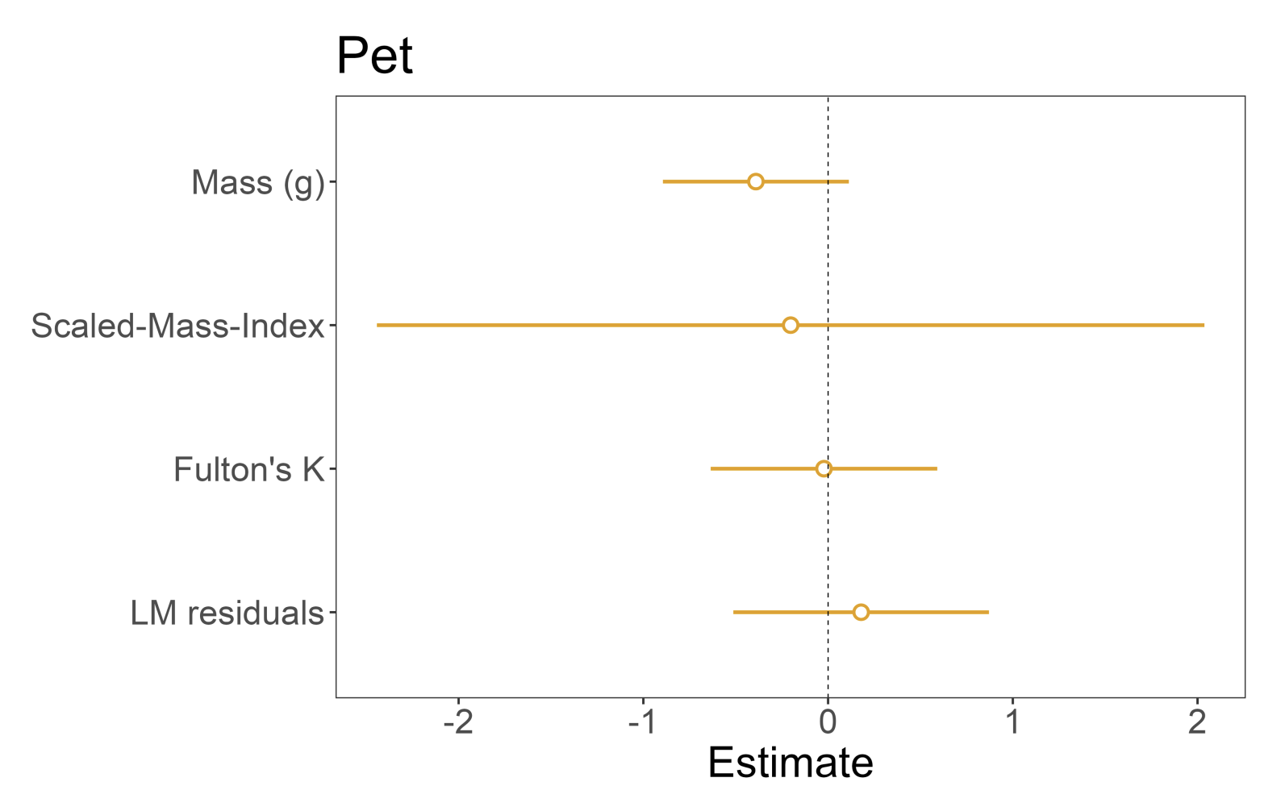
No measure was good

Slide 10
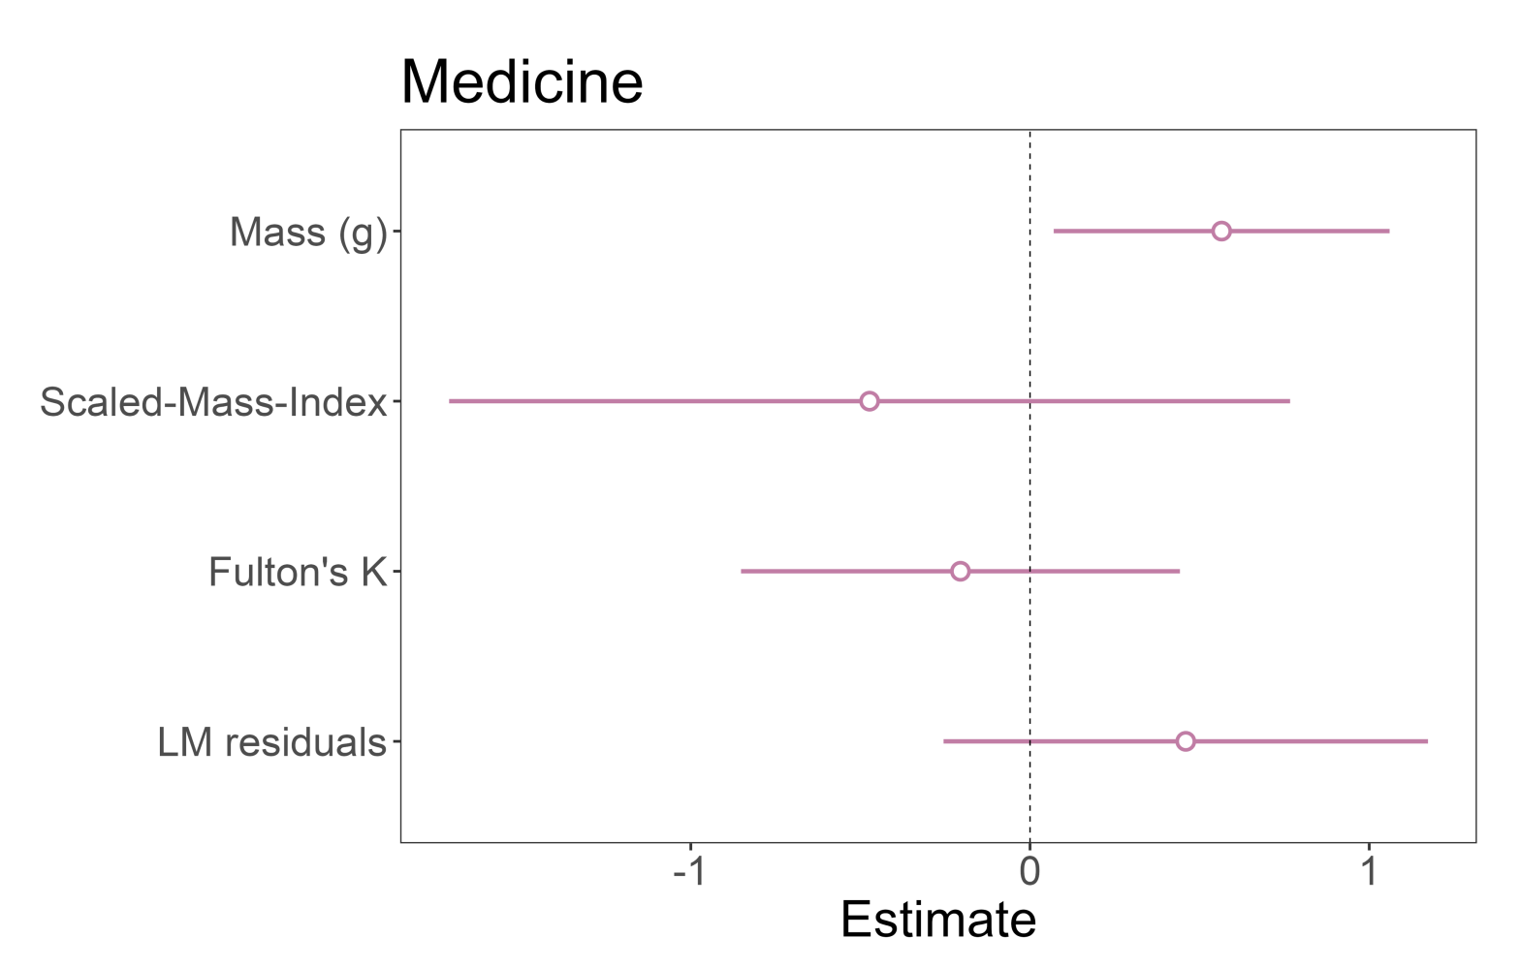
Mass was good, but not Fulton’s K, LM residuals or SMI

Slide 11
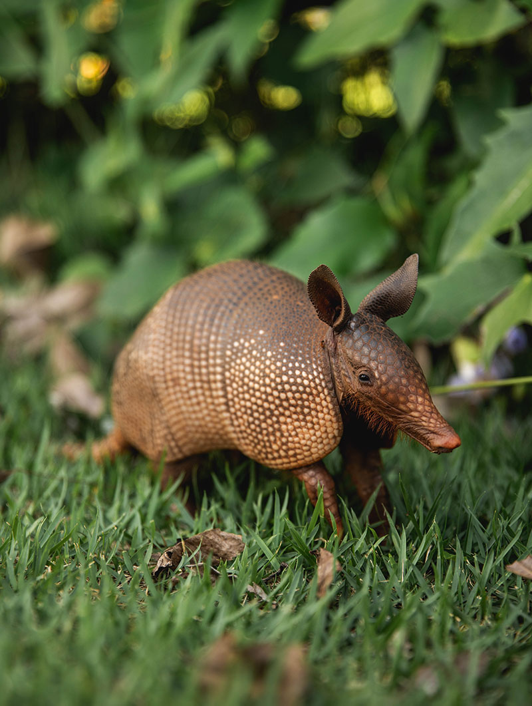
So, do different measures of body size similarly predict if animals get traded?
Not
really!
https://gbu-taganskij.ru/platnie-uslugi/?w=nine-banded-armadillo-%E2%80%93-cosley-zoo-kk-8G1qZaTg

Slide 12
Special Thanks
Dr. Ivana Schoepf
Dr. C. H. Yuen

Slide 13
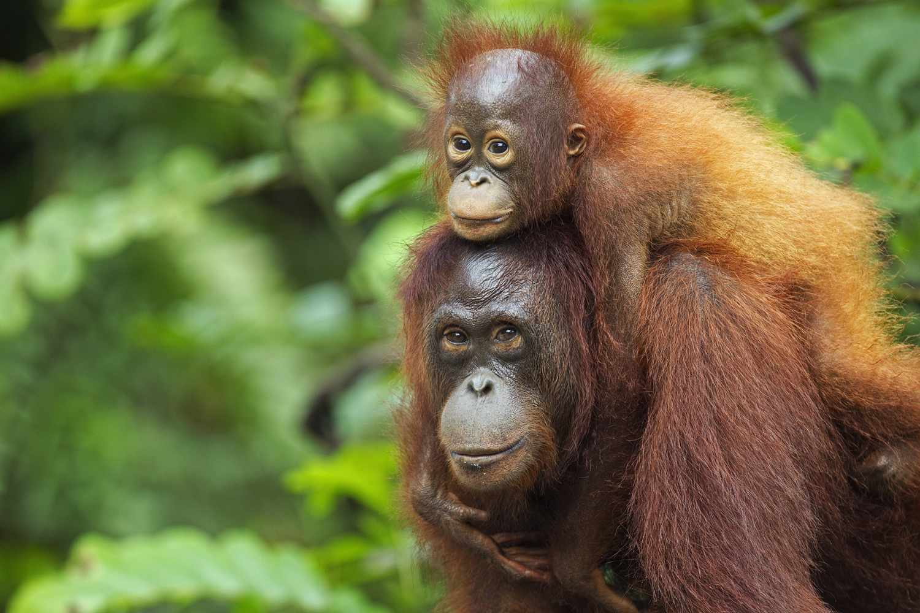
Questions?
https://www.treehugger.com/bornean-orangutan-endangered-5199361

