Slide 1
Copyright Act, Section 3:
Copyright in Works
*April 2019
Notes:
*Updated: February 2024
Hello and welcome to the University of Alberta’s Opening Up Copyright Instructional Module on Copyright in Works, Section 3. Or, the rights covered by copyright.

Slide 2






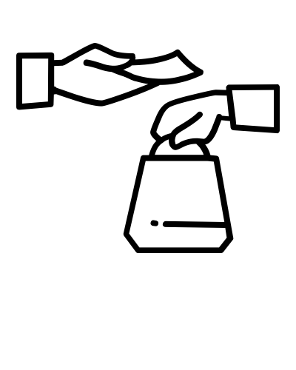



A STAND-IN TERM
COPY
COPY
RIGHT
RIGHT
TO
Notes:
Copyright… it seems pretty straight forward, the right to copy. But the term ‘copyright’ is actually misleading; it refers to a whole bundle of rights – so many different rights that it wouldn’t make sense to list all of them every time, and so the singular, but reductive, ‘copyright’ serves as a stand-in.

Slide 3

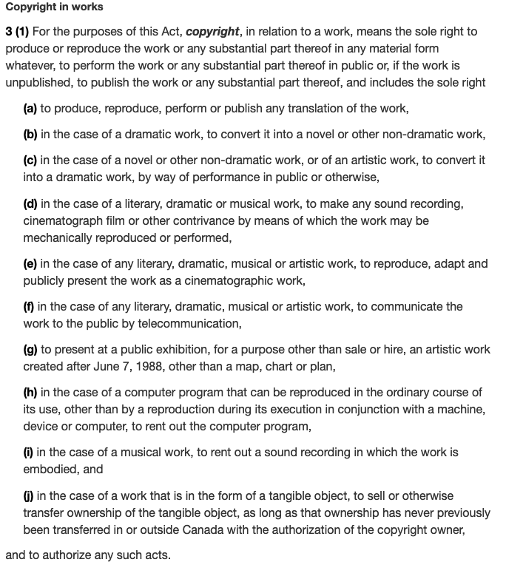


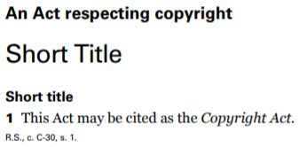
SECTION 3
JUNE 6,
1988
s. 3
Notes:
The rights under ‘copyright’ are detailed in section 3 of the Copyright Act. From a rights holder’s perspective, section 3 is the heart of the Act, even if some of the rights seem rather awkwardly phrased … possibly narrow and maybe even not important at all. For example, one of the rights under ‘copyright’ is the sole right to “present at a public exhibition, for a purpose other than sale or hire, an artist’s work created after June 7, 1988, other than a map, chart or plan.” Don’t ask what happens if you want to present your art created on June 6, 1988, at a public exhibition.

Slide 4
SECTION 3 IS VERY SPECIFIC!
C
O
P
Y
R
I
G
H
T
Notes:
In addition to spelling out the full set of the rights that make up ‘copyright’, section 3 also contains some important elements that influence copyright overall because of the very specific language that is used.

Slide 5
EXAMINING SECTION 3(1)
“… means the sole right to produce or
reproduce the work or any
substantial part thereof
in any material form
whatever...”
Notes:
At the broadest level, section 3(1) notes that copyright in relation to a work “means the sole right to produce or reproduce the work or any substantial part thereof in any material form whatever...” It may not seem like it, but there are some significant points here.

Slide 6
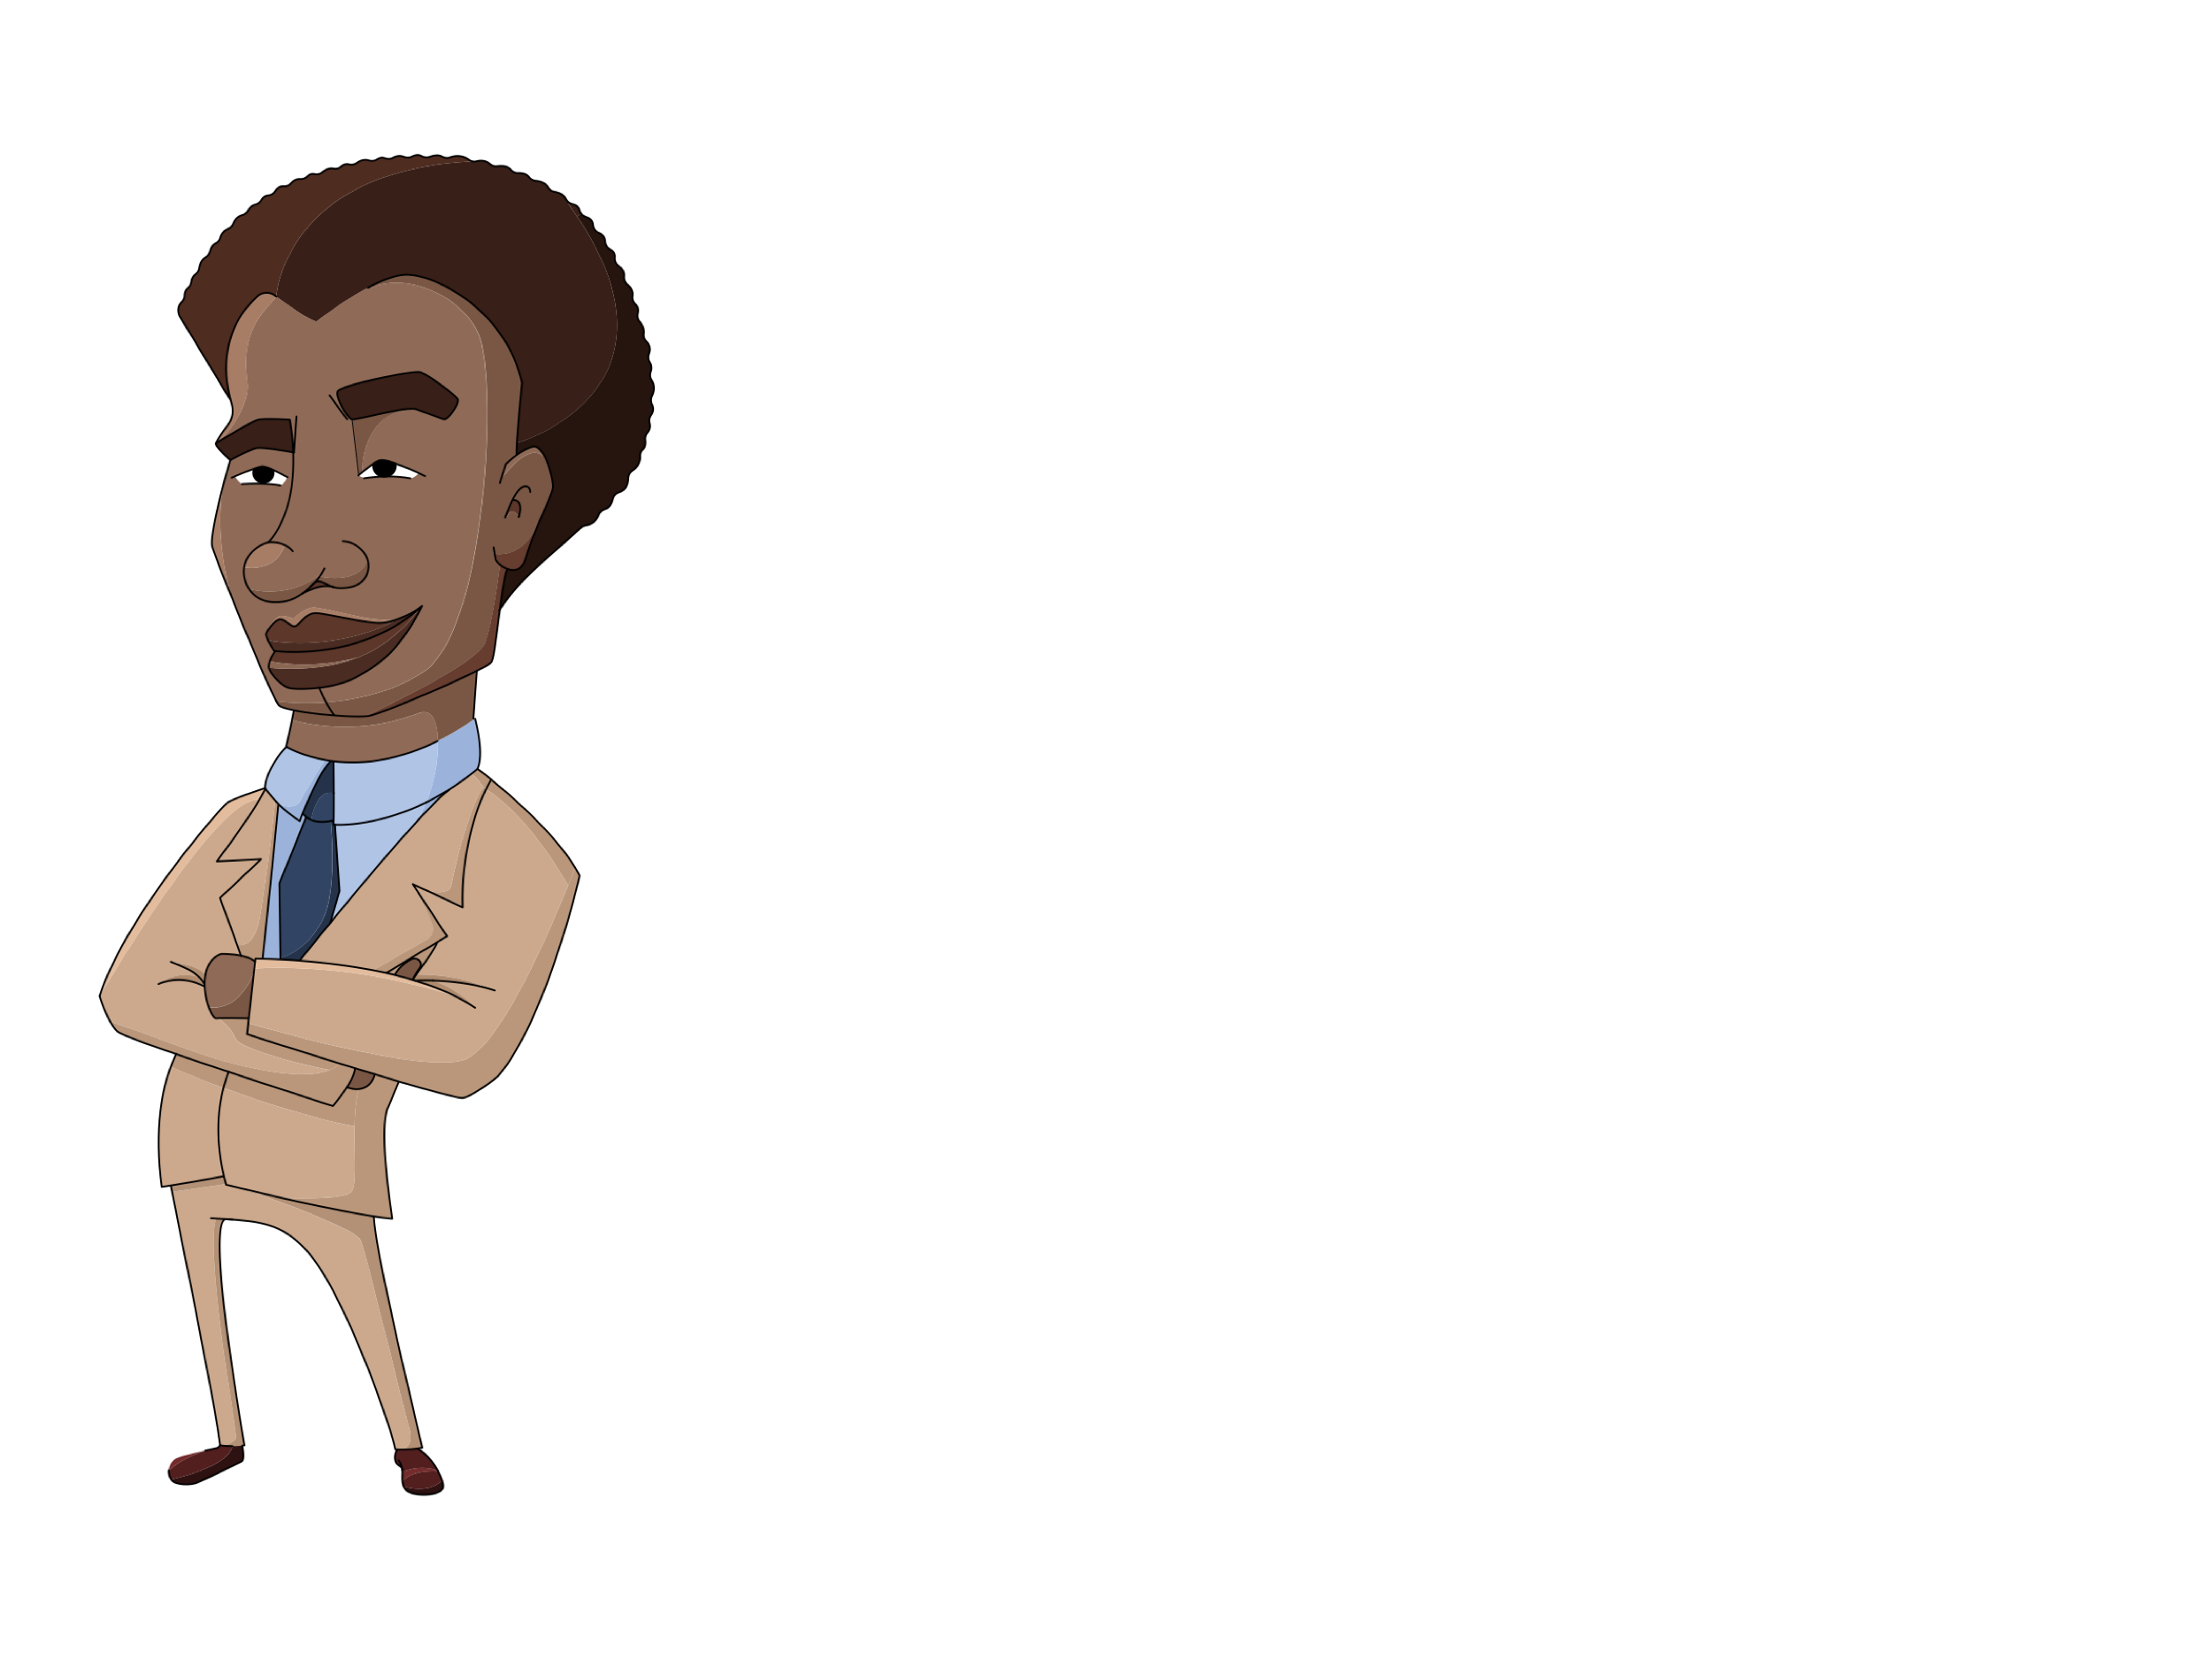

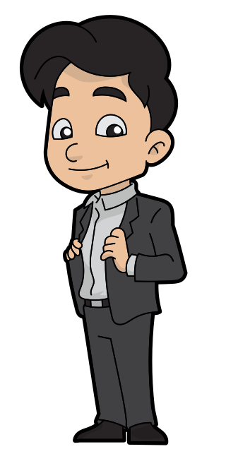




DETAILS IN THE PHRASE
“… means the
sole right
to produce or
reproduce the work or any
substantial
part thereof
in any material form
whatever...”
Thanks, copyright!
Notes:
The first is the phrase “sole right.” Sole right is important because it means the copyright holder doesn’t just have the right to reproduce the work, it means that only the copyright holder has that right. While there are exceptions to copyright infringement, copyrights are exclusive, or perhaps more accurately – exclusionary rights.

Slide 7


DETAILS IN THE PHRASE
“… means the
sole right
to produce or
reproduce the work or any
substantial
part thereof
in any material form
whatever...”
Notes:
Another crucial term is “substantial.” While determining what may constitute substantial or non-substantial isn’t the focus of this module, the inclusion of this word means that in some cases, if what you are reproducing is a very small and non-central piece of a work, copyright concerns do not apply.

Slide 8


DETAILS IN THE PHRASE
“… means the
sole right
to produce or
reproduce the work or any
substantial
part thereof
in any material form
whatever...”
(…because why not?)
Notes:
A third key concept is “in any material form.” This is an important phrase as it notes that reproduction of copyright-protected material is not tied to a specific media or format including the format it was originally produced in. In other words, if an essay first appears as a blog post, the copyright holder has the sole right to reproduce it not only as a blog post, but also as a part of a book or periodical or even, if they want to, on stone tablets.

Slide 9


RIGHTS IN SECTION 3(1)
Oh wait. Nevermind.
You good, boo.
Now hang on there, Sandy…
PROVIDING #attribution IS
#doinItRight!
#WINNING
I THIS SCRIPT!
THEY GOTTA SEE THIS IN ***** !
私はこのテキストが大好きです！
YUSSS!!
University of Alberta. 2019. “Section 3.” Opening Up Copyright Instructional Module. https://www.ualberta.ca/copyright/resources/opening-up-copyright-instructional-modules
Notes:
Section 3(1) also includes a list of other sole rights of the copyright holder. The first of these, 3(1)(a) is the right to produce, reproduce, perform or publish any translation of the work. For example, if you love this script and you want to translate all of it into Japanese, your translation would likely be considered infringement if done without our permission. Of course, since we have applied a Creative Commons licence to this script, you have our permission, subject to the terms of that licence.

Slide 10





RIGHTS IN SECTION 3(1)
©
©
May I?
Sure!
©
Notes:
Section 3 also includes a number of rights involving changing a work betwixt various types of works. It is important to note that changing a work between types of works will generate new copyright-protected works. For example if you write a novel, you have the sole right to convert that novel into a dramatic work like a play. If you were to write the play based on your novel you would have a new copyright on the written play (as well as the original copyright on the novel). If someone else wanted to take your play and perform it, or turn it into a movie, they would need your permission as the copyright holder, and any recordings of the play or the movie itself would result in new copyrights.
These same rights also work going in the opposite direction. For example, if you write a play and it is adapted into a novel. There are also similar provisions regarding adaptations among literary, dramatic and musical works as well as sound recordings and films (or, more accurately, ‘cinematographic works’).

Slide 11





RIGHTS IN SECTION 3(1)
UH, WHO STILL USES FAX?
Notes:
Subsection 3(1)(f) details another important sole right of the copyright owner – the right to communicate a work to the public by telecommunication. Okay, so what exactly does this mean? In simpler terms, this right covers the distribution of works over the internet and other forms of telecommunication. However, this right doesn’t cover every means of telecommunicating a work. This right does not cover single point-to-point, or person-to-person, forms of telecommunication like email, phone, and faxes.

Slide 12



RIGHTS IN SECTION 3(1)
Notes:
That said, the telecommunication right does cover mass unsolicited faxing or emails like spamming. More importantly, it also includes posting material on publicly available internet sites. Furthermore, a communication is still considered “to the public” regardless of whether the material can be downloaded or is streamed. Court and Copyright Board decisions have clarified that in cases where the telecommunication right is infringed on the internet it is not the internet service provider that is responsible, but the uploader.

Slide 13

RIGHTS IN SECTION 3(1)
Notes:
Subsection 3(1)(j) includes another awkwardly worded but important sole right. The subsection notes that “in the case of a work that is in the form of a tangible object, to sell or otherwise transfer ownership of the tangible object, as long as that ownership has never previously been transferred in or outside Canada with the authorization of the copyright owner.”

Slide 14

RIGHTS IN SECTION 3(1)
Notes:
In regard to the ‘tangible object’ piece, this is a way of talking about a book, a vinyl record, a CD or DVD, but not just a digital file. Essentially it is referring to the container of an intellectual good. So as a rights holder, if you have your intellectual work embodied in a physical object like a book or a CD, you can control the right to sell that object; however, this right is not absolute.

Slide 15








EXHAUSTION DOCTRINE
© !
FIRST
SALE
DOCTRINE
©
Notes:
Your ability to limit the sale of the tangible object applies only to the first sale. Looking at it from the user’s perspective, if you buy a book or a CD, you have control over the physical object, though the rights holder still controls copyright in the intellectual work. In other words, if you buy a book or a CD, you can do what you like with the physical object, enjoy it, use it as a coaster, burn it in your fireplace, but you don’t have the same rights to the underlying intellectual work as the rights holder does – you can’t make copies, translate the work or telecommunicate it to the public unless you are relying on an exception to infringement such as fair dealing. Section 3(1)(j) gets at what is known as the ‘exhaustion doctrine’ in Canadian copyright, but you might know it by the similar US concept – the ‘first sale doctrine’.

Slide 16



AUTHORIZING RIGHTS & USES
I GET TO DECIDE HOW MY WORK IS USED!
Notes:
Finally, immediately after subsection j, which covers the last of the 10 rights in copyright, there is one more key element to the section. This notes that, in addition to these 10 rights, the rights holder has the sole right to “authorize such acts.” As noted earlier, the rights in copyright are exclusionary rights, but as the rights holder, you have the ability to separately authorize to groups or other individuals various rights (or uses) of your work. For example, if you write a novel, you might authorize one person to produce and distribute copies of it, another to create a translation of it and authorize a third, different set of individuals to disseminate the work over the internet.

Slide 17
A BUNDLE OF RIGHTS
COPY
RIGHT
Notes:
Thus section 3 of the Copyright Act structures copyright as a bundle of exclusionary rights for the rights holder in a work, who not only has the sole right to make certain uses of the work, but who can also authorize others in relation to those uses of the work.

Slide 18
LEARNING OBJECTIVES
You should now be able to:
Understand copyright as a bundle of rights, rather than just the right to copy
Recognize key words and phrases in section 3 that shape copyright, including “sole right,” “substantial,” and “in any material form”
Understand that copyright holders may authorize uses by others
Notes:
You should now be able to:
Understand copyright as a bundle of rights, rather than just the right to copy
Recognize key words for section 3 that shape copyright (for example, “sole right,” “substantial,” and “in any material form”)
Understand that copyright holders may authorize uses by others

Slide 19
Notes:
This has been the University of Alberta’s Opening Up Copyright Module on section 3 of the Copyright Act. Thank you for your attention.

Slide 20
In section 3(1) of the Copyright Act, the term “sole right” means that:
  The copyright holder must have a soul in order for copyright to be valid
  Only the copyright holder is afforded the rights outlined in the section
  Anyone associated with the creation of a work may enjoy the rights in section 3(1)
  The copyright holder may only exercise one of the rights in the section
Which of the following rights is NOT covered by section 3(1) of the Copyright Act?
  Restricting the ability for anyone to use the work under fair dealing exceptions
  Converting a novel or non-dramatic work into a play or similar dramatic work
  Making a sound recording of a copyrighted work
  Translating the work into another language

Slide 21
The Copyright Act provides some exceptions to the rights given to copyright holders in section 3(1).
  True
  False
The Copyright Act specifies how much copying of a work can be done before the copy is considered “substantial.”
  True
  False

Slide 22
You can distribute copies of an MP3 you have purchased in all these cases except:
  When copying is done under a fair dealing exception
  When the copyright holder has authorized you to copy their work for this purpose
  When the copyright holder cannot be identified
  When the copyright holder made the song available under a Creative Commons licence
As a copyright holder, you can authorize others to use the rights in section 3(1) separately.
  True
  False

Slide 23
Montu Yadav. (n.d.). Broadcast. The Noun Project. CC BY. https://thenounproject.com/term/broadcast/201837
Andrejs Kirma. (n.d.). Process. The Noun Project. CC BY. https://thenounproject.com/term/process/2067352
Saeful Muslim. (n.d.). Buy and sell. The Noun Project. CC BY. https://thenounproject.com/term/buy-and- sell/1214799
Template. (n.d.). Authorize. The Noun Project. CC BY. https://thenounproject.com/term/authorize/2205925
Priyanka. (n.d.). Viewing. The Noun Project. CC BY. https://thenounproject.com/term/viewing/1694590
Blair Adams. (n.d.). Drama. The Noun Project. CC BY. https://thenounproject.com/term/drama/953398
Shastry. (n.d.). DVD. The Noun Project. CC BY. https://thenounproject.com/term/dvd/2163746
Andrey Vasiliev. (n.d.). Film Projector. The Noun Project. CC BY. https://thenounproject.com/term/film- projector/336166
Adrian Coquet. (n.d.). Unlock. The Noun Project. CC BY. https://thenounproject.com/term/unlock/1862800
Geralt. (2017). Atomic bomb. Pixabay. CC0. https://pixabay.com/photos/atomic-bomb-nuclear-weapons- 2621291/

Slide 24
GraphicMama-team. (2016). Arab girl. Pixabay. CC0. https://pixabay.com/en/arabian-arab-girl-female- ethnic-1456184/
Chrystalelizabeth. (2014). Teacher-bookworm-glasses-professor. Pixabay. CC0. https://pixabay.com/illustrations/teacher-bookworm-glasses-professor-359311/
Clip Art by Vector Toons. (2018). Charming Cartoon Businessman. Wikimedia Commons. CC BY. https://commons.wikimedia.org/wiki/File:Charming_Cartoon_Businessman.svg
GraphicMama-team. (2016). AfroAmerican Business. Pixabay. CC0. https://pixabay.com/en/afro- american-afroamerican-business-1454021/
GraphicMama-team. (2016). Guy Music Listening. Pixabay. CC0. https://pixabay.com/en/guy-music- listening-sound-song-1456576/
Twitter. (2019). [smiley face with hearts]. Wikimedia Commons. CC BY. https://commons.wikimedia.org/wiki/File:Twemoji12_1f970.svg
Twitter. (2014). [thumbs up]. Wikimedia Commons. CC BY. https://commons.wikimedia.org/wiki/File:Twemoji_1f44d.svg

Slide 25
Louis Prado. (n.d.). Measuring. The Noun Project. CC BY. https://thenounproject.com/term/measuring/1976046
Dilakuscan. (n.d.). Blog. The Noun Project. CC BY. https://thenounproject.com/term/blog/1299097
Adam Simpson. (n.d.). Ten commandments. The Noun Project. CC BY. https://thenounproject.com/term/ten-commandments/209726
TSkaff. (2016). [flag of Japan]. Wikimedia Commons. CC BY-SA. https://commons.wikimedia.org/wiki/File:Japan_flag.png
Rivercon. (n.d.). Email. The Noun Project. CC BY. https://thenounproject.com/term/email/2131823
Gregor Cresnar. (n.d.). Phone. The Noun Project. CC BY. https://thenounproject.com/term/phone/373695
Gregor Cresnar. (n.d.). Fax. The Noun Project. CC BY. https://thenounproject.com/term/fax/1008089
Celsius Creative. (n.d.). Download. The Noun Project. CC BY. https://thenounproject.com/term/download/2217420
Vicons Design. (n.d.). Podcast. The Noun Project. CC BY. https://thenounproject.com/term/podcast/916000
H Alberto Gongora. (n.d.). Spam. The Noun Project. CC BY. https://thenounproject.com/term/spam/509046

Slide 26
Geralt. (2017). Social Media Manager. Pixabay. CC0. https://pixabay.com/en/social-media-manager-online- 1958774/
Fotocitizen. (2016). Microphone Mic Vocal. Pixabay. CC0. https://pixabay.com/en/microphone-mic-vocal- media-mike-1172260/
Google. (2017). [flexed bicep]. Wikimedia Commons. Apache License 2.0. https://commons.wikimedia.org/wiki/File:Emoji_u1f4aa.svg
Bohdan Burmich. (n.d.). America. The Noun Project. CC BY. https://thenounproject.com/term/america/16699
OpenMoji. (2018). [cat heart eyes]. Wikimedia Commons. CC BY-SA. https://commons.wikimedia.org/wiki/File:OpenMoji-color_1F63B.svg
Twitter. (2019). [hands clapping]. Wikimedia Commons. CC BY. https://commons.wikimedia.org/wiki/File:Twemoji12_1f44f-1f3ff.svg
Enshia. (n.d.). Book. The Noun Project. CC BY. https://thenounproject.com/icon/1787402/
ProSymbols. (n.d.). Art. The Noun Project. CC BY. https://thenounproject.com/icon/1976897
Atif Arshad. (n.d). Gramophone. The Noun Project. CC0. https://thenounproject.com/icon/1306170/

Slide 27
Closing Slides Music: Rybak, Nazar. (n.d.). Corporate Inspired. HookSounds. CC BY. http://www.hooksounds.com/
Unattributed materials are contributions from the Opening Up Copyright Project Team and placed in the Public Domain.

Slide 28
University of Alberta. (2019). Copyright Act, Section 3: Copyright in Works.
Opening Up Copyright Instructional Module. https://sites.library.ualberta.ca/copyright/

