Slide 1
What’s so neat about tweets in the classroom? A case study in medical education
Janice Kung and Thane Chambers
John W. Scott Health Sciences Library
University of Alberta Libraries
WILU 2017

Slide 2
Twitter & Education
Facilitates active participation
Asynchronous learning
Real-time feedback
Pedagogical tool?

Slide 3


How is Twitter used in Medical Education?

Slide 4
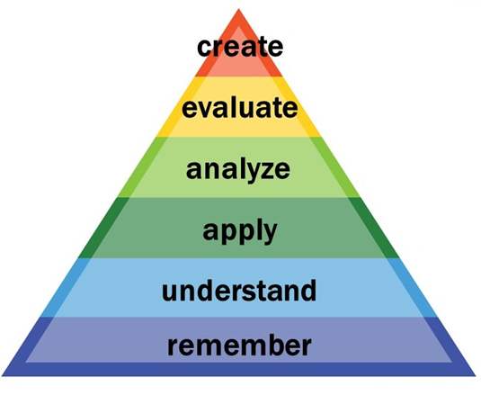
Systematic Review
Search conducted September 2016
Data extraction form:
  Type of medical students
  Level of instruction categorized by Bloom’s Taxonomy
  How Twitter was used
  Subject discipline
  Learning objectives
Image credit: Center for Teaching Vanderbilt University. Bloom’s Taxonomy. (CC BY 2.0)

Slide 5
Results
Bloom’s Taxonomy
Apply | 3
Understand | 6
Remember | 1
N/A | 8

Slide 6
Intervention
Information distribution (e.g. summary of lessons, daily clinical vignettes, distribution of resources, presentations, announcements) | 9
Generate discussion | 5
Question and Answer (e.g. question posted on Twitter to which students were encouraged to respond) | 3
Used as a formal evaluation tool (e.g. Faculty members used direct messages to provide feedback to residents) | 1

Slide 7
Recommendations to Library Instruction
Most effective in providing feedback to students
Careful planning and assessment
May be overwhelming for those unfamiliar with Twitter

Slide 8
Thanks!
thane@ualberta.ca (@thanec)
Janice.kung@ualberta.ca (@janice_kung)

