Slide 1
Applying Fair Dealing
May 2020
Notes:
Hello, and welcome to the University of Alberta’s Opening Up Copyright Instructional Module on Applying Fair Dealing.

Slide 2
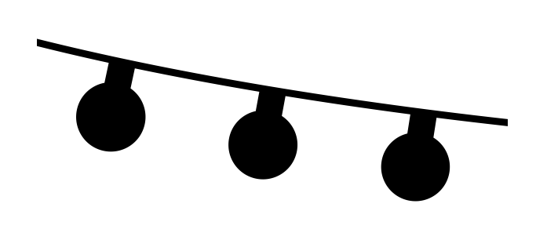
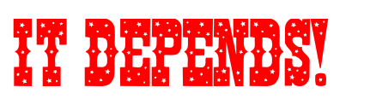


FAIR DEALING
FAIR DEALING
Exceptions
Fair Dealing
Research, private study, etc.
29 Fair dealing for the purpose of research, private study, education, parody or satire does not infringe copyright. R.S., 1985, c.
Criticism or review
29.1 Fair dealing for the purpose of criticism or review does not infringe copyright if the following are mentioned: …
News reporting
29.2 Fair dealing for the purpose of news reporting does not infringe copyright if the following are mentioned: …
s. 29
Notes:
Step right up! Do you want to know the answer to almost every question about whether you can lawfully use a copyright-protected work? Get ready… “it depends.” Okay… so it depends, but depends on what? While there are many different exceptions in the Copyright Act, the most important exception and arguably the most commonly used one is fair dealing.
"Fair Dealing" is a statutory right that allows for the reproduction and use of copyright-protected works for certain purposes without requiring permission, provided that the dealing is "fair".

Slide 3

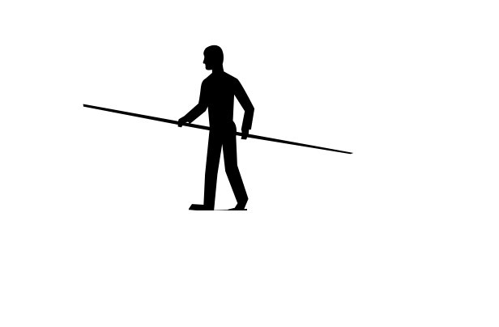

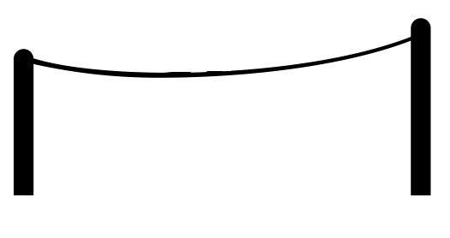


FAIR DEALING
THE BALANCING ACT
$$How do we know if a dealing is fair ?$$
USERS
COPYRIGHT OWNERS
Notes:
The purpose of fair dealing is to balance the exclusive right of copyright owners with the rights of users to make use of works where that use is in the public interest. Most Canadians use this legal “breathing space” daily without even knowing it. It is also considered a safeguard for freedom of expression. See the OUC module Section 29: Fair Dealing for some background on this statutory provision.
Over a century of Canadian and UK legislation and jurisprudence have shaped how fair dealing is applied in Canada.
So, how can you determine if you can use something under fair dealing? There is a two-step test for assessing whether a particular use of some or all of a copyright-protected work might reasonably count as fair dealing.

Slide 4









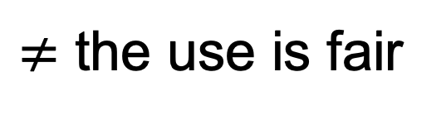
STEP ONE: PURPOSE OF USE
STEP ONE: PURPOSE OF USE
✓
$≠$ the use is fair
Step one = Assess the purpose of use
Intended to be considered broadly
Require attribution when used
s. 29
Notes:
The first step is determining whether the use is eligible to be considered fair dealing. This is done by assessing the purpose of the use. Section 29 of the Copyright Act lists five purposes:
Research,
Private Study,
Education,
Parody, and
Satire
The use of copyright-protected material for any of these purposes will not infringe copyright if that use is accepted by the rights holder or determined by a court of law to be fair.
6. The Act identifies three additional purposes for which fair dealing might also apply. These are:
criticism or review, and
news reporting.
These are separated from the initial list of five because they carry the additional requirement of including proper attribution when used.
Just meeting one of the purposes in the first step doesn’t mean that the use is fair. “It depends” on the outcome of the second step, the ‘six-factor test’. The first step makes it clear that if your use falls outside of the eight purposes, then you cannot rely on fair dealing. However, it is important to note that the eight purposes are intended to be considered broadly - for example listening to short previews of music before purchasing is considered research.

Slide 5


INTERPRETING THE PURPOSES
“In mandating a generous interpretation of the fair dealing purposes, including ‘research’, the Court in CCH created a relatively low threshold for the first step so that the analytical heavy-hitting is done in determining whether the dealing was fair.” (SOCAN v. Bell, para 27).
Notes:
The Supreme Court has noted that “In mandating a generous interpretation of the fair dealing purposes, including “research”, the Court in CCH created a relatively low threshold for the first step so that the analytical heavy-hitting is done in determining whether the dealing was fair.” (SOCAN v. Bell, para 27). So, what does this “analytical heavy hitting” look like?

Slide 6
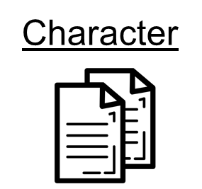
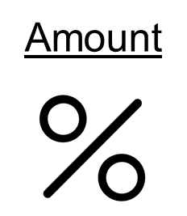
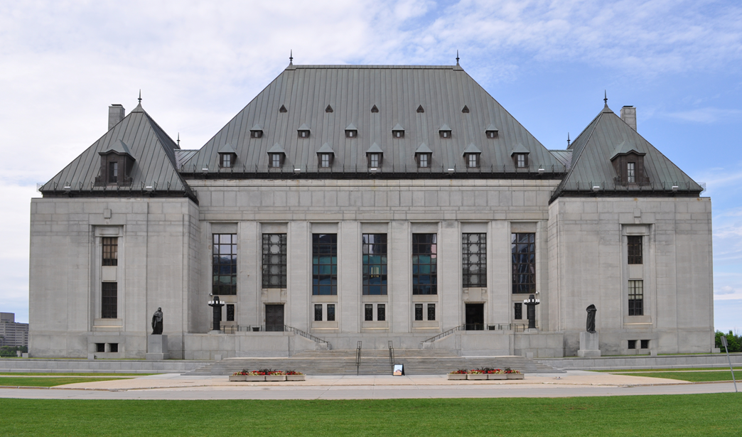

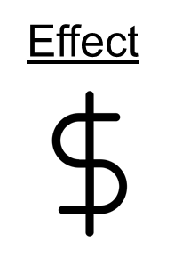
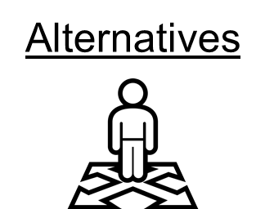
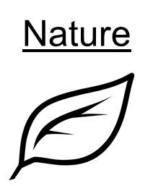
STEP TWO:
THE SIX-FACTOR TEST
STEP TWO:
THE SIX-FACTOR TEST
CCH v. LSUC
Purpose
The factors are a guide to making an interpretation of whether a dealing should be considered fair
SOCAN v. Bell
Alberta (Education) v. Access Copyright
Notes:
The six-factor test is used to assess whether the use of the work can be reasonably considered as fair.
The six-factors are:
The purpose of the dealing,
the character of the dealing,
the amount of the dealing,
alternatives to the dealing,
the nature of the work, and
the effect of the dealing.
9. It is important to note that not all factors will apply in all cases, and the factors do not need to be equally weighted. These factors are simply a guide to making an interpretation of whether a dealing should ultimately be considered to be fair. The Supreme Court also noted that in future cases other factors beyond these six may be considered.
So how do you apply the six factors? Fortunately, the Supreme Court in three fair dealing decisions (CCH, SOCAN and Alberta) has provided some guidance on how to understand and apply the factors.

Slide 7


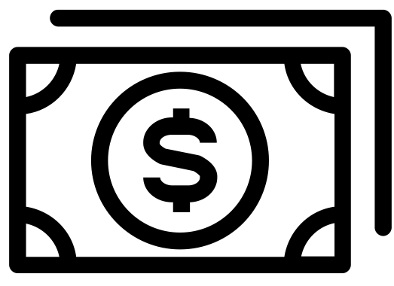

PURPOSE OF THE DEALING
Guidance based on Supreme Court decisions:
Consider the user’s real motivation
Consider safeguards under purpose
Purpose
Notes:
With regard to the purpose of the dealing, the court in CCH stressed that the users real motive should be considered, and added that, for example, research done for a commercial purpose may not be as fair as research done for a charitable purpose. In the SOCAN case the high court noted that safeguards, such as only allowing users to stream 30 second music previews as opposed to allowing the previews to be downloaded, should be considered under purpose.

Slide 8


CHARACTER OF THE DEALING
Guidance based on Supreme Court decisions:
Character refers to how the works is dealt with
Consider how the work is distributed (and the number of copies)
Think about what happens to the work after it is used
Notes:
The character of the dealing factor examines how works were dealt with. If multiple copies are made and widely distributed, this will tend toward unfairness. If a work is destroyed after it is used, this may tend toward fairness, and importantly, custom or practice in a particular trade or industry is also considered. It is important to consider who the user is when considering all factors, including character. For example, in the Alberta case, while teachers may have been making multiple copies for their class, it is the student’s perspective as the ultimate user that must be considered, and thus such copying should properly be seen as an individual copy for each student

Slide 9

AMOUNT OF THE DEALING
Guidance based on Supreme Court decisions:
Consider how much of a work is being copied (not how many copies are being made)
Remember there is no magic percentage
Purpose
Notes:
The amount of the dealing factor deals with the proportion of the work copied, not the total number of copies made, which is considered under the character of the dealing factor. While copying a greater proportion of a work may tend toward unfairness, the Supreme Court has noted that in some cases an entire work can be copied fairly. The character and purpose of the dealing might also be considered in relation to amount. Thus, for example, it may be necessary for research or private study to copy the entirety of an academic article or court decision, but not to copy an entire literary work for the purpose of criticism or review.

Slide 10
ALTERNATIVES FACTOR
Guidance based on Supreme Court decisions:
Consider what the other options are
Whether a non-copyrighted work could be used instead
Availability of a licence does not weigh on fairness
?
Notes:
As the name implies, the alternatives factor considers what alternatives to the dealing might have been used. If a non-copyright-protected equivalent could have been used to achieve the same purpose, this tends toward unfairness. An important element in weighing the alternatives is the extent to which the copying, or dealing, was necessary to achieve the ultimate purpose.

Slide 11
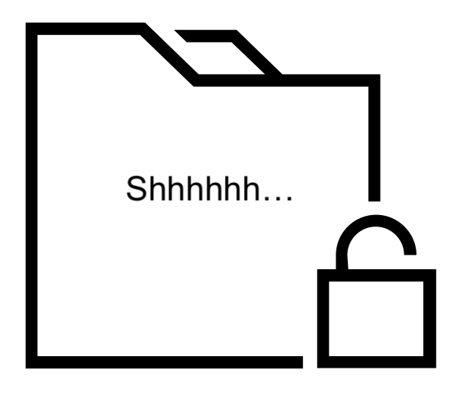
NATURE OF THE WORK
Guidance based on Supreme Court decisions:
Think about the relationship between the work and its distribution
Consider if it is fair to distribute this work
Notes:
The nature of the work factor centres on the relationship between the copied work and its distribution. Copying a confidential work is less fair, although copying an unpublished work may be more fair if the copying is acknowledged and potentially leads to wider public dissemination of that work.

Slide 12
EFFECT OF THE DEALING
Guidance based on Supreme Court decisions:
Consider the financial impact of these copies on the rights-holder
This factor should not be weighed more heavily than the other factors, unlike how it is treated under fair use in the US
Notes:
Finally the effect of the dealing on the work considers to what degree the copies made compete with and adversely impact the market for the original work. Obviously, if the intended distribution of copies diminishes the market for a work, this will tend toward unfairness, but if the copying may increase the market for a work (such as the offering of music previews in the SOCAN case), this may tend toward fairness.

Slide 13
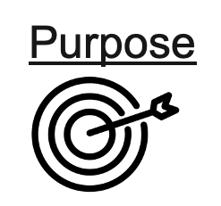

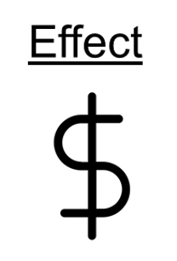
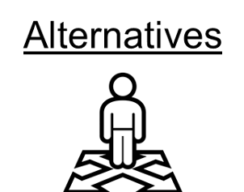

IT DEPENDS
Notes:
It is important to remember that a final decision on fairness involves thinking of all of the six factors and how they relate to each other. There is no simple scorecard such as: if three factors are considered more fair, then the dealing is fair.

Slide 14
FAIR DEALING RESOURCES
Opening Up Copyright Modules:
Other Resources:
Notes:
If you want more details on how these factors were applied in each of the three Supreme Court cases, please have a look at the specific modules.
In addition there are many good supplementary resources such as those from the Universities of Alberta, Ottawa and Toronto, as well as CAUT’s copyright guidelines, all of which can help in applying fair dealing.

Slide 15


INTERPRETING FAIR DEALING
FAIR DEALING
Notes:
Given that fair dealing is, at its root, a determination of fairness made on a specific set of facts, and given that those facts and fairness itself are subject to interpretation, determinations of fair dealing may always be contentious. However, the way fair dealing is interpreted will remain a key element in preserving the balance of rights that is the core of copyright law.

Slide 16
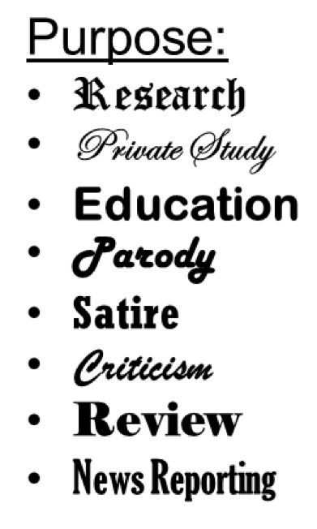
INTERPRETING FAIR DEALING
Purpose
Notes:
Since the application of the two-step test involves a number of interpretations, in many cases no ultimate determination of whether a use is truly “fair dealing” can be made until it has been reviewed and decided by a court.

Slide 17

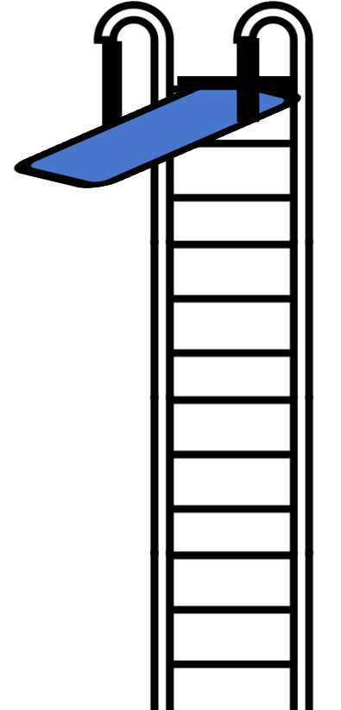



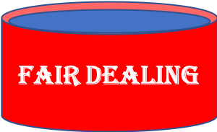
INTERPRETING FAIR DEALING
Yeah. This looks risky!
“It depends.”
…Not sure about this.
What even is fair dealing?
WAY too risky.
Notes:
Therefore, there can often be an element of uncertainty, and such uncertainty can have a chilling effect, encouraging risk-averse institutions to be very conservative in their interpretation and application of fair dealing.
Overly conservative applications of fair dealing can impact general practice within a sector, and when such practices become long established, these practices could become the standards against which interpretations of fairness are made. It may be that, in practice, interpreting fair dealing too narrowly could, over time, lead to a narrowing of what dealings are considered to be fair. From that perspective, user rights may be better maintained and protected through their being applied to their fullest reasonable extent.

Slide 18
LEARNING OBJECTIVES
You should now be able to:
Recognize that satisfying a fair dealing purpose fulfills only the first step of the two-step fair dealing test
Understand the six factors and their relationship to one another in the second part of the two-step fair dealing test
Apply both steps of the fair dealing test to conduct a fair dealing analysis
Notes:
You should now be able to:
Recognize that satisfying a fair dealing purpose fulfills only the first step of the two-step fair dealing test
Understand the six factors and their relationship to one another in the second part of the two-step fair dealing test, and
Apply both steps of the dealing test to conduct a fair dealing analysis.

Slide 19
Notes:
This has been the University of Alberta’s Opening Up Copyright Instructional Module on Applying Fair Dealing. Thank you for your attention.

Slide 20
QUESTIONS
A fair dealing analysis involves:
A one step test that determines if the purpose for using the work matches at least one of the purposes listed in the Copyright Act
A two step test that involves assessing if the purpose for using the work matches at least one the purposes listed in the Copyright Act, and then evaluating fairness based on considering the six factors noted by the Supreme Court of Canada
A six step test that determines fairness based on considering the six factors noted by the Supreme Court of Canada
A 48 step test analyzing fairness for every purpose and every factor
Roll a pair of dice - snake eyes, box cars or a 7 and the dealing is fair, if not the dealing is unfair
In conducting the first step of the two step fair dealing test, the stated purposes should be interpreted:
Narrowly/restrictively
Broadly/liberally
Only by a Major League Baseball heavy hitter

Slide 21
QUESTIONS
Identify the six factors in the fair dealing assessment:
  Nature
  Novelty
  Amount
  Cost
  Effect
  Character
  Purpose
  Coolness
  Popularity
  Alternatives
  Fairness
When considering fairness in the second step of the two-step test, each factor should be considered in isolation with no consideration of how the factors relate.
True
False

Slide 22
QUESTIONS
You can only proceed to the second (considering the six factors) if you pass the first step (meeting at least one of the allowable purposes).
True
False
To conclude a fair dealing assessment you must have a minimum of how many factors weight towards fairness?
  Three factors (50%)
  Four factors (66%)
  Six factors (100%)
  There is no formula, checklist, or scorecard that involves considering all six factors and the relationship among them

Slide 23
Canadian Association of University Teachers (2013). CAUT guidelines for the use of copyrighted material [pdf]. Retrieved from:https://www.caut.ca/docs/default-source/copyright/revised-caut-guidelines-for-the-use-of-copyrighted-material-(feb-2013).pdf
Geist, M (2018). Why fair dealing safeguards freedom of expression: The case of the Vancouver aquarium [Blog post]. Retrieved from: http://www.michaelgeist.ca/tag/vancouver-aquarium/
University of Alberta Copyright Office (n.d.). Fair dealing [webpage]. Retrieved from: https://www.ualberta.ca/faculty-and-staff/copyright/intro-to-copyright-law/fair-dealing/index.html
University of Ottawa (n.d.). Fair dealing guidelines [webpage]. Retrieved from: https://copyright.uottawa.ca/what-is-copyright/exceptions-copyright/fair-dealing-guidelines
University of Toronto Libraries (n.d.). Copyright basics and FAQs [pdf.] Retrieved from: https://onesearch.library.utoronto.ca/sites/default/files/copyright/basicsfaqs_092018.pdf

Slide 24
Alberta (Education) v. Canadian Copyright Licensing Agency (Access Copyright), 2012 SCC 37, [2012] 2 S.C.R 345. Retrieved from: https://scc-csc.lexum.com/scc-csc/scc-csc/en/item/9997/index.do
CCH Canadian Ltd v. Law Society of Upper Canada. 2004 SCC 13. [2004] 1 SCR 339. Retrieved from: https://scc-csc.lexum.com/scc-csc/scc-csc/en/item/2125/index.do
Society of Composers, Authors and Music Publishers of Canada v. Bell Canada, 2012 SCC 36, [2012] 2 S.C.R. 326 Retrieved from: https://scc-csc.lexum.com/scc-csc/scc-csc/en/item/9996/index.do

Slide 25
Klankbeeld (2011). Barrel organ of carousel. Freesound. CC BY. Retrieved from: https://freesound.org/people/klankbeeld/sounds/120368/
Star and Anchor Design, US (n.d.). String lights. The Noun Project. CC BY. Retrieved from: https://thenounproject.com/search/?q=lights%20string&i=1797620
Oliver Gomez, GB (n.d.). Cannon. The Noun Project. CC BY. Retrieved from:https://thenounproject.com/search/?q=cannon%20circus&i=1252720
Isaac200000 (2013). Cannon1. Freesound. CC 0. Retrieved from: https://freesound.org/people/Isaac200000/sounds/184650/
Fabian_lm (2018). Circo/Circus. Freesound. CC BY NC. Retrieved from: https://freesound.org/people/fabian_lm/sounds/436437/
LeftHandedGraffics, ES (n.d.). Equilibrist. The Noun Project. CC BY. Retrieved from: https://thenounproject.com/search/?q=tight%20rope%20walker&i=44479
Loïc Poivet, FR (n.d.). United kingdom flag. The Noun Project. CC BY. Retrieved from: https://thenounproject.com/search/?q=UK%20flag&i=168361
Loïc Poivet, FR (n.d.). Canada. The Noun Project. CC BY. Retrieved from: https://thenounproject.com/term/canada/78131/
Made, AU (n.d.). Carnival game. The Noun Project. CC BY. Retrieved from: https://thenounproject.com/search/?q=carnival%20game&i=1175829
Adnen Kadri (n.d.). Hammer. The Noun Project. CC BY. Retrieved from: https://thenounproject.com/search/?q=hammer&i=1248131

Slide 26
Deleted_user_7146007(2017). Ringing metal bell. Freesound. CC 0. Retrieved from: https://freesound.org/people/deleted_user_7146007/sounds/383900/
Dezign, Ruslan. (n.d.). Target. The Noun Project. CC BY. Retrieved from: https://thenounproject.com/icon/1005058/
ATOM, TH. (n.d.). Copy. The Noun Project. CC BY. Retrieved from: https://thenounproject.com/search/?q=copy&i=1474212
Тимур Минвалеев, RU. (n.d.). Percent. The Noun Project. CC BY. Retrieved from: https://thenounproject.com/search/?q=percent&i=397874
ATOM, TH. (n.d.). Copy. The Noun Project. CC BY. Retrieved from: https://thenounproject.com/search/?q=copy&i=1474212
Тимур Минвалеев, RU. (n.d.). Percent. The Noun Project. CC BY. Retrieved from: https://thenounproject.com/search/?q=percent&i=397874
Farais, B, CL. (n.d.). Decision. The Noun Project. CC BY. Retrieved from: https://thenounproject.com/search/?q=alternatives&i=1074053
AFY Studio, ID. (n.d.). Leaf. The Noun Project. CC BY. Retrieved from: https://thenounproject.com/AFYstudio/uploads/?i=1737325
Cresnar, Gregor. (n.d.). Dollar sign. The Noun Project. CC BY. Retrieved from: https://thenounproject.com/search/?q=dollar%20sign&i=171145

Slide 27
Viktor Vorobyev (n.d.). Clock. The Noun Project. CC BY. Retrieved from: https://thenounproject.com/search/?q=time%20limit&i=635969
Lnhi, NO (n.d.). Charity. The Noun Project. CC BY. Retrieved from: https://thenounproject.com/search/?q=charity&i=1941158
BomSymbols. (n.d.). Money. The Noun Project. CC BY. Retrieved from: https://thenounproject.com/search/?q=MONEY&i=890872
Daria Szymonowicz (n.d.). Essay. The Noun Project. CC BY. Retrieved from: https://thenounproject.com/search/?q=essay&i=1353220#
Adrien Coquet (n.d.). Who. The Noun Project. CC BY. Retrieved from: https://thenounproject.com/search/?q=who&i=2714591
Daria Szymonowicz (n.d.). Quarter.The Noun Project. CC BY. Retrieved from: https://thenounproject.com/search/?q=black%20circle&i=607600
Agniraj Chatterji (n.d.). Locked Folder. The Noun Project. CC BY. Retrieved from: https://thenounproject.com/search/?q=confidential&i=608660
Banjirolove (n.d.). Sun. The Noun Project. CC BY. Retrieved from: https://thenounproject.com/search/?q=sun&i=1777177
Hannah Anderson (n.d.). Crystal Ball. The Noun Project. CC BY. Retrieved from: https://thenounproject.com/search/?q=fortune%20teller&i=2126128
Ari_Glitch (2018). Magic circle medium ringing. Freesound. CC 0. Retrieved from: https://freesound.org/people/Ari_Glitch/sounds/432288/

Slide 28
Alberto LM (n.d.). Table. The Noun Project. CC BY. Retrieved from: https://thenounproject.com/search/?q=table%20cloth&i=929234
Alfredo @alfredoicons.com (n.d.). Ladder. The Noun Project. CC BY. Retrieved from: https://thenounproject.com/search/?q=ladder&i=424668
QualityIcons (n.d.). Banners. The Noun Project. CC BY. Retrieved from: https://thenounproject.com/search/?q=banner&i=23248
Dima Lagunov, RU (n.d.). Walking. The Noun Project. CC BY. Retrieved from: https://thenounproject.com/search/?q=walking&i=26898
National Park Service (n.d.). Diving. The Noun Project. CC BY. Retrieved from:https://thenounproject.com/search/?q=DIving%20&i=229
Qubodup (2013). Circus climax drums. Freesound. CC BY Retrieved from: https://freesound.org/people/qubodup/sounds/182442/
Closing Slides Music: Rybak, Nazar. “Corporate Inspired.” HookSounds. N.d. http://www.hooksounds.com (used under a CC-BY 4.0 Licence)
Unattributed materials are contributions from the Opening Up Copyright Project Team and placed in the Public Domain

Slide 29
University of Alberta (2020). “Applying Fair Dealing.” Opening Up Copyright Instructional Module. https://sites.library.ualberta.ca/copyright/

