Slide 1
Nintendo v. Go Cyber
April 2020
Notes:
Hello, and welcome to the University of Alberta’s Opening Up Copyright instructional module on Nintendo v. Go Cyber.

Slide 2
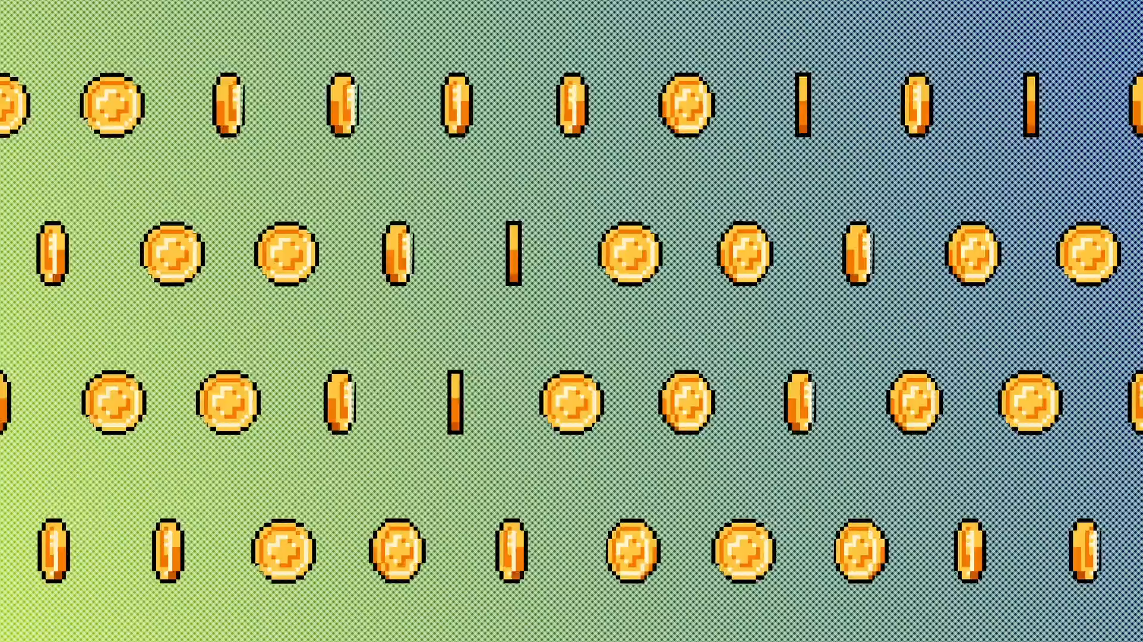
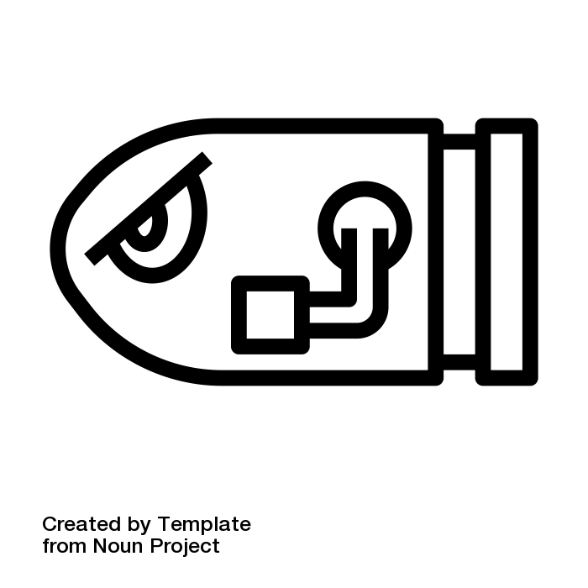
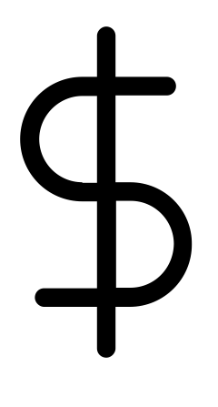
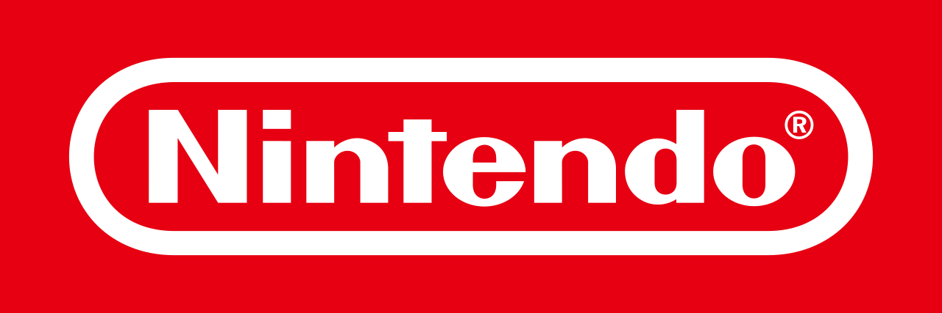
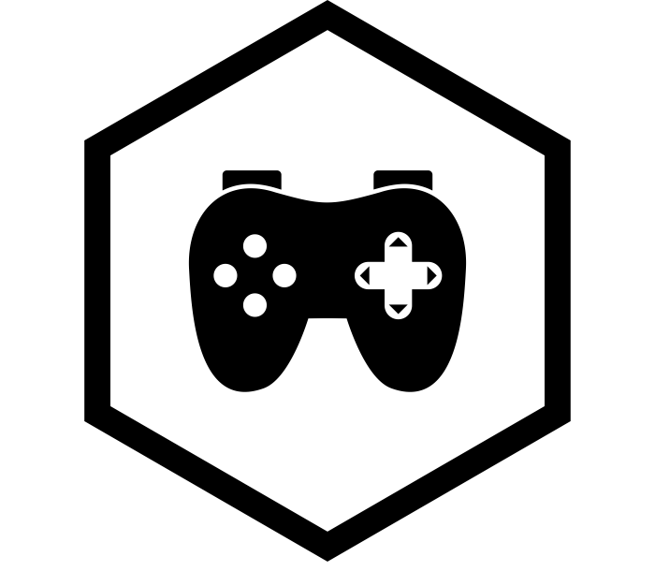

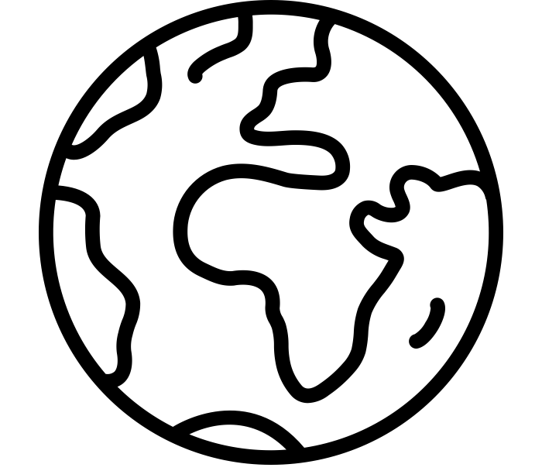
VIDEO GAMES
Notes:
Ah, video games… An escape from reality that allows us to put off our chores for... *Timmy, dinner’s ready!*… just give me a few more minutes, okay mom?! In the real world, video games have become part of a global multi-billion dollar industry fuelled by consumers from all demographics, and its momentum shows no signs of slowing down anytime soon. Companies like Nintendo have played a major role in its sustained growth and have developed measures to prevent others from profiting off their hard work and success. So, what happens when other companies circumvent these measures to try to make a few coins of their own?

Slide 3
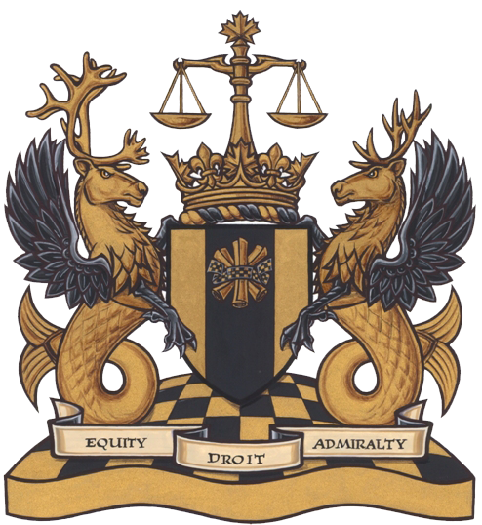

WHAT IS A TPM?
Technological Protection Measures (TPMs)
= Digital Locks
Notes:
This module will explain what Technological Protection Measures are in Canadian copyright law, how they have been interpreted in court, and how they ended up costing a company in Windsor, Ontario $12.7 million dollars.

Slide 4


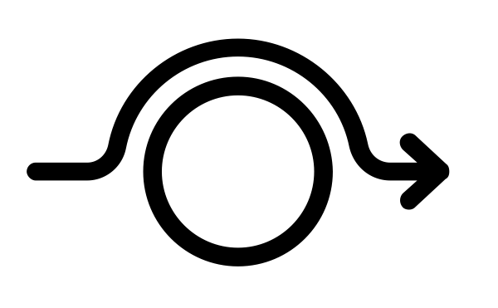



S.41 OF THE COPYRIGHT ACT
Technology
Device
Component
s. 41
Notes:
As of 2012, provisions in section 41 of Canada’s Copyright Act have made it illegal to bypass - or circumvent, to be specific - “any effective technology, device, or component” that are intended to control access to a work, or that are intended to protect a copyright holder’s exclusive rights over the use of a work.

Slide 5

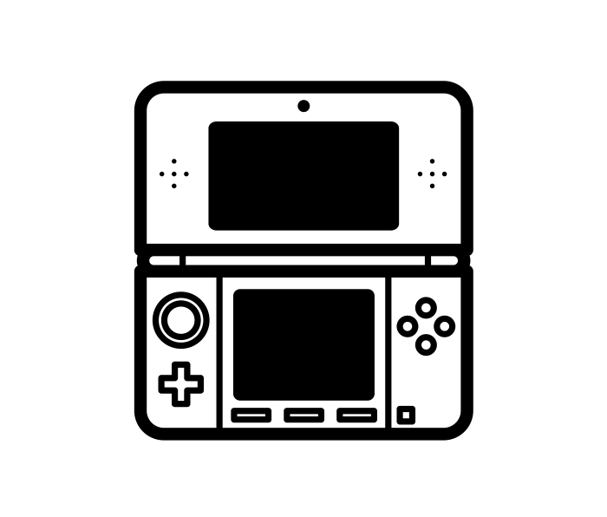
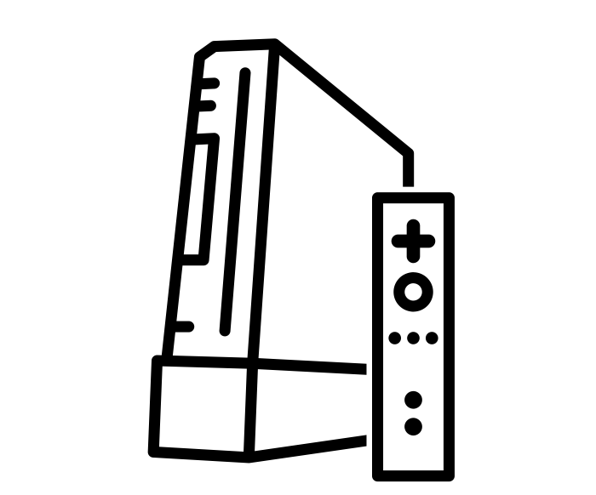
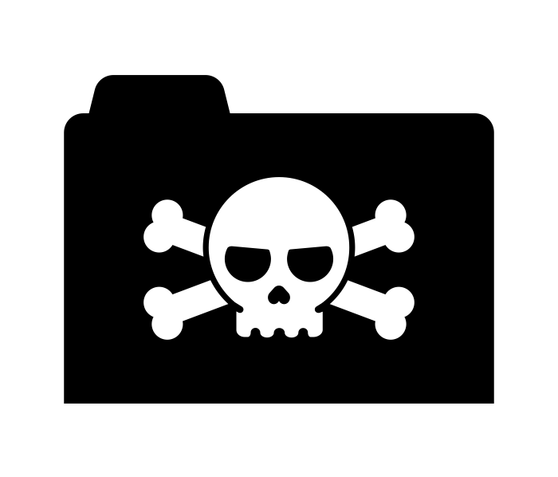
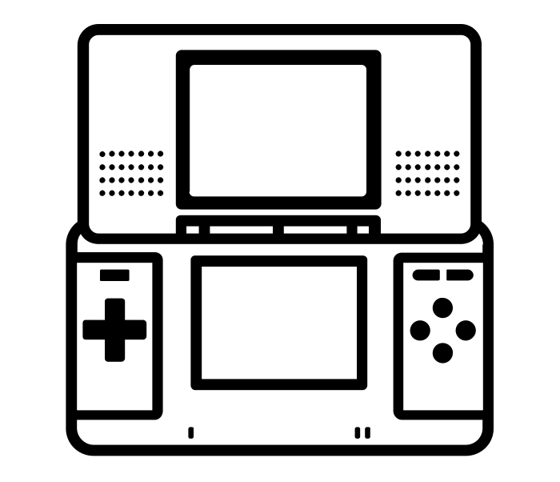
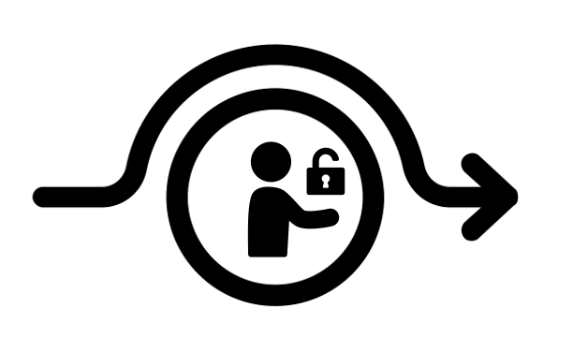
NINTENDO v. KING & GO CYBER
You cannot:
Circumvent a TPM
Manufacture
Offer circumvention services
Import
s. 41.1
Market circumvention services
Distribute
Notes:
This definition is broad and can thus be interpreted by courts in many ways. This is where Nintendo and a company called Go Cyber Shopping come into the picture. In 2016, Nintendo filed a claim against Go Cyber, stating that the company was violating the Copyright Act by selling devices that allowed Nintendo DS, 3DS and Wii gaming systems to play pirated copies of their video games.
Go Cyber was accused of violating section 41.1 of the Copyright Act, which states that you cannot circumvent a TPM, offer services primarily-intended to circumvent them, or market those services. It also says you cannot manufacture, import or distribute - for sale or rent - any technology intended to circumvent TPMs.

Slide 6
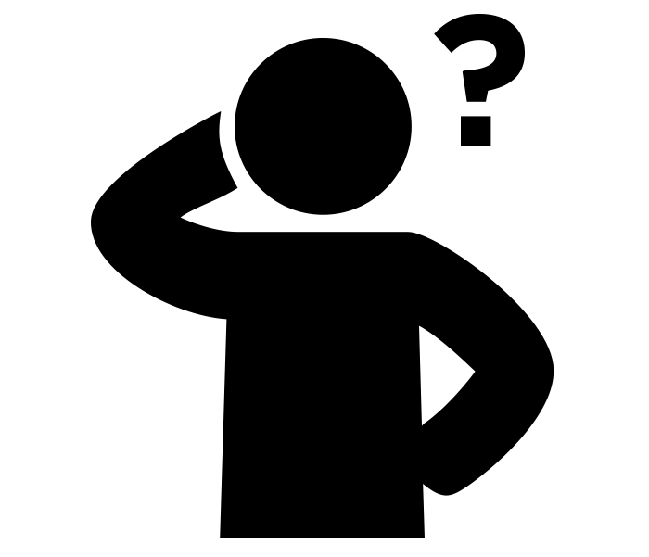
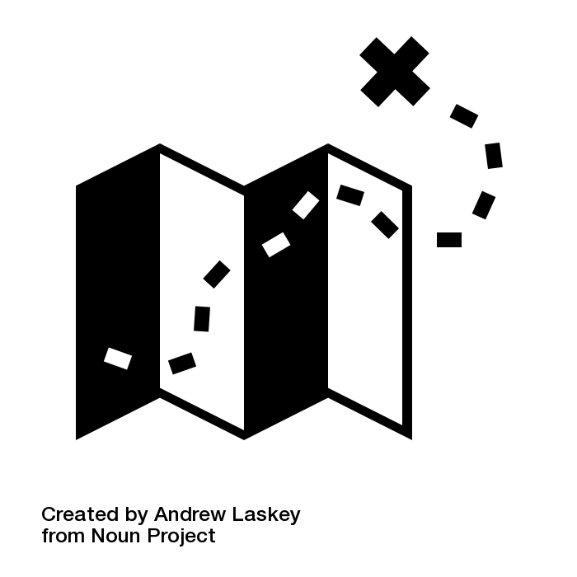
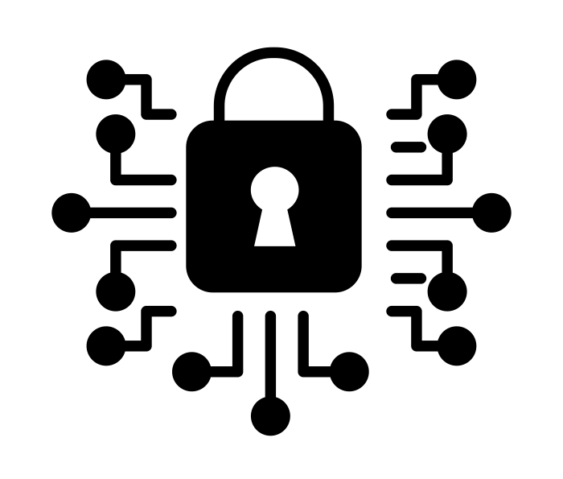
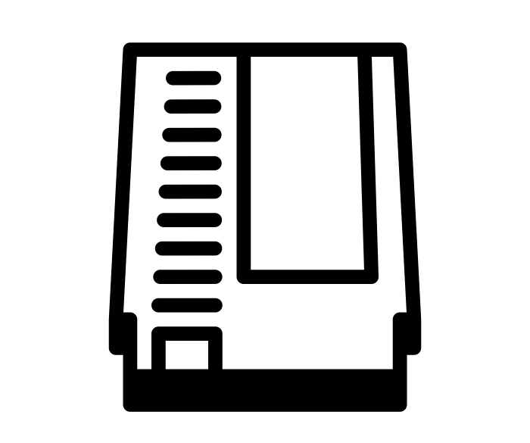
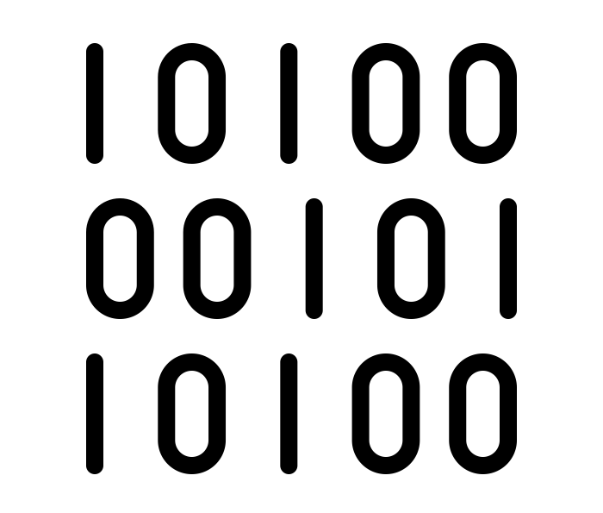
NINTENDO’S USE OF TPMs
1. Shape of cartridges
2. Copy
protection code
3. Data
encryption
Notes:
This case was the first time the Copyright Act’s rules for TPM circumvention were tested. What exactly WAS a TPM, and what counted as an “effective” technology for controlling access to a work? Nintendo said that they were using multiple methods to control access to and use of their copyright-protected material, including:
a) The shape of the Nintendo cartridges, which were designed to fit ONLY Nintendo systems, like a key in a lock
b) A “copy protection code” (or “header data”) on game discs, including Nintendo logos, that had to be validated before a game could be played. Nintendo had registered copyrights on this code.
c) And finally, data encryption, or scrambling, of game content that only the gaming console was supposed to be able to decrypt and read.

Slide 7




DEFINING TPMs
TPMs for controlling access
TPMs for controlling use
Notes:
There are many other examples of technological protection measures that you may have seen. Some TPMs are for controlling access and others are for controlling use, or copying of a work.

Slide 8
DEFINING TPMs
TPMs = Any effective technology
?
s. 41
Notes:
The Copyright Act says that TPMs can be “any effective technology,” so it stands to reason that a court would consider what this phrase means when deciding what is and is not a TPM. This is what happened in the Nintendo case.
In their defence, Go Cyber did not believe that the shape of Nintendo cartridges was a form of “protection” (para 95). They also provided a narrow definition of “circumvent” to assert that they were not ‘going around’ or ‘impairing’ Nintendo’s protection mechanisms, but were in fact “replicating” them.

Slide 9

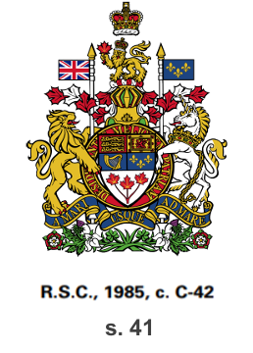

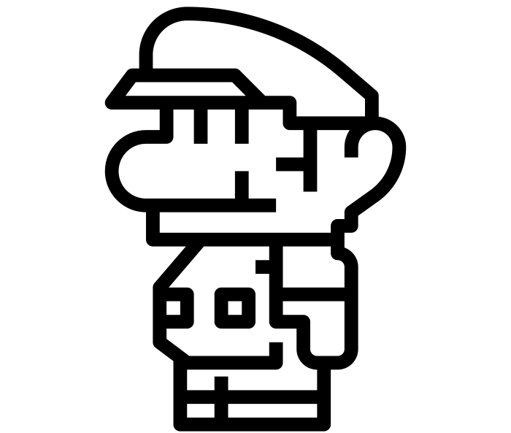

COURT DECISION
2)
2) Section 41: Replication = Circumvention
TPM = Any effective measure
Cartridges = An effective measure
(paras. 77-83)
TPM = Transforms a
copyrighted work through encryption or other means
Notes:
The federal court disagreed with Go Cyber on two main grounds:
First, since the Act says a TPM is ANY effective measure, the shape of the cartridges counted as a TPM (paras. 77-83). This is different than the interpretation in the UK, where a TPM is defined as something that “transforms” a copyrighted work, through encryption or other means.
Second, the intent of s. 41 in the Act was not to exclude “replication” from the definition of “circumvent,” so duplicating the measure just to get around it is still a violation. As an example, the court noted that a burglar who makes a copy of a key to get into someone’s house is still a burglar.
Go Cyber lost their case. They were found accountable for violating Nintendo’s copyright on its “header data” AND for circumventing their technological protection measures. Nintendo was awarded more than $12.7 million dollars in damages.

Slide 10
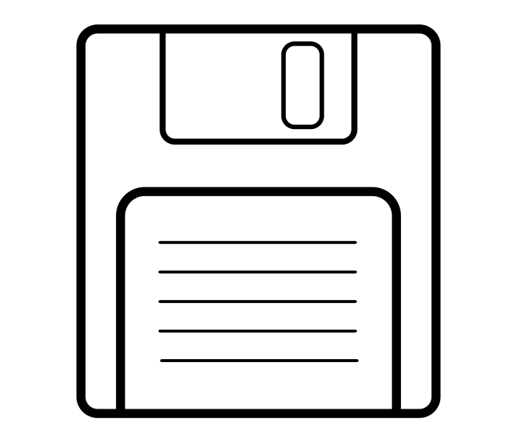
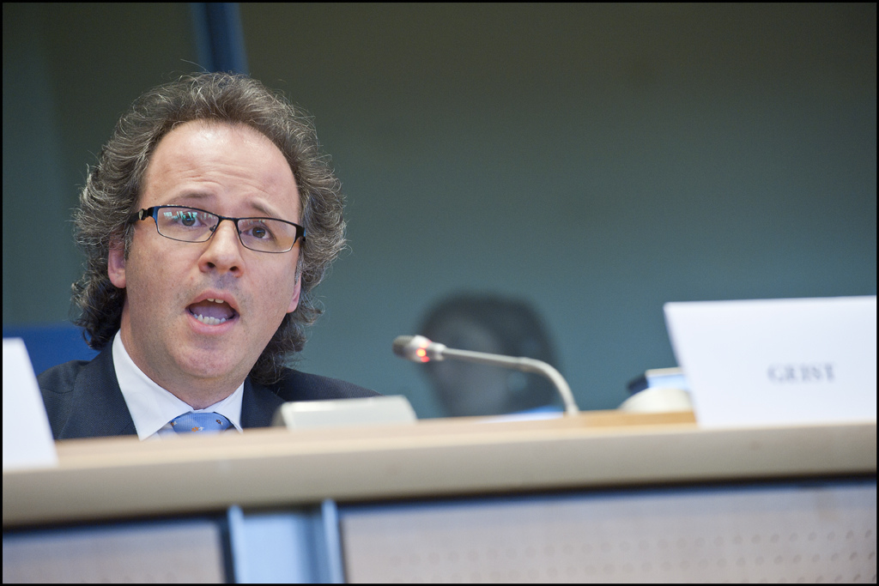
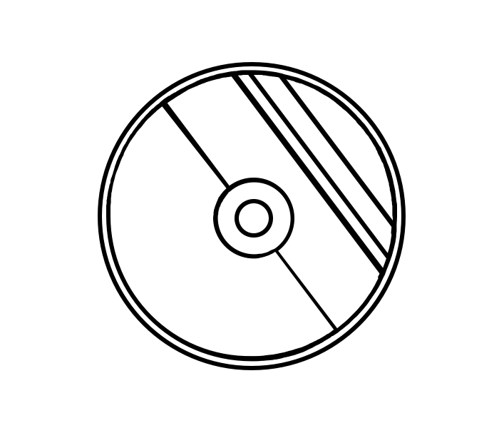
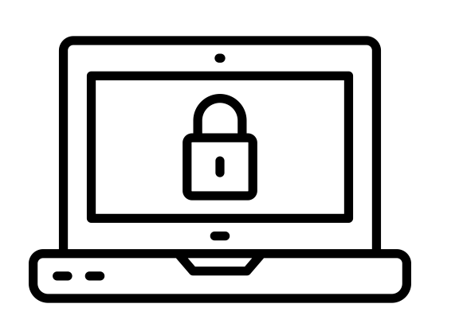
SHAPE AS A TPM
“Shape”
= Effective TPM?
Notes:
In his commentary on the case, Michael Geist points out that the court’s allowance of “shape” as an effective TPM is alarmingly broad. It could allow a rights holder to claim that any physical or digital aspect of the “container” for a work is a technological protection measure, since TPMs do not need to “transform” the work itself in any way.

Slide 11
COPYRIGHT IMPLICATIONS
You risk violating the Copyright Act
You risk violating the Copyright Act by intentionally circumventing any TPMs
You risk violating the Copyright Act by intentionally circumventing any TPMs to gain access
You risk violating the Copyright Act by intentionally circumventing any TPMs to gain access to copyrighted material
No fair dealing!
Notes:
In essence, this case sheds light on how users of copyrighted material run the risk of violating the Copyright Act by intentionally circumventing any technological protection measure to gain access to copyrighted material, and they cannot rely on fair dealing provisions as valid reasons for doing so.

Slide 12
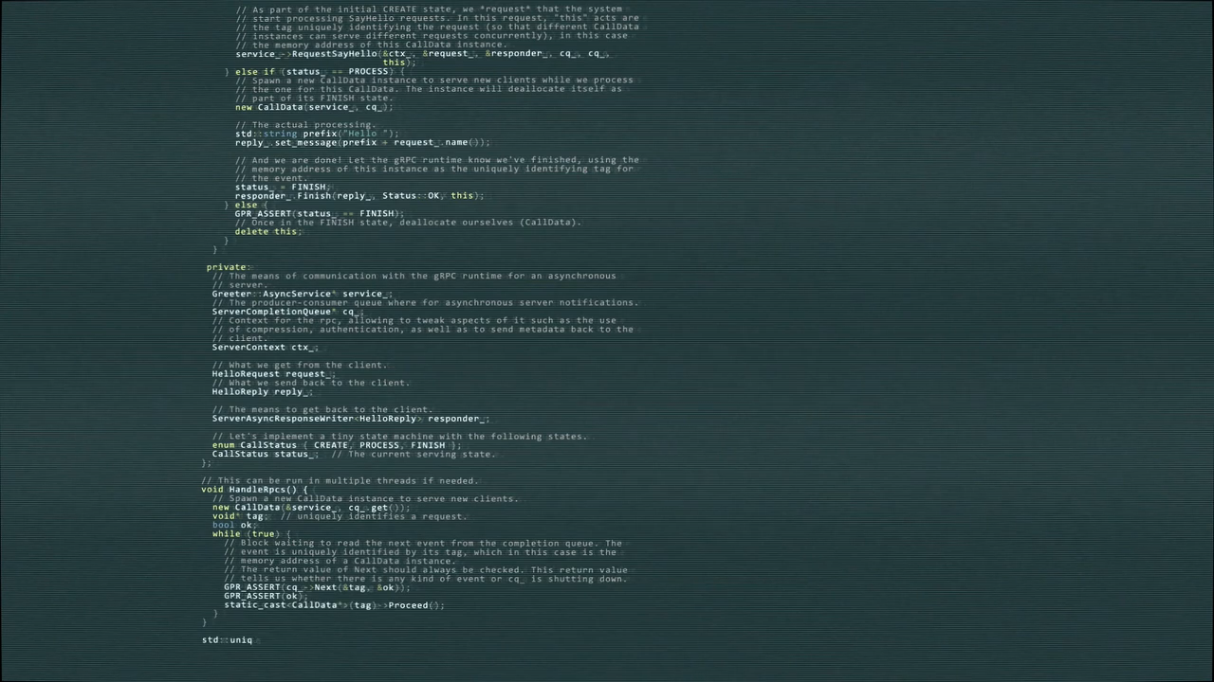

IMPACT OF THE RULING
Notes:
As a result of providing services and goods that circumvent TPMs, Go Cyber Shopping faced a heavy fine for selling devices that modify Nintendo systems. The federal court’s ruling in this case means that even alternative uses of Nintendo hardware - like using the platform to write your own game - are now less accessible to users.

Slide 13
IMPACT OF THE RULING
Notes:
In light of what is and is not allowed, Nintendo claimed that Go Cyber knew they were making it possible to violate copyright, and were advertising their services for that purpose. The limited exceptions for circumvention of TPMs did not apply in this case.

Slide 14
LEARNING OBJECTIVES
You should now be able to:
Describe and recount the arguments in the Nintendo v. Go Cyber case
Recognize how a broad interpretation of protections and a limited interpretation of exceptions was applied in this case
Notes:
You should now be able to:
Describe and recount the arguments in the Nintendo v. Go Cyber case
Recognize how a broad interpretation of protections and a limited interpretation of exceptions was applied in this case

Slide 15
Notes:
This has been the University of Alberta’s Opening Up Copyright instructional module on Nintendo v. Go Cyber. Thank you for your attention.

Slide 16
QUESTIONS
Nintendo’s case against Go Cyber was based on the argument:
  Go Cyber had circumvented the shape of the Nintendo cartridges, which constitute a TPM because they were designed to be used exclusively with Nintendo consoles
  Go Cyber’s replication and circumvention was not transformative
  Go Cyber had not equally circumvented Playstation and Xbox consoles
  Go Cyber had suggested Luigi was better than Mario
Nintendo’s three pronged TPM strategy included:
  Shape of the cartridges, header data code, and data encryption
  Shape of the cartridges, special keys, transformative code
  Replication, transformation, encryption
  Zelda, Peach and Daisy

Slide 17
QUESTIONS
The Canadian interpretation of TPMs differs from the UK approach because
  The UK requires a higher standard of the TPM being transformational
  The UK requires a lower standard of the TPM being occasional
  The UK requires TPMs be “affective”; Canada requires TPMs be “effective”
The Federal Court’s broad interpretation of shape as an effective TPM is problematic because:
  It may allow any physical or digital aspect of the container of a copyright protected work to be considered a TPM
  It allows for both affective and effective TPMs
  It requires burglars to have keys
  Bowser must now appear smaller than Mario in all Nintendo games

Slide 18
Canadian DMCA in Action: Court Awards Massive Damages in First Major Anti-Circumvention Copyright Ruling. (2017, March 3). Michael Geist (blog). Retrieved April 18, 2020, from http://www.michaelgeist.ca/2017/03/canadian-dmca-in-action-court-issues-massive-damage-award-in-first-major-anti-circumvention-copyright-ruling/
Copyright Act, Statutes of Canada 1985, c. C-42. https://laws-lois.justice.gc.ca/eng/acts/c-42/page-1.html
Crowne, E. (2017). Federal Court Interprets Canada’s Technological Protection Measures for the First Time. Journal of Intellectual Property Law & Practice, 12(6). 459–61. https://doi.org/10.1093/jiplp/jpx071
History of Modding. (n.d.). From Pacman to Pool: Research on User Generated Content. Retrieved May 13, 2019, from https://mediaindustries1.wordpress.com/modmoddermodding/history-of-modding/
Hutchison, C. (2016). Digital Copyright Law. Irwin Law.
IFPI (2003). “The WIPO Treaties: Technological Measures.” Retrieved from: https://www.ifpi.org/content/library/wipo-treaties-technical-measures.pdf
Kerr, I. R., Maurushat, A., & Tacit, C. S. (2002). Technical Protection Measures: Tilting at Copyright’s Windmill. Ottawa Law Review, 34(1), 7–82.
Sapp, H. (2005). North American Anti-Circumvention: Implementation of the WIPO Internet Treaties in the United States, Mexico and Canada. Computer Law Review & Technology Journal, 10(1), 1–40.
World Intellectual Property Organization. (n.d.). WIPO Copyright Treaty (WCT). Retrieved from: https://www.wipo.int/treaties/en/ip/wct/

Slide 19
Nintendo of America Inc. v. King. 2017 FC 246. [2018] 1 FCR 509. http://canlii.ca/t/h0r1j

Slide 20
Gam-Ol. (2019). [Coin video]. Pixabay. https://pixabay.com/videos/pixel-bit-coin-game-8-video-20495/
IYIKON. (n.d.). Video Game. The Noun Project. CC BY. https://thenounproject.com/search/?q=video%20game&i=3009098
priyanka. (n.d.). Earth. The Noun Project. CC BY. https://thenounproject.com/search/?q=earth&i=2848269
Cresnar, Gregor. (n.d.). Dollar sign. The Noun Project. CC BY. https://thenounproject.com/search/?q=dollar%20sign&i=171145
mungang kim. (n.d.). Stock. The Noun Project. CC BY. https://thenounproject.com/search/?q=stock&i=3127443
Trisreed. (2009). [Nintendo logo]. Wikimedia. https://commons.wikimedia.org/wiki/File:Nintendo.svg
Template. (n.d.). Bullet. The Noun Project. CC BY. https://thenounproject.com/search/?q=mario&i=2208746
mattpavone. (2009). Planetary Flyby faster. Freesound. CC 0. https://freesound.org/people/mattpavone/sounds/76175/
Adrian Coquet. (n.d.) Unlock. The Noun Project. CC BY. https://thenounproject.com/term/unlock/1862800/
Federal Court. (n.d.). [Federal Court Coat of Arms]. Federal Court. http://cas-cdc-www02.cas-satj.gc.ca/portal/page/portal/fc_cf_en/Index

Slide 21
Cresnar, Gregor. (n.d.). Dollar sign. The Noun Project. CC BY. https://thenounproject.com/search/?q=dollar%20sign&i=171145
Adrien Coquet. (n.d.). Access. The Noun Project. CC BY. https://thenounproject.com/search/?q=access&i=2448901
Kimmi Shield. (n.d.). Shield. The Noun Project. CC BY. https://thenounproject.com/search/?q=shield&i=874630
Go Cyber Shopping. (n.d.). [Go Cyber logo]. https://www.gocybershopping.com/
David Peréz. (n.d.) nintendo ds. The Noun Project. CC BY. https://thenounproject.com/search/?q=nintendo%20ds&i=1504614
Ryan Beck. (n.d.). Nintendo 3DS. The Noun Project. CC BY. https://thenounproject.com/search/?q=3ds&i=44992
Mr. Minuvi. (n.d.). nintendo wii. The Noun Project. CC BY. https://thenounproject.com/minuvi/collection/video-game-consoles/?i=942076
Andrew Cameron. (n.d.). Pirate Software Folder. The Noun Project. CC BY. https://thenounproject.com/search/?q=illegal&i=1211543

Slide 22
JordanDurren. (2017). pirate arr! Freesound. CC 0. https://freesound.org/people/JordanDurren/sounds/399851/
Andrew Laskey. (n.d.). Map. The Noun Project. CC BY. https://thenounproject.com/term/off-trail/59520/
Thomas Deckert. (n.d.). Confused. The Noun Project. CC BY. https://thenounproject.com/search/?q=confused&i=2536418
Wireform. (n.d.). NES Cartridge. The Noun Project. CC BY. https://thenounproject.com/search/?q=game%20cartridge&i=900660
Vectorstall. (n.d.). coding. The Noun Project. CC BY. https://thenounproject.com/search/?q=code&i=2512494
Vectors Point. (n.d.). encryption. The Noun Project. CC BY. https://thenounproject.com/search/?q=encryption&i=2761067
Click-Free-Vector-Images. (2012). [UK Flag]. Pixabay. https://pixabay.com/vectors/union-jack-flag-union-flag-26119/
ProSymbols. (n.d.). robber. The Noun Project. CC BY. https://thenounproject.com/search/?q=robber&i=563999
Template. (n.d.). retro mario. The Noun Project. CC BY. https://thenounproject.com/search/?q=retro%20mario&creator=3440499&i=2208759

Slide 23
Bobby Richardson. (n.d.). coin. The Noun Project. CC BY. https://thenounproject.com/search/?q=mario%20coin&i=13774
ProjectsU012. (2016). [Coin sound]. Freesound. CC BY. https://freesound.org/people/ProjectsU012/sounds/341695/
European Parliament (2012). ACTA workshop at the EP. [Michael Geist]. Flickr. CC BY-NC-ND 2.0. https://www.flickr.com/photos/european_parliament/6944244255/
James Strange. (n.d.). CD. The Noun Project. CC BY. https://thenounproject.com/search/?q=CD&i=1618119
popcornarts. (n.d.). Floppy Disk. The Noun Project. CC BY. https://thenounproject.com/search/?q=floppy%20disk&i=3040140
Edwin PM (n.d.). Lock. The Noun Project. CC BY. https://thenounproject.com/search/?q=encryption&i=1786028
voltamax. (2018). [System failure]. Pixabay. https://pixabay.com/videos/code-programming-system-fails-14214/
Closing Slides Music: Rybak, Nazar. (n.d.). Corporate Inspired. HookSounds. CC BY. http://www.hooksounds.com

Slide 24
University of Alberta. (2020). Nintendo v. Go Cyber. Opening Up Copyright Instructional Module. https://sites.library.ualberta.ca/copyright/

Slide 25
Kris Joseph

