Slide 1
Design vs. Pedagogical Considerations for OERs
Presented at IL-Palooza 2015, MacEwan University, Apr. 23, 2015
Michael B. McNally
Assistant Professor, School of Library and Information Studies
University of Alberta
mmcnally@ualberta.ca

Slide 2
For Whom is this Learning Object?
Creating materials for use in class or presentations to also serve as OERs makes sense
However, considering of the needs of both leads to competing design needs
Need to consider primary and secondary audience (Smith and Ragan, 2005)
Secondary audience for OERs though include both learners and OER creators, arguably across the whole globe
Learners do seem to be the most common users – MIT notes that only 9% of those who use its Open Courseware Portal are educators (MIT, 2011)

Slide 3
OERs Are Not Universal
Secondary audience should not be considered to be everyone on earth, despite rhetoric on the universal nature of OERs (see UNESCO, 2014).
Access to OERs is limited by several divides:
Language divide – less that 500 million native English speakers (Ethnologue, 2015).
Digital divide – 15% of Canadians still do not use the internet (ITU, 2014)
Electrical Divide – estimated 20% of the global population doesn’t have access to electricity; 32% lack access in rural areas globally (IEA, 2012)
Even reaching every Martha and Henry in Alberta with an OER is a considerable stretch

Slide 4
Copyright Considerations
The Canadian Copyright Act provides numerous exceptions for educators
Fair dealing (for the purposes of research, private study and education (among others)) (s. 29)
Non-commercial user-generated content (s. 29.21)
Educational exceptions (s. 29.4 to 30.04)
International users don’t benefit from the latter two, and fair dealing/use in other countries may be more restrictive

Slide 5
Copyright Considerations
Berne Convention for the Protection of Literary and Artistic Works does allow for quotations (Art. 10); it states:
However, long block quotations are less effective for in-class instruction
(1) It shall be permissible to make quotations from a work which has already been lawfully made available to the public, provided that their making is compatible with fair practice, and their extent does not exceed that justified by the purpose, including quotations from newspaper articles and periodicals in the form of press summaries.
(2) It shall be a matter for legislation in the countries of the Union, and for special agreements existing or to be concluded between them, to permit the utilization, to the extent justified by the purpose, of literary or artistic works by way of illustration in publications, broadcasts or sound or visual recordings for teaching, provided such utilization is compatible with fair practice.
(3) Where use is made of works in accordance with the preceding paragraphs of this Article, mention shall be made of the source, and of the name of the author if it appears thereon.

Slide 6
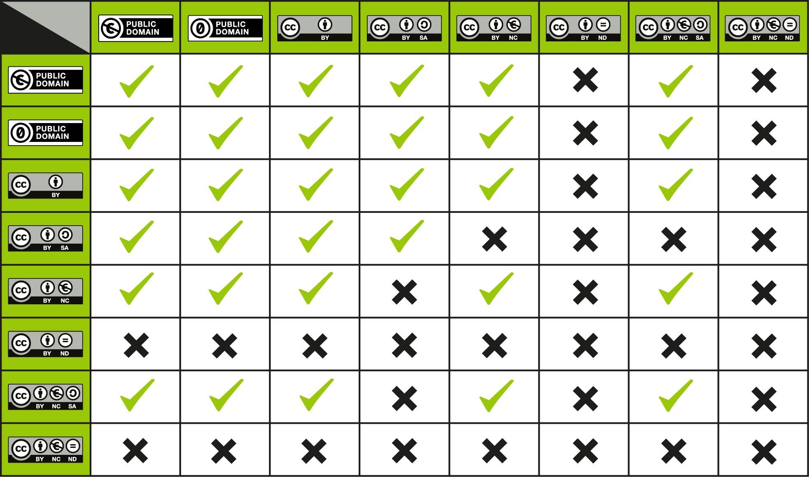
Licensing Considerations
Generally creative common licensing is an effective solution, with the least restrictive license (CC-BY) being preferred
Public domain, and CC-BY licensed material should also be made, with file types that are the most editable (HTML, RTF, PNG)

Slide 7
Considerations for Alternatively Abled Users
Ideally OERs should consider people with visual, hearing, physical, and cognitive disabilities (OECD, 2007)
These considerations include (among others):
Easily readable text
Descriptions for graphics and text
Ensuring screen reader compatibility
Captioning for audio
Appropriate language level
Ideally this textual presentation should be accompanied by and audio and video recording (with captions)
However, this creates privacy/consent concerns, and most importantly can dampen instruction

Slide 8
Considerations for Users with Limited Connectivity
Hyperlinks should be both embedded and explicit (McNally, 2012; http://ir.lib.uwo.ca/fimspres/13/)
OER users may rely on printed versions of presentations – as such presentations should be optimized for greyscale printing
Proprietary file types should be avoided
Avoid slang and local references, as these will be misunderstood by others
Be mindful that OERs can be seen as a form of educational neo-colonialism (Amiel, 2012)

Slide 9
Case Study – This Presentation
Numerous faults with this presentation if the intended second audience is to be anyone
Slide 2: Smith and Ragan is not an accessible source; MIT is never spelled out
Slide 3: ITU data comes from and Excel file; ‘Martha and Henry’ reference is localized slang
Slide 4: Copyright Act is embedded hyperlink; Section referrals (s. ???) assume considerable knowledge of the user;
Slide 5: Mickey Mouse covered by copyright (covered under Canadian exceptions but not universally); text box not optimized for printing; text box not well suited to visual disabled viewers
Slide 6: Table should have explanatory text

Slide 10
References and Image Sources
References:
Ameil, Tel. 2012. “Identifying Barriers to the Remix of Translated Open Educational Resources.” International Review of Research in Open and Distance Learning, 14(1): p. 16-144.
Berne Convention for the Protection of Literary and Artistic Works (1979). http://www.wipo.int/treaties/en/text.jsp?file_id=283698#P144_26032
Copyright Act. R.S.C., 1985, c. C-42. http://laws-lois.justice.gc.ca/eng/acts/C-42/FullText.html
International Energy Agency (IEA). 2012. “Access to Electricity.” http://www.worldenergyoutlook.org/resources/energydevelopment/accesstoelectricity/
International Telecommunications Union (ITU). 2014. “Percentage of Individuals Using the Internet.” http://www.itu.int/en/ITU-D/Statistics/Pages/stat/default.aspx
Lewis, M. Paul, Gary F. Simons, and Charles D. Fennig (eds.). 2015.Ethnologue: Languages of the World, Eighteenth edition. Dallas, Texas: SIL International. Online version: http://www.ethnologue.com.
McNally, Michael B. “Democratizing Access to Knowledge: Find Out What Open Educational Resources Have to Offer.” Presented to University of Western Ontario Libraries, Mar. 7, 2012. http://ir.lib.uwo.ca/fimspres/13/
MIT. 2011. “MIT OpenCourseWare 2011 Program Evaluation Findings Summary.” http://ocw.mit.edu/about/site-statistics/11_Eval_Summary_112311_MITOCW.pdf
Organisation for Economic Cooperation and Development (OECD). 2007. Giving Knowledge for Free: The Emergence of Open Educational Resources. http://www.oecd.org/edu/ceri/givingknowledgeforfreetheemergenceofopeneducationalresources.htm
Smith, Patricia L., and Tillman J. Ragan. 2005. Instructional Design. 3rd Ed. Hoboken, NJ: Wiley.
United Nations Educational, Scientific and Cultural Organization. (UNESCO). 2014. “Open Educational
Image Sources:
Slide 5 – Mickey Mouse – Copyright (Walt Disney Company); Source: http://en.wikipedia.org/wiki/File:Mickey_Mouse.png
Slide 6 – Creative Commons Compatibility Chart – Public Domain (created by Kennisland); Source: https://wiki.creativecommons.org/File:CC_License_Compatibility_Chart.png#metadata

Slide 11
Feedback and Licensing Information
Feedback
Feedback (including criticism) on this presentation can be sent to mmcnally@ualberta.ca
Licensing Information
Licensed under a CC-BY 3.0 license, with the exclusion of Mickey Mouse image. Slide 6 image is in the public domain. See previous slide for additional details on sources.

